Slide 1

FOOT calorimeter
Status Report
Crystals
SiPMs
Readout
DAQ
Mechanics
Plans
Contributions by:
S. Argirò
N. Bartosik
F. Cavanna
G. Giraudo
E. Lopez Torres
M. Mignone
N. Pastrone
M. Penna
L. Ramello
G. Scalise
L. Scavarda
M. Sitta
Piergiorgio Cerello

Slide 2
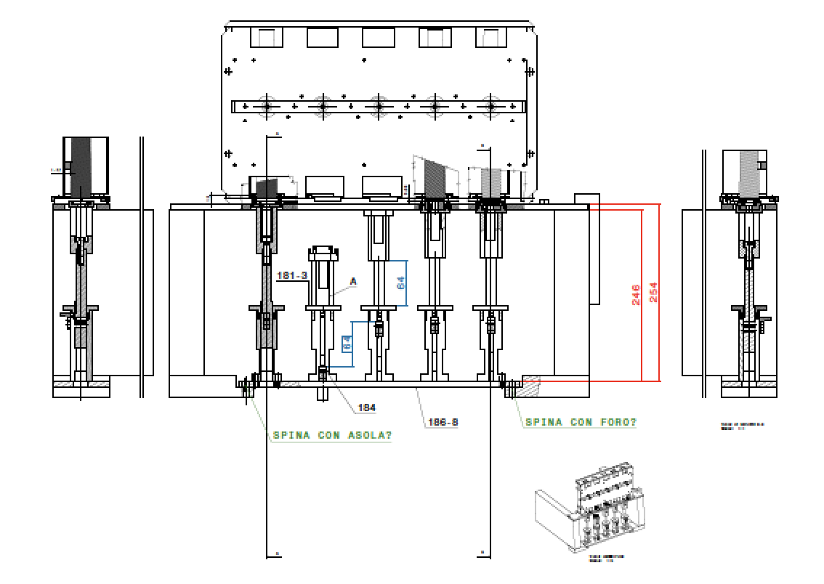
BGO Crystals
BGO crystals
Crystal size mapping: completed
Crystal painting vs. wrapping, coupling
- TYVEK wrapping
- SiPM coupling: tested in Feb2020
4 Crystals coupled to this slice of fast scintillator in front
        Crystals wrapping and coupling at CERN
              Holder design completed, order being placed

Slide 3
SiPM tiles
SiPM tiles: to do list
Order for production and packaging placed
Silicon production successfully completed
Tile delivery: 10 tiles by May 2021, 160 by August, 160 by November
Front-end boards
received
Module holders
received

Slide 4
SiPM tiles
Power supply distribution: to do list
System designed (4 switch boards + 32 supply boards)
        Board1 (32 pieces): design completed, order being places
        Board2 (4 pieces): design completed by June 2021
Cables:
  Readout: 5m length, order being placed
  Power supply: stage 3 (from Board1 to FE-board), order being placed
  Power supply: stage 1 (create to Board2) and 2 (Board2 to Board1): order as soon as Board2 design completed)

Slide 5
Racks
LV 1 in, 8 out
Calorimeter
HV 1 in, 8 out (2 ch/connector)
1
Crystals
Switch
Board
2x
HV
DB25
1 in, 10 out
16 ch
.
.
.
.
.
.
.
.
16 ch
Temp.
x2
Switch
Board
2 x +6V
2 x -6V
LV
4 ch
DB37
16
4 ch
2 x +6V
2 x -6V
Board2
Board1

Slide 6
SiPM readout
SiPM readout: to do list
Power supplies (CAEN SY5527 + supply boards) - received
Readout: from CAEN V1742 to Wavedream – received
Temperature correction
System designed
Prototype completed
Orders to be placed in 2021 (2022?)

Slide 7
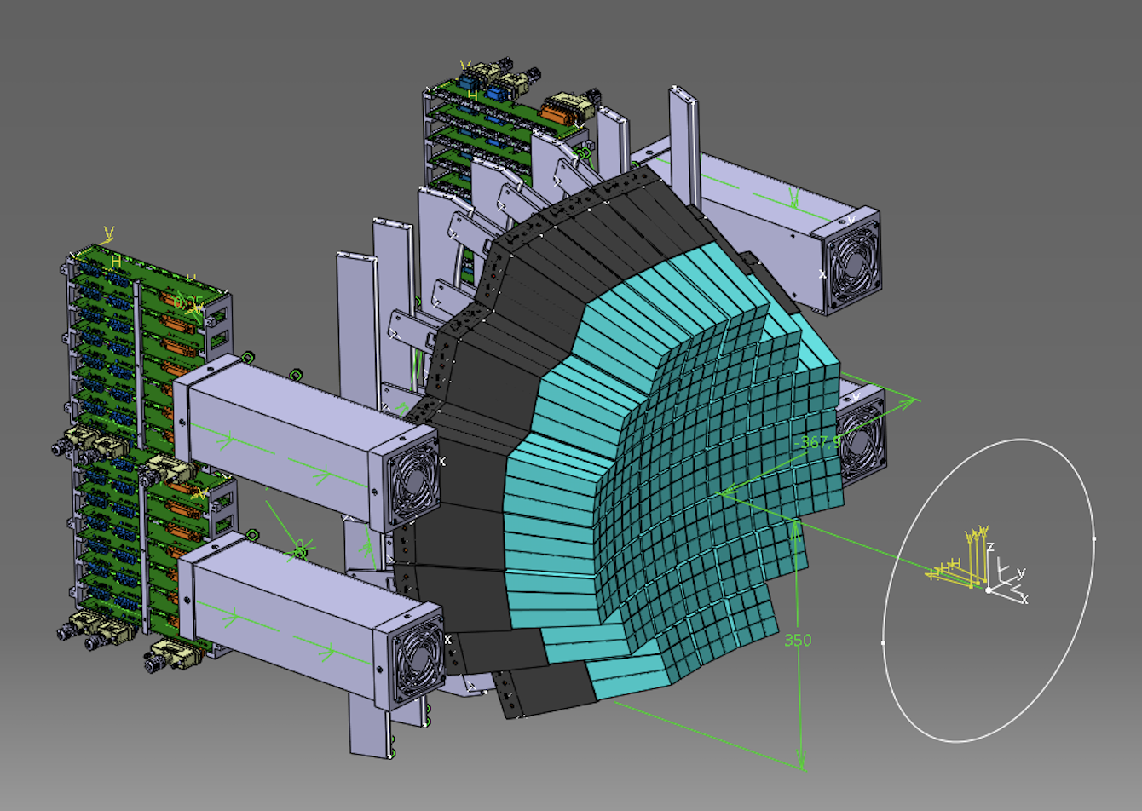
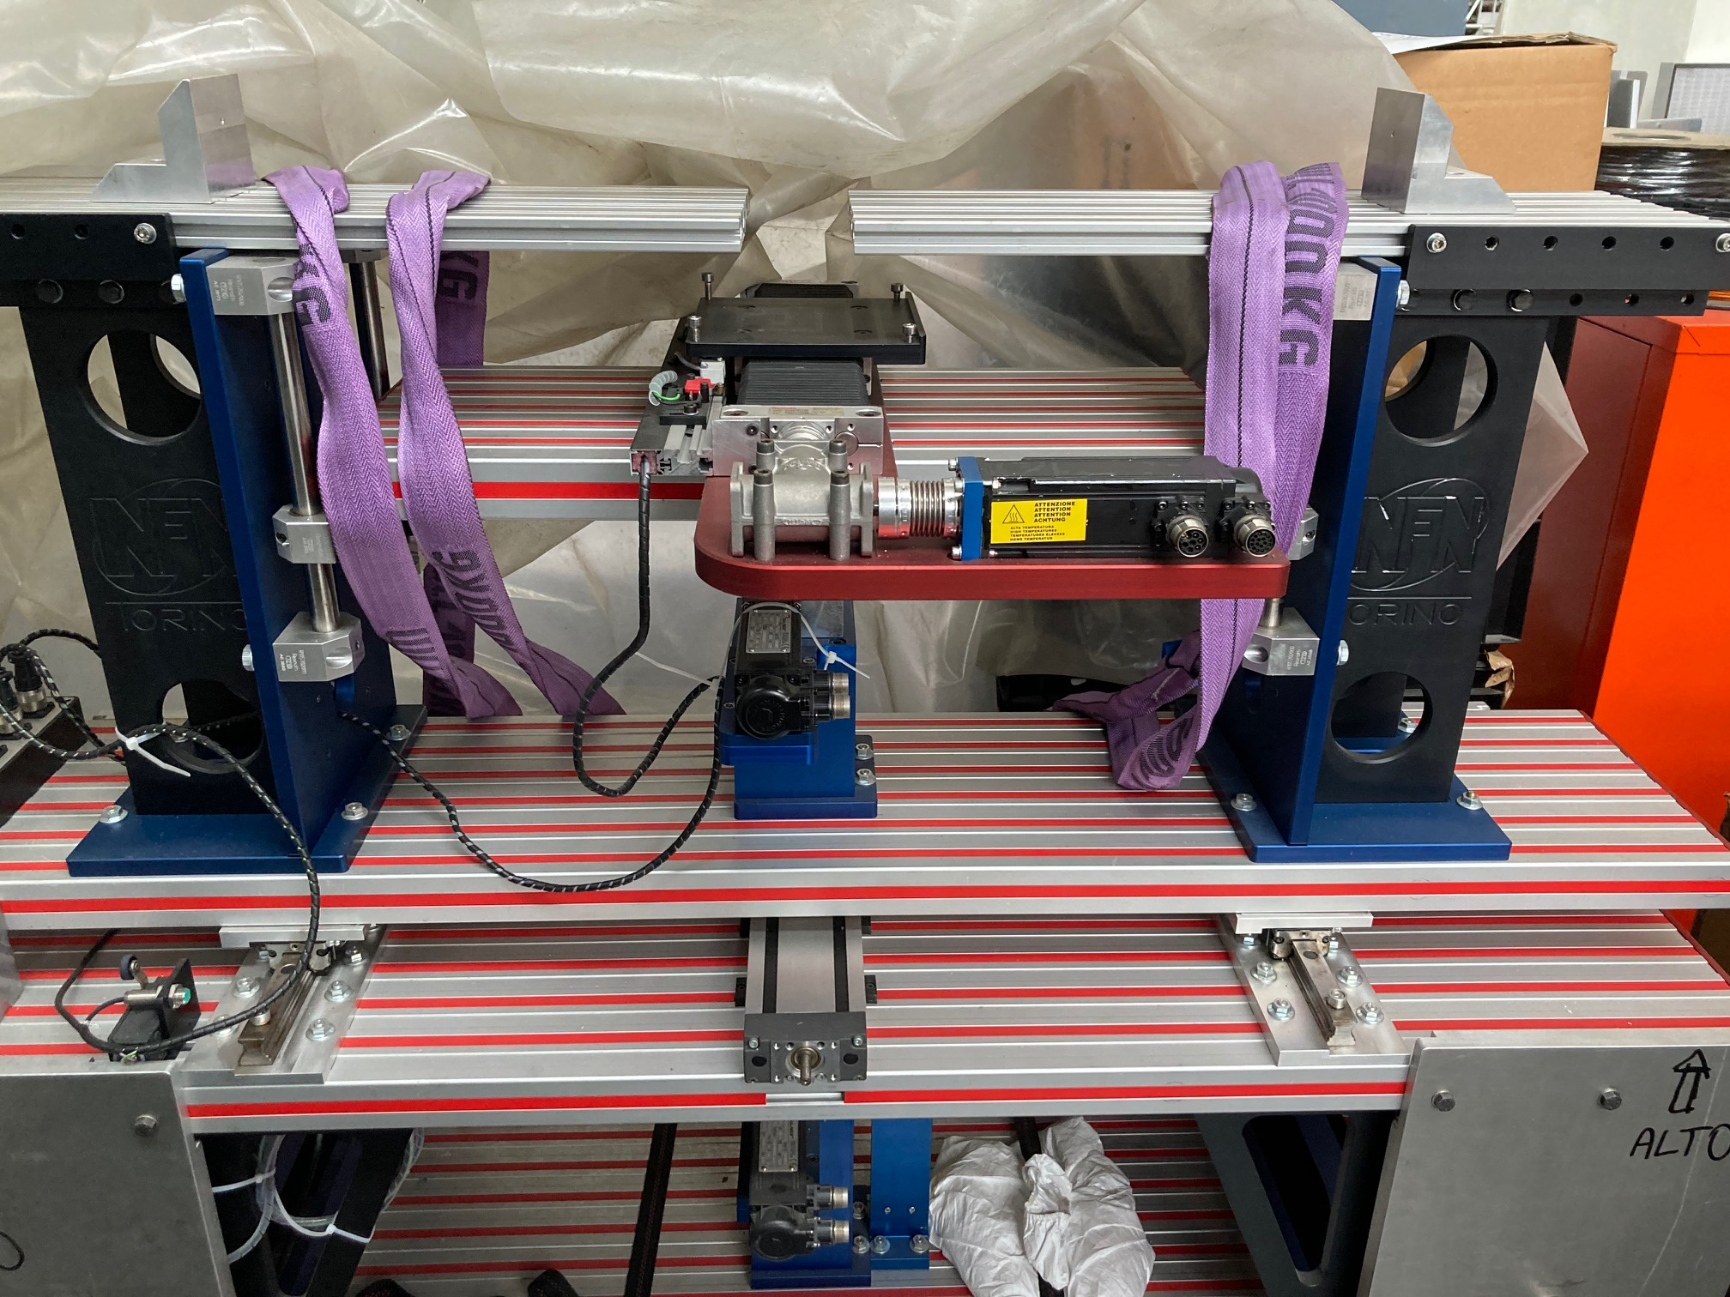
Mechanics
Mechanics: to do list
  System design completed
  Components: order procedure started
  Mechanical structure for calibration
          - x/y displacement remote control

Slide 8
Mechanics
Temperature Readout
FOOT-CTR-aux
U1, U2, U4, U5:
Presa DB-25 da c.s. 90° femmina
65 mm
U3, U6:
Connettore 3M-24 da c.s. maschio
N2524-6002RB diritto a 24 pin
U5
12.4 mm
U6
U4
233.35 +0 -0.3 mm
U2
53.1 mm
U3
pin 1
U1
Da U3 e U6 partono due cavi piatti verso
connettori identici sulla scheda principale

Slide 9
Mechanics
Temperature Readout
FOOT-CTR-main
U1, U2, U3, U4:
Presa DB-25 da c.s. 90° femmina
160 mm
U4
U5, U6:
Connettore 3M da c.s. maschio
N2524-6002RB diritto a 24 pin
J1
U6
U3
J1, J2:
Connettore VME tipo C da c.s. maschio a 90°, 96 pin (DIN 41612) su 3 file (a, b, c)
233.35 +0 -0.3 mm
U2
59 mm
U5
J2
U1
81 mm
65 mm
ingombro
scheda FOOT-CTR-aux
Lasciare spazio per Arduino,
verrà montato sulla
scheda «master»

Slide 10
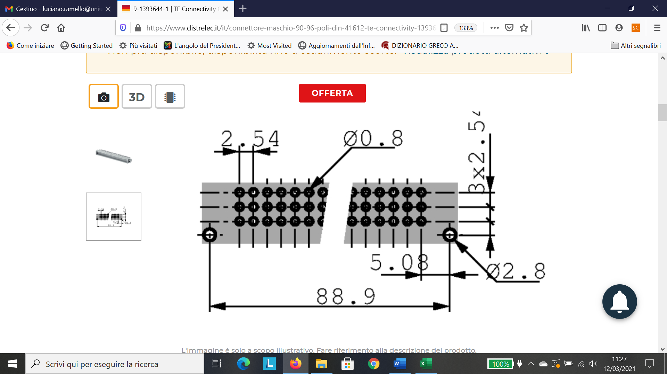
Mechanics
Temperature Readout
FOOT-CTR-main (detailed view)
//
c b a
J2
J4
GND
riga 1
J3
GND
riga 32
Disegno non in scala, solo
per l’orientamento di J3 e J4
rispetto ad Arduino e a J2
//

Slide 11
Software
Software
Calibration protocol to be defined
  Dedicated Beam test at CNAO asap

Slide 12
Overview
Overview
Design (nearly) completed – only intermediate mixing power supply board to be completed (end of June)
Procurement is ongoing
We will definitely have budget issues (about ~ 10 kE missing, even though the Temperature readout system funded by UPO)

