Slide 1
RD_MUCOL
INFN activities for Muon Colliders
CERN Open Council Announcement on June 19 released the update of the EU Strategy
U.S. Snowmass21 process was lauched at: https://snowmass21.org/start
Muon Collider community is ready to establish the international collaboration
è Meeting July 3
CSN1 activities
Bari interests

Slide 2

Why Muons?
Full collision energy available for particle production: 14 TeV lepton collisions are comparable to 100 TeV proton collisions for selected new physics process, if sufficient luminosity is provided ~ 𝟏𝟎^{𝟑𝟓}𝒄𝒎^{.𝟐}𝒔^{.𝟏}
Strong interest to reuse existing facilities and infrastructure (i.e. LHC tunnel) in Europe

Slide 3
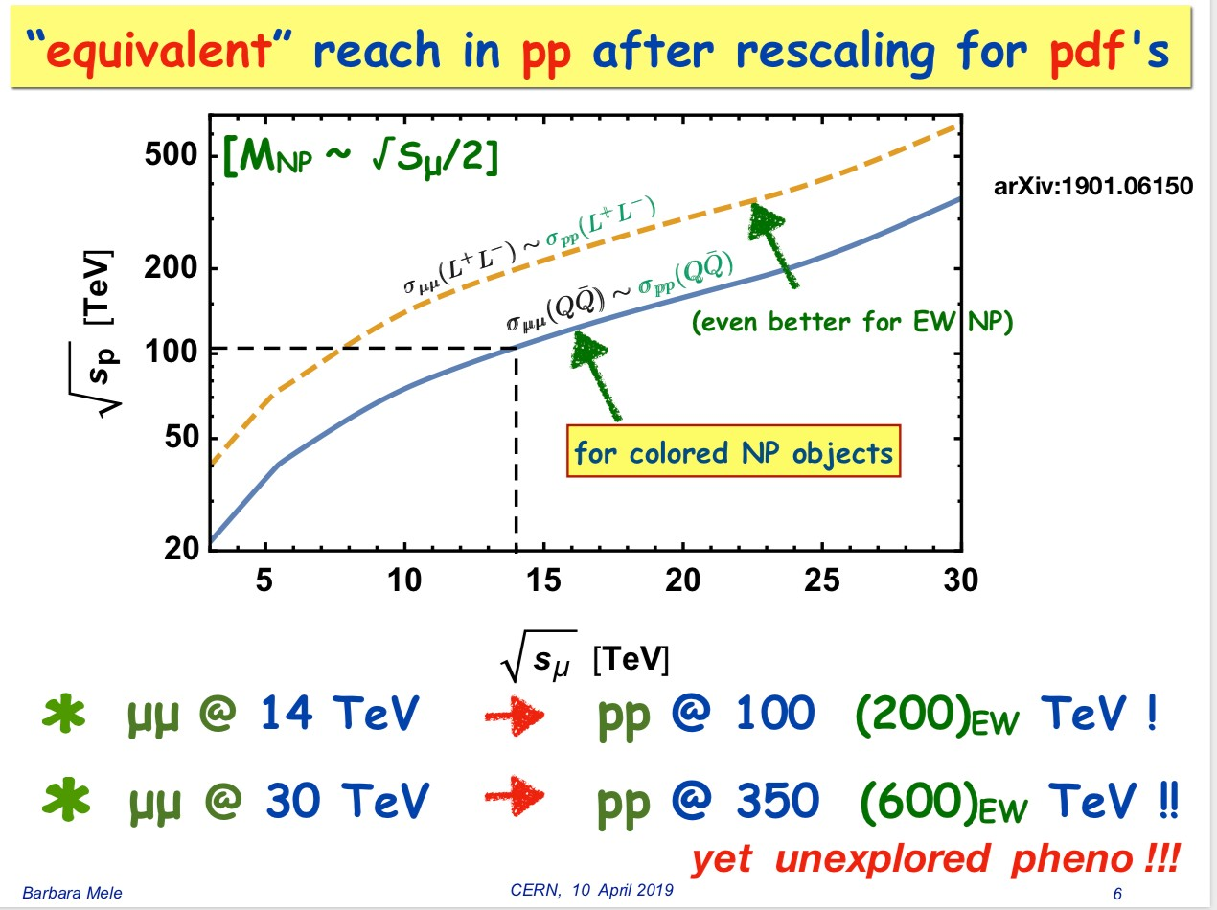
Proton vs Muon Colliders
to - June 1, 2019 Nadia Pastrone 15

Slide 4
Brief history
The muon collider idea was first introduced in early 1980’s
[A. N. Skrinsky and V. V. Parkhomchuk, D. Neuffer ]
the idea was further developed by a series of world-wide collaborations
US Muon Accelerator Program – MAP, created in 2011, was killed in 2014 MAP developed a proton driver scheme and addressed the feasibility of the novel technologies required for Muon Colliders and Neutrino Factories
"Muon Accelerator for Particle Physics," JINST,
https://iopscience.iop.org/journal/1748-0221/page/extraproc46
LEMMA (Low EMittance Muon Accelerator) concept was proposed in 2013
a new end-to-end design of a positron driven scheme is presently under study
by INFN-LNF et al. to overcome technical issues of initial concept è arXiv:1905.05747
an input document was submitted to the European Particle Physics Strategy Update on existing muon collider studies, to support further R&Ds
“Muon Colliders,” arXiv:1901.06150
https://cerncourier.com/a/sketching-out-a-muon-collider/

Slide 5
Two options: proton (MAP) vs positron (LEMMA) driven muon source
MAP: MUON JINST, shorturl.at/kxKU7
𝟏𝟎^{𝟏𝟑}-𝟏𝟎^{𝟏𝟒}𝝁/𝒔𝒆𝒄
LEMMA arXiv:1905.05747v2 [physics.acc-ph]
è need consolidation to overcome technical limitations to reach higher muon intensities
muons produced with low emittance è “no/low cooling” needed low production cross section: maximum σ(𝑒⁻𝑒. → 𝜇⁻𝜇.) ~ 1 𝜇b high heat load and stress in μ production target
11
synchrotron power O(100 MW) ç available 45 GeV positron sources

Slide 6
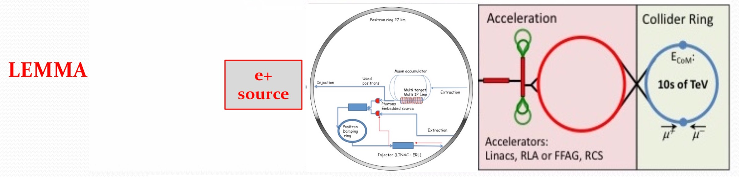
Recent LEMMA effort
M.Antonelli, M.E.Biagini, M.Boscolo, S.Guiducci, P.Raimondi, A.Variola et al.
Asymmetric collisions 𝒆⁺𝒆⁻ → 𝝁⁺𝝁. at the 𝝁⁺𝝁. threshold (√s ≈ 0.212 GeV)
maximize 𝝁⁺𝝁.pairs production cross section
minimize the 𝝁_𝝁. beam angular divergence and energy spread
Extremely promising:
muons produced with low emittance è “no/low cooling” needed
But difficult:
low production cross section: maximum σ(𝑒⁻𝑒. → 𝜇⁻𝜇.) ~ 1 𝜇b
high heat load and stress in μ production target
synchrotron power O(100 MW) ç available 45 GeV positron sources
è need consolidation to overcome technical limitations to reach higher muon intensities
arXiv:1905.05747
21

Slide 7
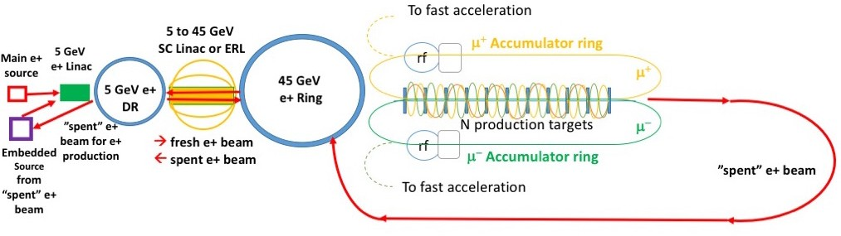
Positron driven muon source
recent developments (2019)
A. Variola, M. Biagini,
S. Guiducci, M. Antonelli,
M. Boscolo, P. Raimondi et al.
IPAC2019: MOZZPLS2
Positron Source (PS) @ 300 MeV, plus LINAC to accelerate up to 5 GeV
5 GeV 𝒆⁺ Damping Ring (DR) with damping time order of 10 msec
SC Linac or ERL accelerate 𝒆⁺ @ 45 GeV, and decelerate @ 5 GeV after μ production
45 GeV 𝒆⁺ Ring (PR) to accumulate 1000 bunches needed for μ production
1/more Target Lines (TL): e+ beam collides with targets for the direct μ production
2 Muon Accumulation Rings (AR) – 123 m – to store μ till μ bunch reach typically 10⁹ μ
Average muon energy 22 GeV (γ(μ) = 200 μs , τ(μ)_{lab} = 500 μs )
Embedded 𝒆⁺ source to restore the design 𝑒⁺ beam current
using γ coming from μ production targets, or using the 45 GeV “spent” beam

Slide 8
Use of Existing Infrastructure
Might be able to reuse much of the proton and general infrastructure
Needs detailed study
Much of the expertise is available
Use of the largest tunnels, i.e. LHC or potentially FCC
Can house positron ring in the LEMMA case
  In FCC, even lepton equipment might exist from FCC-ee
  Large rings means less synchrotron radiation and power consumption
Consider to use ring as a collider
  But means to have larger ring for acceleration
  Or to use combined final accelerator / collider
    This compromises luminosity and generates technical challenges but may save cost
Use tunnel for final accelerator
  Have a small optimised collider ring
  Seems natural solution

Slide 9
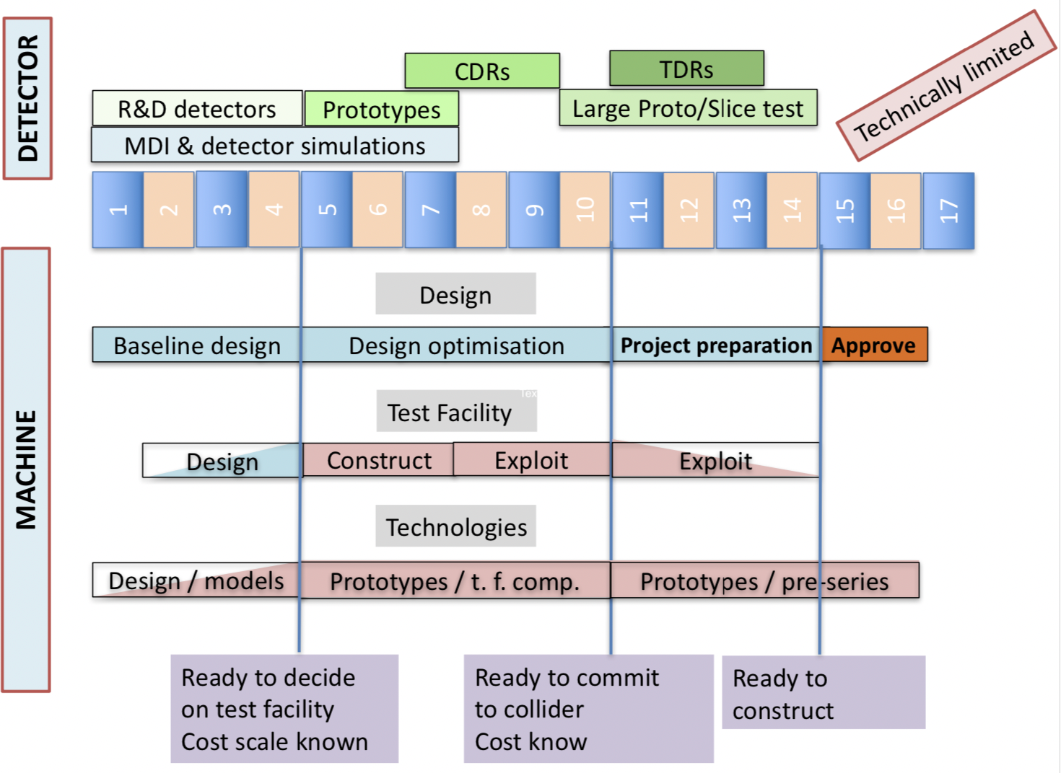
Technically Limited Potential Timeline
Physics Briefing Book arXiv:1910.11775v2 [hep-ex]

Slide 10

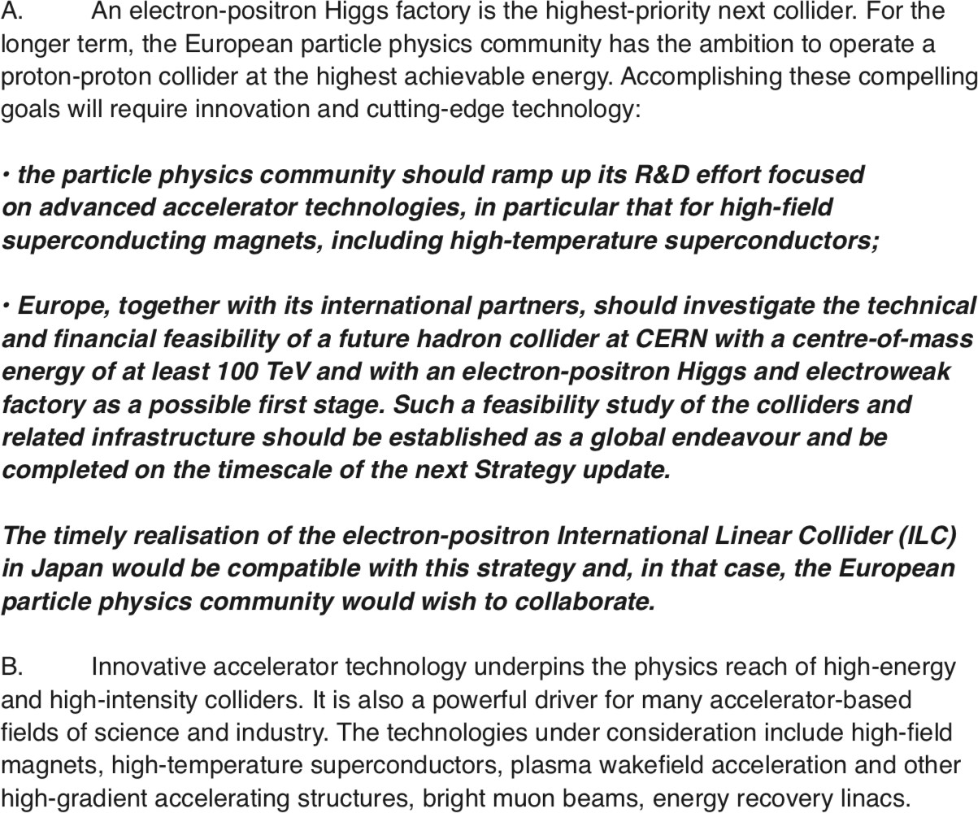

Strategy update
http://europeanstrategyupdate.web.cern.ch/
EU

Slide 11
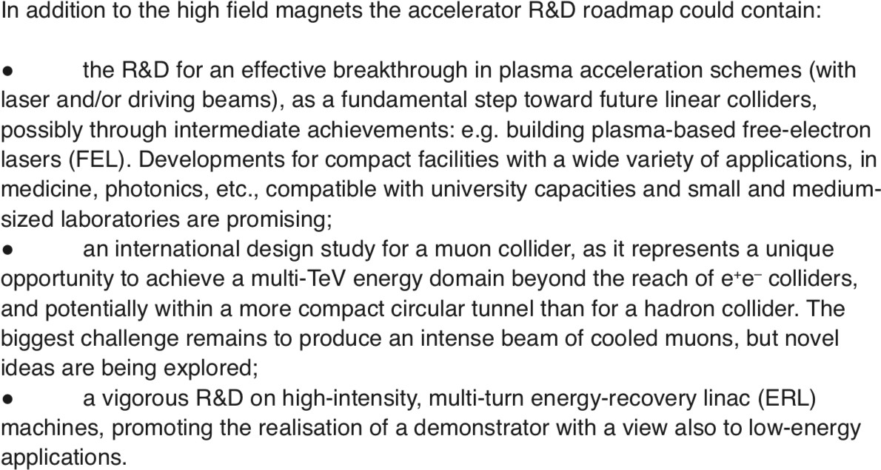
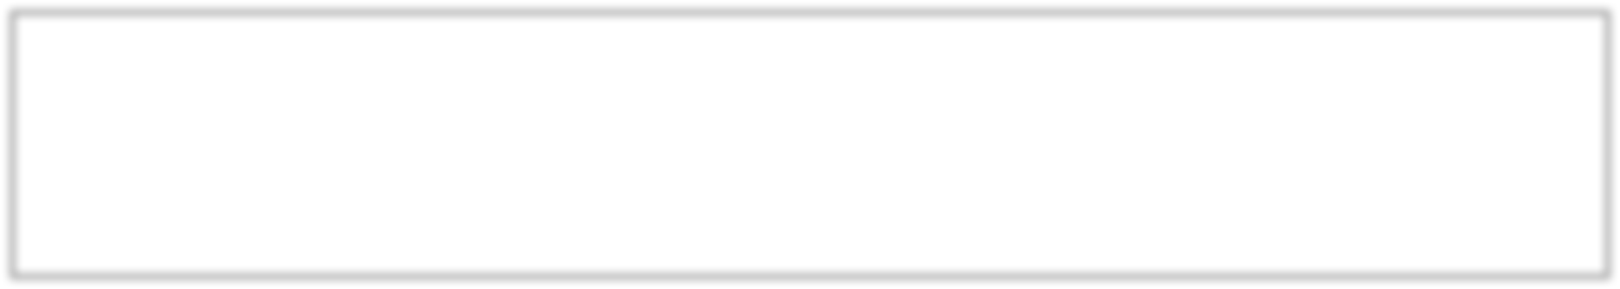
Strategy update
EU

Slide 12
International Collaboration
Since muon collider R&D is a part of the strategy, we will hold the first meeting for the muon collider to prepare an actual collaboration on July 3 at 14:00-18:00
https://indico.cern.ch/event/930508/
The goal of this meeting is to start identifying who intents to contribute to a muon collider study and, if already possible, in which field. At this stage, some of us might still be looking for subjects of interest, while others might already have a clear idea and some might even be in the lucky position to know the available resources.
Please prepare a slide or two with your intent and interest and what you currently know about a potential contribution. It would be good, but not mandatory, to
contact daniel.schulte@cern.ch in advance so that we can put this on the agenda.
The meeting will start with an introduction to the key issues and the potential workplan and then give the floor to all partners. The attached document contains a list of fields of expertise that should help you to see where you would like to contribute.
the Muon Collider Working Group.

Slide 13
international collaboration
to develop an integrated muon collider design concept that encompasses the physics, the detectors, and accelerator
to develop fully the muon collider design study
è exploring the various options
to pursue R&D priorities, according to an agreed upon work plan
Master plan:
A start-to-end collider design è this would be the first facility of its kind
A machine detector interface that protects the detector from collider background while allowing good machine performance
A physics and detector study to assess the physics reach of the collider

Slide 14
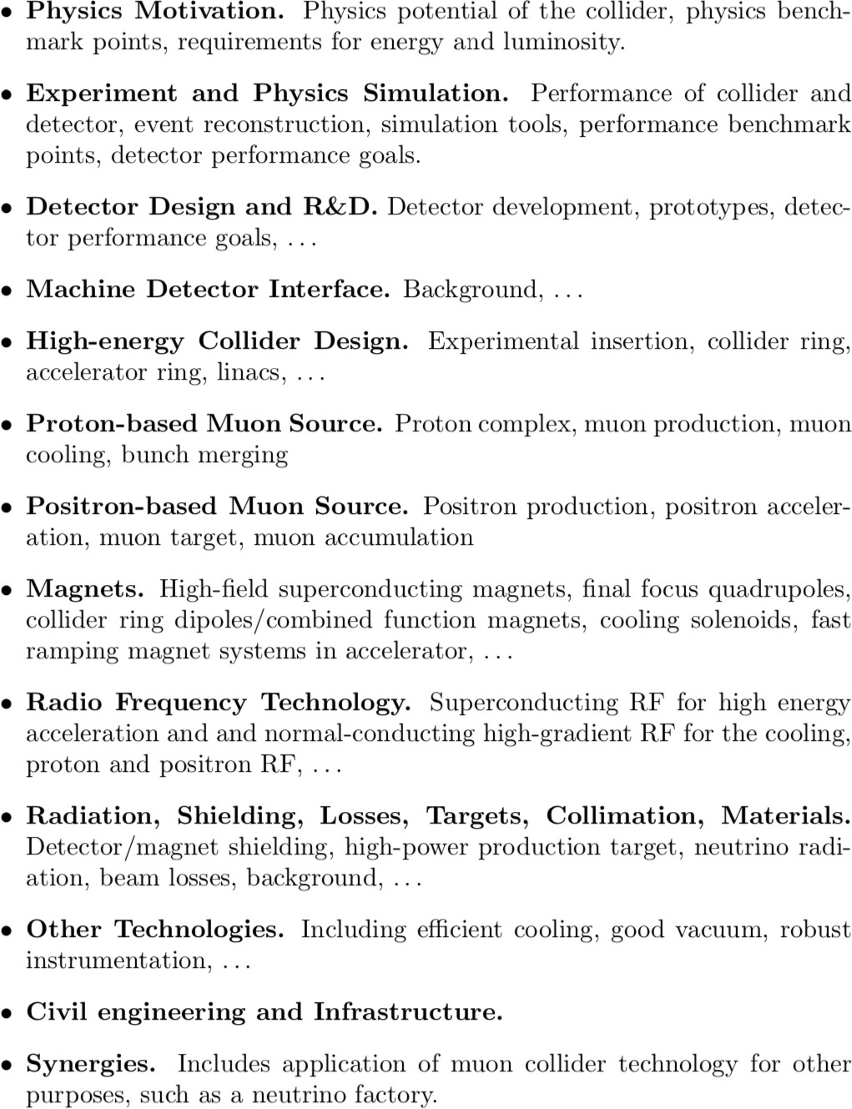
Fields of interest

Slide 15
INFN activities (1)
Parametri di macchina cruciali e strettamente legati al disegno dell'esperimento e al raggiungimento degli obbiettivi di fisica Marica Biagini - Donatella Lucchesi - Nadia Pastrone
Simulazioni di fisica
Barbara Mele - Antonio Costantini - Roberto Franceschini - Mauro Chiesa
==> reach di fisica vincolato dal disegno dell'esperimento
Donatella Lucchesi - Massimo Casarsa
Disegno dell'esperimento: richiede simulazioni e R&D anche in sinergia con altri sviluppi in corso (attivita' in AIDAinnova)
Nadia Pastrone - Massimo Casarsa - Lorenzo Sestini

Slide 16
INFN activities (2)
Machine Detector Interface ==> studi linebuilder e FLUKA - in collaborazione con esperti di acceleratori
Francesco Collamati - Paola Sala
Studi di radiazione da neutrino prodotti dal decadimento dei fasci - in collaborazione con esperti di acceleratori
Paola Sala ==> in futuro - sviluppi per l'utilizzo di fasci intensi di neutrini
Sorgente LEMMA: fascio di positroni - materiali per bersagli – accumulatore
Nadia Pastrone ==> da discutere nel contesto internazionale
Test Beam @ CERN in ambito LEMMA (primi test 2017-2018) ==> richiesto ora per 2022
Fabio Anulli - Marco Zanetti - Nicola Amapane - Mario Antonelli
R&D tecnologia per magneti ( et al.) dedicati al muon collider

Slide 17
Attivita’ INFN – Fisica
Studi di fisica: prossimi passi da discutere anche con CSN4
@ 1.5-3 TeV benchmark per confronto con studi di CLIC
è primo studio della misura 𝜇𝜇 → 𝐻𝜈𝜈 → 𝑏𝑏𝜈𝜈 pubblicato (J. Inst. 15 P05001, 2020)
@ 10+ TeV completamente nuovi
è studio fisica potenziale di Higgs (arXiv:2003.13628) – manca simulazione esperimento
valutare potenzialità di fisica ad energie intermedie, ad esempio 6 TeV
devono essere integrati con gli studi di esperimento
occorre esplorare la possibilità di studi parametrici

Slide 18
Attivita’ INFN – Esperimento
Esperimento: da disegnare ex novo
studi conclusi con apparato di MAP pubblicati (J. Inst. 15 P05001, 2020) studi in corso con nuovo software condiviso
https://sites.google.com/site/muoncollider/home
è sinergia CLICdp
è AIDAinnova
WP7 (gas detector MPGD, RPC,TPC)
WP11 (microlectronics: ASIC design)
WP12 (software/reco for future accelerators TurnHEPkey)→ Capire sinergie con RD_FCC e altre attivita’ in corso)

Slide 19
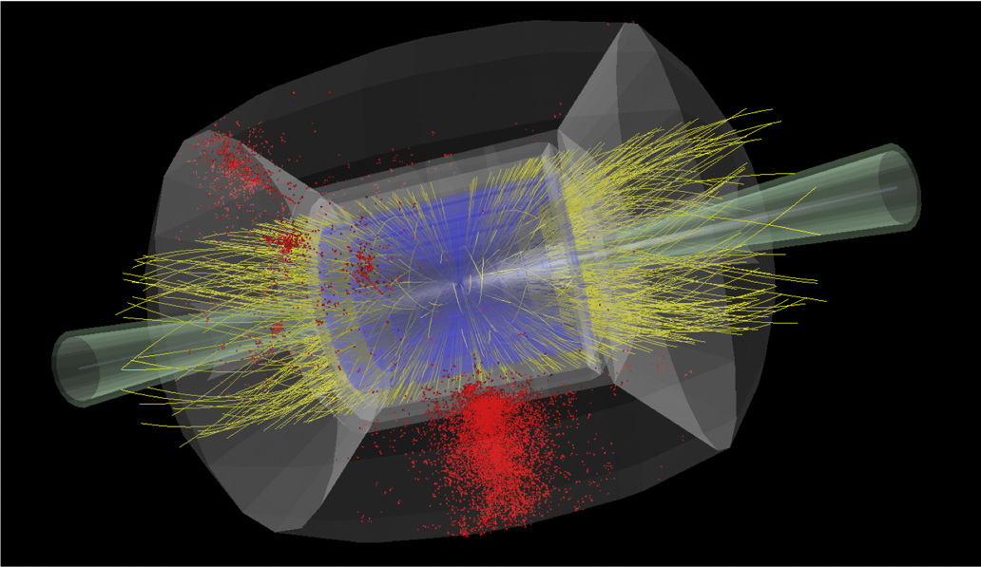
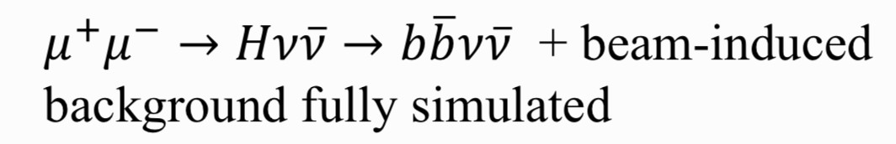
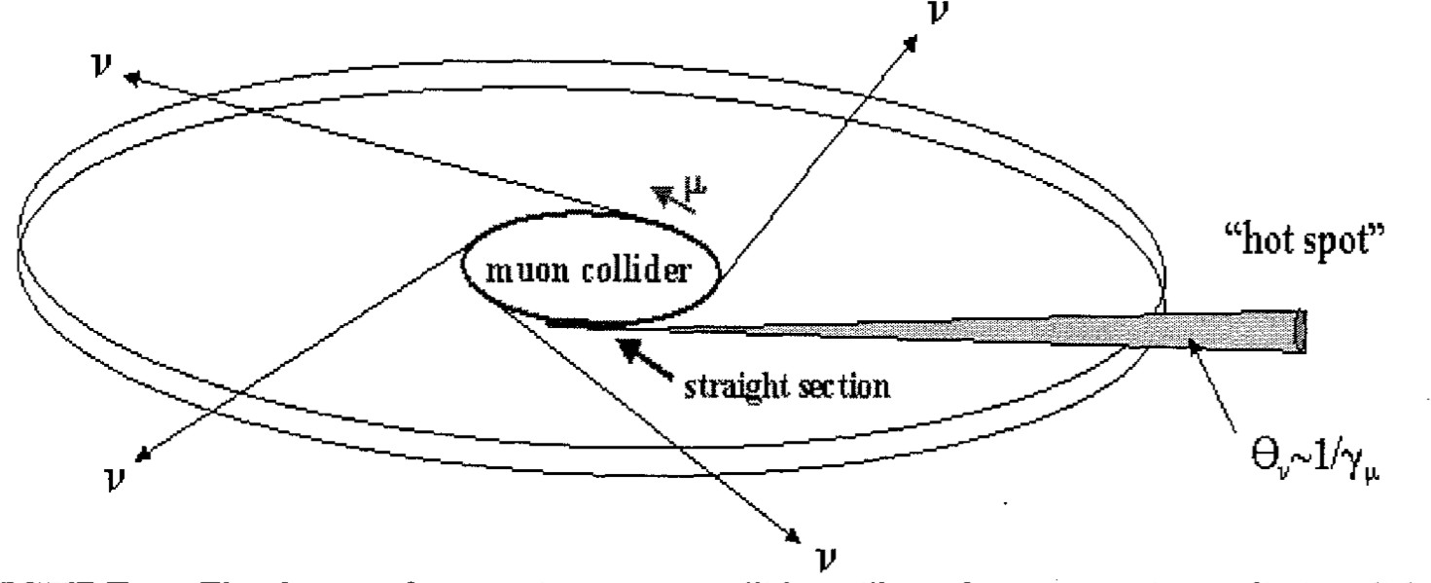
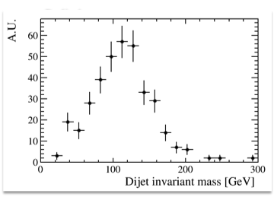
Muon Beams Induced Background
Nikolai Mokhov et al. - MARS15
𝑠 = 1.5 𝑇𝑒𝑉
Neutrino radiation
critical limit at highest energies
Paola Sala – Youri Robert CERN Muon Collider Meeting
https://indico.cern.ch/event/886491/
Highly collimated neutrino beam: background but also opportunity for neutrino’s studies
Dose comes from energy released by neutrino interaction products. Collider is underground: problem is when beam reaches surface.
22

Slide 20

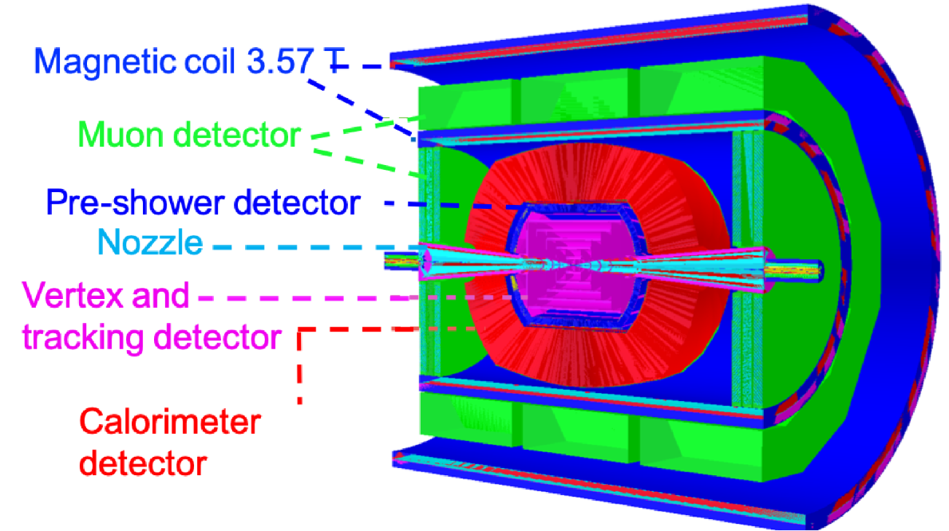

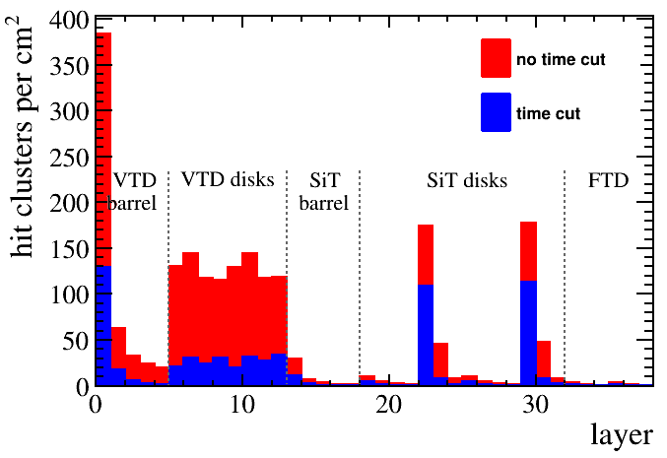
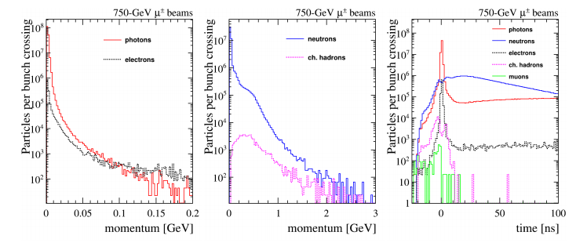
Detector Response Simulation at =1.5 TeV
Use the simulation/reconstruction tools previously developed within the MAP collaboration based on the ILCroot package: it supports signal + MARS15 background merging
Effects of beam-induce background can be mitigated by exploiting “5D” detectors, i.e. including timing
For the moment the studies done with an existing geometry (MAP) but the final detector needs to be assess.

Slide 21
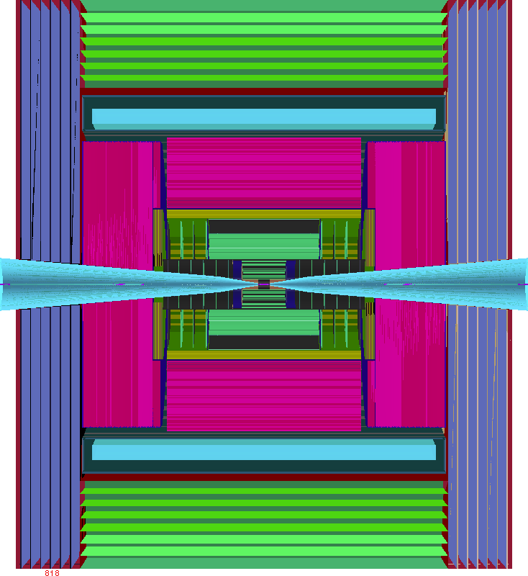



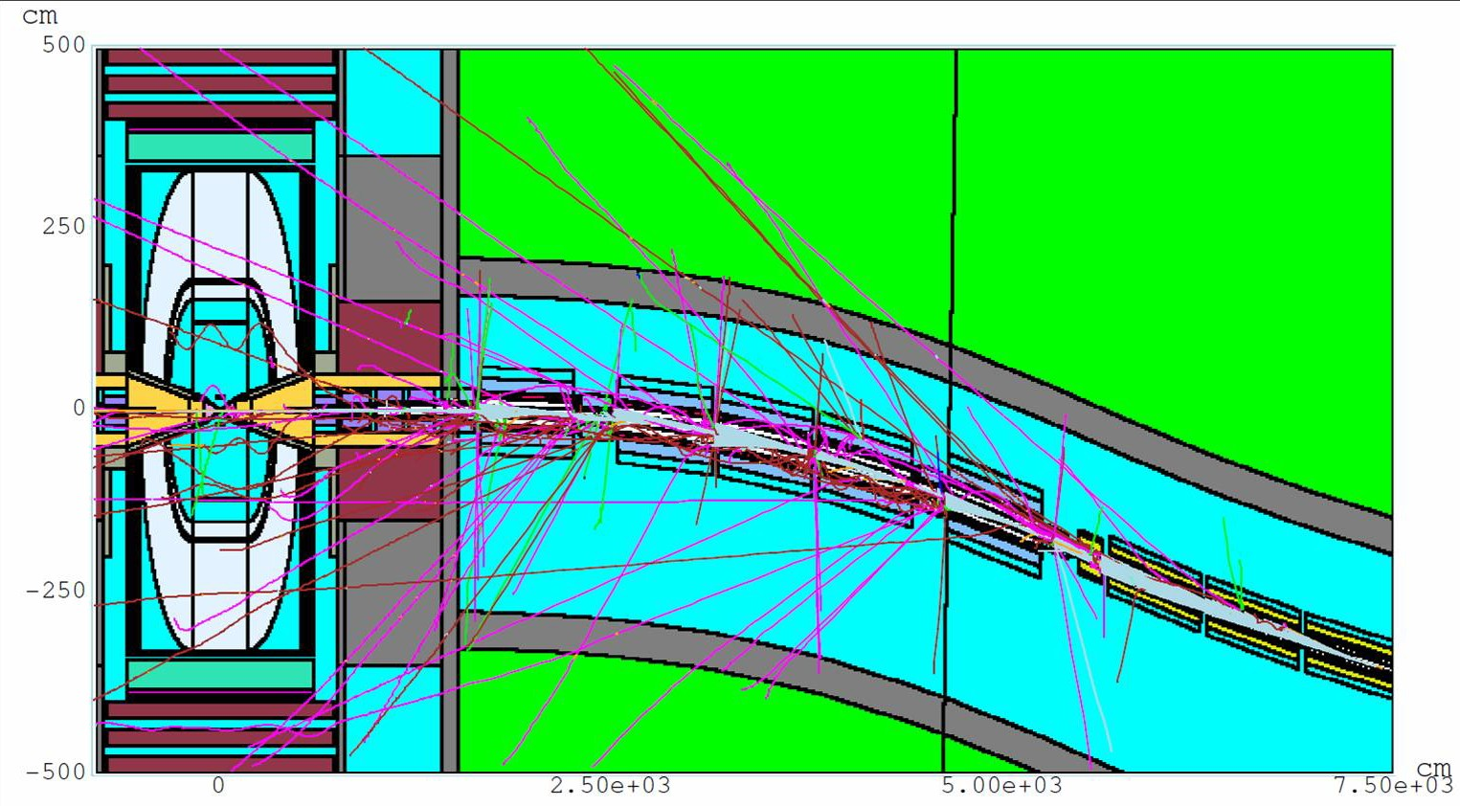
Next steps
q Move to use the Future Collider Framework
Description of the detector already done including the nozzle
A new, up to the state of the art detector is needed
q Simulate the beam-induced background with FLUKA
MDI and IR descriptions provided by MAP collaboration for 1.5 and 3 TeV s
Importing the description in FLUKA and generate new beam-induced background
q Re-evaluate Physics performance @ s=1.5 TeV as double check then study Physics performance @ s=3 TeV with full simulation
q Collaborate with MAP to have MDI and IR @ 𝐬=10 TeV to evaluate Physics performance
q Determine physics objects efficiency and resolution for each configuration and parametrize them to estimate broad physics reaches smearing Monte Carlo generated process

Slide 22





Simulation Framework
WHIZARD PYTHIA
Signals and Physic Background generation
Full simulation results
Public
Simulation and reconstruction
FLUKA
Input for other studies
Beam Induced Background
Resolution functions and efficiencies
DDSim Marlin Particle Flow
The work done so far used the MAP framework
Now moved to a Future Collider Framework, ILCSoftware.
Set up a GRID VO, muoncoll.infn.it everybody can register
Preparing the environment to be able to submit to the GRID/cloud
Right now we have a cloud VM that can be installed anywhere
Some resources, machines and disk space is available on CloudVeneto
Code on github
https://sites.google.com/site/muoncollider/home

Slide 23


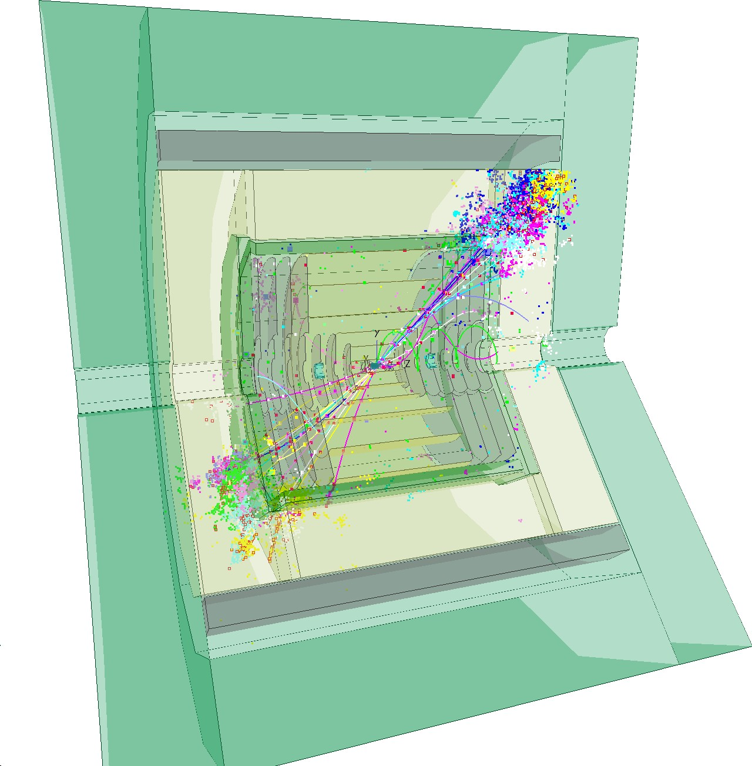
Key4HEP: Turnkey Software for Future Collider Experiments
Key4HEP: The Turnkey Software Stack
Ingredients
Geometry
Event Data Model Framework
Functionality
Detector Descriptions Reconstruction from iLCSoft
Conclusion
A. Sailer: Key4HEP: Turnkey Software for Future Collider Experiments

Slide 24

Motivation for Key4HEP
Future detector studies critically rely on well-maintained software to model detector concepts and to understand a detector’s potential and physics reach
There is a scattered landscape of specific software tools on one hand, and integrated frameworks tailored to a specific experiment on the other hand
Aim at a low-maintenance common stack for FCC, ILC/CLIC, CEPC, SCT/STC, Muon Collider, . . . with ready to use plug-ins to develop detector concepts
Reached consensus among all communities for future colliders to develop a common turnkey software stack at recent
Future Collider Software Workshop
Identified as an important project in the CERN EP R&D initiative, submitted EoI for AIDA++ → AIDAInnova WP12
Rif. Lucia Silvestris a Bari.
A. Sailer: Key4HEP: Turnkey Software for Future Collider Experiments

Slide 25
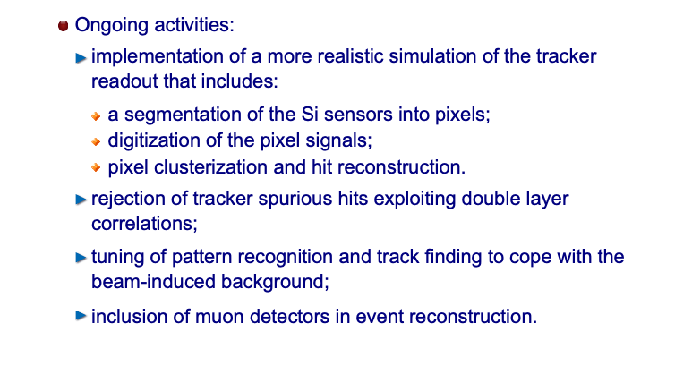
Ongoing activities
Issue to reconstruct background + signal due to high occupancy in the inner tracking.
(also CPU consuming)
Opportunity to work on new algorithms and tracking with GPU.
Opportunity for contributions
Evaluate the impact of the background on the different detectors (hit occupancy, rates) and impact on the reconstructions (ok for degree thesis)
  → improve by software (better algorithms, GPU?, contribution to KEY4HEP)
  → improve by hardware (better detectors)

Slide 26
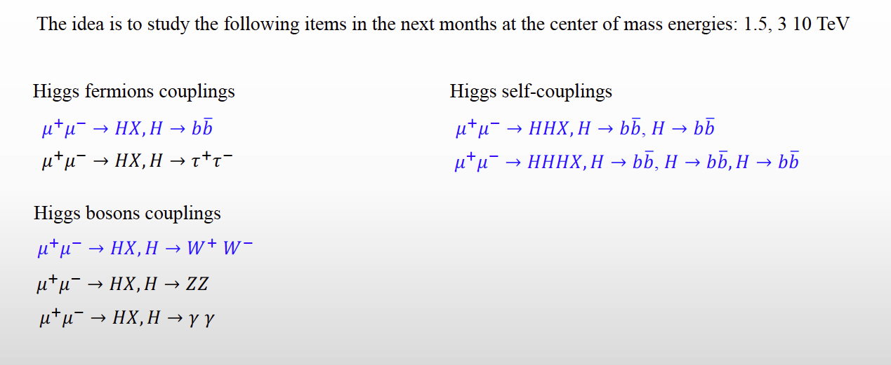
Physics program in next months
Con il software esistente (rivelatore non ottimizzato) possible realizzare questi studi:
Dovrebbe essere sufficientemente facile senza fondi.
Opportunity for contributions (thesis)

Slide 27
Computing issues
Il Muon Collider presenta un beam-induced background di notevole entità, generato dal decadimento in volo dei muoni e dalle interazioni dei prodotti di decadimento con la macchina.
Data la sua unicità le strategie di mitigazione devono essere studiate tramite full simulation:
Le simulazioni sono pesanti sia in termini di storage che di CPU time: necessità di adottare un sistema di calcolo distribuito sulla GRID.
Accesso a file di simulazione comuni, sia per INFN che per collaboratori esterni (es. USA)
VO è già stata aperta, SE in preparazione al CNAF. Il framework di CLIC dispone già di un suo sistema di sottomissione dei job sulla GRID.
Sviluppo del detector
Disegno della Machine Detector Interface
Benchmark di Fisica
Opportunity for contributions from Bari

Slide 28
Computing in 2021: richieste CPU
Benchmark: CPU Intel Xeon ES-2670 → 200 HS06 per 10 Multi-Thread
Simulazione: 1 evento di BIB richiede 10 processi in parallelo per 7 giorni
Ricostruzione: 3 giorni per processare 10 eventi di segnale+BIB
Goal:
10k eventi * 200 HS06 * 7/365 = 38k HS06 per la simulazione
100k eventi * 200 HS06 * 0.3/365 = 16k HS06 per la ricostruzione
Si richiedono in totale 54k HS06
Una frazione consistente delle risorse calcolo puo' essere su GPU o su CPU dei siti IBISCO/RECAS
10k eventi di BIB simulati (per essere usati a rotazione nella ricostruzione)
100k eventi di segnale + BIB ricostruiti (2-3 canali di Fisica)
28

Slide 29
Computing in 2021: richieste storage
Simulazione: 1 evento simulato di BIB occupa ~10 GB
Ricostruzione: 1 evento ricostruito di segnale+BIB occupa ~5 GB
10k eventi * 10 GB = 100 TB per i campioni simulati di BIB
100k eventi * 5 GB = 500 TB per i campioni di segnale+BIB ricostruiti
Si richiedono in totale 600 TB di storage
Contributi aggiuntivi:
5k euro per Cloud-Veneto (INFN-Padova)
5k euro per acquisto macchina a INFN-Trieste
29

Slide 30
Attivita’ INFN – zona di interazione
Zona di interazione (Machine Detector Interface): da capire come/se contribuire
richiede disegno di macchina: parametri dell’ottica – esiste solo per MAP disegno nozzle da integrare nell’esperimento
fondi di macchina prodotti con FLUKA utilizzando line-builder (postdoc PD)
Studi di radiazione in funzione del sito e del disegno di macchina
studi preliminari simulazione completa FLUKA (parzialmente pubblicati) supporto definizione parametri macchina con esperti di acceleratori valutazioni con FLUKA dell'ottica e in base a siti e disegni di macchina

Slide 31
Attivita’ INFN – LEMMA sorgente
LEMMA (sorgente di produzione dei fasci di muoni da positroni):
studio start-to-end completo è articolo in fase di pubblicazione
studi per la sorgente di positroni in collaborazione con LAL – sinergia FCCee
studi materiali bersagli di produzione positroni e muoni in collaborazione con SBAI-Roma è articolo da pubblicare
  simulazioni (postdoc)
  test su fascio con camera a vuoto e termocamera (LNF e CERN +?)
studi accumulatore (grant giovani CSN5 e dottorando):
  FFAG (collaborazione UK)
  0ttica multibend-achromat (con ESRF)
PIANO DI LAVORO preCDR MACCHINA sottoposto alla GE da A. Variola (10/2019)
è richiede intensa attività anche in ambito internazionale per valutarne fattibilità

Slide 32
Attivita’ INFN – LEMMA Test Beam
misure test beam al CERN su fascio di muoni (J. Inst. 15 P01036, 2020
proposta nuova presa dati – fascio al CERN 2022 (2023 ?)
two beam tests in the CERN NA in the past (2017 and 2018) -→ Bari not involved
  both done with essentially ~0 budget, reusing equipment from other experiments
  One week only at the time

Slide 33
Proposal to SPSC submitted
Learn from gathered experience, design proper experiment to overcame past limitations
➔ Enlarge collaboration, sufficient budget for detector and hardware
Exploit 2021 SPS resumed operations
  Will that suffer from (unavoidable) delays? How much?
  We are ourselves late with the preparation
Key to get >2 weeks of continuous operations

Slide 34
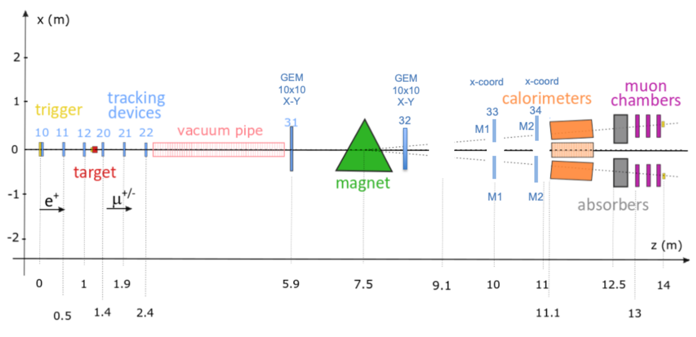
2022 layout
Fast and high-resolution pixel-based telescopes (CMS modules) in the target region
Fast GEM detectors from CMS beyond the magnet
Combination of several Calorimeters
4+2 CMS Muon DT chambers (triggerless readout)
Improved (integrated, low dead time) CMS DAQ system and trigger system
CMS DT
Tracking around target with CMS Phase-2 Strip/Pixel
Tracking Modules
Tracking in Muon Arms:
GE2/1 M1 & M2 modules
+ dedicated HighRes 10x10

Slide 35
GEM
2 Dedicated hi-resolution 10x10 triple-GEM X-Y, 260 um pitch (75 um resolution)
Standard CMS GE2/1 M1 and Me2 modules in muon arms
  Trapezoidal, 360-600 um resolution
All (to be..) read-out by CMS phase2 DAQ
We plan to have a dedicated CMS TB before Lemma TB to assess the performance of the detectors and integrate the electronics.

Slide 36
Summary of possible interest in Bari
Considerando le nostre competenze possibili ambiti:
Physics studies:
  Utilizzando il framework esistente
Detector optimization
  Studio del fondo e interazione con detector: ottimizzazione detector
  Sinergia con AIDAINNOVA WP7.
Recontruction algorithm:
  Tecniche ML
  Tracking con GPU
Software development for future collider
  Sinergia con AIDAINNOVA WP12.
Test beam:
  Sinergia CMS Phase2 (pixel, GEM, DT , ECAL e DAQ per il momento)
Neutrino background and physics
  Expertise a Bari su fisica neutrino

Slide 37
RD_MUCOL anagrafica
Attualmente
C.Aruta | 10%
A. Colaleo | 20%
M. Maggi | 10%
S. My | 10%
F. Simone | 10%
L. Silvestris | 10%
R. Venditti | 10%
P. Verwilligen | 10%
Totale | 100 %
Sigla su dot1z.
Le percentuali non sono sinergiche con altre sigle al momento. Ma e’ prevista sinergia con AIDAINNOVA (approvazione inizio 2021).
Ovviamente siete invitati a contribuire al progetto:
→ ma non e’ indispensabile avere delle percentuali.

Slide 38
BACKUP

Slide 39
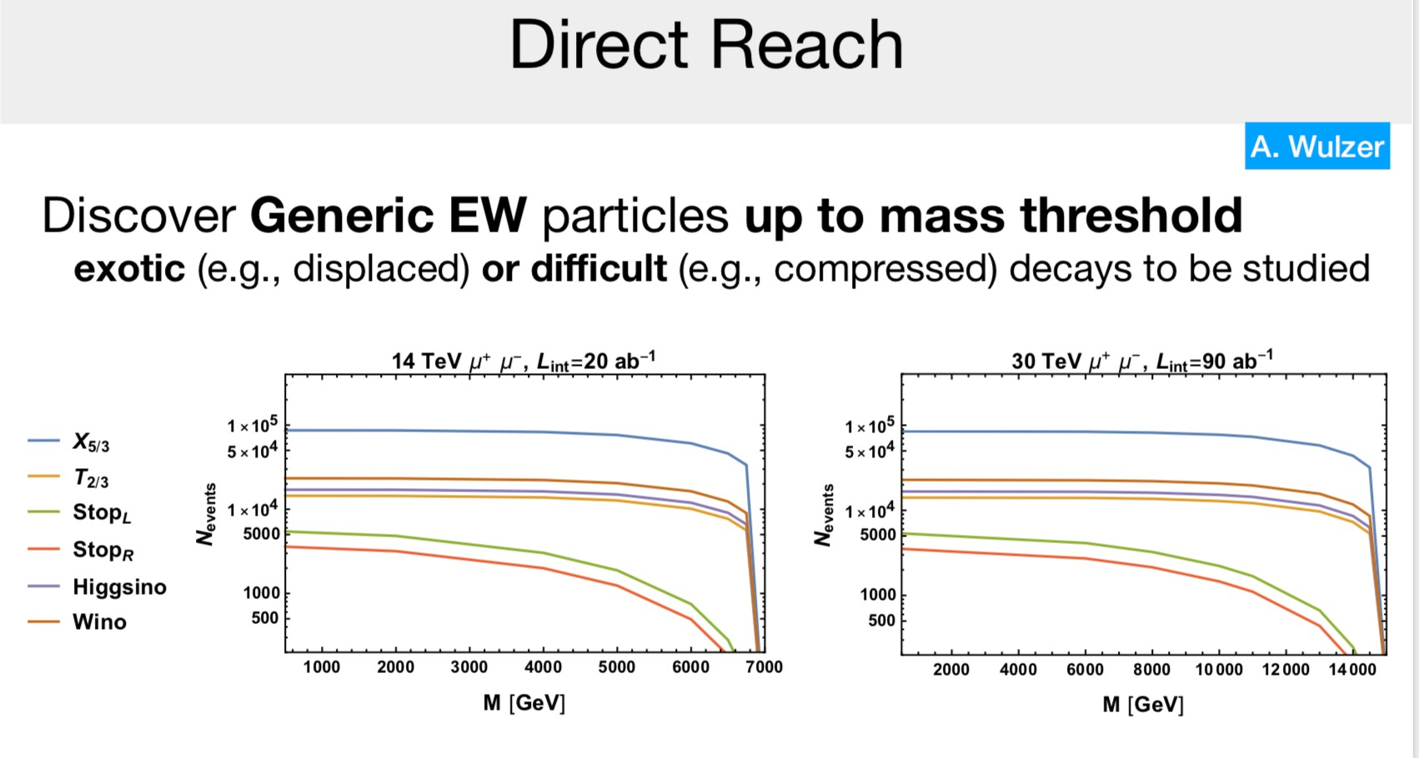
Physics at high energy
Multi-TeV energy scale allows to explore physics beyond SM both directly and indirectly

Slide 40
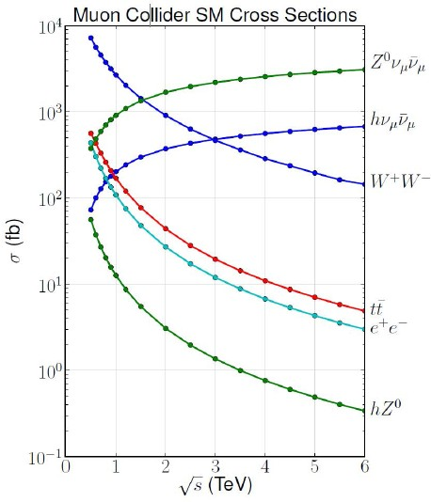

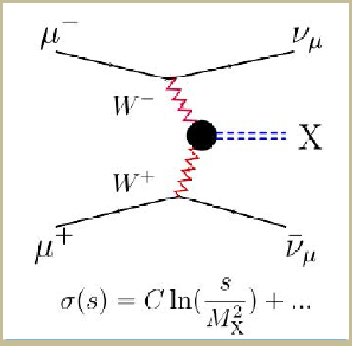
High energy Muon Collider
High Energy Collisions
At √s > 1 TeV:
Fusion processes dominate
  An Electroweak Boson Collider
  A discovery machine complementary to very high energy pp collider
At >5TeV: Higgs self-coupling resolution <10%

Slide 41
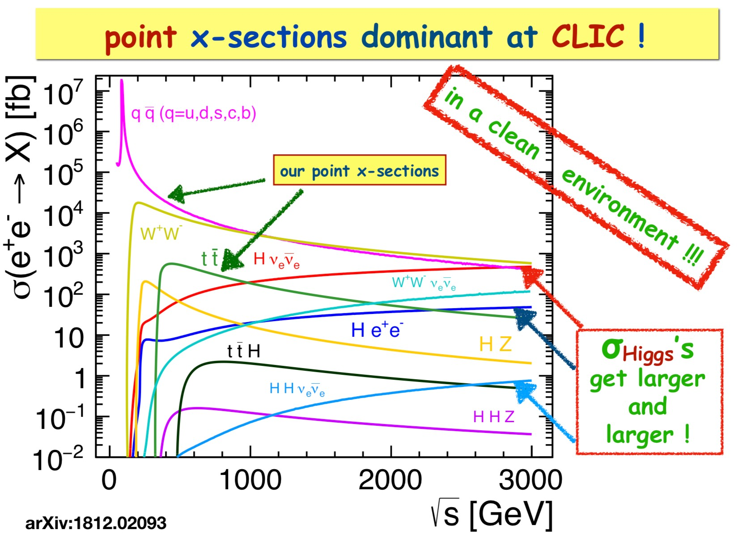
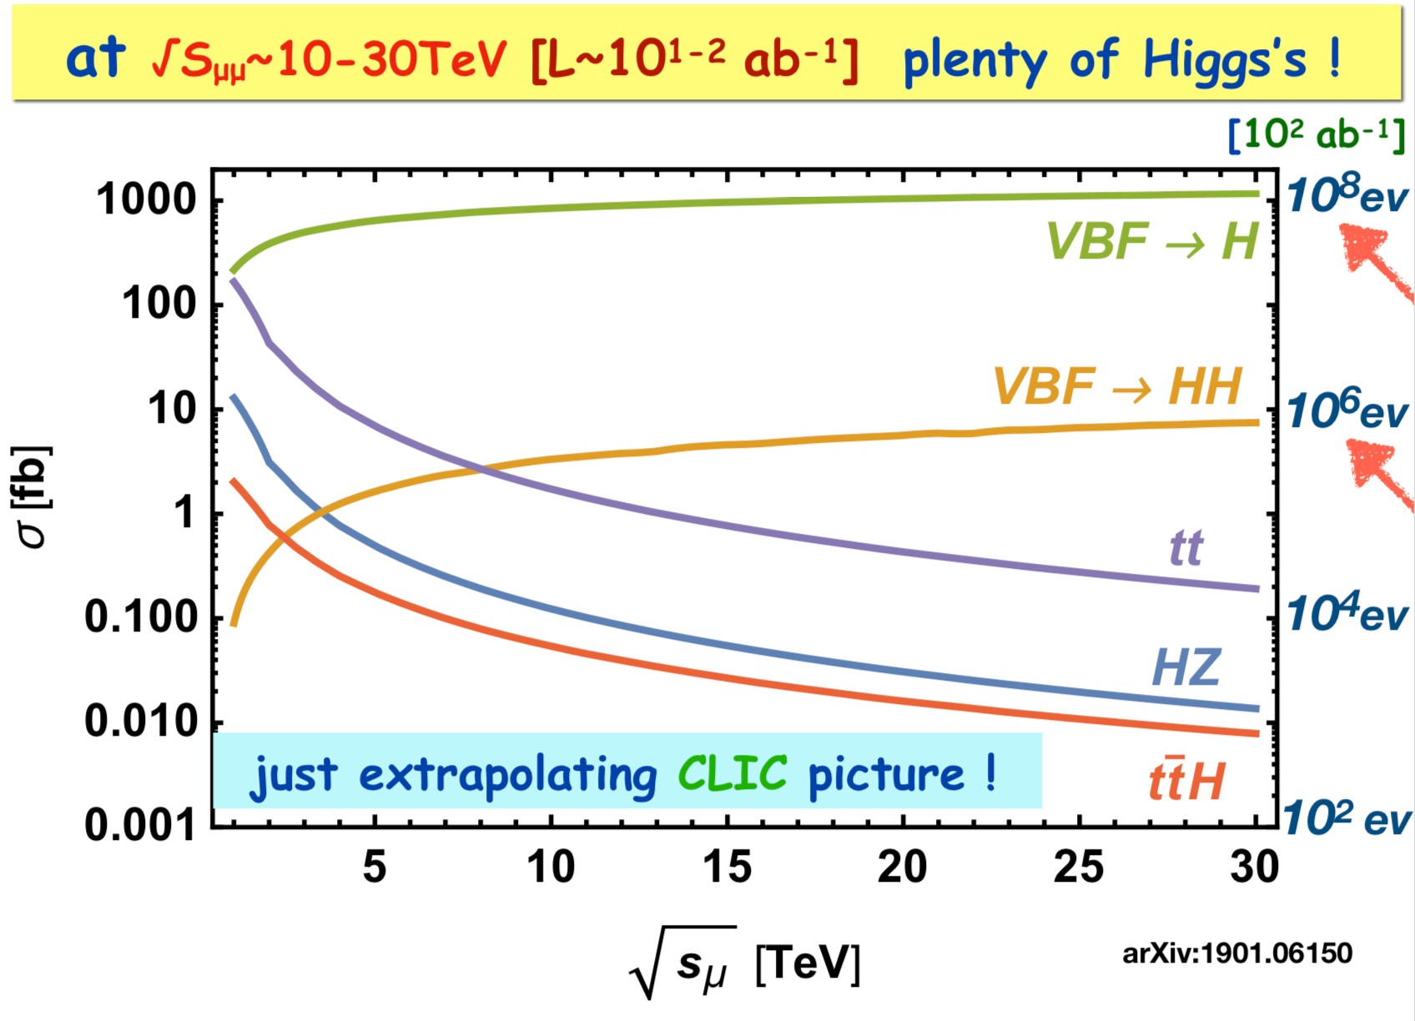
Higgs production at Lepton Collider
Circular muon colliders might reach center-of-mass energies of tens of TeV thanks to the limited amount of synchrotron radiation compared to 𝑒<𝑒² colliders
Otranto - June 1, 2019 Nadia Pastrone
B. Mele et al.

Slide 42
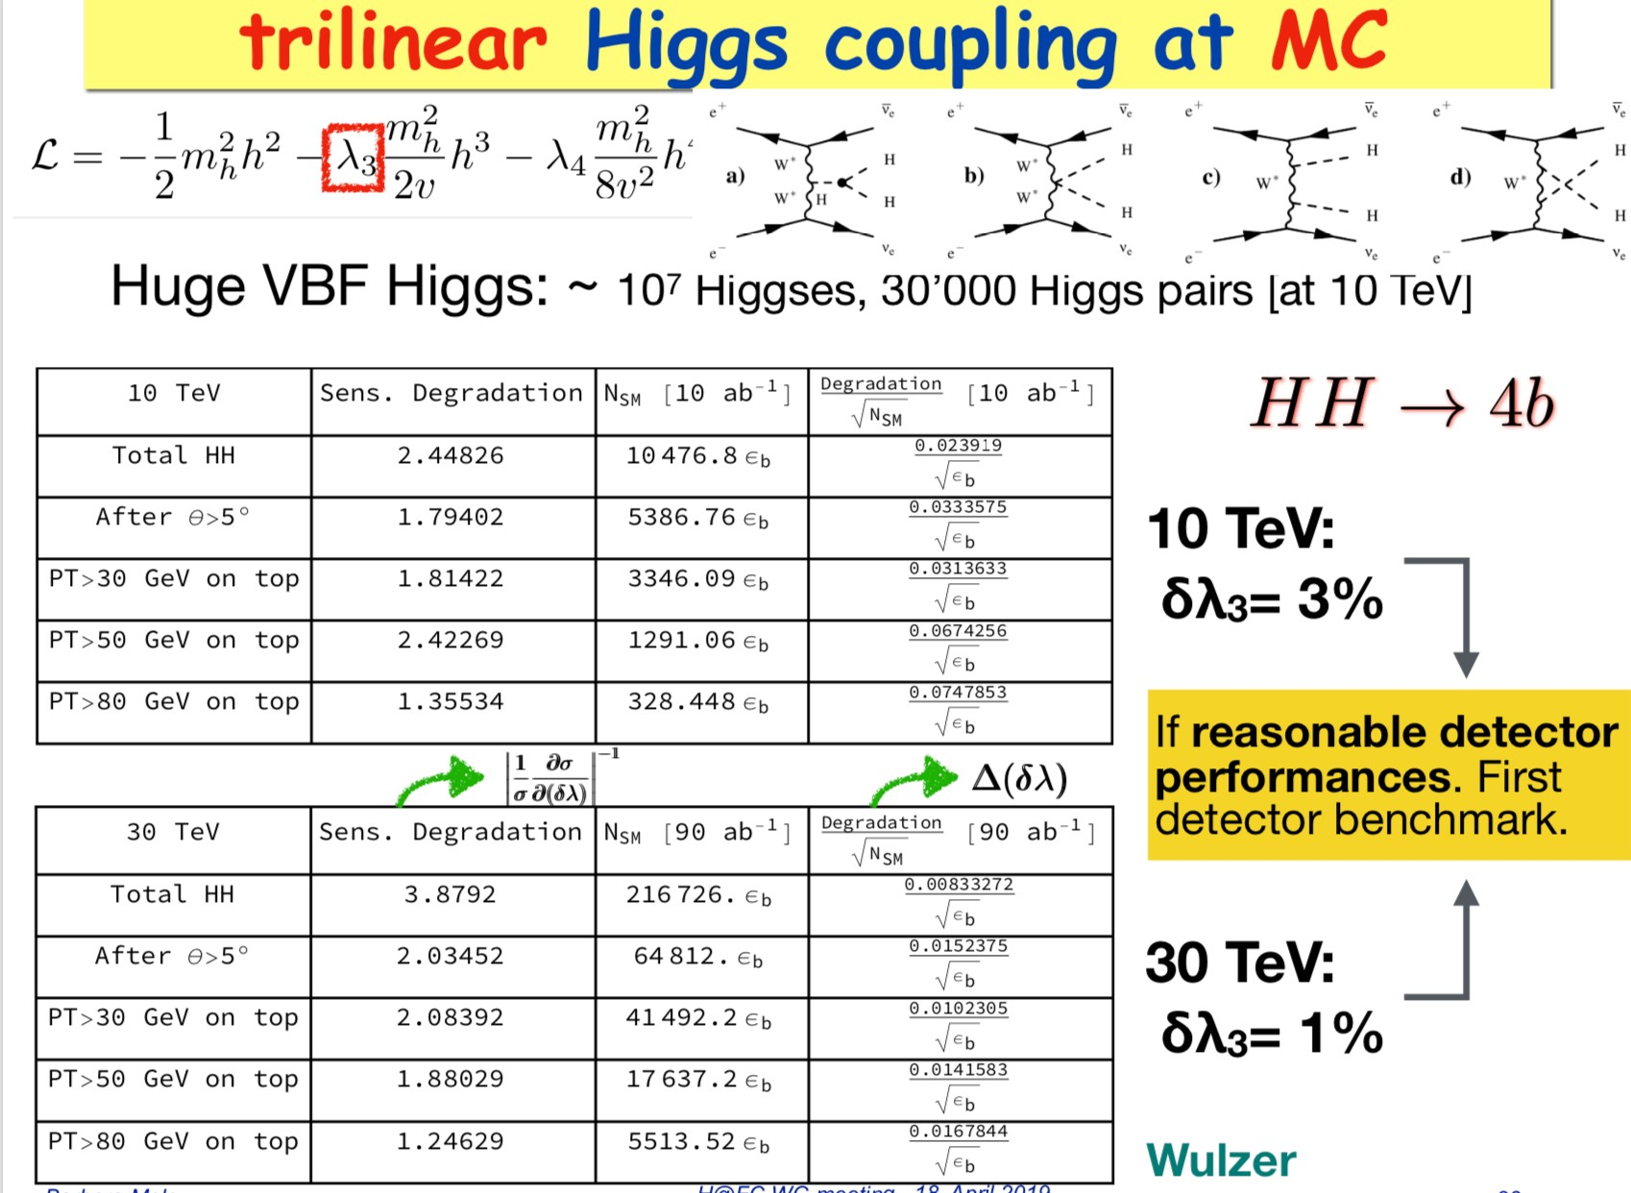
Trilinear and Quadrilinear couplings

Slide 43
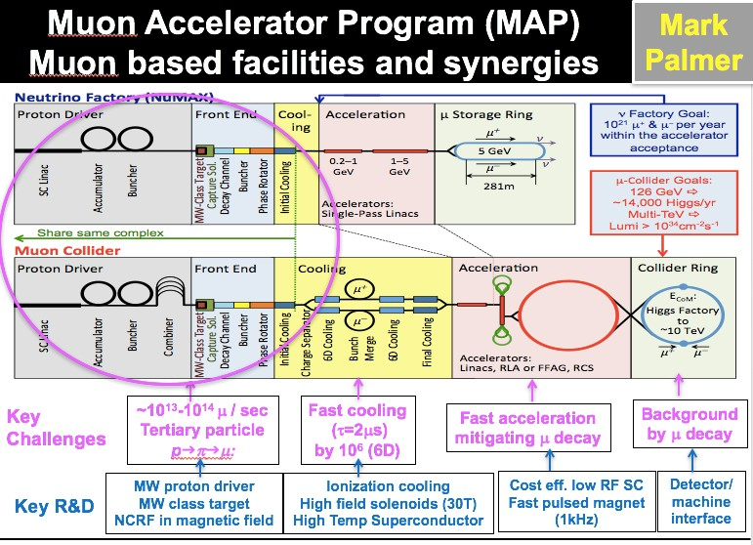
Otranto - June 1, 2019
Nadia Pastrone

Slide 44
Main design requirements
Positron Source like CLIC/ILC è 1 x 10¹⁴ 𝒆</s è injection 5 s
Damping Ring has to provide fast 𝒆< cooling, limiting total collider cycle
Lattice may be similar to the main Positron Ring
A DR similar to ILC one could provide needed damping time (12 msec) and emittance
è about 100 wigglers (ILC type) to be installed
è a shorter ring (i.e. 6.3 km) is preferred to minimize number of damping wigglers
First injection - no time constraints, then 1000 bunches with 5 x 10¹¹ 𝒆< need to be injected
45 GeV Positron Ring: high energy acceptance and low emittance with 27 km ring
è choice of final lattice based on the larger energy acceptance: it is mandatory to successfully re-inject all the “spent” beam from the muon production to be later decelerated and re-injected in the DR for cooling
100 km solution will increase the luminosity of at least a factor 3.5
Multi-target system to alleviate issues due to power deposited and integrated PEDD (*)
Source needed to replace the positrons lost in the muon production process is a real challenge, since the time available is very short
(*) Peak Energy Density Deposition

Slide 45
Tentative Considerations on Baseline
Focus on first stage with energy of O(1.5 + 1.5 = 3 TeV)
  To come after higgs factory and matching highest CLIC energy
  Using the high-energy strength of muon colliders
  Realistic design for implementation at CERN, with cost power and risk scale
  If successful, feasibility demonstration for CDR
Explore 14 TeV as further step
  To match FCC-hh discovery potential
  Mainly exploration of parameters to guide choices
  Provide evidence for feasibility, maybe cost frame
Some exploration of lower energies / Higgs factory
  Scaling from higher energies
  Not a main focus, except if other projects do not cover lower energies
Open for input

Slide 46
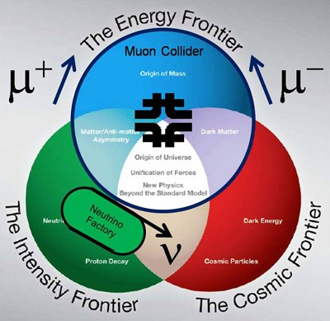
Physics reach
Muon rare processes
Neutrino physics
Higgs factory
Multi-TeV frontier
U.S. Muon Accelerator Program (MAP)
  Recommendation from 2008 Particle Physics Project Prioritization Panel (P5)
  Approved by DOE-HEP in 2011
Ramp down recommended by P5 in 2014
http://map.fnal.gov/
AIM: to assess feasibility of technologies to develop muon accelerators for the Intensity and Energy Frontiers:
Short-baseline neutrino facilities (nuSTORM)
Long-baseline neutrino factory (nuMAX) with energy flexibility
Higgs factory with good energy resolution to probe resonance structure
TeV-scale muon collider

Slide 47

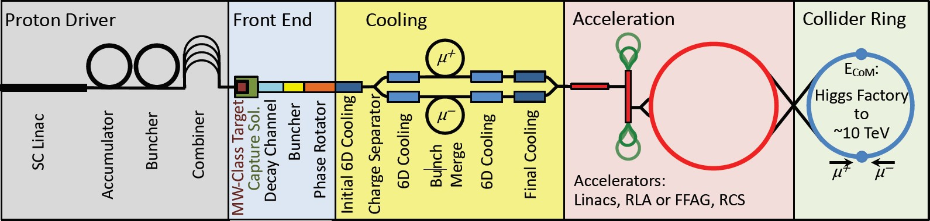
Proton-driven Muon Collider Concept
US Muon Accelerator Program – MAP, launched in 2011, wound down in 2014 MAP developed a proton driver scheme and addressed the feasibility of the novel technologies required for Muon Colliders and Neutrino Factories
Short, intense proton bunches to produce hadronic showers
Pions decay into muons that can be captured
Muon are captured, bunched and then cooled
Acceleration to Collision collision energy
Design is not complete but did not find anything that does not work
No CDR exists No coherent baseline No reliable cost estimate
"Muon Accelerator for Particle Physics," JINST,
https://iopscience.iop.org/journal/1748-0221/page/extraproc46
20

Slide 48
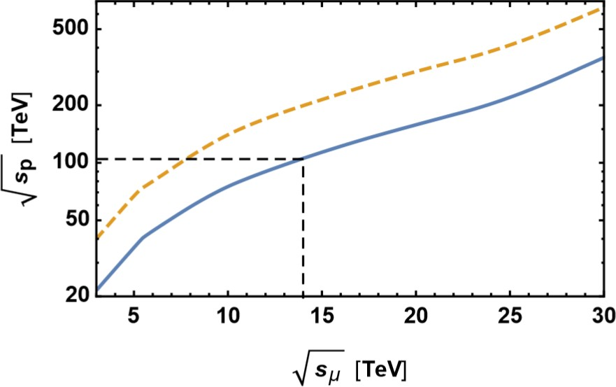

Why a multi-TeV Muon Collider?
cost-effective and unique opportunity for lepton colliders @ 𝒔 >3 TeV
1.2
1.1
1
0.9
0.8
0.7
0.6
0.5
0.4
0.3
0.2
0.1
CLIC
MuColl
M_{NewPhysics} = sqrt(s)/2
34 -2 -1
L/P_{beam} [10 cm s /MW]
A. Wulzer
D. Schulte
μμ @ 14 TeV
=
pp @ 100 TeV
0
1
2
3
E_{cm} [TeV]
4
5
6
The luminosity per beam power is independent of collision energy in linear colliders, but increases linearly for muon colliders
Full collision energy available for particle production: 14 TeV lepton collisions are comparable to 100 TeV proton collisions for selected new physics process, if sufficient luminosity is provided ~ 𝟏𝟎^{𝟑𝟓}𝒄𝒎^{.𝟐}𝒔^{.𝟏}
Strong interest to reuse existing facilities and infrastructure (i.e. LHC tunnel) in Europe

Slide 49
INFN @ WP
WP |  |  | Indus | INFN
7 | gas detector MPGD, RPC,TPC | ATLAS – CMS – LHCb – EIC – Higgsfact - neutrino | CAEN ELTOS | BA, BO, LE, LNF, PV, RM3, TS
11 | microlectronics: ASIC design | all |  | BA, BO, PV, TO, MI, CA, FE, LNF
12 | software/reco for future accelerators | all |  | FE, PD, PI, BA, RM3, BO,PV

Slide 50
Factor of merit
1.2
1.1
1
0.9
0.8
0.7
0.6
0.5
0.4
0.3
0.2
0.1
CLIC
MuColl
34 -2 -1
L/P_{beam} [10 cm s /MW]
D. Schulte
0
1
2
3
E_{cm} [TeV]
4
5
6
MAP studies addressed design issues from muon production to final acceleration:
è proton driver option: advanced studies for a 3-6 TeV machine
è however a 6D cooling TEST FACILITY is MANDATORY to demonstrate feasibility A new idea not requiring 6D cooling – LEMMA – represent an appealing scheme: è further studies and solid R&D program needed for such positron driven option

Slide 51
Effort for Baseline Design
Put together coherent design requires (mainly human) resources
  This goes beyond US effort
  Consistent parameters and layouts
  Integration of collider systems, trade-offs, choices, …
  May highlight additional important issues
  Requires (mainly human) resources
  Currently MAP is main option, LEMMA is alternative
Key R&D list with priorities
  Identify key / feasibility issues
    i.e. largest technical risks
    Key cost driver, if critical
    Key power consumption, if critical
  Entry point for collaborators
Proposed MUST
(MUon collider STudy network) submitted I.FAST EU project

Slide 52

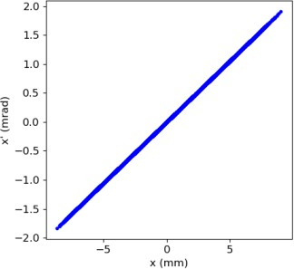
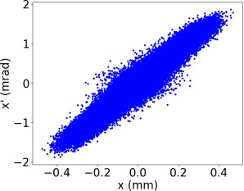
The challenge
“intrinsic” emittance of emerging muons is tiny, and buried deep into the emittance of the incoming 𝑒⁺beam
  In order to get a meaningful result, the measured muon kinematics must be
corrected by that of the the incoming positron:
Requires extremely good tracking resolution both before and after the target
𝜀_{𝑔𝑒𝑜} = 3.8 nm rad
𝜀_{𝑔𝑒𝑜} = 30.1 nm rad
Positron-corrected measured 𝜇⁻ emittance with reasonably achievable tracking system
intrinsic true 𝜇⁻ emittance
Cross section measurement requires an efficient trigger and DAQ system with small dead-time, ability to assess the trigger efficiency, and well controlled acceptance
More like a small experiment than a typical test beam
5

Slide 53
