Slide 1



WP4: Radiobiology
Lorenzo Manti
2nd NEPTUNE collaboration meeting
19th June 2020

Slide 2
Outline
Overview of carried out activity
Milestone/deliverable status for 2020
Outlook for 2021

Slide 3
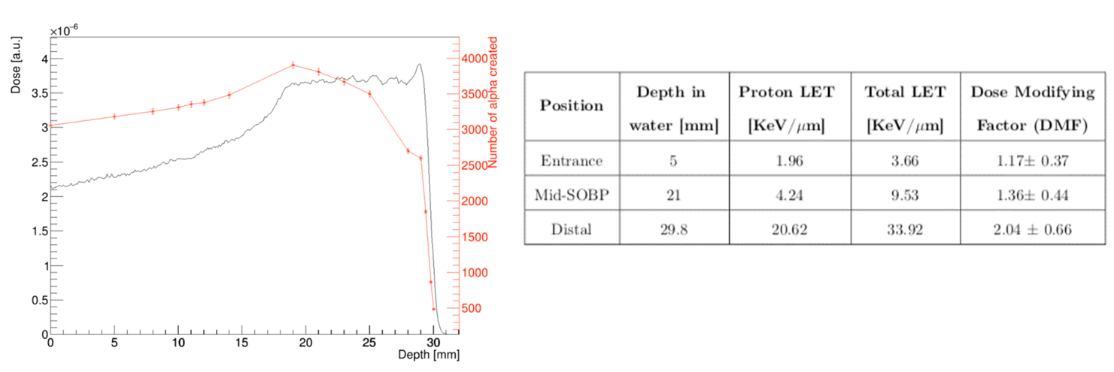
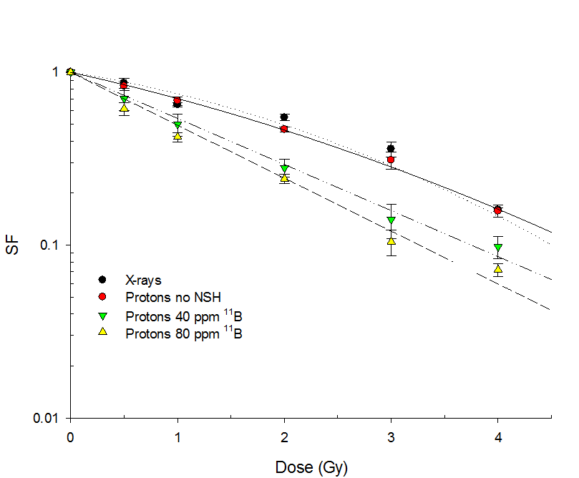
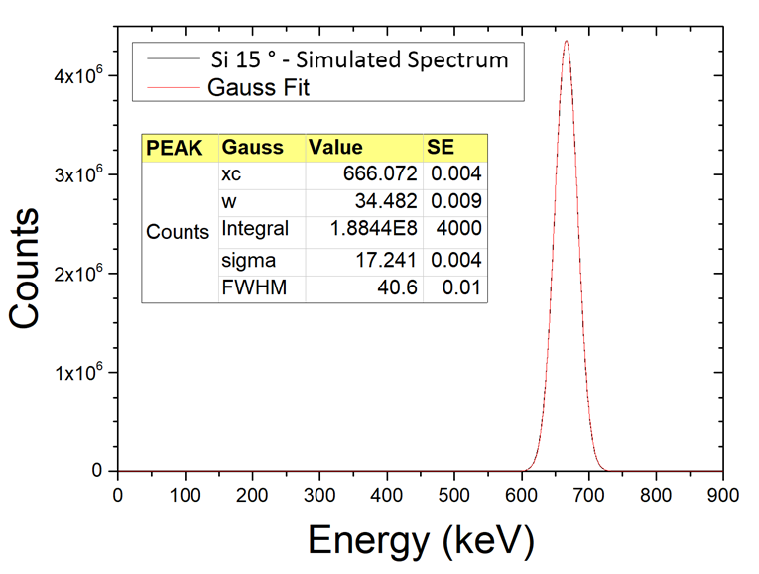
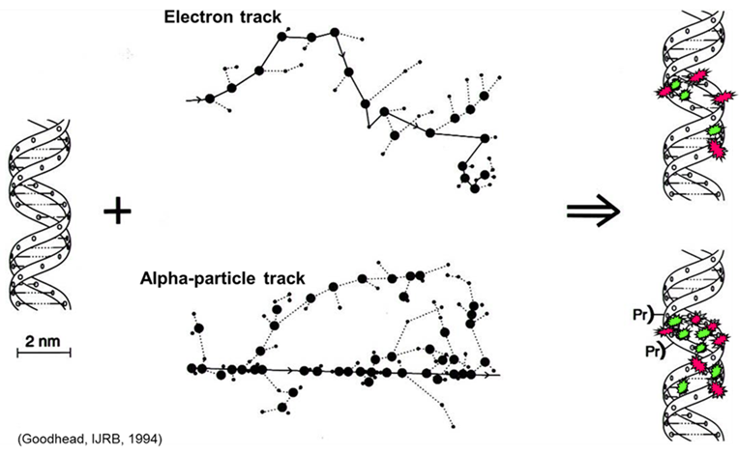
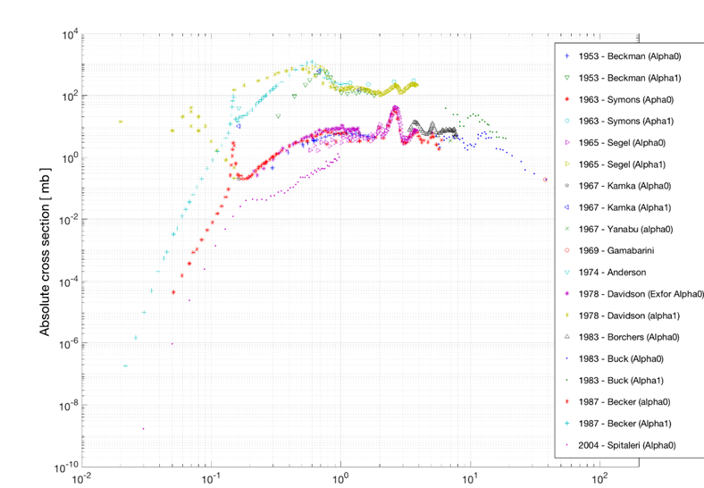
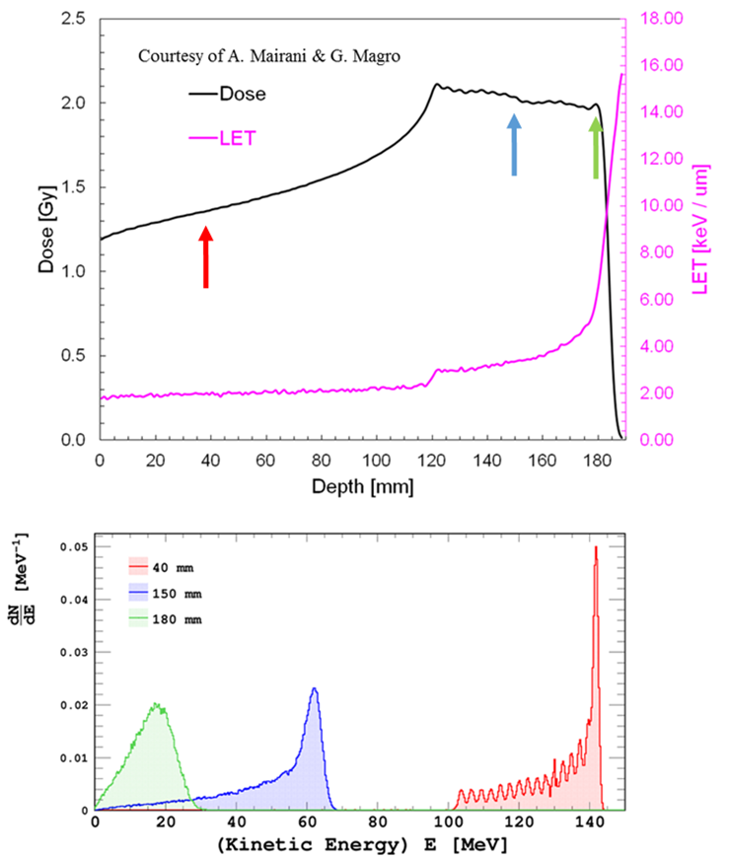
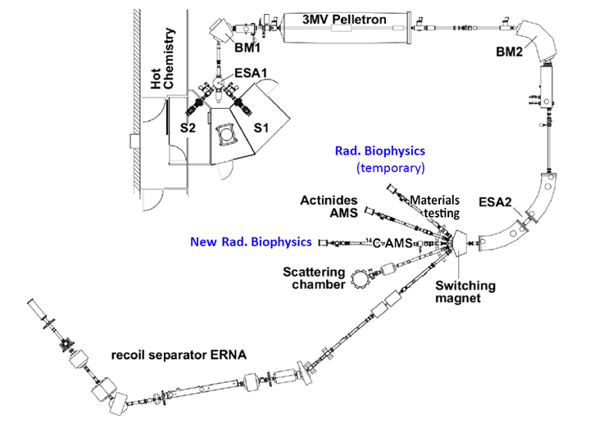

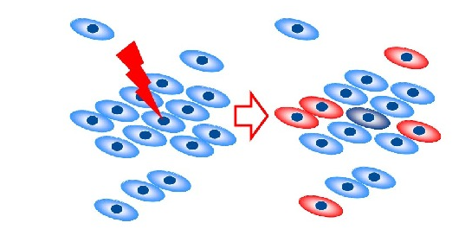
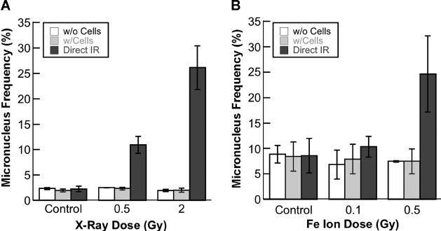
WP4 tasks
Task 1: Nuclear-reaction driven enhancement of proton-induced cytogenetic damage
Task 2: Dependence of measured effects on proton energy
Task 3: Detection of specific high-LET radiobiological signatures
Task 4: Investigation of non-targeted phenomena

Slide 4
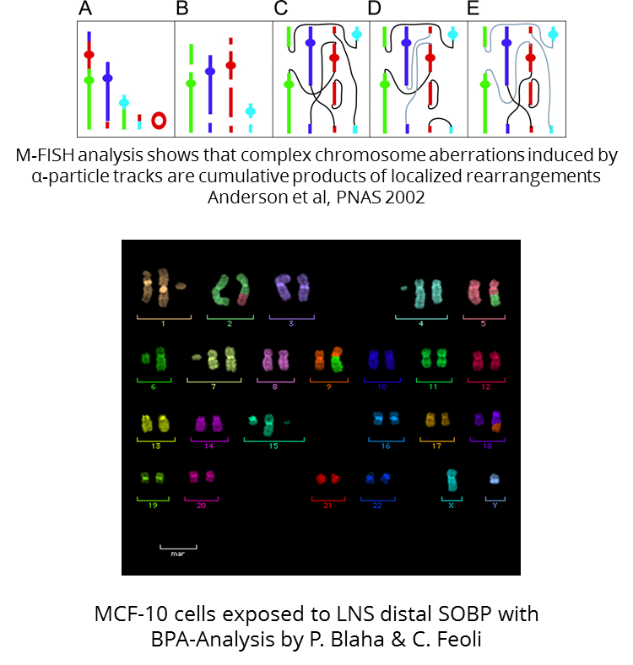
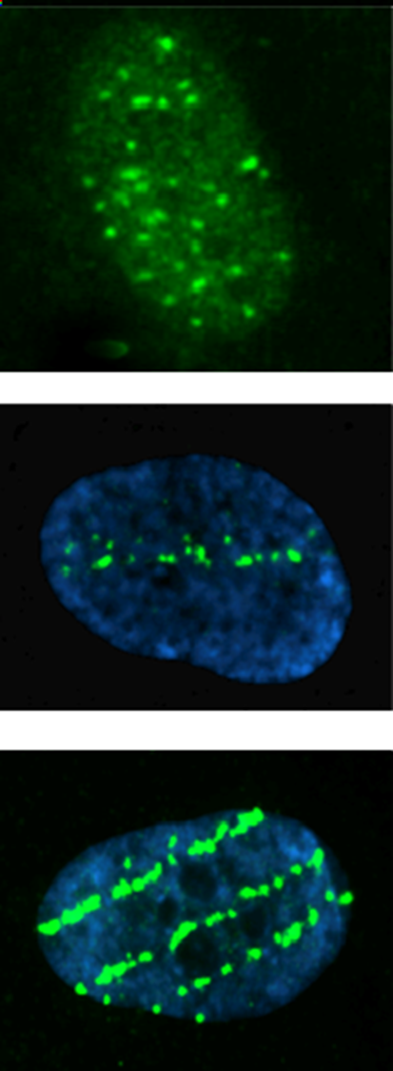
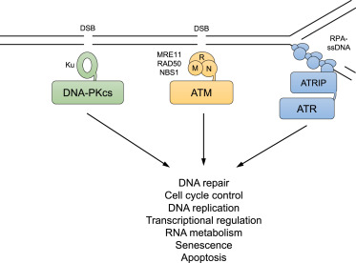
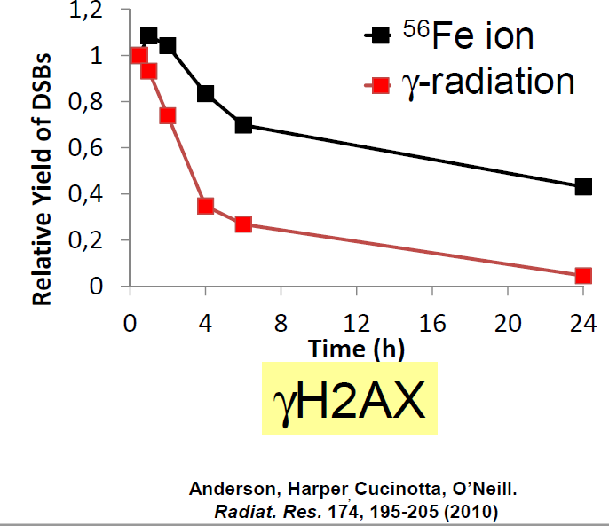
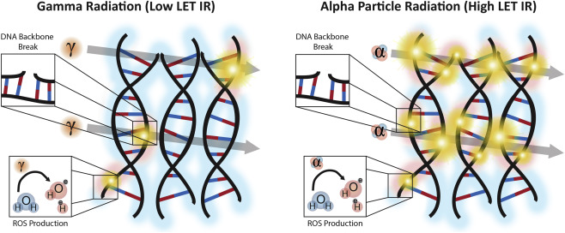
Clustered lesions
ATM, ATR, and DNA-PK: The Trinity at the Heart of the DNA Damage Response. Blackford and Jackson Mol Cell, 2017
Intra-track recombination lowers yields of radical species (e.g. OH*) raising that of molecular products. Azzam et al., Cancer Lett 2012

Slide 5
Experimental activity-2019
Feb 2019, LNS
BSH, entrance distal CA (WCP & mFISH) MCF-10; 0, 0.5, 2, 4 Gy
Clonogenic PANC-1, Mid-SOBP 0, 0.5, 1, 2, 4, 5 Gy
MCF10 2 Gy mid-SOBP for DNA damage by immunofluorescence analysis
June 2019, CNAO
BSH, 3 positions (entrance, Mid, distal) MCF-10 CA 0 0.5 1 2 4 Gy
July 2019, LNS
BSH and ¹⁰B BSH, DU 145, clonogenic 0 0.5, 2 4 Gy
BSH Clonogenic Panc-1 0 0.5 1 2 4 5 Gy
CA MCF-10 entrance distal (WCP+mFISH)
MCF10 2 Gy mid-SOBP for DNA damage by immunofluorescence analysis
MCF10 2Gy mid-SOBP protein analysis by Western blot
July 2019, CNAO
BSH CA MCF-10 entrance, mid, distal (WCP+mFISH)
October 2019, LNS
BPA DU 145 and Panc-1 clonogenic
0 0.5, 1,2 4 5 entrance, mid e distal
MCF10 entrance mid distal 0 0.5 2 4 (WCP & mFISH)
Evaluation ROS Production (Panc-1), mid-SOBP and Distal: 0, 1, 2, 5 Gy
November 2019, CNAO
BPA DU145 clonogenic entrance mid distal 0 0.5,1, 2 4 Gy
MCF10 CA entrance mid distal (WCP & mFISH) 0, 2 4 Gy
December 2019, LNS
BPA Boron incorporation;
Clonogenic Panc-1, Entrance, mid-SOBP and Distal: 0, 0.5, 1, 2, 4, 5 Gy
MCF10 2Gy, mid-SOBP for DNA damage by immunofluorescence analysis
MCF10 2Gy mid-SOBP to collect pellet for protein analysis by Western blot

Slide 6
Experimental activity-2020
February 2020, LNS
BPA DU & Panc clonogenic entrance distal mid 0 0.5 1 2 4 5 Gy
MCF 10 Micronuclei (MN) mid SOBP 0 0.5 2 4 Gy
MCF 10 immunofluorescence & protein analysis e distal 1 Gy February 2020, CNAO,
BPA Boron incorporation
DU 145 entrance mid distal 0 0.5 1 2 4 Gy
March & June 2020, Caserta, tandem CIRCE
DU145 clonogenic no BSH
Scheduled
June & July 2020, CNAO
BPA Clonogenic, Panc, entrance, mid and distal
Premature senescence, HUVEC 0 0.5 2 Gy
Bystander-medium transfer

Slide 7
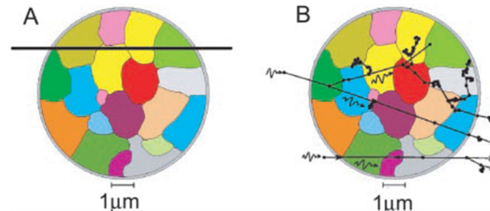
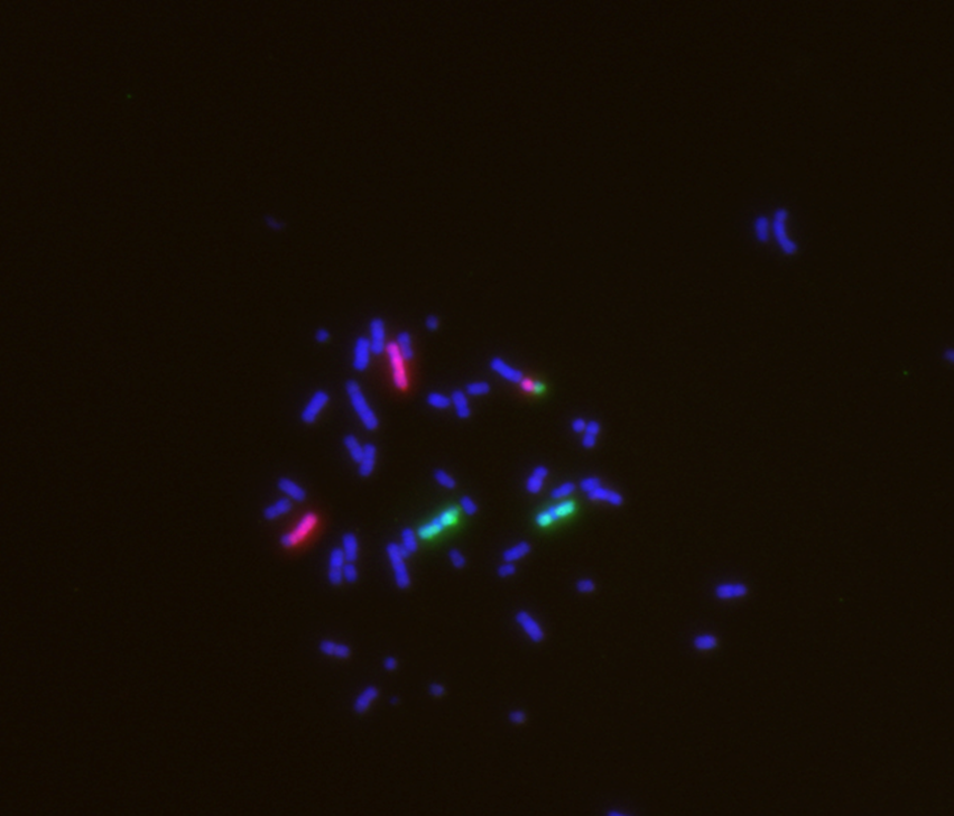
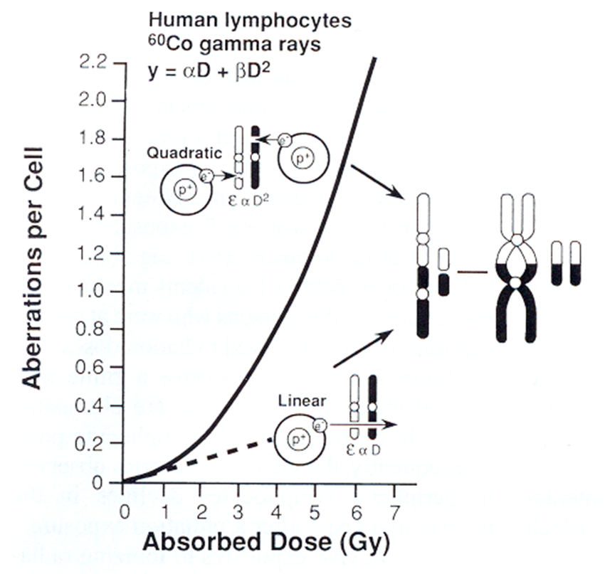
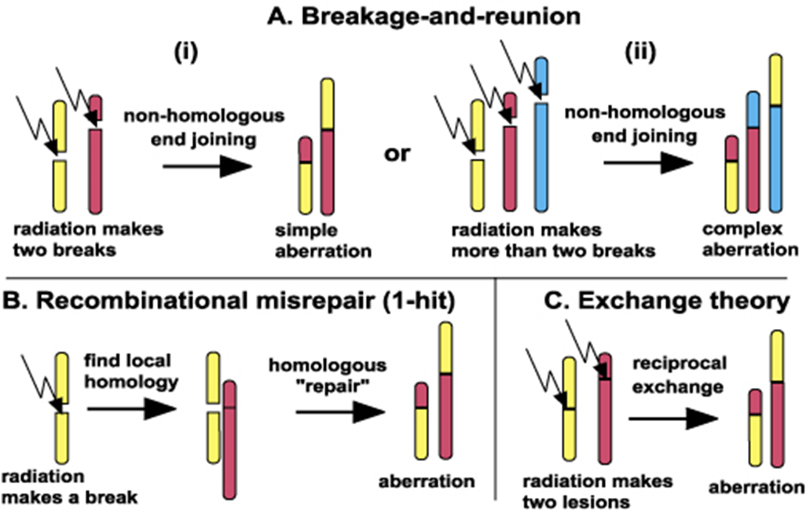
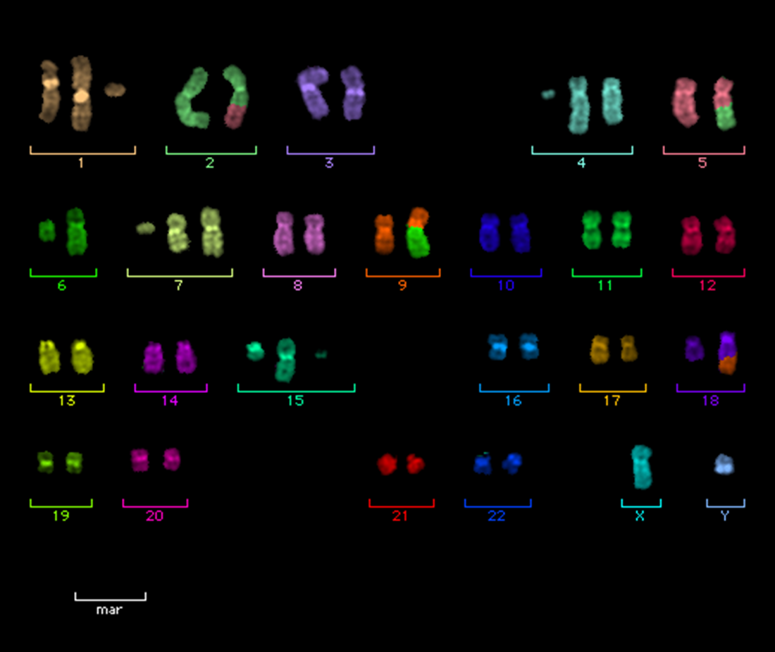






Danno radioindotto: aberrazioni cromosomiche strutturali

Slide 8
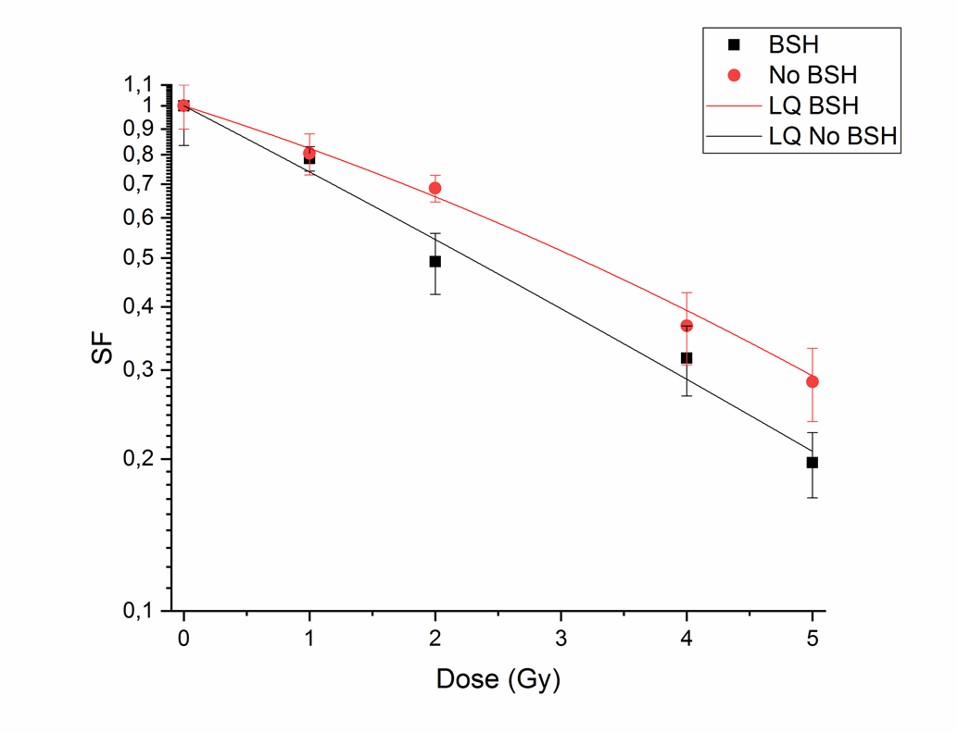
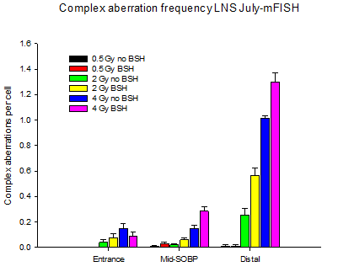
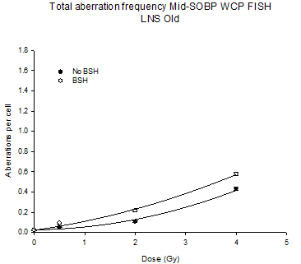
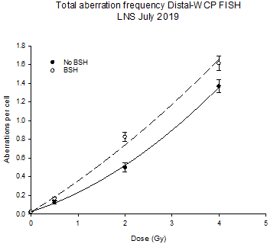
Results-1
Chromosome aberrations and survival-BSH-LNS
Panc

Slide 9
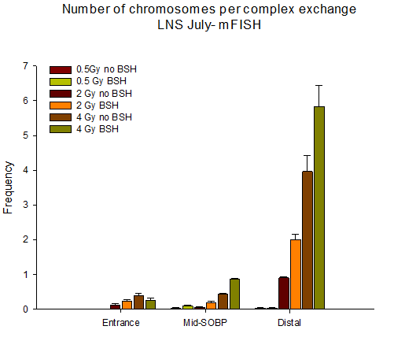
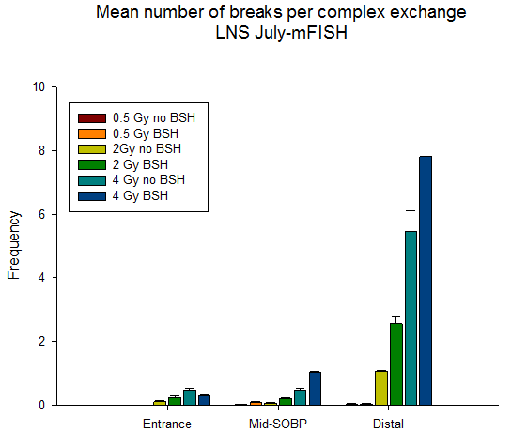
Results-2
Chromosome aberrations BSH LNS

Slide 10
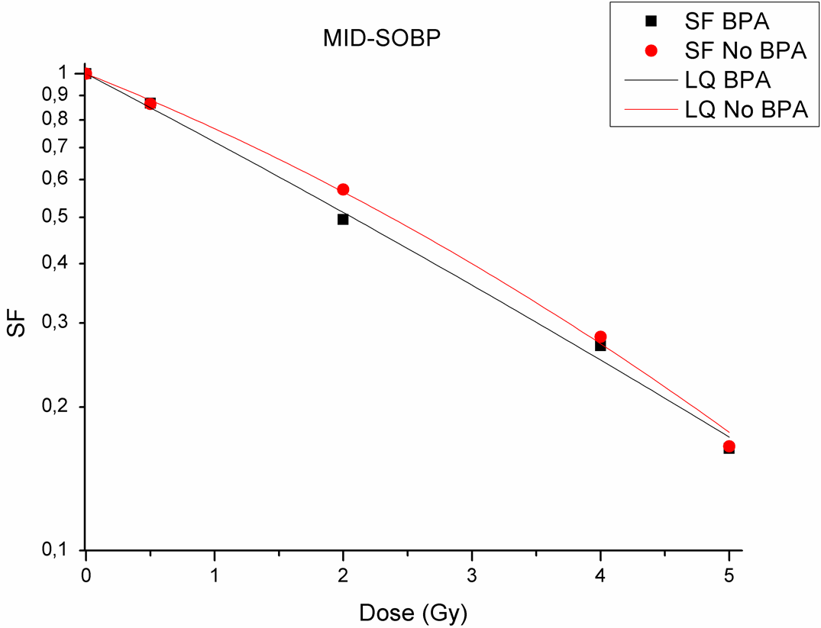
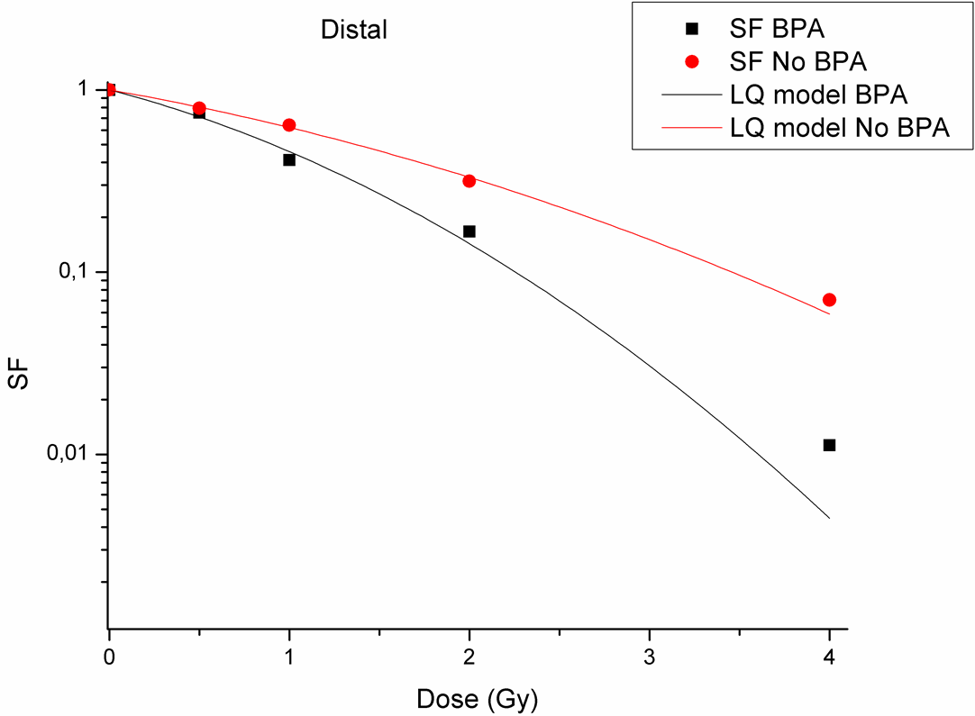
Results-3
BPA-survival-LNS
Panc-1

Slide 11
Results-4
Fitting parameters-DU145 survival dose response curves BPA-LNS
DMF₁₀∼1.31 @ mid-SOBP
1.42 @Distal

Slide 12
Results-5
BPA Survival in DU145-CNAO

Slide 13
Results-6
Fitting parameters-DU145 clonogenic survival curves-BPA CNAO
Nov 2019
DMF₁₀∼1.20 @mid-SOBP
Feb 2020
DMF₁₀∼1.26 @mid-SOBP
Need to average the two exps!

Slide 14
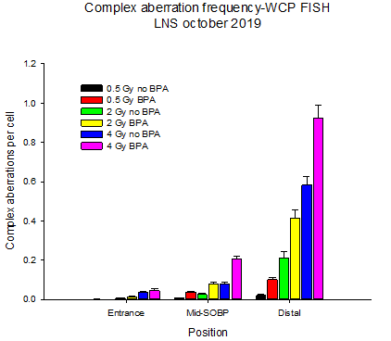
Results-7
-BPA-Chromosome aberrations-LNS

Slide 15
Results-8
BPA-Chromosome aberrations-LNS

Slide 16
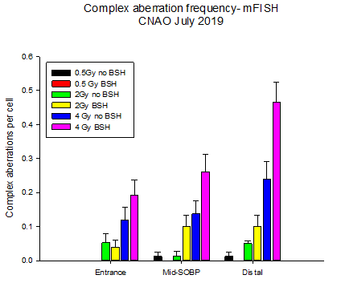
Results-9
BSH Chromosome aberrations-CNAO

Slide 17
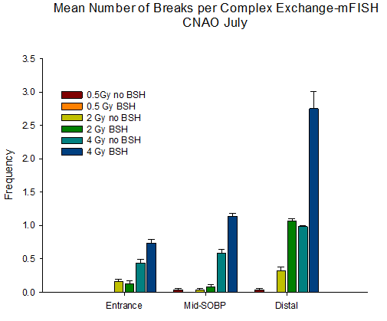
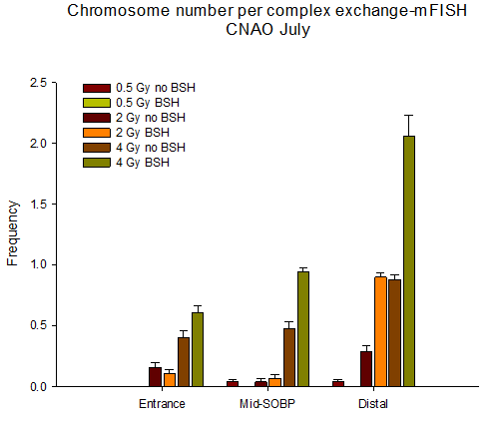
Results-10
BSH Chromosome aberrations-CNAO

Slide 18
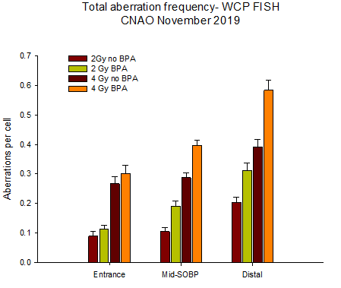
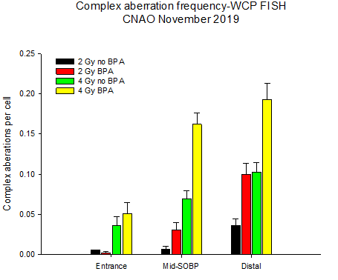
Results-11
BPA-Chromosome aberrations CNAO
m-FISH analysis in progress

Slide 19
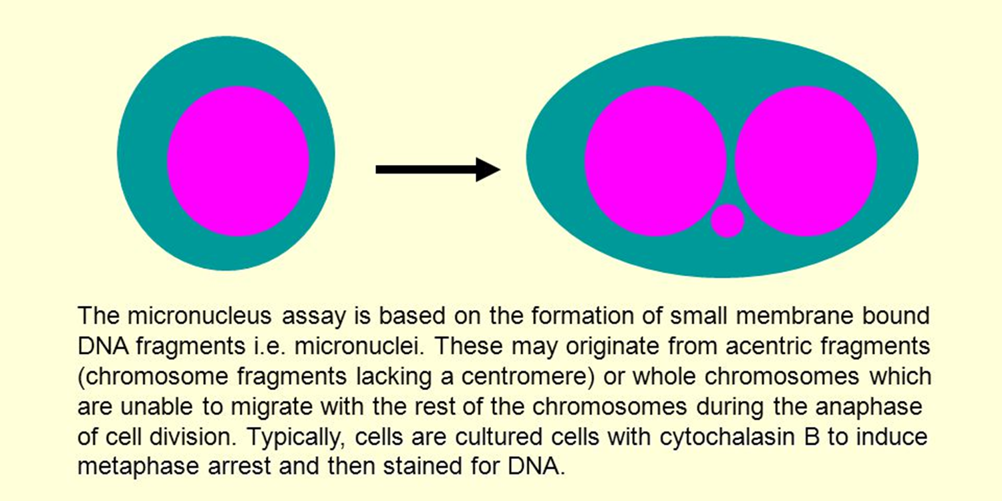
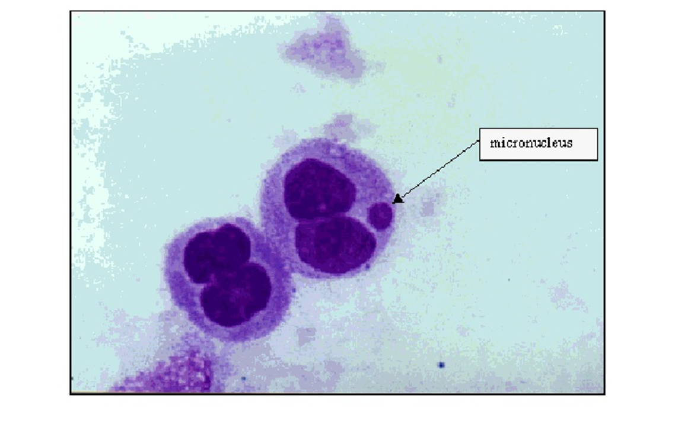
Results-12
Micronuclei-BPA mid-SOBP LNS

Slide 20
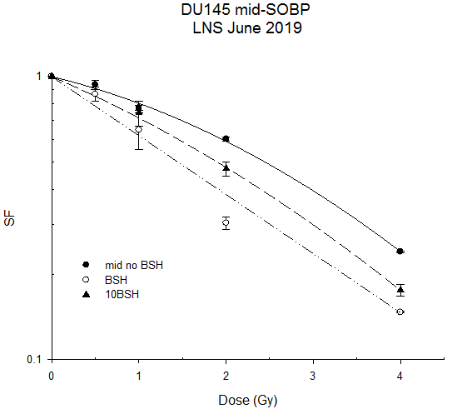
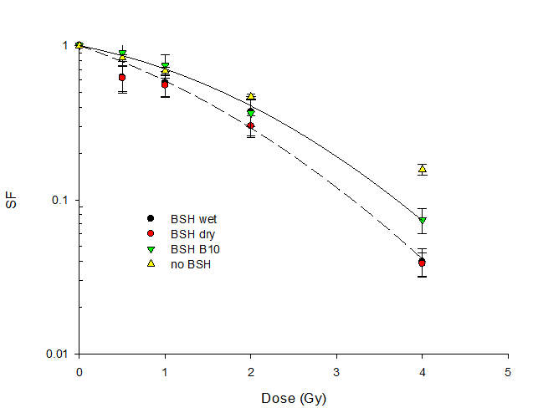
Results-13
Neutron contribution ?
DU145 mid SOBP
March 2018
Curve | a (Gy⁻¹) | b (Gy⁻²)
BSH wet | 0.433 ± 0.198 | 0.091 ± 0.054
BSH with ¹⁰B | 0.246 ± 0.063 | 0.102 ± 0.017
Fitting parameters | a (Gy⁻¹) | b (Gy⁻²)
No BSH | 0.171 ± 0.024 | 0.0463 ± 0.0061
¹⁰B-enriched BSH | 0.304 ± 0.024 | 0.0320 ± 0.0066
BSH | 0.48 ± 0.14 | 7.742 10⁻¹³ ± 0.036
N.B.Wet and dry refer to flasks irradiated with medium and without to BSH “incorporation”
mid SOBP

Slide 21
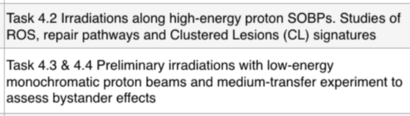
Deliverable & milestone status for 2020
Deliverable 31-12-2020
  Results on high-LET radiation induced Clustered Lesions (CL) as an effector of proton biological enhancement by p-B and p-F reactions. Cell survival studies with BNCT 50%
Milestones
  30-06-2020 50%
  31-12-2020 25%

Slide 22
Spese missioni 2020
Assegnati (in k€)
Turni di misura & collaboration meetings 3.0+5.0 SJ
  LNS: 1+1 SJ
  TIFPA: 2 SJ
  CNAO: 2 SJ
  Collaboration meetings: 2
Spesi: 1
Da spendere
  2-3?

Slide 23
Outlook for 2020
Things to do with high-energy beams (BPA):
  Clonogenic PANC-1
  ROS, DNA damage & repair pathways
Other things to do (BSH/BPA)
  Low-energy proton clonogenic survival
  Bystander experiments
Even more things to do (2021?):
  p-F reaction experiments-
    FDG
    F-BPA

Slide 24


Outlook for 2021
Milestones
Deliverables

