Slide 1
LNF @ NToF
F.Murtas
INFN - Laboratori Nazionali di Frascati and CERN
LNF participation at nTOF @ CERN
Beam dump in EAR1 instrumentation
Use of Timepixes in nTOF
Alignment system using TimepixQuad
nGEM : a gas chamber for thermal neutron high efficiency detection
Experimental group and requests

Slide 2
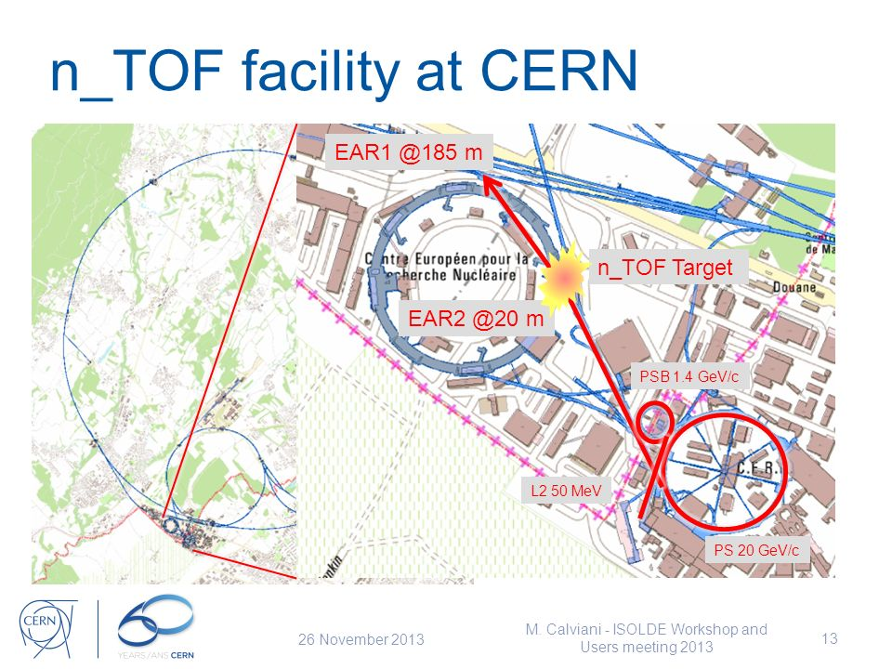
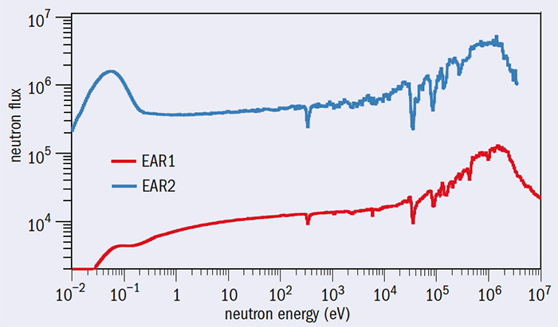
Beam Dump Area at nTOF
NTOF facility with two neutron beams
Measuring the time of arrival from the proton hit on target
a precise measurement of the neutron energy can be obtained.
Two experimental areas : EAR1 (low flux) with a Beam Dump and EAR2 (high flux)

Slide 3
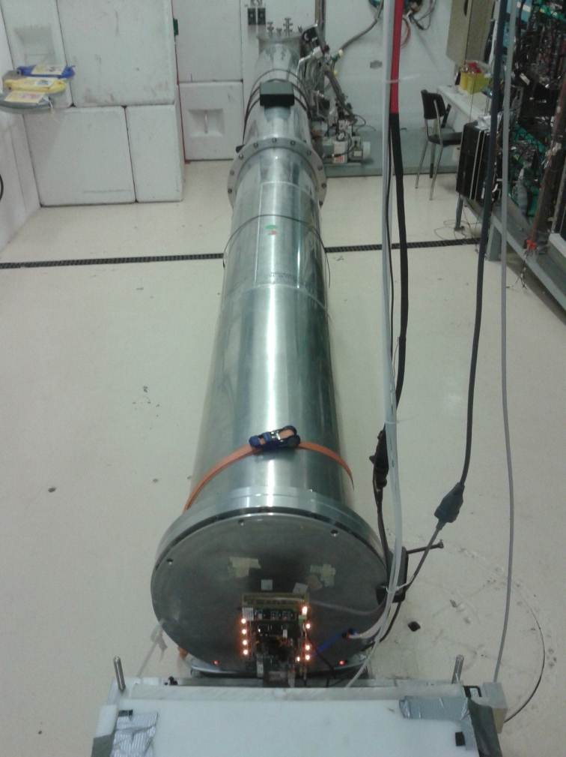
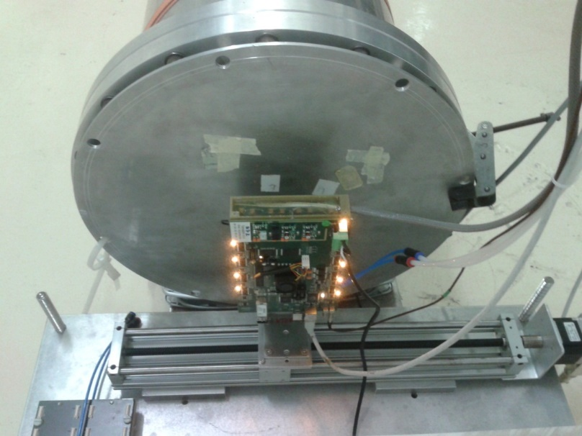
Beam Dump Area at nTOF
FPGA board
Step motor (10 um)
NTOF neutron Beam Dump
NTOF Beam dump area
GEM detector setup
One of LNF contribution in the past years was the instrumentation of the dump area with
a linear stage for detector tests and characterization (2013-2019) .
Thermal and fast neutron GEM detectors were tested in this area during this period.

Slide 4
Use of Timepixes in nTOF

Slide 5
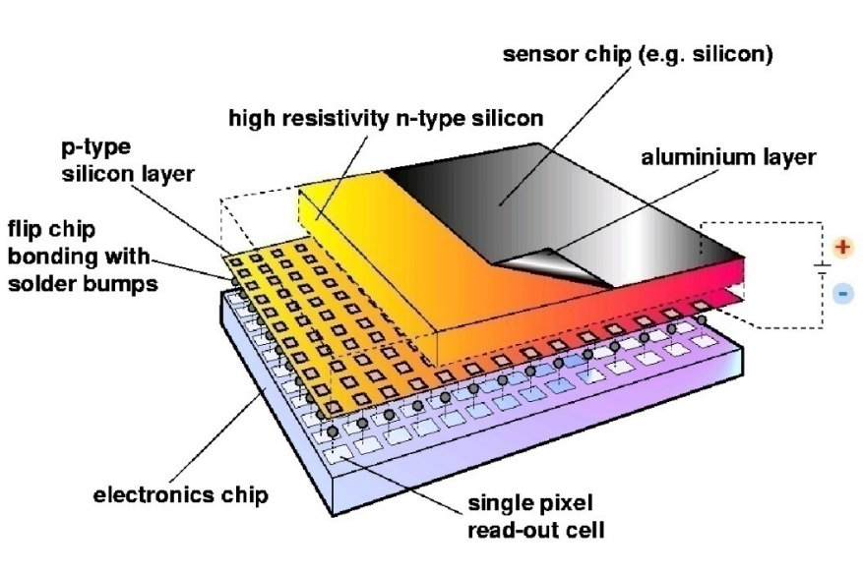
Hybrid Silicon Pixel Detectors
Standard CMOS can be used allowing on-pixel signal processing
Sensor material can be changed according to the application you need :
Silicon, GaAs, CdTe, Diamond … and gas → GEMPix detector )
Notes:
Mention signal generation Add X section?

Slide 6
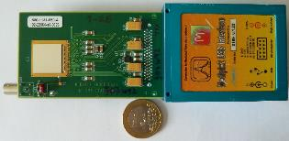
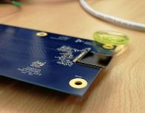
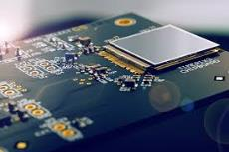
Timepix family
Timepix :
Time frame oriented
Counting mode or
Time of arrival or
Charge
Dead Time
E_{vis}> 5 keV
10 ns resolution
kB/s
Timepix3
Pixel oriented AND
Time frame oriented
Counting mode and
Time of arrival and
Charge
Continous measurement
E_{vis}> 3 keV
1.5 ns resoution
MB/s
High Temperature
Timepix4
Pixel oriented
Time frame oriented
4 x active area
?
?
…finally INFN re-enter
in Medipix collaboration !

Slide 7
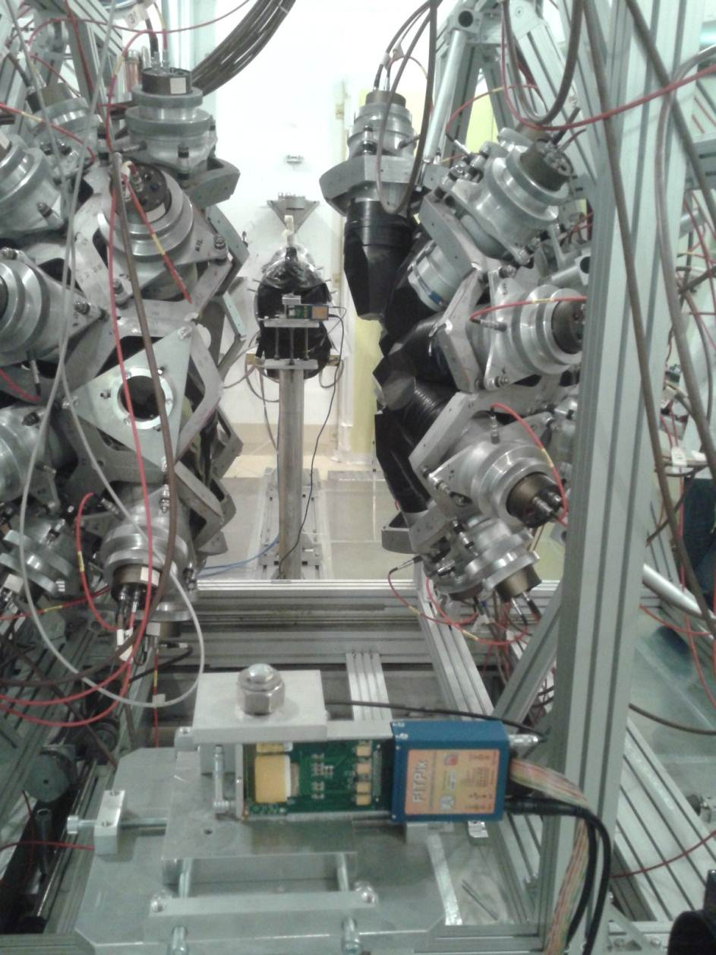
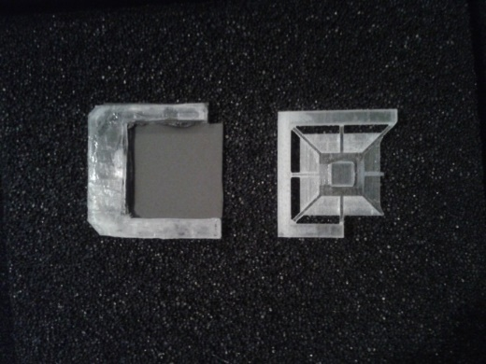
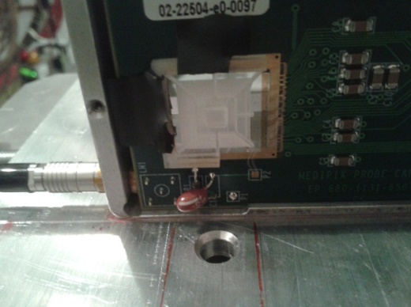
Timepix in EAR1
A converter can be placed on top of the silicon
sensor (15x15 mm² x 300 micron)
Boron layer (1 micron)
PE layer (2 mm)
Machined PMMA
The converter can be replaced with the
detector in position
The sensitivity to thermal or fast neutrons
can be changed easily
First measurements were done also
with Timepix detectors in 2014
in EAR1

Slide 8
DIAMONDPix
Higly pixelated diamond detector
tested at nTOF

Slide 9
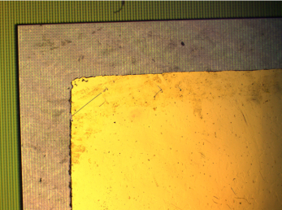
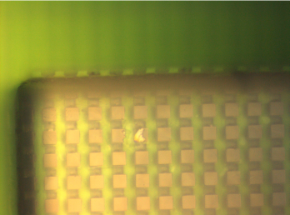
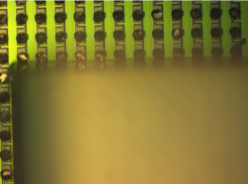
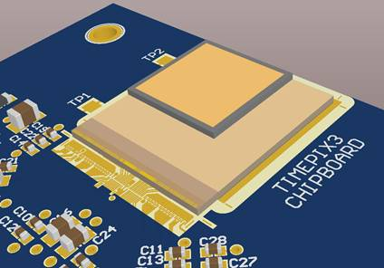
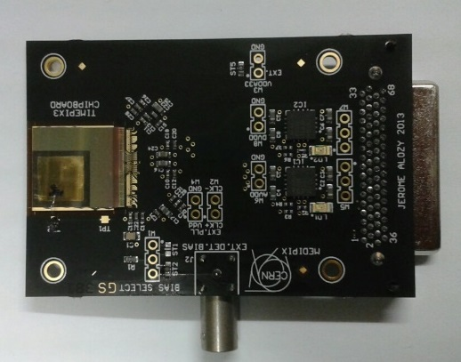
Diamondpix : a radiation hardness detector
Made by Element6 and Fraunhofer IZM
Gold cathode on diamond
upward surface
Pads on diamond
downward surface
Timepix3 Pads
In 2018 two Diamondpix have been tested on
nTOF for detector characterization and neutron-gamma
discrimination.

Slide 10
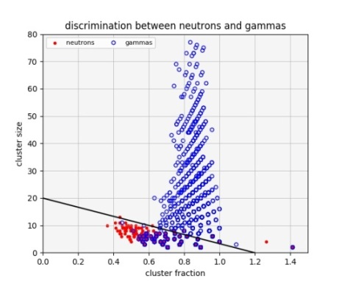
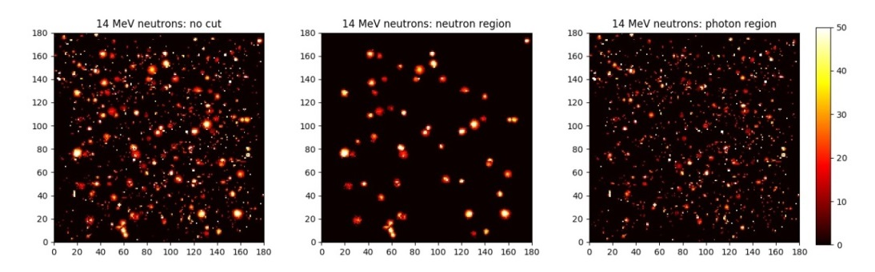
Diamondpix : a radiation hardness detector
Beam image
Neutrons
Gammas
Neutron / Gamma discrimination
Details on :
Diamondpix: a CVD diamond detector with Timepix3 chip interface TNS 00581-2018-R1
G.Claps, F, Cordella, C.Di Giulio, L. Foggetta, F.Murtas, G.Cavoto

Slide 11
Neutron Beam Alignment
with Timepix

Slide 12
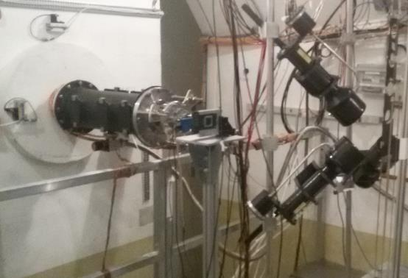
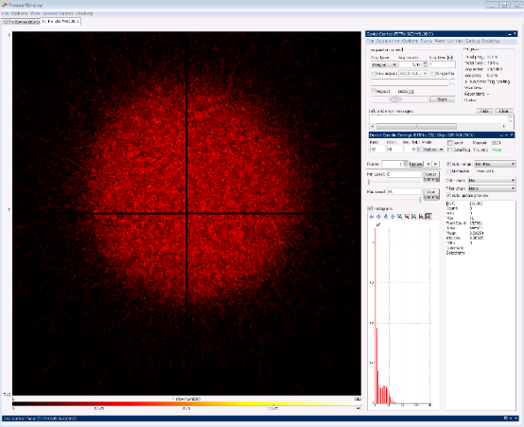
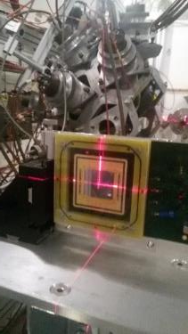
Timepix Neutron Beam Monitor at nTOF
nTOF EAR1
Beam image
In 2018 a beam monitor based on 2 Quad Timepixes has been installed in nTOF EAR1
It has been used for the beam alignment and it will be used for flux measurements in 2022
LNF proposed in 2019 to realize a second alignment system in EAR2 (financial requests for 2020)

Slide 13
Tests on GEM neutron detector

Slide 14
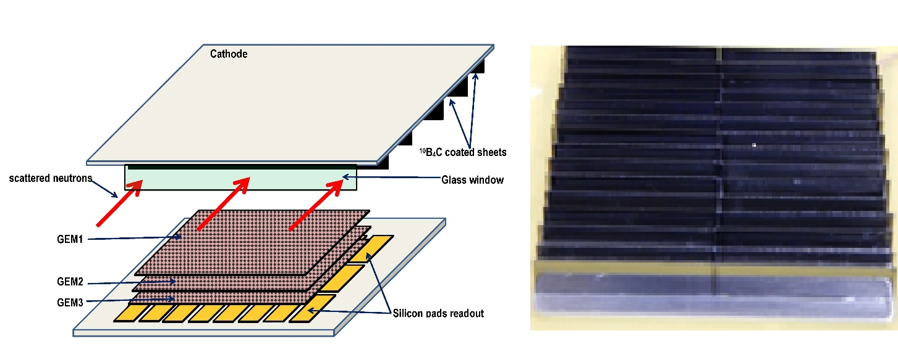
The side-on nGEM detector
Borated Slides
α
THERMAL NEUTRON
1 mm
2 mm
1 mm
Borated Slides
Detector cross section
30% neutron detection
efficiency at 25 meV

Slide 15
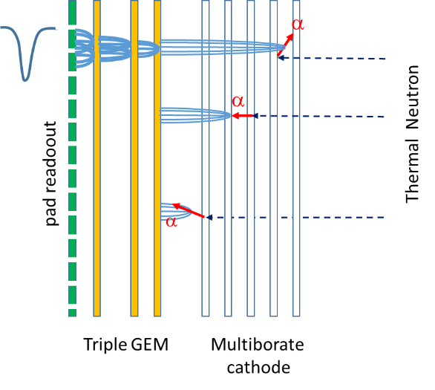
Borated GEM: multiborated head-on converter
The borated GEM was proposed for the first time by Cascade project
but problems on boron deposition stability
and GEM reliability.
In three years several attempts have been made in collaboration with Milano Bicocca, CERN and ESS Liopking
and now a new etching and Boron deposition procedure has been defined
We are assembling a detector for the first characterization.
Good prospective for high efficiency thermal neutron imaging for nTOF.

Slide 16
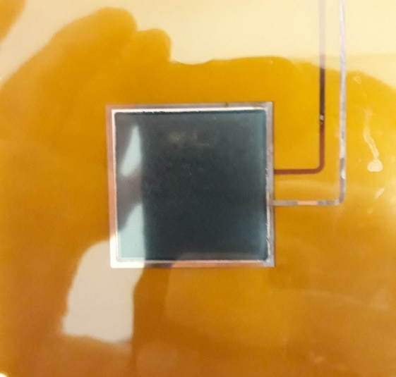
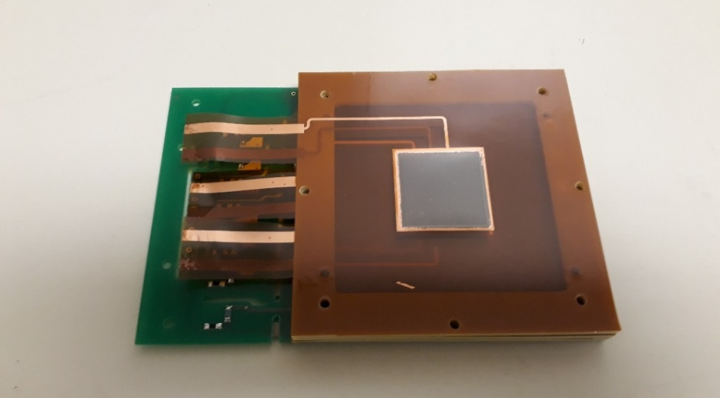
Borated GEM for high efficiency thermal neutrons detector
The GEMPix detector allows to develop and optimize a new thermal neutron detector based on GEM technology.
A collaboration between CERN ESS INFN has recently develop a new procedure to realize borated GEM.
A detector efficiency 7 times the single foil has be reached on a uniform big surface (3x3 cm²)
with high time (10 ns) and spatial resolution (50 μm) with Timepix electronics.
F.Murtas, G.Claps, R.De Oliveira, C.Lai, G.Croci, A.Muraro

Slide 17
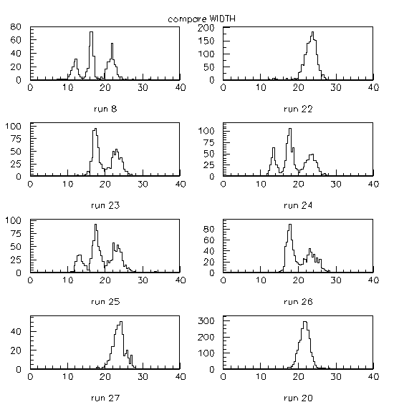
Multiboron GEM Detector
Applying voltage to the GEM foils
the layers can be switched on/off
320 300 280
thermal neutron
efficiency = 5.9 % (7 layers)
0 100 100
efficiency = 4.0 % (5 layers)
GEM Boron Layers
0 0 100
efficiency = 2.6 % (3 layers)
GEMPix detector
0 0 0
efficiency = 1.0 % (1 layer)

Slide 18
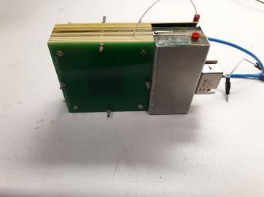
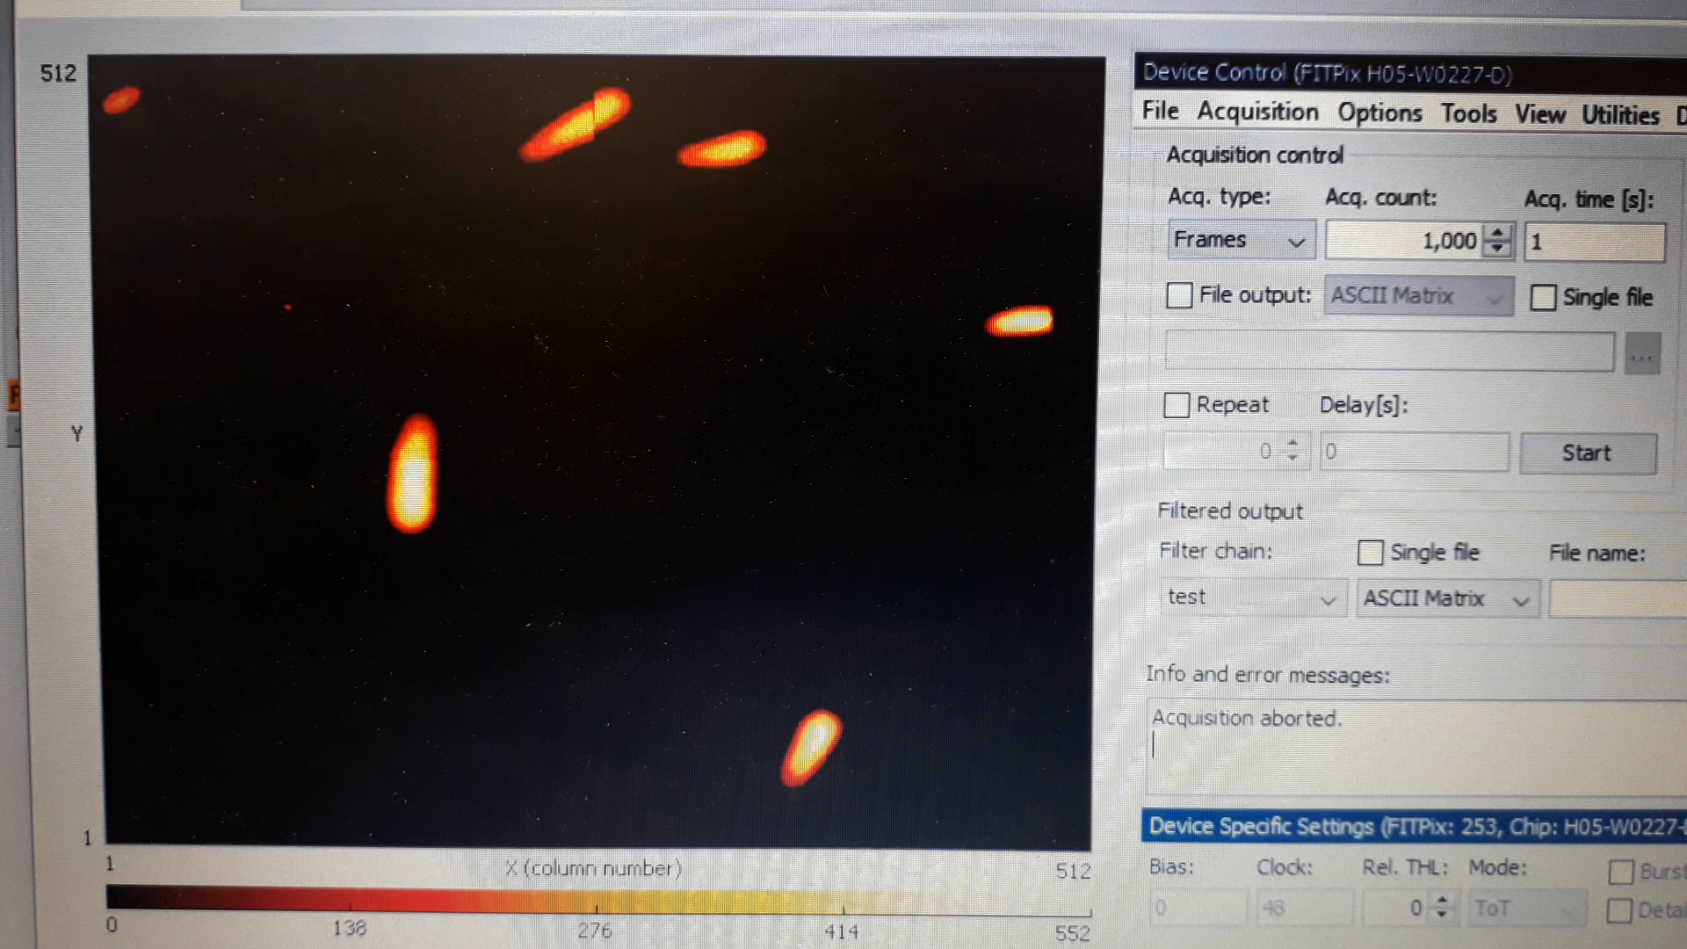
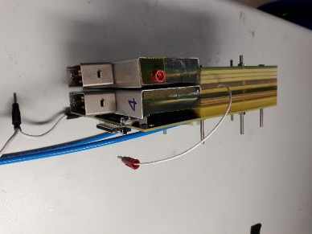
Thermal Neutron detection
Active area 3x3 cm²

Slide 19
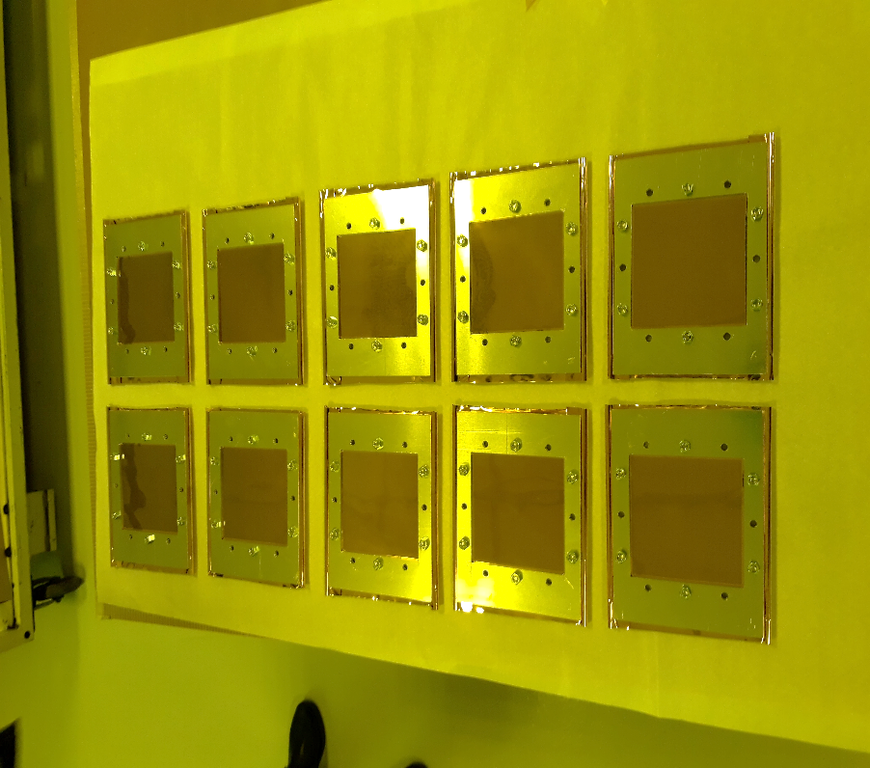
Production of 10 Borated GEM foils 10x10 cm²
10 GEM foils (10x10 cm²) have been borated
in Sweden on February 15th
They are at CERN ready after the etching
(Rui’s Laboratory)
Two detectors we’ll be built in Frascati
before September.
The electronic readout is ready :
- 256 pads 6x6 mm²
8 Gemini32 boards and FPGA board
(designed by Corradi Tagnani)
Paid by nTOF-LNF and MIB

Slide 20
Financial requests for 2021
1.5 FTE
50 % FM INFN
20 % Tonino Pietropaolo ENEA
30 % Gerardo Claps ENEA
50 % Nicholas Terranova ENEA
Financial requests :
3 Keuro Beam Monitor (fine tuning position system)
9 Keuro Thermal neutron detector for new GEMINI boards and FPGA
Missions :
5 Keuro for installations and collaboration meetings
LNF Facility : clean room

