Slide 1
MOM 2021 G. Modestino LNF-GR2
Multimessenger Observatory Model
Study of gravitational wave signals in association with extreme astrophysical phenomena
Review of coincident analysis between GW-GRB events
GRB data and progenitors
Astrophysical constraints
GW170817 vs previous LVC measurements
Open-ended questions

Slide 3
GRB Telescopes

Slide 4
GRB Astronomy
(since 1968)
10 < EM Satellites
~ 10000 Detected Events
(GRB - GF - SGR – Afterglow)
~ 10000 Candidates for
Supernovae (SN)
Magnetars - Soft Gamma Repeaters (SGR)
Binary system coalescence – merger (NS-NS; BH-NS)

Slide 5
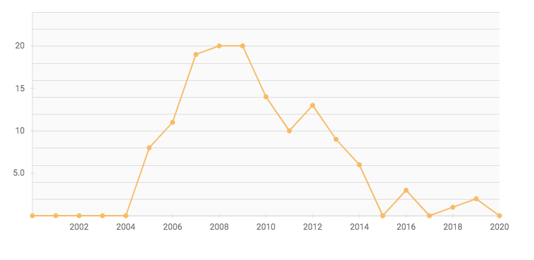
Search for gravitational waves associated with the gamma ray burst GRB030329
using the LIGO detectors
PHYSICAL REVIEW D 72, 042002 (2005)
137 citations (2005-2020)

Slide 6
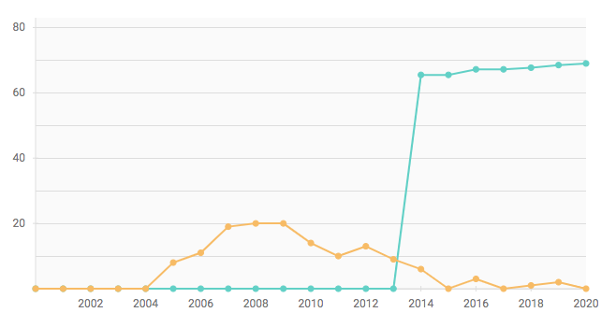
Search for gravitational waves associated with the gamma ray burst GRB030329
using the LIGO detectors
PHYSICAL REVIEW D 72, 042002 (2005)
Research interest
Citations per year

Slide 7
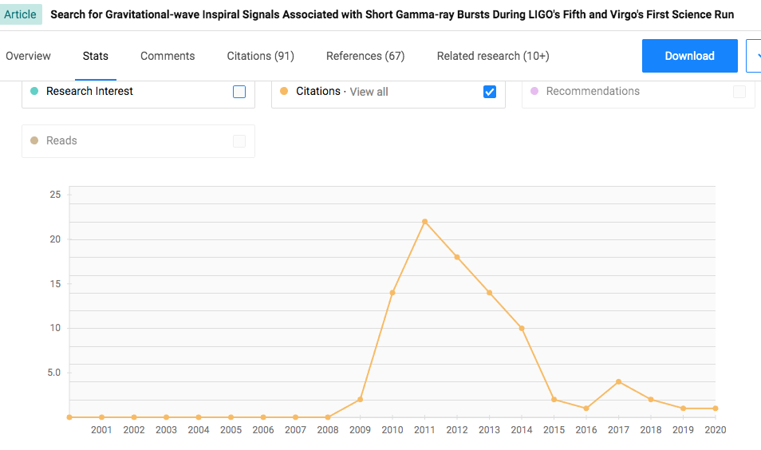

Slide 8
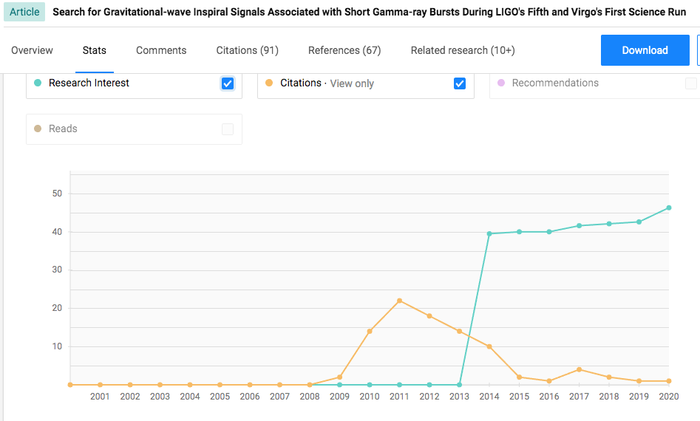

Slide 9
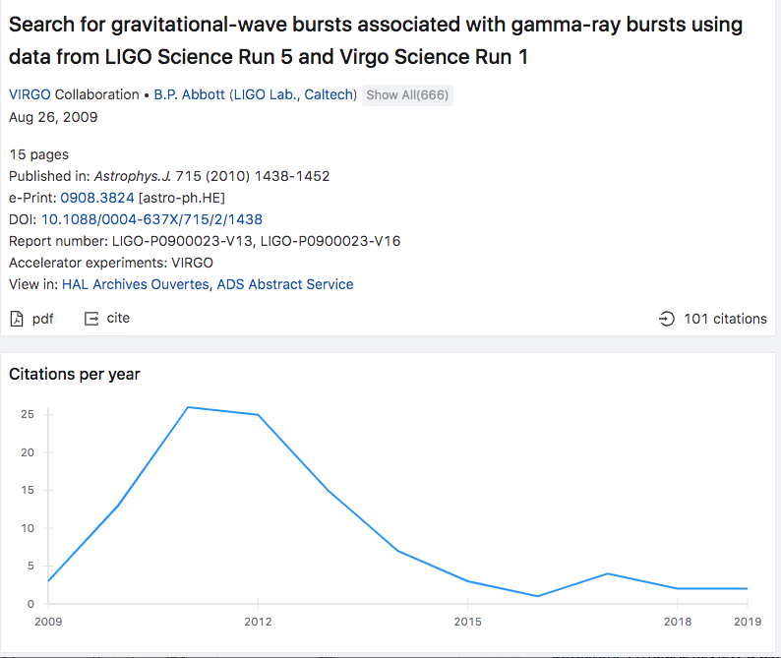

Slide 10
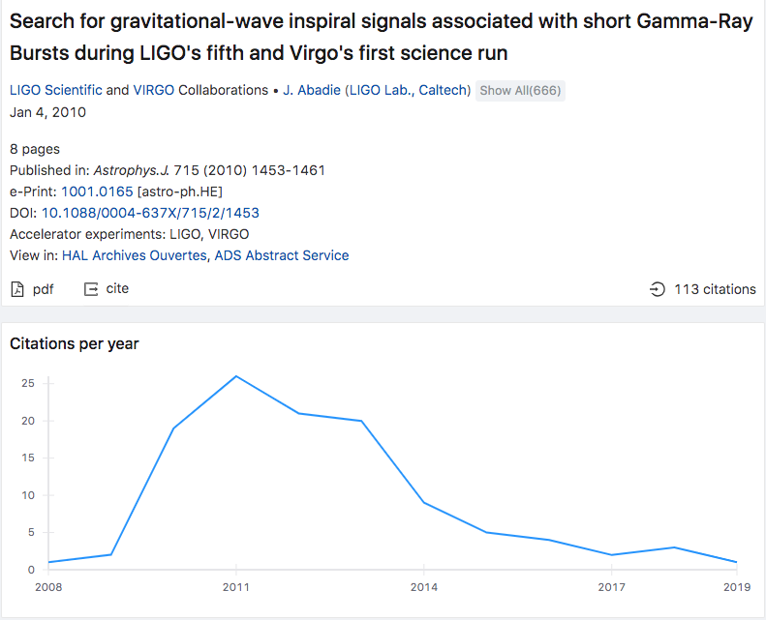

Slide 11
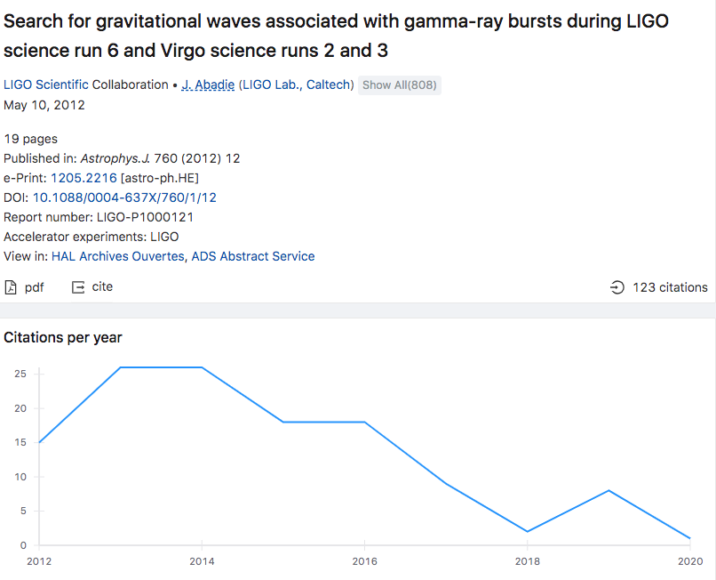

Slide 12
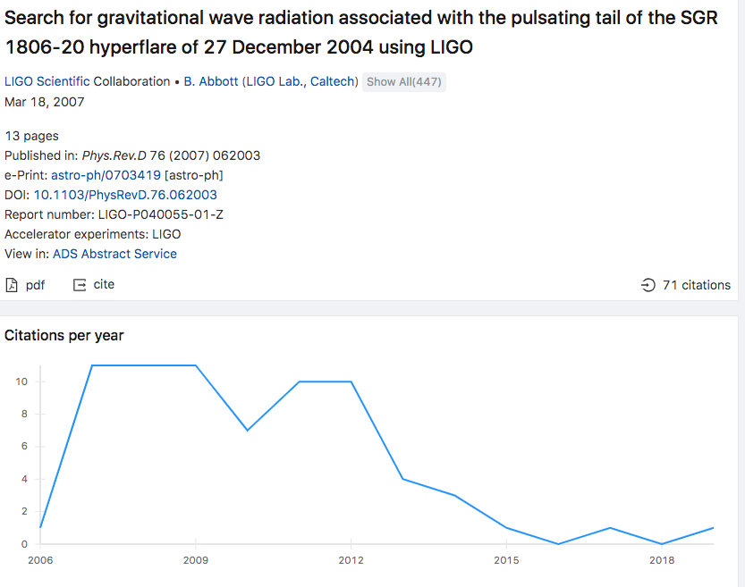

Slide 13
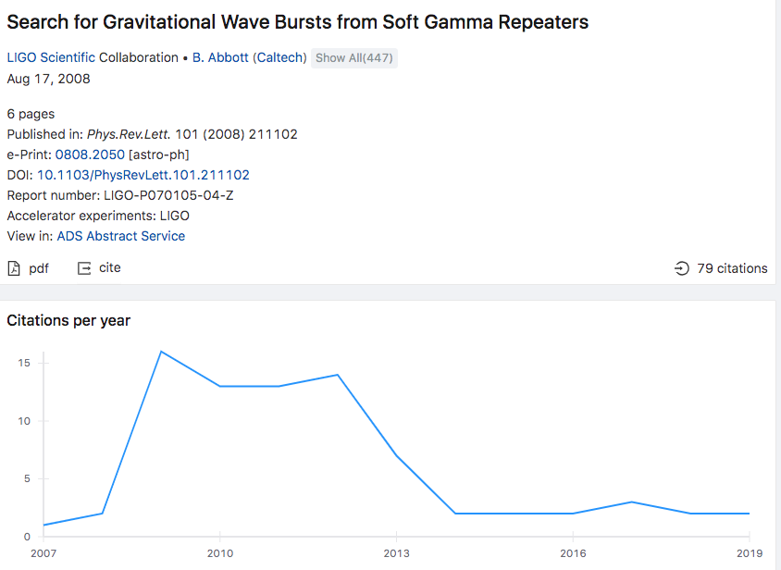

Slide 14
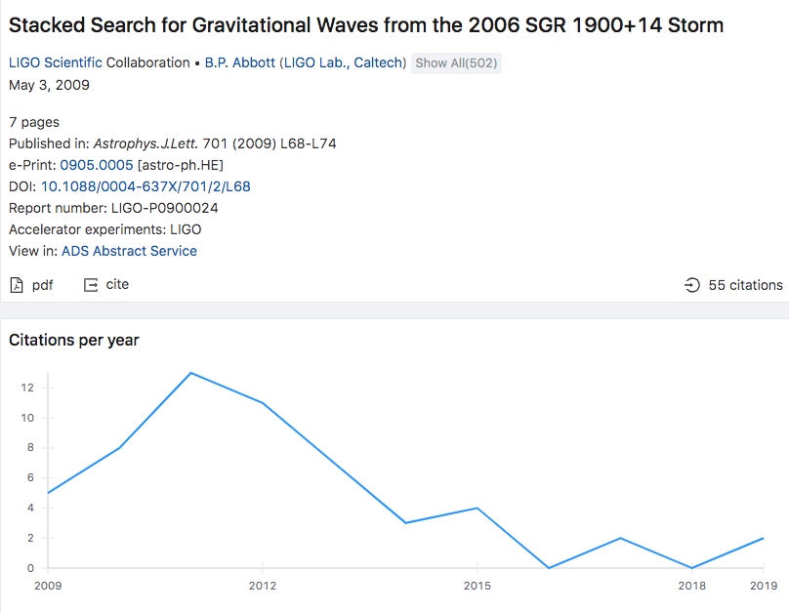

Slide 15
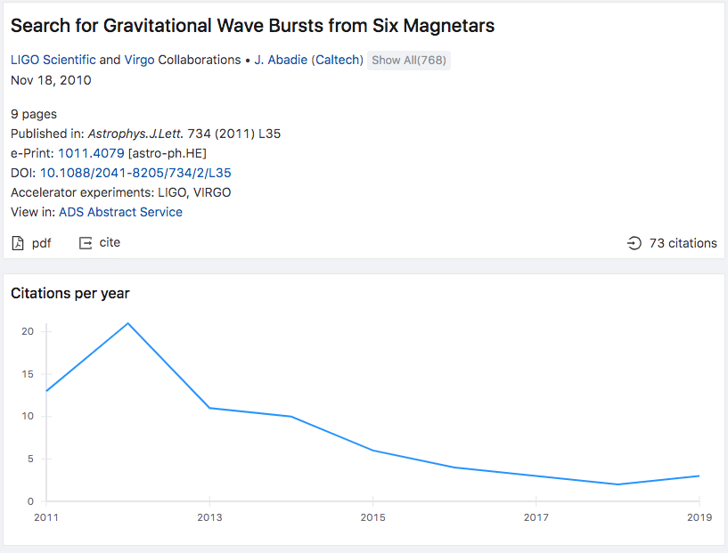

Slide 16
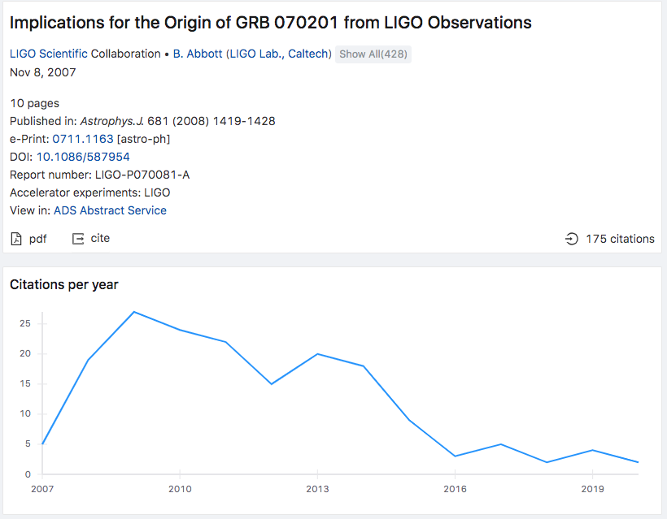

Slide 17
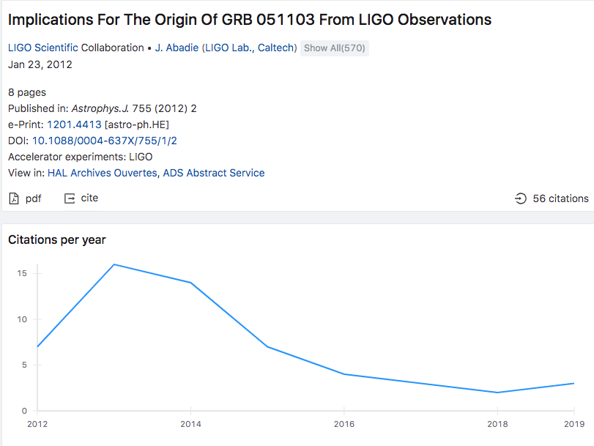

Slide 18
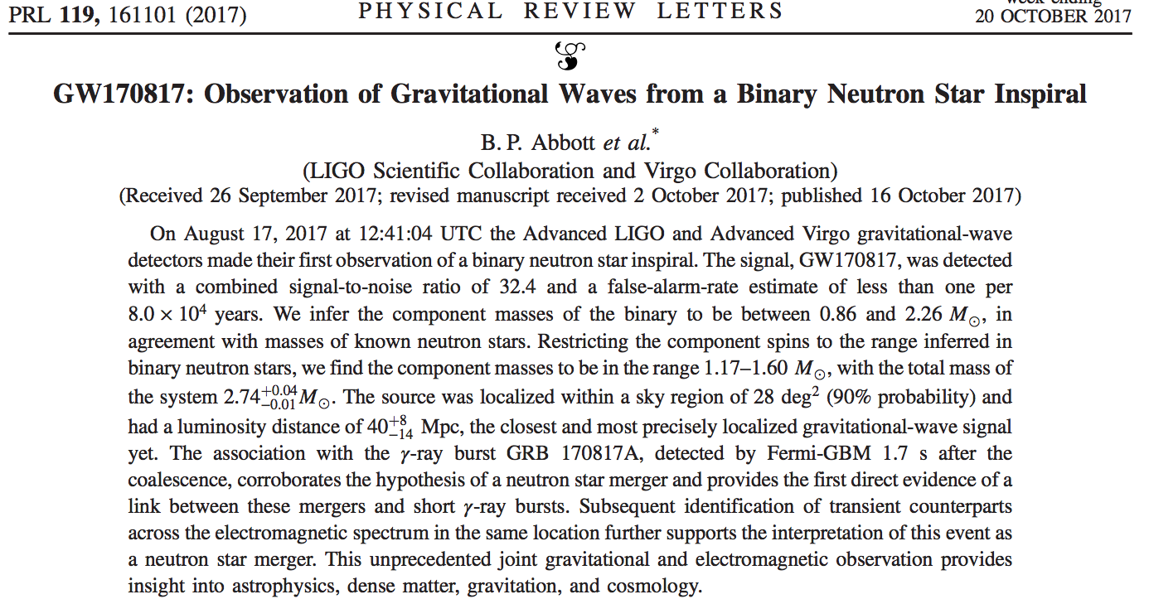

Slide 19
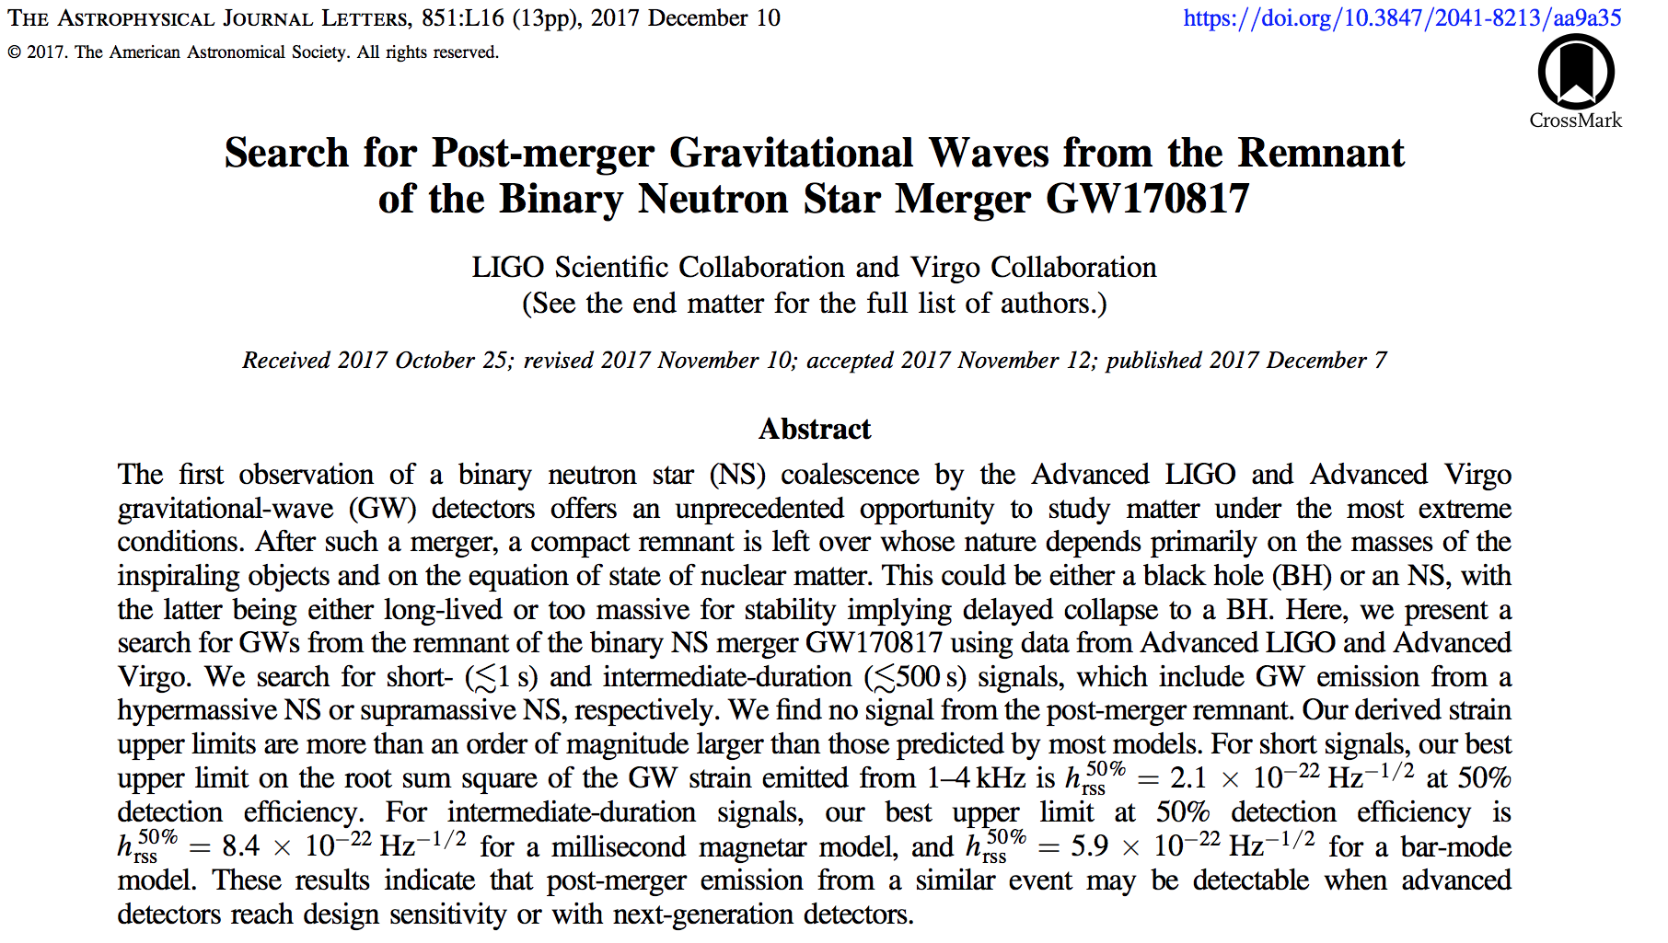

Slide 20
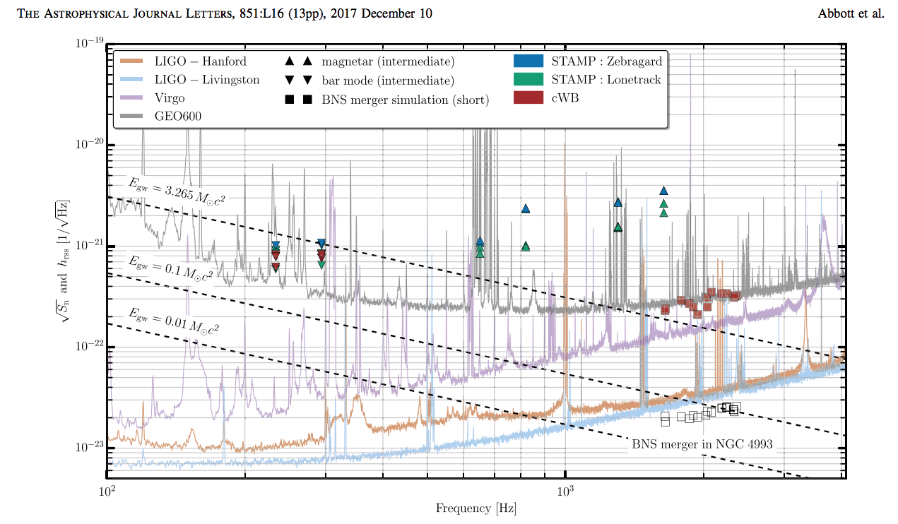
BNS merger in NGC 4993

Slide 21
LIGO S2
LIGO S3-4
LIGO S6
Virgo 2017
LIGO O2
0.01 < E_{GW} [M_{O}c² ] < 0.1
10⁻¹⁷
10⁻¹⁸
10⁻¹⁹
10⁻²⁰
10⁻²¹
10⁻²²
10⁻²³
.
SGR 0501+5729, SGR0418+5729
1-2 kpc
AXP 1E 1547.0-5408
4 kpc
SGR 1627-41, SGR 1900+14, SGR 1806-20
10 kpc
Strain sensitivity and h_{rss} [1/Hz^{1/2}]
GRB 070201
770 kpc
GRB 051103
3.6 Mpc
GRB 170817
40 Mpc
BNS merger in NGC 4993
10² Frequency [Hz] 10³

Slide 22
Multimessenger Astronomy
(Searching for)
Supernovae (SN)
Magnetars - Soft Gamma Repeaters (SGR)
Binary system coalescence – merger – (NS-NS; BH-NS)
MOM Questions
Astrophysical data interpretation (only) from EM Telescopes
GRB-GW astrophysical correlation (LVC-GRB since 2003)
GW170817 vs (previous) LVC measurements

