Slide 1
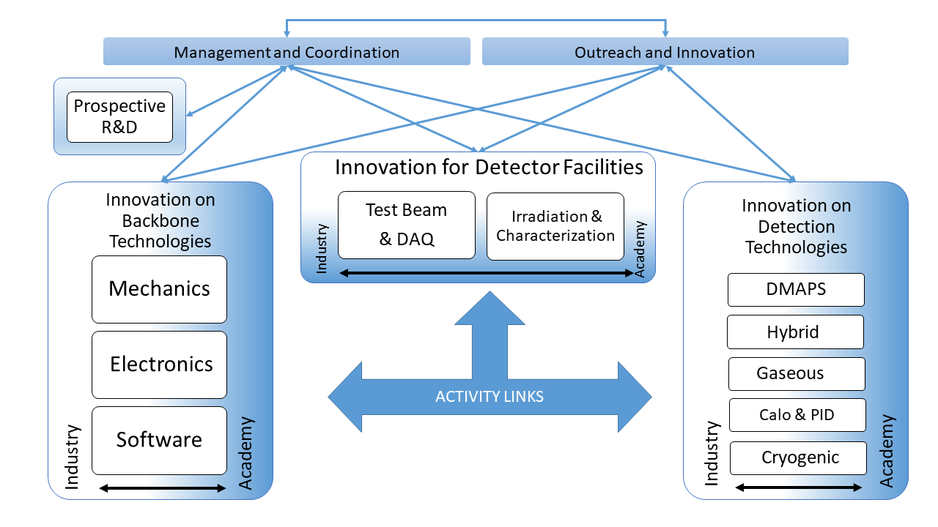
WP6: Hybrid Pixel Sensors for 4D Tracking and Interconnection Technologies attivita’ - sezioni coinvolte – sinergie C. Gemme (INFN Genova) on behalf of the INFN beneficiaries
AIDAInnova@Italy, June 12th, 2020

Slide 2
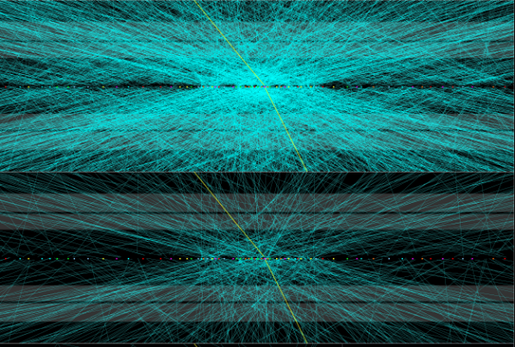
WP6 Scientific Overview
The hybrid silicon technology is the natural solution to include enhanced timing information with tens of picoseconds resolution, which can revolutionise the performance of a tracker, especially at hadron colliders → 4D Tracking. Advanced interconnection techniques will be developed to allow reduced pixel size, and improve spatial resolution to unprecedented levels with cost-effective solutions.
Ζ->μμ candidate event in ATLAS with 65 additional reconstructed primary vertices.
The two panels show tracks with a cut on track PT of 100 MeV, 1 GeV

Slide 3
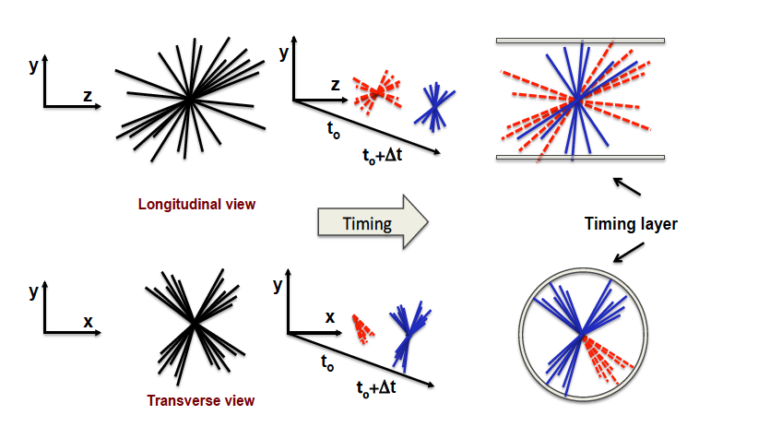
WP6 Scientific Overview
The hybrid silicon technology is the natural solution to include enhanced timing information with tens of picoseconds resolution, which can revolutionise the performance of a tracker, especially at hadron colliders → 4D Tracking. Advanced interconnection techniques will be developed to allow reduced pixel size, and improve spatial resolution to unprecedented levels with cost-effective solutions.

Slide 4
WP6 Organizational Overview
~ 25 EoIs received on the hybrid sensors. Grouped according to the schema in 4 sub-tasks:
Design and Production of 3D/LGAD sensors for timing
FBK
3D+LGAD
CNM
3D+iLGAD
Interconnection
CERN-LPNHE-Bonn- conpart
Simulation
Perugia-DESY
3D validation
FBK: Tn-Ca
CNM: IFAE-JSI
LGAD validation
FBK: TO-UZH
CNM: CSIC-CERN
~ 25% of the funding to the Productions of 3D and LGAD in FBK/CNM;
~ 35% in the interconnections funding.

Slide 5
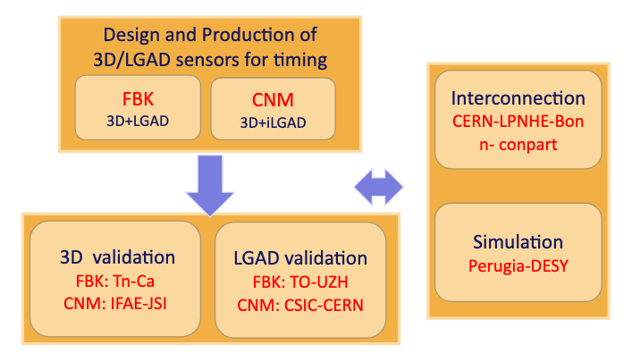
Objectives of the tasks
Task 6.2. Simulation and processing of common 3D and LGAD sensor productions
Optimisation of processes for 3D and LGAD sensors for timing applications
Simulations of various designs for 3D and LGAD sensors to compare and optimise the layout in terms of timing performance
Simulations of surface and bulk radiation damage for 4D (tracking+timing) detectors toward more radiation tolerant solutions
Processing of two common 3D sensor productions and two common LGAD productions by FBK/CNM
Design and implementation of simulation software which is applicable to a large range of technologies and includes models for the description of effects from sensor level to readout electronics in semiconductor detectors

Slide 6
Objectives of the tasks
Task 6.3. Validation of common 3D and LGAD sensor productions
Characterisation of the 3D sensors in terms of timing, radiation hardness, efficiency and uniformity via measurements in the laboratory and beam tests
Characterisation of small pitch LGAD and inverse LGAD sensors (iLGADs) from the common production in terms of timing and efficiency via measurements in the laboratory and beam tests
Feedback to the foundries for further process optimisation of 3D and LGAD sensors

Slide 7
Objectives of the tasks
Task 6.4. Development of interconnection technologies for future pixel detectors
(see spares slides)
Post-processing of 3D and LGAD sensor prototypes
Development of suitable Anisotropic Conductive Films (ACF) material and die-to-die bonding process flows for small pixel pitches
Production and post-processing of dedicated planar sensor wafers for ACF trials
Test of the performance of sensor modules interconnected with ACF
Production and test of ultra-thin assemblies interconnected with a wafer to wafer bonding technology

Slide 8
3D processing and validation
GF Dalla Betta - A. Lai
3D sensors already used in ATLAS IBL and planned for Phase-II for their high rad-hardness. The 3D solution has been demonstrated very beneficial also concerning time resolution (Kramberger 2019 ~60ps – columns, INFN TIMESPOT 2020 ~20ps – trenches). By simulation, trenches are expected to be even more rad-hard than columns.
Planned activities: Design and production of new 3D geometries for enhanced timing and rad-hardness. Characterisation of performances in yield production, timing and rad-hardness. Matching with suitable front-end electronics, both discrete and integrated. Electronics is absolutely crucial at this level of timing performance of the sensors – especially low-power CMOS ASIC (see also the Timespot1 ASIC in 28-nm CMOS).
INFN role: The R&D and results by the TIMESPOT project (ending in 2021) are a precious starting point about further developments on 3D pixels for timing. Expertise in simulation, design and testing is growing in various INFN sites.
Strong synergy with silicon foundries (FBK and CNM). Strong synergies also with AIDAinnova WP on new ASIC developments and WP on dedicated simulations.

Slide 9
LGAD processing and validation
N. Cartiglia
Sensor design:
Two LGAD designs for small pitch sensors are established and proved to work:
Trench-isolated LGAD (TI-LGAD) ~ 98-99% fill factor
Resistive AC-LGAD ⇒ 100% fill factor
Both designs achieved ~ 35 ps timing resolution. Leveraging on these results, arrays of small pixels will be manufactured to test additional evolutions of both approaches in term of temporal and spatial resolutions. Specifically, TI-LGAD are deemed more radiation hard than AC-LGAD. This hypothesis needs verification.
Readout:
Discrete components boards: boards with up to 16 analog channels are presently completed and available. We foresee several designs evolution
ASIC: the new FAST ASIC will be used for testing small arrays. FAST, available in Torino, is an ASIC with 16 channels explicitly designed to read small pitch arrays of LGADs. The evolution of this chip, FAST2 is almost completed, submission Q3/2020
Testing:
Irradiation with neutrons and protons is planned. Beamtest campaigns at FERMILAB is programed, development of a in house beam test facility in Torino, using a 6 MeV medical LINAC is progressing. Warm and cold testing capabilities available

Slide 10
Simulation
F. Moscatelli, G. Bilei, D. Passeri
Calibration/extension of the previously developed simulation models
Calibration/extension of the previously developed models (“Perugia model” and its recent upgrade) by comparing the simulation findings with measurements carried out on dedicated test structures as well on different classes of 3D and LGAD detectors.
Study the effect of surface and bulk radiation damage with reference to 4D (tracking+timing) detectors toward more radiation resistance solutions.
The proposed activity will focus specifically on disentangling the effects of the two main radiation damage mechanisms, e.g. the surface damage due to ionizing effect and the bulk damage due to atomic displacement, with reference to 4D detectors toward more radiation resistance solutions.
Deliverables:
Simulation of timing performance of 3D and LGAD detectors after irradiation.
TCAD Radiation damage modelling handbook

Slide 11
SPARES

Slide 12
Interconnections - I
Responsible institutes: CERN, LPNHE, Beneficiary company: Conpart (Norway)
Anisotropic Conductive Films (ACF), composed of microscopic conductive particles suspended in an adhesive matrix, are an industrial solution for flexible die-to-die interconnections.
A common development between industry (Conpart) and research institutions will validate ACF-bonding for pixel detectors at future colliders.
Planar sensors from a dedicated multi-project wafer production and existing readout components (such as Timepix3, CLICpix2, RD53 chips) will be used to develop suitable ACF materials and process flows for pixel pitches down to 25 μm.
https://indico.cern.ch/event/912674/contributions/3839877/attachments/2027459/3392235/20200428_ACF_compressed.pdf

Slide 13
Interconnections - II
Responsible institutes: Bonn, DESY (+IZM)
Ultra-thin hybrid pixel assemblies will be developed, where sensors and front-end electronics are connected directly at the wafer surfaces (face-to-face wafer bonding) and thinned down.
Fraunhofer IZM will develop an appropriate wafer-to-wafer bonding process using technologies like oxide-oxide or Cu-Cu fusion bonding.
The sensor and the electronics could be thinned in material to 50-100 μm for the sensor and 10 μm for the electronics after the wafer bonding process.
No Through Silicon Vias (TSVs) are necessary for the electrical connection to the readout electronics because the input/output-pads could be opened from the backside using standard etching techniques. For this demonstrator, 200 mm CMOS wafers will be employed.

Slide 14
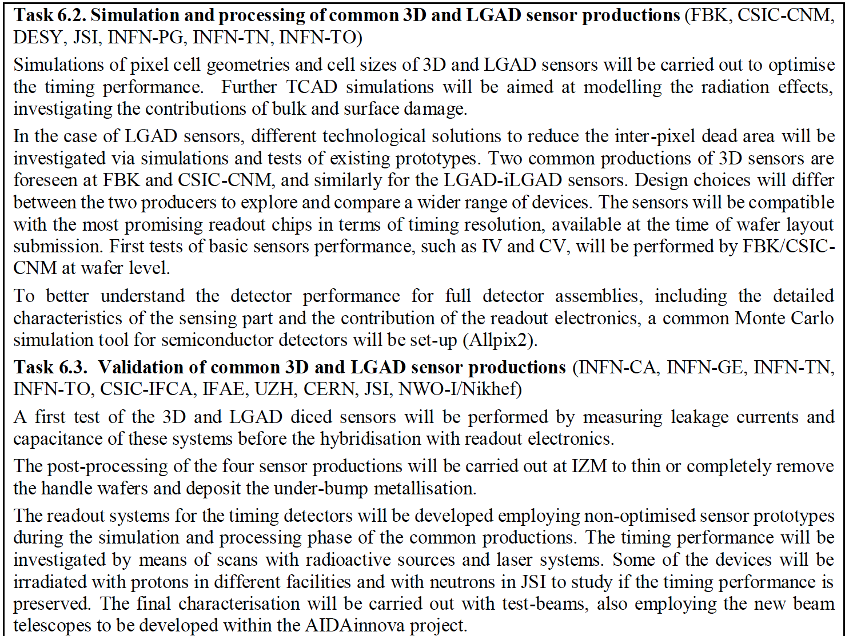
Tasks Details

