Slide 1
RD_MUCOL
INFN activities for Muon Colliders
CERN Open Council Announcement on June 19 released the update of the EU Strategy
U.S. Snowmass21 process was lauched at: https://snowmass21.org/start
Muon Collider community is ready to establish the international collaboration
è Meeting July 3
CSN1 activities
Bari interests

Slide 2

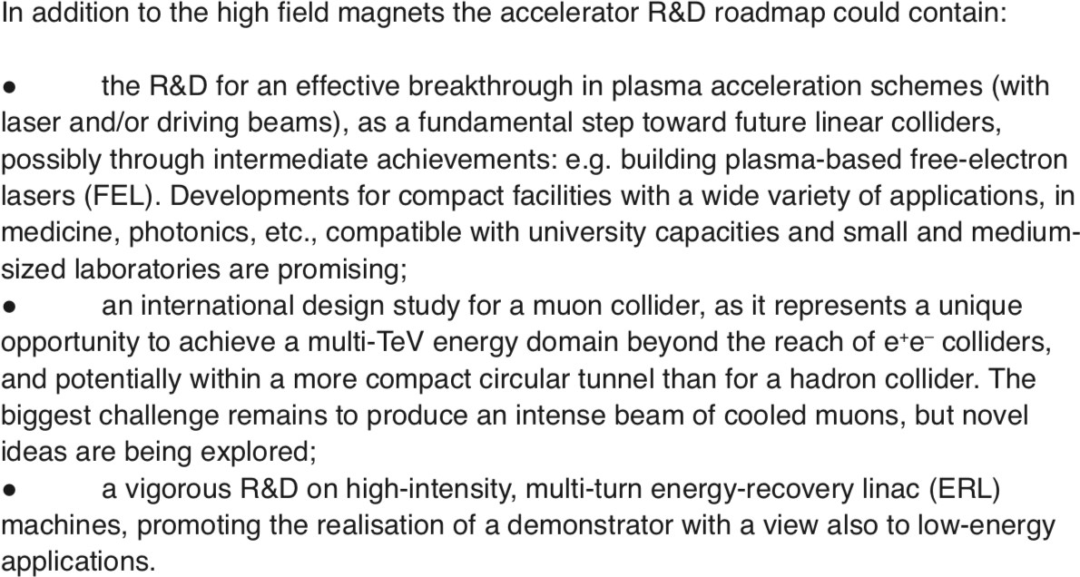
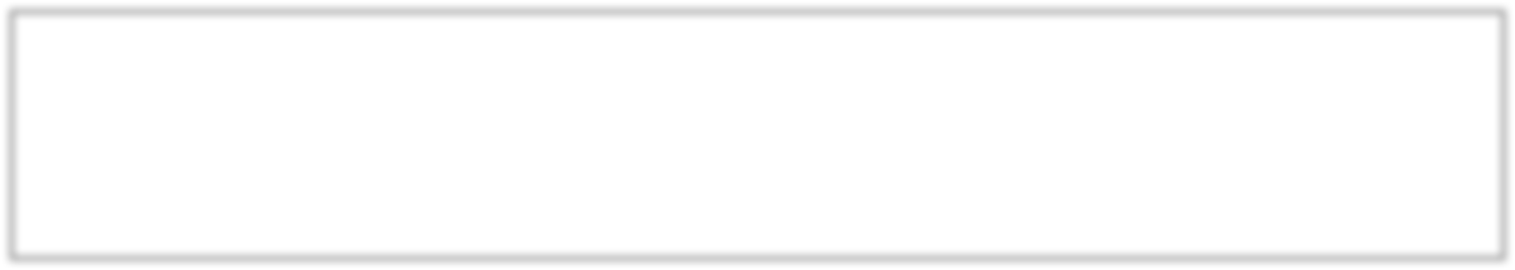
Strategy update
EU

Slide 3
Toward the international collaboration
to develop an integrated muon collider design concept that encompasses the physics, the detectors, and accelerator
to develop fully the muon collider design study
è exploring the various options
to pursue R&D priorities, according to an agreed upon work plan
The first meeting for the muon collider to prepare an actual collaboration on July 3 at 14:00-18:00
https://indico.cern.ch/event/930508/
The goal of this meeting is to start identifying who intents to contribute to a muon collider study and, if already possible, in which field.

Slide 4
Brief history
Muon collider: Strong coupling to particles like the Higgs; reduced synchrotron radiation a multi-pass acceleration; beams can be produced with small energy spread
→ full collision energy available for particle production: 14 TeV muon collisions are comparable to 100 TeV proton collisions for selected new physics process, if sufficient luminosity is provided ~ 𝟏𝟎^{𝟑𝟓}𝒄𝒎^{.𝟐}𝒔^{.𝟏}
The muon collider idea was first introduced in early 1980’s [A. N. Skrinsky and V. V. Parkhomchuk, D. Neuffer]
US Muon Accelerator Program – MAP, created in 2011, was killed in 2014 MAP developed a proton driver scheme and addressed the feasibility of the novel technologies required for Muon Colliders and Neutrino Factories
"Muon Accelerator for Particle Physics," JINST,
https://iopscience.iop.org/journal/1748-0221/page/extraproc46
LEMMA (Low EMittance Muon Accelerator) concept was proposed in 2013
  a new end-to-end design of a positron driven scheme is presently under study
by INFN-LNF et al. to overcome technical issues of initial concept è arXiv:1905.05747
an input document was submitted to the European Particle Physics Strategy Update on existing muon collider studies, to support further R&Ds
“Muon Colliders,” arXiv:1901.06150

Slide 5

Two options
MAP: MUON JINST, shorturl.at/kxKU7
LEMMA arXiv:1905.05747v2 [physics.acc-ph]
LEMMA
Positron Source (PS) @ 300 MeV, plus LINAC to accelerate up to 5 GeV
45 GeV 𝒆⁺ Ring (PR) to accumulate 1000 bunches needed for μ production
2 Muon Accumulation Rings (AR) – 123 m – to store typically 10⁹ μ
Average muon energy 22 GeV (γ(μ) = 200 μs , τ(μ)_{lab} = 500 μs )
Reuse of the infrastructure:
Es. FCC-ee/FCC-hh/γ−factories for the prod. LHC o FCC for the collider.
muons produced with low emittance è “no/low cooling” needed
low production cross section: maximum σ(𝑒⁻𝑒. → 𝜇⁻𝜇.) ~ 1 𝜇b
11

Slide 6
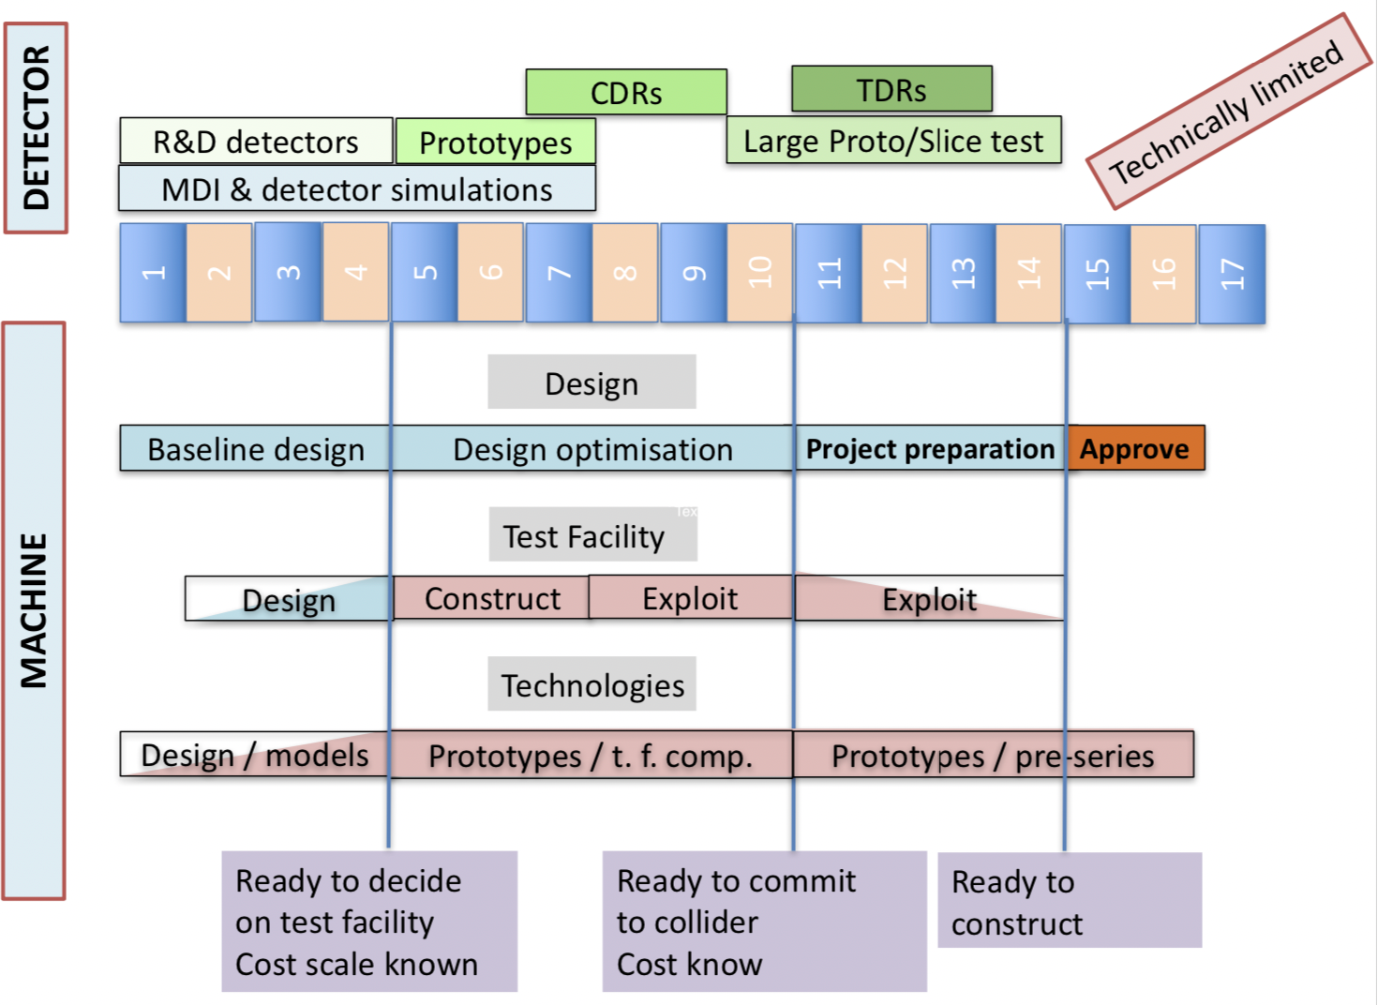
Technically Limited Potential Timeline
Physics Briefing Book arXiv:1910.11775v2 [hep-ex]

Slide 7
INFN activities (1)
Parametri di macchina cruciali e strettamente legati al disegno dell'esperimento e al raggiungimento degli obbiettivi di fisica Marica Biagini - Donatella Lucchesi - Nadia Pastrone
Simulazioni di fisica → Bari
Barbara Mele - Antonio Costantini - Roberto Franceschini - Mauro Chiesa
==> reach di fisica vincolato dal disegno dell'esperimento
Donatella Lucchesi - Massimo Casarsa
Disegno dell'esperimento: richiede simulazioni e R&D anche in sinergia con altri sviluppi in corso (attivita' in AIDAinnova) → Bari
Nadia Pastrone - Massimo Casarsa - Lorenzo Sestini

Slide 8
INFN activities (2)
Machine Detector Interface ==> studi linebuilder e FLUKA - in collaborazione con esperti di acceleratori
Francesco Collamati - Paola Sala
Studi di radiazione da neutrino prodotti dal decadimento dei fasci - in collaborazione con esperti di acceleratori → Bari
Paola Sala ==> in futuro - sviluppi per l'utilizzo di fasci intensi di neutrini
Sorgente LEMMA: fascio di positroni - materiali per bersagli– accumulatore
Nadia Pastrone ==> da discutere nel contesto internazionale
Test Beam @ CERN in ambito LEMMA (primi test 2017-2018) ==> richiesto ora per 2022 → Bari
Fabio Anulli - Marco Zanetti - Nicola Amapane - Mario Antonelli
R&D tecnologia per magneti ( et al.) dedicati al muon collider

Slide 9
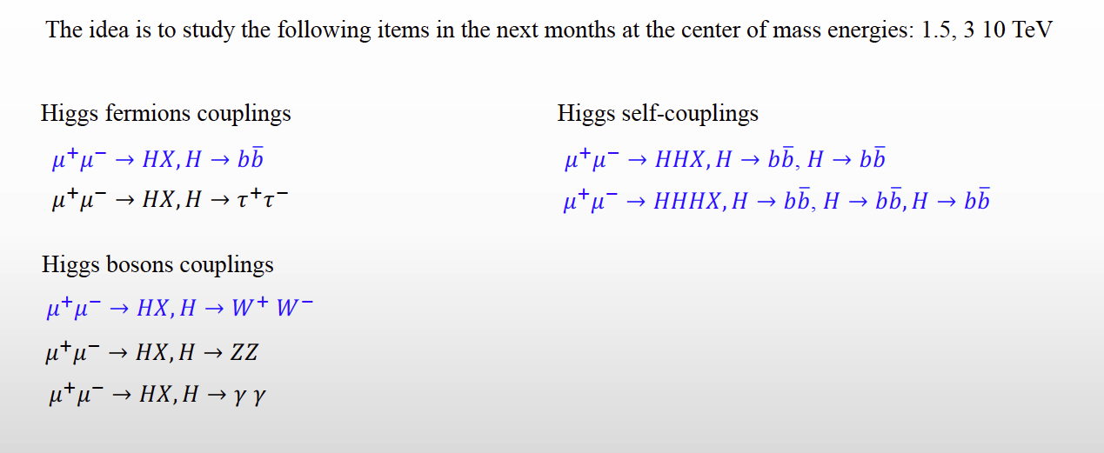
Attivita’ INFN – Fisica
Studi di fisica: prossimi passi da discutere anche con CSN4
@ 1.5-3 TeV benchmark per confronto con studi di CLIC
è primo studio della misura 𝜇𝜇 → 𝐻𝜈𝜈 → 𝑏𝑏𝜈𝜈 pubblicato (J. Inst. 15 P05001, 2020)
@ 10+ TeV completamente nuovi
è studio fisica potenziale di Higgs (arXiv:2003.13628) – manca simulazione esperimento
Con il software esistente (rivelatore non ottimizzato) possible realizzare l’analisi: opportunita’ per tesi di laurea.
Direct production of heavy states (Z’, Higgsino, Wino, stop etc)

Slide 10
Attivita’ INFN – Esperimento
Esperimento: da disegnare ex novo
studi conclusi con apparato di MAP pubblicati (J. Inst. 15 P05001, 2020) studi in corso con nuovo software condiviso
https://sites.google.com/site/muoncollider/home
è Sinergia con AIDAinnova a Bari:
WP7 (gas detector MPGD, RPC,TPC)
WP11 (microlectronics: ASIC design)
WP12 (software/reco, frameworks for heterogeneous infrastructures (CPU/GPU) at future accelerators)→ Capire sinergie con RD_FCC e altre attivita’ in corso)

Slide 11
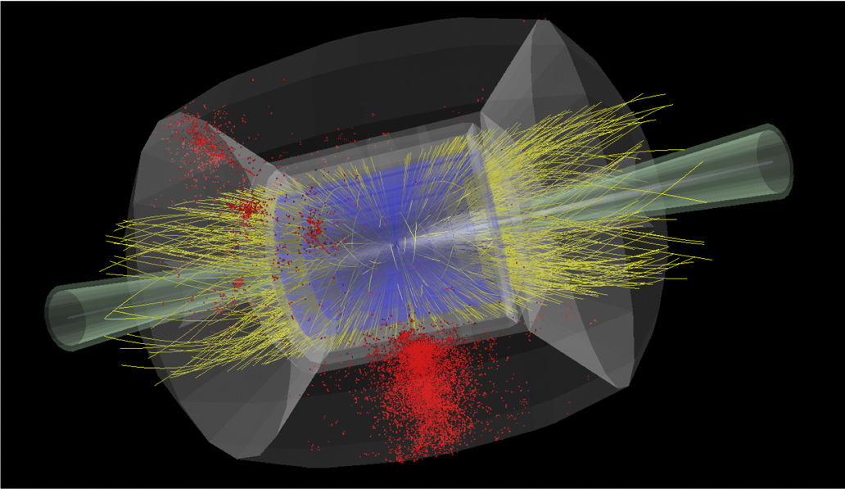
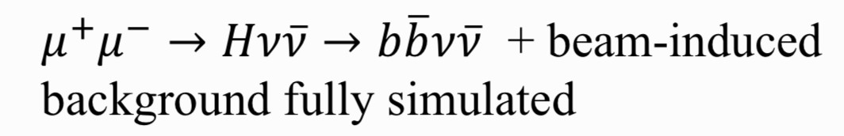
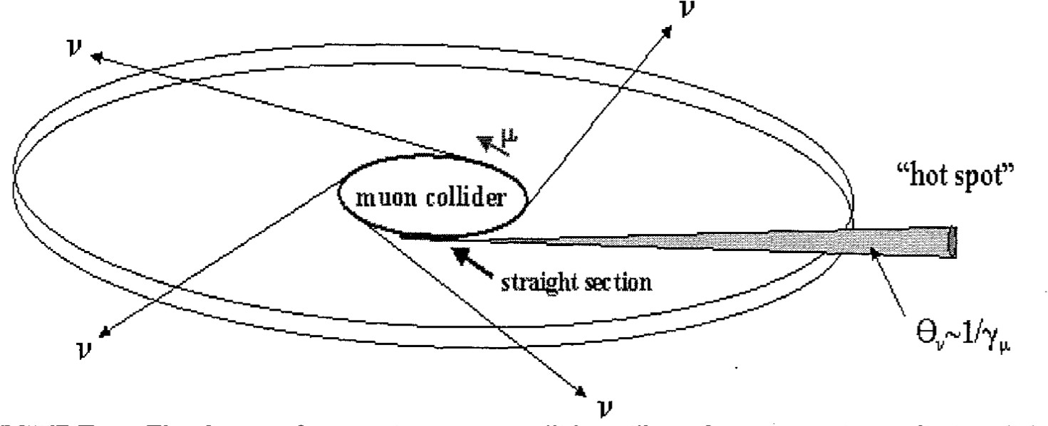
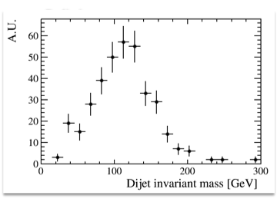
Muon Beams Induced Background
Nikolai Mokhov et al. - MARS15
𝑠 = 1.5 𝑇𝑒𝑉
Neutrino radiation
critical limit at highest energies
Paola Sala – Youri Robert CERN Muon Collider Meeting
https://indico.cern.ch/event/886491/
Highly collimated neutrino beam: background but also opportunity for neutrino’s studies at Bari
Dose comes from energy released by neutrino interaction products. Collider is underground: problem is when beam reaches surface.
22

Slide 12

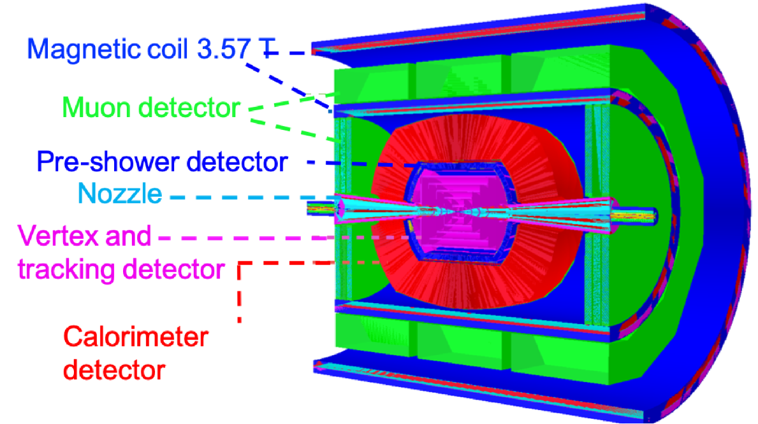

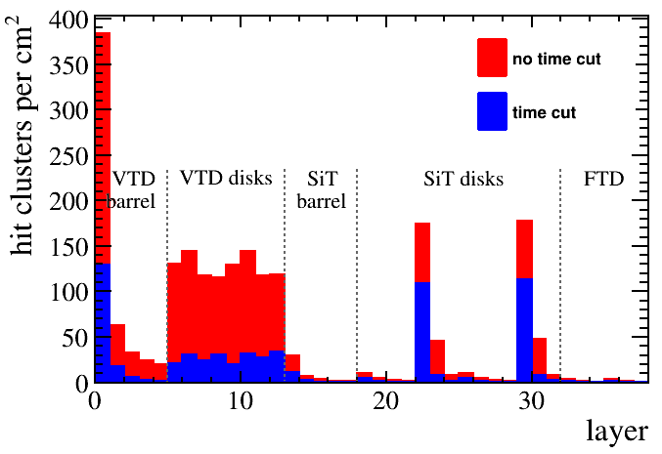
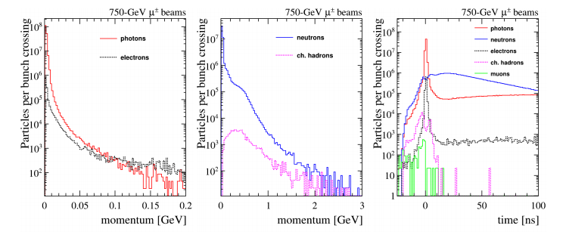
Detector Response Simulation at =1.5 TeV
Use the simulation/reconstruction tools previously developed within the MAP collaboration based on the ILCroot package: it supports signal + MARS15 background merging
Effects of beam-induce background can be mitigated by exploiting “5D” detectors, i.e. including timing
For the moment the studies done with an existing geometry (MAP) but the final detector needs to be assess.

Slide 13
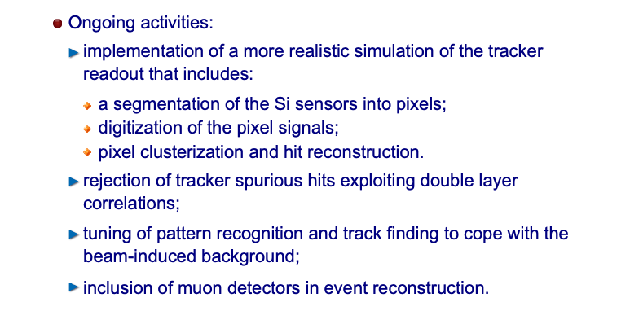
Attivita’ in corso sul disegno esperimento
The work done so far used the MAP framework. Now moved to a Future Collider Framework, ILCSoftware. Set up a GRID VO, muoncoll.infn.it everybody can register
Issue to reconstruct background + signal due to high occupancy in the inner tracking.
(also CPU consuming)
.
Opportunity for Bari contributions
Evaluate the impact of the background on the different detectors (hit occupancy, rates) and impact on the reconstructions
→ improve by hardware (better detectors)
→ improve by software: better algorithms, contribution to KEY4HEP, integration of software for heterogeneous resource and usage of Bari farm)

Slide 14



Key4HEP
Future detector studies critically rely on well-maintained software to model detector concepts and to understand a detector’s potential and physics reach
Aim at a low-maintenance common stack for FCC, ILC/CLIC, CEPC, SCT/STC, Muon Collider, . . . with ready to use plug-ins to develop detector concepts
Reached consensus among all communities for future colliders to develop a common turnkey software stack at recent Future Collider Software Workshop
Identified as an important project in the CERN EP R&D initiative, submitted EoI for AIDA++ → AIDAInnova WP12
Rif. Lucia Silvestris a Bari.

Slide 15
Test beam @ CERN
  Positrons (45 GeV) on target (e- at rest), aiming at e+e- → mu+ mu-
  Study of the emittance at the test beam:
  Intrinsic emittance due to muon kinematics and interaction with the target is tiny
  How much does it depend on the properties of the e+ beam, kinematics, target features?
proposal for test beam In 2022 submitted to SPSC
Key to get >2 weeks of continuous operations at NA

Slide 16
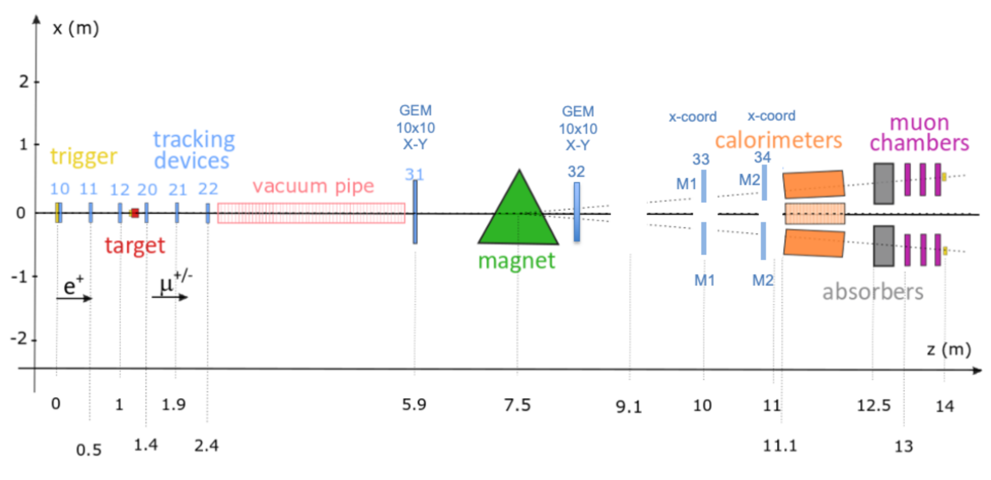
2022 layout
Fast and high-resolution pixel-based telescopes (CMS modules) in the target region
Fast GEM detectors from CMS beyond the magnet
Combination of several Calorimeters (included CMS ECAL)
4+2 CMS Muon DT chambers (triggerless readout) + CMS iRPC and new electronics
Improved (integrated, low dead time) CMS DAQ system and trigger system
Tracking around target with CMS Phase-2 Strip/Pixel
Tracking Modules
Tracking in Muon Arms:
GE2/1 M1 & M2 modules
+ dedicated HighRes 10x10
CMS DT+RPC

Slide 17
Summary of possible interest in Bari
Considerando le nostre competenze e sinergie con le attivita’ in corso, possibili ambiti di interesse :
Physics studies:
  Utilizzando il framework esistente
Detector optimization
  Studio del fondo e interazione con detector: ottimizzazione detector
    Sinergia con AIDAINNOVA WP7 per rivelatori di muoni
Software and computing development for future collider
    Sinergia con LHC experiment (CMS/ALICE/LHCb new tracking algo/GPU)
    Sinergia con AIDAINNOVA WP12.2 (R&D software framework)
    Sinergia con IBISCO (GPU/CPU and storage)
Test beam:
➔ Sinergia CMS Phase2 (pixel, GEM, DT , RPC, ECAL e DAQ/Trigger)
Neutrino background and physics
  Expertise a Bari su fisica neutrino

Slide 18
RD_MUCOL anagrafica
C.Aruta | 10%
G. Catanesi | 10% (tbc)
A. Colaleo | 20%
M. Maggi | 10%
S. My | 10%
F. Simone | 10%
L. Silvestris | 10%
R. Venditti | 10%
P. Verwilligen | 10%
Totale | 110 %
Attualmente
Sigla su dot1z.
Le percentuali non sono sinergiche con altre sigle al momento. Ma e’ prevista sinergia con AIDAINNOVA (approvazione sigla inizio 2021).
Ovviamente siete invitati a contribuire al progetto:
→ ma non e’ indispensabile avere delle percentuali.

Slide 19
BACKUP

Slide 20
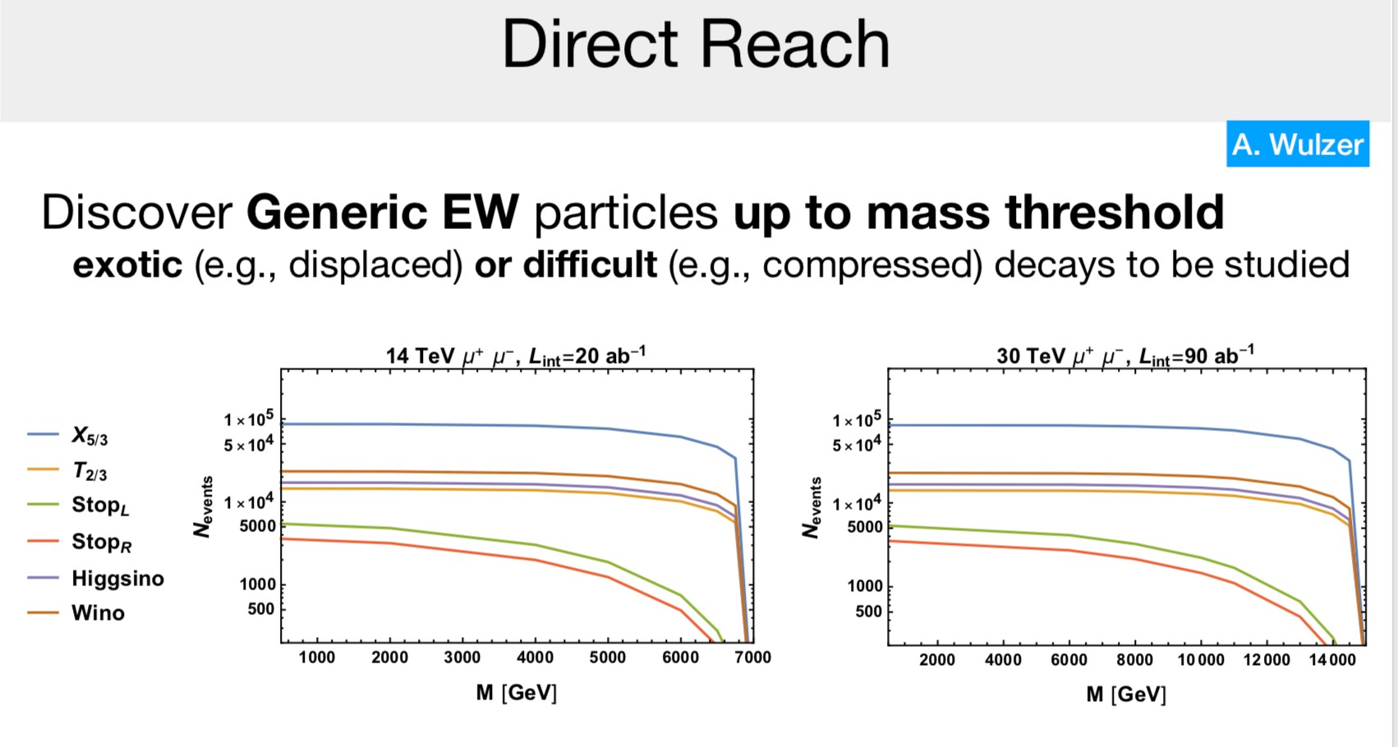
Physics at high energy
Multi-TeV energy scale allows to explore physics beyond SM both directly and indirectly

Slide 21
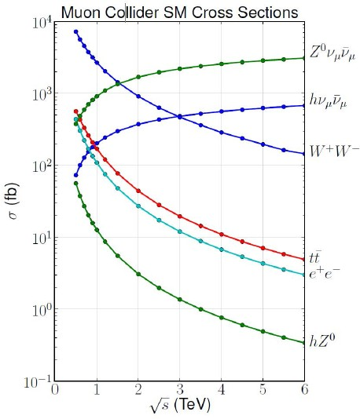

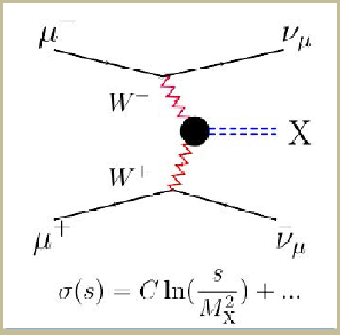
High energy Muon Collider
High Energy Collisions
At √s > 1 TeV:
Fusion processes dominate
  An Electroweak Boson Collider
  A discovery machine complementary to very high energy pp collider
At >5TeV: Higgs self-coupling resolution <10%

Slide 22
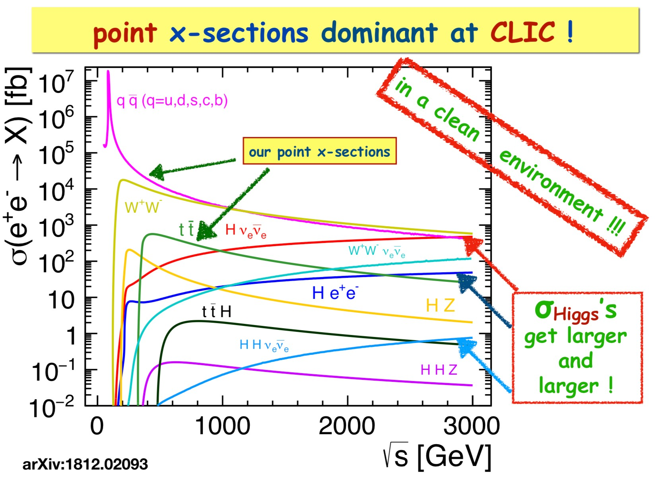
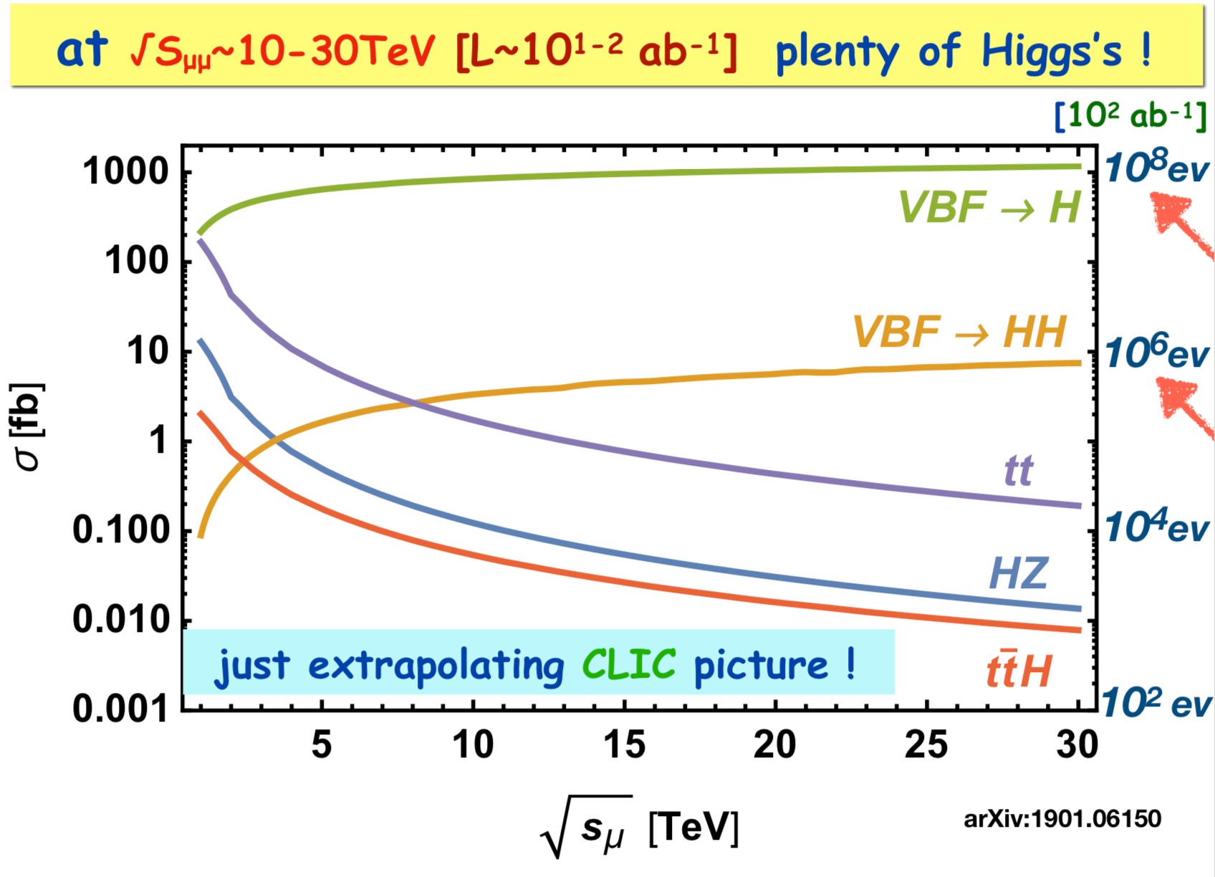
Higgs production at Lepton Collider
Circular muon colliders might reach center-of-mass energies of tens of TeV thanks to the limited amount of synchrotron radiation compared to 𝑒<𝑒² colliders
Otranto - June 1, 2019 Nadia Pastrone
B. Mele et al.

Slide 23
Computing issues
Il Muon Collider presenta un beam-induced background di notevole entità, generato dal decadimento in volo dei muoni e dalle interazioni dei prodotti di decadimento con la macchina.
Data la sua unicità le strategie di mitigazione devono essere studiate tramite full simulation:
Le simulazioni sono pesanti sia in termini di storage che di CPU time: necessità di adottare un sistema di calcolo distribuito sulla GRID.
Accesso a file di simulazione comuni, sia per INFN che per collaboratori esterni (es. USA)
VO è già stata aperta, SE in preparazione al CNAF. Il framework di CLIC dispone già di un suo sistema di sottomissione dei job sulla GRID.
Sviluppo del detector
Disegno della Machine Detector Interface
Benchmark di Fisica
Opportunity for contributions from Bari

Slide 24
Computing in 2021: richieste CPU
Benchmark: CPU Intel Xeon ES-2670 → 200 HS06 per 10 Multi-Thread
Simulazione: 1 evento di BIB richiede 10 processi in parallelo per 7 giorni
Ricostruzione: 3 giorni per processare 10 eventi di segnale+BIB
Goal:
10k eventi * 200 HS06 * 7/365 = 38k HS06 per la simulazione
100k eventi * 200 HS06 * 0.3/365 = 16k HS06 per la ricostruzione
Si richiedono in totale 54k HS06
Una frazione consistente delle risorse calcolo puo' essere su GPU o su CPU dei siti IBISCO/RECAS
10k eventi di BIB simulati (per essere usati a rotazione nella ricostruzione)
100k eventi di segnale + BIB ricostruiti (2-3 canali di Fisica)
24

Slide 25
Computing in 2021: richieste storage
Simulazione: 1 evento simulato di BIB occupa ~10 GB
Ricostruzione: 1 evento ricostruito di segnale+BIB occupa ~5 GB
10k eventi * 10 GB = 100 TB per i campioni simulati di BIB
100k eventi * 5 GB = 500 TB per i campioni di segnale+BIB ricostruiti
Si richiedono in totale 600 TB di storage
Contributi aggiuntivi:
5k euro per Cloud-Veneto (INFN-Padova)
5k euro per acquisto macchina a INFN-Trieste
25

Slide 26
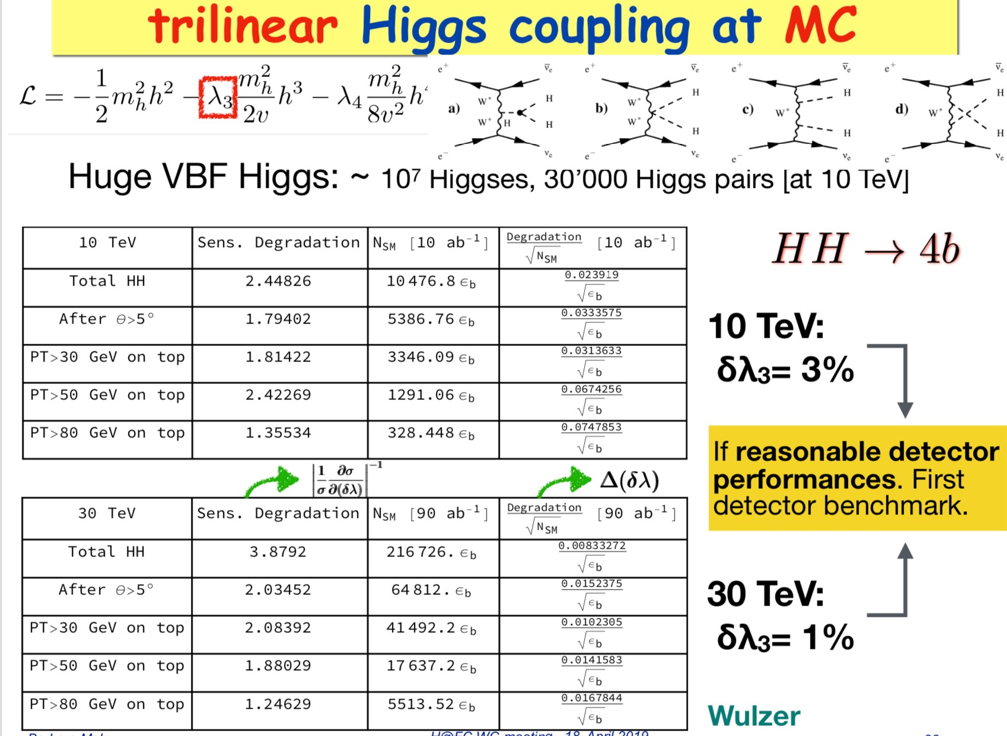
Trilinear and Quadrilinear couplings

Slide 27
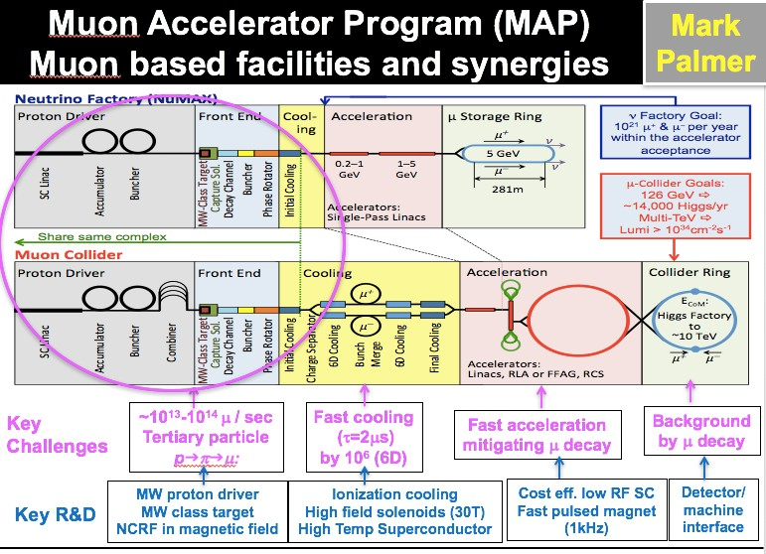
Otranto - June 1, 2019
Nadia Pastrone

Slide 28
Main design requirements
Positron Source like CLIC/ILC è 1 x 10¹⁴ 𝒆</s è injection 5 s
Damping Ring has to provide fast 𝒆< cooling, limiting total collider cycle
Lattice may be similar to the main Positron Ring
A DR similar to ILC one could provide needed damping time (12 msec) and emittance
è about 100 wigglers (ILC type) to be installed
è a shorter ring (i.e. 6.3 km) is preferred to minimize number of damping wigglers
First injection - no time constraints, then 1000 bunches with 5 x 10¹¹ 𝒆< need to be injected
45 GeV Positron Ring: high energy acceptance and low emittance with 27 km ring
è choice of final lattice based on the larger energy acceptance: it is mandatory to successfully re-inject all the “spent” beam from the muon production to be later decelerated and re-injected in the DR for cooling
100 km solution will increase the luminosity of at least a factor 3.5
Multi-target system to alleviate issues due to power deposited and integrated PEDD (*)
Source needed to replace the positrons lost in the muon production process is a real challenge, since the time available is very short
(*) Peak Energy Density Deposition

Slide 29
Tentative Considerations on Baseline
Focus on first stage with energy of O(1.5 + 1.5 = 3 TeV)
  To come after higgs factory and matching highest CLIC energy
  Using the high-energy strength of muon colliders
  Realistic design for implementation at CERN, with cost power and risk scale
  If successful, feasibility demonstration for CDR
Explore 14 TeV as further step
  To match FCC-hh discovery potential
  Mainly exploration of parameters to guide choices
  Provide evidence for feasibility, maybe cost frame
Some exploration of lower energies / Higgs factory
  Scaling from higher energies
  Not a main focus, except if other projects do not cover lower energies
Open for input

Slide 30
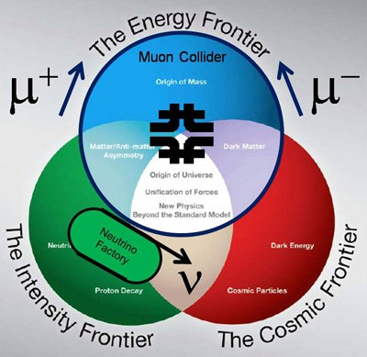
Physics reach
Muon rare processes
Neutrino physics
Higgs factory
Multi-TeV frontier
U.S. Muon Accelerator Program (MAP)
  Recommendation from 2008 Particle Physics Project Prioritization Panel (P5)
  Approved by DOE-HEP in 2011
Ramp down recommended by P5 in 2014
http://map.fnal.gov/
AIM: to assess feasibility of technologies to develop muon accelerators for the Intensity and Energy Frontiers:
Short-baseline neutrino facilities (nuSTORM)
Long-baseline neutrino factory (nuMAX) with energy flexibility
Higgs factory with good energy resolution to probe resonance structure
TeV-scale muon collider

Slide 31
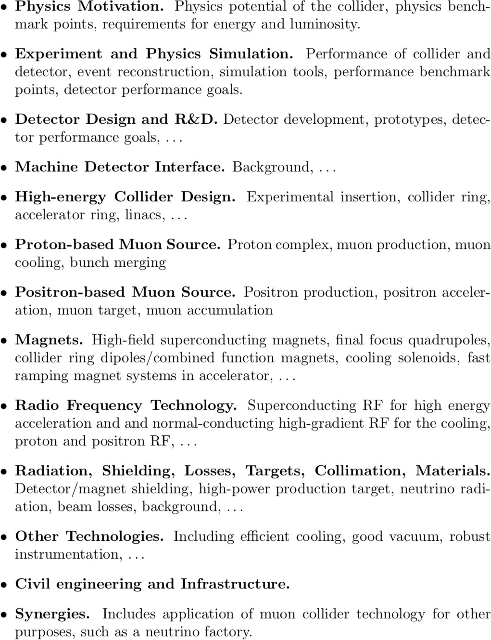
Fields of interest

Slide 32

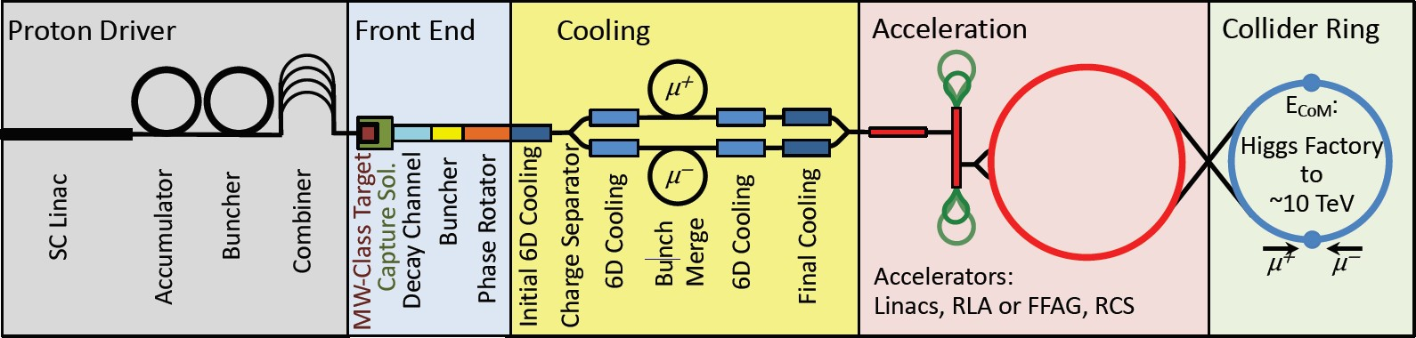
Proton-driven Muon Collider Concept
US Muon Accelerator Program – MAP, launched in 2011, wound down in 2014 MAP developed a proton driver scheme and addressed the feasibility of the novel technologies required for Muon Colliders and Neutrino Factories
Short, intense proton bunches to produce hadronic showers
Pions decay into muons that can be captured
Muon are captured, bunched and then cooled
Acceleration to Collision collision energy
Design is not complete but did not find anything that does not work
No CDR exists No coherent baseline No reliable cost estimate
"Muon Accelerator for Particle Physics," JINST,
https://iopscience.iop.org/journal/1748-0221/page/extraproc46
20

Slide 33
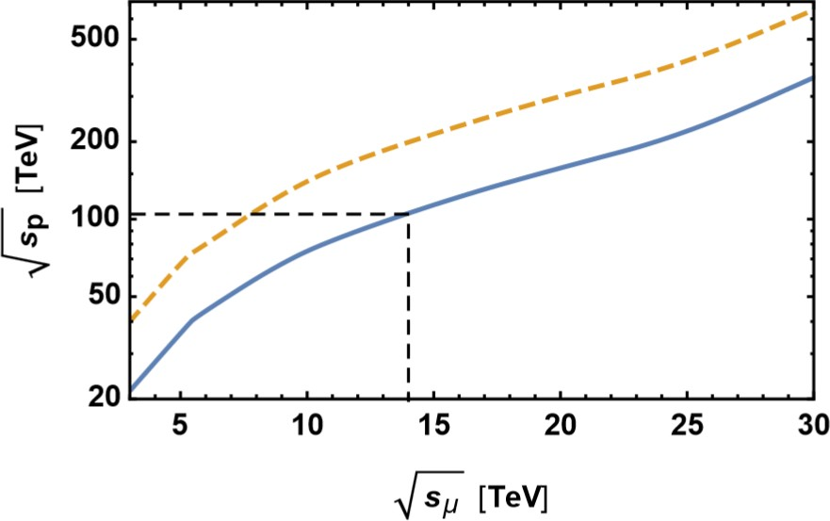

Why a multi-TeV Muon Collider?
cost-effective and unique opportunity for lepton colliders @ 𝒔 >3 TeV
1.2
1.1
1
0.9
0.8
0.7
0.6
0.5
0.4
0.3
0.2
0.1
CLIC
MuColl
M_{NewPhysics} = sqrt(s)/2
34 -2 -1
L/P_{beam} [10 cm s /MW]
A. Wulzer
D. Schulte
μμ @ 14 TeV
=
pp @ 100 TeV
0
1
2
3
E_{cm} [TeV]
4
5
6
The luminosity per beam power is independent of collision energy in linear colliders, but increases linearly for muon colliders
Full collision energy available for particle production: 14 TeV lepton collisions are comparable to 100 TeV proton collisions for selected new physics process, if sufficient luminosity is provided ~ 𝟏𝟎^{𝟑𝟓}𝒄𝒎^{.𝟐}𝒔^{.𝟏}
Strong interest to reuse existing facilities and infrastructure (i.e. LHC tunnel) in Europe

Slide 34
INFN @ WP
WP |  |  | Indus | INFN
7 | gas detector MPGD, RPC,TPC | ATLAS – CMS – LHCb – EIC – Higgsfact - neutrino | CAEN ELTOS | BA, BO, LE, LNF, PV, RM3, TS
11 | microlectronics: ASIC design | all |  | BA, BO, PV, TO, MI, CA, FE, LNF
12 | software/reco for future accelerators | all |  | FE, PD, PI, BA, RM3, BO,PV

Slide 35
Factor of merit
1.2
1.1
1
0.9
0.8
0.7
0.6
0.5
0.4
0.3
0.2
0.1
CLIC
MuColl
34 -2 -1
L/P_{beam} [10 cm s /MW]
D. Schulte
0
1
2
3
E_{cm} [TeV]
4
5
6
MAP studies addressed design issues from muon production to final acceleration:
è proton driver option: advanced studies for a 3-6 TeV machine
è however a 6D cooling TEST FACILITY is MANDATORY to demonstrate feasibility A new idea not requiring 6D cooling – LEMMA – represent an appealing scheme: è further studies and solid R&D program needed for such positron driven option

Slide 36
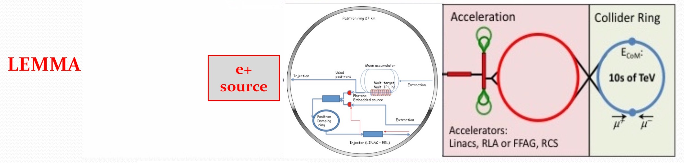
Recent LEMMA effort
M.Antonelli, M.E.Biagini, M.Boscolo, S.Guiducci, P.Raimondi, A.Variola et al.
Asymmetric collisions 𝒆⁺𝒆⁻ → 𝝁⁺𝝁. at the 𝝁⁺𝝁. threshold (√s ≈ 0.212 GeV)
maximize 𝝁⁺𝝁.pairs production cross section
minimize the 𝝁_𝝁. beam angular divergence and energy spread
Extremely promising:
muons produced with low emittance è “no/low cooling” needed
But difficult:
low production cross section: maximum σ(𝑒⁻𝑒. → 𝜇⁻𝜇.) ~ 1 𝜇b
high heat load and stress in μ production target
synchrotron power O(100 MW) ç available 45 GeV positron sources
è need consolidation to overcome technical limitations to reach higher muon intensities
arXiv:1905.05747
21

Slide 37
Use of Existing Infrastructure
Might be able to reuse much of the proton and general infrastructure
Needs detailed study
Much of the expertise is available
Use of the largest tunnels, i.e. LHC or potentially FCC
Can house positron ring in the LEMMA case
  In FCC, even lepton equipment might exist from FCC-ee
  Large rings means less synchrotron radiation and power consumption
Consider to use ring as a collider
  But means to have larger ring for acceleration
  Or to use combined final accelerator / collider
    This compromises luminosity and generates technical challenges but may save cost
Use tunnel for final accelerator
  Have a small optimised collider ring
  Seems natural solution

Slide 38





Simulation Framework
WHIZARD PYTHIA
Signals and Physic Background generation
Full simulation results
Public
Simulation and reconstruction
FLUKA
Input for other studies
Beam Induced Background
Resolution functions and efficiencies
DDSim Marlin Particle Flow
The work done so far used the MAP framework
Now moved to a Future Collider Framework, ILCSoftware.
Set up a GRID VO, muoncoll.infn.it everybody can register
Preparing the environment to be able to submit to the GRID/cloud
Right now we have a cloud VM that can be installed anywhere
Some resources, machines and disk space is available on CloudVeneto
Code on github
https://sites.google.com/site/muoncollider/home

Slide 39
Attivita’ INFN – LEMMA Test Beam
misure test beam al CERN su fascio di muoni (J. Inst. 15 P01036, 2020
proposta nuova presa dati – fascio al CERN 2022 (2023 ?)
two beam tests in the CERN NA in the past (2017 and 2018) -→ Bari not involved
  both done with essentially ~0 budget, reusing equipment from other experiments
  One week only at the time

Slide 40
GEM
2 Dedicated hi-resolution 10x10 triple-GEM X-Y, 260 um pitch (75 um resolution)
Standard CMS GE2/1 M1 and Me2 modules in muon arms
  Trapezoidal, 360-600 um resolution
All (to be..) read-out by CMS phase2 DAQ
We plan to have a dedicated CMS TB before Lemma TB to assess the performance of the detectors and integrate the electronics.

Slide 41
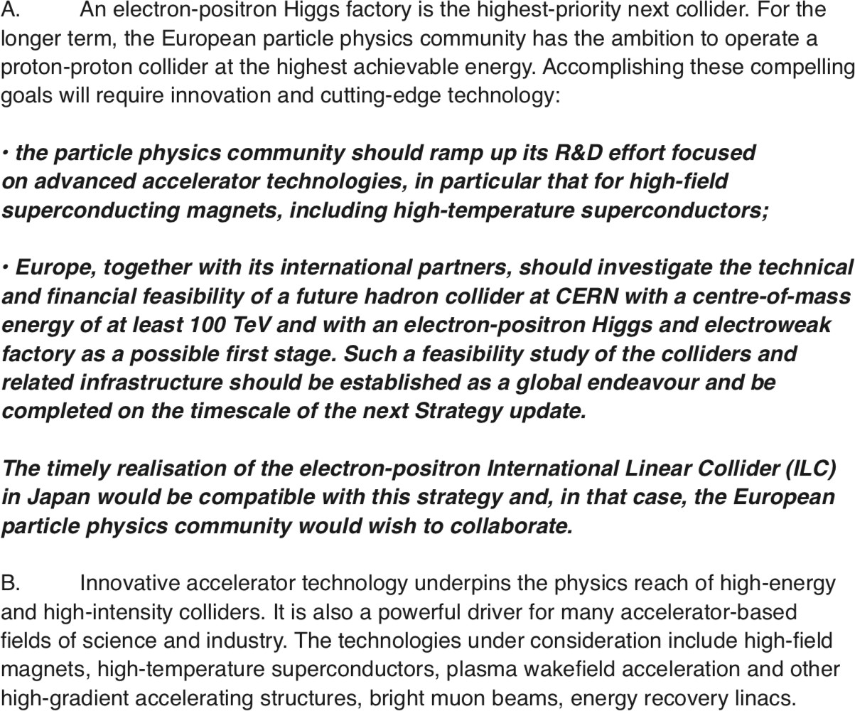

Strategy update
http://europeanstrategyupdate.web.cern.ch/
EU

Slide 42
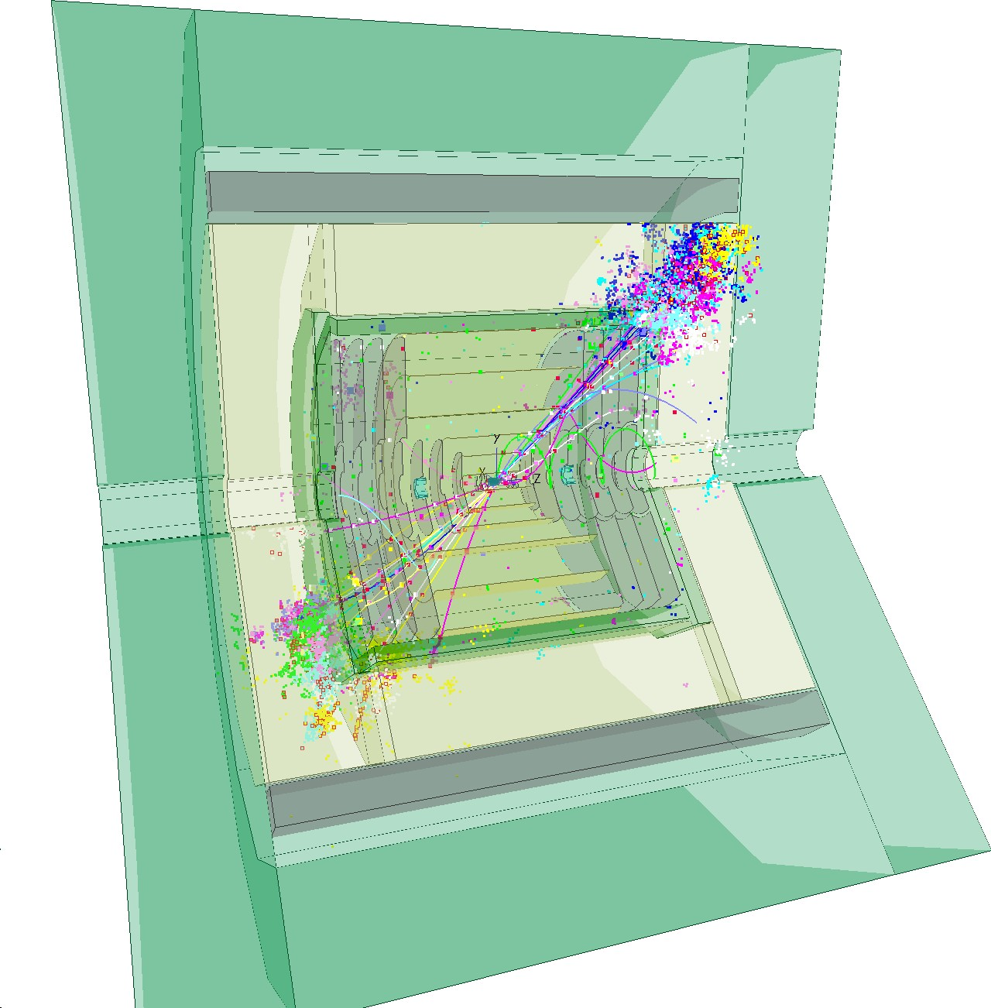
Key4HEP: Turnkey Software for Future Collider Experiments
Key4HEP: The Turnkey Software Stack
Ingredients
Geometry
Event Data Model Framework
Functionality
Detector Descriptions Reconstruction from iLCSoft
Conclusion
A. Sailer: Key4HEP: Turnkey Software for Future Collider Experiments

Slide 43
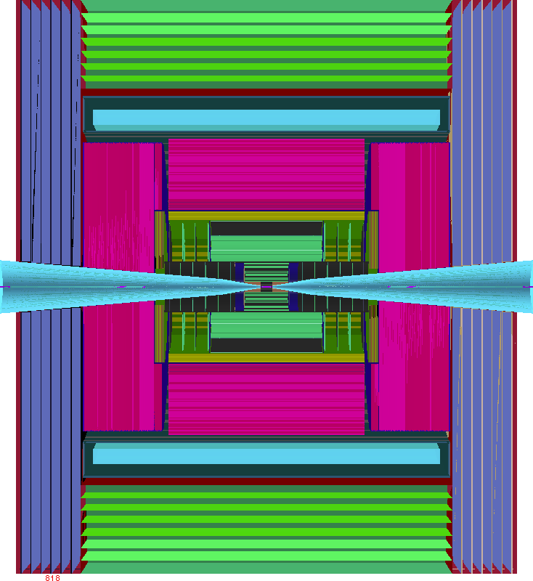



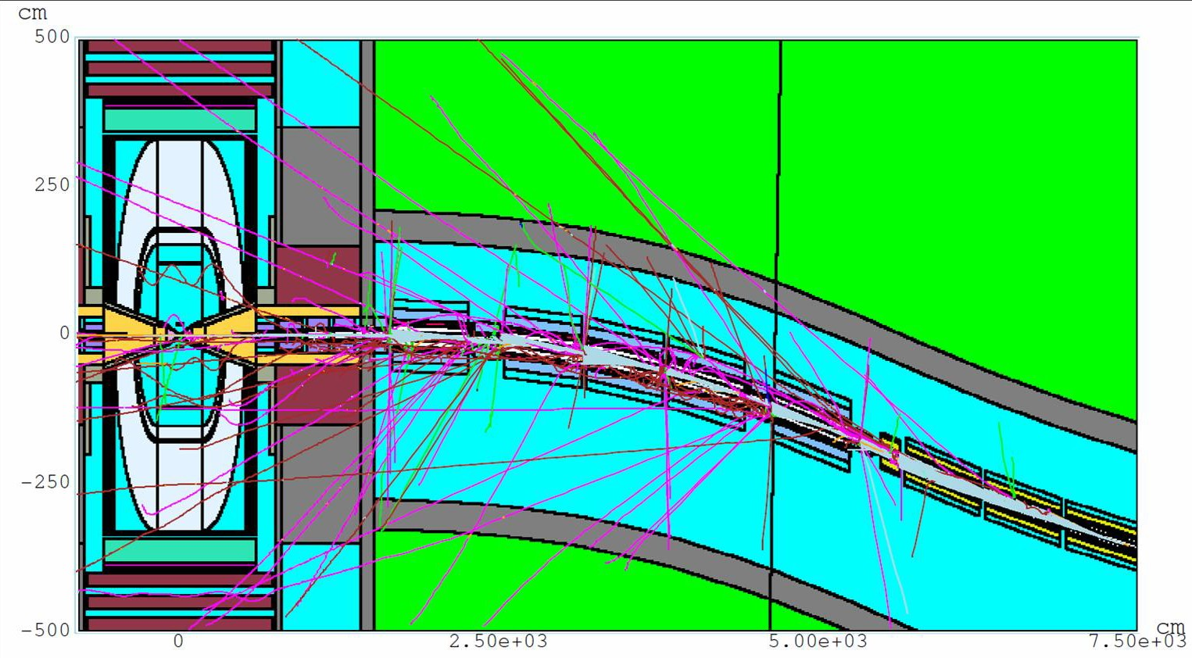
Next steps
q Move to use the Future Collider Framework
Description of the detector already done including the nozzle
A new, up to the state of the art detector is needed
q Simulate the beam-induced background with FLUKA
MDI and IR descriptions provided by MAP collaboration for 1.5 and 3 TeV s
Importing the description in FLUKA and generate new beam-induced background
q Re-evaluate Physics performance @ s=1.5 TeV as double check then study Physics performance @ s=3 TeV with full simulation
q Collaborate with MAP to have MDI and IR @ 𝐬=10 TeV to evaluate Physics performance
q Determine physics objects efficiency and resolution for each configuration and parametrize them to estimate broad physics reaches smearing Monte Carlo generated process

Slide 44
Attivita’ INFN – zona di interazione
Zona di interazione (Machine Detector Interface): da capire come/se contribuire
richiede disegno di macchina: parametri dell’ottica – esiste solo per MAP disegno nozzle da integrare nell’esperimento
fondi di macchina prodotti con FLUKA utilizzando line-builder (postdoc PD)
Studi di radiazione in funzione del sito e del disegno di macchina
studi preliminari simulazione completa FLUKA (parzialmente pubblicati) supporto definizione parametri macchina con esperti di acceleratori valutazioni con FLUKA dell'ottica e in base a siti e disegni di macchina

Slide 45
Attivita’ INFN – LEMMA sorgente
LEMMA (sorgente di produzione dei fasci di muoni da positroni):
studio start-to-end completo è articolo in fase di pubblicazione
studi per la sorgente di positroni in collaborazione con LAL – sinergia FCCee
studi materiali bersagli di produzione positroni e muoni in collaborazione con SBAI-Roma è articolo da pubblicare
  simulazioni (postdoc)
  test su fascio con camera a vuoto e termocamera (LNF e CERN +?)
studi accumulatore (grant giovani CSN5 e dottorando):
  FFAG (collaborazione UK)
  0ttica multibend-achromat (con ESRF)
PIANO DI LAVORO preCDR MACCHINA sottoposto alla GE da A. Variola (10/2019)
è richiede intensa attività anche in ambito internazionale per valutarne fattibilità

Slide 46
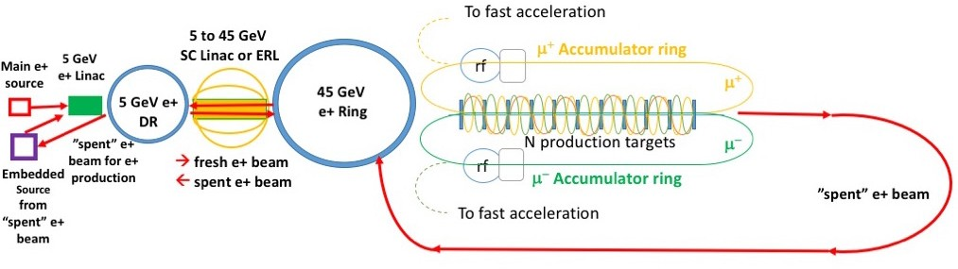
Positron driven muon source
recent developments (2019)
A. Variola, M. Biagini,
S. Guiducci, M. Antonelli,
M. Boscolo, P. Raimondi et al.
IPAC2019: MOZZPLS2
Positron Source (PS) @ 300 MeV, plus LINAC to accelerate up to 5 GeV
5 GeV 𝒆⁺ Damping Ring (DR) with damping time order of 10 msec
SC Linac or ERL accelerate 𝒆⁺ @ 45 GeV, and decelerate @ 5 GeV after μ production
45 GeV 𝒆⁺ Ring (PR) to accumulate 1000 bunches needed for μ production
1/more Target Lines (TL): e+ beam collides with targets for the direct μ production
2 Muon Accumulation Rings (AR) – 123 m – to store μ till μ bunch reach typically 10⁹ μ
Average muon energy 22 GeV (γ(μ) = 200 μs , τ(μ)_{lab} = 500 μs )
Embedded 𝒆⁺ source to restore the design 𝑒⁺ beam current
using γ coming from μ production targets, or using the 45 GeV “spent” beam

Slide 47
Effort for Baseline Design
Put together coherent design requires (mainly human) resources
  This goes beyond US effort
  Consistent parameters and layouts
  Integration of collider systems, trade-offs, choices, …
  May highlight additional important issues
  Requires (mainly human) resources
  Currently MAP is main option, LEMMA is alternative
Key R&D list with priorities
  Identify key / feasibility issues
    i.e. largest technical risks
    Key cost driver, if critical
    Key power consumption, if critical
  Entry point for collaborators
Proposed MUST
(MUon collider STudy network) submitted I.FAST EU project

Slide 48
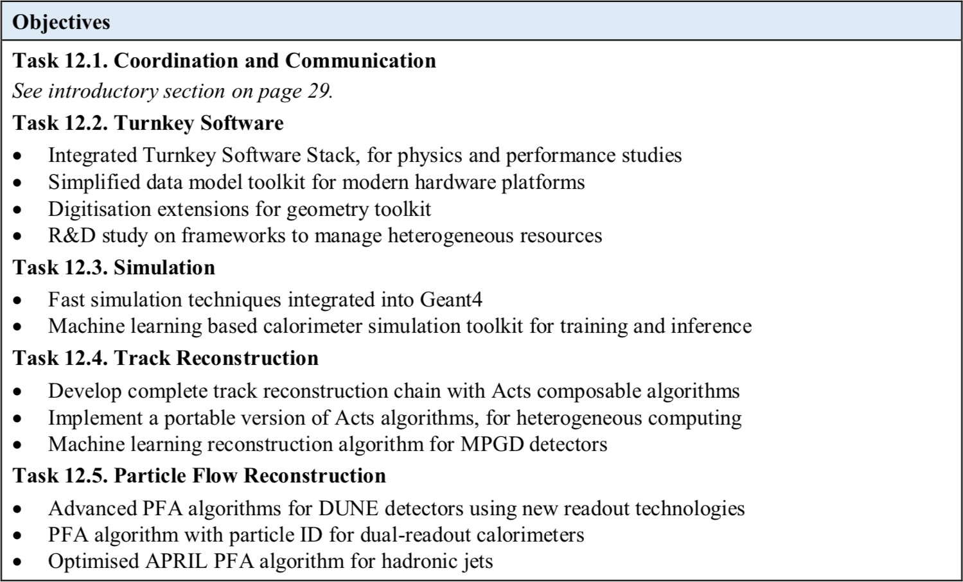

Slide 49
Why Muons?
Full collision energy available for particle production: 14 TeV lepton collisions are comparable to 100 TeV proton collisions for selected new physics process, if sufficient luminosity is provided ~ 𝟏𝟎^{𝟑𝟓}𝒄𝒎^{.𝟐}𝒔^{.𝟏}
Strong interest to reuse existing facilities and infrastructure (i.e. LHC tunnel) in Europe

Slide 50
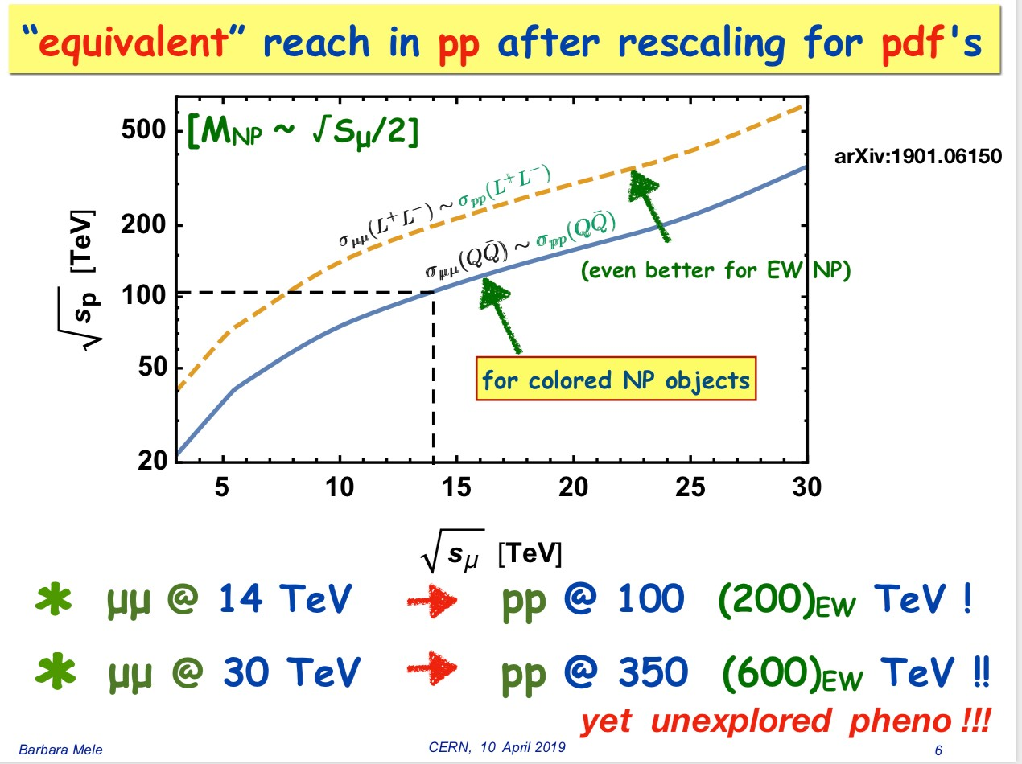
Proton vs Muon Colliders
to - June 1, 2019 Nadia Pastrone 15

