Slide 1



MC_INFN - Napoli
G. Mettivier, A. Sarno, F. di Franco*, P. Russo

Slide 2
Milestones 2020
GEANT4-NAPOLI: sviluppo piattaforma MC per Virtual Clinical in breast imaging
GEANT4-NAPOLI: Comparazione con codici che usano GPU
GEANT4-NAPOLI: Validazione del codice sviluppato rispetto ad immagini di fantocci di seno stampati 3D

Slide 3





ML1: Virtual clinical trials
Advanced Geant4-based Application for in-silico clinical Trial in x-ray breAst imaging
The first platform for virtual clinical trials in 2D and 3D (2D mammography, DBT and BCT) x-ray based breast imaging based on a Monte Carlo software and patient-derived digital breast models.

Slide 4
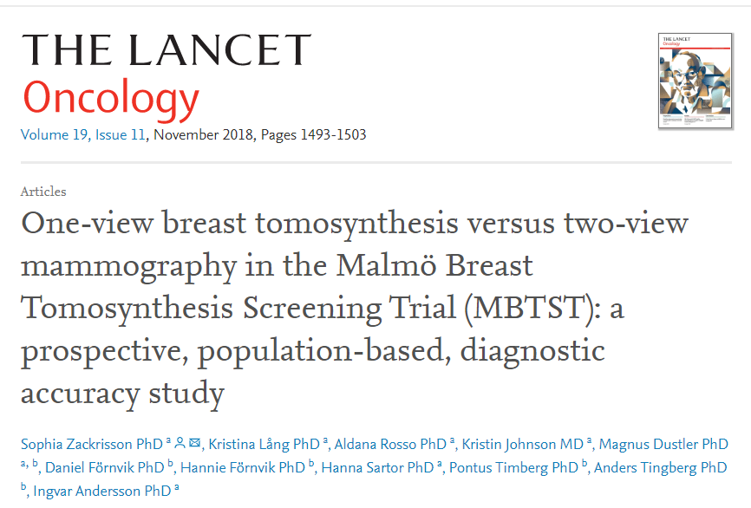
ML1: Virtual clinical trials

Slide 5
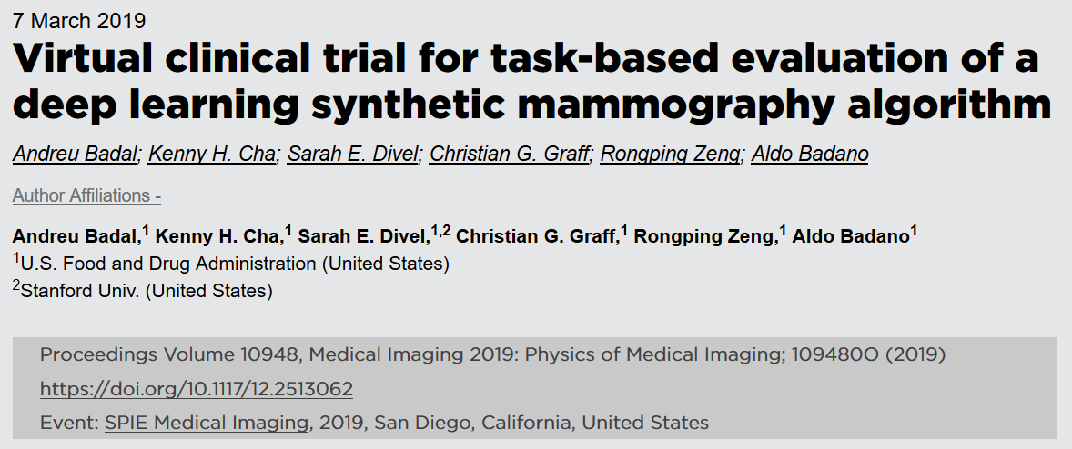
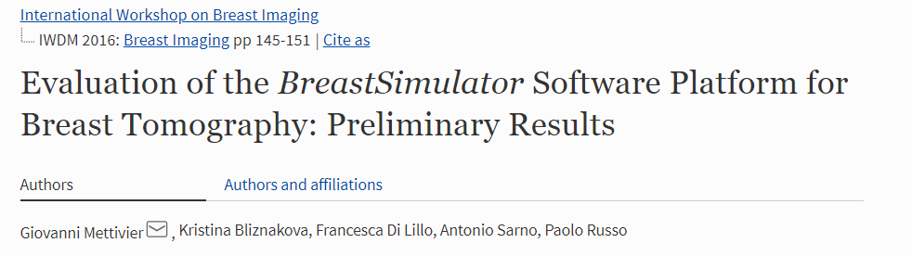
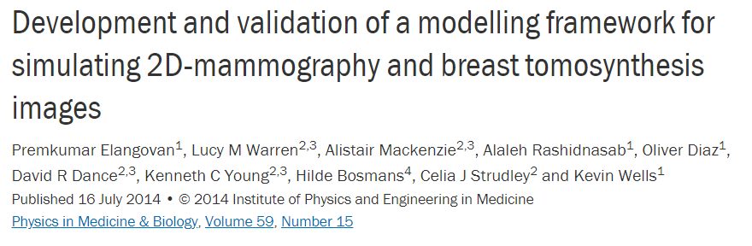
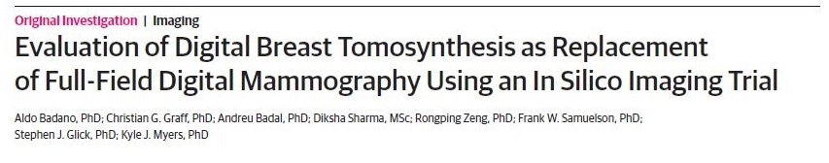
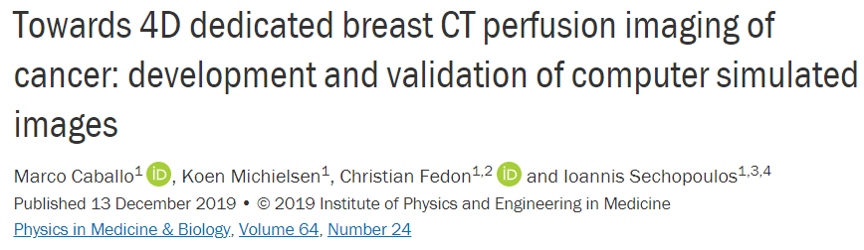
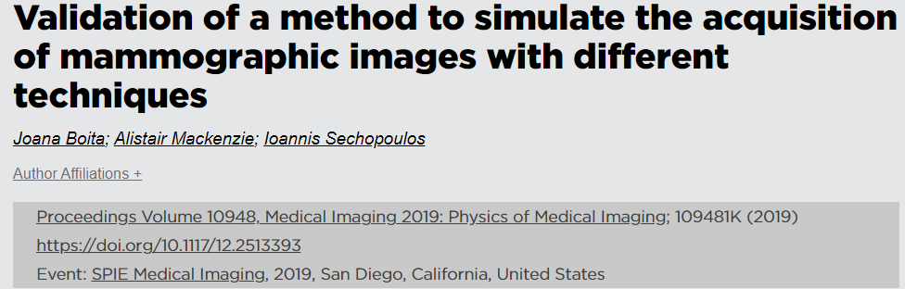
State of the art

Slide 6
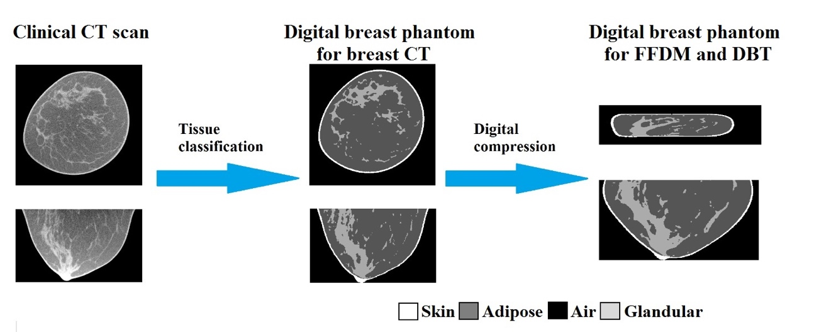
Patient derived digital breast phantoms
Up to 300 cases provided by UC Davis
Sarno A et al, Personalised estimates of mean glandular dose and image quality investigations in cone-beam computed tomography dedicated to the breast, ECR2019, Wien (Austria), 27th February−3rd March 2019.
Sarno A et al, Dedicated cone-beam breast CT: a patient specific GEANT4 study, 3rd Geant4 international User Conference, Bordeaux (France), 29th–31st October 2019
Sarno A et al, Monte Carlo evaluation of glandular dose in cone-beam X-ray computed tomography dedicated to the breast: Homogeneous and heterogeneous breast models, Phys Medica (2018); 51:99-107.

Slide 7
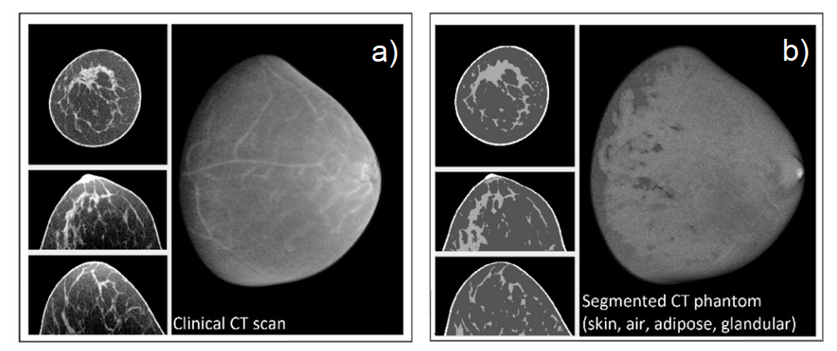
Database of uncompressed breast phantoms
85 digital breast phantoms from 85 unaffected breast acquired with the UC Davis BCT scanner
 | Mean | Std. Dev. | Min. | Max.
Glandular fraction by mass | 0.13 | 0.10 | 0.01 | 0.59
Glandular fraction by volume | 0.11 | 0.10 | 0.01 | 0.53
Breast volume – skin excluded (cm³) | 513.83 | 198.24 | 139.36 | 880.25
Breast length from chest wall to nipple (mm) | 84.29 | 12.93 | 49.85 | 104.14
Equivalent diameter at the center of mass (mm) | 105.87 | 14.66 | 57.13 | 136.23
Breast length-to-equivalent radius ratio (mm) | 1.62 | 0.35 | 1.11 | 3.25

Slide 8
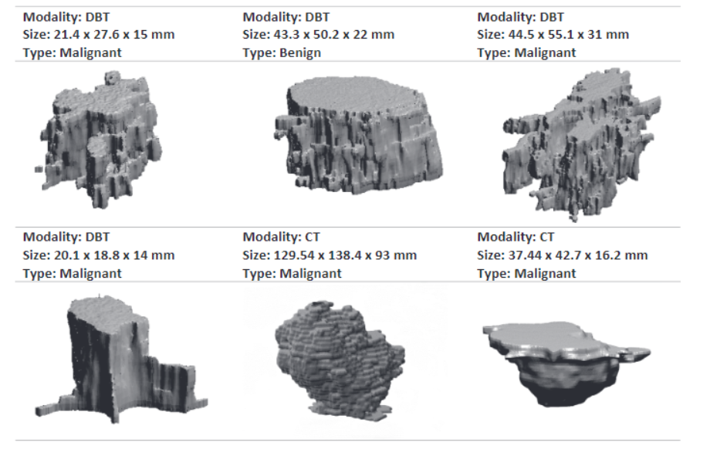
Digital tumor models
138 3D digital breast tumor models developed within th Horizon 2020 MaXIMA project
Bliznakova K et al. Development of breast lesions models database. Physica Medica 64, 293-303 (2019).

Slide 9
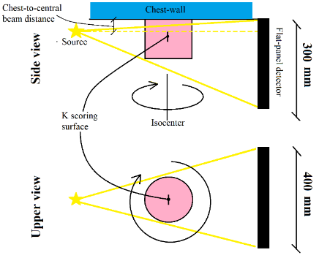
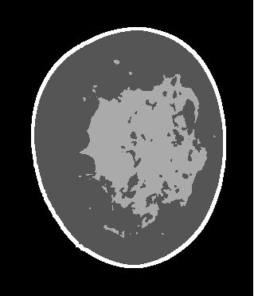
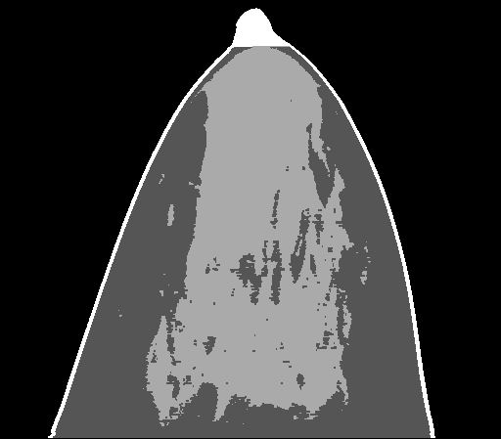
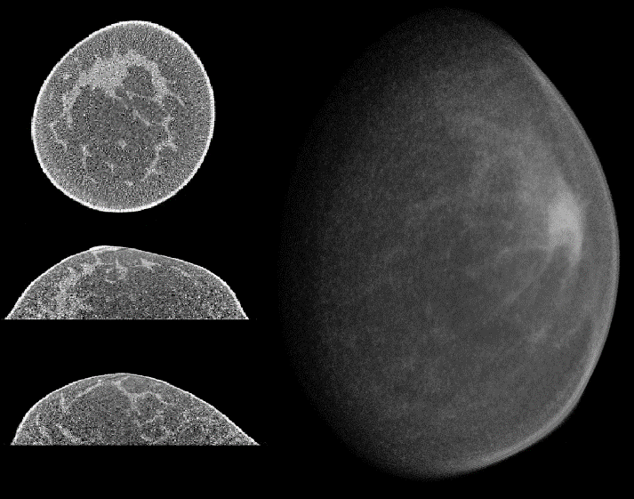
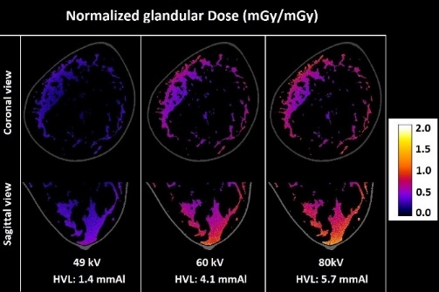
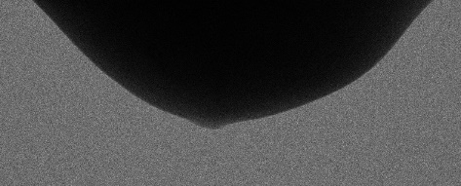
The simulation platform
Digital Breast Phantoms
INPUT
Skin
Adipose
Glandular
Air
Scanner specifications
Monte Carlo
based on GEANT4
Post processing
OUTPUT
Image projections

Slide 10
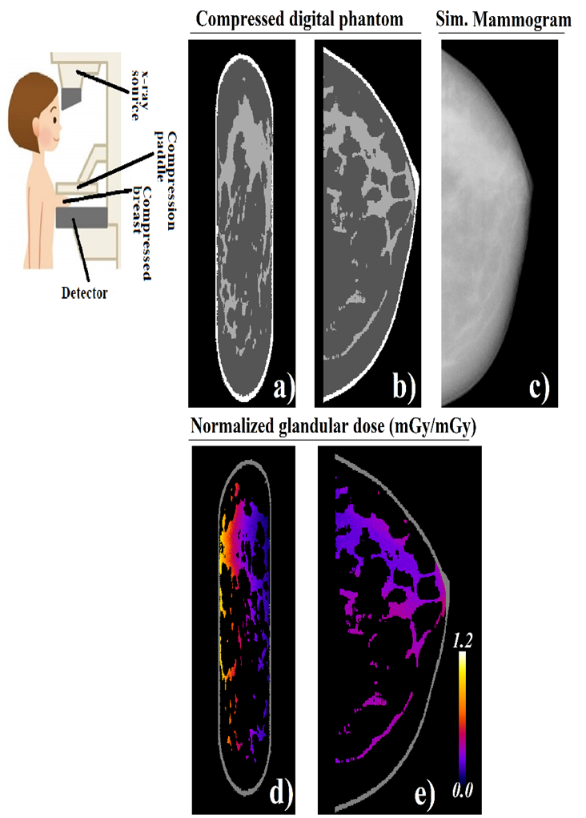
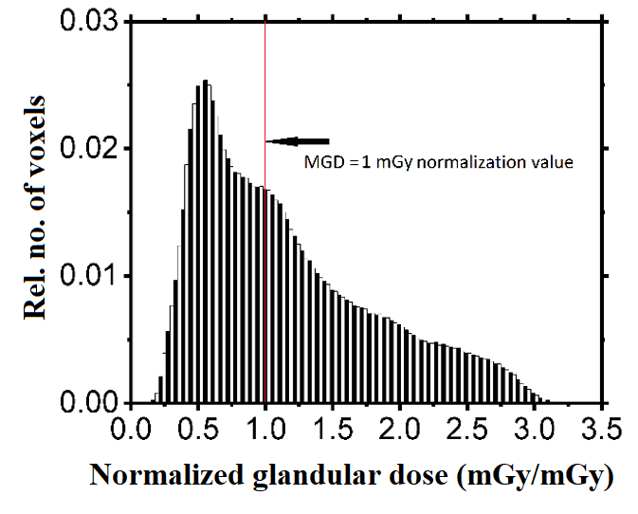
MC simulated mammography
28 kV W/Al; HVL = 0.486 mm Al; MGD = 0.01 mGy

Slide 11
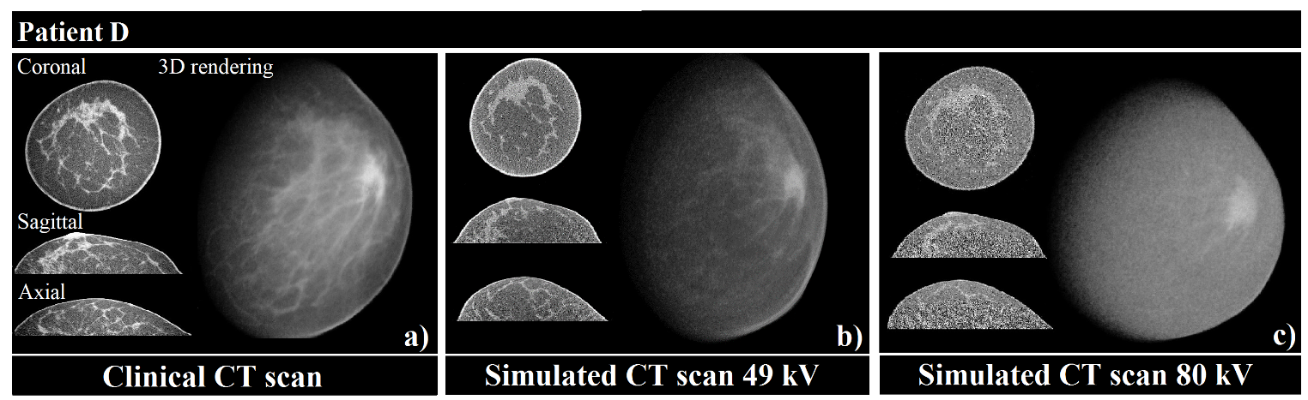
Simulated dedicated breast CT
MGD = 5.0 mGy
MGD = 0.5 mGy
MGD = 0.5 mGy
Comparison of clinical and simulated CT dataset
Multiscale structural similarity index – MS-SSID: 0.88 @ 49 kV, 0.84 @ 80 kV
- di Franco et al, GEANT4 Monte Carlo simulations for virtual clinical trials in breast x-ray imaging: proof of concept, Physica Medica, in press

Slide 12
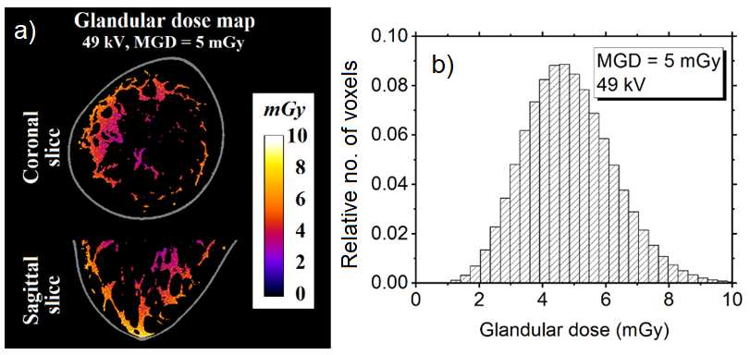
Simulated glandular dose distribution
Breast CT exam
Dose distribution assesment with patient derived digital breast phantoms can help in evaluating peak doses and validating homogeneous breast models for average glandular dose estimates.

Slide 13
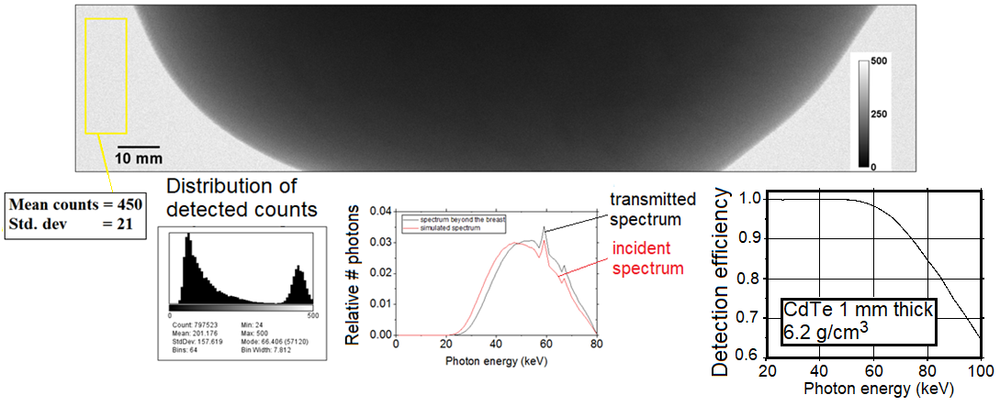
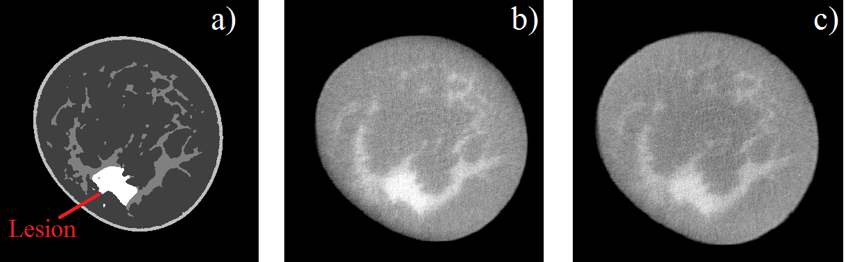
Simulated photon counting BCT
Breast projection at 80 kV
For each voxel, the impinging x-ray spectrum is scored
Coronal view
Digital phantom
Energy window: 1-80 keV
Energy window: 1-50 keV

Slide 14
ML1: Virtual clinical trials
Articoli
Mettivier et al, ‘The Napoli-Davis-Varna project for virtual clinical trials in X-ray breast imaging’, IEEE Conf proceedings
di Franco et al., ‘Geant4 Monte Carlo simulations for virtual clinical trials in breast X-ray imaging: proof of concept’, Physica Medica, 2020
Mettivier et al., ‘Virtual clinical trials in 3D and 2D breast imaging with digital phantoms derived from clinical breast CT scans’, SPIE Medical Imaging
Sarno et al., ‘Advanced Monte Carlo application for in silico clinical trials in x-ray breast imaging’, IWBI proceedings
Conference
F. di Franco, ‘The Napoli-Davis-Varna project for virtual clinical trials in X-ray breast imaging’, IEEE MIC 2019
P. Russo, The U Napoli- UC Davis - U Varna - U Campinas Virtual Clinical Trial for 3D X-ray breast imaging , ICMP 2019
A. Sarno, Geant4 Monte Carlo simulations for virtual clinical trials in X-ray breast imaging, MCMA 2019
di Franco, Trial clinico virtuale nell'imaging a raggi X 2D e 3D del seno, IDMP 2019
Mettivier, Virtual clinical trials in 3D and 2D breast imaging with digital phantoms derived from clinical breast CT scans , SPIE MI 2020
Sarno, Advanced monte carlo application for in-silico clinical trials in x-ray breast imaging, IWBI 2020
Sarno, AGATA: Advanced Geant4-based Application for in-silico clinical Trial in x-ray breAst imaging, ECMP 2020
Sarno, Evaluation of glandular dose distribution in 2D and 3D x-ray breast imaging, ECMP 2020

Slide 15

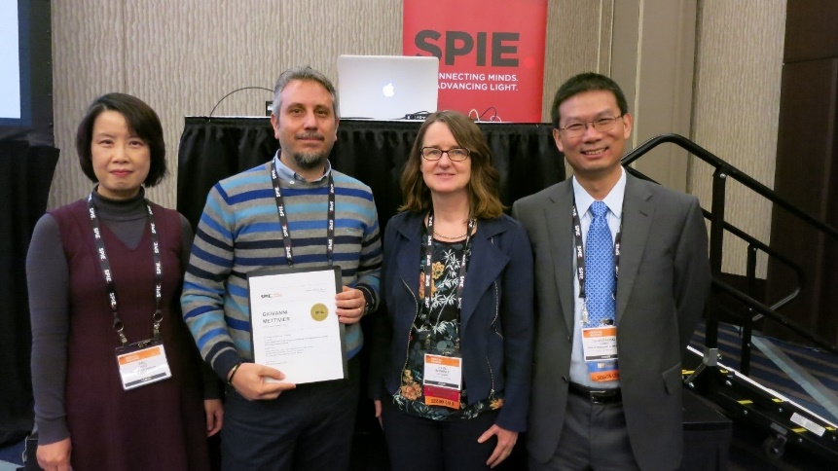
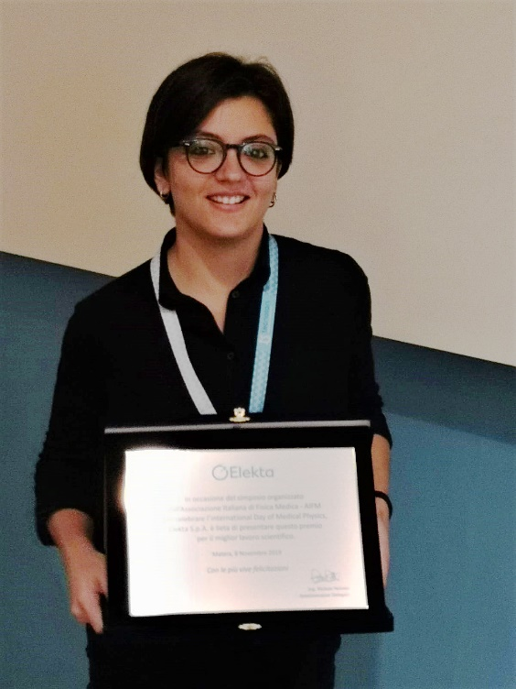
ML1: Virtual clinical trials
Antonio Sarno tra i vincitori del Grant Giovani INFN col progetto AGATA
Al Prof. Giovanni Mettivier il premio per il miglior poster a SPIE Medical Imaging 2020
A Francesca di Franco il premio Pietro Pasqualone dell'Associazione Italiana di Fisica Medica

Slide 16
ML2: Confronto codici su GPU
Codice 1: XRMC Montecarlo, Variance Reduction, Cagliari
Codice 2: Cuda code, UTexas based on GPU CUDA
Codice 3: Geant4 ver 10.4, Napoli
Test details
Source spectrum: W anode, 80 kVp, inherent filtration 1.58 mm Al
Irradiation geometry: half-cone beam,
Detector-isocenter distance = 273 mm,
Source-isocenter distance = 650 mm
Detector dimension: 29 cm (h) x 23 cm (w)
Proj Number: 360 proj, 1 proj/deg
Result: Deposited energy (mJ) for each voxel
Number of simulated photons: 36*10¹¹

Slide 17
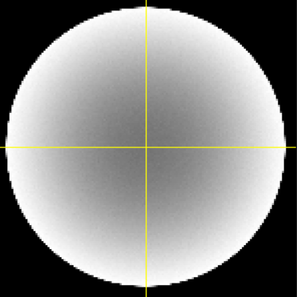
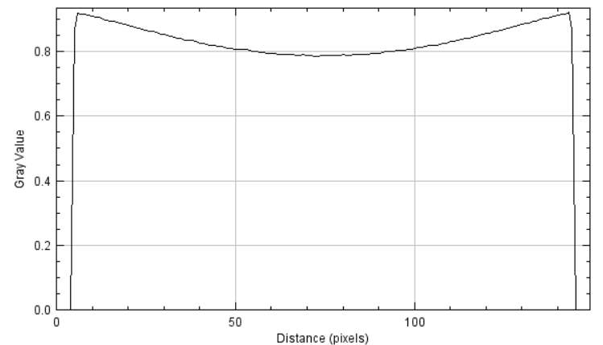
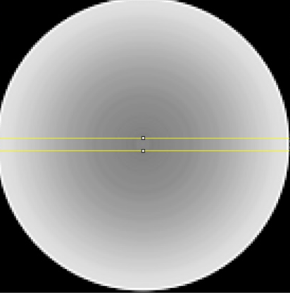
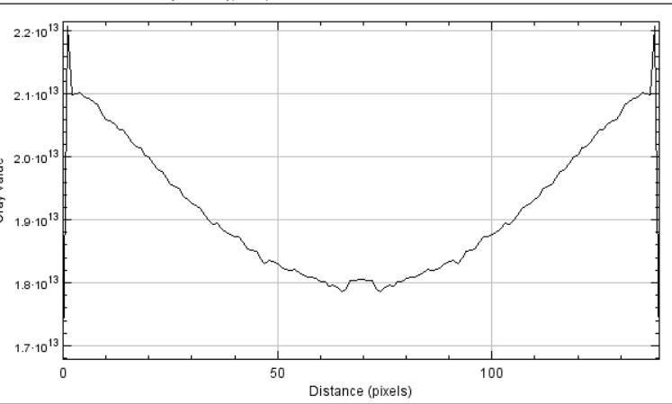
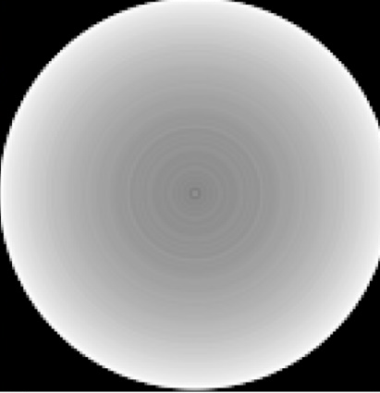
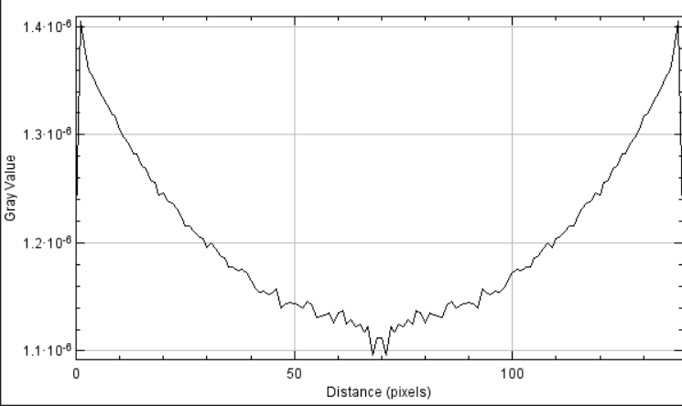
ML2: Confronto codici su GPU
Variance
40 giorni
PC 16 core
14 minuti
Cuda
NVIDIA Quadro P400
35 giorni
Cilindro con diametro di 14 cm ed altezza 15 cm. Materiale 50/50, Voxel 1 x 1 x 1 mm³.
Geant4
PC 16 core

Slide 18
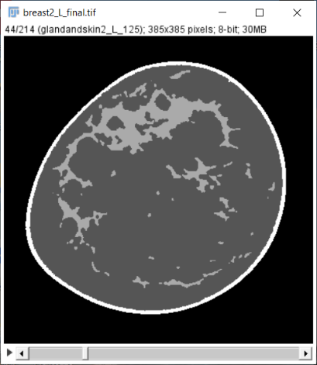
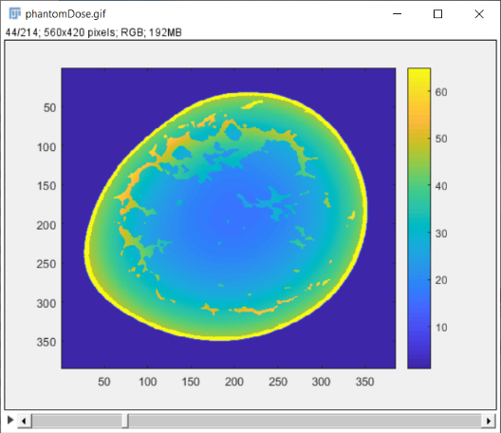
?
ML2: Confronto codici su GPU
Variance
PC 16 core
Cuda
2-3 mesi
?
Real Breast Phantom
4 Giorni
NVIDIA Quadro P400
Geant4

Slide 19
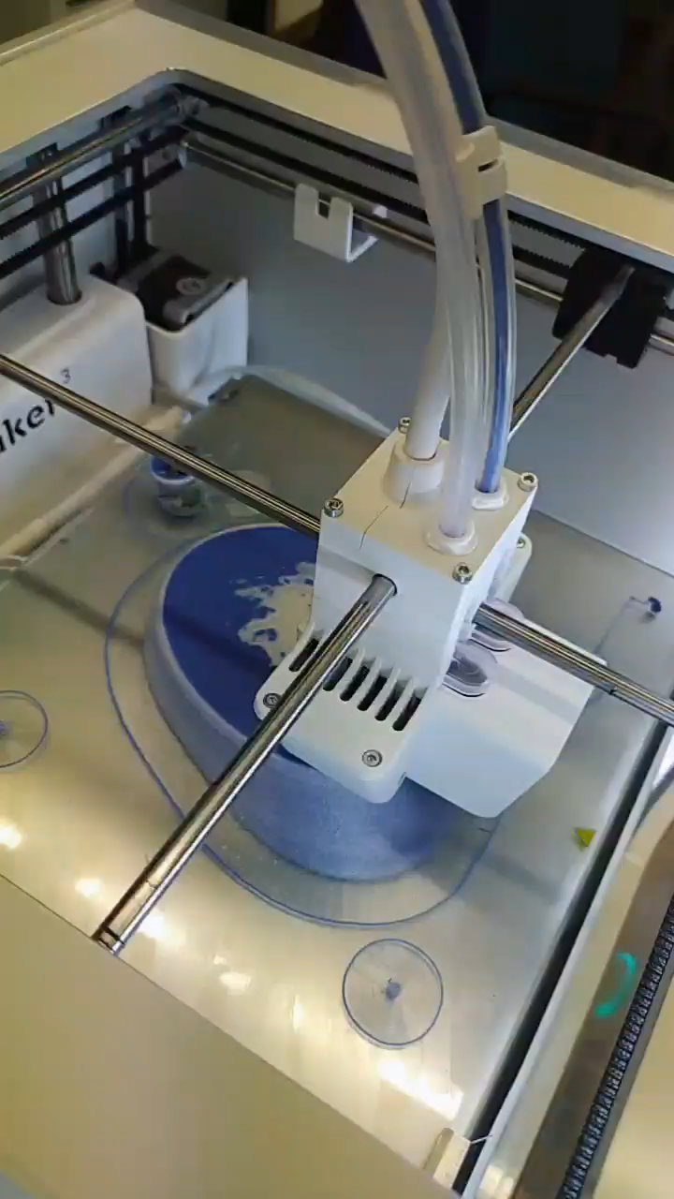
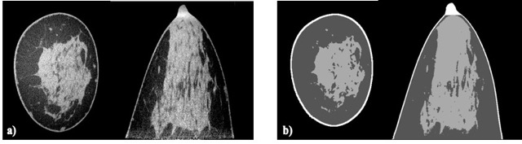
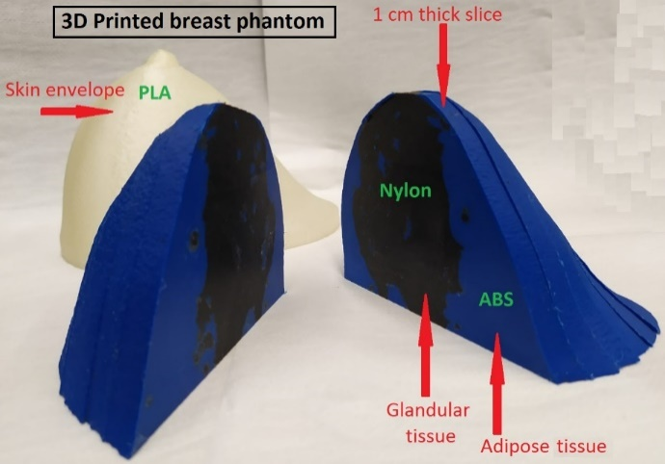
ML3: Validazione stampa 3D
3D printing @INFN Napoli
Physical breast phantom
*Printing materials selected by means of suitable studies at monochromatic synchrotron radiation (ESRF) during the MaXIMA project
Esposito G et al. "Investigation of the refractive index decrement of 3D printing materials for manufacturing breast phantoms for phase contrast imaging." Phys Med Biol 64 2019
Ivanov D et al. "Suitability of low density materials for 3D printing of physical breast phantoms." Phys Med Biol 63 2018

Slide 20
ML3: Validazione stampa 3D
Preliminary data
Effective attenuation coefficient of 3D printing materials (ABS, PLA, PET) as a function of the effective energy (data points), as determined from measurements with the x-ray spectra indicated in Tab. 1. The data points corresponding to measurements are positioned on the corresponding curves (lines) for the linear attenuation coefficient of ABS, PLA and PET, respectively, calculated with the software XMUDAT based on their elemental compositions. The plot has been split in two graphs covering a different energy range, for ease of reading.
Russo, Characterization of 3D printing materials for manufacturing patient-derived compressed breast phantoms, ECMP 2020

Slide 21
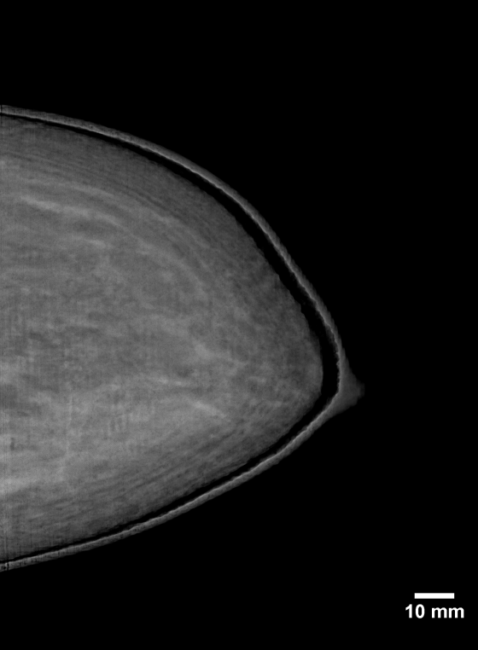
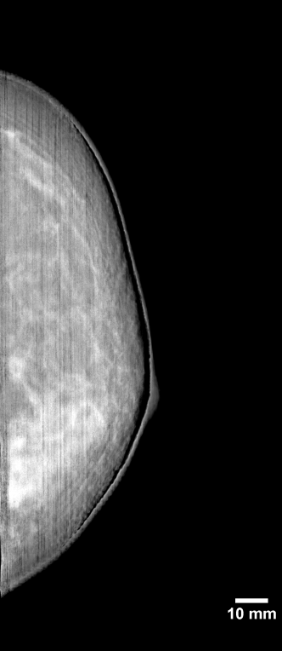
ML3: Validazione stampa 3D
Preliminary data
Mammo
Mammo
Simul
Russo, Characterization of 3D printing materials for manufacturing patient-derived compressed breast phantoms, ECMP 2020

Slide 22
Attività DgN Mammo
- Sarno et al., ‘Monte Carlo calculation of monoenergetici and polyenergetic DgN coefficients for mean glandular dose estimates in mammography using a homogeneous breast model’, PMB, 10.1088/1361-6560/ab253f
- A. Sarno, Geant4 Monte Carlo calculation of normalized glandular dose coefficients in mammography, MCMA 2109

Slide 23
Attività DgN DBT
Sarno et al., ‘Normalized glandular dose coefficients for digital breast tomosynthesis systems in craniocaudal view with a homogeneous breast model’, submitted to PMB

Slide 24
2021
Paolo Russo, 10 %
Giovanni Mettivier 5%
Antonio Sarno 5%

