Slide 1


Attività Geant4
Riunione telematica del gruppo Geant4 (progetto MC-INFN)
Giovedì, 11 Giugno 2020
Barbara Caccia, Carlo Mancini-Terracciano, Alessandro Campa, Silvia Pozzi

Slide 2
Nota
Le attività in corso elencate in questa presentazione probabilmente non sono esaustive;
I colleghi elencati nella prima slide hanno contribuito e contribuiscono in misura diversa alle attività e, anche in questo caso, l’elenco non è esaustivo;
La vita lavorativa in questa fase di pandemia ha avuto ritmi ed emergenze diverse per tutti noi, ma aver mantenuto le fila ed esserci è già in se un’ottima cosa.
2￼

Slide 3
Milestones - INFN-RM1
31-12-2020 - GEANT4-ROMA I: Proposta alla collaborazione Geant4 di un advanced example basato su acceleratori medici Tomotherapy, con dati dosimetrici su fantoccio ad acqua
30-11-2020 - GEANT4-ROMA I: Organizzazione di una attività divulgativa in occasione del meeting annuale della collaborazione MC-INFN presso ISS
30-06-2020 - GEANT4-ROMA I: Benchmark dell'interfaccia BLOB-Geant4 con ulteriori dati sperimentali
30-06-2020 - GEANT4-ROMA I: Release di un esempio di Geant4 con l'interfaccia fra i modelli BLOB o SMF e Geant4
3￼

Slide 4
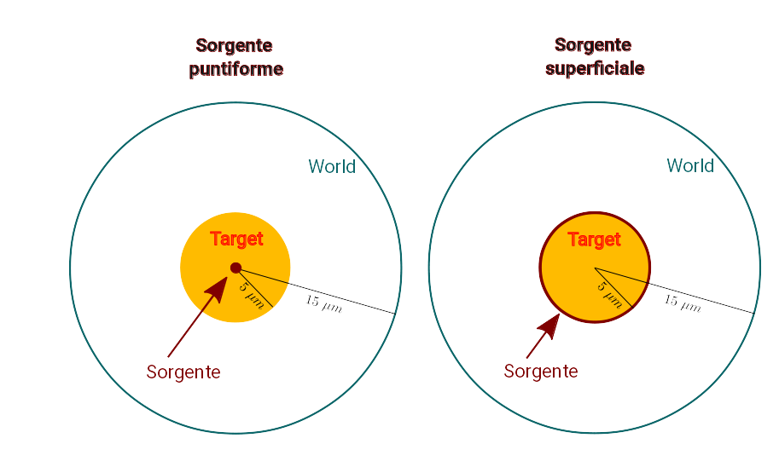
Microdosimetry
Monte Carlo technique used to evaluate microdosimetric spectra for irradiation with radionuclides – basato su un esercizio Eurados (Carmen Villagrasa)
Target di acqua (diametro 10 μm) in un “mondo” di acqua (diametro 30 μm)
Sorgente di I-125 in due configurazioni geometriche: una sorgente puntiforme posta al centro del bersaglio e una distribuzione di radionuclidi sulla superficie del bersaglio
In media 26 elettroni per decadimento (25 Auger + 1 da IC)
GEANT4-DNA + Monte Carlo ad hoc
Lavoro non ancora sottomesso a rivista, sono in corso test con Physics List diverse
4￼

Slide 5
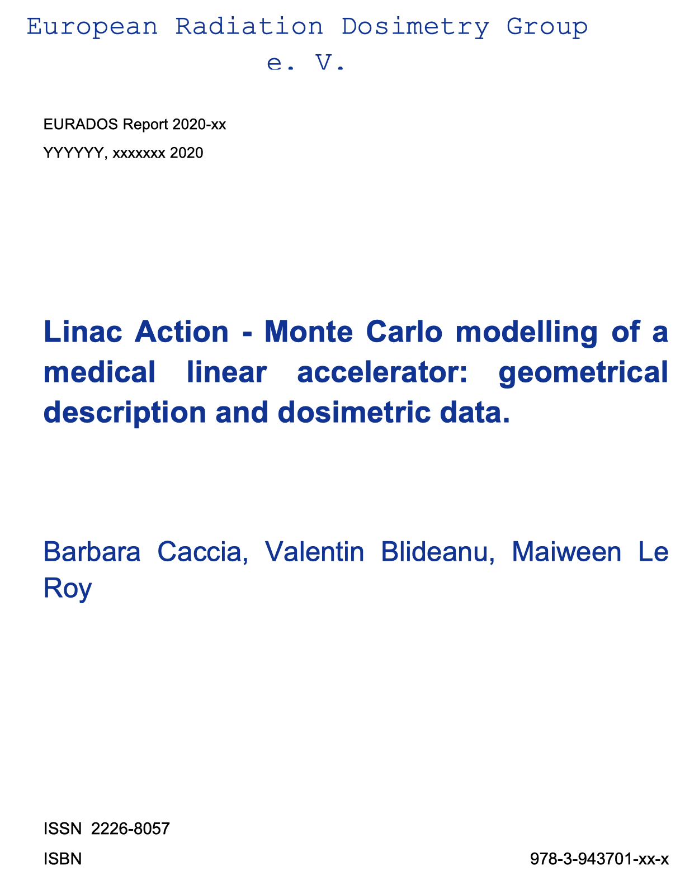
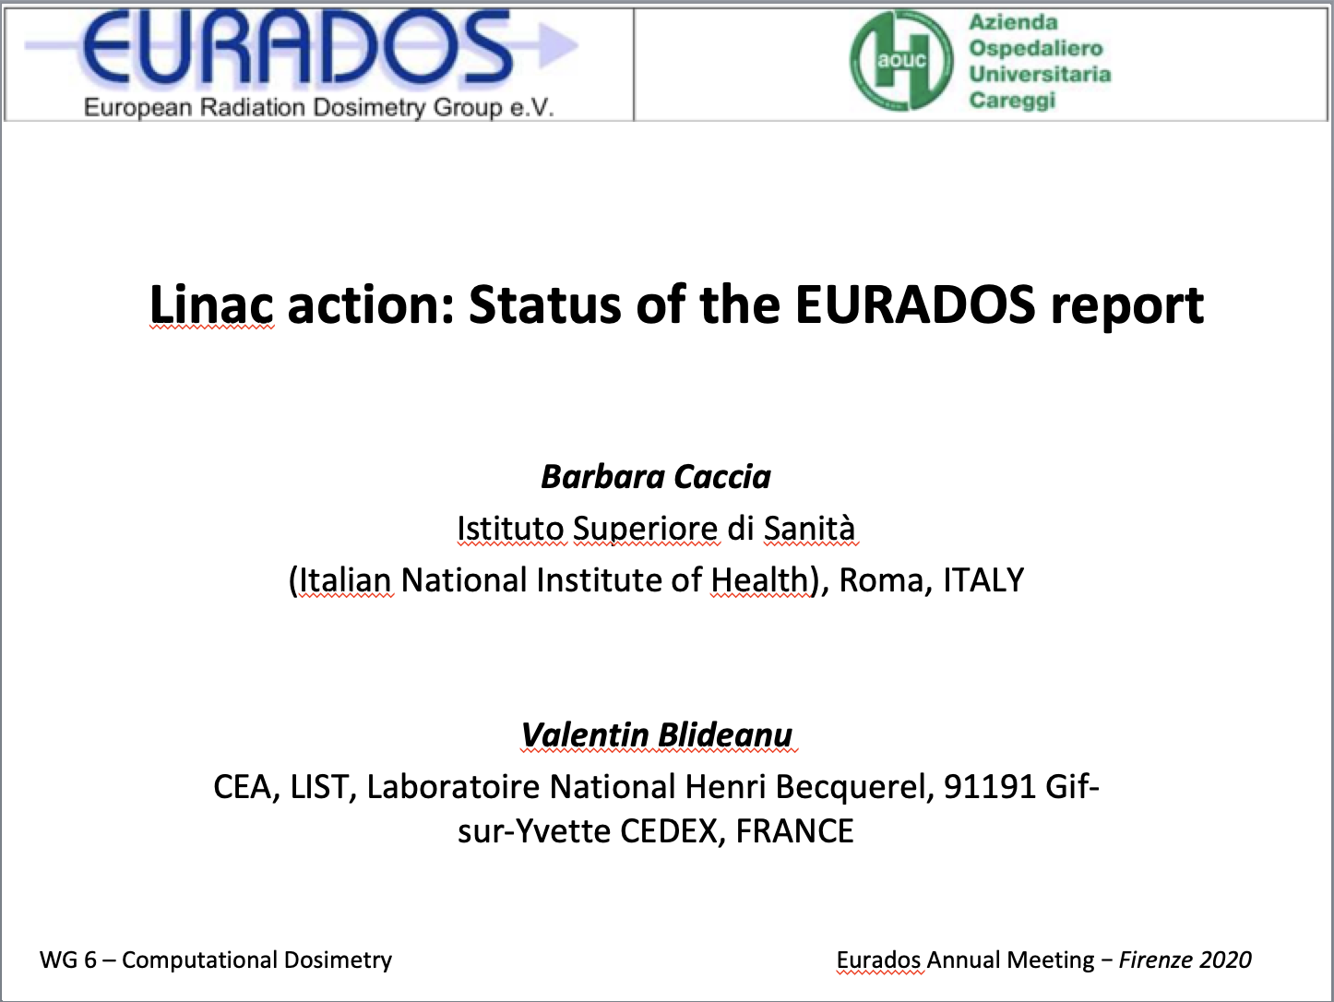
Medical Linac
Eurados Annual Meeting (Firenze, 27-30 gennaio 2020) – Il lavoro di interconfronto (Linac Action) condotto nell’ambito del WG6 (Computational Dosimetry) viene riassunto in un Report Eurados che potrà essere distribuito anche a corredo dell’Advanced Example Medical Linac di Geant4.
I dati descrittivi dell’acceleratore e i dati dosimetrici dei fantocci eterogenei usati nell’interconfronto (prodotti da Laboratoire National Henry Bequerel – CEA, LIST, LNA-LNHB) saranno disponibili.
Stato del report: completato e in attesa di revisione da parte del Council di Eurados.
Sarà stampato e distribuito da Eurados. Data presumibile settembre 2020.
5￼

Slide 6
dal Resoconto su GeNIALE (Carlo Mancini-Terracciano)
Geant4 Nuclear Interaction At Low Energy
Finanziato dalla CSN5 per 2017-2019
Come “progetto giovani”
Un anno dalla Sapienza (assegno di ricerca per progetti proposti dai candidati)

Slide 7
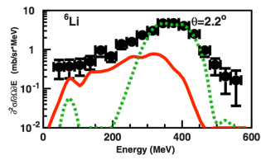
Problems in Geant4 below 100 MeV/u
Despite the numerous and relevant application would use it, there is no dedicated model to nuclear interaction below 100 MeV/u in Geant4
Many papers showed the difficulties of Geant4 in this energy domain:
  Braunn et al. have shown discrepancies up to one order of magnitude in ¹²C fragmentation at 95 MeV/u on thick PMMA target
  De Napoli et al. showed discrepancy specially on angular distribution of the secondaries emitted in the interaction of 62 MeV/u ¹²C on thin carbon target
  Dudouet et al. found similar results with a 95 MeV/u ¹²C beam on H, C, O, Al and Ti targets
[Plot from De Napoli et al. Phys. Med. Biol., vol. 57, no. 22, pp. 7651–7671, Nov. 2012]
Exp. data
G4-BIC
G4-QMD
Cross section of the ⁶Li production at 2.2 degree in a ¹²C on ^{nat}C reaction at 62 MeV/u.

Slide 8

GeNIALE collaborations
Maria Colonna, (INFN-LNS)
G. A. Pablo Cirrone and Luciano Pandola
Paolo Napolitani (IN2P3-Orsay)
Barbara Caccia (National Center for Radiation Protection and Computational Physics of the Italian Institute of Health)
Andrea Dotti (previously at SLAC)
Makoto Asai and Dennis Wright (SLAC)
Possible with:
Alberto Ribon and John Apostolakis (CERN)
Indaco Biazzo (Politecnico di Torino)

Slide 9

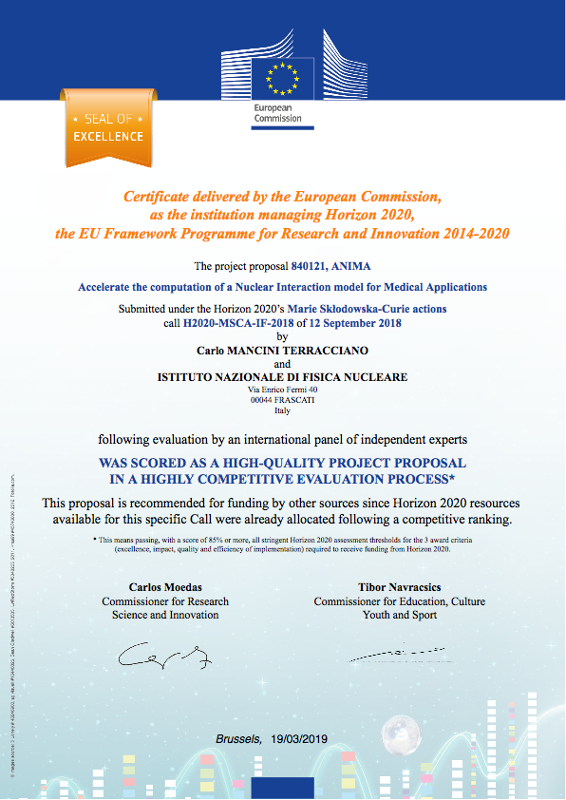

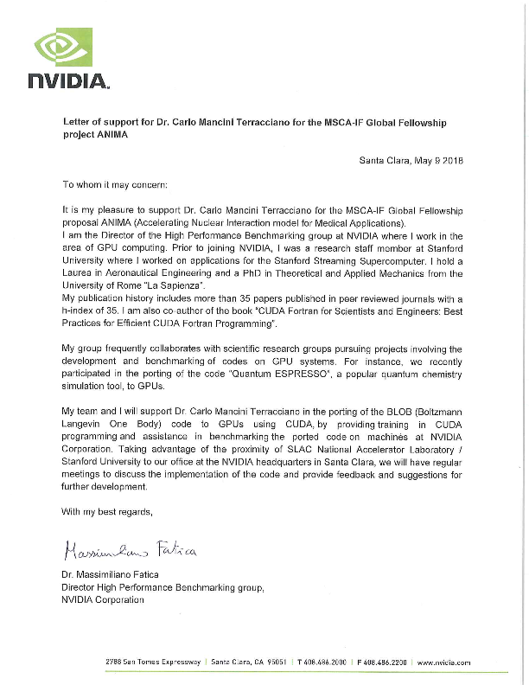
ANIMA
(Accelerate the computation of a Nuclear Interaction model for Medical Applications )
I proposed a GeNIALE spin-off as a
Marie Curie Global Fellow
A complete re-design of BLOB
  Adapting it to light ion interactions
  Porting the code on GPU
INFN as host institution
SLAC as outgoing phase
institutions
Nvidia as a partner
Got the “Seal of Excellence”

Slide 10
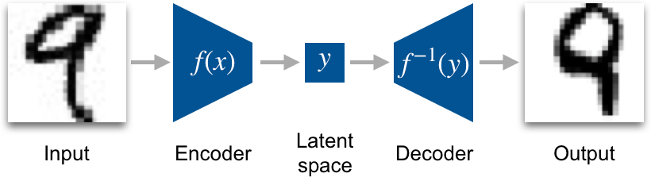
Exploring Deep Learning to emulate BLOB
Another possibility is using Deep Learning to emulate BLOB
Bin the PDF output of BLOB (creating a 3D “image”)
Train a Variational Auto Encoder (VAE) to reproduce such “images”
Condition the VAE to the impact parameter
The decoder part of the VAE is then used to generate events, sampling from the latent space

Slide 11

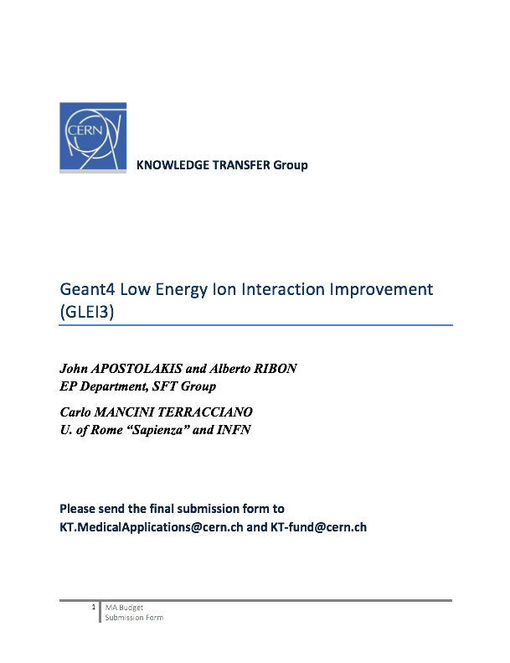
A possible collaboration with CERN Geant4 team
John Apostolakis and Alberto Ribon expressed interest in the GeNIALE outcomes and ideas
We are working to present a project for a CERN Knowledge Transfer call
GLEI3 (Geant4 Low Energy Ion Interaction Improvement)
We are evaluating if proposing
  the porting on GPU
  or the Deep Learning approach

Slide 12
Publications related to MC-INFN
C. Mancini-Terracciano et al. Preliminary results coupling “Stochastic Mean Field” and “Boltzmann-Langevin One Body” models with Geant4. In: Physica Medica 67 (2019), pp. 116–122. doi: 10.1016/j.ejmp.2019.10.026.
A. Ciardiello et al. Preliminary results in using Deep Learning to emulate BLOB, a nuclear interaction model. In: Physica Medica 73 (May 2020), pp. 65-72. doi: 10.1016/j.ejmp.2020.04.005. arXiv: 2004.0496
P. Arce et al. Report on G4-Med, a Geant4 benchmarking system for medical physics applications developed by the Geant4 Medical Simulation Benchmarking Group. In: Medical Physics (2020). doi: 10.1002/mp.14226.
C. Mancini-Terracciano et al. Validation of Geant4 nuclear reaction models for hadron therapy and preliminary results with BLOB. In: IFMBE Proceedings Series 68/1 (Mar. 2018), pp. 675–685. doi: 10.1007/978-981-10-9035-6_126.
P. Napolitani, M. Colonna, and C. Mancini-Terracciano. Cluster formation in nuclear reactions from mean-field inhomogeneities. In: Journal of Physics: Conference Series 1014.1 (Mar. 2018), p. 012008. doi: 10.1088/1742-6596/1014/1/ 012008.
C. Mancini-Terracciano et al. Validation of Geant4 nuclear reaction models for hadrontherapy and preliminary results with SMF and BLOB. In: Physica Medica 42, Supplement 1 (2017), p. 12. doi: 10.1016/j.ejmp.2017.09.030.

Slide 13
Talks and an invited seminar about MC-INFN
Preliminary results in using Deep Learning to emulate BLOB, a nuclear interaction model. Talk at the IEEE Nuclear Science Symposium and Medical Imaging Conference, 28 October - 2 November 2019, Manchester (United Kingdom)
Preliminary results in using Deep Learning to emulate BLOB, a nuclear interaction mode. Talk at the ICCR-MCMA Conference, 17-21 June 2019, Montreal (Canada)
Interfacing a nuclear interaction model (BLOB) with Geant4. Talk at the ICCR-MCMA Conference, 17-21 June 2019, Montreal (Canada)
Machine learning for medical applications of Physics. AI-at-SLAC invited seminar. 16th January 2019, SLAC, Menlo Park (CA, US).
The interface of BLOB with Geant4. Invited talk at the ENSAR2 workshop, 24-26 April 2019, CIEMAT Madrid (Spain)
Activities of Eurados Working Group 6 “Computational Dosimetry” MathMet 2019, 20-22 Nov 2019, Lisboa, Portugal (Richiesto lavoro esteso entro Agosto)
Preliminary results coupling SMF and BLOB with Geant4. First Biennial African Conference on Fundamental Physics and Applications. July 2018, Windhoek (Namibia).

