Slide 2
Preliminary Fluka Geometry for MDI Studies of the 1.5 TeV Muon Collider
Alessio Mereghetti

Slide 3
Outline
Introduction
LineBuilder and FLUKA Element DataBase
Application of LB/FEDB to MC MDI Studies
Building the FLUKA Geometry
Conclusions and Outlook

Slide 4
Introduction
Accelerator lattice design and optics calculation
Detector background estimation (MC)
In a high-luminosity, high-intensity muon collider (MC) ring, high background is expected in the experimental apparatus due to muon decays in the circulating beam;
Measures to lower the background in the detector may also impact the design of the accelerator in the vicinity of the detector;
It is essential to have a flexible simulation set up, in order to:
Estimate the background induced by the machine / circulating beam;
Feed the design of the machine back with results from Monte Carlo (MC) simulations about the detector background;
At CERN, studies where a similar flexibility is needed are conducted daily;
Optics/Lattice design: MADX;
Energy deposition / particle fluences / etc… (MC): FLUKA;
From the lattice structure (MADX) to MC geometry (FLUKA): LineBuilder (LB) and FLUKA Element DataBase (FEDB);
LB and FEDB: from the lattice structure to the FLUKA geometry

Slide 5
LineBuilder and FLUKA Element DataBase
The FLUKA Element DataBase (FEDB) is a collection of FLUKA geometries of accelerator / beam lines elements:
Full description of each object: bodies, regions, material assignments;
Each object is described in its own reference system, independently of the other elements → easy to modify / update / debug;
Any type of element can be described: magnets, collimators, interconnects, monitors, etc…;
The LineBuilder (LB) is a python program capable of producing complex accelerator geometries in FLUKA:
Lattice structure and powering of magnets is taken from output files of optics codes (e.g. MAD-X);
Twiss file: lattice structure, powering of magnets and linear optics → generation of the geometry + check of optics;
Survey file: beam position throughout the beam line in a global 3D reference system → check of orbit;
Geometries of accelerator elements are taken from the FEDB;
User directives, to customize the geometry: which portion of accelerator/beam line, further manipulation to lattice structure, tunnel geometry, detailed position of monitors, etc…

Slide 6
Application of LB/FEDB to MC MDI Studies
Set up LB/FEDB for MC MDI studies: complications due to:
lattice/optics has been studied with MAD-8: peculiar format of files, that could not be modified!
Naming convention of elements completely different from that used at CERN – e.g. elements cannot be uniquely identified by their names;
Very limited use of MARKERs – e.g. separation between arcs and long straight sections (LSS);
Usual tasks when a new machine has to be built:
Build the FEDB + tunnel geometries;
Customize the geometry construction;
Script to convert MAD-8 output files into MAD-X format (crunched by LB);
General tool, inserted in LB code repo (MR), crunches both twiss and survey files;
Customization of crunching twiss sequence by LB + further manipulation;
Building the FLUKA geometry of the MC was also the occasion for fixing a couple of bugs in LB (MR);

Slide 7
Building the FLUKA Geometry
View of the MC FLUKA geometry from top;
Used MAD-8 output files describing half-ring;
Entire ring cannot be really built, since all the MB kicks sum to >2π…
Visible already in the part of beam line close to the second IP;
Half-ring is presently the largest MC geometry that we can build for the time being;
Used to verify that the set-up is sound;
Production of simulation results will come with a smaller portion of beam line – typically, few hundreds meters downstream of IP;
Tried to come up with something usable by others ASAP:
F. Collamati, C. Curatolo and P. Sala can proceed with missing points in simulation set-up (e.g. scoring, physics cards, relevant details of geometry of cavern/detector);
A. Mereghetti can have some more detailed checks on correctness of geometry;
1300 m
750 m
450 m

Slide 8
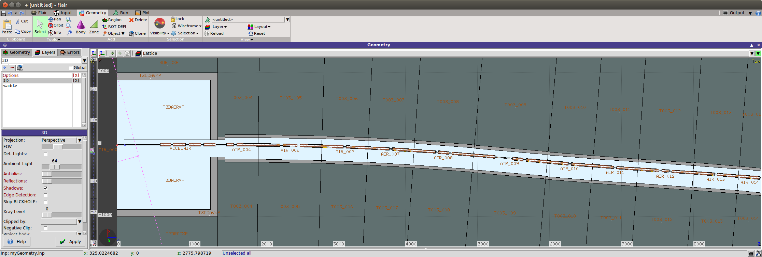
Building the FLUKA Geometry (II)
View of the MC FLUKA geometry from top;
Very essential geometry at the detector location and in the region of the magnets immediately next to it;
To be developed, following geometry used by N. Mokhov;
Created the muoncollider_mdi_flukageo group on gitlab.cern.ch, collecting the git repos of the FEDB and geometry for MDI studies (+config files);

Slide 9
Building the FLUKA Geometry (III)
A very basic FEDB (for the time being):
Only dipoles and quadrupoles;
To be enriched with missing elements (e.g. sextupoles);
All quads / dipoles have same cross section, and lengths as per each family;
Is this true? From comments in the MAD-8 input files this seems not to be the case…
Dimensions / shapes based on my personal experience on LHC studies;
Are these adequate for the MC MDI studies?
Using materials pre-defined in FLUKA (i.e. no SC coils, SS collars / beam pipe, etc…);
We should check that this is acceptable for our studies…

Slide 10
Building the FLUKA Geometry (IV)
3D view of the MC FLUKA geometry experimental cavern towards machine tunnel;

Slide 11
Conclusions
The necessary set-up to create FLUKA geometries of the MC ring with LB and FEDB based on MAD-8 output files is now available;
Tried to have something usable ASAP;
Git repos on gitlab.cern.ch, such that work can progress in parallel;
For the time being:
Used MAD-8 output files describing half-ring;
Largest geometry possible, to verify that set up is solid;
For the actual simulations, only some hundreds of meters around the detector will be needed;
Created (not so) dummy geometries of SC magnets;

Slide 12
Outlook (for discussion)
Detailed verification of machine geometry:
Add missing models of SC magnets – mainly sextupoles (A. Mereghetti, F. Collamati, C. Curatolo);
Verify that the design closed orbit and linear optics is reproduced with acceptable accuracy (A. Mereghetti);
Check that models of SC magnets are actually representative of what was used by N. Mokhov et al. (F. Collamati, C. Curatolo);
SC material, dimensions, opening, etc…
Improve geometry of experimental cavern: nozzle, tunnel around final focusing, etc… (F. Collamati, C. Curatolo);
Collect relevant physics cards (F. Collamati, C. Curatolo, A. Mereghetti, P. Sala) and set up suitable scoring;
Run!

