Slide 1
Belle II Detector
Sep. 28, 2010
Yutaka USHIRODA (KEK)
for the Belle II Collaboration

Slide 2
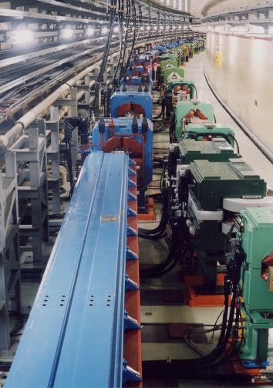
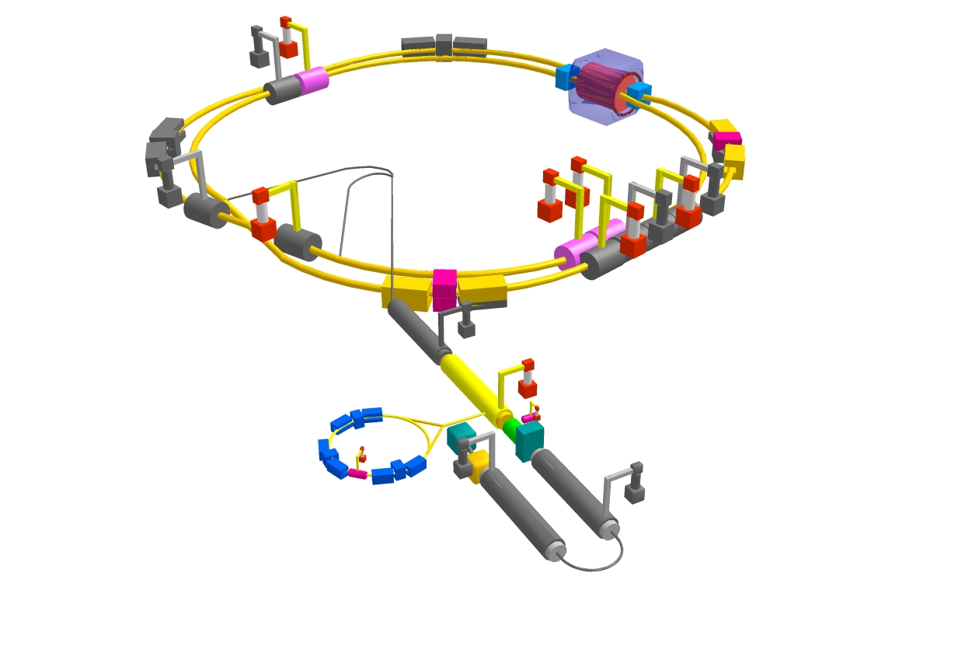
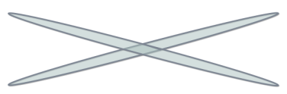
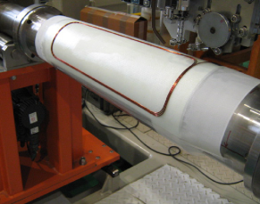
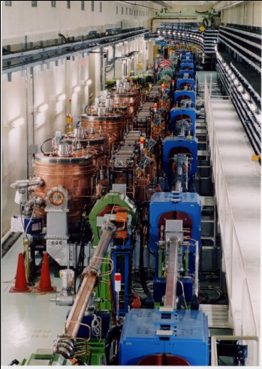


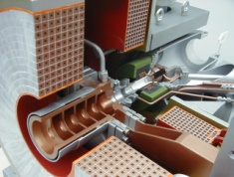
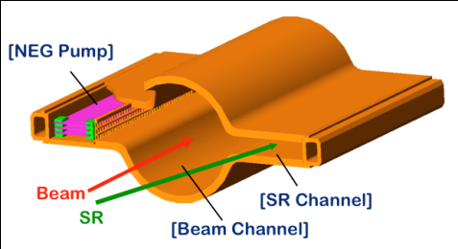
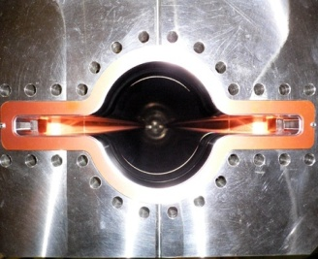

SuperKEKB collider
M. Tobiyama’s talk on Oct. 1
e⁺ 4GeV 3.6 A
Colliding bunches
Belle II
New IR
e⁻ 7GeV 2.6 A
New superconducting /permanent final focusing quads near the IP
New beam pipe
& bellows
SuperKEKB
Replace short dipoles with longer ones (LER)
Add / modify RF systems for higher beam current
Low emittance positrons to inject
Positron source
Redesign the lattices of HER & LER to squeeze the emittance
Damping ring
New positron target / capture section
TiN-coated beam pipe with antechambers
Low emittance gun
Low emittance electrons to inject
Target: L = 8x10³⁵/cm²/s

Slide 3

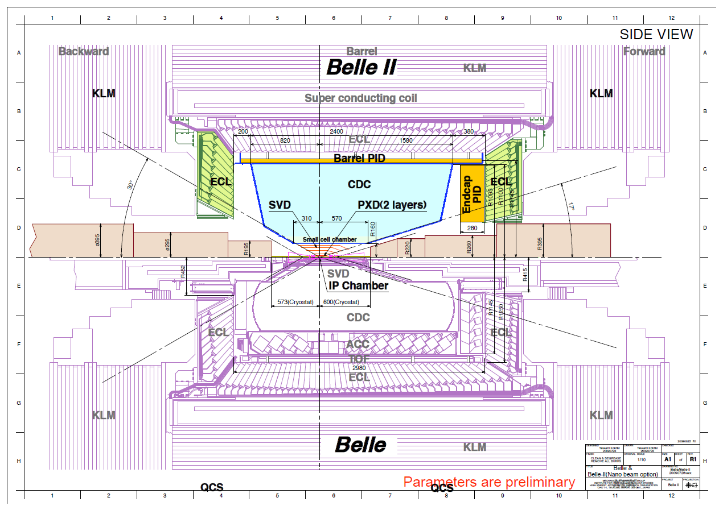
Belle II Detector (in comparison with Belle)
SVD: 4 DSSD lyrs g 2 DEPFET lyrs + 4 DSSD lyrs
CDC: small cell, long lever arm
ACC+TOF g TOP+A-RICH
ECL: waveform sampling (+pure CsI for end-caps)
KLM: RPC g Scintillator +MPPC(end-caps)

Slide 4
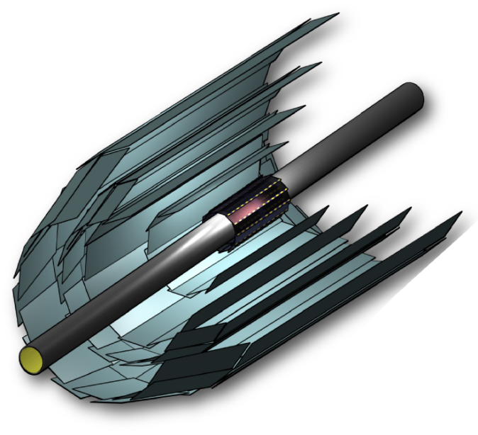
Vertex Detector
Belle II Belle
Beam Pipe r = 10mm 15mm
DEPFET
Layer 1 r = 14mm
Layer 2 r = 22mm
DSSD
Layer 3 r = 38mm 20mm
Layer 4 r = 80mm 43.5mm
Layer 5 r = 115mm 70mm
Layer 6 r = 140mm 88mm

Slide 5
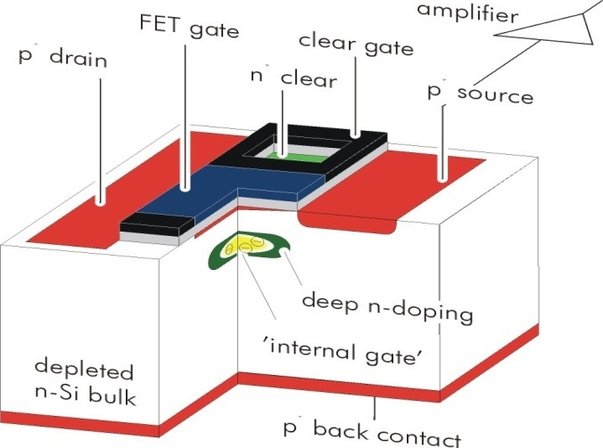


DEPFET
DEPFET:
http://aldebaran.hll.mpg.de/twiki/bin/view/DEPFET/WebHome
Each pixel is a p-channel FET on a completely depleted bulk
A deep n-implant creates a potential minimum for electrons under the gate (“internal gate”)
Signal electrons accumulate in the internal gate and modulate the transistor current (g_{q} ~ 400 pA/e⁻)
Accumulated charge can be removed by a clear contact (“reset”)
Fully depleted: => large signal, fast signal collection
Low capacitance, internal amplification: => low noise
High S/N even for thin sensors (50µm)
Rolling shutter mode (column parallel) for matrix operation => 20 µs frame readout time
=> Low power (only few lines powered)

Slide 6
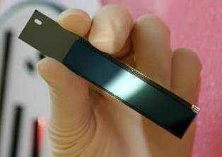
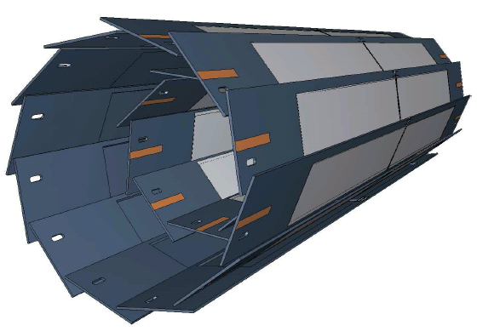
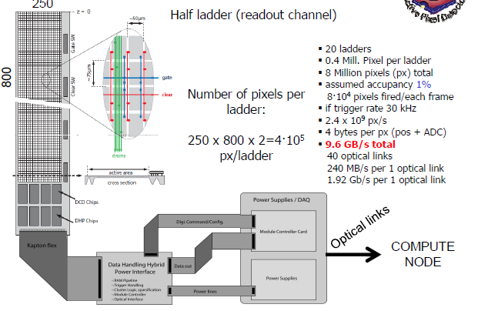
DEPFET for Belle II
radius pixel thickness
Layer 1 r = 14mm 50x50μm² 75μm(0.18%X0)
Layer 2 r = 22mm 50x75μm² 75μm
total of 8 Mpx
Mechanical mockup
Power consumption in sensitive area: 0.1W/cm² => air-cooling sufficient

Slide 7
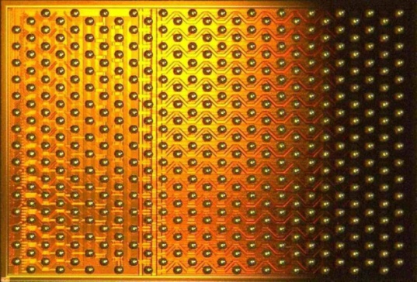
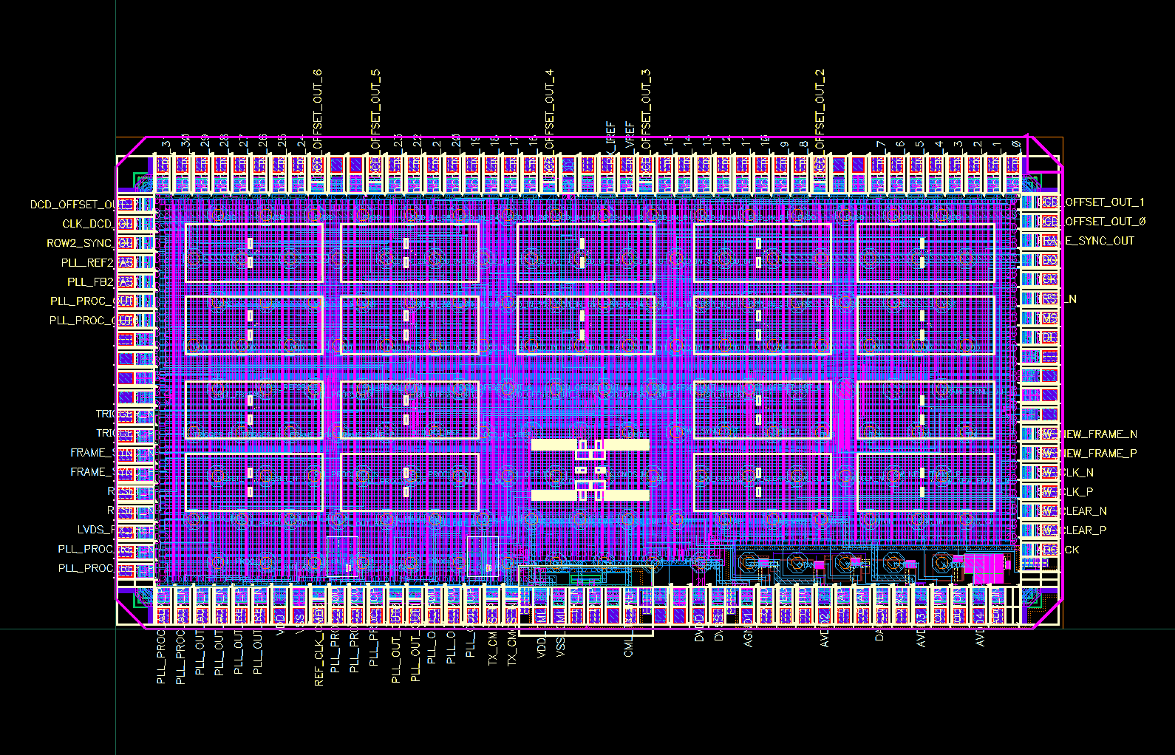
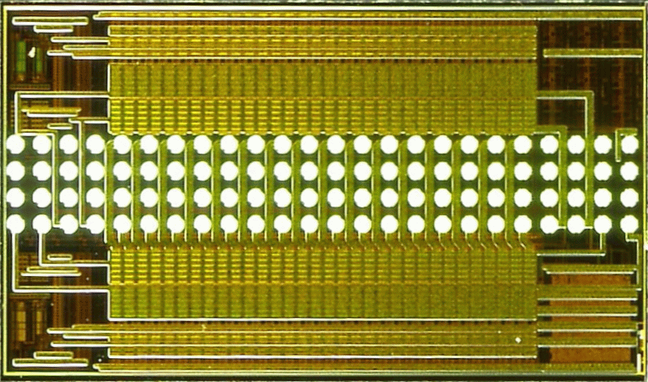
ASICs for control and readout
ACTIVE AREA
Switcher
Control of gate and clear
32 x 2 channels
Switches up to 30V
AMS 0.35 µm HV technology
Tested up to 36 Mrad
DCDB
Amplification and digitization of DEPFET signals
256 input channels
8-bit ADC per channel
92 ns sampling time
UMC 189nm
Rad hard design
DHP
Signal processor
Common mode correction
Pedestal subtraction
0-supression
Timing and trigger control
IBM 90 nm
Rad hard design
½ size (32 channel) test chip
All three chips fabricated and successfully tested

Slide 8
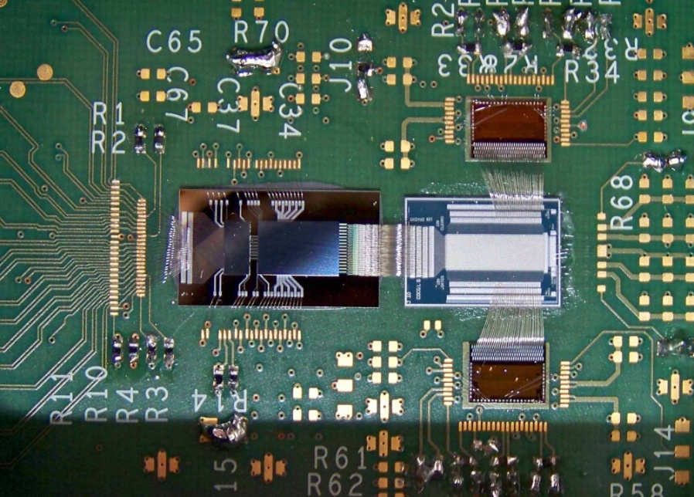
Test System
DCDB readout chip,
Bump bonded on interface board
PXD5 DEPFET matrix
Switcher control chip
New switcher and DCD is tested with a DEPFET PXD5 matrix
So far the system reaches 120ns sampling time with 40nA (~ 100 electrons) noise
Some fine tuning needed to reach full speed (<100ns) (tests started 2 weeks ago)
Side remark: flipping and bump bonding of DCDB in adapter board worked without problems

Slide 9
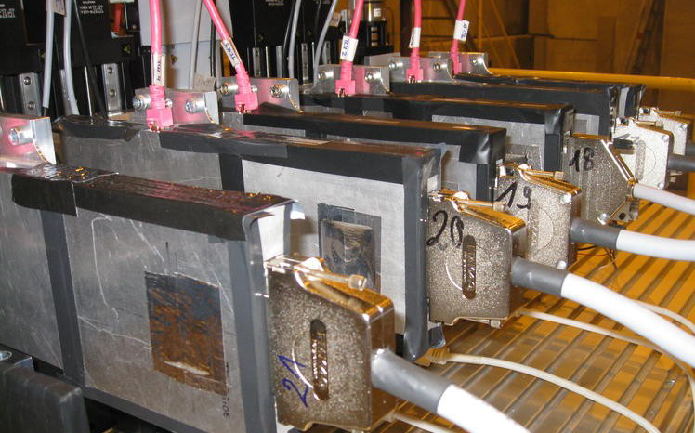
Test Beam in 2009 (ILC version)
Array of 6 DEPFET modules
TB 2009
120GeV π
(Not a typical) event display

Slide 10
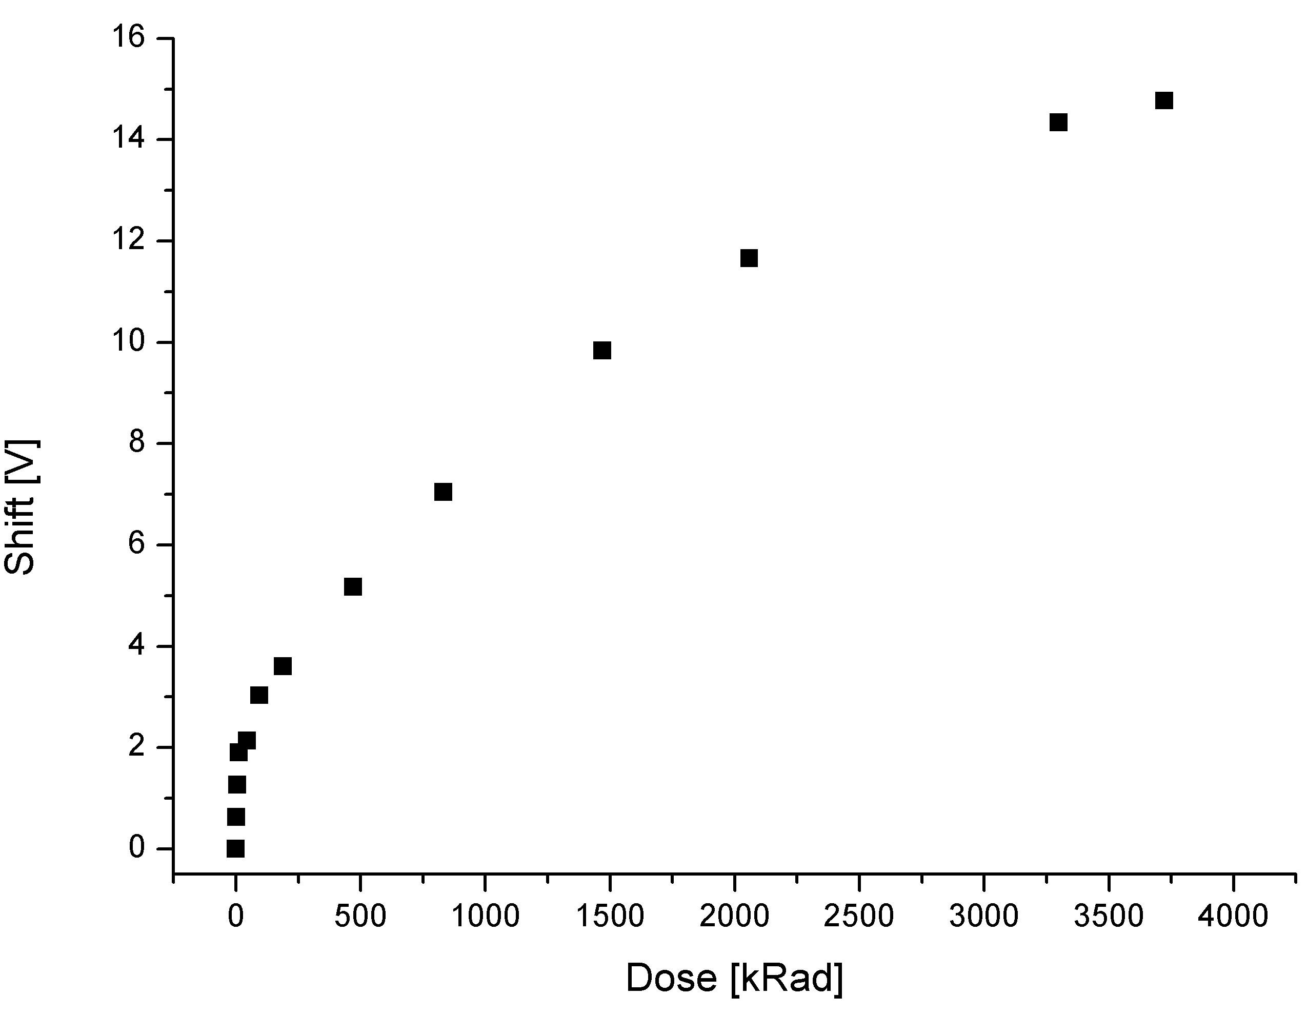
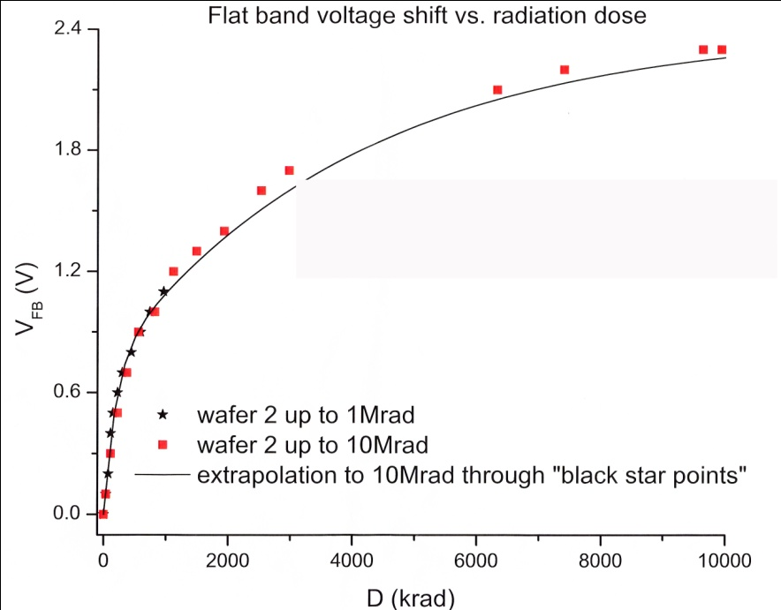
Radiation Damage
DEPFET based on a MOS structure
problem with ionising radiation:
Creation of fixed (positive) charges in the oxide layer and at the interface
Attracts electrons at the Si/SiO₂ interface
Need more negative gate voltages to compensate
=> Shift of transistor threshold
Gate oxide
Solution: thin oxides
< 2.5V shift at 10Mrad
For standard DEPFETs the thereshold voltage shifts reach 14 V after 4 Mrad
Too large for safe operation!

Slide 11
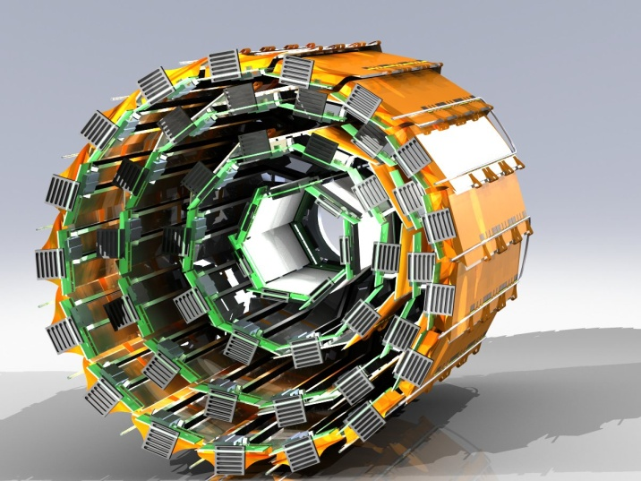
SVD
HPK resumed DSSD production with 6’’ wafers
Two types of rectangular sensors and
Trapezoidal sensors for slanted part (still under discussion)

Slide 12
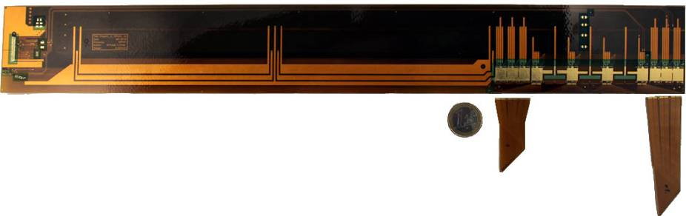
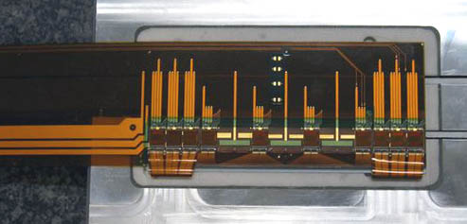
Flex PCBs and APV25
Origami PCB
Origami PCB
  3-layer design
  237µm thick (nominal)
PA0, PA1 and PA2
  2-layer design
  145µm thick (nominal)
PA0
glued onto hybrid
PA1
PA2
Thinned APV25
(300μmg~100μm)
~0.55%X₀/layer

Slide 13
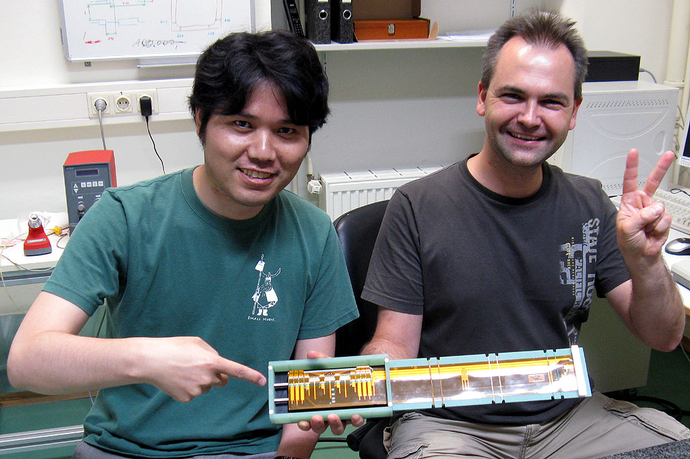
First prototype ladder
A prototype ladder using the first 6 inch DSSD from HPK has been assembled and tested.

Slide 14
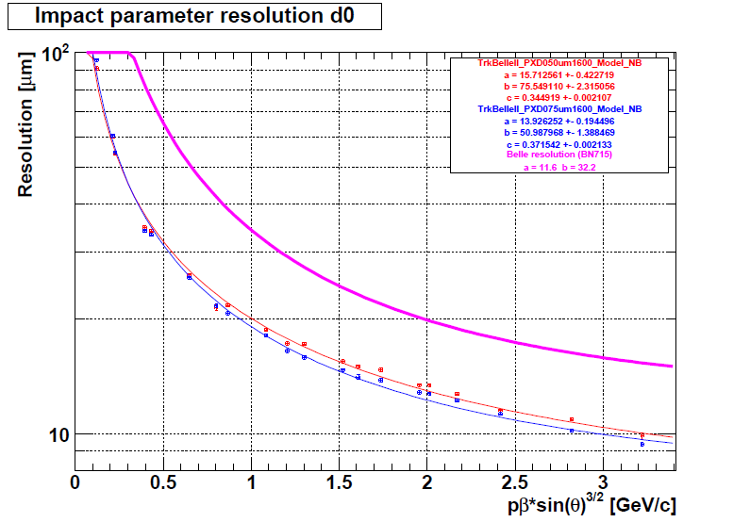
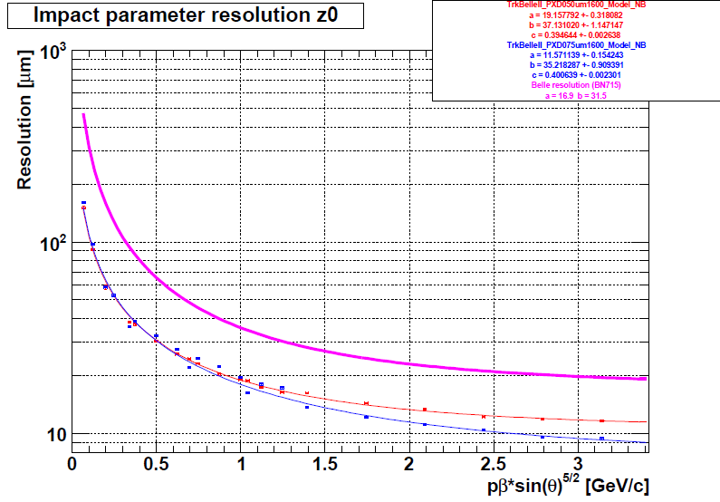
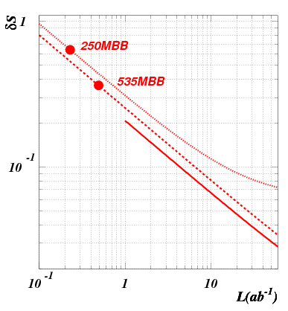
Expected performance
Significant improvement in IP resolution!
Pixel detector close
to the beam pipe
Less Coulomb
scatterings
σ[μm]
Belle
σ[μm]
Belle II’
Belle II
20μm
10μm
0
1.0
2.0
0
1.0
2.0
pβsin(θ)^{3/2} [GeV/c]
pβsin(θ)^{5/2} [GeV/c]
Significant improvement in δS(K_{S}π⁰γ)
γ
Ks track
π⁺ π⁻
γ
B vertex
IP profile
γ
Larger radial coverage of SVD
B decay point reconstruction
with K_{S} trajectory

Slide 15

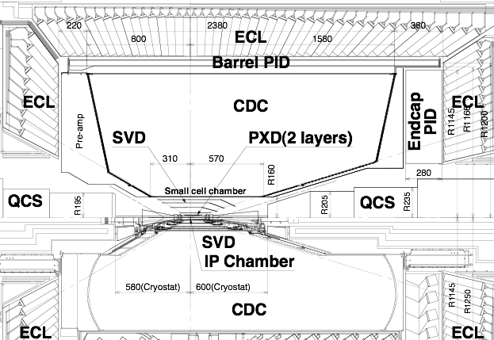

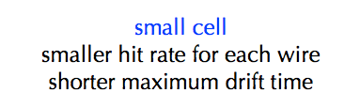
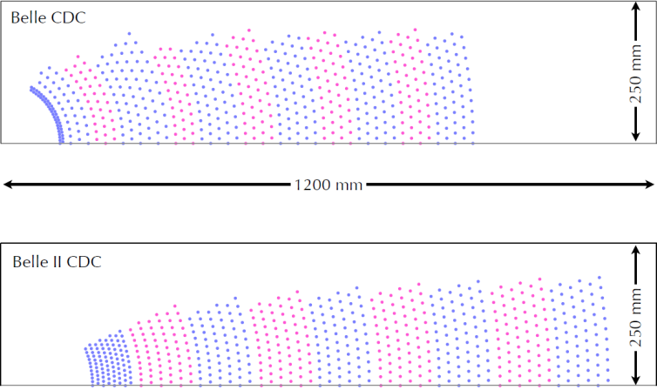
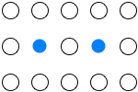

Central Drift Chamber
longer lever arm
improve resolution of momentum and dE/dx
Belle
 | Belle | Belle II
inner most sense wire | r=88mm | r=168mm
outer most sense wire | r=863mm | r=1111.4mm
Number of layers | 50 | 56
Total sense wires | 8400 | 14336
Gas | He:C2H6 | He:C2H6
sense wire | W(Φ30μm) | W(Φ30μm)
field wire | Al(Φ120μm) | Al(Φ120μm)
Belle II
small cell
normal cell
10 mm
18 mm
6~8 mm
10~20 mm

Slide 16
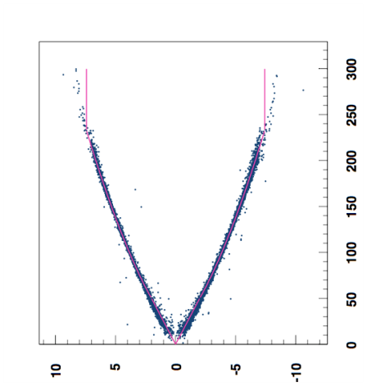
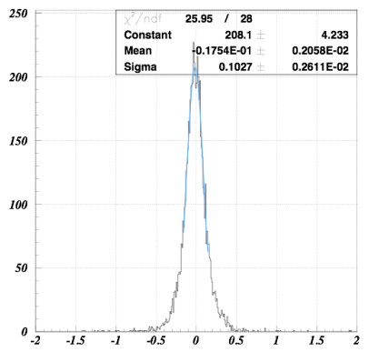
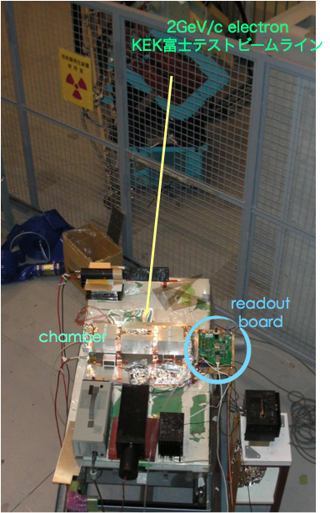


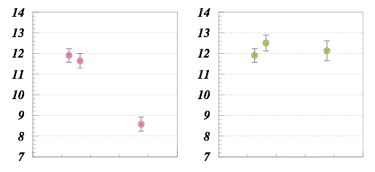
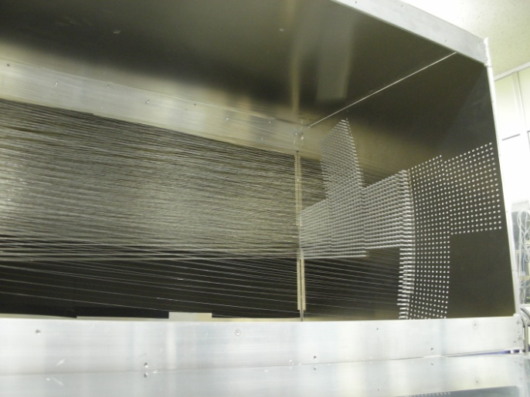
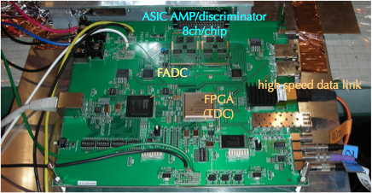
Test Chambers
X-t relation (B=0T)
Residual distribution
Drift time [nsec]
position resolution
σ ~ 100μm
distance from sense wire [mm]
[mm]
dE/dx resolution
12% with “9” layers
5% with 56 layers
90 60 30 [degree]
90 60 30 [degree]
incident angle
Readout board (prototype)
5 layer test chamber
Full-length (540x570x2200) test chamber has also been made

Slide 17
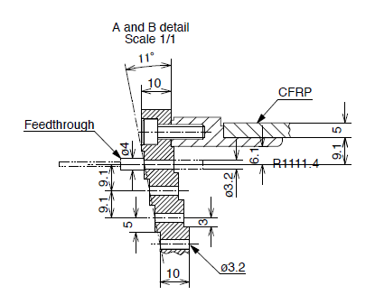
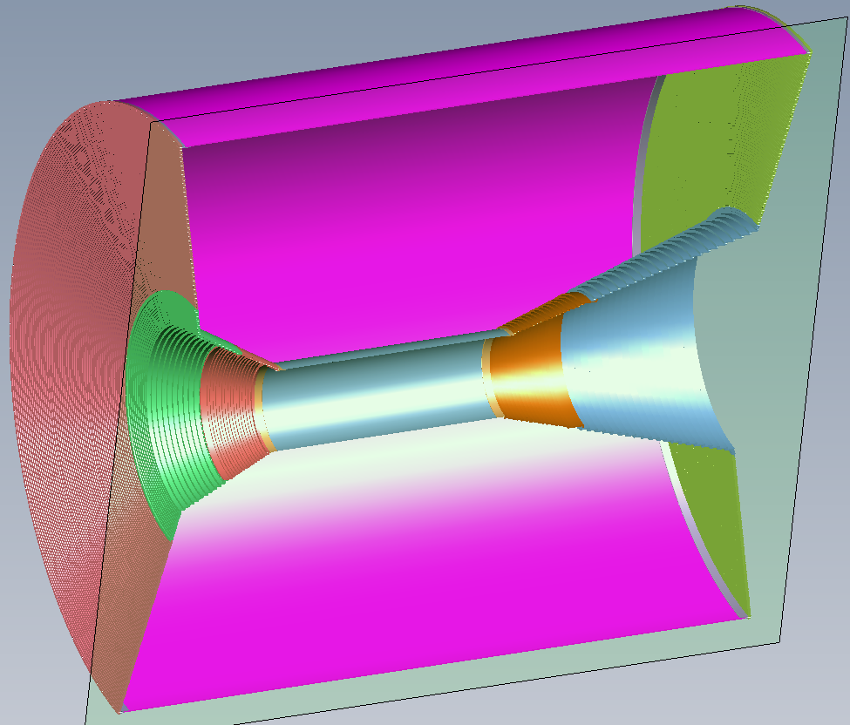
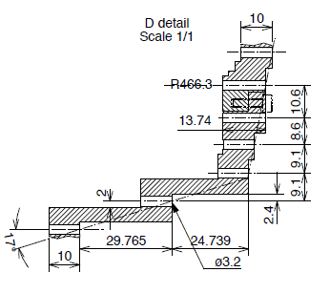
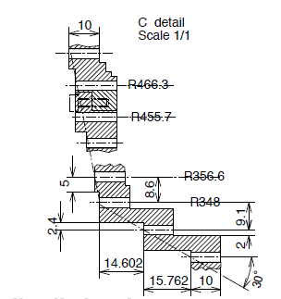
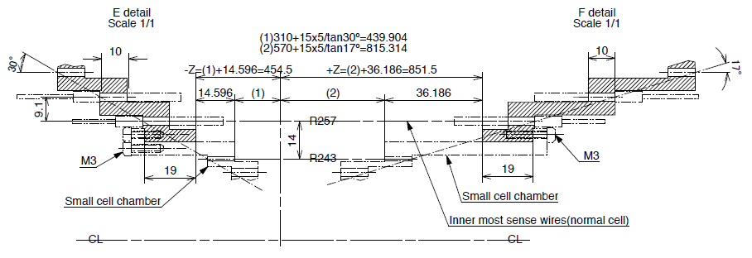
Design of end plates
being finalized.
To be purchased in this FY.

Slide 18

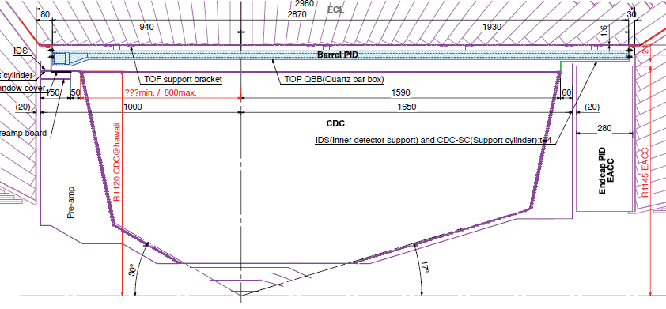
Particle Identification Devices
Endcap PID: Aerogel RICH (ARICH)
200mm
Barrel PID: Time of Propagation Counter (TOP)
Cherenkov photon
Quartz radiator
Aerogel radiator
Focusing mirror
Small expansion block
Hamamatsu MCP-PMT (measure t, x and y)
n~1.05
Hamamatsu HAPD
+ new ASIC
Aerogel radiator
Hamamatsu HAPD + readout
200

Slide 19
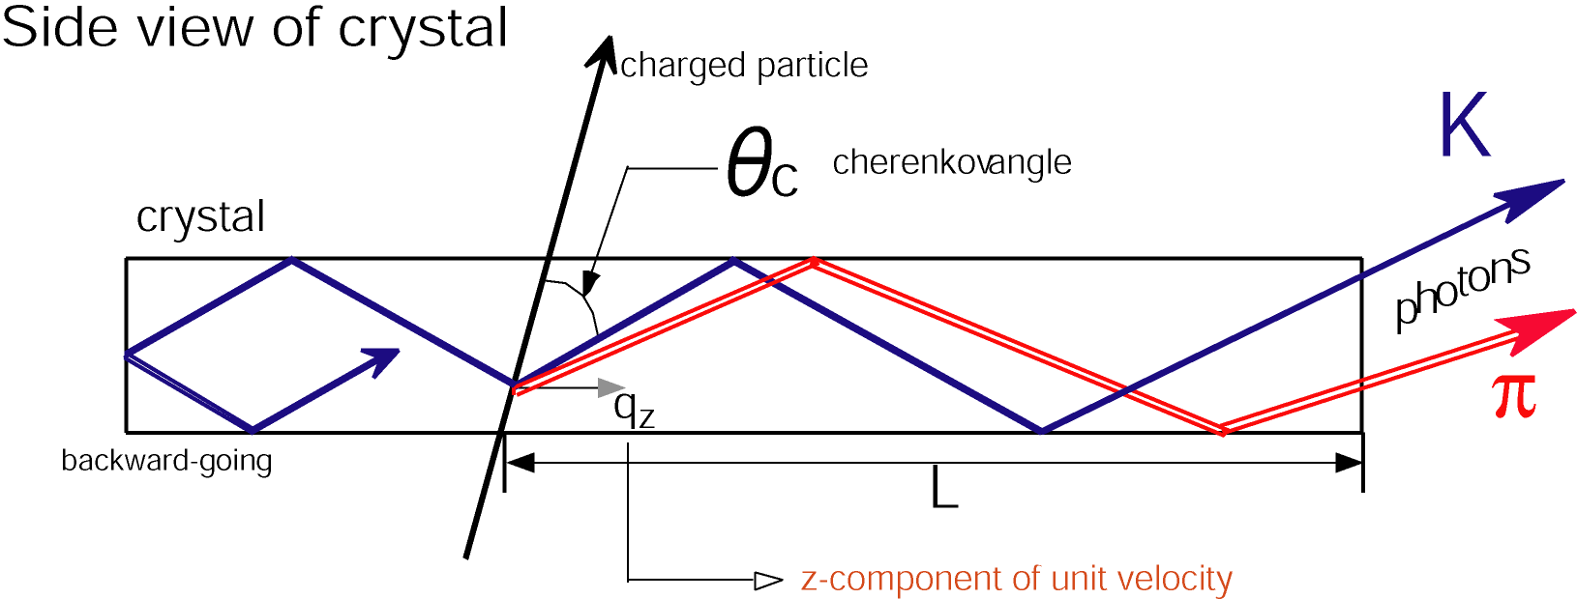
Time of Propagation Counter (TOP)
Quartz radiator
  2.6m^{L} x 45cm^{W} x 2cm^{T}
  Excellent surface accuracy
MCP-PMT
  Hamamatsu 16ch MCP-PMT
    Good TTS (<35ps) & enough lifetime
    Multialkali photo-cathode → SBA
Barrel PID: Time of Propagation Counter (TOP)
Quartz radiator
Focusing mirror
Small expansion block
Hamamatsu MCP-PMT (measure t, x and y)
TOP
MCP-PMT
～1.2m
TOF

Slide 20
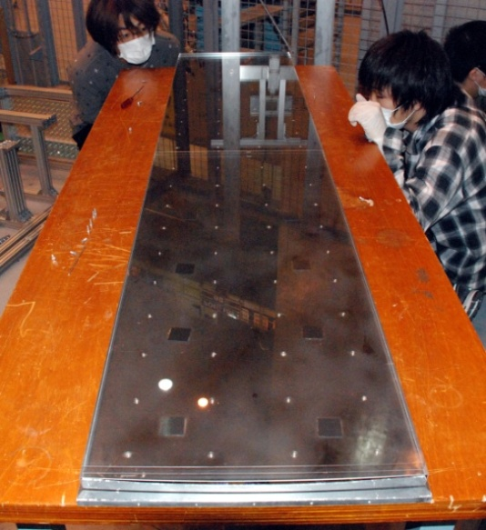
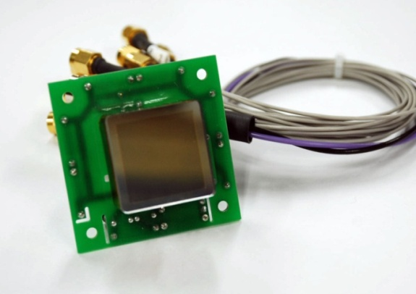
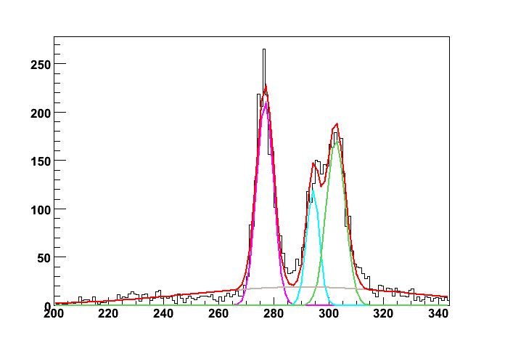
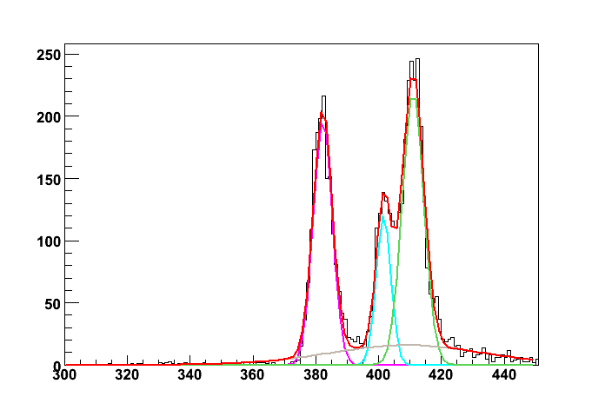
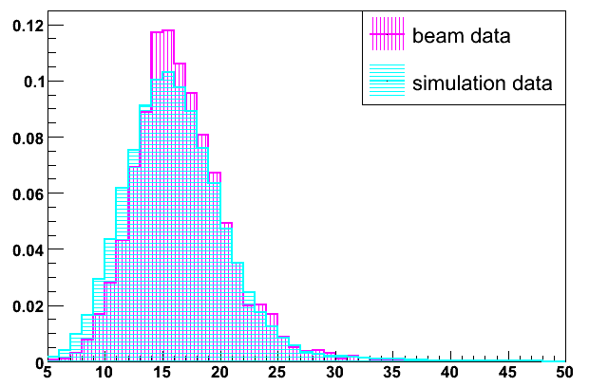
TOP (Barrel PID)
quartz
Beam spot
Beam test done in 2009
  # of photons consistent
  Time resolution OK
915mm
3rd
2nd
875mm
1st
Quartz Radiator
Hamamatsu MCP-PMT
Time resolution
beam data
1st
Simulations
1st
3rd
3rd
2nd
2nd
# of photons
[1count/25ps]
[1count/25ps]

Slide 21

End-cap Particle Identification
Ring imaging Cherenkov counter based on silica aerogel radiator
  Space limited -> proximity focusing with expansion distance of 20 cm
  Requirements
    Transparent silica aerogel
    Photo-detector
      Single-photon sensitivity
      Pixel 5x5mm²
      Operational in 1.5T
      Compact
    Readout electronics
      ~70K channels
２０ｃｍ
n=1.05 aerogel
|σ_{c}(π)-σ_{c}(K)| = 23 mrad at P=4GeV/c
Target: More than 4 σ π/K separation at 4 GeV/c

Slide 22






Novel “focusing” radiator
Possible only with aerogel !
Simple accumulation of radiator layer gives more photons, but degrades PID performance
➔ Multiple aerogel layers with different indices
4cm-thick single index aerogel
σ_{θ}(1p.e.) = 22 mrad
Npe ~ 10.6
σ_{θ}(track) = 6.9 mrad
Focusing by 2cm+2cm aerogel (n1:1.047, n2:1.057)
n1
n2
σ_{θ}(1p.e.) = 14.4 mrad
Npe ~ 9.6
σ_{θ}(track) = 4.8 mrad
NIM A548(2005)383

Slide 23



Test beam result
Test Beam setup
Aerogel
Clear Cherenkov image observed
Cherenkov angle distribution
Hamamatsu HAPD
Q.E. ~33% (recent good ones)
Single photon angle resolution σ₀ = 13.5mrad
# of photoelectrons Npe = 15.3
6.6 σ π/K at 4GeV/c !

Slide 24

Expected Performance (Luminosity gain)
No upgrade
BAD
Upgrade
GOOD
No upgrade
BAD
Upgrade
GOOD
B⁰gρ⁰γ
FWD BRL | ACC only | dE/dx only | As good as Belle | A-RICH
TOF, dE/dx NA | –74% | –69% | –68% | –62%
TOF NA | –41% | –35% | –32% | –22%
As good as Belle | –10% | –4% | 0% (definition) | +12%
TOP opt.0 | +27% | +33% | +40% | +59%
TOP opt.2 | +45% | +51% | +60% | +83%
Completely different world with excellent PID detectors!

Slide 25

Electromagnetic Calorimeter (ECL)
For Day 1
Upgrade electronics to do waveform sampling & fitting
Upgrade crystals for end caps (pure CsI + photomultiplier as the baseline)

Slide 26





New shaper/readout boards
Basically ready for mass production
(minor revisions because we still have time.)
One of old versions has been installed in Belle to readout part of the end cap in 2008. Tested OK.

Slide 27

KLM: K_{L}&Muon detector (RPC g Scintillator)
GENERAL LAYOUT
One layer: 75 strips (4 cm width)/sector
5 segments
1 segment = 15strips
Two orthogonal layer = superlayer
F&B endcap KLM:
  Total area ~1400 m²
  16800 strips
  the longest strip 2.8 m; the shortest 0.6 m
WLS fiber in each strip
Hamamatsu MPPC at one fiber end
mirrored far fiber end

Slide 28





One strip
MPPC: Hamamatsu
1.3×1.3 mm 667 pixels
(used in T2K ND)
fiber: Kuraray Y11 MC
Scintillator bar: Vladimir (Russia)
(used in T2K ND)
part II
part I

Slide 29





Test modules adjacent to Belle (2008)
Muon tag

Slide 30
Construction Schedule of SuperKEKB/Belle II
Jun. 24, 2010
FY2009
FY2010
FY2011
FY2012
FY2013
FY2014
Linac
e+ new matching & L-band acc.
R&D
Construction
RF-gun & laser system
A1 gallery
extension
e+ beam commissioning
Design study
move to A1
Commissioning at test stand
e- beam commissioning
Damping Ring
Facilities
Tunnel construction
DR commissioning
Components
Building construction
R&D, Design
Mass Fabrication
Installation
Main Ring
Facilities
Building construction
Components
R&D, Design
MR commissioning
Mass Fabrication
Installation
BEAST II
Belle II Detector
Ad-hoc detector for MR commissioning
R&D
Mass Production
Construction
Belle roll-out in Dec. 2010
Installation (KLM)
Installation (E-cap)
Ready to Roll-in
Installation (Barrel)
Cosmic Ray Test

Slide 31

Belle on Sep. 22, 2010

Slide 32
Conclusion
Belle II detector R&D went well.
Ready for mass production for most of parts.
A few technical decisions to be made (within this year).
  SVD slant part
  Barrel KLM
Next collaboration meeting: Nov. 17-20 @KEK, still open to everyone.
  http://belle2.kek.jp/B2GM/7th/index.html

Slide 33
back-up

Slide 34



The last beam abort of KEKB on June 30, 2010
First physics run on June 2, 1999
Last physics run on June 30, 2010
L_{peak} = 2.1x10³⁴/cm²/s
L > 1ab⁻¹

Slide 35

Belle II Collaboration http://belle2.kek.jp
PNNL
13 countries/regions, 53+1 institutes

Slide 37

DEPFET Performance
Fe⁵⁵: 1.6 e- rms noise, Room temperature !
10 μs shaping time
Low noise: x-ray spectroscopy and imaging
High speed -> noise ~ τ^{-1/2}
At 50MHz: ENC < 40e (for 50ns readout )
For tracking: even thinned (but fully depleted) detectors have excellent S/N
S/N > 200 measured for d=450 μm
S/N ~ 40 achievable for d=50 μm
Position resolution < 2 μm in beam tests

Slide 38


Sensor Thinning
?
Need thin (50µm-75µm) self supporting all silicon module
Process backside
e.g. structured implant
Wafer bonding
SOI process
Thinning of top wafer (CMP)
Processing
etching of handle wafer (structured)
diodes and large mechanical samples
Belle II module

Slide 39





Interconnection ASIC- DEPFET
:Bump Bonding
DCD (UMC 180nm) and DHP (IBM 90 nm) delivered with bumps from manufacturer
MPW delivered with bumps (SnAgCu, pitch 180µm)
Switcher: no bumping offered by AMS for MPW => in house (Heidelberg)
DCD with solder bumps
Solder jetter bumps
Copper UBM on sensor wafer
DEPFET: copper deposition needed as UBM for bumping
Test depositions done at CNM, Barcelona showed no deterioration of the Si test structures
Notes:
MPW: Multi Project Wafer
UBM: Under Bump Metarization

Slide 40


PXD6 Prototype Production
Sensor Production has started at MPI semiconductor lab (to be finished 2010)
SOI material: 50 µm sensor wafer (production started before 75µm was decided)
6 wafers (+ 2 monitor wafers on standard material)
Small test sensors to sample different pixel sizes from 50 µm to 200 µm
Full size sensors for prototyping
Technology variations (plasma etching)
Design variations (short gate, improve g_{q}, clear behaviour, charge collection uniformity)
Complex process:
9 implantations
19 Lithographies
2 Poly-layers
2 Alu-layers
Many QC/QA measures:
inspections
processing of dummies
Together: 89 steps (1-5 WD each)
19 months processing time (16 after SOI preprocessing)
today
Front side processing finished (DEPFET functional)
Only back etching of SOI handle wafer remains
First tests on wafer prober: devices work, yield acceptable
Layout of PXD6 wafer:
the 4 large structures in the center are full size Belle II modules

Slide 41




Support
1) Beam pipe with PXD support (sliver)
2) End flanges for module mounting and cooling
3) Inner layer modules
4) Outer layer modules

Slide 42



End Flange - Cooling Block
End flange sitting on
beam pipe
½ of the end flange
Blue: integrated capillaries for
2 phase CO2 cooling
Yellow: channels for air cooling
Prototype of end flange made in stainless steel using DMLS
(direct metal laser sintering)
To be used for pressure and cooling
tests

Slide 43

Configuration study
Two options
  1-bar/2-bar configurations
    Use the similar detector components and technologies.
      Same quartz radiator size, same MCP-PMT, same mirror shape
  By simulation studies and prototype operations, we have confirmed the robustness against the timing jitter, tracking resolution, production readiness etc.

Slide 44


Performance
1-bar
2-bar
Incident angle fluctuation (1mrad)
Timing fluctuation (25ps)
Performance similar (weighted) for physics case studies
3% fake~4σ

Slide 45
Configuration choice
2-bar configuration shows slightly better performance than 1-bar configuration.
1-bar configuration shows stable performance as a function of increased timing jitter. 2-bar need precise, continual timing calibration during experiment operation. (Naively, the 2-bar configuration consists of two different detectors, one is largely imaging, the other is timing detector.)
1-bar case has larger forward acceptance and requires readout only in the backward direction. (forward cable routing is very crowded)
We chose the 1-bar configuration as baseline, with 2-bar as a backup option, due to these practical considerations.

Slide 46
Multi-anode MCP-PMT
Size | 27.5 x 27.5 x 14.8 mm
Effective area | 22 x 22 mm(64%)
Photo cathode | Multi-alkali
Q.E. | ~20%(λ=400nm)
MCP Channel diameter | 10 μm
Number of MCP stage | 2
Correction efficiency | ~60%
Anode | 4 x 4
Anode size (1ch) | 5.3 x 5.3 mm
Anode gaps | 0.3 mm
R&D with Hamamatsu photonics
High time resolution σ<40ps
Large effective area 64% by square shape
Position information 4ch linear anode (5mm pitch)
Sufficient lifetime >1C/cm²

Slide 47



MCP-PMT performance
Basic performance of new version
  Before aging
TTS

Slide 48

MCP-PMT lifetime
QE variation
  10% drop at ~2C/cm² ; sufficient lifetime!
New type
Old type
0
1
10
Belle-II year
48

Slide 49




Hybrid Avalanche Photo-Detector (HAPD)
Developed with Hamamatsu Photonics
Single photon pulse height
Bi-alkali Photocathode
pedestal
-7~-8kV
1 p.e.
Pixelated APD
Gain ~10⁵
S/N ~17
2 p.e.
Recent improvement in QE: peak 25% → 33%
using “Super Bi-alkali” technique

Slide 50



Neutron Radiation Damage
APD damaged due to neutron flux
  Large noise and S/N degraded in single photon detection
  Estimated 10¹² neutrons/cm² for 10-year Belle II operation
HAPD irradiated using fast neutrons from a reactor
1 μsec peaking time
100 nsec peaking time
HV=-7kV
HV=-7kV
100 nsec peaking time
S/N~3
HV=-8kV
single p.e.
S/N~6
After 5x10^11 exposure
Optimization of readout electronics can improve S/N
Further studies are going on
S/N~7

Slide 51



Simulation Study
Final detector geometry is being studied using G4 simulation
Radiator plan
Photodetector plan
Aerogel radiator tile shape and HAPD tiling scheme are being optimized
Detector configuration will be finalized by the end of this year

Slide 52


Calorimeter problems for high luminosity
Radiation damage of the components
Fake clusters
Pileup noise
To make shorter shaping time of the electronics
Replace CsI(Tl) to faster scintilator

Slide 53
Calorimeter upgrade

Slide 54




Electronics modification
Shorter shaping time and numerical shaping allows to suppress pileup noise
Time measurement allows to suppress fake clusters rate about 7 times

Slide 55





Pure CsI + 2” Photopentrode option

Slide 56






Beam test results

Slide 57
Pure CsI and photopentrode

Slide 58

Full-size Mechanical Mockup

Slide 59

Level 1 Trigger

Slide 60

Data Acquisition

Slide 61


Belle II Computing Model
Common framework
for DAQ and offline
based on root I/O
Grid-based Distributed Computing
Raw Data Storage
and Processing
Belle II
detector
MC Production
(optional)
MC Production
and Ntuple
Production
Ntuple
Analysis

