Slide 1
Lab activities @LNF Status Report
A. Calcaterra, R. de Sangro, G. Felici,
G. Finocchiaro, P. Patteri, M. Piccolo
INFN LNF
XIV SuperB General Meeting
DCH-I parallel session
LNF, 27 September 2010

Slide 2
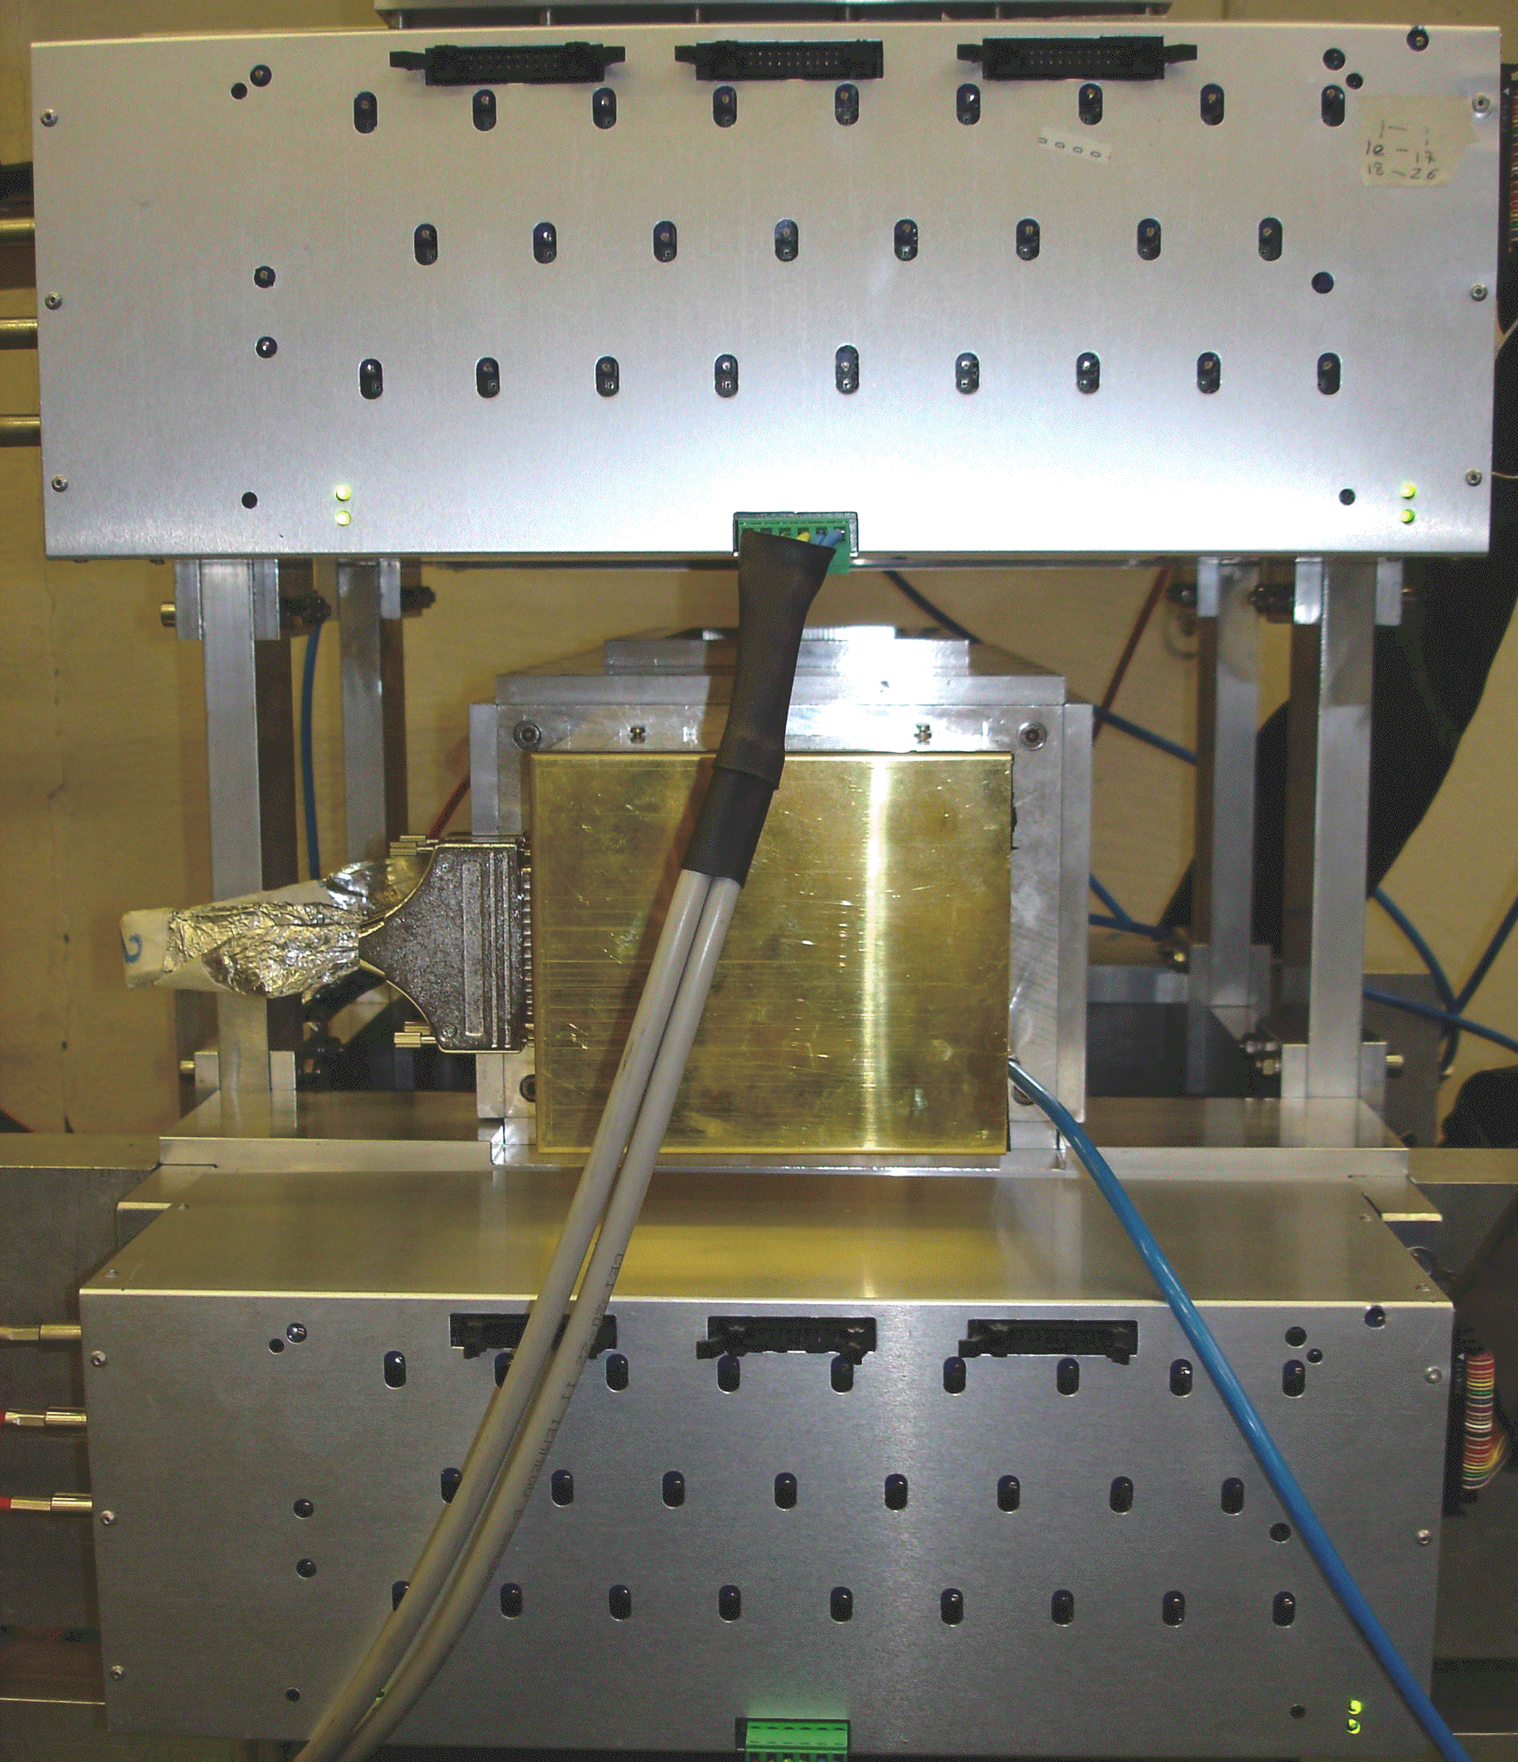
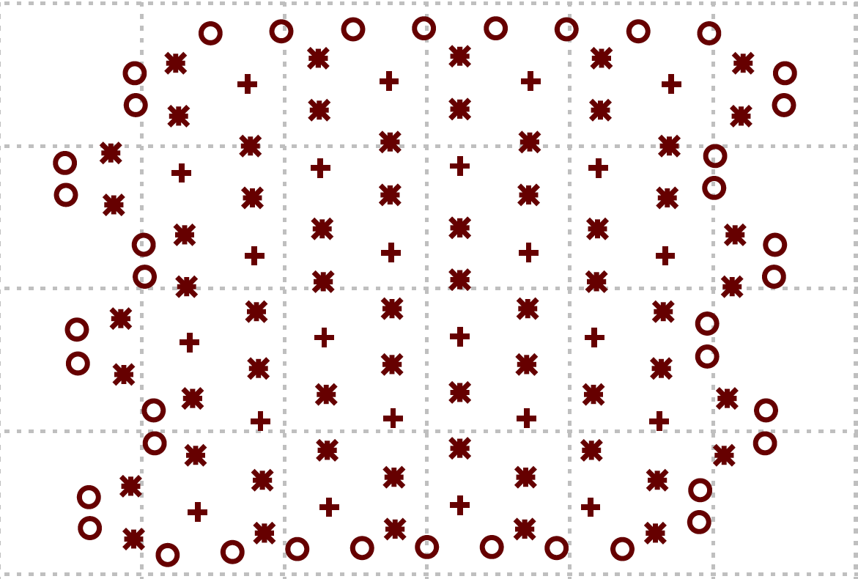
Experimental Setup
LST Telescope:
Two identical assemblies of 26 tubes each
3 cm diameter, 100 μm wires
40%-60% Ar-iC4H10 mixture
Prototype 1
6x4 hexagonal cells à la BABAR
Guard wires to ensure uniformity of electric field among cells
Aluminized mylar windows on entrance-exit faces
small gas volume
low rate on cosmics
fast gas mixture switching times

Slide 3
Tracks reconstructed in the telescope
Al-Mylar
windows
10cm lead
p_{cut}~150MeV/c

Slide 4
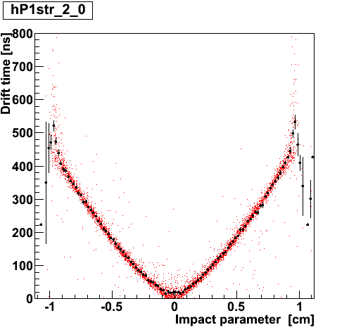
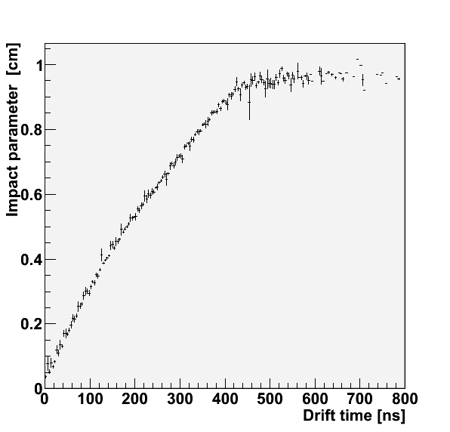
Space-time relations
Measured time vs. extrapolated impact parameter – t vs. R
Impact parameter vs. time – R vs. t
Example:
60%He-40%C₂H₆ @ HV=2010V

Slide 5
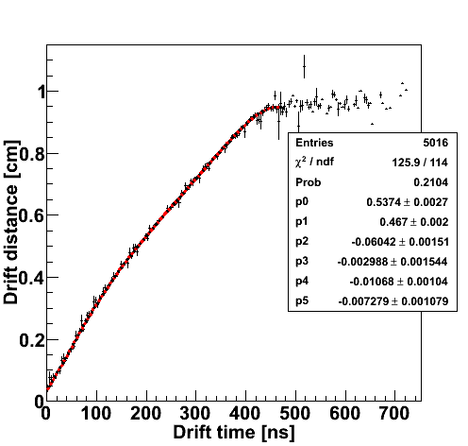
Space-time relations fits
Fit R vs. t relation using Chebyshev polynomials of order (up to) 5
Time range rescaled to [-1,+1] interval
60%He-40%C₂H₆
HV=2010V

Slide 6
Drift velocity
60%He-40%C₂H₆
HV=2010V

Slide 7
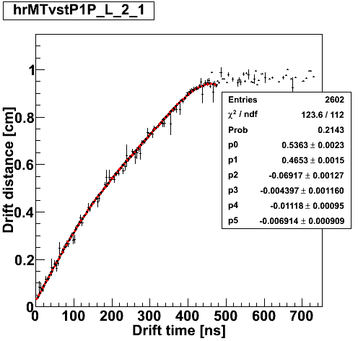
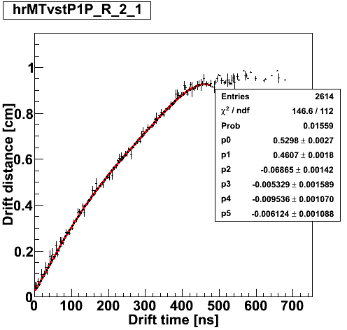
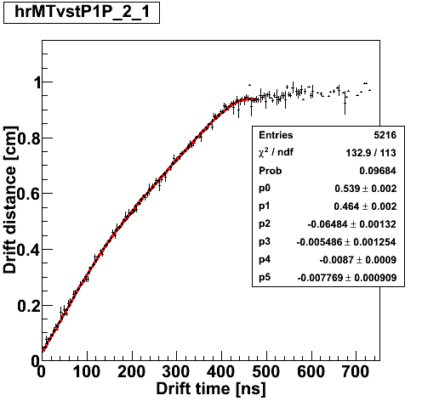
Space-time relations fits (cont.)
Internal cells tend to be left-right symmetric
Column 0 1 2 3
Row
0
1
2
3
4
5
L+R
RIGTH
LEFT
60%He-40%C₂H₆
HV=2010V

Slide 8
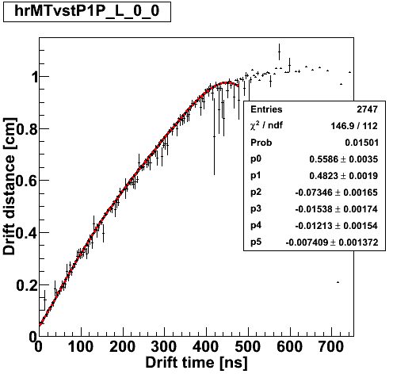
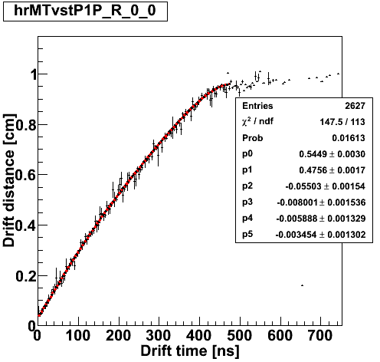
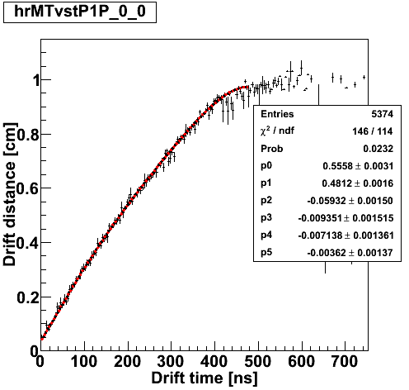
Space-time relations fits (cont.)
Border cells show some asymmetry
Column 0 1 2 3
Row
0
1
2
3
4
5
L+R
RIGTH
LEFT
60%He-40%C₂H₆
HV=2010V

Slide 9
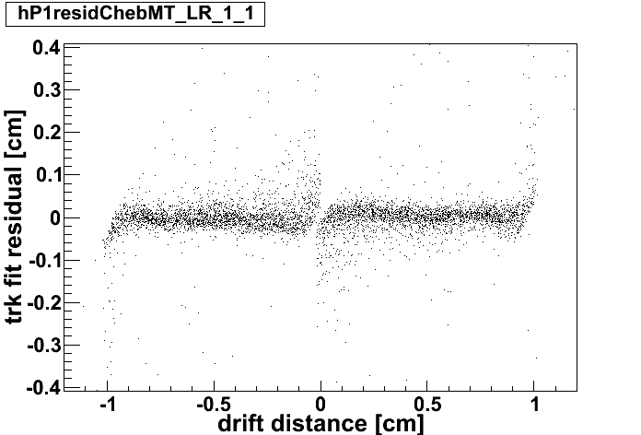
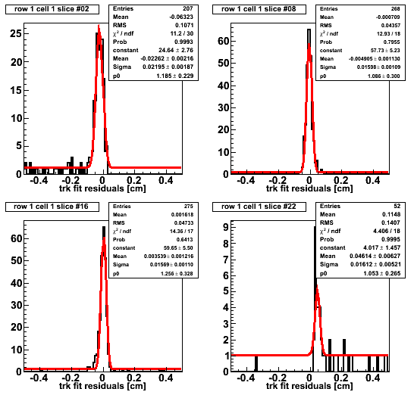
Track fit residuals
Fit X slices with Gaussian + pol0

Slide 10
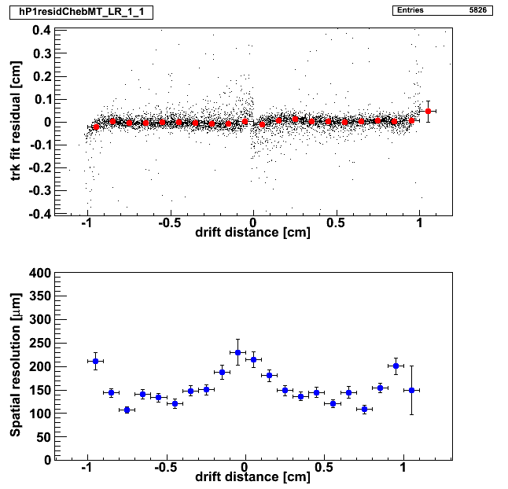
Spatial resolution – 60%He-40%C₂H₆
60%He-40%C₂H₆
HV=2010V

Slide 11
Tracks reconstructed in Proto1
BLUE line is MT track
RED line is PROTO1 track
Al-Mylar
windows
10cm lead
p_{cut}~150MeV/c

Slide 12
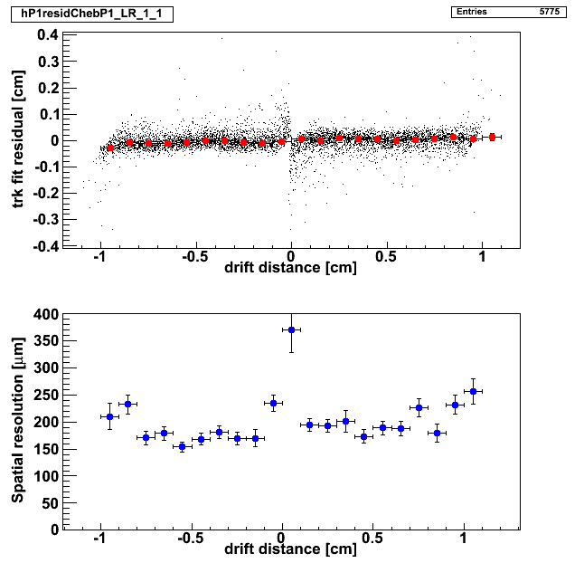
Spatial Resolution form Proto1 tracks
Studied layer excluded from track fit in prototype
Preliminary: still need to work out fine details (tails, de- convolution of track resolution… )
60%He-40%C₂H₆
HV=2010V

Slide 13
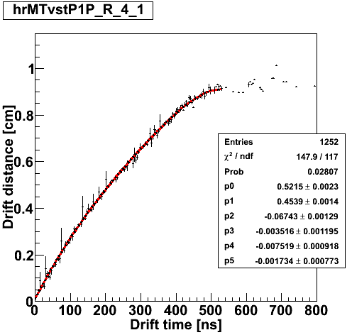
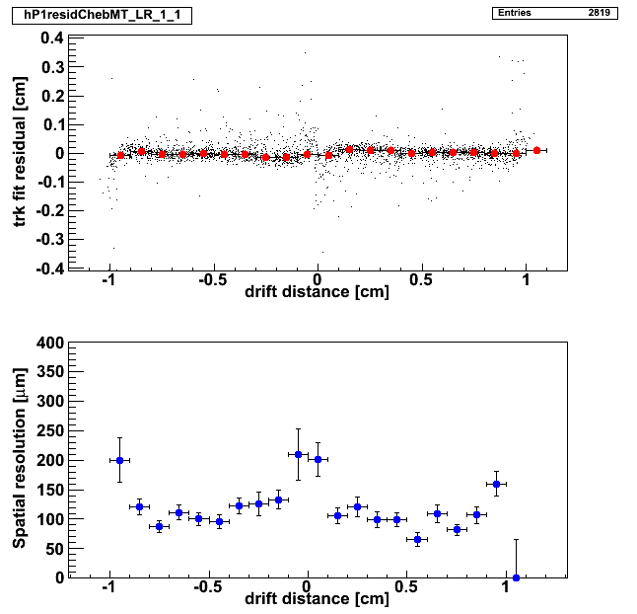
STR & Spatial resolution – 73%He-27%C₂H₆
73%He-27%C₂H₆
HV=1910V

Slide 14
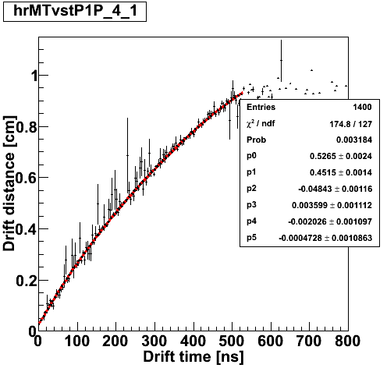
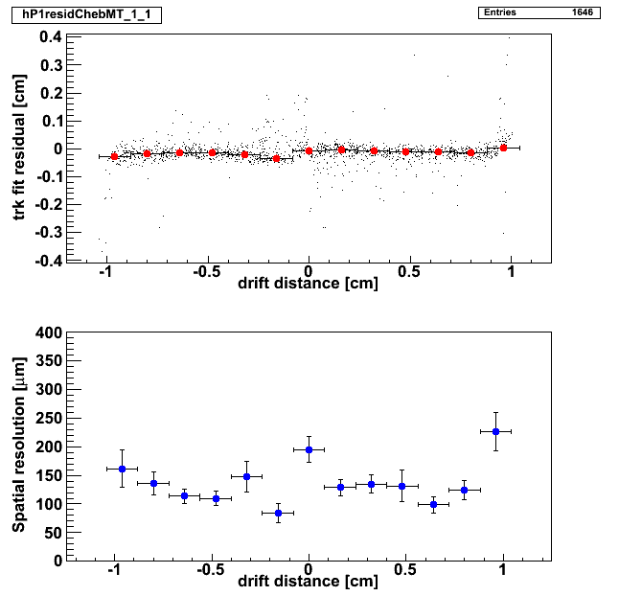
STR & Spatial resolution – 80%He-20%C₂H₆
80%He-20%C₂H₆
HV=1860V

Slide 15
Gas Mixture Comparison
 | ρ(g/cm³) x1 0⁴ | X0(m) | N_{P}(cm⁻¹) | N_{T}(cm⁻¹) | t_{max}(ns) | σ(μm)
80%He-20%iC₄H₁₀ | 6.3 | 810 | 21 | 47 | 420 | 130
90%He-10%iC₄H₁₀ | 4.0 | 1410 | 13 | 26 | 550 | 170
95%He- 5%iC₄H₁₀ | 4.0 | 1410 | 9 | 15 | 700 | 200
35%He-65%CH₄ | 4.9 | 1010 | 26 | 37 | 210 | 200
51%He-49%CH₄ | 4.1 | 1260 | 20 | 29 | 300 | 220
67%He-33%CH₄ | 3.3 | 1690 | 15 | 21 | 350 | 200
79%He-21%CH₄ | 2.7 | 2270 | 11 | 15 | 470 | 200
60%He-40%C₂H₆ | 6.4 | 780 | 19 | 49 | 550 | 130
73%He-27%C₂H₆ | 4.9 | 1080 | 15 | 36 | 600 | 130
79%He-21%C₂H₆ | 4.2 | 1310 | 12 | 30 | 650 | 130
t_{max} and space resolution depend on other parameters. Figures shown are preliminary and indicative
Results for iC₄H₁₀ and CH₄ –based gas mixtures to be updated with analysis software used for C₂H₆ gases

Slide 16
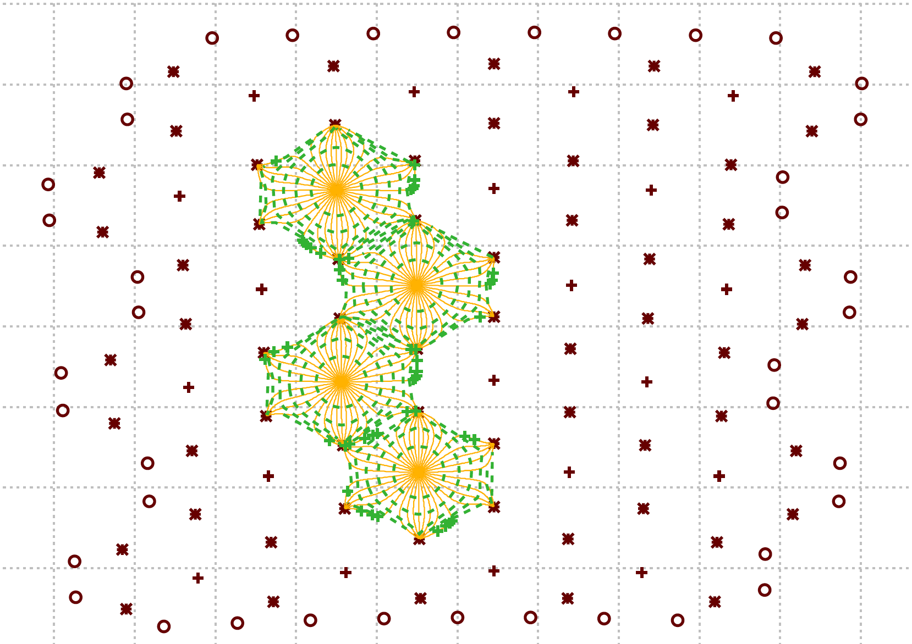
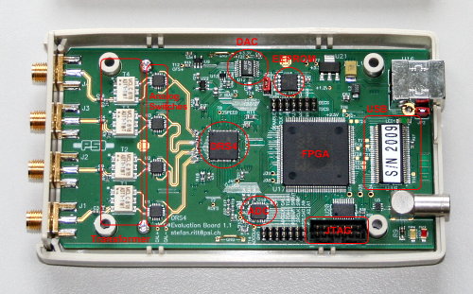
Waveform Digitization & Cluster Counting
Read 3 channels of proto1 through DRS4^{(*)} “evaluation board”
Channel arrangement chosen to see cosmic ray tracks
Same channels (after active splitters) as in the standard DAQ chain
Same acquisition trigger (scintillator counters coincidence) as telescope+proto1 setup shown so far
Proto1 preamp bandwidth <100 MHz
Channel #1 of DRS4 board connected to drift tube with faster preamplifier (see next slides)
(*) A switched capacitor array (SCA) with 1024 cells, capable of digitizing eight analog signals with high speed (6 GSPS) and high accuracy (11.5 bit SNR) on a single chip (http://drs.web.psi.ch/)
[only 4 channels read-out with current version of firmware]

Slide 17
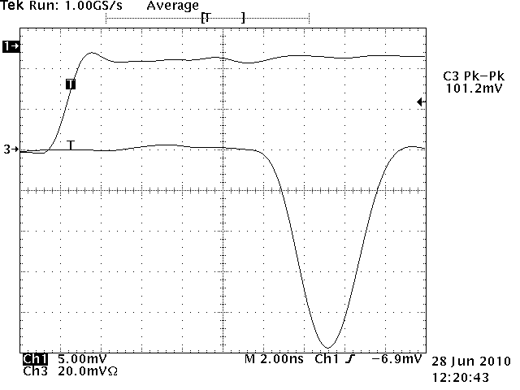
Drift Tubes for Cluster Counting
Two square-section tubes (24mm side) built to study cluster counting issues in simplified environment. The anode - as in Proto1 - is a 20μm Tungsten wire.
One tube (400mm long) already equipped with 300MHz bandwidth preamplifier
Gain ~5mV/fC; noise ~1900 e⁻ RMS

Slide 18
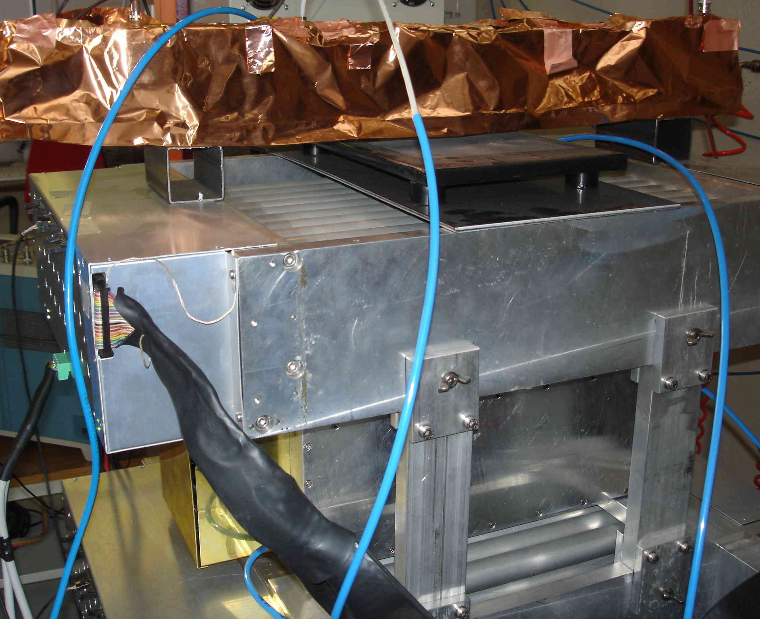
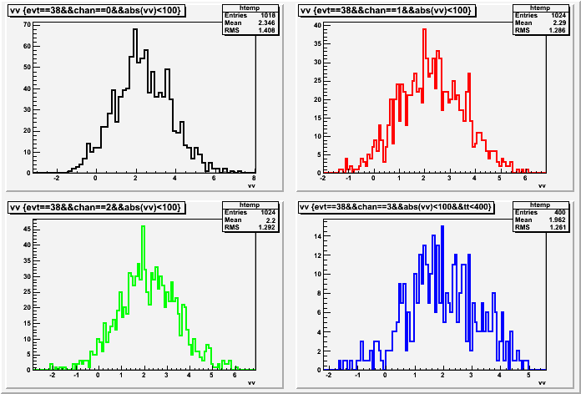
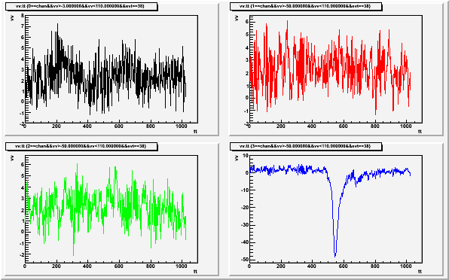
Drift Tubes for Cluster Counting
400mm long tube currently on top of our setup
Dump the four waveforms when at least one of them exceeds 25mV
In spite of x3.5 higher preamp bandwidth, a noise level similar to proto1 (~1.4 mV RMS) is obtained with a careful shielding (…)

Slide 19
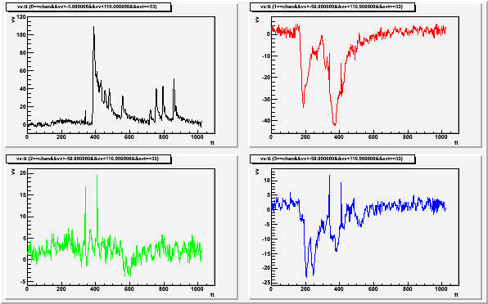
Drift Tubes for Cluster Counting (cont.)
Adequate preamp bandwidth is (clearly) crucial to count clusters
85%He-15%C₂H₆ n_{P}=10.2/cm

Slide 20
Counting Clusters
INPUT SIGNAL
1024 channels,
2Gsample/sec
TARGET SIGNAL
(cluster)
Position of peaks
from finding algorithm

Slide 21
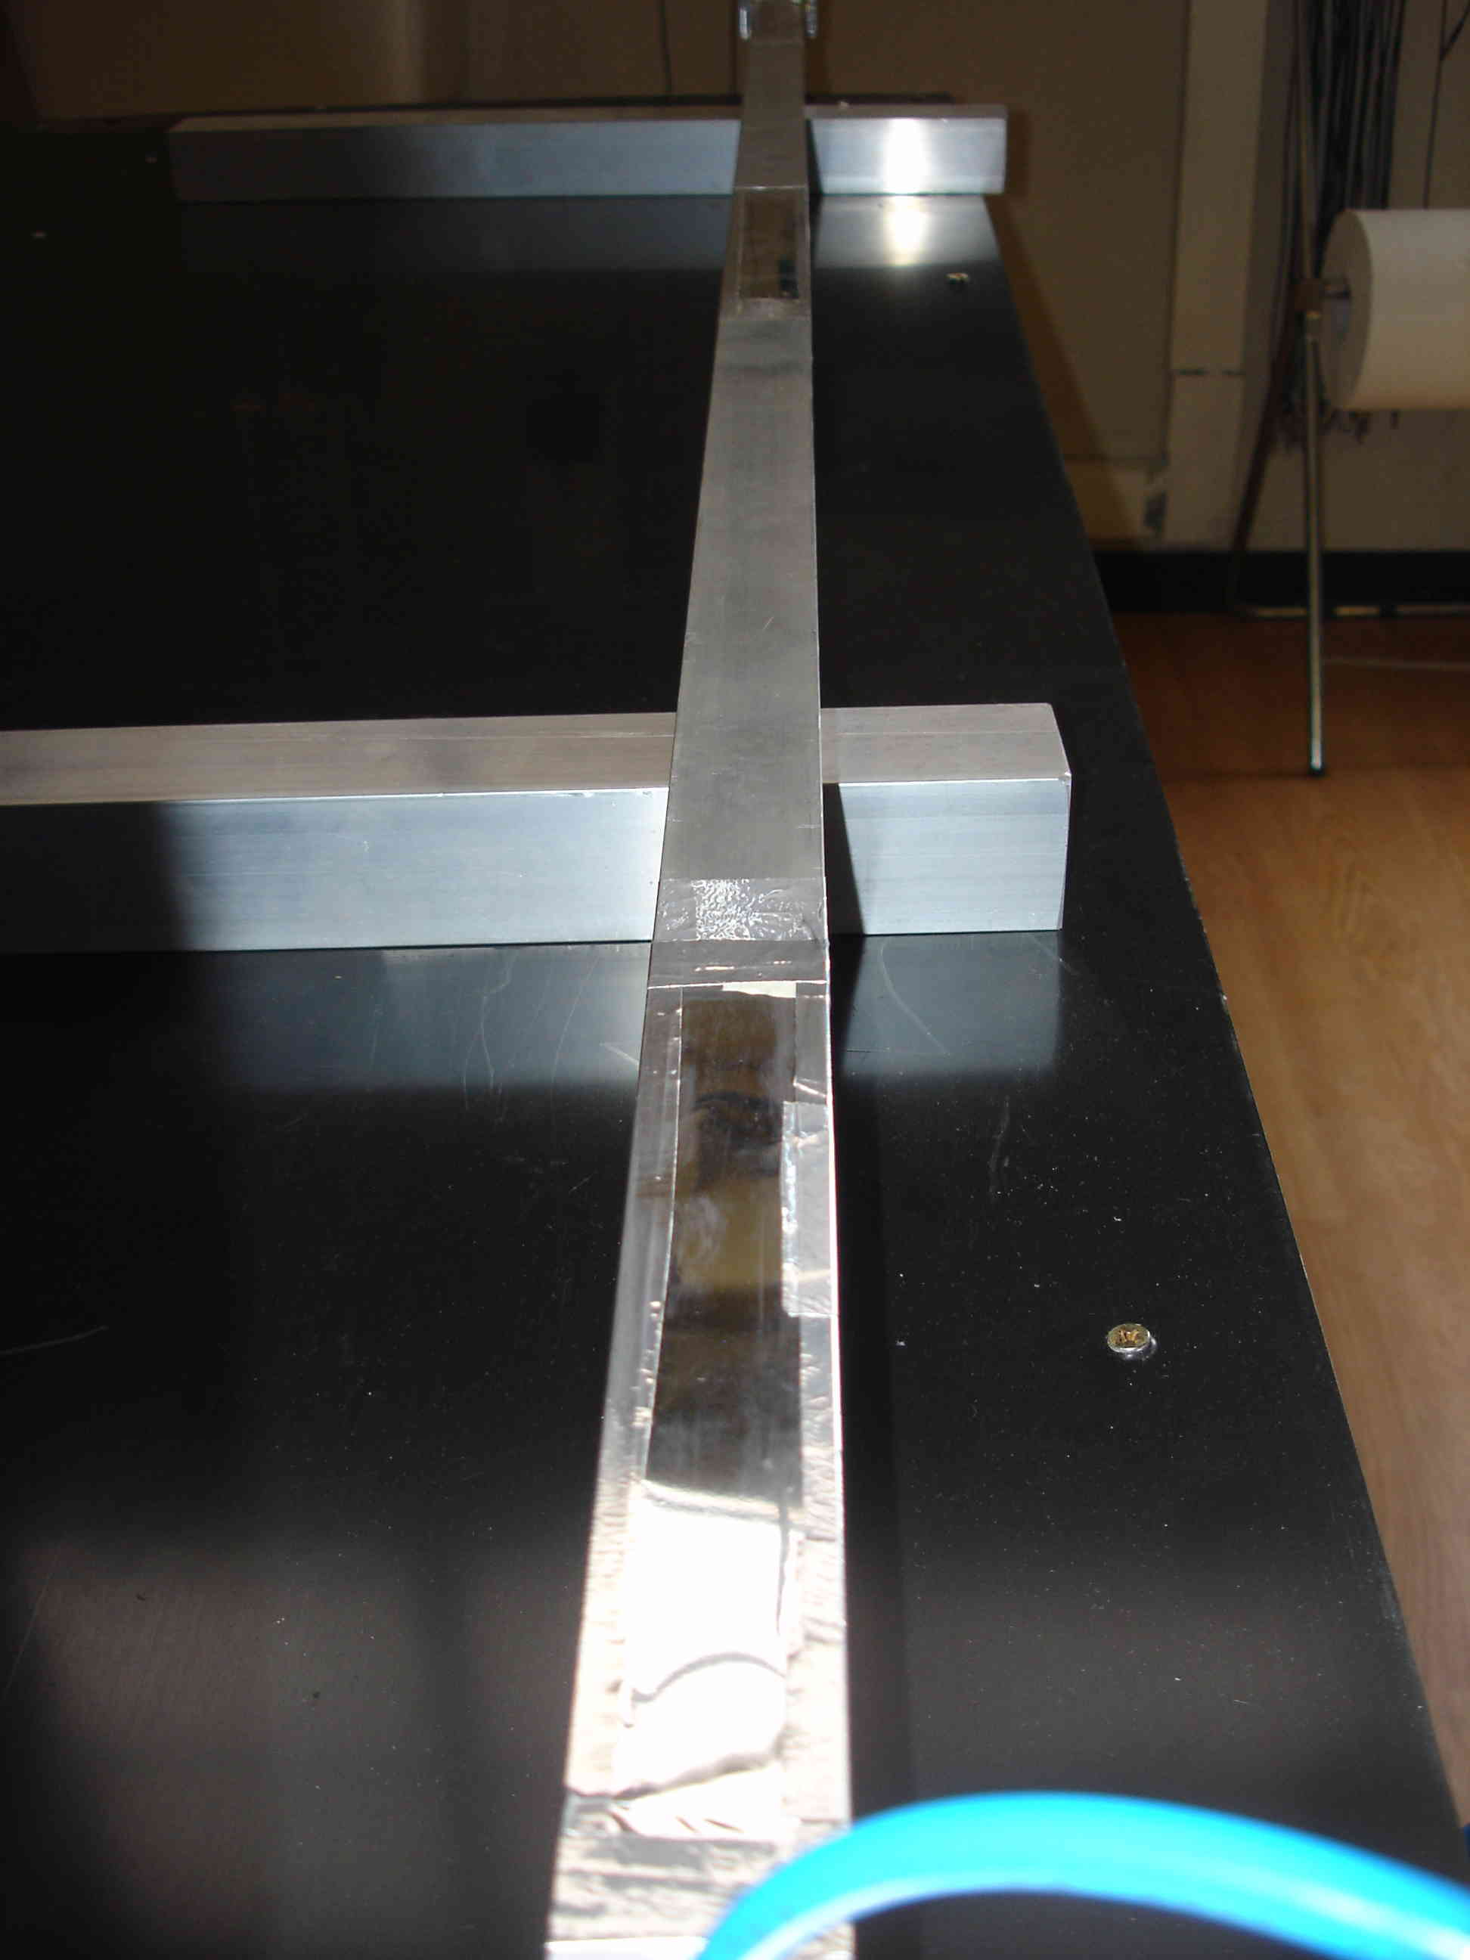
More Detectors for Counting Clusters
1700mm long tube to study signal propagation along the wire
built, strung and tested for gas tightness
in the gas flow circuit and with HV on for some days now
to be equipped with fast preamp soon
2000 mm long square cell prototype (~20 cells) for realistic study (X-talk, undetected clusters, signal propagation…) being designed
hope to have it in hand early 2011

Slide 22
Summary
More He-based mixtures, using ethane as quencher, have been analyzed.
preliminary v_{drift} and spatial resolution results show good performance
Methane still seems best candidate for light, fast mixtures (short readout time window to reduce background)
Very first attempts at identifying clusters in (almost) realistic conditions
need fast preamps, low noise, low n_{P} mixtures, good control of track length

