Slide 1
TRIUMF laboratory studies
Christopher Hearty
University of British Columbia/IPP
27-Sep-2010

Slide 2
Outline
Aging
Single cell cluster counting
Large prototype

Slide 3
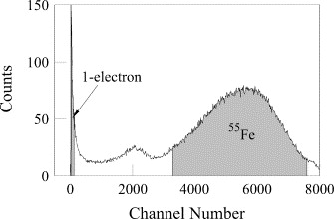
Wire Aging Tests
Goal is to verify that the chamber will survive the SuperB lifetime.
Test proposed materials using single cell, as per Boyarski. e.g. bare Al wire.
Primarily a test of Malter effect (field wire aging).
Uses ⁵⁵Fe both to age the wires and to characterize performance.
size of single electron peak increases due to Malter effect as chamber ages
A. M. Boyarski, Nucl. Instr. Meth. A 535, 632 (2004)

Slide 4
Schematic
10 mm
20μ gold-plated tungsten sense wire
120μ gold-plated aluminum field wires
Bias wires @ 1450V gives same field as an infinite BaBar chamber
picoammeter monitors total deposited charge

Slide 5
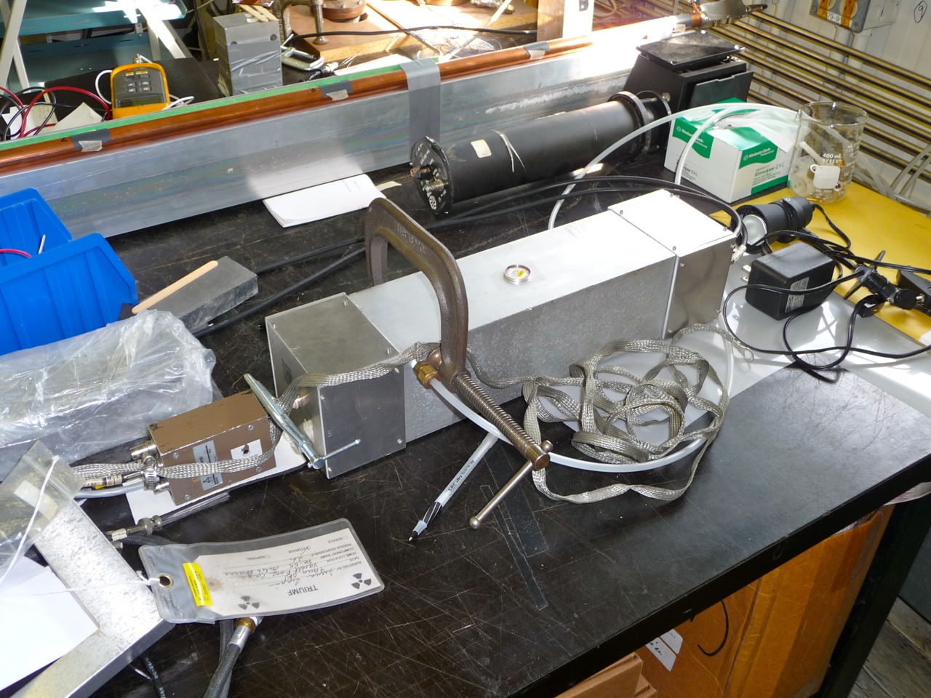

Slide 6
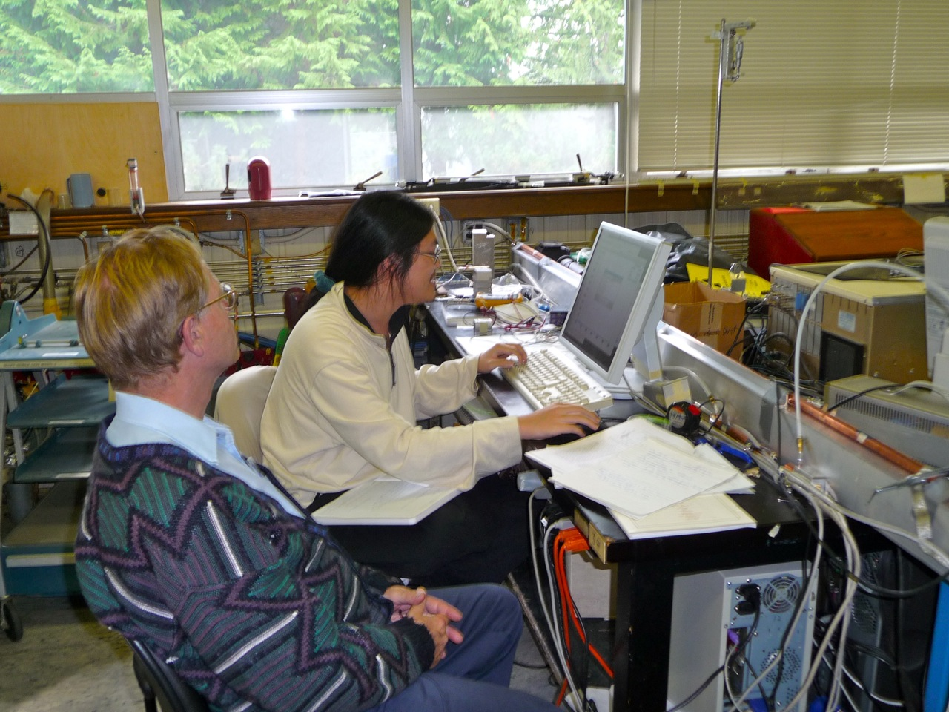

Slide 7
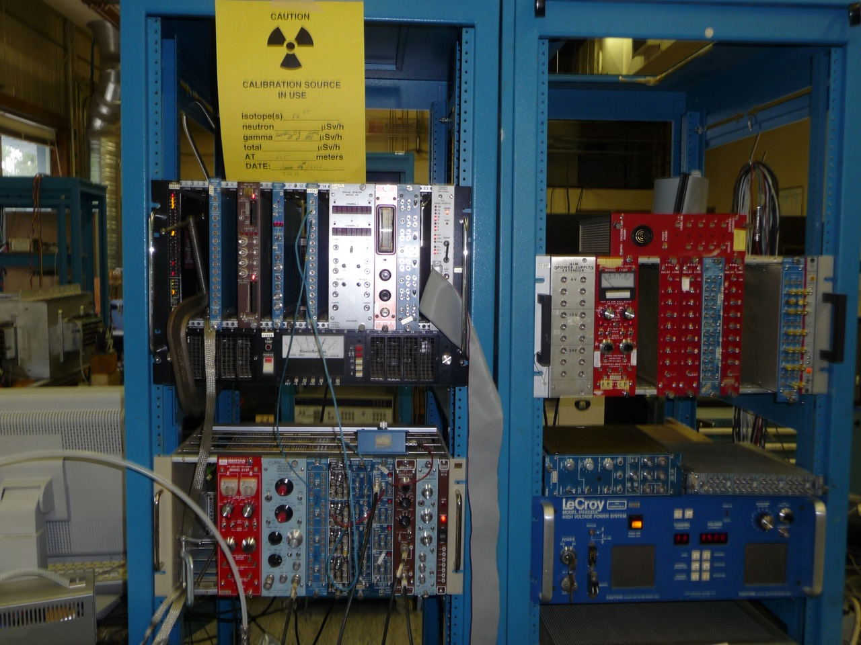

Slide 8
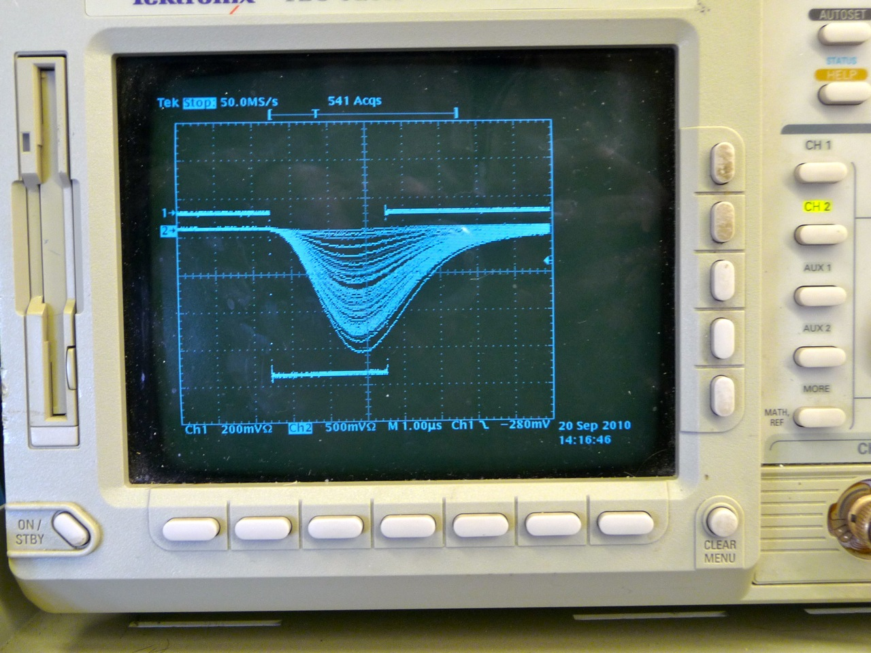

Slide 9
Charge collected by aging chamber in ⁵⁵Fe events
low pulse-height events due to interactions near edge of cell
Background (only) spectrum
auger events in gold
normalized noise/cosmic spectrum
⁵⁵Fe
ADC channel

Slide 10
Charge collected by aging chamber in ⁵⁵Fe events
Higher gain (3.3x) — ⁵⁵Fe peak off scale

Slide 11
Status
Read out is working
Need to add picoammeter
Do we need a lower gas flow?
Most important: use light to produce a single e⁻ (only) spectrum. Requires some mechanical modifications.
Adam’s single electron spectrum

Slide 12
Plans - I
Adam has tested BaBar materials and gas (inc. water) to 80 mC/cm with no signs of Malter effect. Lu (Princeton) has gone to 230 mC/cm.
some gain drop seen in actual chamber.

Slide 13
Plans - II
Is it reasonable to track absolute gain?
Adam normalized ⁵⁵Fe peak to bin 5500 in all cases
But small drop in gain is not particularly a concern.
Each test takes ~2 months. Test to 3x SuperB charge? 10x?
do we have an estimate of the expected charge?
Start with BaBar materials and gas.
need to add a water bubbler. Or no water initially to get bigger effect?
Then bare aluminum wire and SuperB gas.

Slide 14
Cluster Counting
Use a single-cell 2.7m long drift tube to test the feasibility of detecting individual clusters as they drift to the sense wire.
dispersion and attenuation as a function of distance from the preamp.
Start with ⁵⁵Fe, ~170 e⁻ in BaBar gas (He:Iso 80:20, no water).

Slide 15
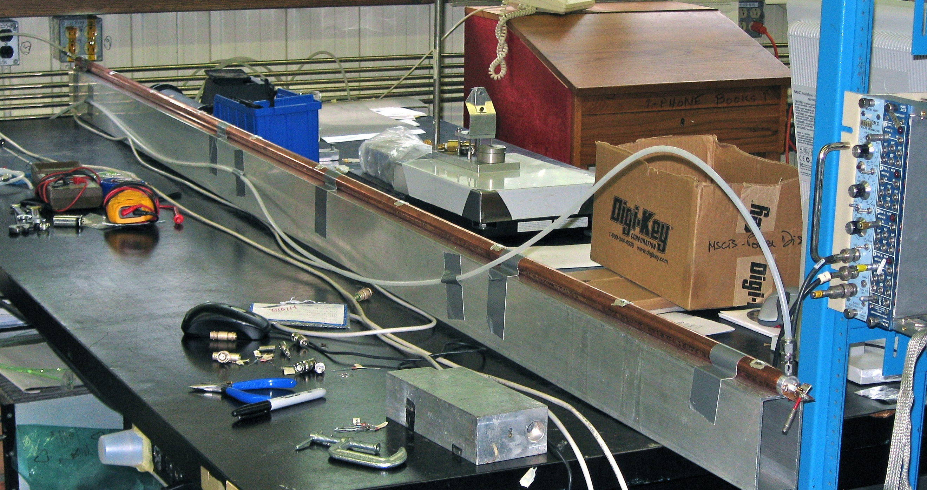
aluminized-mylar windows
2700 mm long 19-mm diameter copper tube strung with 20μm gold-coated tungsten wire (Luma).

Slide 16
Schematic
Garfield studies (Philip Lu) indicate that 1750V should give the same gain as a BaBar cell at 2000 V
Isolation capacitor (from BaBar)
R = 775 Ω
Protection diodes
~400 Ω Termination at far end to suppress reflections

Slide 17
Amplifier / DAQ
Wenteq ABL-0100-01-4010 10–1000 MHz bandwidth, 40 dB power gain
otherwise, don’t really know its properties
DAQ is 1 GHz / 4 Gs scope. 1 channel for triggering, 1 channel for readout.

Slide 18
Status
Progress has been slow.
It has been difficult to get a trigger / DAQ system that is adequate. We do not have a preamp designed for this purpose.
Noise is not adequately controlled – still sensitive to environmental pickup, despite the tube being solid copper.

Slide 19
Sample ⁵⁵Fe trace, window close to amplifier
Not clear where the rapid differentiation is coming from
10 ns rise time

Slide 20
⁵⁵Fe at far window
⁵⁵Fe at near window
Spectrum is not what we would expect for ⁵⁵Fe.
Attenuation is ~2x over length of tube

Slide 21
Rise time of signal does not depend distance from amplifier. May be dominated by dispersion in arrival time at sense wire.

Slide 22
Rise time vs charge for far and near windows
far
near

Slide 23
Next steps
We are building a similar tube for Mike Roney at Victoria for preamp studies.
We need to understand amplifier properties. A preamp built for this purpose would be great.
In the long run, move towards using a UV laser to generate pulses. Allows for small pulses and provides an external trigger.

Slide 24
Large Prototype
2.7 m long; 44 square cells, 15 mm square, 3 field wires per sense wire, plus surrounding cells for field shaping.
Drawings by R. Henderson
http://bblab.triumf.ca/~hearty/Super-B-DCH/Prototype/Prototype-1h.dwg

Slide 25
Status
On hold
our grant request for capital was not funded
await cluster counting results from single drift tube
We had tentatively requested test beam time this fall, but have released it.
If cluster counting does not seem feasible, we may still want a large prototype with final cell design for testing front-end electronics.
like BaBar proto-II
We have required materials and tools in hand.

