Slide 1
DCH FEE STATUS
Some ideas for Level 1 Triggered Data Flow
&
A preliminary study on Cluster Counting Data Processing Algorithm
G. Felici

Slide 2
Outline
DCH TRIGGERED DATA FLOW
Trigger & OL Specs (reminds)
ADB main blocks & data frame (remind)
The trigger burst case – 2 possible readout implementation
A pushing-mode front-end readout architecture
Cluster Counting Data Processing algorithm
The preamplifier
Noise filtering based on DSP correlation technique
The correlation algorithm
Example of the technique applied to acquired waveform
Conclusions

Slide 3
Trigger & OL specs (remind)
Specs
System
Trigger rate (average): 150 kHz
Trigger (fixed) latency : ≈ 4 (6 !?) μs
Data OL BW : 16 OL @ 2 Gbits/sec
ECS OL BW : 16 OL @ 2 Gbits/sec
Trigger OL BW : 64 OL @ 1.2 Gbit/sec
Trigger spacing (min) ≈ 60 ns (!?)
Trigger burst : 3 events (?)
Detector
Number of cells (guess): ≈ 9216
Chamber occupancy : 15% (Inner layers)
Chamber gain : 5•10⁴ - 1•10⁵
Sense wire parasitic (C_{D}) ≈ 25 pF

Slide 4
ADB main blocks & data frame (remind)
L1
Single Channel ROIB Digitizer (ADB)
Trigger Latency Time + n samples
3 Events RO Buffer
28 MHz sampling rate
LPF
FADC
n
1
0
?
3
2
1
DISCR
TDC
32 samples (≈ 1.14 μs) allow DC full signal development and includes distribution time jitter
7 MHz
SAMPLING
Trigger
Digitized Data Frame Example
ADC
#
31
ADC
#
30
ADC
#
29
ADC
#
28
ADC
#
27
ADC
#
26
ADC
#
25
ADC
#
24
ADC
#
23
ADC
#
22
ADC
#
21
ADC
#
20
ADC
#
19
ADC
#
18
ADC
#
17
ADC
#
16
ADC
#
15
ADC
#
14
ADC
#
13
ADC
#
12
ADC
#
11
TDC
#
2
ADC
#
9
ADC
#
8
ADC
#
7
TDC
#
1
ADC
#
5
ADC
#
4
ADC
#
3
ADC
#
2
ADC
#
1
ADC
#
0
Position inside the frame → coarse time measurement (5 bits)
Content → fine time measurement (6 bits)

Slide 5
The trigger burst case
Data transfer optimization
Ch n
32 samples
Trigger 1
Ch n+i
32 samples
Trigger 2
Ch n+i
32 samples
Trigger 3
FEE data transfer optimization : download the 3 events as a single “big” event
Pro : Front-End data transfer optimization
Cons :
events are overlapped in the same data frame (further elaboration required to split single events)
data frames do not have the same lengths (L1 trigger occurrences)
Event management optimization
Ch n
32 samples
Trigger 1
Ch n+i
32 samples
Trigger 2
Ch n+i
32 samples
Trigger 3
Single event data transfer : readout each event separately
Pro :
Front-End events have the same size
FEX can be applied while reading the event
Readout procedure provides event de-randomization
Cons :
Partial (previous) L1 event re-reading

Slide 6
A pushing-mode FE readout architecture
Trigger Latency Time + n samples (Dual-port memory)
32 word block data readout
RO buffer
Sampled data
n
2
1
0
DATA RO SM
(FEX)
Pushing mode
Ev3
Ev2
Ev1
Concentrator board
Read ADDR
(counter value @ L1) - Latency
ADDR
Sampling clock
COUNTER (0 – n)
ADDR
FiFO Empty
L1 (synchronized by sampling clock)
L1 FIFO
FiFO Read
Data (counter value @ L1)
NB : minimum trigger spacing > sampling period (≈ 36 ns)
A simulation of the readout architecture will be carried out in the next weeks

Slide 7
A preliminary study on Cluster Counting Data Processing Algorithm

Slide 8
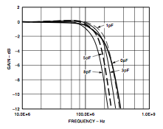
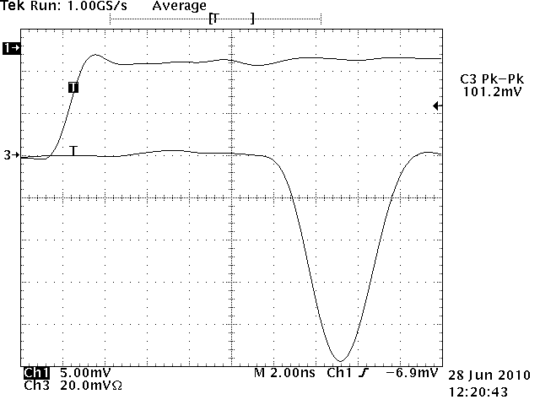
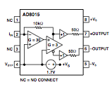
Preamplifier
Reduce 8015 C_{IN} sensitivity
≈ 250 MHz BW
Gain ≈ 5 mV/fC
Noise ≈ 1900 erms @ C_{IN} = 3pF
C_{INJ} = 1.8 pF

Slide 9
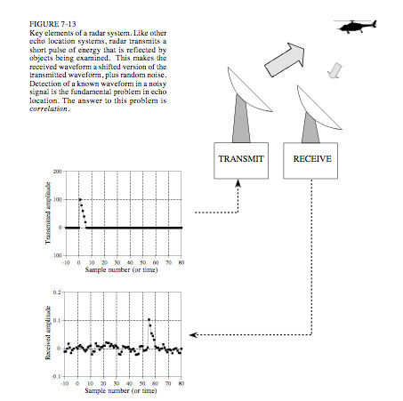
Cluster Counting – noise filtering
Sampled signal
noise filtering using an algorithm with low area consumption in a FPGA
We are trying to use a DSP technique based on the correlation concept to determine if a target signal (a signal with a shape close to a well separated cluster) is present inside another signal (the digitized signal). This technique is generally used in radar systems where the received signal consist of a shifted and scaled version of the transmitted pulse and overlapped random noise (interference, thermal noise etc)

Slide 10
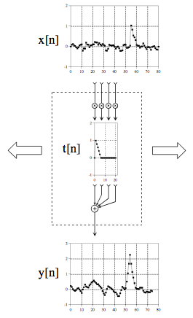
Cluster Counting – The correlation machine
Received signal
Correlation is the optimal technique for detecting a known waveform in random noise (matched filtering technique)
Target signal
x[n]*t[-n] = y[n]
The value of the cross-correlation is maximized when the target signal is aligned with the same features in the received signal
Cross-correlated signal

Slide 11
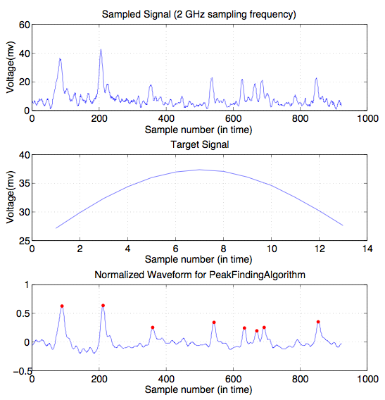
Cluster Counting – An example
The Peak Finding algorithm is under study

Slide 12
Conclusions
A (very preliminary) front-end data readout architecture capable to manage short dead-time (less than 100 ns) has been presented. We plan to validate the architecture by means of (VHDL) simulations in the next weeks
Some work has been done to verify the possibility of using Cluster Counting for dE/dx measurements. A setup made of a short tube (≈ 40 cm), a fast preamplifier/digitizer has been built.
A very preliminary algorithm based on a matched filtering and peak finding procedure to count single ionization events has been implemented. First results look encouraging.

