Slide 1
Status of the
W→τν Analysis:
INT note @10 TeV,
D3PDs production+validation,
preliminary results @7 TeV
& plans for the future
Lidia

Slide 2
W→τν Analysis

Slide 3
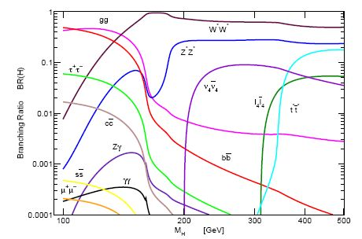
Motivation to W→τν analysis
Taus are interesting objects because:
the τ leptons in the final state are important signature for Higgs boson and SUSY searches – as the heaviest lepton, they have the largest coupling to the Higgs boson both in the Standard Model and in the MSSM.
BUT hadronically decaying taus are difficult to identify in hadron collision, due to the overwhelming QCD background.
understand τ _{had} reconstruction and
identification
is essential and challenging
Main processes with τ _{had} final states:
ttbar σ = 3.74 x 10² pb (@10TeV)
Z →ττ σ = 1.13 x 10³ pb (@10TeV)
W→τν is an interesting channel to study taus:
it is the most abundant source of τ leptons with σ = 7.69 x 10³ pb @10TeV
it will be possible to study this channel only with the very first data at low luminosity (10³¹ - 10³² cm⁻²s⁻¹), due to the QCD background rate
There are some interesting measurements that can be done with 100 pb⁻¹ of data:
cross section
BR(W→τν)/BR(W→eν) ratio

Slide 4
Status of the analysis in ATLAS
14 TeV analysis – documented in a note (ATL-PHYS-INT-2009-011) by Y.Coadou, P.Malecki and E.Richter-Was
10 TeV analysis – documented in a note (ATL-COM-PHYS-2010-067) G.Nunes-Hanninger, L.Dell’Asta, A.Andreazza, D.Casadei, Y.Coadou, J.Dingfelder, O.Igonkina, J.Kroseberg, P.Malecki, M.Neubauer, E.Richter-Was and A.Sfyrla.
For the moment it is just a communication, but we are waiting to be assigned a rewier to become at least an INT note.
7 TeV analysis – just started!
for the first data analysis many other groups are joining the effort:
NYU (D.Casadei) wants to do (W+jet)/(Z+jet) ratio in the tau channel
Yale (S.Demers, many studies done in CDF) specialized in trigger, data quality and tau discrimination from other leptons
Desy (P.Bechle)
Witwatersrand (T.Vickey)

Slide 5
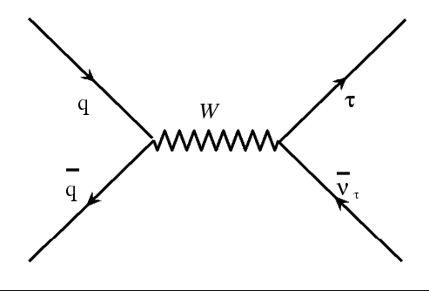
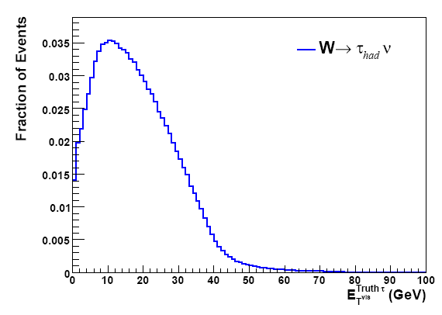
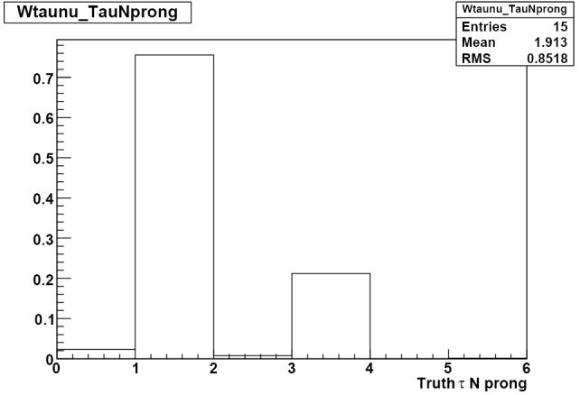
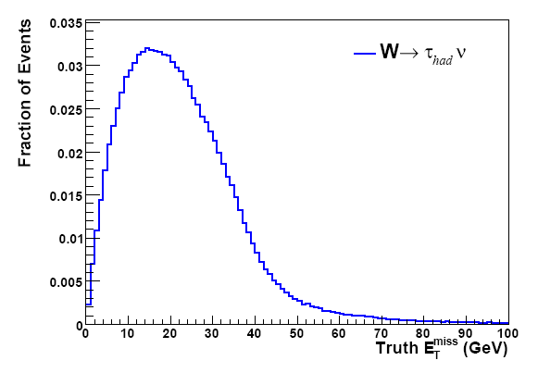
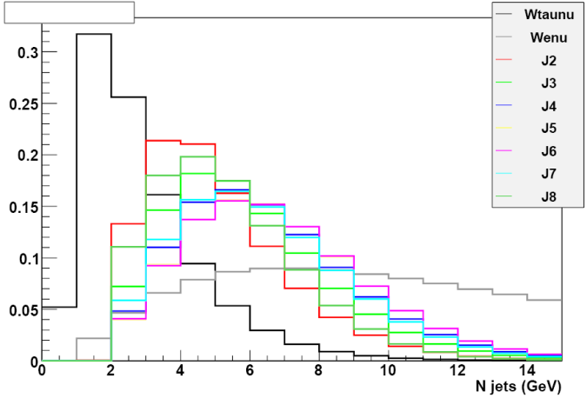
W→τν – signal
Soft τ lepton with 20<p^{τ}_{T} <40 GeV
Signature:
τ lepton
missing transverse energy
@10TeV
Relative low missing transverse energy, tipically in the range from 10 GeV to 40 GeV (+ a long tail)
When the τ lepton decays hadronically, we have an hadronic jet which is well collimated and has few charged particles.
@10TeV

Slide 6
W→τν – backgrounds
W→eν / W→μν
the electron (muon) from the W decay is identified as a single-prong hadronic τ decay
the electron (muon) is lost and a fake τ is reconstructed from the initial state QCD radiation
signal | cross section
W→τν (τ→had) | 7.69 x 10³ pb
background | cross section
W→τν (τ→lep) | 4.18 x 10³ pb
W→eν | 1.176 x 10⁴ pb
W→μν | 1.176 x 10⁴ pb
Z→ττ | 1.128 x 10³ pb
Z→ee | 1.144 x 10³ pb
Z→μμ | 1.144 x 10³ pb
ttbar | 3.7 x 10² pb
QCD di-jets | 10¹⁰ pb
Z→ee / Z→μμ
one electon (muon) is wrongly identifed as hadronic τ and the other is lost or ouside the geometrical acceptance
Z→ττ
one τ is identified as an hadronic τ decay and the other one is lost, i.e. neither reconstructed as second hadronic τ nor as electron or muon
ttbar
one of the W decays into a τ lepton and the other decays into a pair of quarks, or electron or muon which are not reconstructed
QCD di-jet
cross section ~6 order of magnitude higher
one jet is wrongly identifed as a τ
The background can be taken under control and the signal extracted:
using the proper trigger
applying some specific cuts on cinematic variables:
missing E_{T}
tau p_{T}
using some algorithms that help in the particle identification, such as the electron/muon veto
applying topological cuts.
The cut flow must be tuned to maximize the S/B ratio.

Slide 7
W→τν Event Selection
Trigger: combined trigger which asks for a certain amount of missinig E_{T} and for an isolated τ with a minimum p_{T} of 16 GeV → EF_tau16i_loose_xe(15,15,25)
Missinig E_{T}: the offline reconstructed missing E_{T} must be higher than 40 GeV (now using MET_RefFinal, has to move to MET_Final for first data)
Tau identification: there must be only one τ which passes certain selection cuts, both on identification and on momentum. The τ has to have been reconstructed by both the reconstruction algorithms (calorimeter and tracking based), the identification must satisfy the safe tight cuts, the energy must be 20 GeV < E_{T} < 60 GeV, |η|<2.4 and not 1.3<|η|<1.4. Finally the τ candidate must not be flagged as an electron or a muon.
Veto leptons in the event. If in the event there is an electron identified as a loose electron or a muon (STACO muon) the event is rejected.
Veto jets in the crack region.
Topological cut: Δφ(τ, MET) > 2.5
Cut flow @10TeV

Slide 8
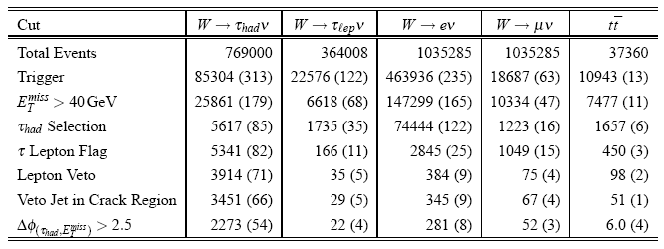
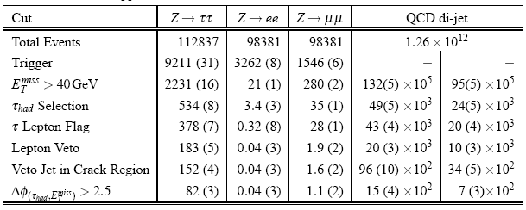
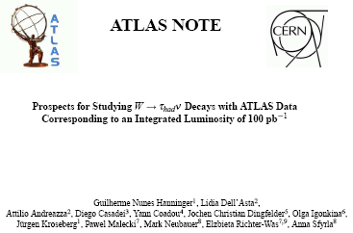
W→τν Event Selection (100 pb⁻¹)
Cut flow @10TeV

Slide 9
D3PD & W→τν Analysis

Slide 10
D3PDs: why?
A D3PD is a flat ntuple.
Many physics/performance groups are slowly moving to D3PDs.
Each physics/performance group has private D3DPs with what it needs (e.g. tau D3PD contains info about MET, jets, tracks…).
D3PDs will be produced centrally by each group.
so it’s important that we are able to use them and eventually to produce them, if we need something particular that is not in the “official” production
It’s very easy to run on D3PDs: they are smaller than AODs, no need of Athena…
we can run our analysis more quickly
But if we want to do our analysis entirely on D3PDs we have to make sure that:
our analysis on AOD and on D3PD gives the same results (i.e. the quantities there are correct!)
they contain what we need to do standard analysis

Slide 11
D3PDs validation
I choose the signal sample: mc08.106023.PythiaWhadtaunu.merge.AOD.e347_s462_r635_t53/
I produced both my usual ntuple and D3PDs, from the same AODs.
I run the analysis on the two data format (just 100000 events).
I tried to isolate the cuts that made the cut flow different.
The differences in the selections come from the trigger and the electron and muon identifications/vetos.

Slide 12
Problems
Trigger
In the D3PD the trigger bit is available (i.e. passed: yes or no) and also some quantities like MET at level 1 or event filter.
In the old AOD analysis, instead of using the trigger bit, the trigger selection was done by a piece of code written by Guilherme which “simulated” the trigger bit by looking at the variables reconstructed at the different trigger levels.
I tried to disentangle the effects, looking at the simple triggers which make the trigger chain.
Now Guilherme is looking into his code to find where the bug is.
Electron/Muon veto
In the old analysis we use some “flags” that define if the tau candidate was similar to an electron or a muon.
It seems that this flags are no more used (hence they are not in D3PDs) and have been substituted by “vetos”, which of cource have a different efficiency.

Slide 13
W→τν Analysis @ 7 TeV

Slide 14
W→τν Analysis @ 7 TeV
Once it has been decided that we can trust D3PDs, I tried to move the analysis on 7 TeV MonteCarlo samples, that were made available few weeks ago.
I produced all the D3PDs for the dataset we need in our analysis (see backup for a complete list). These dataset are all available at Milano.
As a first step I have tried to see how the “old” analysis looks like. Then I tried to change some cuts and do some preliminary optimization.
NB No event weight for ttbar events! The event weight is not available in D3PDs and we have to understand how to access it and add it.

Slide 15
Cut flow @ 7 TeV – “10TeV cuts”
same number of signal event (2300) respect to 10 TeV analysis (trigger!)
Wenu background too high (lepton flag to be changed)
very low statistic of QCD background available

Slide 16
Cut flow @ 7 TeV – EleVeto Medium
changing the efficiency of electron veto to medium
signal: from 2373 to 2264
Wenu background: from 3038 to 232

Slide 17
Cut flow @ 7 TeV – EleVeto Tight
changing the efficiency of electron veto to tight
signal: from 2373 to 2097
Wenu background: from 3038 to 98

Slide 18
Cut flow @ 7 TeV – Trigger
asking just a tau trigger (not MET trigger)
increase in QCD background

Slide 19
Cut flow @ 7 TeV – MET
Cutting with MET > 30 GeV instead of 40 GeV
increase in QCD background
4 X signal

Slide 20
Cut flow @ 7 TeV
Many changes in the thresholds of the cuts have been tried.
trigger
missing Et
tau Et
lepton veto
…
The one that turned out to be the most useful is the electron veto from the tau identification.
Starting from this change, it is possible to adjust the other cuts

Slide 21
Plans for the future

Slide 22
ToDoList
The tau ID community has just swithched from Cone4H1TopoJets to AntiKt4H1TopoJets for the jet algorithm used to seed a tau.
I am participating in the production of D3PDs from the newly reconstructed datasets.
The analysis has to be moved to this new jet collection.
Data will soon arrive: I would like to have some tool to quickly check data and compare it to MonteCarlo:
understand trigger efficiency, which is a crucial point for our analysis. We will have the possibility to use tau+MET trigger only this year and we have to make sure that this trigger works and has the expected rate
check electron/muon Veto efficiencies
Some studies I did for the 10 TeV note are useful also now for the evaluation of the QCD background. It will be important to learn to factorize both the cuts and the trigger.
The most dangerous background is QCD dijets. I have already had a look at estimation of QCD from data (looking at track multiplicity) but for our analysis this seems not to be a very promising approach.

Slide 23
Back up

Slide 24
(W+jet) / (Z+jet) ratio – τ channel

Slide 25
From 10 TeV to 7 TeV
signal | cross section
W→τν (τ→had) | 7.69 x 10³ pb
background | cross section
W→τν (τ→lep) | 4.18 x 10³ pb
W→eν | 1.176 x 10⁴ pb
W→μν | 1.176 x 10⁴ pb
Z→ττ | 1.128 x 10³ pb
Z→ee | 1.144 x 10³ pb
Z→μμ | 1.144 x 10³ pb
ttbar | 3.7 x 10² pb
QCD di-jets | 10¹⁰ pb
signal | cross section
W→τν (τ→had) | 5.765 x 10³ pb
background | cross section
W→τν (τ→lep)
W→eν | 8.819 x 10³ pb
W→μν | 8.819 x 10³ pb
Z→ττ | 0.848 x 10³ pb
Z→ee | 0.860x 10³ pb
Z→μμ | 0.860 x 10³ pb
ttbar | 1.6 x 10² pb
QCD di-jets | 10¹⁰ pb

Slide 26
D3PD produced
D3PDs produced for the following datasets:
mc09_7TeV.105009.J0_pythia_jetjet.merge.AOD
mc09_7TeV.105010.J1_pythia_jetjet.merge.AOD
mc09_7TeV.105011.J2_pythia_jetjet.merge.AOD
mc09_7TeV.105012.J3_pythia_jetjet.merge.AOD
mc09_7TeV.105013.J4_pythia_jetjet.merge.AOD
mc09_7TeV.105014.J5_pythia_jetjet.merge.AOD
mc09_7TeV.105015.J6_pythia_jetjet.merge.AOD
mc09_7TeV.106020.PythiaWenu_1Lepton.merge.AOD
mc09_7TeV.106021.PythiaWmunu_1Lepton.merge.AOD
mc09_7TeV.106022.PythiaWtaunu_1Lepton.merge.AOD
mc09_7TeV.106023.PythiaWhadtaunu.merge.AOD
mc09_7TeV.106050.PythiaZee_1Lepton.merge.AOD
mc09_7TeV.106051.PythiaZmumu_1Lepton.merge.AOD
mc09_7TeV.106052.PythiaZtautau.merge.AOD
mc09_7TeV.105200.T1_McAtNlo_Jimmy.merge.AOD
and for reco tags:
e468_s624_s633_r1085_r1113/
e468_s624_s633_r1064_r1051/
all stored in /users2/dellasta/WTauNuAnalysis/WTauNu_7TeV
(called user09.LidiaDellAsta.DATASET.D3PD.blabla) – will subscribe them to Milano
If you are already using D3PDs or wondering if they are useful for your analysis, please try and use them!

Slide 27
Cut flow @ 7 TeV – Tau energy /1
changing the the upper cut on tau Et to 100 GeV

Slide 28
Cut flow @ 7 TeV – Tau energy /2
changing the lower cut on tau Et to 15 GeV

