Slide 1
INFN meeting – 5 maggio, 2020
Contesto internazionale – prossimi passi
Nadia Pastrone
June Council will release the update of the EU Strategy (from April RRB news)
U.S. Snowmass21 process was lauched at: https://snowmass21.org/start
Muon Collider community is ready to establish the international collaboration
as announced at the General Meeting: https://indico.cern.ch/event/886491/
INFN ha contribuito e collaborato attivamente su vari fronti – come procedere oltre?
Integrare e discutere il documento roadmap della collaborazione internazionale
➔ importante partecipare e convergere su un impegno INFN condiviso
CSN1 riconosce 2 attività principali RD_FA (Muon Collider e collider ee) – 2 sigle?
LEMMA paper ➔ LEMMA richiede un review internazionale
Impegno 2020 – LoI Snowmass21….

Slide 2
Agenda
Propongo di andare attraverso le attività
senza discutere i dettagli e di convocare
prossima settimana una
Riunione aperta a tutti
con un’agenda che permetta di illustrare
il lavoro in corso e quanto si vorrebbe
fare per il futuro
Vorrei discutere oggi principalmente in
vista della riunione internazionale ristretta
di domani che riguarda il documento che
definirà la roadmap della collaborazione

Slide 3
Punti fermi
Cruciale coordinare uno sforzo congiunto: fisica, macchina, esperimento
3 filoni principali:
  esplorare la frontiera dell’energia ➔ unico lepton collider >10 TeV
  individuare e disegnare le test facility indispensabili per un CDR
  (➔ ci sono delle misure di fisica fattibili?)
  confrontare le potenzialità della macchina a 3 TeV con CLIC
Per quanto riguarda INFN:
  molto importante il contributo finora
  discutiamo oggi ➔ potrebbero aggiungersi anche altre attività
  partecipiamo domani con attenzione ➔ verranno proposti WP
  preparo un breve documento per aggiornare il Presidente in merito
  organizzare riunione aperta a tutti su attività Muon Collider

Slide 4
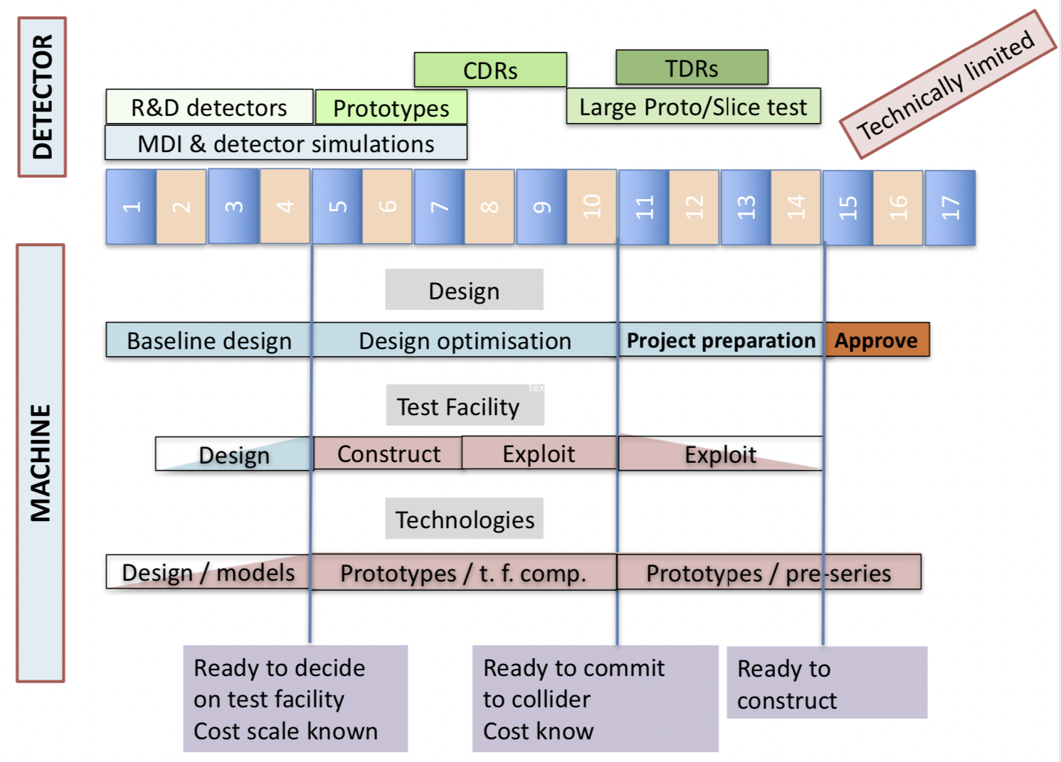
Technically Limited Potential Timeline
Physics Briefing Book arXiv:1910.11775v2 [hep-ex]

Slide 5
Recent Tentative Target Parameters
D. Schulte – CERN Muon Collider Meeting https://indico.cern.ch/event/886491/
Parameter | Unit | 3 TeV | 3 TeV* | 10 TeV | 10 TeV* | 14 TeV | 14 TeV*
L | 10³⁴ cm⁻²s⁻¹ | 1.8 | 1.8 | 20 | 20 | 40 | 40
N | 10¹² | 2 2.2 | 2 2.2 | 1.8 | 1.8 | 1.8 | 1.8
f_{r} | Hz | 6 5 | 35 29 | 4 5 | 10 12 | 4 5 | 7 9
P_{beam} | MW | 5.8 5.3 | 34 32 | 12.8 14.4 | 32 35 | 18 20 | 32 37
C | km | 4.5 | 26.7 | 10 | 26.7 | 14 | 26.7
<B> | T | 7 | 1.2 | 10.5 | 3.9 | 10.5 | 5.5
ε_{L} | MeV m | 7.5 | 7.5 | 7.5 | 7.5 | 7.5 | 7.5
σ_{E} / E | % | 0.1 | 0.1 | 0.1 | 0.1 | 0.1 | 0.1
σ_{z} | mm | 5 | 5 | 1.5 | 1.5 | 1.07 | 1.07
β | mm | 5 | 5 | 1.5 | 1.5 | 1.07 | 1.07
ε | μm | 25 | 25 | 25 | 25 | 25 | 25
σ_{x,y} | μm | 3.0 | 3.0 | 0.9 | 0.9 | 0.63 | 0.63
Adjust for staging, G = 1 MV from 1.5 to 5 TeV,
or 1.3 MV from 1.5 TeV to 7 TeV
*Use of LHC tunnel for collider

Slide 6
Next steps
Muon Colliders is a unique opportunity at the high-energy frontier
Several teams from different countries already contributed to present knowledge
The on-going work is fostering the preparation of an organized study:
  identification of feasibility issues and potential incremental steps
  resurrect studies of Muon Colliders taking advantage of the enormous progress already done
  identify resources required to address most critical issues
  launch international collaboration on Muon Colliders covering Physics, Detector and Accelerator
Synergies with other future accelerators can be easily identified for example on:
  high field magnets and fast ramping magnets with efficient energy recovery
  efficient RF power production and high field cavities
  robust targets
  techniques for the large acceptance, rapid acceleration (RLA, LEMMA and other applications)
A strong recommendation for a vigorous R&D on Muon Colliders would be key
to enforce the international collaboration needed to promote the development
of such a novel and promising project for the future of High Energy Physics

Slide 7
extras

Slide 8
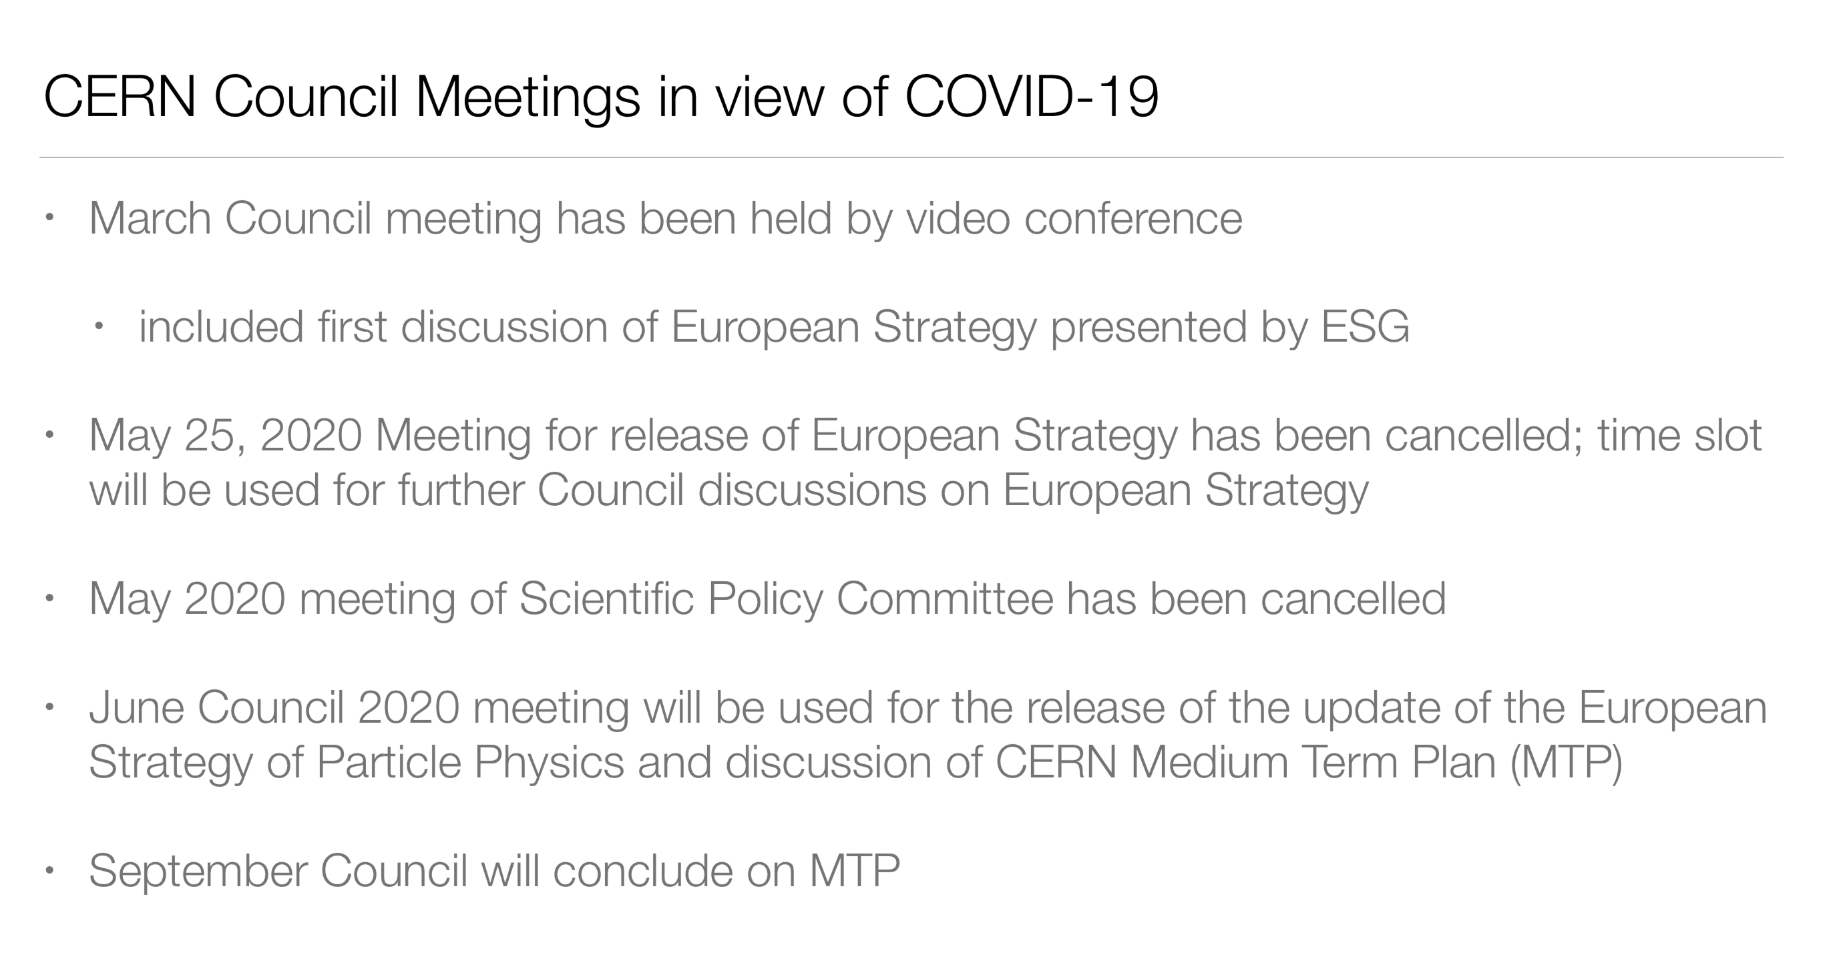
RRB – aprile 2020
E.Elsen

Slide 9
Muon Collider Working Group
Jean Pierre Delahaye, CERN, Marcella Diemoz, INFN, Italy,
Ken Long, Imperial College, UK, Bruno Mansoulie, IRFU, France,
Nadia Pastrone, INFN, Italy (chair), Lenny Rivkin, EPFL and PSI, Switzerland,
Daniel Schulte, CERN, Alexander Skrinsky, BINP, Russia, Andrea Wulzer, EPFL and CERN
appointed by CERN Directorate in September 2017
to prepare an Input Document to the European Strategy Update
de facto the seed of a renewed on-going international effort
Input Document to EU Strategy Update - Dec 2018:
“Muon Colliders,” arXiv:1901.06150 [physics.acc-ph]
by CERN-WG on Muon Colliders
FINDINGS and RECOMMENDATIONS:
Set-up an international collaboration to promote muon colliders
and to organize the effort on the development of both accelerators and detectors and to define the road-map towards a CDR by the next Strategy update
……
Carry out the R&D program toward the muon collider:
RF, magnets, materials, cooling, targets… ➔ SYNERGIES with other Future Colliders

Slide 10
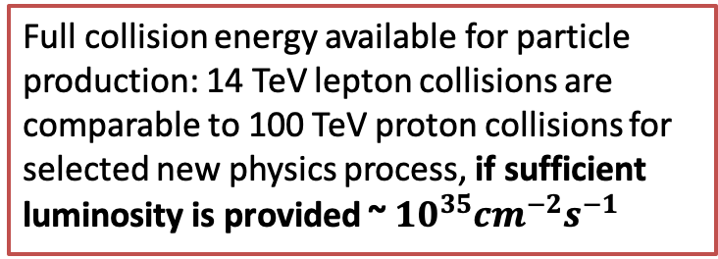
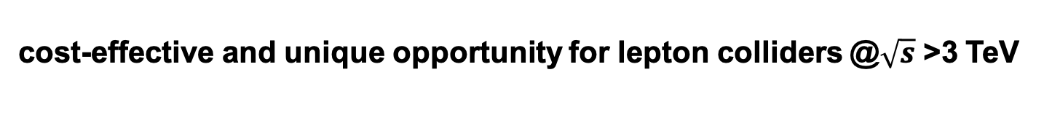
Why a multi-TeV Muon Collider?
cost-effective and unique opportunity for lepton colliders @$\sqrt{s}$ >3 TeV
A. Wulzer
D. Schulte
The luminosity per beam power is independent of collision energy in linear colliders, but increases linearly for muon colliders
Full collision energy available for particle production: 14 TeV lepton collisions are comparable to 100 TeV proton collisions for selected new physics process, if sufficient luminosity is provided ~ ${10}^{35}{cm}^{−2}s^{−1}$
Strong interest to reuse existing facilities and infrastructure (i.e. LHC tunnel) in Europe

Slide 11
Snowmass 2021
Snowmass Planning Meeting Fermilab November 4 - 6, 2020
Snowmass Summer Study Univ. of Washington, Seattle July 11 - 20, 2021
Letters of Interest (submission period: April 1, 2020 – August 31, 2020)
Letters of interest allow Snowmass conveners to see what proposals to expect and to encourage the community to begin studying them. They will help conveners to prepare the Snowmass Planning Meeting that will take place on November 4 - 6, 2020 at Fermilab. Letters should give brief descriptions of the proposal and cite the relevant papers to study. Instructions for submitting letters are available at https://snowmass21.org/loi.
Authors of the letters are encouraged to submit a full writeup for their work as a contributed paper.
Contributed Papers (submission period: April 1, 2020 – July 31, 2021)
Contributed papers will be part of the Snowmass proceedings. They may include white papers on specific scientific areas, technical articles presenting new results on relevant physics topics, and reasoned expressions of physics priorities, including those related to community involvement. These papers and discussions throughout the Snowmass process will help shape the long-term strategy of particle physics in the U.S. Contributed papers will remain part of the permanent record of Snowmass 2021. Instructions for submitting contributed papers are available at https://snowmass21.org/submissions/.

Slide 12
Briefing Book Tentative Timeline (2019)
CDRs
TDRs
Technically limited
DETECTOR
R&D detectors
Large Proto/Slice test
Prototypes
MDI & detector simulations
1
2
3
4
5
6
7
8
9
10
11
12
13
14
15
16
17
year
Higher cost for test facility
Specific prototypes
Significant resources
Limited Cost
Mainly paper design
And some hardware component R&D
Design
Higher cost for technical design
Significant resources
Higher cost for preparation
Full project
Baseline design
Design optimisation
Project preparation
Approve
Test Facility
Design
Construct
Exploit
Exploit
MACHINE
Technologies
Design / models
Prototypes / t. f. comp.
Prototypes / pre-series
Ready to decide on test facility
Cost scale known
Ready to commit
to collider
Cost know
Ready to construct

Slide 13
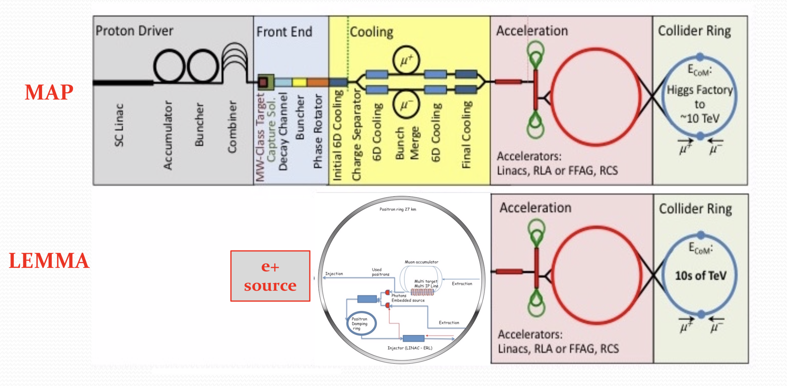


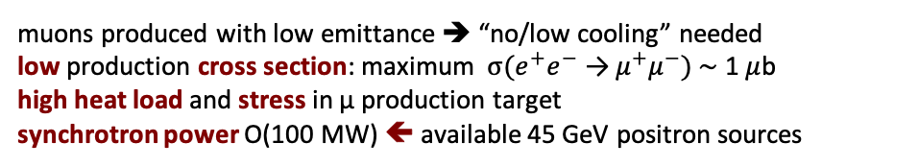
proton (MAP) vs positron (LEMMA) driven muon source
${10}^{13}$-${10}^{14}μ/sec$
MUON JINST, shorturl.at/kxKU7
arXiv:1905.05747v2 [physics.acc-ph]
➔ need consolidation to overcome technical limitations to reach higher muon intensities
muons produced with low emittance ➔ “no/low cooling” needed
low production cross section: maximum $σ(e^{+}e^{−} \text{→}{ μ}^{+}μ^{−})$ $\sim$ 1$μ$b
high heat load and stress in μ production target
synchrotron power O(100 MW) ⬅ available 45 GeV positron sources

Slide 14
Proton-driven Muon Collider Concept
US Muon Accelerator Program – MAP, launched in 2011, wound down in 2014
MAP developed a proton driver scheme and addressed the feasibility of the
novel technologies required for Muon Colliders and Neutrino Factories
Short, intense proton bunches to produce hadronic showers
Pions decay into muons that can be captured
Muon are captured, bunched and then cooled
Acceleration to collision energy
Collision
Design is not complete but did not find anything that does not work
No CDR exists No coherent baseline No reliable cost estimate
"Muon Accelerator for Particle Physics," JINST,
https://iopscience.iop.org/journal/1748-0221/page/extraproc46

Slide 15
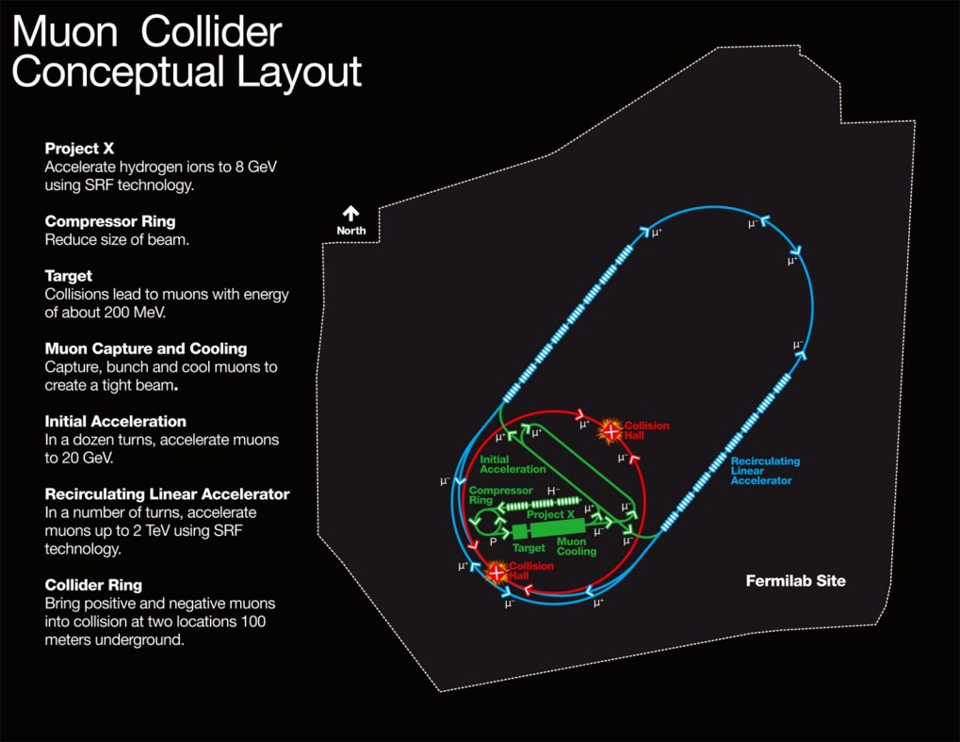
Muon Collider Parameters
M. Palmer: https://map.fnal.gov/
Site Radiation mitigation with depth and lattice design: ≤ 10 TeV
Exquisite Energy Resolution
Allows Direct Measurement
of Higgs Width
Success of advanced cooling
concepts a several × 10³²

Slide 16
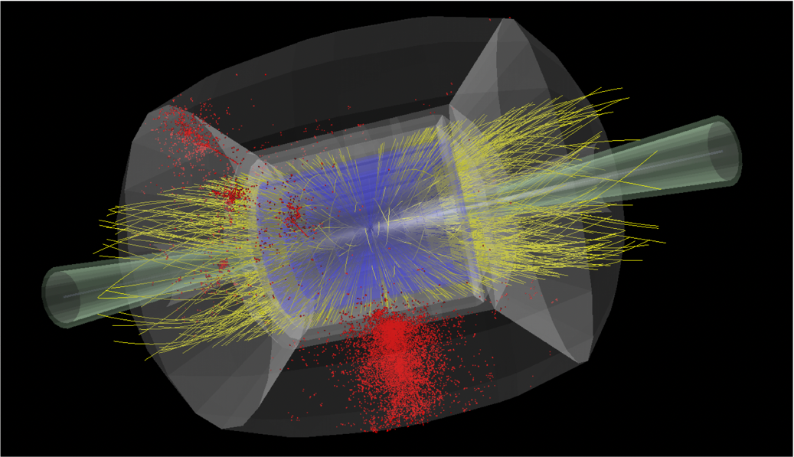
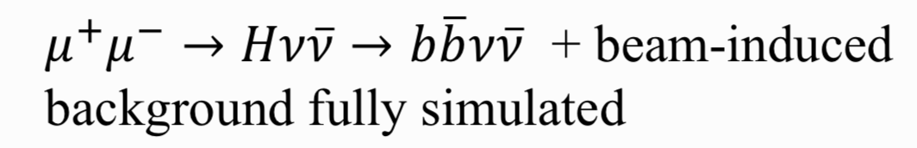
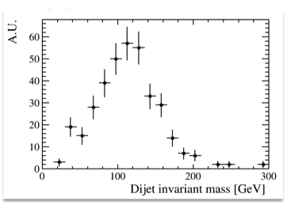
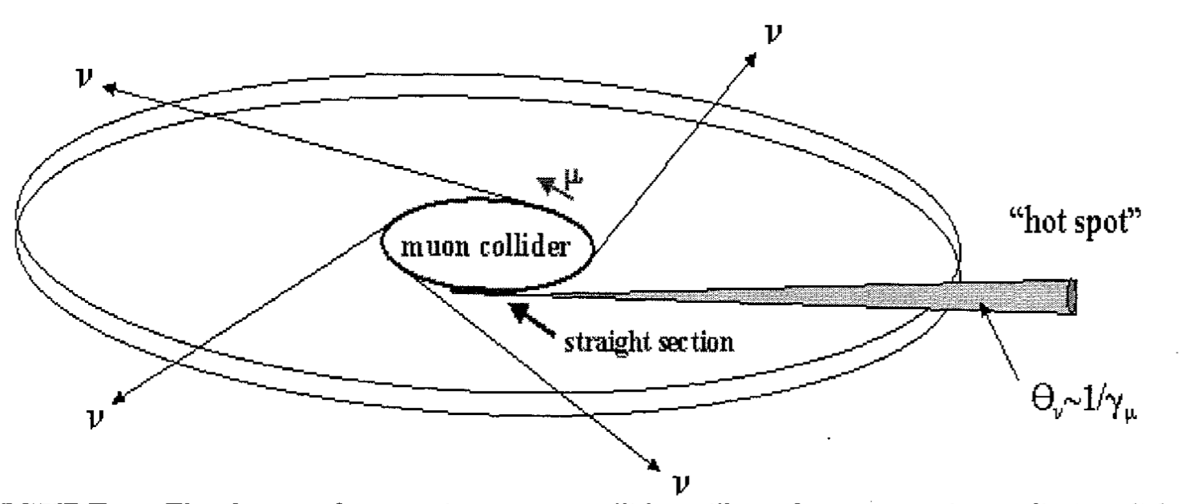
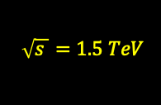
Muon Beams Induced Background
Nikolai Mokhov et al. - MARS15
$$\sqrt{s }=1.5 TeV$$
Neutrino radiation
critical limit at highest energies
Paola Sala – Youri Robert
CERN Muon Collider Meeting https://indico.cern.ch/event/886491/
On-going simulations and studies for mitigation even with existing/future tunnels

Slide 17
e-groups towards an international collaboration
E-group: MUONCOLLIDER-DETECTOR-PHYSICS
MUST-phydet@cern.ch
E-group: MUONCOLLIDER-FACILITY
MUST-mac@cern.ch

Slide 18
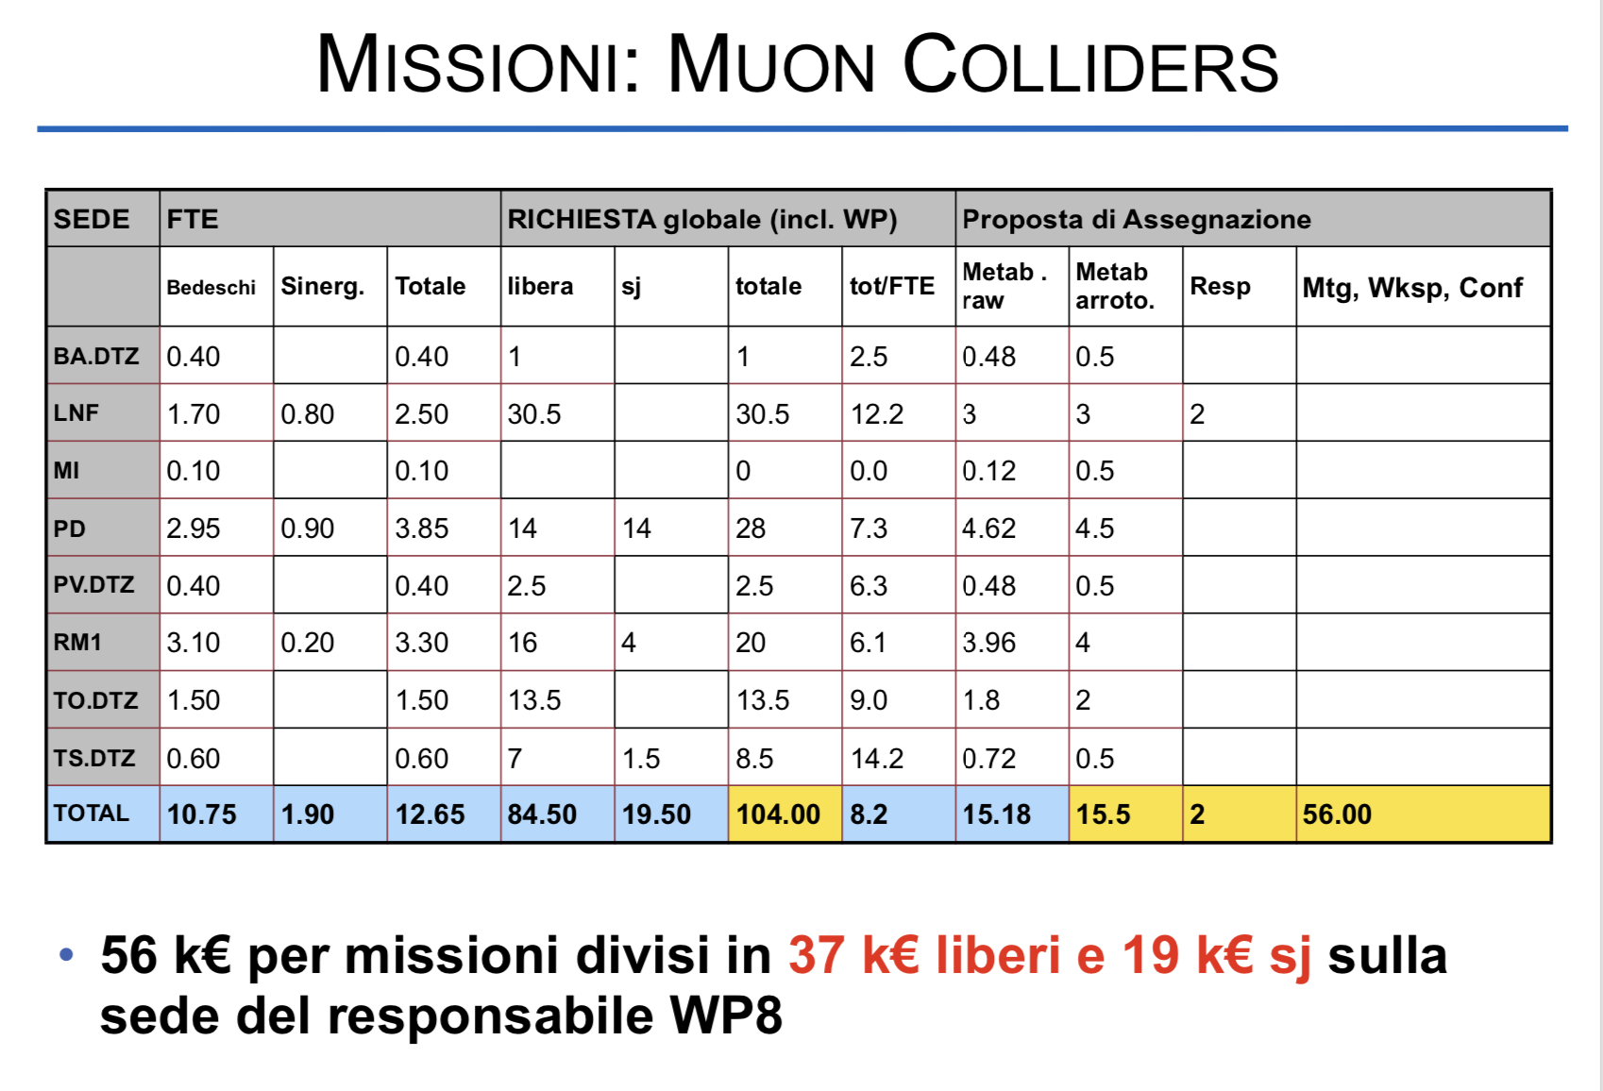
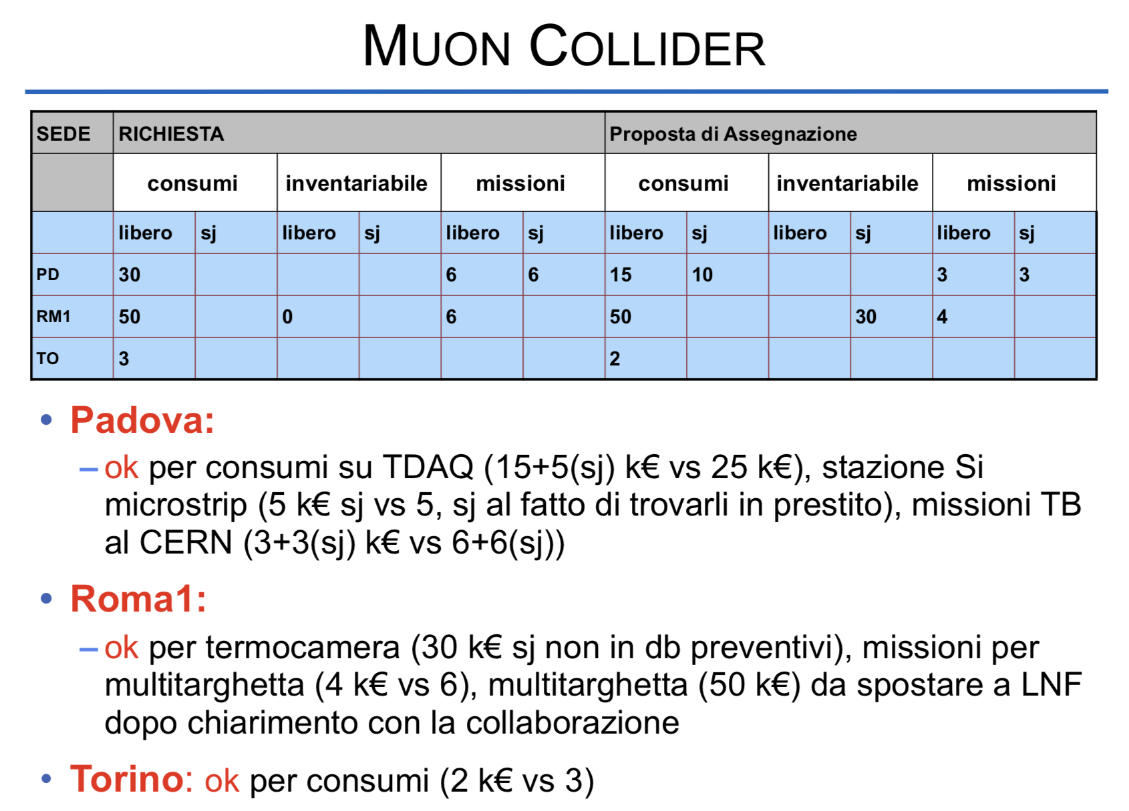
Referee CSN1 – RD_FA 2020

