Slide 1
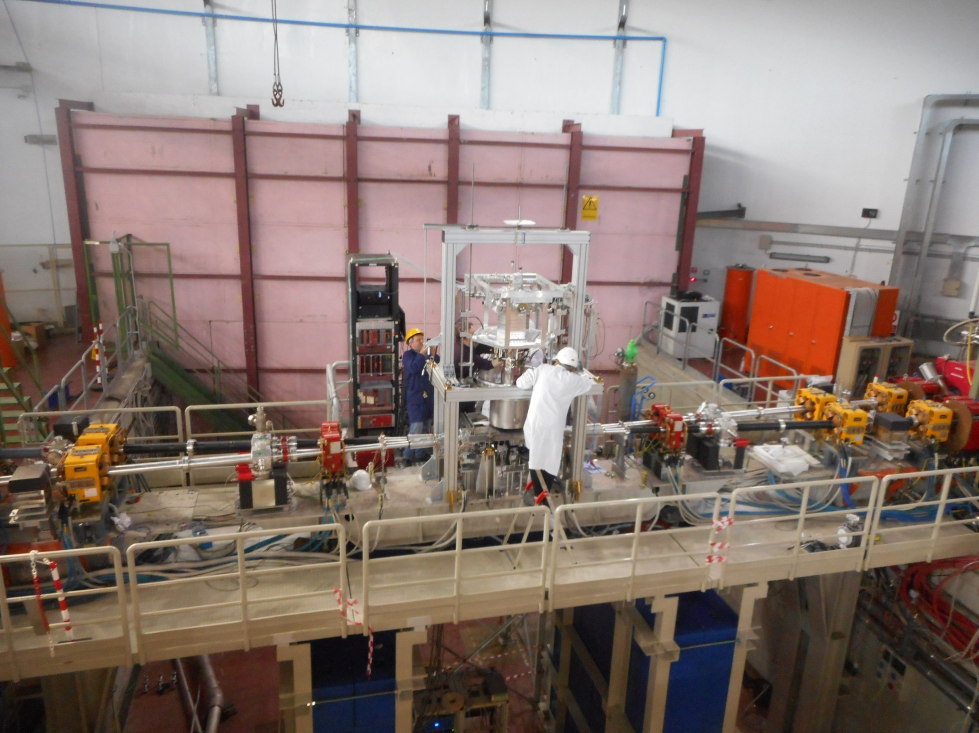
SIDDHARTA-2 Status Report
Catalina Curceanu, INFN - LNF
on behalf of the SIDDHARTA-2 collaboration
7th May 2020
SC-LNF

Slide 2
SIDDHARTA-2
SIlicon Drift Detector for Hadronic Atom Research by Timing Applications
Research Center for Electron Photon Science (ELPH), Tohoku University

Slide 3
Papers 2020 2020:
Kaonic Atoms to Investigate Global Symmetry Breaking, Symmetry 12(4) (2020) 547
Kaonic atoms experiment at the DAΦNE collider by SIDDHARTA/SIDDHARTA-2, SciPost Phys.Proc. 3 (2020) 039
Kaonic Deuterium Precision Measurement at DAΦNE: The SIDDHARTA-2 Experiment, Springer Proc.Phys. 238 (2020) 965
Low-Energy K− Nucleon/Multi-nucleon Interaction Studies by AMADEUS, Springer Proc.Phys. 238 (2020) 937
Kaonic Deuterium Measurement with SIDDHARTA-2 on DAΦNE, Acta Phys.Polon. B51 (2020) 251
Recent Experimental Results on the Low-energy K− Interaction with Nucleons by AMADEUS, Acta Phys.Polon. B51 (2020) 121
Revisiting the Charged Kaon Mass, Acta Phys.Polon. B51 (2020) 115

Slide 4
SIDDHARTA-2 - present status
We are presently in Phase 1 with SIDDHARTINO:
during the commissioning of DAΦNE optimization with the SIDDHARTINO setup
for the K-⁴He measurement
(with 8 SDD arrays)
This phase should have been realized within
3/9th April but….Coronavirus….rescheduled
(Phase 2: Kd measurement)

Slide 5
MID-TERM MEETING OF THE LNF SCIENTIFIC COMMITTEE 06/02/2020
During the following two months, first priority should be given to the completion of the DAFNE commissioning steps and to the subsequent delivery of high-quality collisions to SIDDHARTHINO, at the best possible S/B conditions, with the goal to complete the presented SIDDHARTINO programme.

Slide 6
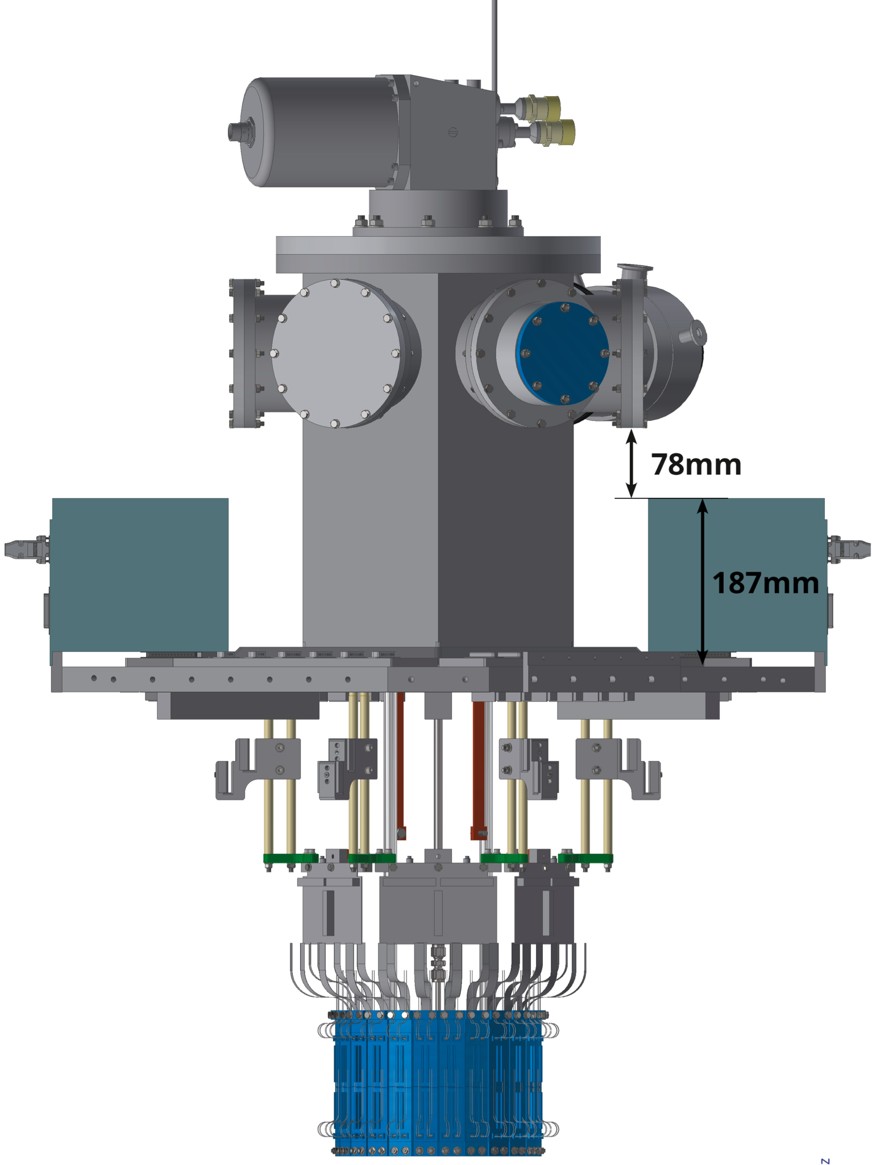
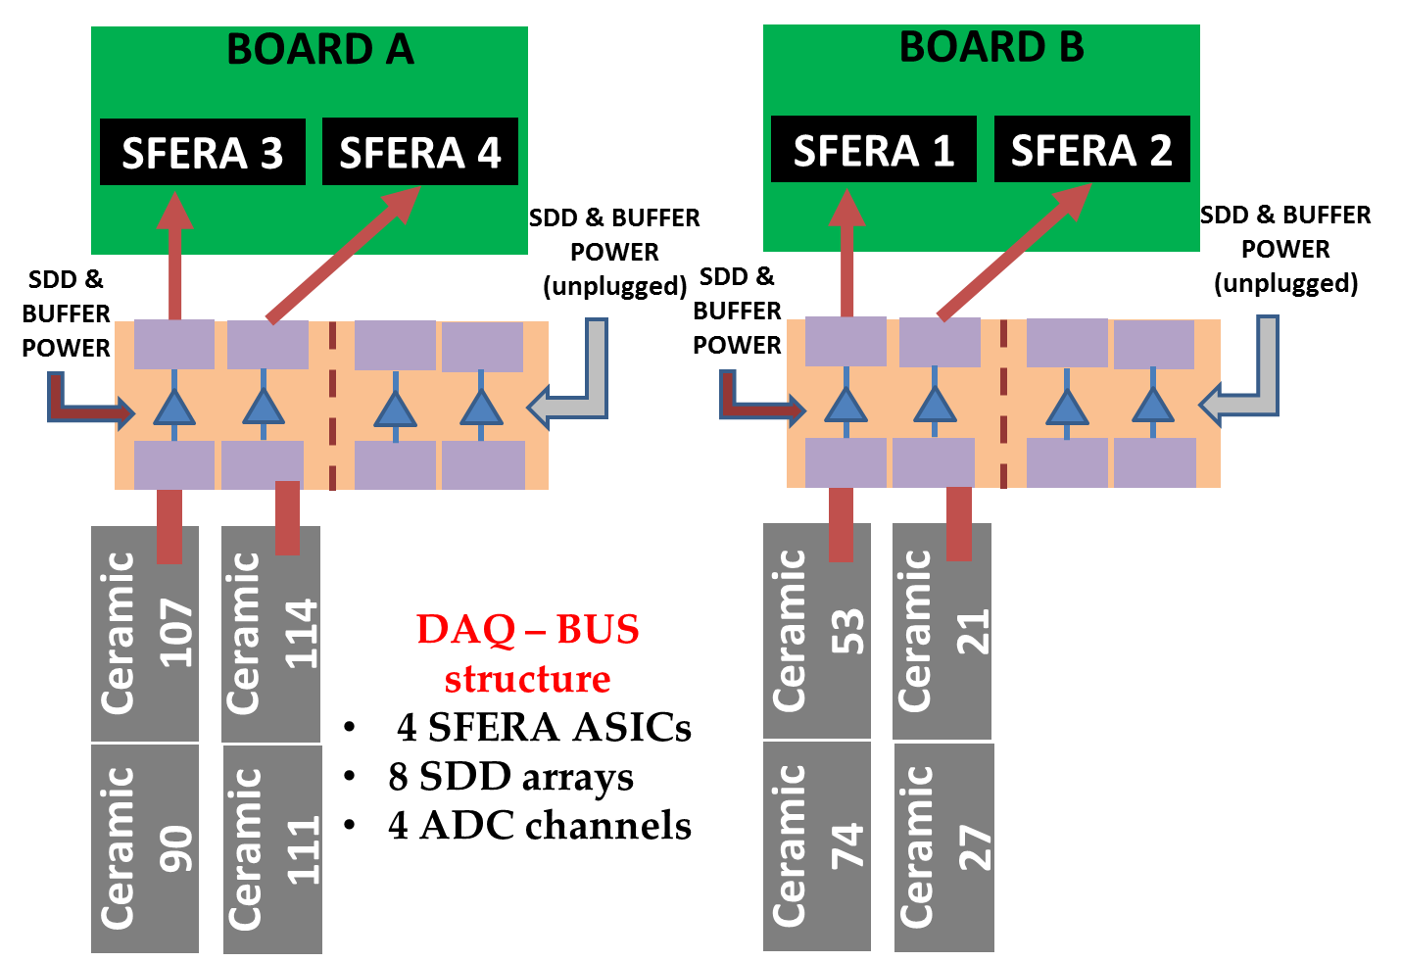
SIDDHARTINO = SIDDHARTA-2 with 8 SDD’s
DAQ BUS configuration

Slide 7
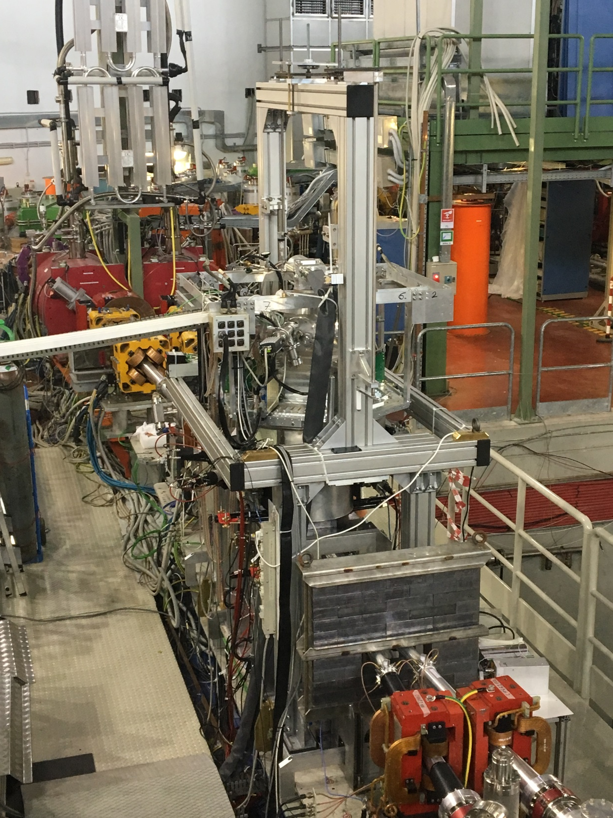

Slide 8
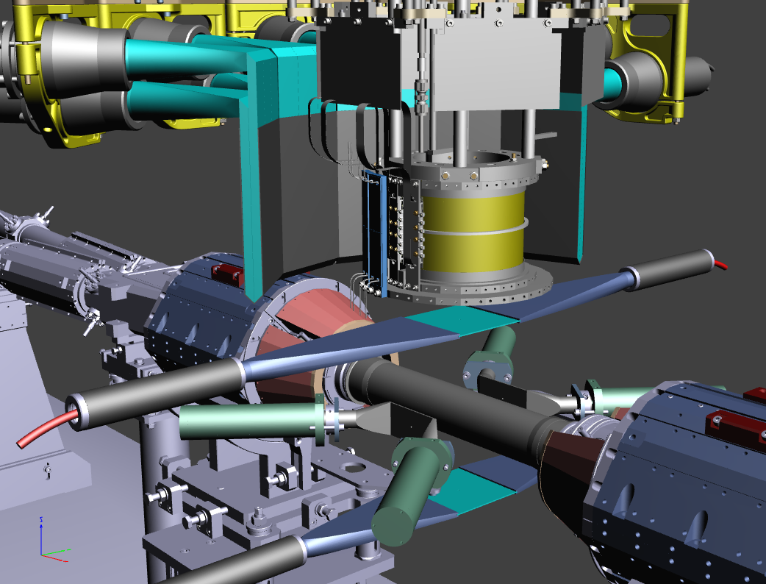
SIDDHARTINO apparatus and constraints
equipped with
8 SDD (1/6)
arrays
target filled
with He-4 gas
trigger
setup lifted by ~100 mm w.r.t. nominal position
complete
Veto systems
SIDDHARTA-2 luminosity monitor included
work with DAΦNE
luminosity monitor
Aim: confirm when DAΦNE background conditions are similar
to those in SIDDHARTA 2009

Slide 9
Work done:
SDD calibration optimization
Luminosity measurement: SIDDHARTA-2 luminometer and kaon trigger
Procedure for comparison between SIDDHARTA and SIDDHARTA-2 refinement

Slide 10
Work done:
SDD calibration optimization
Luminosity measurement: SIDDHARTA-2 luminometer and kaon trigger
Procedure for comparison between SIDDHARTA and SIDDHARTA-2 refinement

Slide 11
Optimization of calibration of SDD’s in DAΦNE
SDD 48 BUS 5
Counts
X-ray tube
target materials
ADC channels
W Lα
Counts
Ti Kα
Fe Kα
Cu Kα
W Lβ1
W Lβ2
Missing lines in the upper region
Ti Kβ
Fe Kβ
W Lγ
Energy [eV]

Slide 12
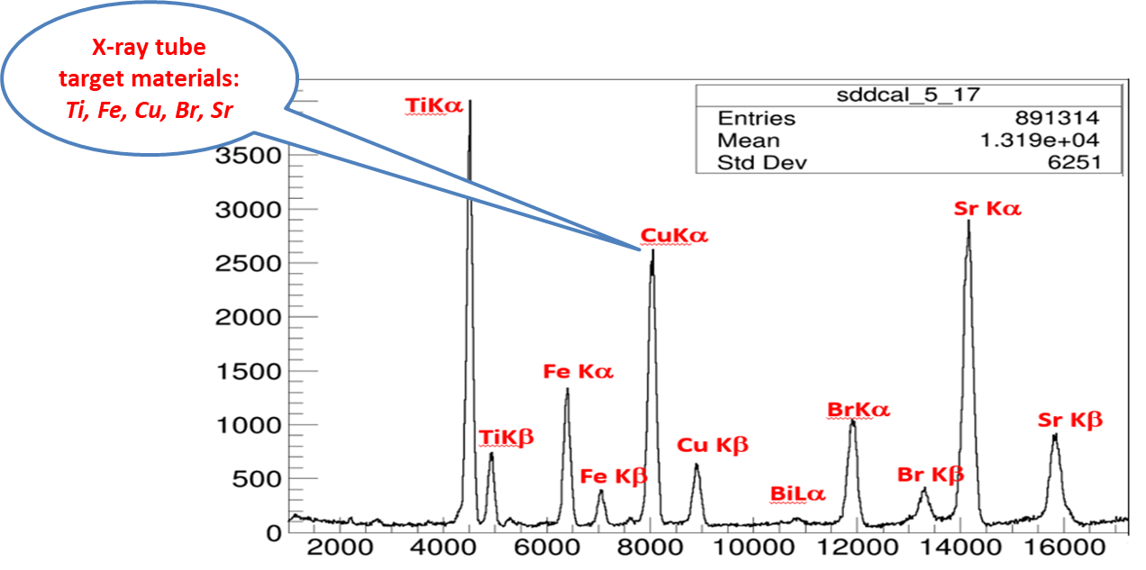
Optimization of calibration of SDD’s in DAΦNE (window to eliminate W)

Slide 13
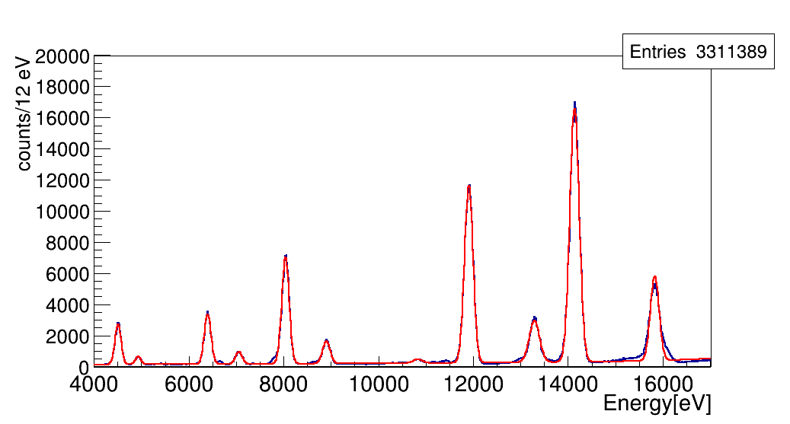
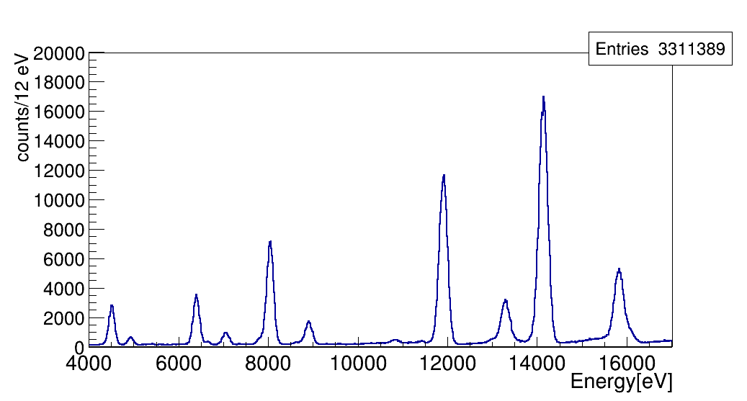
Spectrum SDD 52 (X-ray tube and beam)
Sr Kα
Br Kα
Cu Kα
Sr Kβ
Ti Kα
Fe Kα
Br Kβ
Cu Kβ
Ti Kβ
Fe Kβ
Sr Kα
Br Kα
Cu Kα
Sr Kβ
Ti Kα
Fe Kα
Br Kβ
Ti Kβ
Fe Kβ
Cu Kβ

Slide 14
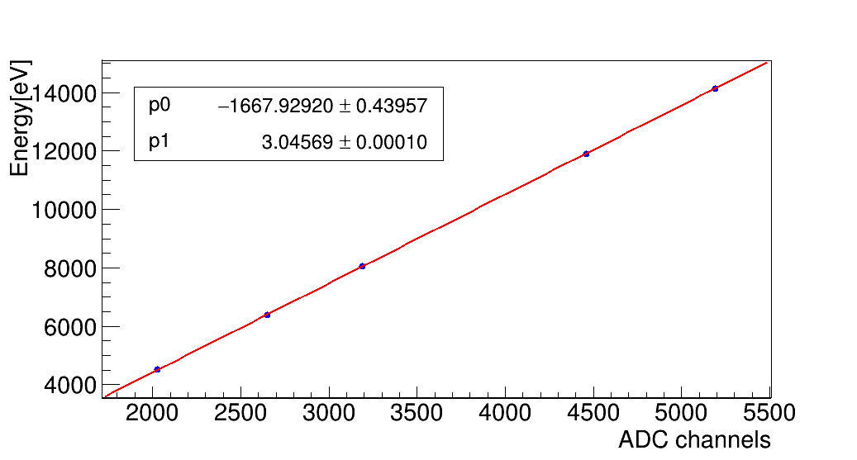
Calibration Line SDD 52
Sr Kα
Br Kα
Cu Kα
Fe Kα
Ti Kα

Slide 15
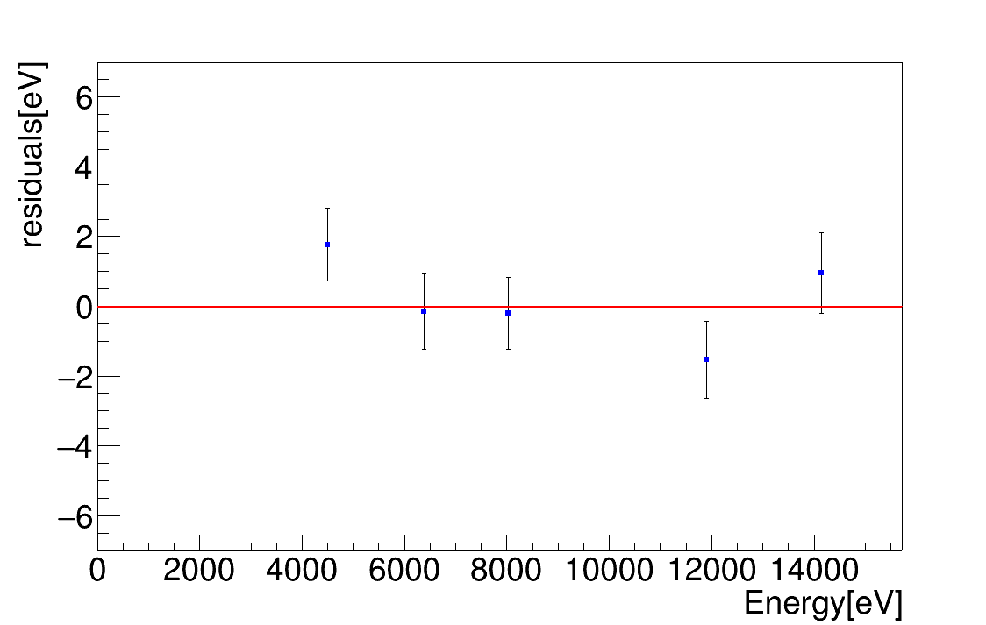
Residuals SDD 52 – systematics at 7 keV (Kd) within 2 eV
Ti Kα
Sr Kα
Fe Kα
Cu Kα
Br Kα

Slide 16
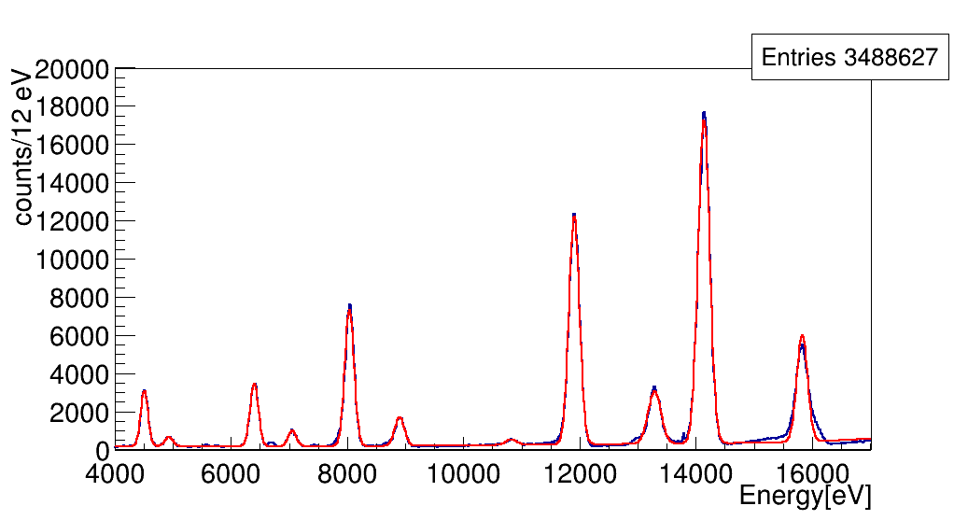
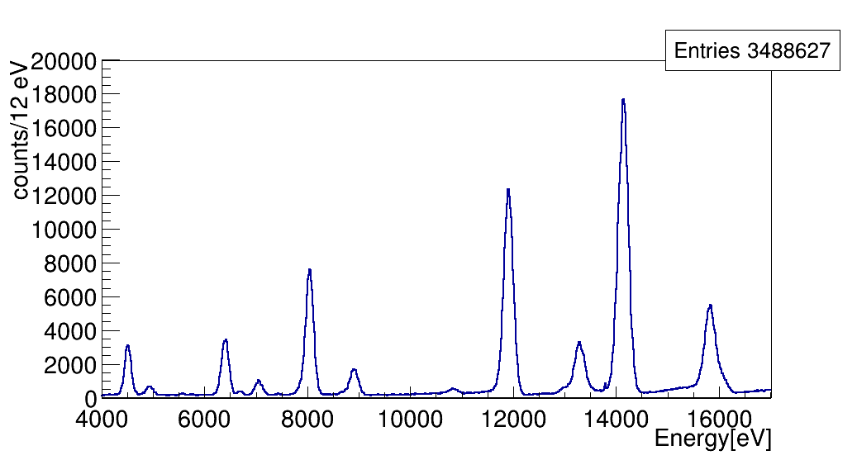
Spectrum SDD 53
Sr Kα
Br Kα
Cu Kα
Sr Kβ
Ti Kα
Fe Kα
Br Kβ
Fe Kβ
Cu Kβ
Ti Kβ
Sr Kα
Br Kα
Cu Kα
Sr Kβ
Ti Kα
Fe Kα
Cu Kβ
Br Kβ
Ti Kβ
Fe Kβ

Slide 17
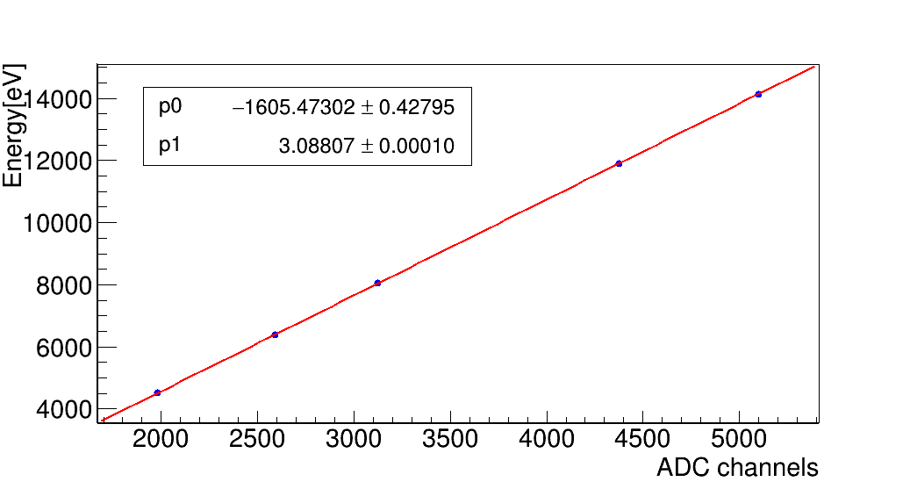
Calibration Line SDD 53
Sr Kα
Br Kα
Cu Kα
Fe Kα
Ti Kα

Slide 18
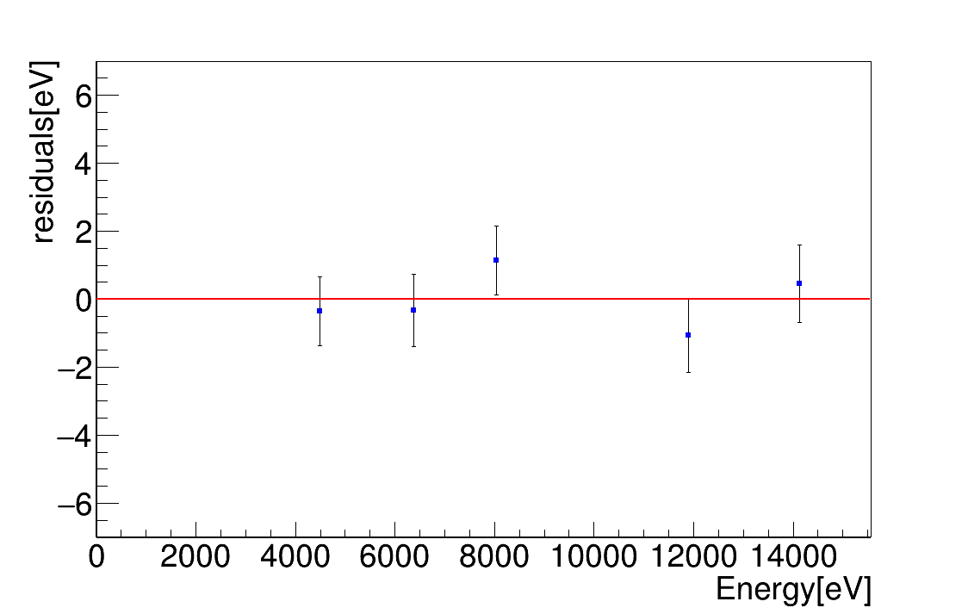
Residuals SDD 53
We plan to write a technical article – JINST or NIM
Cu Kα
Sr Kα
Ti Kα
Fe Kα
Br Kα

Slide 19
Work done:
SDD calibration optimization
Luminosity measurement: SIDDHARTA-2 luminometer and kaon trigger
Procedure for comparison between SIDDHARTA and SIDDHARTA-2 refinement

Slide 20
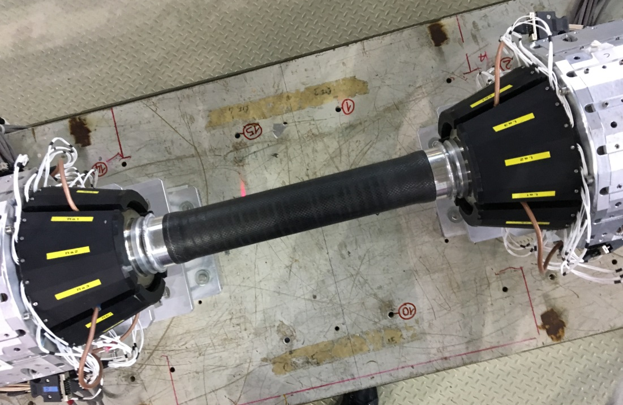
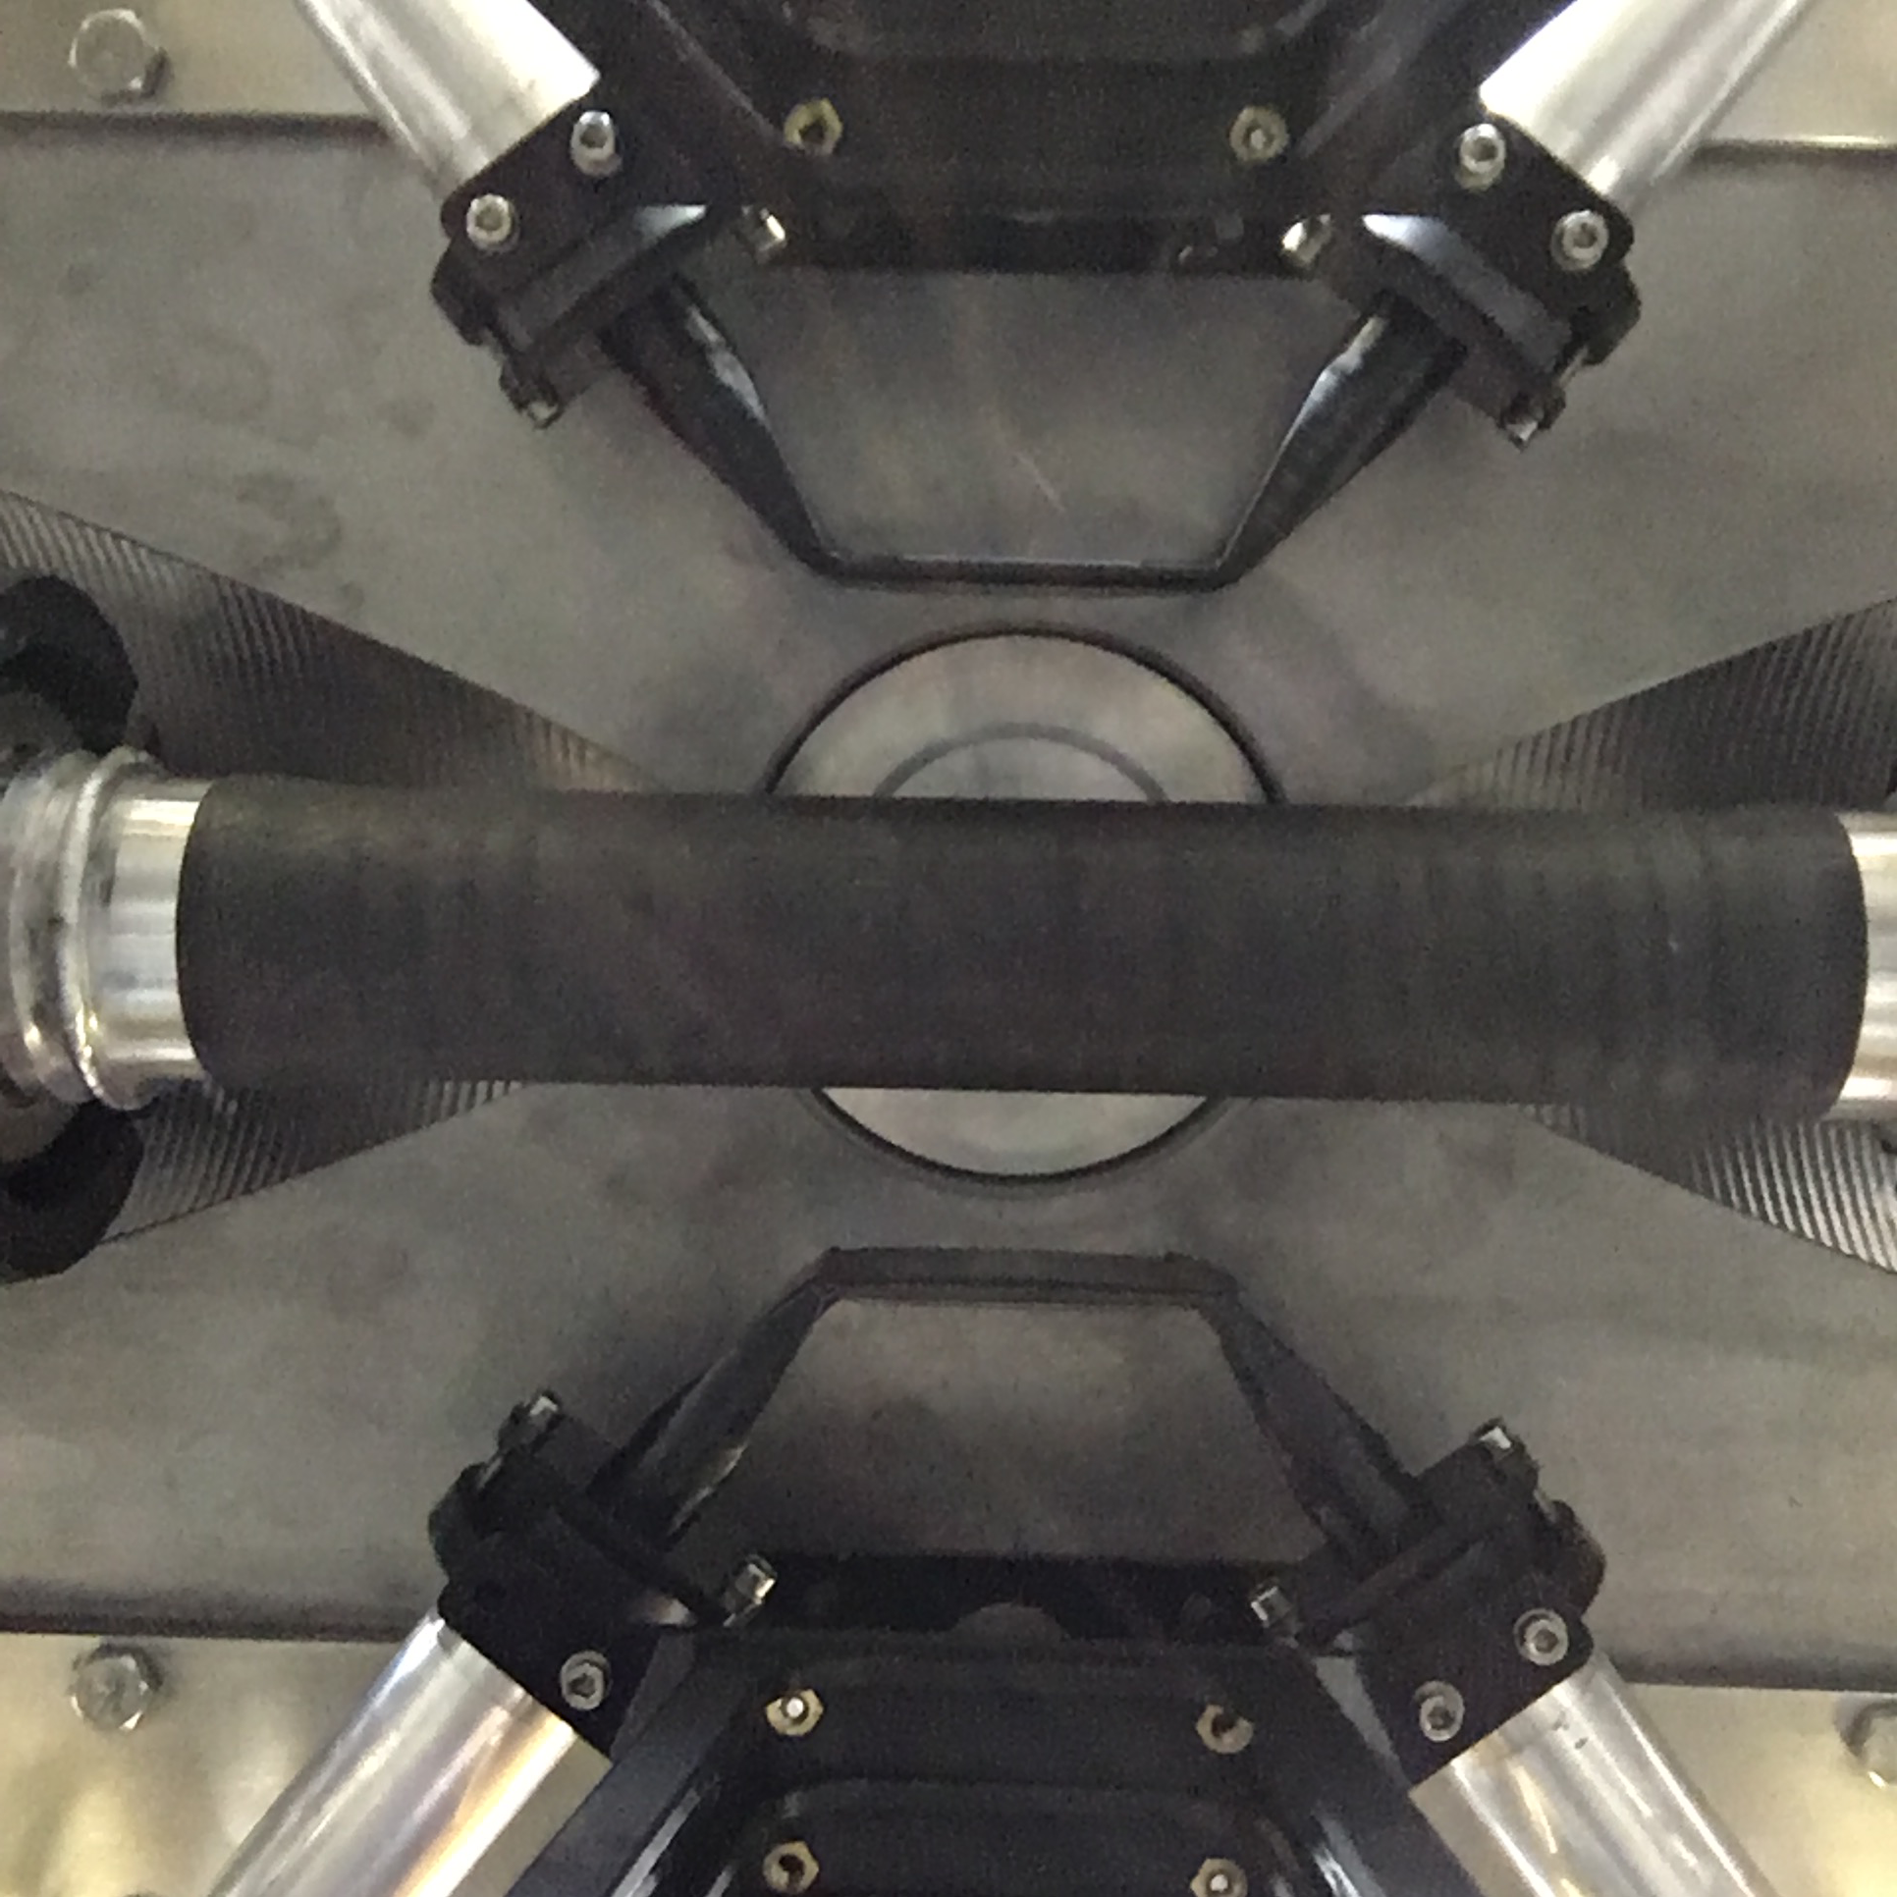
DAΦ NE luminosity monitor
SIDDHARTA-2
luminosity monitor

Slide 21
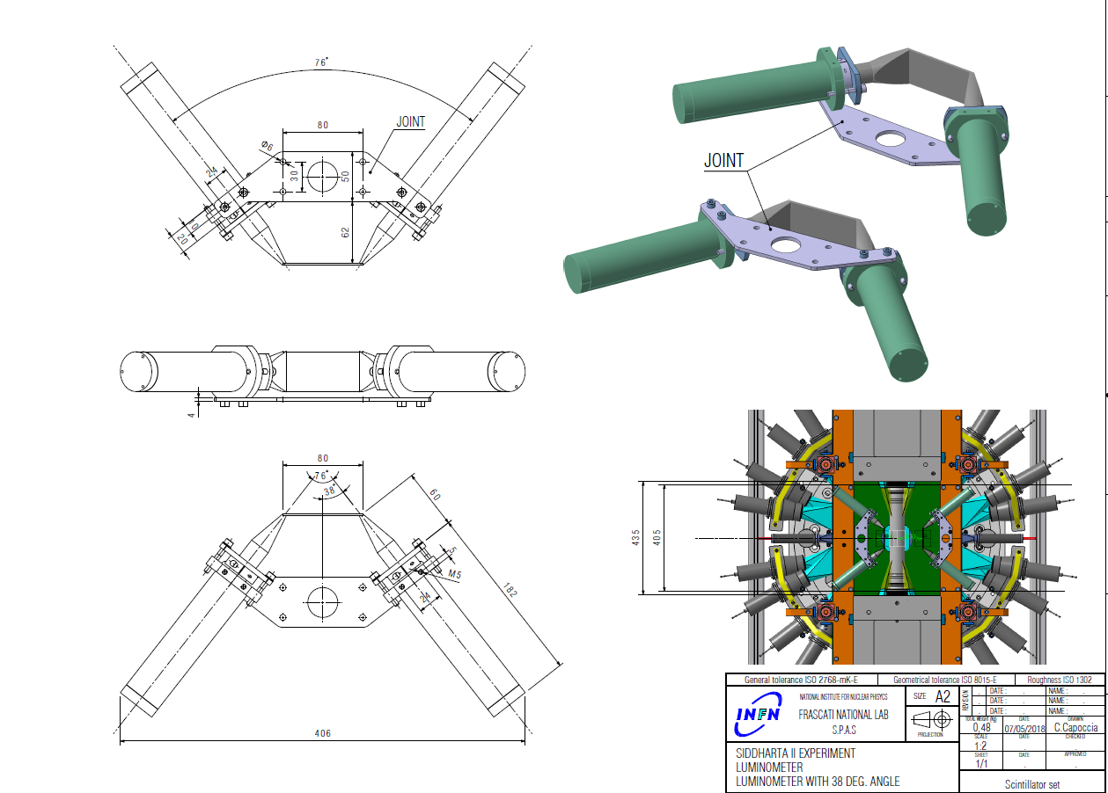
Luminometer of SIDDHARTA-2
scintillator: 80x40x2 mm³ Scionix EJ-200 (BC408)
R4998 PMTs (at an angle of 38deg with respect to scintillator axis)
lightguides
aluminum tube + μMetal (0.1mm)
reflective and light proof foil
optical cement
/prepared by Andrzej Heczko/

Slide 22
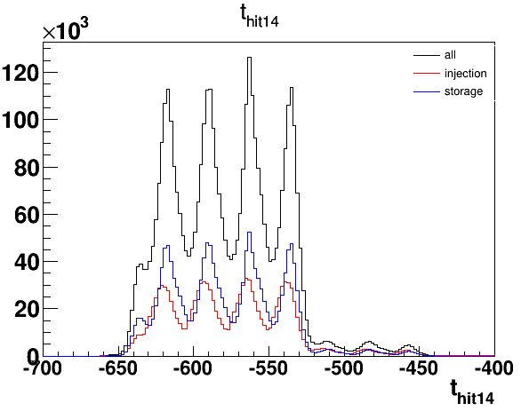
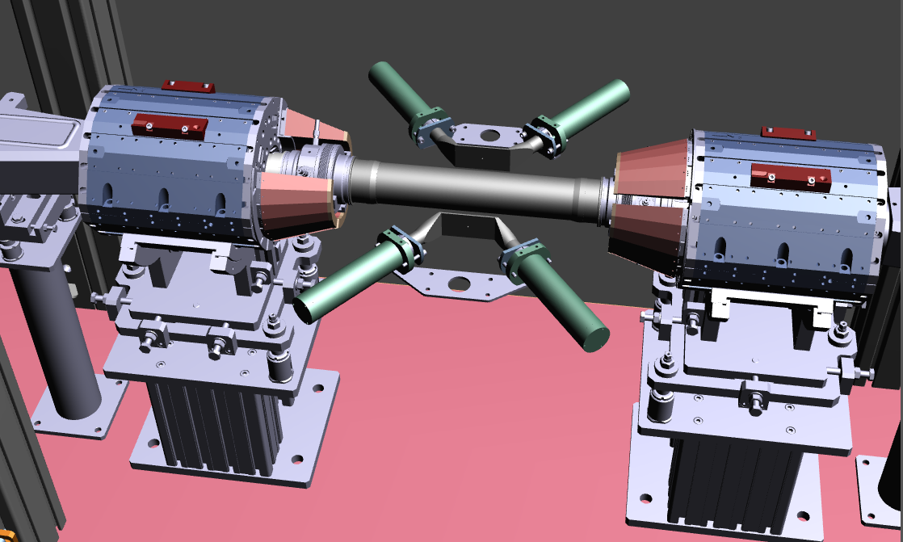
SIDDHARTA-2 Luminosity monitor
● 2 pairs of scintillators: 80x40x2 mm³
Scionix EJ-200
● R4998 PMTs Hamamatsu
● light-guides
● aluminum tube + μMetal (0.1mm)
● reflective and light proof foil
● optical cement
RF/4 structures
SIDDHARTA-2 Interaction regions

Slide 23
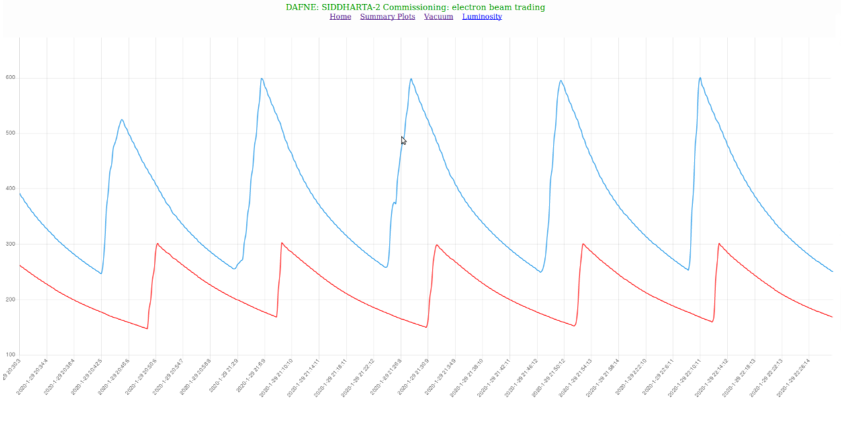

Slide 24
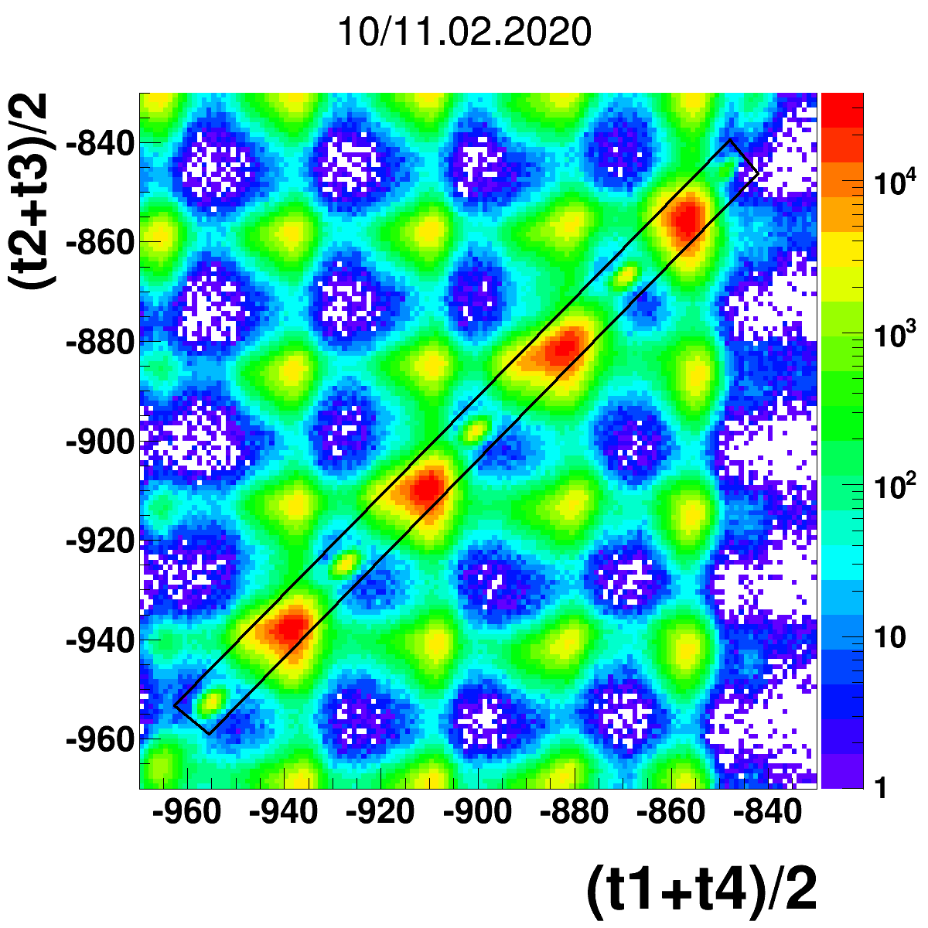
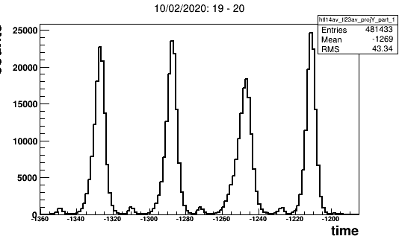
Luminosity estimation
Projection on diagonal
MIPS
Kaons
[channel/100ps]
After cut
Kaons
[channel/100ps]

Slide 25
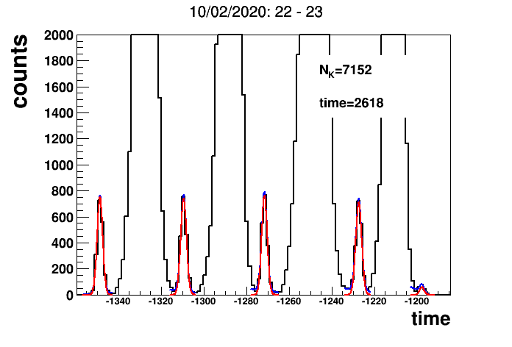
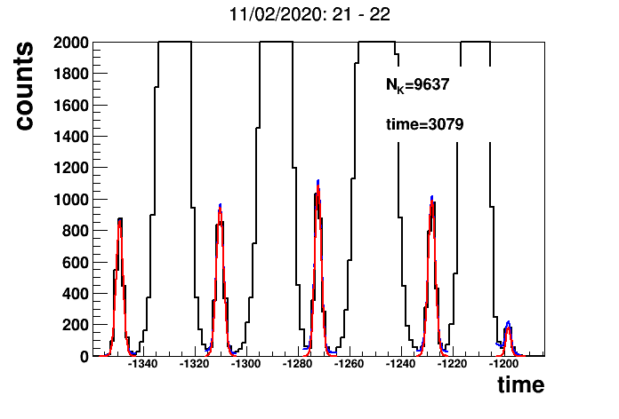
11/02/2020
1 hour slots

Slide 26
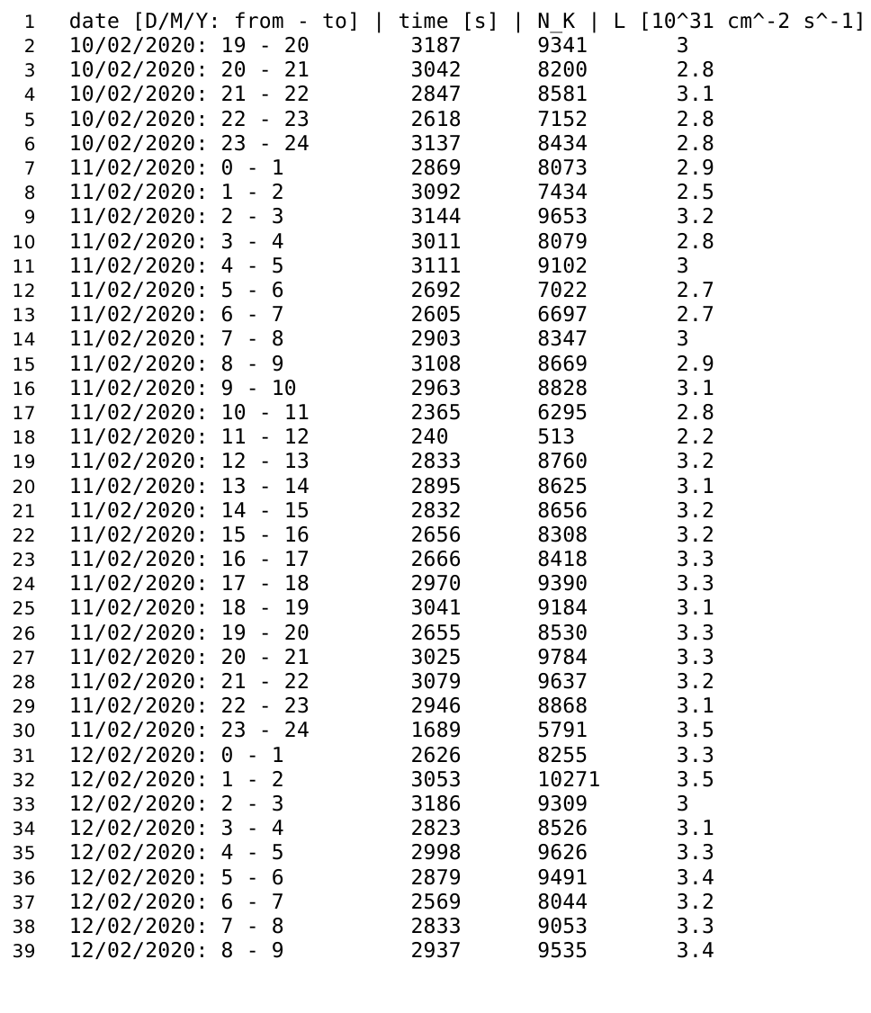
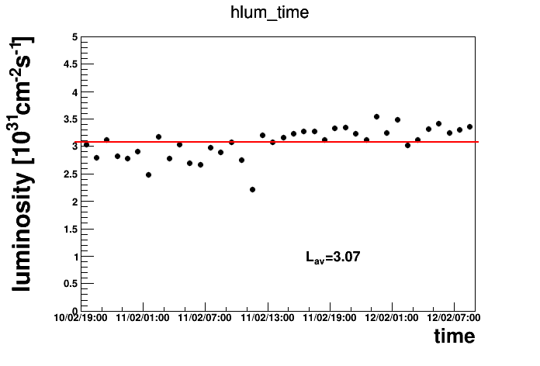
Measurement
10.02 18:22 - 12.02 9:19
PRELIMINARY
𝛆=5.79+-0.04%
10³² cm⁻² s⁻²=> 𝛔_{𝛗->e+e-}=3.34 𝛍b
334𝛗/s => 167K/s

Slide 27
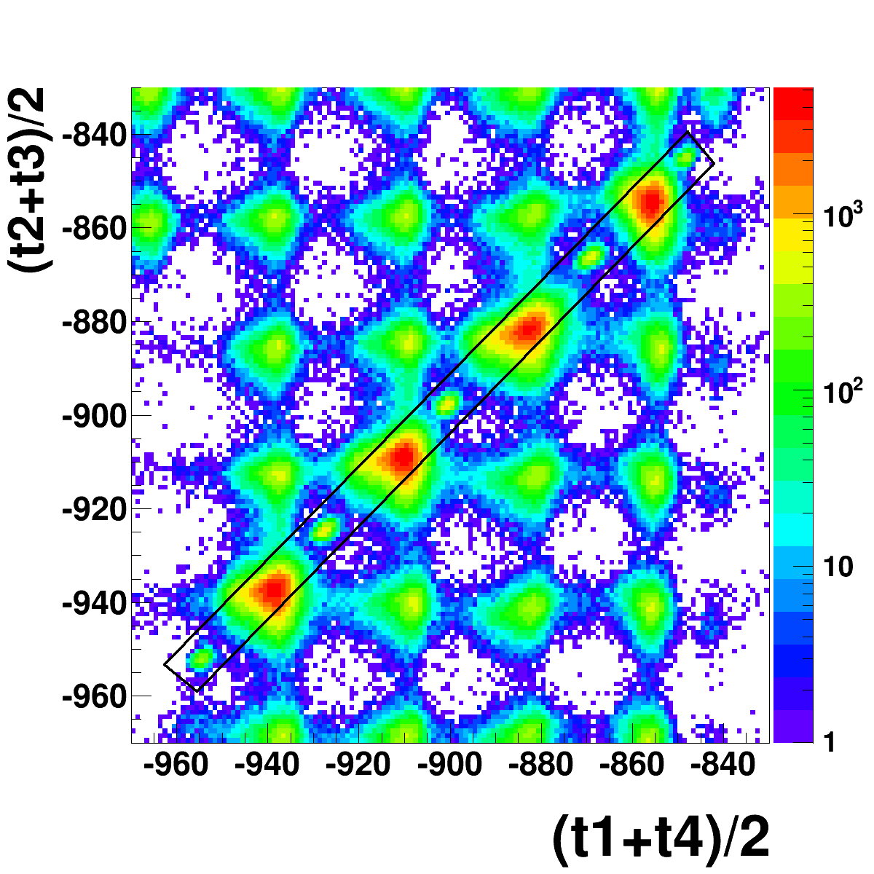
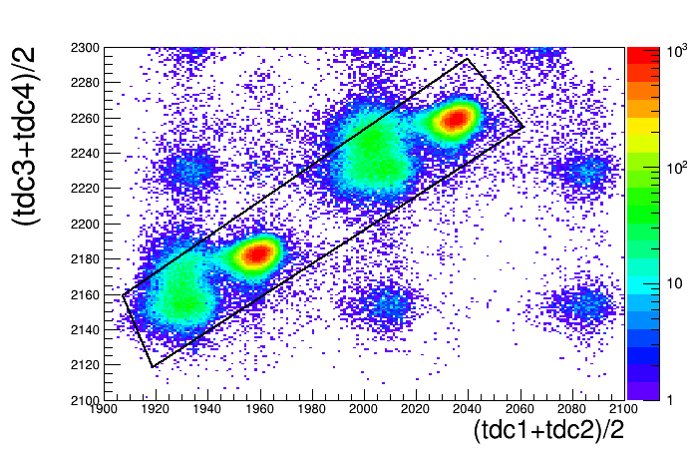
Luminometer
Kaon Monitor
L =7.2cm
𝛆=5.79+-0.04%
L =11.0cm
𝛆=4.82+-0.03%
MIPS
MIPS
Kaons
Kaons

Slide 28
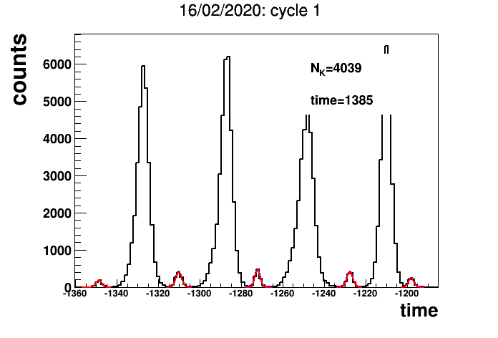
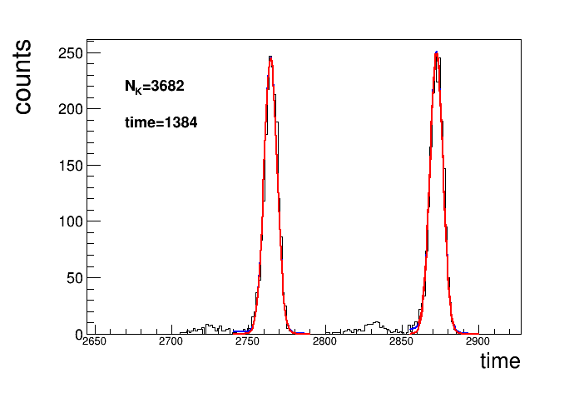
Luminometer
Kaon Monitor
L =7.2cm
𝛆=5.79+-0.04%
L =11.0cm
𝛆=4.82+-0.03%
Projections on diagonal

Slide 29
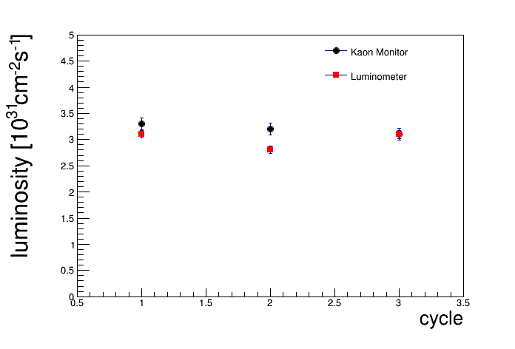
Comparison: Kaon Monitor and Luminometer
Good Agreement
date [D/M/Y] | time [s] | N_K | L | L_err
16/02/2020: cycle 1 1384 3696 3.3 0.12
16/02/2020: cycle 2 1404 3634 3.2 0.12
16/02/2020: cycle 3 1317 3324 3.1 0.08
//Luminometer
16/02/2020: cycle 1 1385 4039 3.1 0.07
16/02/2020: cycle 2 1405 3753 2.8 0.07
16/02/2020: cycle 3 1317 3868 3.1 0.08
L [10^31 cm^-2 s^-1]
PRELIMINARY
Plan: paper on cross section phi

Slide 30
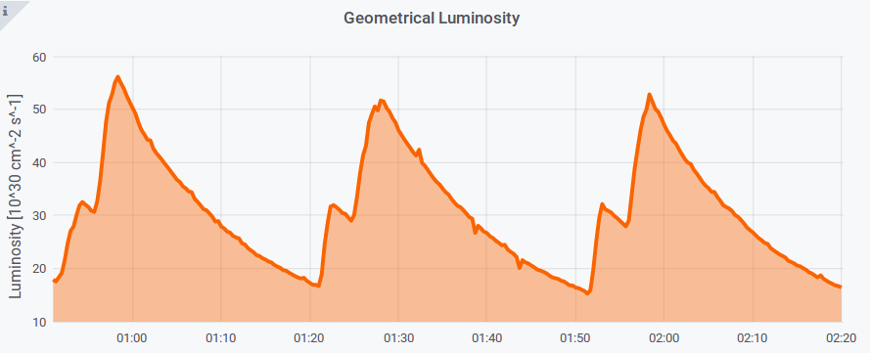
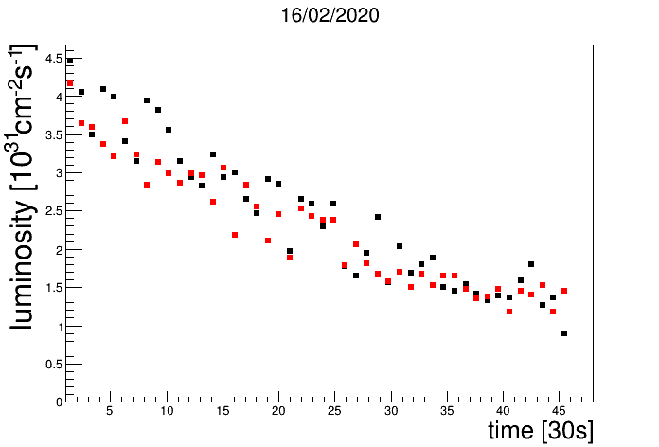
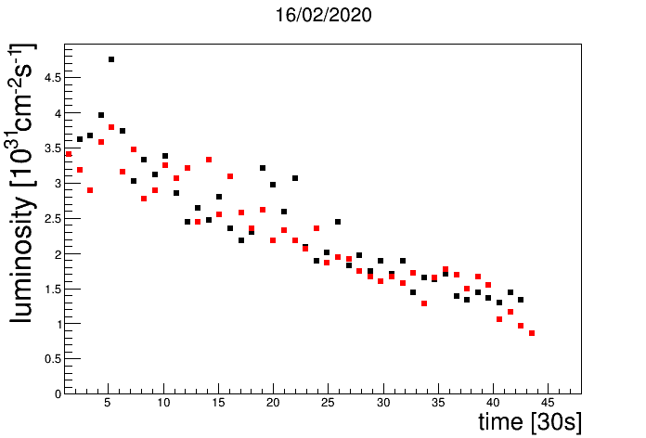
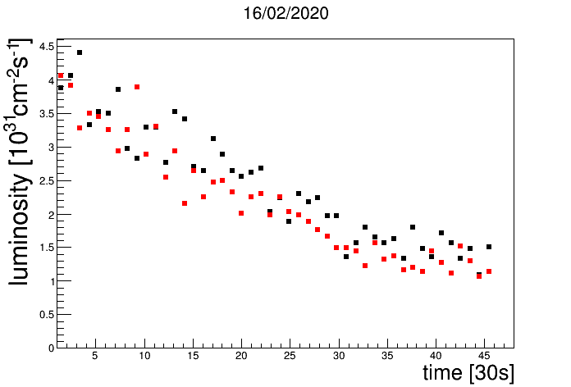
DAFNE: geometric luminosity
DAFNE
Luminometer
Kaon Monitor

Slide 31
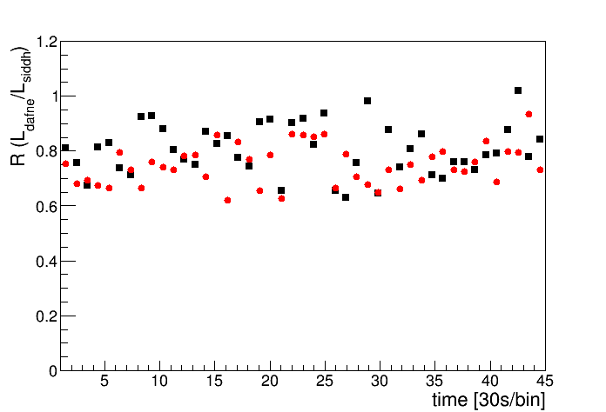
Rate: L_DAFNE/L_SIDDHARTA
Luminometer
Kaon Monitor

Slide 32
Work done:
SDD calibration optimization
Luminosity measurement: SIDDHARTA-2 luminometer and kaon trigger
Procedure for comparison between SIDDHARTA and SIDDHARTA-2 refinement

Slide 33
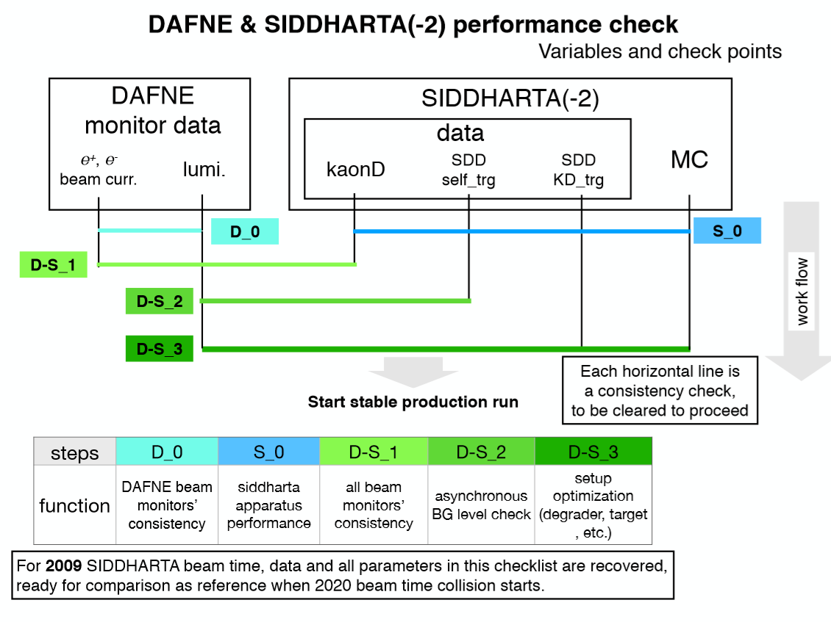

Slide 34
SIDDHARTA-2 strategy and requests
Run with SIDDHARTINO for: optimization of run conditions (backg) verified with the
measurement of K-⁴He (8 SDD arrays)
3rd April 2020 -> autumn/october 2020 (meet. 16/04/2020 for planning)
(S/B on K-⁴He better than 100/1)
Phase 1
SIDDHARTINO

Slide 35
Work with SIDDHARTINO inside DAFNE during months: June – September – optimization veto, trigger, DAQ, calib….
Refine optimization of luminosity detector and cross check with DAFNE luminometer
Background reduction and optimization together with DAFNE for kaonic atoms measurements
Kaonic Helium measurement with SIDDHARTINO -> background w.r.t. SIDDHARTA and SIDDHARTA-2 for Kd goal
depending on DAFNE’s plans (autumn 2020?)
4) HPGe test run in parallel with SIDDHARTINO
Plan – Phase1:

Slide 36
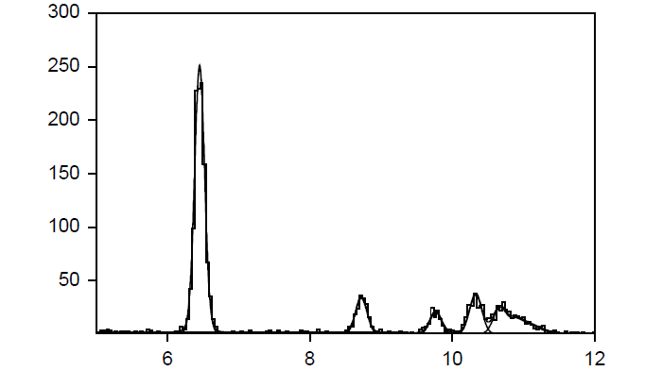
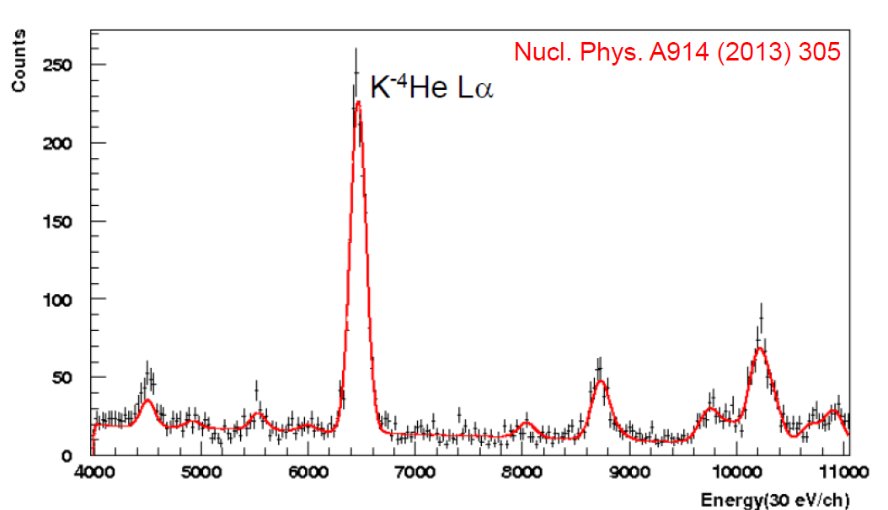
SIDDHARTINO – K-⁴He test measurement
About 1000 events in La peak, S/B > 100/1
(ideally should be 300/1)
Position precision :
6.452 +- 0.002 (stat) keV
SIDDHARTINO expected spectrum for ~ 50 pb⁻¹
(one week of data taking in
SIDDHARTA-like conditions)
K-⁴He Lα
3d -> 2p
counts
SIDDHARTA
measurement
5d -> 2p
4d -> 2p
6d -> 2p
Energy [keV]
S/B was 10/1 for the K-⁴He
measurement with ~ 30 pb⁻¹

Slide 37
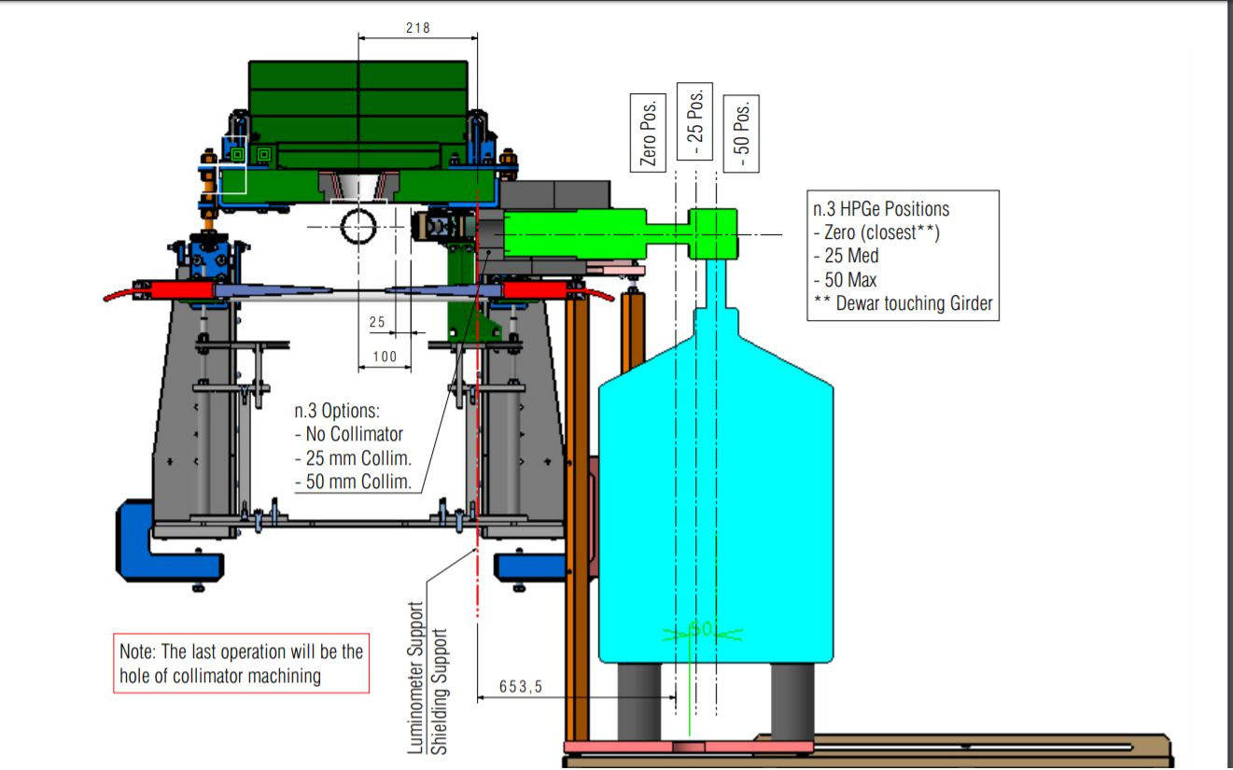
HPGe: kaonic lead for kaon mass

Slide 38
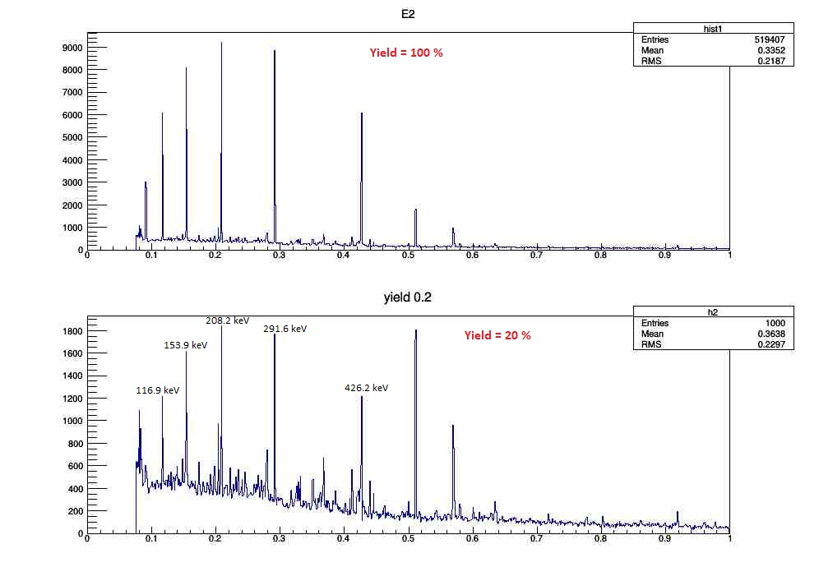
HPGe detector on d=110mm from the Pb target (closest position), 100 pb^-1
X-rays from Pb, in the peak at 291.6 keV there are approx 2.316 X-rays (yield 20%).

Slide 39
the SC issues the following recommendations:
• During the following two months (i.e. within 3rd April 2020) -> months from October to December 2020, first priority should be given to the completion of the DAFNE commissioning steps and to the subsequent delivery of high-quality collisions to SIDDHARTHINO, at the best possible S/B conditions, with the goal to complete the presented SIDDHARTINO programme.

Slide 40
Following this plan, the BTF-2 setup and SIDDHARTA-2 operations will happen in late summer/fall-> 2021. A closer look at the progress and this longer-term schedule will be made during the next regular SC meeting in May 2020.

Slide 41
SIDDHARTA-2 strategy and requests
we will install all the SDDs (48 SDD arrays) in late summer/autumn (?) 2020 -> rescheduled 2021 and start the kaonic deuterium measurement for a run of 800 pb⁻¹
Action plan for Kd measurement:
First run with SIDDHARTA-2 setup as planned
(about 300 pb⁻¹ integrated)
Second run with optimized shielding, readout electronics and other necessary optimizations; (for other 500 pb⁻¹ integrated)
Test runs for other kaonic atoms measurements (HPGE…)
Phase 2
SIDDHARTA-2

Slide 42
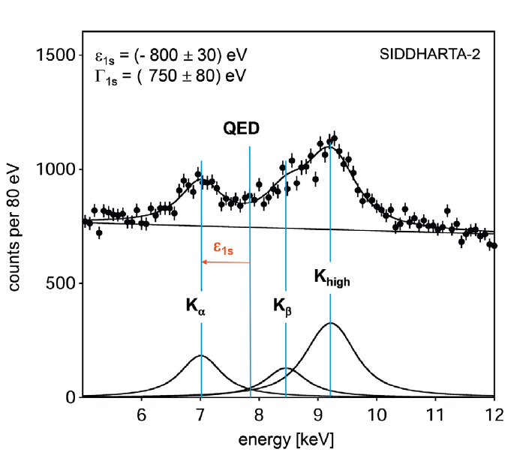
Phase-2: SIDDHARTA-2 K-d measurement
Kaonic deuterium run in (all) 2021
for S/B as 1/3:
for an integrated luminosity
of 800 pb⁻¹
to perform the first measurement of the strong interaction induced energy shift and width of the kaonic deuterium ground state
(similar precision as K⁻p) !
Includes:
veto-2 second layer
Optimizations SDD, veto1
Shielding, trigger….
achievable precision
Notes:
This window of opportunity should be realized.

Slide 43
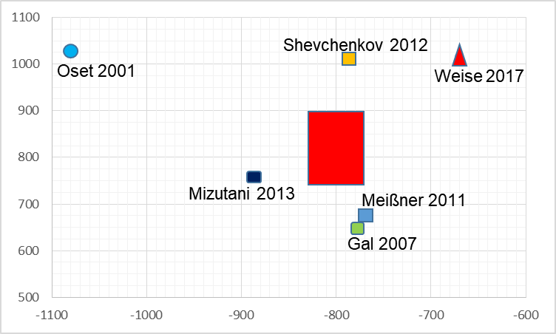
SIDDHARTA-2 kaonic deuterium at DAFNE
width [eV]
shift [eV]

Slide 44
Kaonic Atoms to Investigate Global Symmetry Breaking, Symmetry 12(4) (2020) 547
A very useful instrument to study the chiral and SU(3) symmetries breaking mechanisms is the measurement of X-ray transitions in kaonic hydrogen and kaonic deuterium. These measurements allow to extract the antikaon-nucleon scattering lengths, which are relevant for the calculation of the kaon-nucleon sigma terms,related to the chiral and SU(3) symmetries breaking part of the Hamiltonian…. This will fuel theoretical activities aimed to extract the kaon-nucleon sigma terms and unveil the mechanism at work in the chiral and SU(3) symmetry breaking, on which the mass of (most part) of our visible Universe depends.

Slide 45
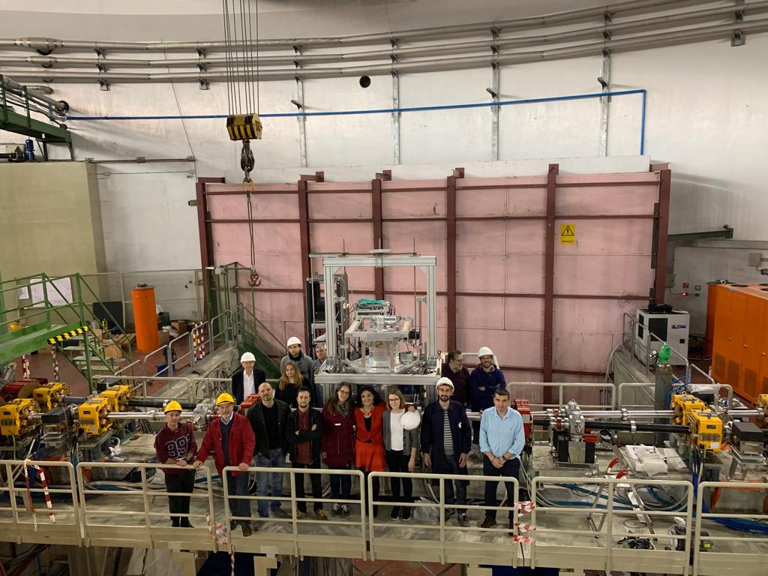
Many thanks to the DAFNE team
and LNF Management
and to INFN gr 3!

