Slide 1
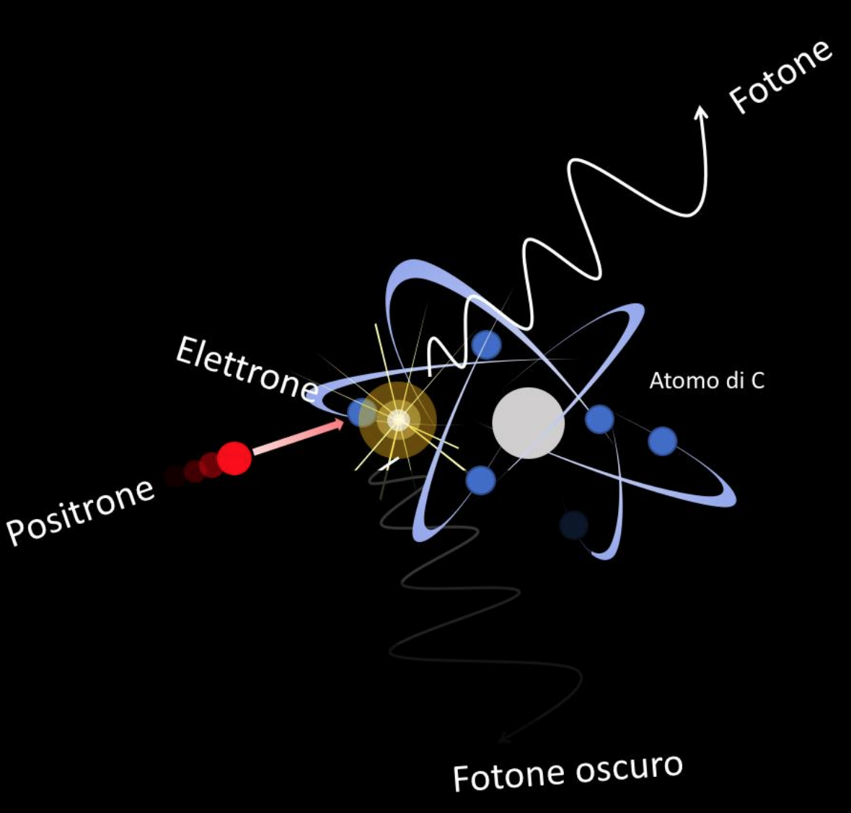
PADME status report
Mauro Raggi,
Sapienza Università di Roma e INFN Roma
59th meeting of the LNF Scientific Commitee

Slide 2
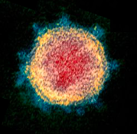
Outline
Consequences of COVID-19 on PADME plans
Planning for the PADME detector commissioning
Tentative 2020 run plan
RUN-1 data analysis status
Expected publications 2020 - early 2021

Slide 3
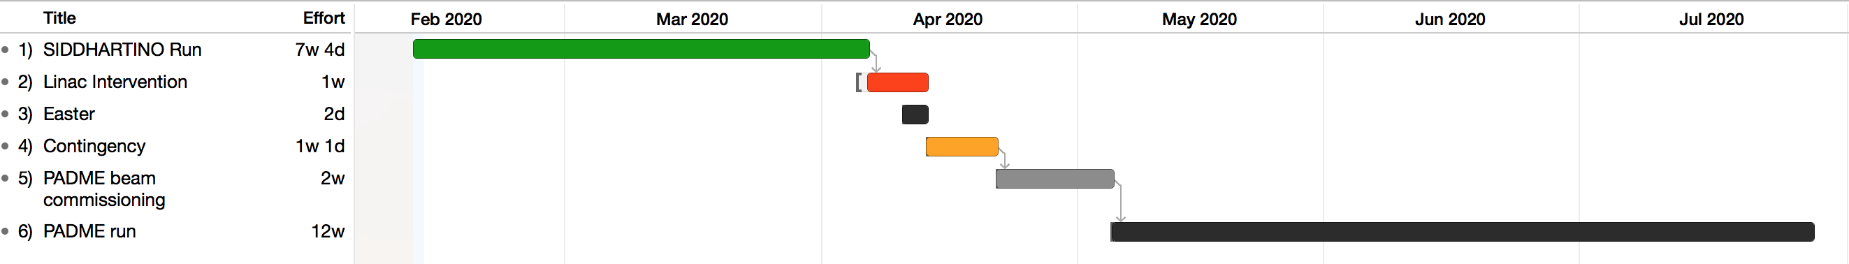
Mid-term scicom plan 2020 and COVID
Plan of the last meeting of the SciCom
COVID-19
emergency
Normal operating conditions??
COVID-19
phase II
Original plan
  15-30 April PADME beam commissioning
  Start data taking first week of May
Beginning of March COVID-19 emergency started
Beginning of May COVID phase II start (~ 60 days complete shutdown)
Normal operating conditions?

Slide 4
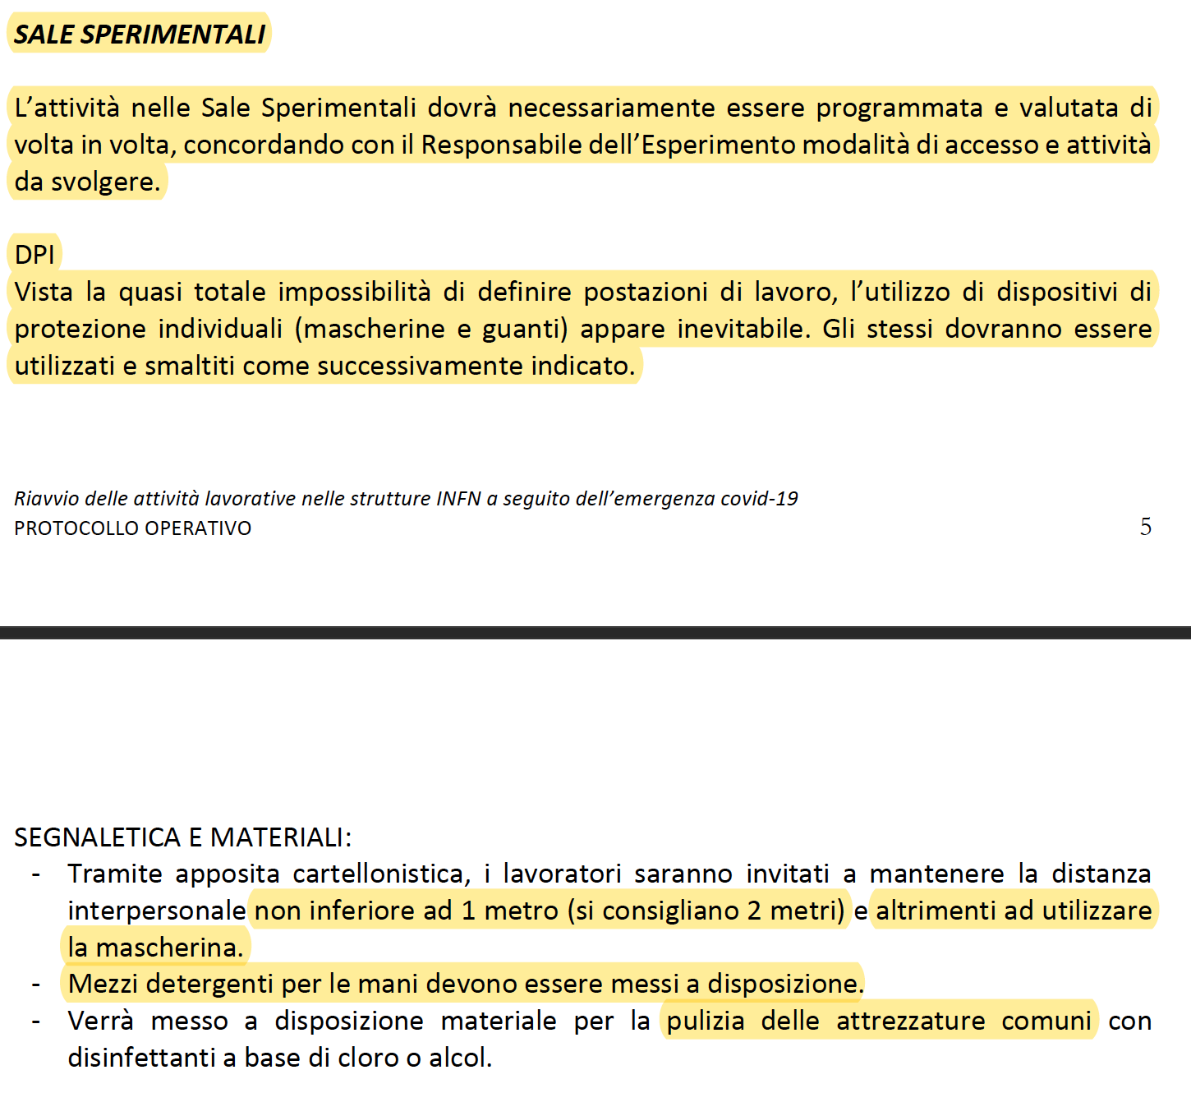
COVID-19 INFN protocol May 5th

Slide 5
Impact on PADME restart activities
Almost no hardware preparation activity during COVID-19 phase I
  Need to perform some repairs and small improvements
Activity during phase II limited to RM1 and LNF personnel only
  Only travels from Rome to LNF
  No help in preparation activities from Lecce, Sofia and Torino
COVID-19 rules limit personnel access in BTF area, control room, etc.
  Not possible to parallelize interventions in BTF area
  Access to the area should be coordinated with accelerator division operators
Restart operations much longer wrt to normal operating conditions
COVID-19 rules will also affect RUN-2 operations (e.g. use of control rooms)

Slide 6
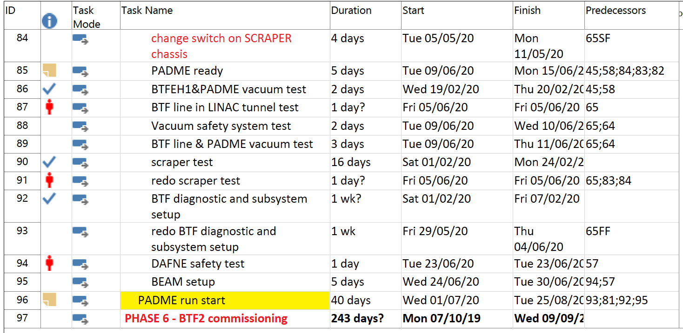
Tentative BTF schedule
see L. Foggetta’s talk for details

Slide 7
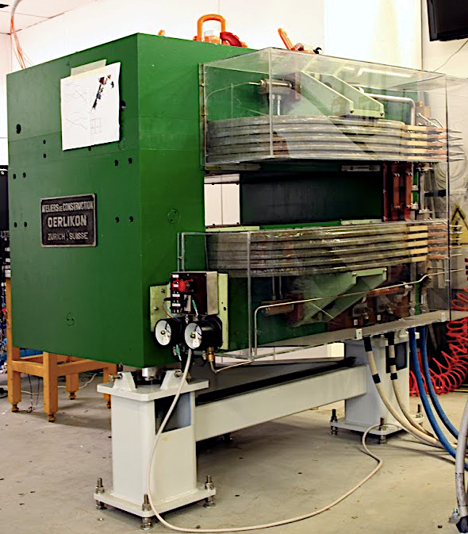
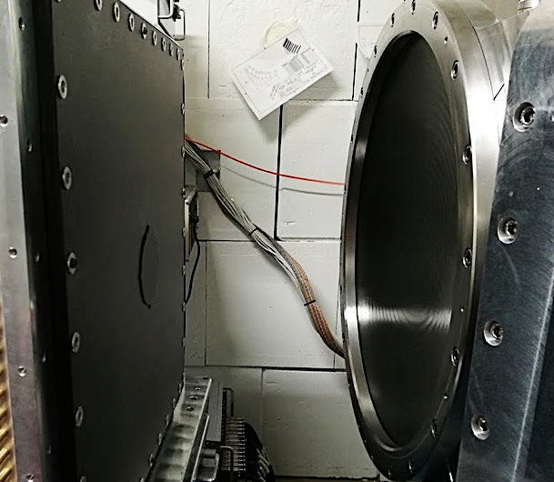
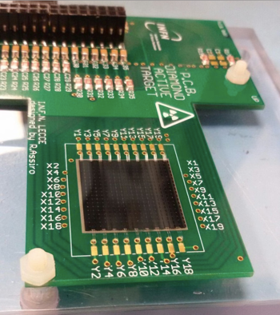
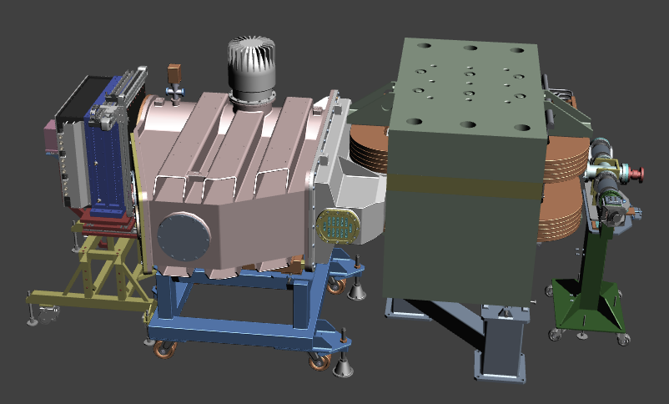
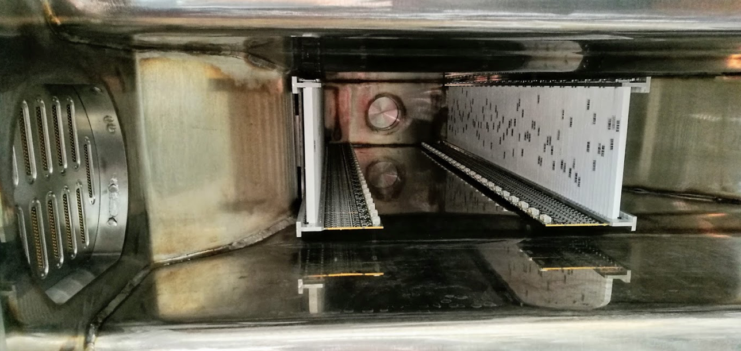
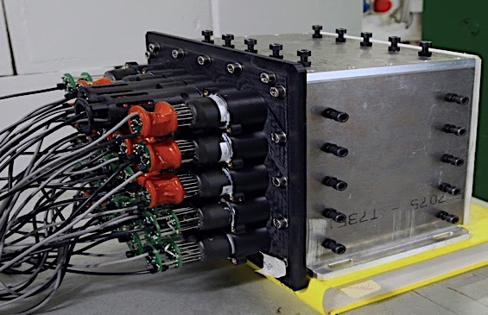
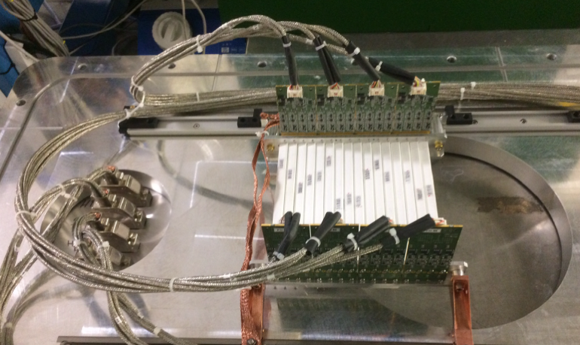
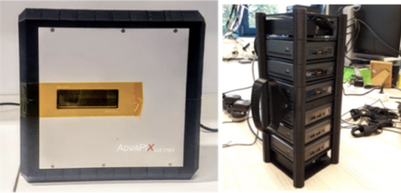
The PADME detector 1 slide
BGO calorimeter
(616 L3 endcap crystals:
Roma, Cornell U., LNF, LE)
Active target
Lecce & University Salento
C-fiber window
Dipole magnet
(CERN TE/NSC-MNC)
PbF₂ calorimeter
(MTA Atomki, Cornell U., LNF)
Veto scintillators
(University of Sofia, Roma)
TimePIX3 array
(ADVACAM, LNF, RM1)

Slide 8
Planned hardware operation
F. Ferrarotto: 2 days/week (PADME LAB)
G. Piperno: 2 days/week (BTF)
M. Raggi: 2 days/week (PADME LAB-BTF)
P. Valente: 1 day/week (BTF)
F. Ferrarotto: 2 days/week (BTF)
G. Piperno: 2 days/week (PADME CR)
E. Leonardi: 1 day/week (PADME CR)
M. Raggi: 2 days/week (BTF)
P. Valente: 1 day/week (PADME CR)

Slide 9
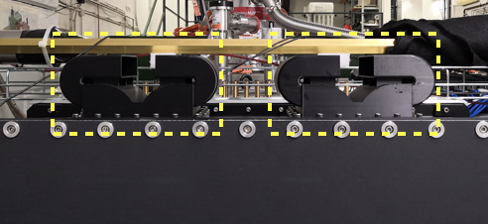
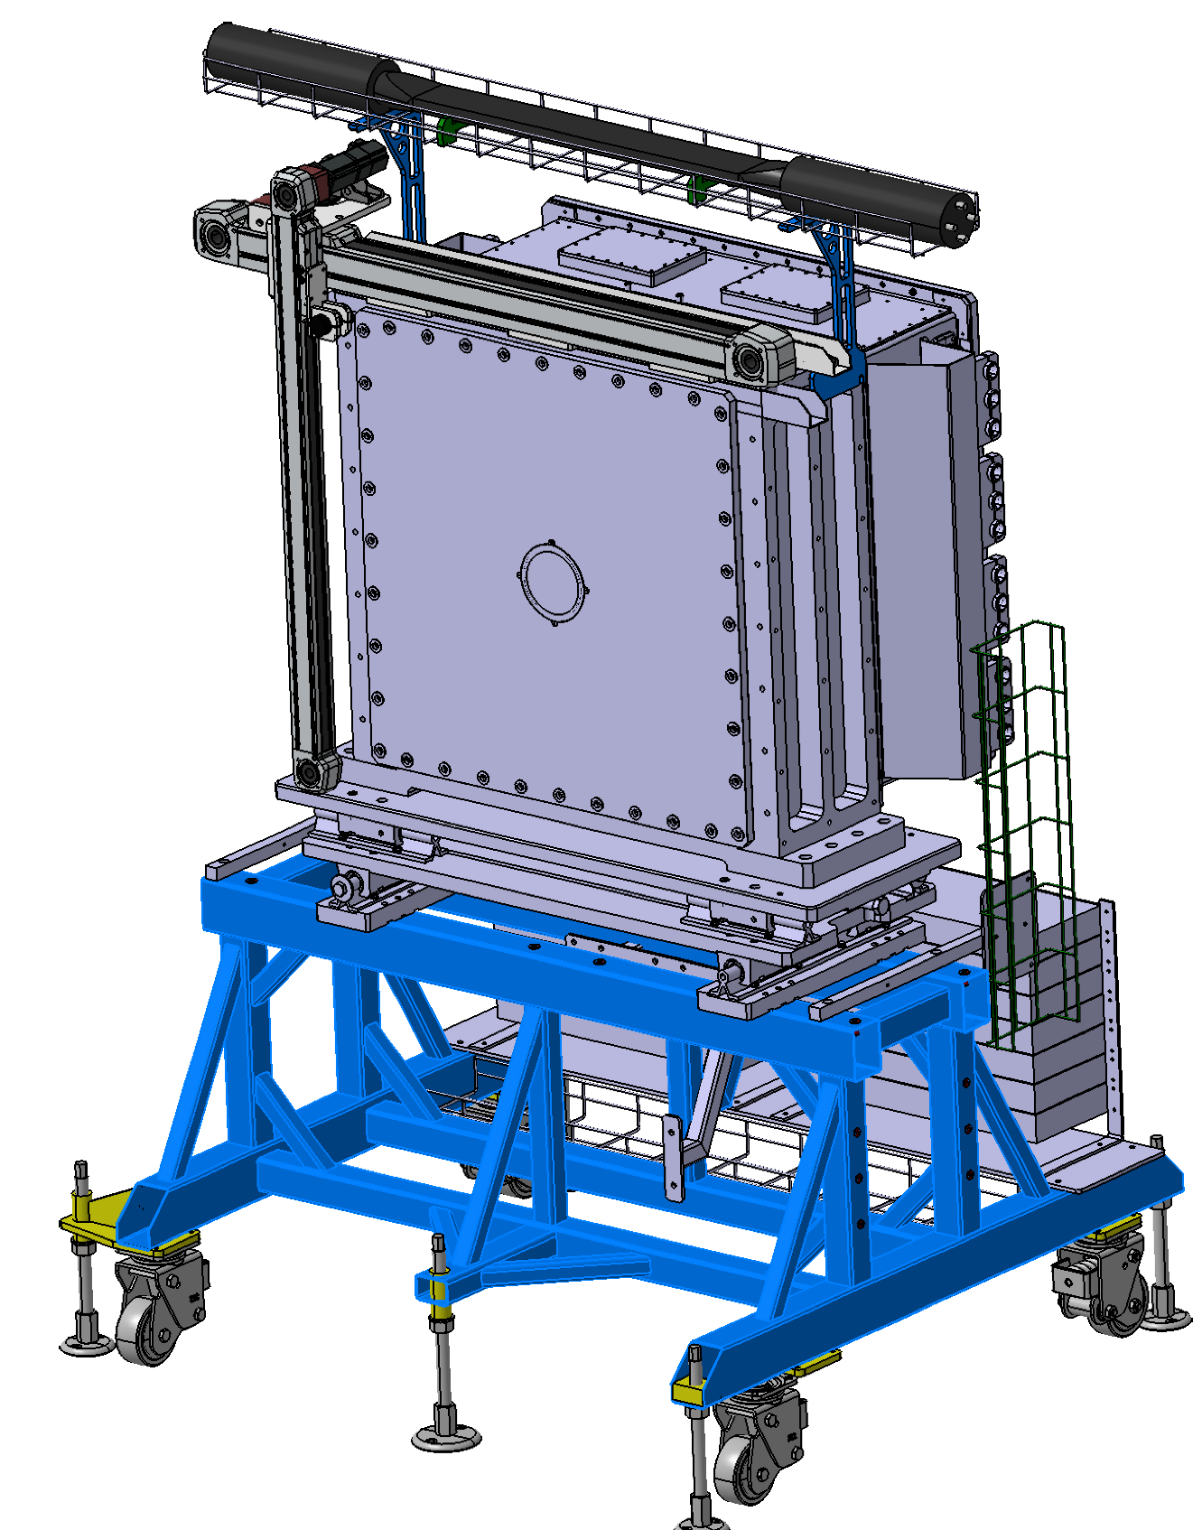
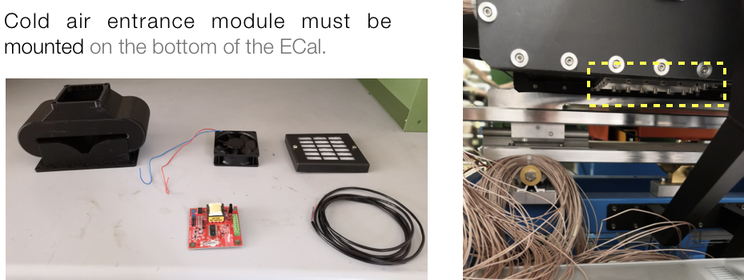
Ecal ventilation system
In July ‘19 test-run temperature of ECal was critical
  PMT box T ~14º higher than BTF hall
Light-tight ventilation system designed and built to improve air exchange:
  All component available at LNF
  Top part already in place
  Need testing the fan controls (PADME Lab)
  Install air inlets and controls in BTF (1d 2P)
Can profit from shutdown period to test Ecal temperature during June

Slide 10
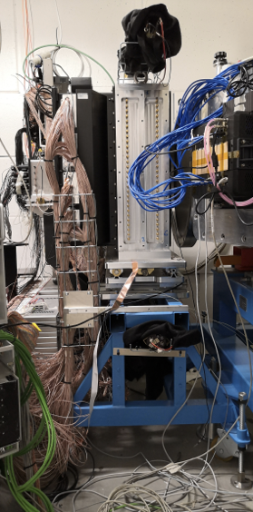
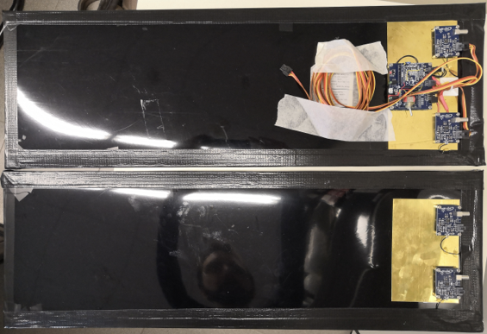
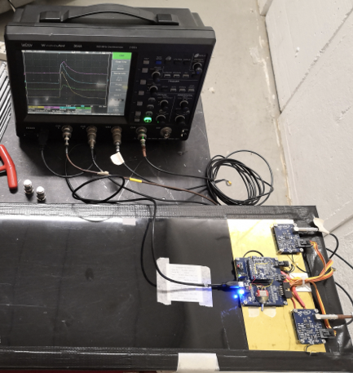
ECal new cosmic rays trigger
Improve efficiency and uniformity of cosmic rays trigger
New scintillating tiles ready and tested
  Electronics is on board and polarity reversed
Need to be installed in BTF on ECal
  Needs connection to PADME DAQ system
Estimated effort 1d 2P in BTF
  installation and integration in DAQ
Calibrate Ecal with cosmics from early June
23 cm
70 cm

Slide 11
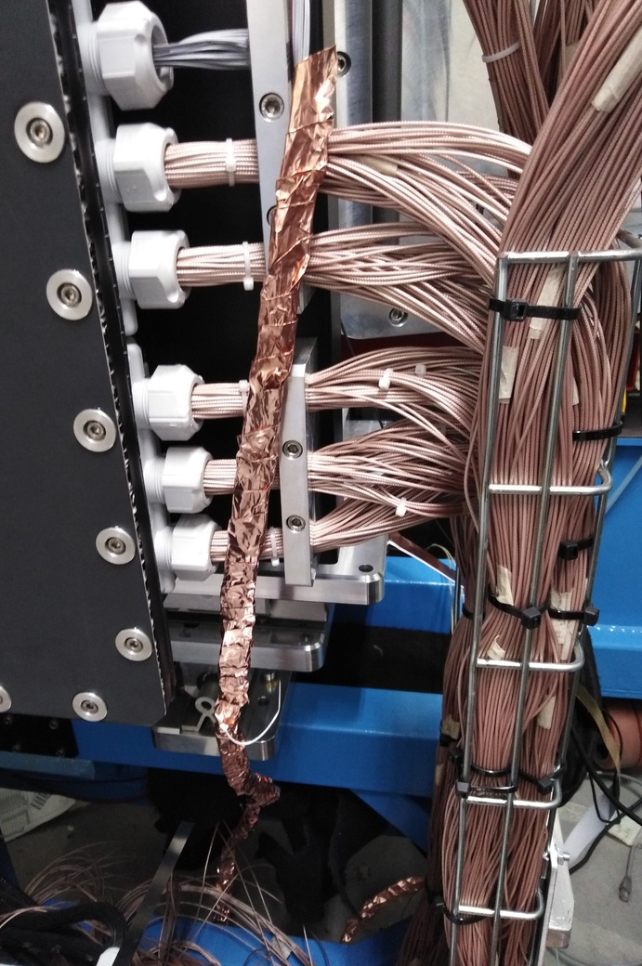
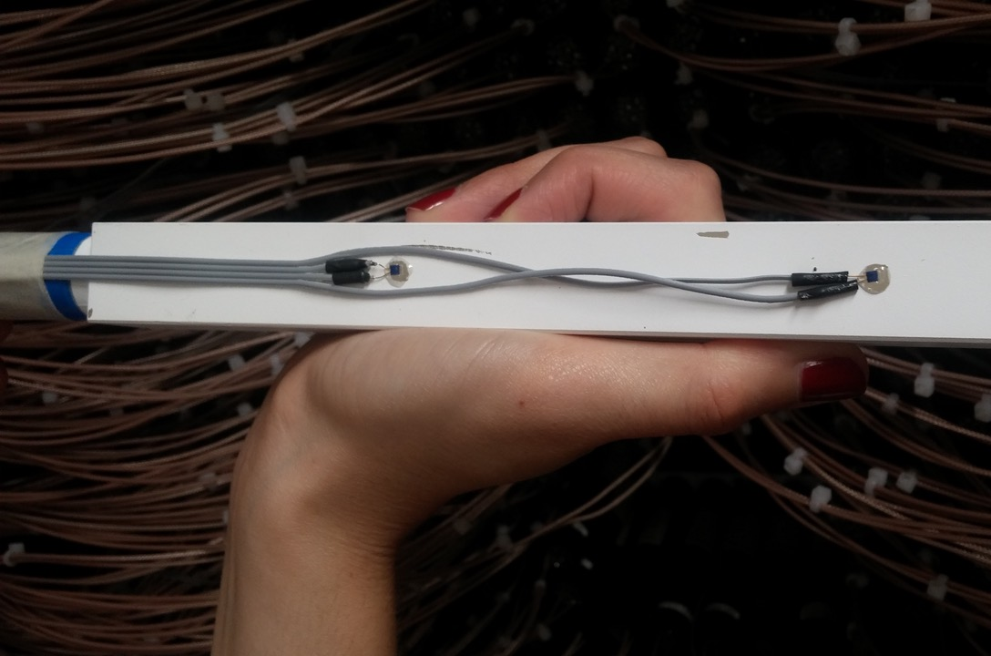
Ecal temperature monitoring system
Temperature sensors readout ADC crashing the DAQ system (noise on the VMEbus to the digitizers)
  Crucial to measure temperature of the BGO crystals, especially during RUN-2 spanning summer period
Estimated effort 2d 2P (F. Ferratotto + E. Leonardi)
Status before lockdown
  Properly shielded flat cables with new copper shielding tape
  Grounded copper shielding to Ecal metal frame
  Tested with DAQ and still having noise problem
  Keysight power from far away power line (near servers)
  New version of ECAL thermocouples readout program
  (loop every 120 sec and read 1 channel only each 2 sec)
  Not yet tested if noise problem solved by these last changes
To do in BTF/Control room :
  Test new version of readout with all boards and DAQ components UP and RUNNING
  ??? Try other solutions ????
  If nothing else works: Read temperature at run start and end only (and possibly make shorter runs)

Slide 12
Ecal not working scintillating units
SU 91834 already fixed: software and cabling configuration issue
SU 2105124: broken signal cable connector,
need fixing cabling and test
SU 2104022, SU 2104032 “clocked” divider:
Extract the divider, check its integrity and
reconnect it. Not an easy task due to density
of cables in the ECal back region.
Estimated effort (2d 2P)
  Need to open Ecal back cover
  Extract and plug back units
  Close again the back cover
An electronic technician needed

Slide 13
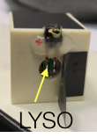
²²Na based Ecal calibration system
Moving ²²Na crystal calibration system
  Check stability of the crystals response in addition to cosmic
  Now in PADME Lab to check moving software and motors
Mounting the bars on the Ecal structure
  Test and install the motorized system
Estimated effort 2d 2P in BTF for hardware installation
  F. Ferrarotto + E. Capitolo

Slide 14
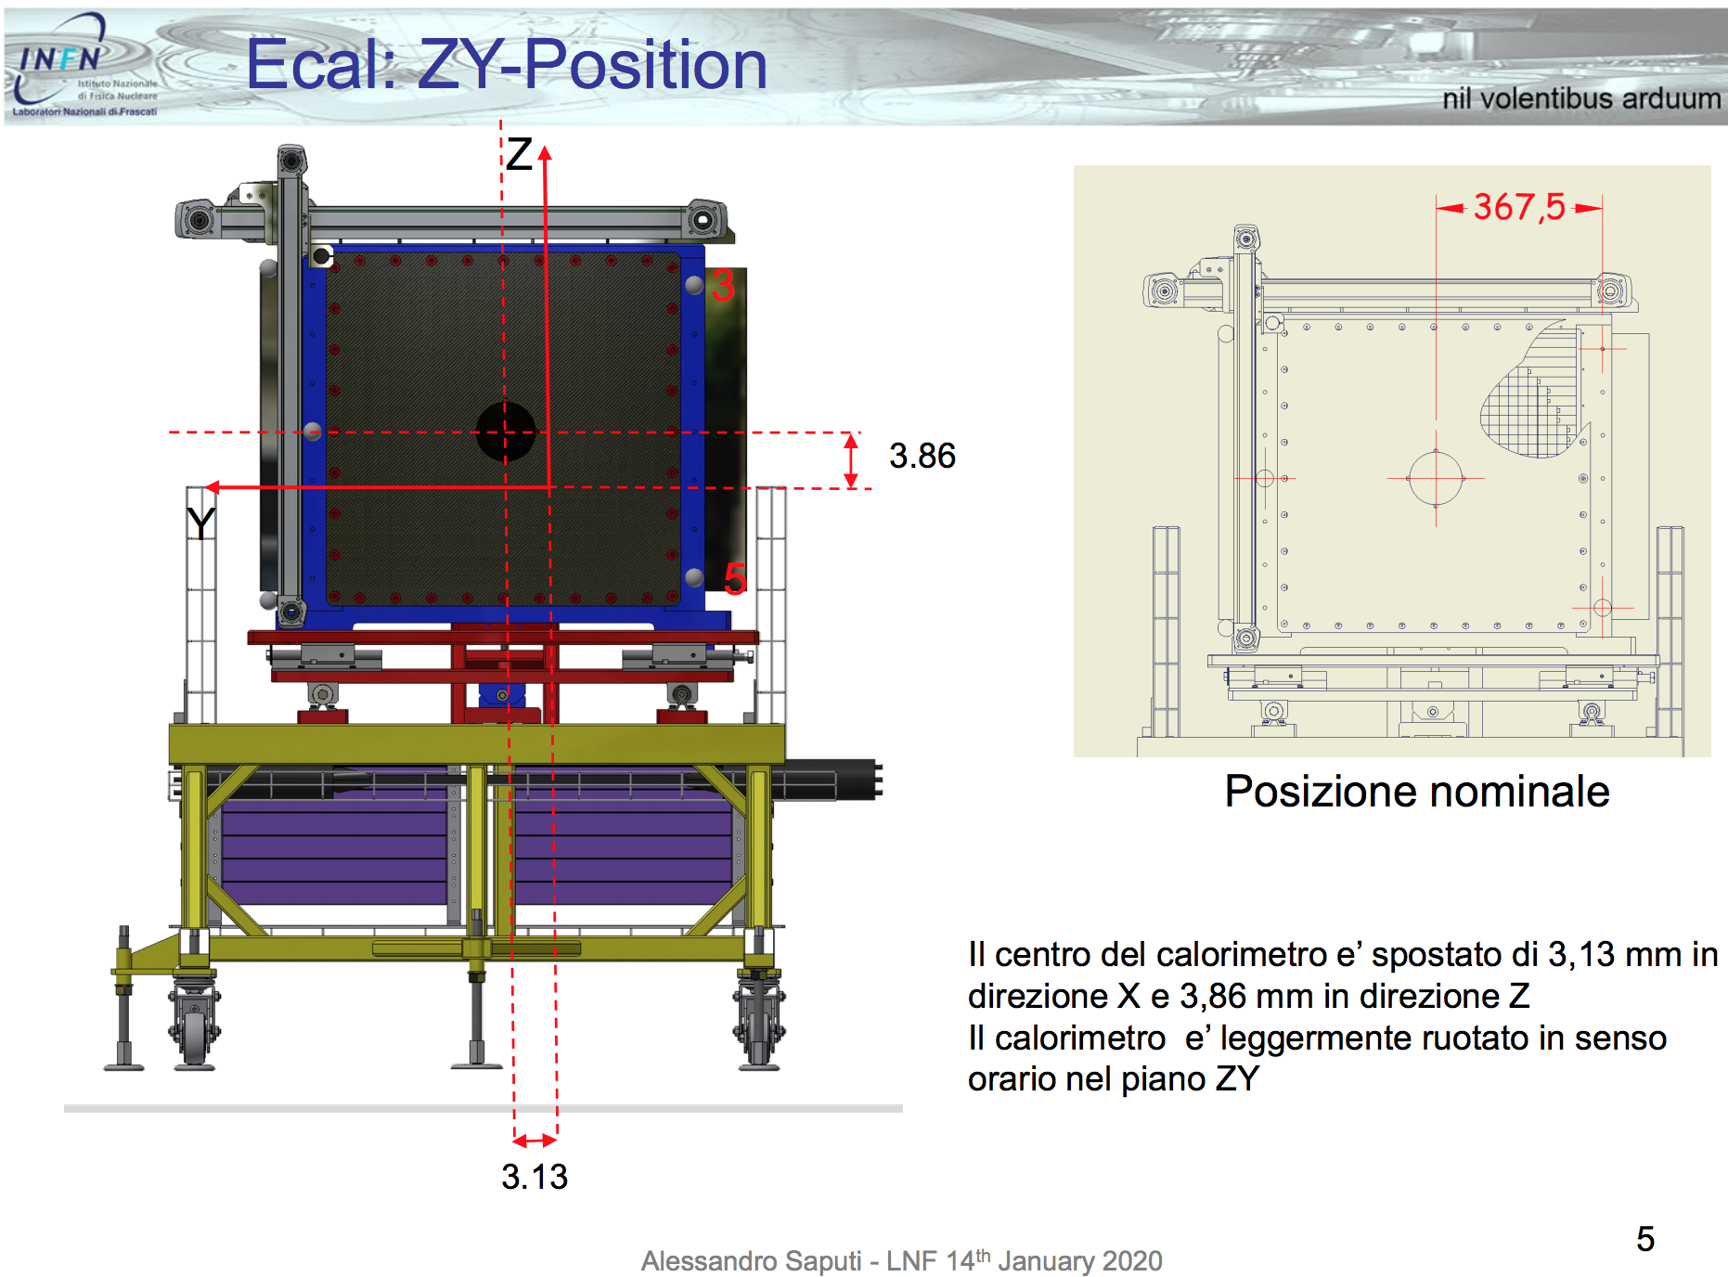
Ecal fine alignment
Effort (1d 2P): LNF alignment service in BTF
Present survey has shown millimetre scale misalignment of Ecal
  3,8 mm too high and 3.1 mm too much on the BTF wall direction
Can refine the alignment at the sub millimetre level
  Can check better the rotation angle, if any

Slide 15
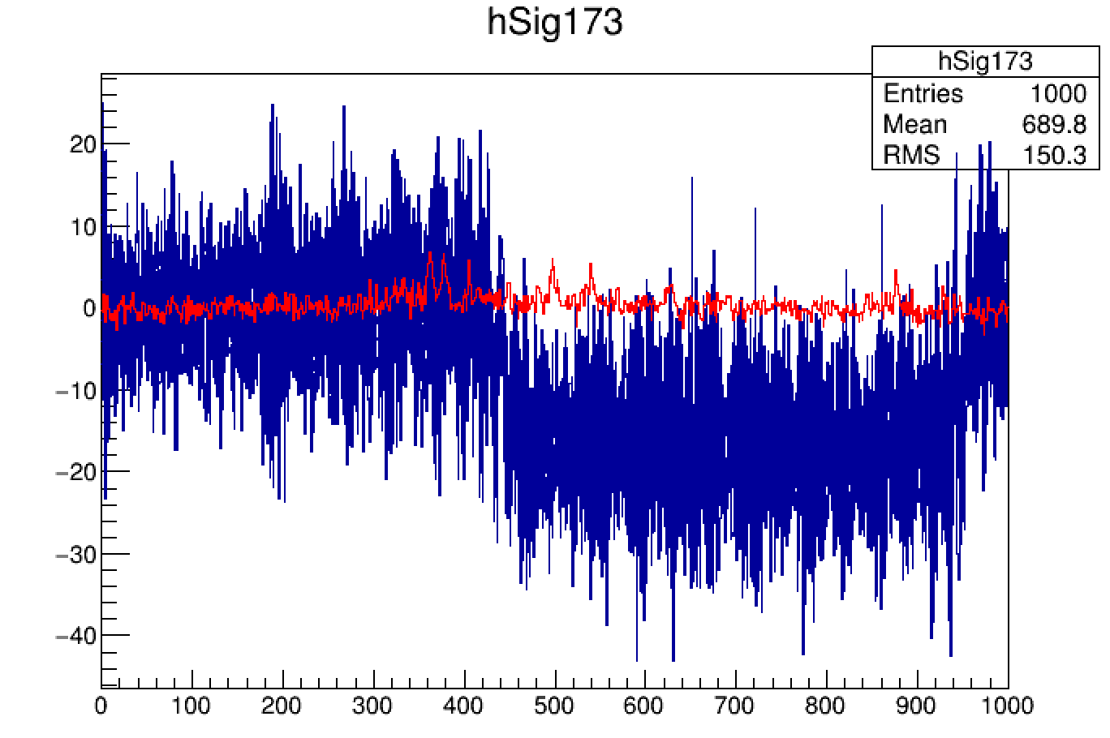
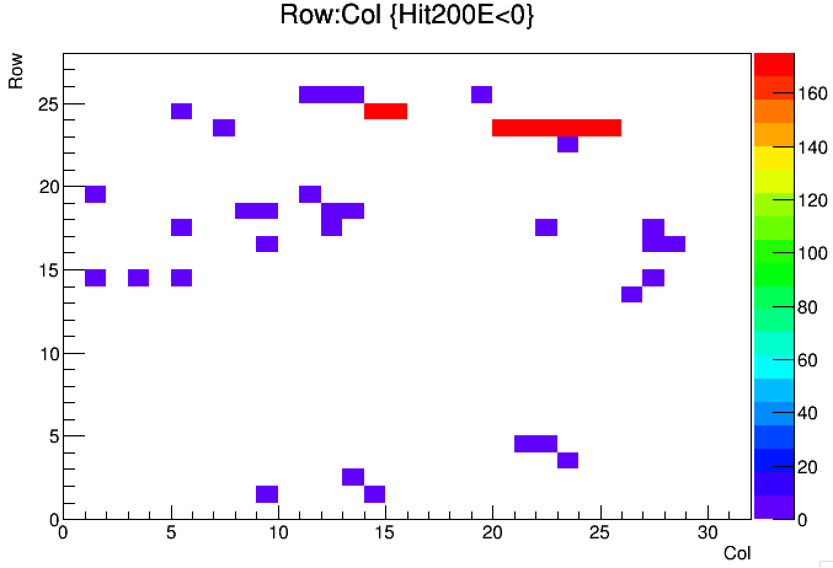
Intervention on DAQ system
Estimated effort (1d 2P): E. Leonardi + 1
One V1742 CAEN board from ECal readout has oscillating pedestal
  Remove the 32 channels cables and connection to DAQ
  Need to dismount the board and cable back 32 channels
  Test the DAQ system with the new board.

Slide 16
Intervention on the diamond target
Apparently no damages during BE window accident
  Target never operated again
  Readout need to be moved to allow BTF2 installation
Operations can be performed without experts from Lecce
  Estimated effort: (1d 2P)

Slide 17
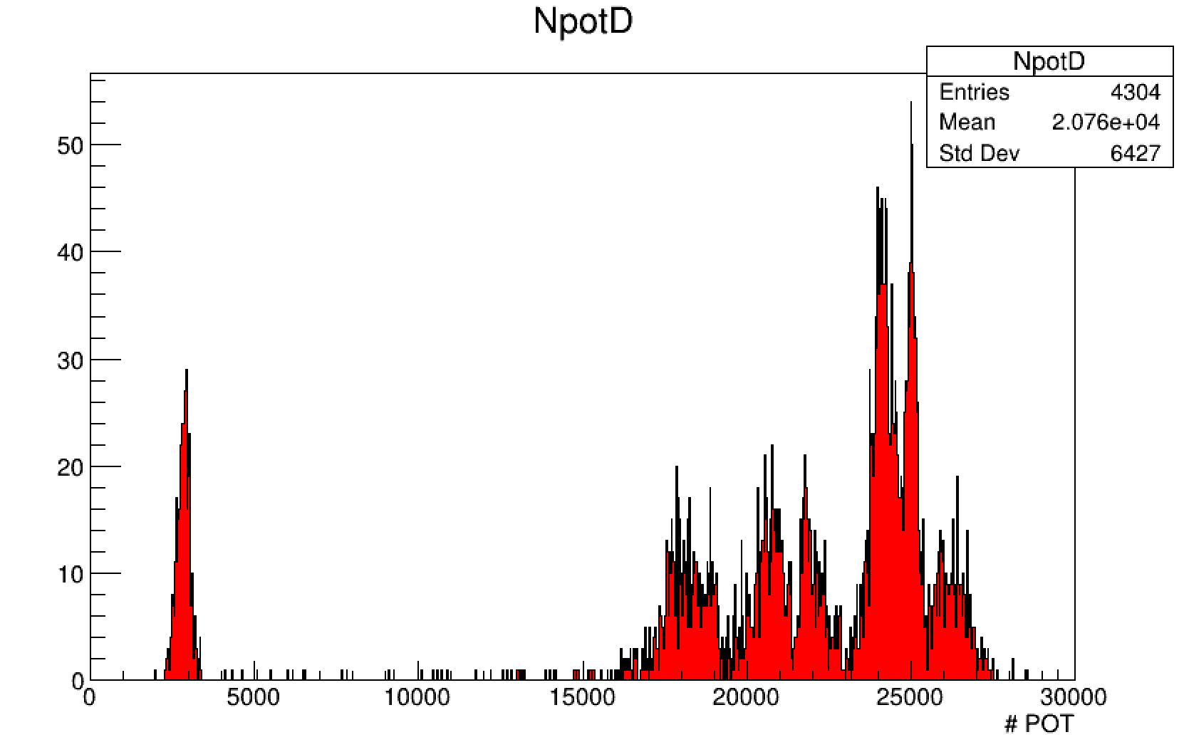
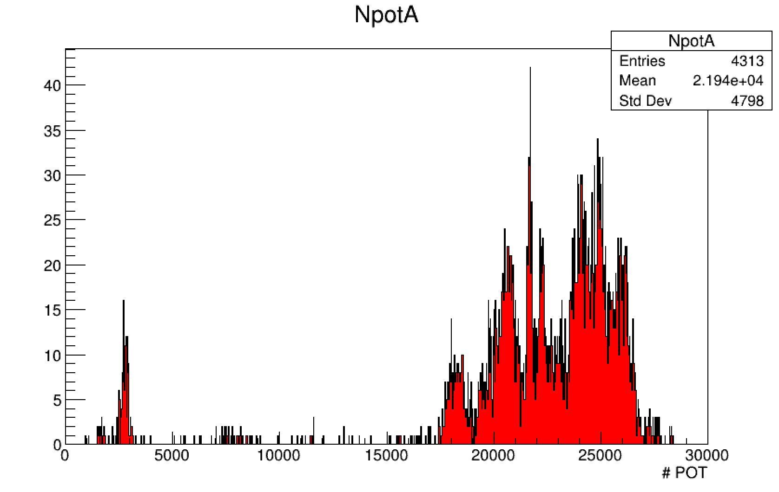
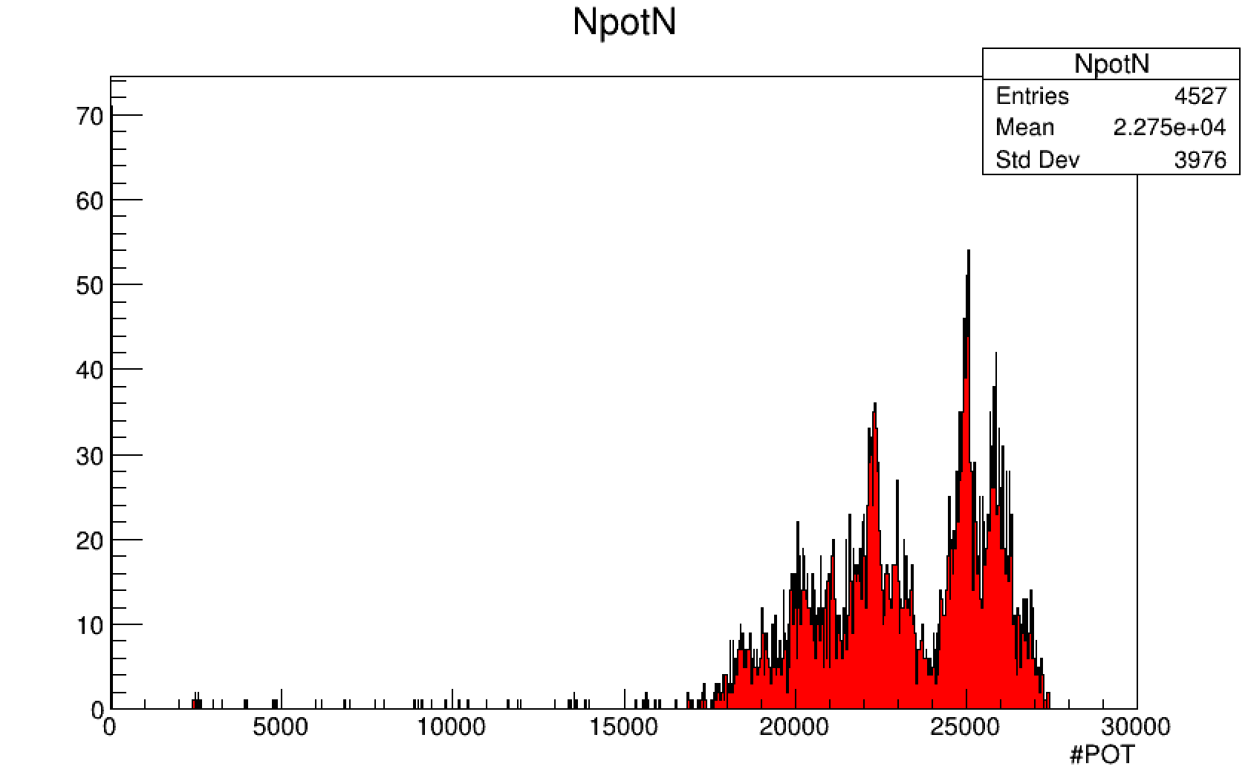
“Smart running” PADME from remote
Running PADME during summer 2020 will be an important effort
  No possibility of having shifters at LNF from outside Rome area
  Losing Sofia, Lecce, US contribution.
  30% less man power expected for shifts
  Possibility of new restrictions on the mobility due to COVID-19 crisis
PADME can be operated remotely thanks to our web based online monitor
  During RUN-1 night shift were performed mainly from remote
  Efficiency similar or even slightly higher than day shifts
Day 7-15
Afternoon 15-23
Night 23-7

Slide 18

Run 1 Data analysis status
SM annih. e⁺e⁻−>γγ(γ)
SM Brems.: e⁺N->e⁺Nγ
γ
γ
γ
e⁺
e⁺
2γ in Ecal in time with E₁+E₂ = E_{beam}
e⁺ in veto +γ in SAC
in time with E_{e+}+E_{γ} = E_{beam}

Slide 19

γγ signal selection
Two photons in Ecal ΔT<10. ns

Slide 20
γγ signal selection
Two photons in Ecal ΔT<10. ns
Δφ < 20 deg.

Slide 21
γγ signal selection
Taglio temporale 10. ns
Δφ < 20°
γγ Center Of Gravity < 2. cm

Slide 22
γγ signal selection
Taglio temporale 10. ns
Δφ < 20°
γγ Center Of Gravity < 1. cm
σ∼4.8%
Bunch time structure
> 5000 events γγ in (DATA & MC)
- Potential statistical error: ∼1-2 %
- Good data MC agreement
- Rescaled MC beam time structure using SAC time measurement

Slide 23
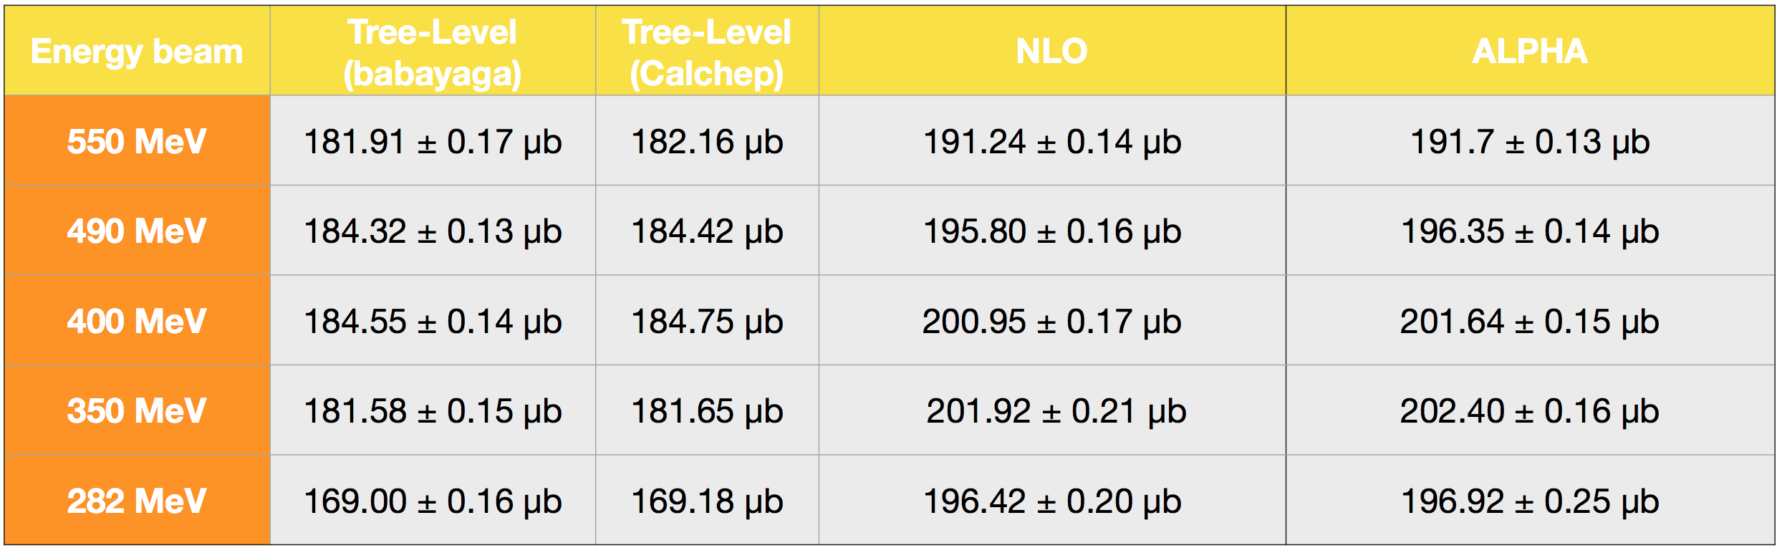
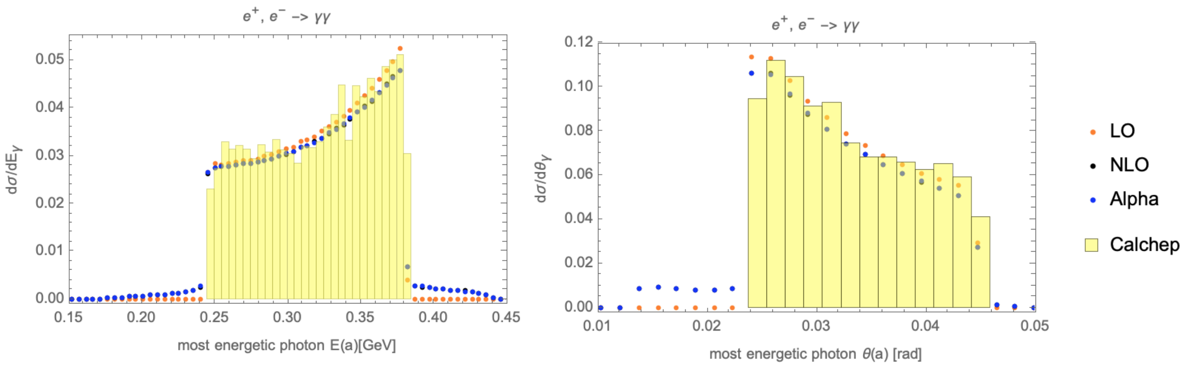
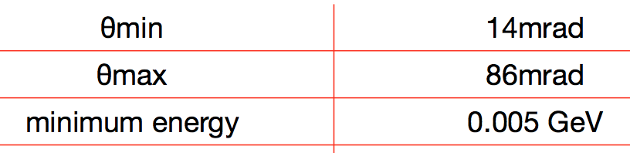
e⁺e⁻ −> γγ next to leading order
NLO calculation needed to compare PADME to SM at % level
Many thanks to C. Carloni Calame for adapting Babayaga to fixed target and PADME energy scale.
  Very good agreement <1% at tree level with Calchep calculations
  NLO correction ~5%
  Event generator for PADME MC
  Allows correct acceptance calculation

Slide 24


PADME veto used as spectrometer
Impact point of particles in veto can be used to measure |P|
beam
Good correlation around fingers 20-70
  In region >70: beam halo pile-up
  in the region <15: particles from interaction with vacuum chamber
Region covered by fingers 15-70 corresponds to energy range
  E_{min} > 50 MeV and E_{max} < 350 MeV

Slide 25
Bremsstrahlung spectrum in PVeto
Target
a) In red in the plot
Beam
b) In black in the plot
Beam
No Target
Difference in rate observed in data MC
  Due to non perfect beam shape simulations
  Significant difference target On-Off beam radiation!
a) target - b) no target data in the region 15-70
  Bremsstrahlung spectrum is obtained
  Very good data-MC agreement in large energy range
  Higher finger index region: disagreement due to inefficiency in data reconstruction for higher pile up
a) – b) data
a) – b) MC
Rate is very well reproduced
  Bremsstrahlung cross section well understood in PADME
  Means luminosity measurement is working
  Correlation of different detector works

Slide 26
SM and beyond in ee collisions

Slide 27

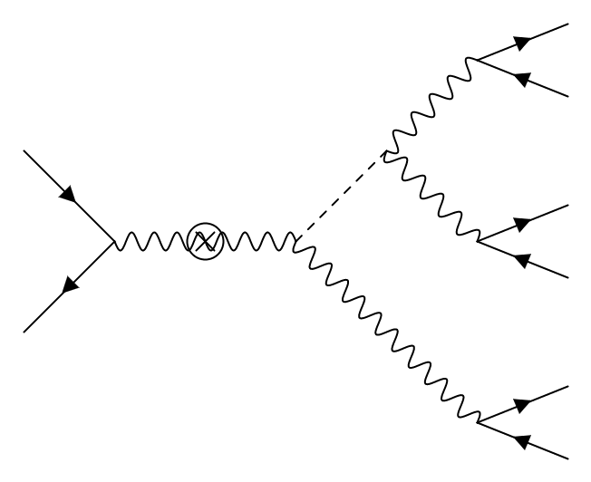















searching for DH in multi leptons
Extended dark sector with a dark Higgs h’
  Minimal suppression: only ε²α_{D}
  BR(A’−>ee=1)
Main production mechanism: higgs-strahlung
  Main decay of h’: h’→A’A’
  Assuming A’ → e⁺e⁻
  Can produce e⁺e⁻ → e⁺e⁻e⁺e⁻e⁺e⁻

Slide 28

Summary of multi-lepton events
Final state | σ in pb | PADME lumi | Events/s | Events/day | Events/y | Acc/y
e⁺e⁻→4e± | 1.32E8 | 1.2E-8 pb⁻¹ | ~ 1.6 | ~ 136K | ~ 13.7M | ~ 6400
e⁺e⁻→w_{D}w_{D} | 6E3 | 1.2E-8 pb⁻¹ | ~7E-5 | ~ 6 | ~ 600 | ??
e⁺e⁻→6e± | 2.0E4 | 1.2E-8 pb⁻¹ | ~ 2.4E-4 | ~ 20.7 | ~ 2.07E3 | ~ 20
e⁺e⁻→h’A’ | 485 | 1.2E-8 pb⁻¹ | ~ 6e-6 | ~ 0.5 | ~ 50 | ~ 30
PADME luminosity assuming (24.5K x 49) =1.2E6 POT/s
In Events/y column 1y=100 days at 100% efficient data taking
  The dark sector related calculation are for ε²=1E-6 and α_{D}=0.1
In the Acc/y a cut on the E_{min}>50 MeV is applied
  4e scales down by ~2000 (Calchep), 6e scales by only ~100 (phase space)
  DH scales by 0.6 (phase space)
Seem that DH contribution to 6 leptons production cross section
could be sizable, even with ε² as low as 10⁻⁶

Slide 29
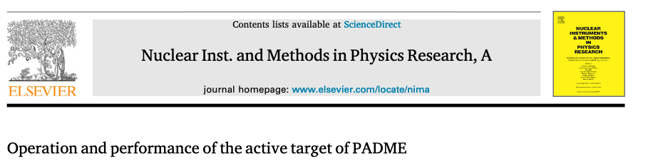

Publications detector during 2020
A first technical paper on target performance has been published:
NIMA Volume 958, 1 April 2020, 162354
https://doi.org/10.1016/j.nima.2019.162354
Three papers are in preparation and likely will be submitted within next SciCom meeting (Nov.2020):
Presents the performance of the PADME detectors obtained with the data collected from Sep.2018 to Feb.2019, the software algorithms employed to reconstruct physics objects, and the calibration procedures adopted [NIM A or JINST].
Reviews each step of the construction of ECal, from the initial L3 crystal recovery, to the final assembly. The trigger, DAQ unit equalisation and energy calibration are described [NIM A or JINST].
Development and deployment of the Trigger and Timing System.

Slide 30
Physics papers in early 2021
Paper on 2018-2019 data set
  Measurement of the ee −> γγ cross section with the PADME experiment
Phenomenological papers on PADME physics (preparation of RUN II)
  A next to leading order e⁺e⁻ −> γγ generator for the PADME experiment
  PADME sensitivity to multi-lepton final states
  Searching for ALPs at PADME

Slide 31
Conclusions
COVID-19 emergency has significantly delayed the expected restart of the experiment data taking wrt to last mid-term meeting plan.
The PADME restart program has been established
  Hardware fixes and small upgrade are foreseen in May to mid June
First sample of 5000 clean ee->γγ candidate identified
  Working hard to improve Data-MC comparisons to extract acceptance
  Next-to-leading order generator obtained
First solid evidence of the Bremsstrahlung process has been extracted
Beam expected for beginning of July
  2 month of physics-grade data are expected to be delivered to PADME by the end of the 2020.
Data reconstruction quality much higher wrt to RUN1- will allow faster and better feedback in the beam commissioning phase.

Slide 32
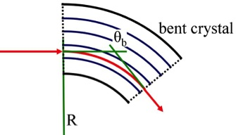


SHERPA
“Slow High-efficiency Extraction from Ring Positron Accelerator”
CSN5 grant, P.I.: Marco Garattini (LNF-INFN)
R&D study to extract a high-quality e⁺ beam from the DAΦNE ring
The idea is to use a bent crystal to steer the positron beam
Channeling
Bent crystal
DAΦNE
e⁺
BTF
Target spill parameters:
Energy spread: Δp/p < 10⁻³
Emittance: ε < 10⁻⁶ rad⋅m
Length: ms < Δt < s
Current BTF spill parameters:
Energy spread: Δp/p < 0.5 x 10⁻²
  Emittance: ε < 10⁻⁵ rad⋅m
  Length: Δt < 200 ns
VS
With the SHERPA beam, PADME could increase the statistics by a factor 10⁴ and its sensitivity by a factor ~10², largely extending the discovery potential
2 year grant (120K) by CSN5 to realize a proof of principle and a realistic design

Slide 33
backup slides

Slide 34
A’ visible decays at PADME
1.
2.
3.
Process | Name | a^{X} | Fin. state | Detectors | Main BG | Sens. Est.
1.e⁺N→e⁺NA’→e⁺Ne⁺e⁻ | A’-stra. | 3 | e⁺e⁺e⁻ | Vetos | PileUp+Trident | None
2.e⁺e⁻→γA’→γe⁺e⁻ | 2γ-ann | 2 | γe⁺e⁻ | Ecal+Veto | Rad-BhaBha
3.e⁺e⁻→A’→e⁺e⁻ | Res.an | 1 | e⁺e⁻ | Vetos | BhaBha | X boson
A-stra.: Production cross section high, but very high background from QED
  Need to measure e⁺e⁻ invariant mass distribution.
  Strong competition from electron based experiment A1, APEX, HPS.
  In principle masses up to >100 MeV are accessible
2γ-annihilation: lower cross section but can use Ecal to measure A’ mass.
  Bump hunt possible by computing missing mass to the recoil γ
  Helps in rejecting radiative BhaBha, γ−conversion and trident BG.
  Mass reach limited to 23.7 MeV for 550MeV beam
Resonant Annihilation: very high cross section but a very narrow mass region
  Need to know the particle mass in advance. (Xboson)

Slide 35
Novità da Torino
Gruppo di Numen interessato ad entrare in PADME
  Primi contatti allo scorso PADME collaboration meeting
Il gruppo è del politecnico ed è composto da
  Iazzi Felice PO, Pinna Federico RTDa, Capirossi Vittoria PHD
Interesse a lavorare nei rivelatori di fascio al silicio di PADME
  TimePix e Mimosa primi contatti e raccolta di informazioni
Sarebbero anche interessati a partecipare al RUN di quest’anno
  Inclusi nello sblocco di SJ di 120gg

Slide 36
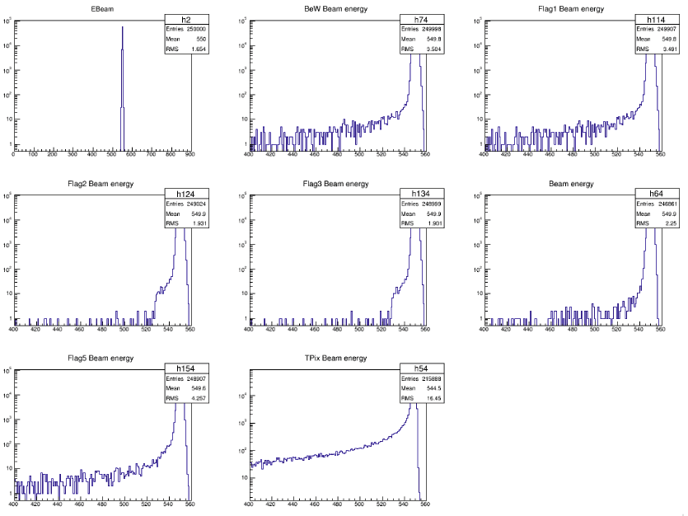
Due diversi tipi di fascio e di fondo
Secondario
BeW
250μm
DHSTB001
DHSTB002
LINAC
wall
BTF target
in
1E4 e⁺ 550 MeV
1E9 e⁻ 750 MeV
Primario
LINAC
wall
BeW
250μm
DHSTB001
DHSTB002
BTF target
out
1E4 e⁺ 490 MeV
1E5 e⁺
500 MeV

Slide 37
Origine del fondo
Fascio secondario
  1E9 e⁻ generano e⁺ e fotoni di qualunque energia.
  Fotoni creati al collimatore in uscita dal primo magnete colpiscono il secondo magnete creando un fondo diffuso di fotoni ~7 GeV su ECAL dovuti a sciami sul secondo magnete
  Se si spegne il secondo magnete si vede ancora molto fondo quindi fondo dominato dal collimatore
Fascio primario
  Niente bersaglio BTF
  Molti meno primari e tutti dell’energia giusta passano attraverso la linea senza creare fondi importanti
  All’attraversamento della finestra di Be si creano piccole code di positroni fuori energia che colpiscono la parte interna del magnete creando fondo nel calorimetro
  Questo fondo può essere mitigato migliorando il fascio e spostando la finestra

Slide 38
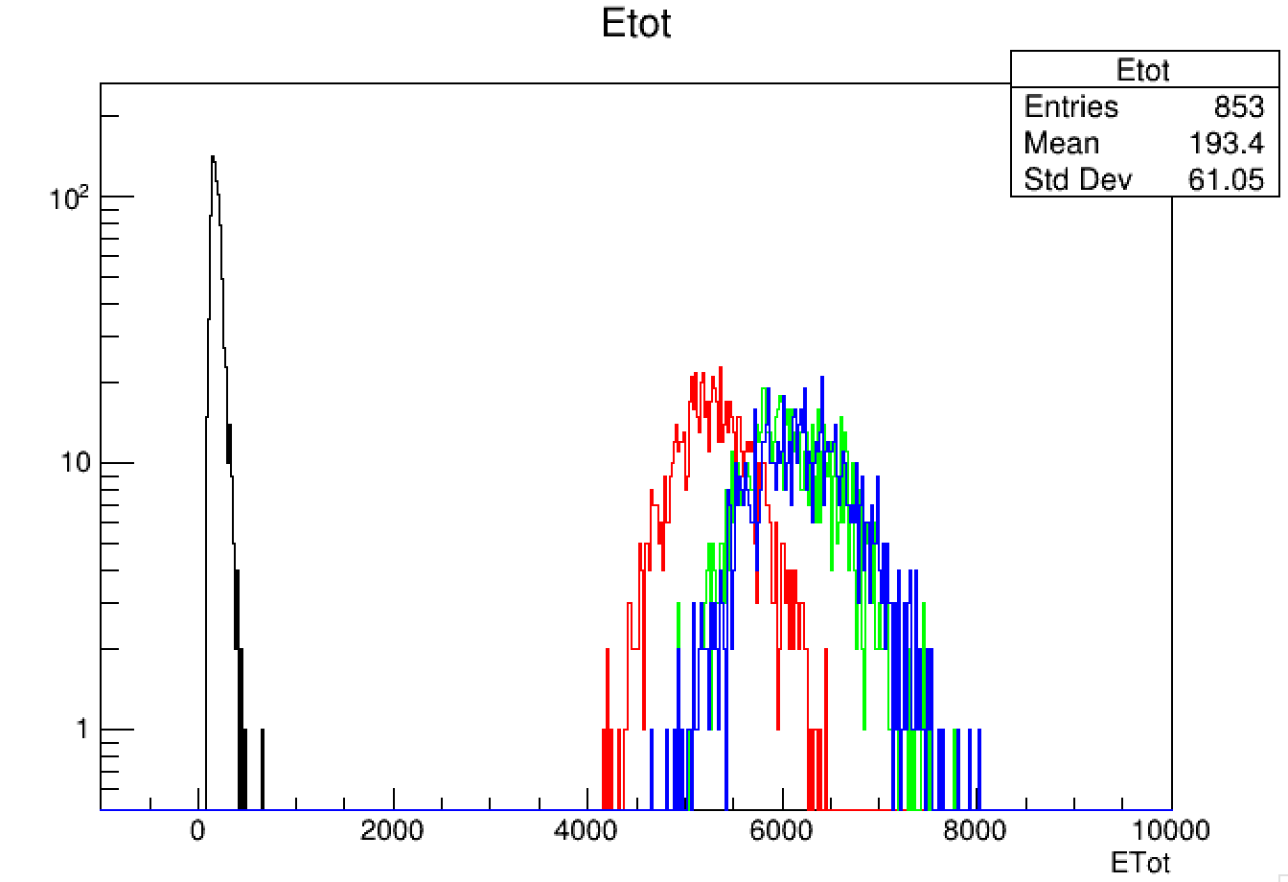
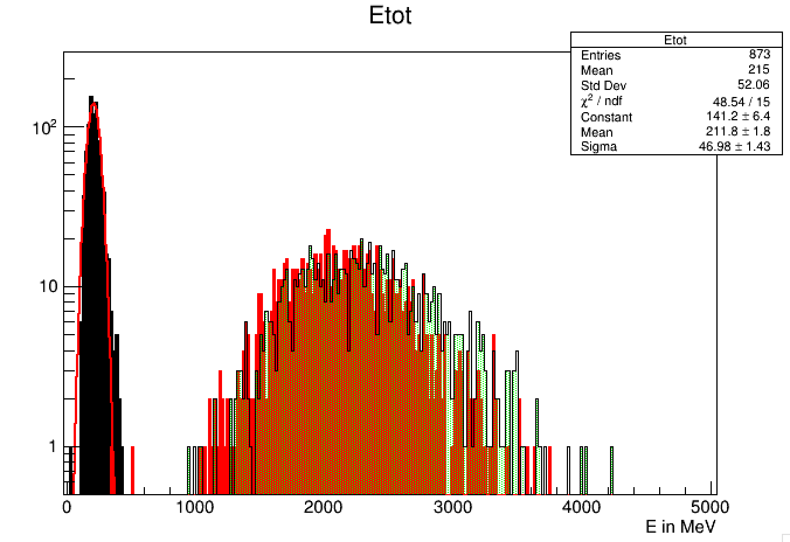
Beam background PADME
Fondo fascio secondario
Fondo con fascio primario
March 2019
  Background ~7 GeV for DHSTB001 and DHSTB002 ON
  Background ~5.5 GeV for DHSTB001 On and DHSTB002 OFF
  Background ~0.2 GeV for DHSTB001 OFF and DHSTB002 OFF
July 2019 run
24/07/2019 ore15

Slide 39
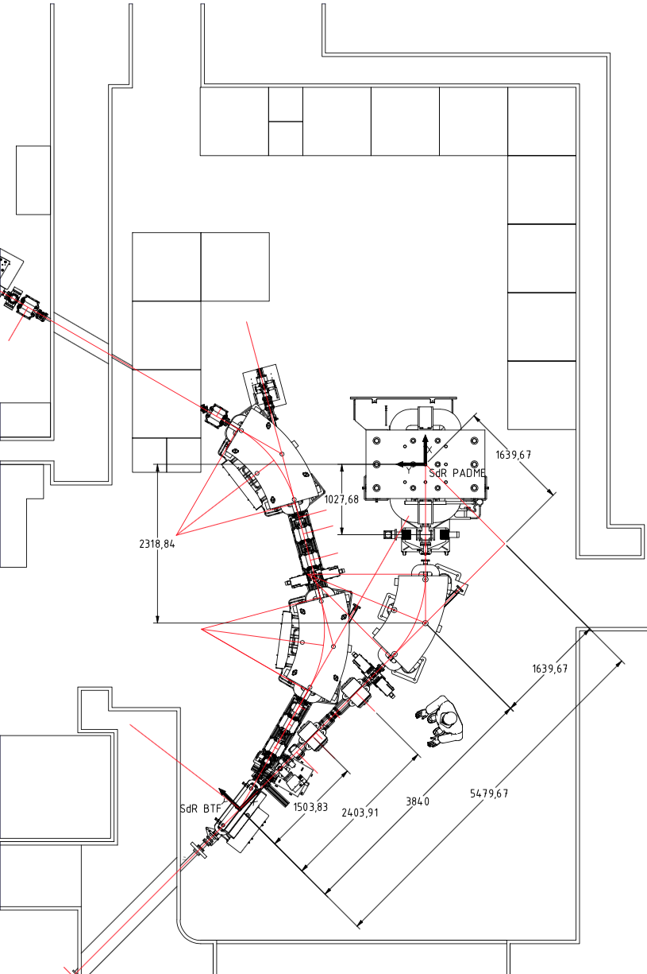
Nuovo layout della linea
Vecchia Linea
Nuova Linea
BeW 250 μm
Mylar
Mylar
125μm

Slide 40
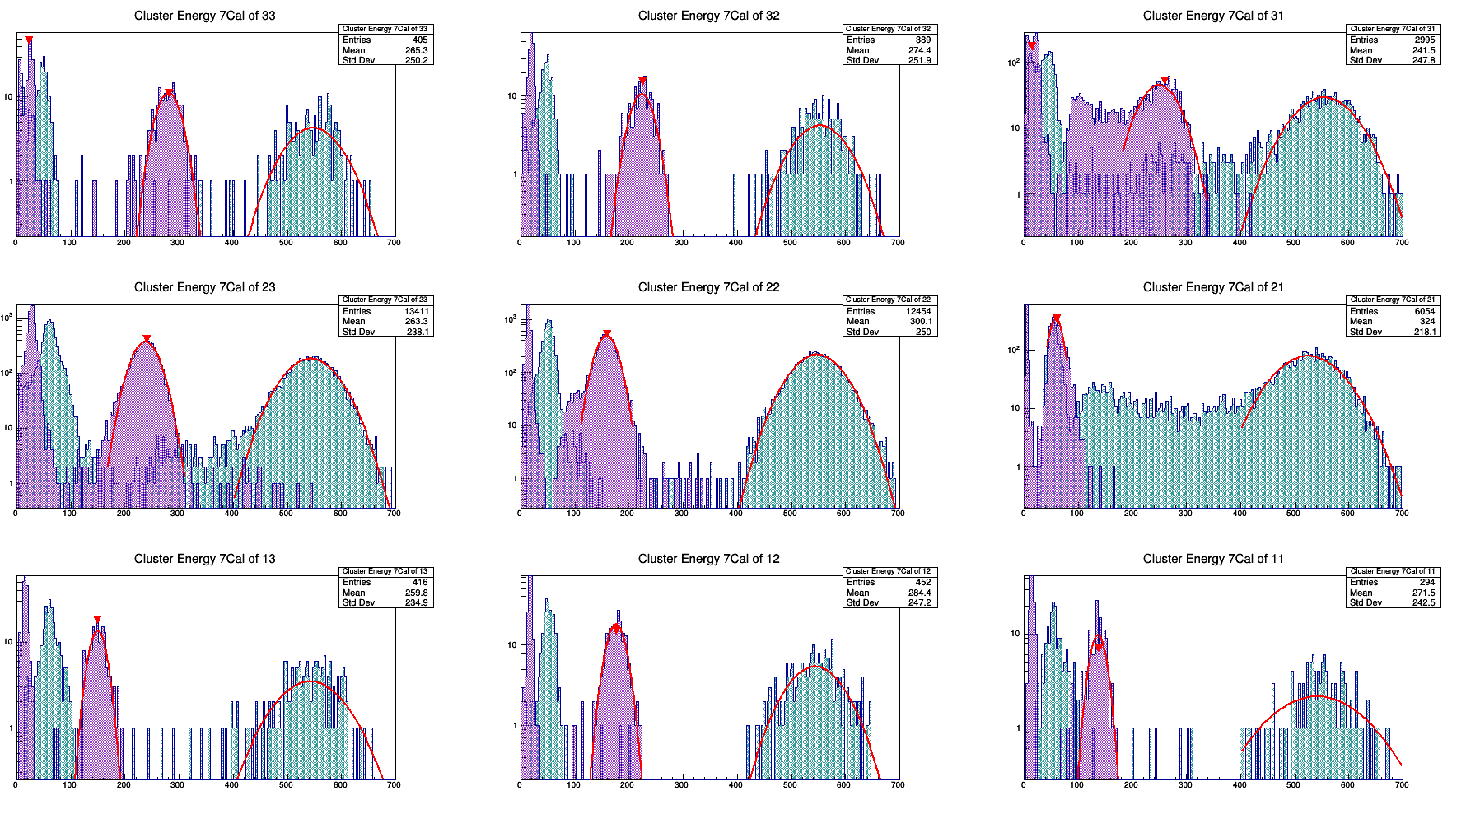
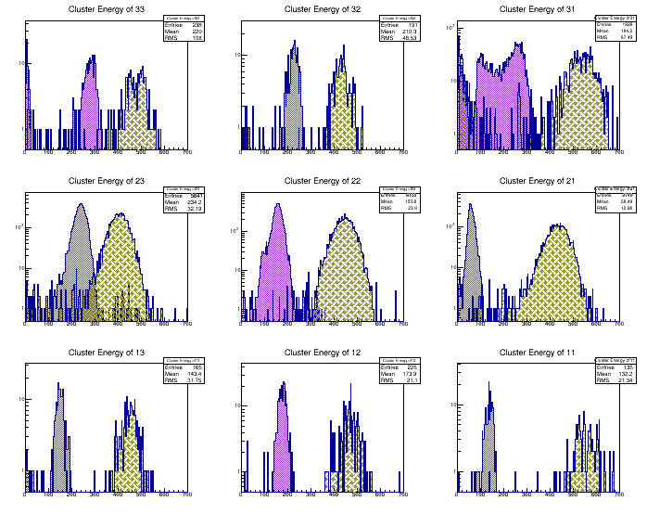
SAC calibration status
SAC calibration beam
CR results on calibration are encouraging:
- better with a fixed-energy source beam
- need data for all the 25 crystals (9 so far)
Positron runs with the beam into each crystal is needed
Parasitic secondary beam in Ok for this task
9 crystals few hours
- 1-2 days of data taking should be enough
SAC cosmic rays

Slide 41
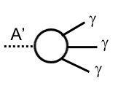
A’ decay modes MeV-GeV scale
M_{A’}
Heavy DM χ>GeV light mediator
M_{A’}
Light DM χ and light mediator
A’−>𝓁⁺𝓁⁻
e⁺e⁻ μ⁺μ⁻ decay allowed
Invisible
A’−> χχ
(Visible A’->𝓁⁺𝓁⁻
suppressed by ε²⁾
Visible
A’−>𝓁⁺𝓁⁻
2m_{μ}
A’−>𝓁⁺𝓁⁻
e⁺e⁻ only region
M_{A’}=2m_{χ}
2m_{e}
2m_{e}
long lived A’−>γγγ
long lived A’−>γγγ
M_{χ}
M_{χ}
If 1MeV <M_{A’}< 2mχ dilepton “visible” decays (at PADME energy just ee)
  Min M_{A’}>1MeV lifetime depends mostly on ε² long lived
2mχ<M_{A’} dark matter decays “invisible” decays
  Min M_{A’}<1MeV lifetime depends mostly on α_{D}² short lived
Decays in 3γ are not interesting for the accelerator searches

Slide 42
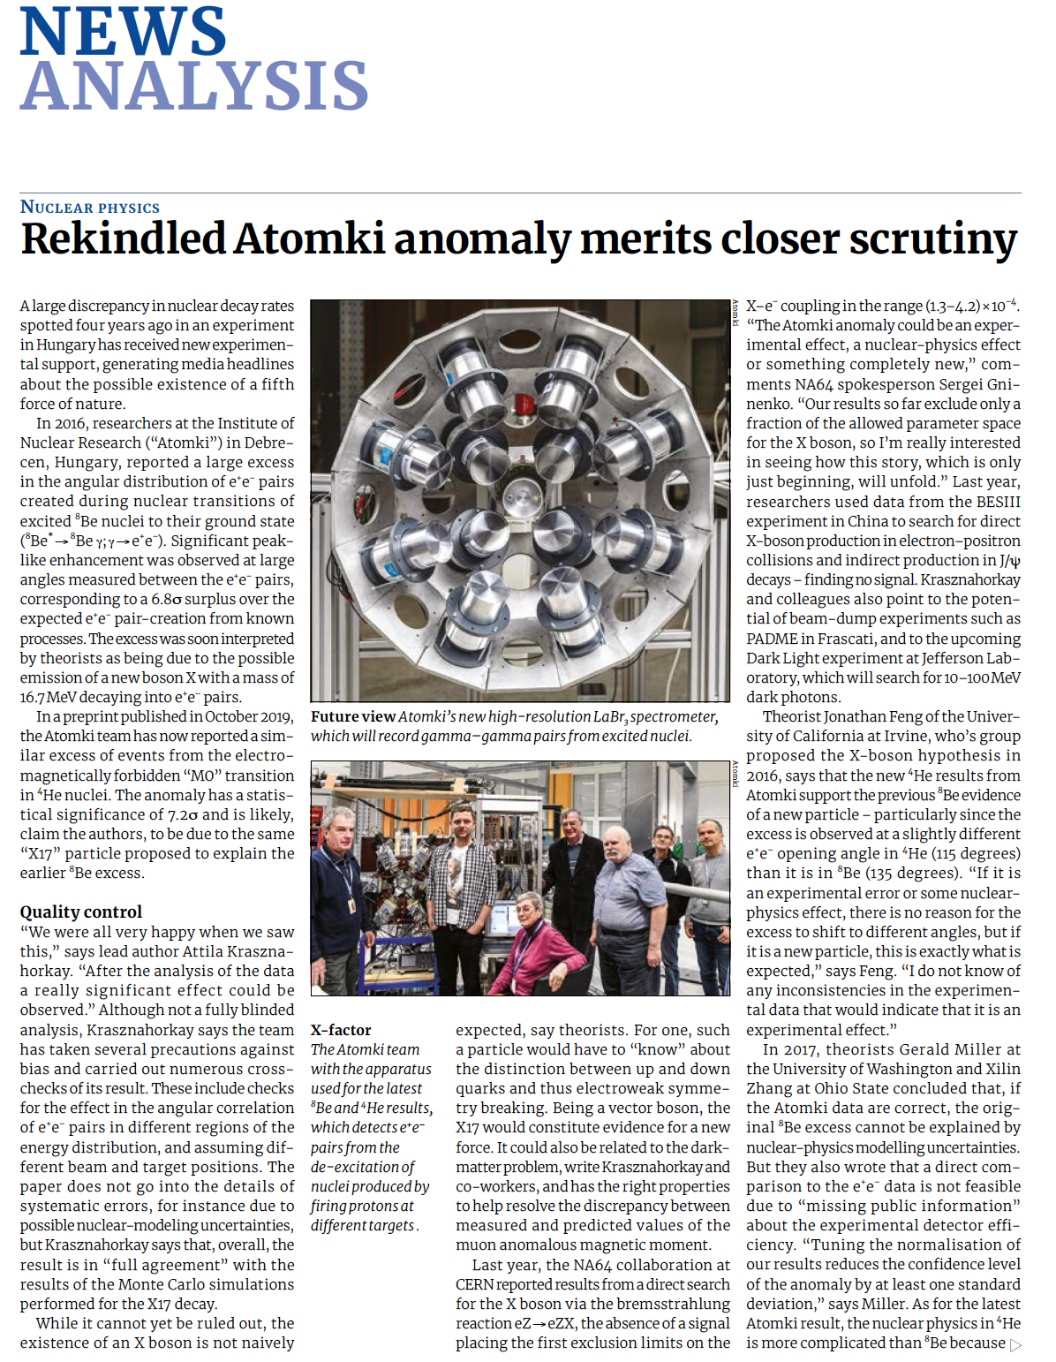
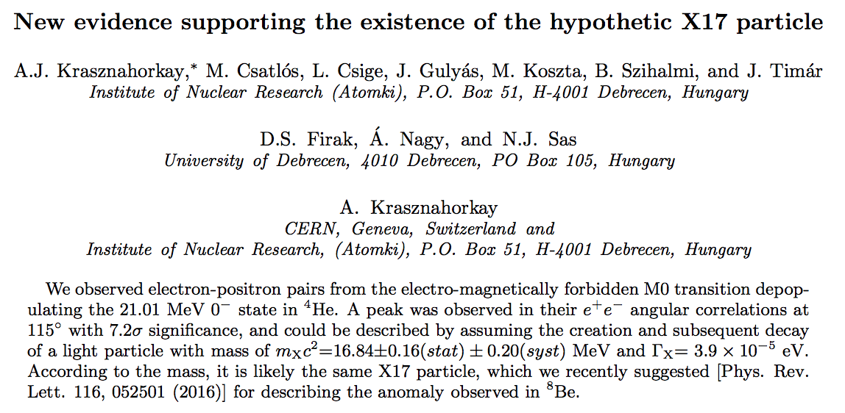
X17 dal ⁸Be al ⁴He
23 Oct 2019
arXiv:1910.10459v1

Slide 43
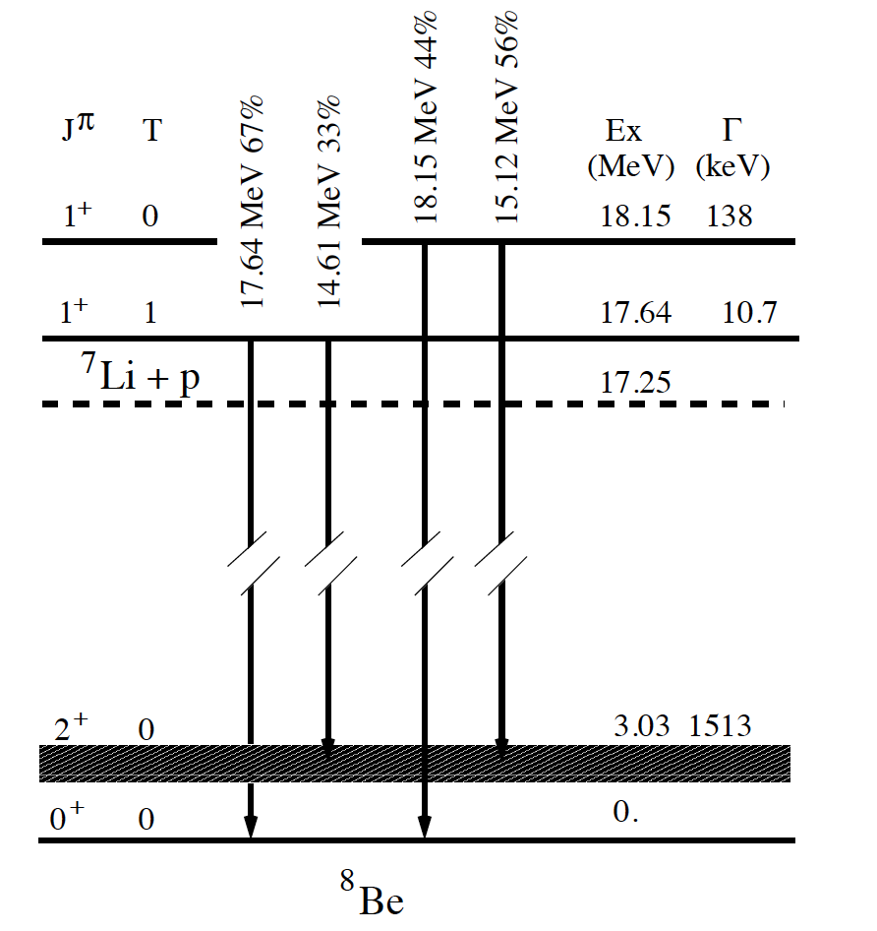
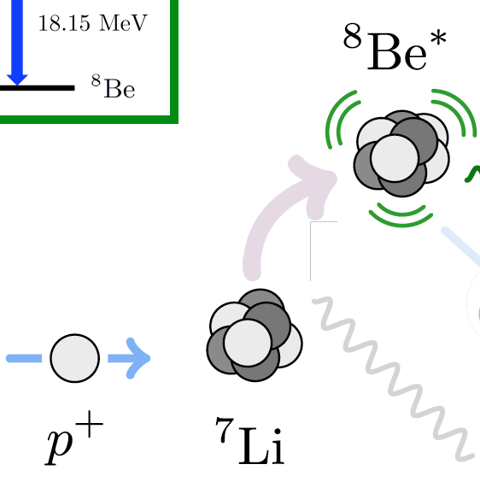
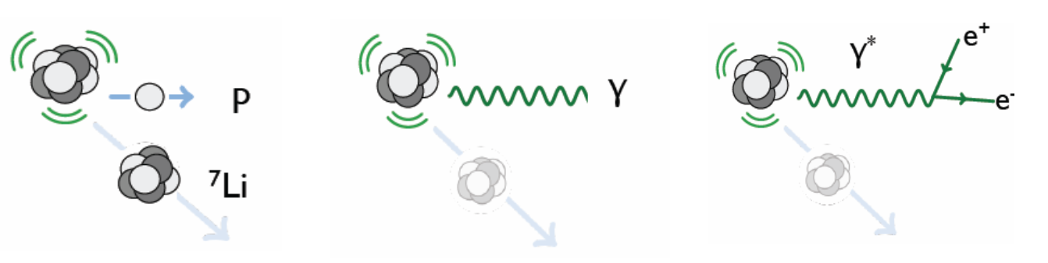
The 8Be nucleus
Resonant proton capture
8Be decay
HAD
EM
IPC
Can excite the ⁸Be(18.15 MeV) by using proton capture E_{p}=1030 KeV
The Be is a peculiar nuclei having high energy transitions to the ground state
  1⁺0 T=0 has 18.15 MeV if it goes directly to ground state 0⁺0 E_{p}= 1030 KeV
  1⁺0 T=1 has 17.64 MeV if it goes directly to ground state 0⁺0 E_{p}= 441 KeV

Slide 44
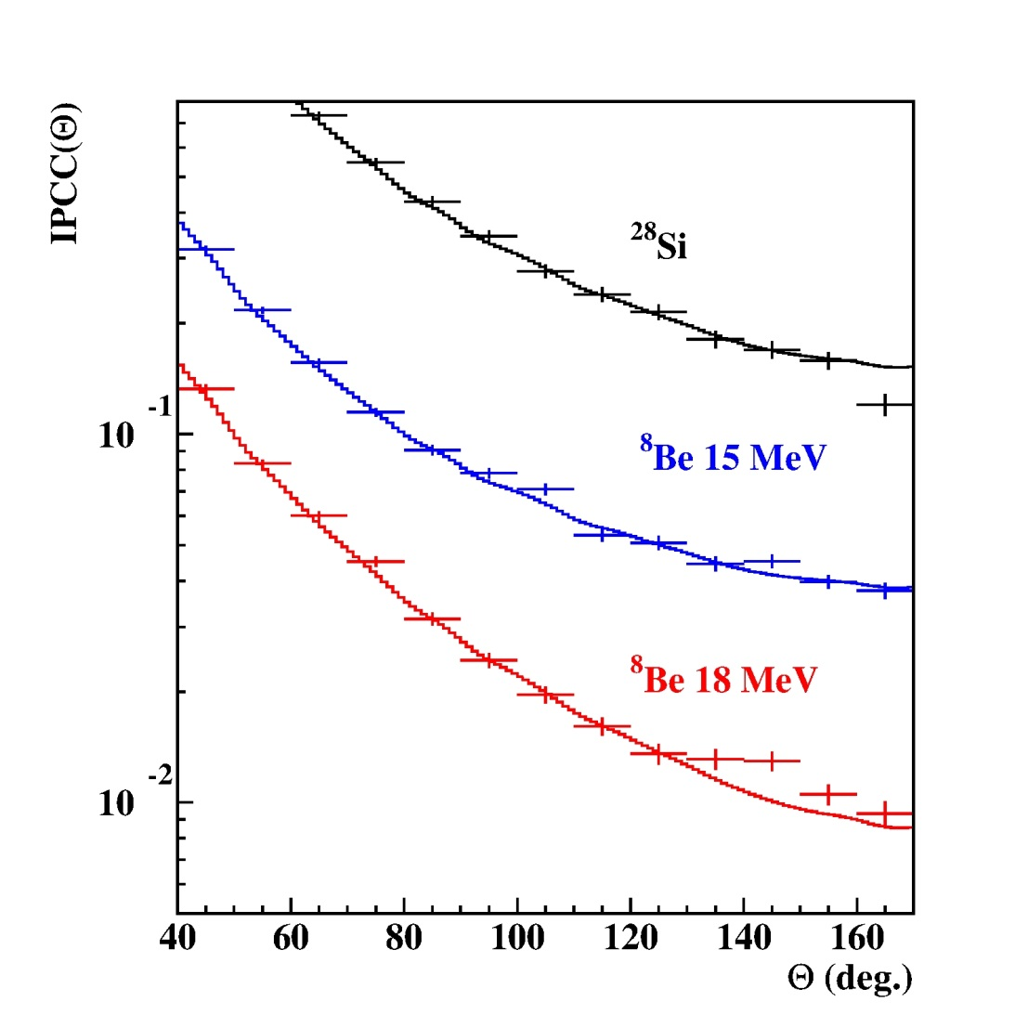
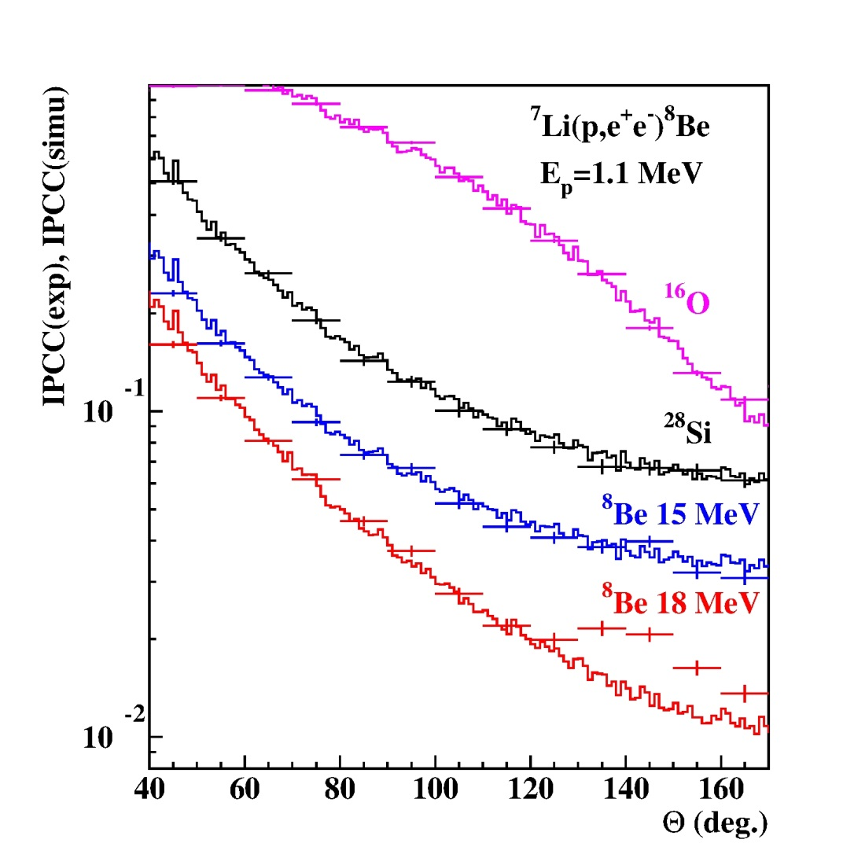
On resonance measurements
Ep=1.04 MeV
Ep=1.10 MeV
Deviation from IPC

Slide 45
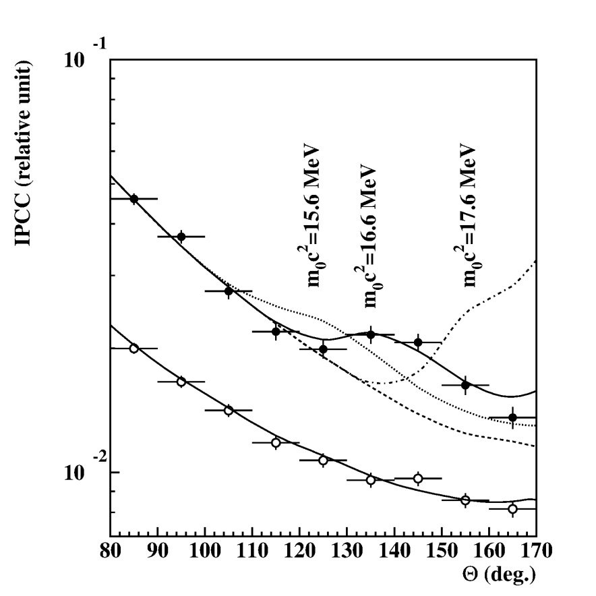

Scanning the resonance with Ep
y=$\frac{E^{+}−E^{−}}{E^{+}+E^{−}}$
Experimental angular e⁺e⁻ pair correlations measured in the ⁷Li(p,e⁺e⁻) reaction at Ep=1.10 MeV with -0.5< y <0.5 (closed circles) and |y|>0.5 (open circles). The
results of simulations of boson decay pairs added to those of IPC pairs are shown for different boson masses.

Slide 46
The ⁴He anomaly
The ³H was absorbed in a 3 mg/cm² thick Ti layer evaporated onto
a 0.4 mm thick Mo disc. The density of the 3H atoms was 2.66x10²⁰ atoms/cm². The disk was cooled down to liquid N² temperature to prevent ³H evaporation.
Resonant proton capture
⁴He*
³H
E_{p}=900 keV
The 3 H(p,γ )4 He reaction at Ep =900 keV bombarding energy was used to populate the wide (Γ = 0. 84 MeV) 0− second excited state in ⁴He, located at Ex = 21.01 MeV.
The investigated 0− state overlaps with the first ex-
cited state in ⁴He (J=0+, Ex=20.21 MeV, Γ=0.50 MeV), which was also excited but but give only a managable background to the e+e− spectra.

Slide 47
The ⁴He anamaly peak
External pair creation
IPC e⁺e⁻ pairs crated in the J =0+ -> 0+ gs E₀ transition
The data measured for the background
were fitted by a 4-th order exponential polynomial, and the result is shown in a blue full curve. This blue curve was rescaled to fit the background of the angular correlation shown in red in the range of 40◦ < θ < 90◦ .

Slide 48
Comparing anomaly peaks
⁸Be anomaly (18MeV to GS)
⁴He anomaly (21MeV to GS)
6.8 σ
7.2σ
M_{X} =16.70±0.35.stat.± 0.5.syst. MeV
M_{X}=17.00 ± 0 .13 ± 0 .2 MeV
Γ_{𝑋}=Γ_{γ}xB_{x}=1.9x6x10⁻⁶ eV= 1.2x10⁻⁵ eV
Γ_{𝑋}= 3.9x10⁻⁵ eV

Slide 49


The experimental constraints A’
Na64 no beam up to end of 2021
Mesa no beam before 2024
Interesting target for PADME mass is within reach.
  Unfortunately PADME is not designed to search for visible decay.

Slide 50

Veto di PADME
Active diamond target
Positron Veto system
(PVeto)
Electron Veto system
(EVeto)
PADME spectrometer inside the vacuum chamber from the calorimeter point of view

Slide 51
the acceptance of the veto
Particle with momentum <50 MeV do not enter the PADME vacuum chamber due to bending of the fringe field of the magnet

