Slide 1
CMS – Bari 4th meeting…with COVID-19 G. Pugliese 17 aprile 2020

Slide 2
CMS TC – Covid-19 team
CERN and CMS is working on several initiatives to help the global fight against COVID 19:
A Twiki page is available here:
https://twiki.cern.ch/twiki/bin/view/CMS/CMSvsCOVID19
In case you are interested in knowing about the ongoing projects or want to help, please contact the project leaders listed on the twiki pages. Lucia and I are in the group, please contact us if you prefer.
David Lange reported about this at WGM: https://indico.cern.ch/event/904406/
Attivita’di computing …
Coinvolgimento di Recas (Lucia – Giacinto)

Slide 3
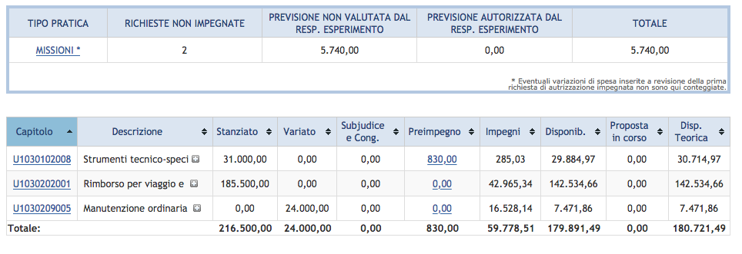
Founds 2020 (1)
NO changes with respect to February/March
Missions can be closed: you can close them online (papers will be included later). Non saranno evase prima del cartaceo ..

Slide 4
Voli Alitalia cancellati/annullati
Maggiori info:
https://www.alitalia.com/it_it/volare-alitalia/news-e-attivita/news/info-passeggeri.html

Slide 5
Founds 2020 (2)
CMS Phase 2
Modules of the ME0prototype 5kCHF→ Done
The table (8kEURO) will be payed by INFN – Bari as infrastructures
To be processed from CMS – Bari budget:
GEM HV module (cost will be shared with with GR1)
Oscilloscope ? 3 kEuro

Slide 6
Bari Paper review
CMS-HIG-19-013-001-COMMENT-006 ‬
Review done in January by Piet – Antonello
http://cms.cern.ch/cds/HIG-18-024
Done by Nicola –ilirian
http://cms.cern.ch/cds/SMP-19-006
Mon, Apr 20, 2020.
Marcello M. –Wallaa

Slide 7
NEWS from last CB
Succession of TC (Austin is leaving cern by the end of the year)
Wolfram Zeuner, presently Deputy TC, is the new TC starting from July 2020
Mar Capeanswill remain deputy TC, and Upgrade TC
New LV2 positions:
LV2 ML L2 Convener: Jean-RochVlimant
ML L2 Convener: Gregor Kasieczka
Data and Workload Management L2: Katy Ellis
Upgrade R&D and TDR L2: Daniel Elvira
HGCAL L2 Manager for Scintillator, SiPMsand Tile-boards
L2 Generators group Gurpreet Singh Chahal
LV1 positions:
Offline and Computing James Letts, UCSD
Run Coordination 1 Gaëlle Boudoul, and Gianni Masetti
Physics Coordination Andrea Rizzi
PPD Coordinator Salvatore Rappoccio
TSG Coordinator Darin Acosta

Slide 8
NEWS from last CB
CMSWEEEK
June CMS week to be video only too
Next CMSWEEK (in Egypt) is postponed to 2022
New institutes applying for CMS membership:
Presentation from OMEGA, CNRS/IN2P3 Micro-Electronics Design Laboratory done at CB (vote will be online).
Online vote last week overwhelming in favor of Cranfield University's admission to CMS as an Associated Member.
The results of the vote are:
Votes cast: 103
Yes: 98
No: 3
Abstain: 2s

Slide 9
Restarting activity
Our INFN director created a working group for the re-starting of activity. Actions:
Start planning the re-starting of activity on the following bases:
Access to Offices and laboratories alone or in VERY small team
Reduce moving to workers not residence in Bari
Reduce the incoming of international students and colleagues.
Document to be filled for CMS (before Monday): https://docs.google.com/document/d/1fNfPhuzIDtX61YyKQiUH6uEs3AskcFXqtsz-4rC5H4Q/edit
INFN Meeting is planned for April 27, 11.30
Similar policy will be followed by MIUR (Alexis’s email):
Phase 2: May-August
Phase 3: Sept – Jan 2021!!

Slide 10
Paper Authorship
We all received this email from CB chair about the authorship of papers on technical methods. The email was triggered by the POG group started a discussion to publish a Technical Paper on DeepJet with a Limited Authorship
On June 28, 2019, the CB (in CB124) approved rules for the limited authorship of papers on technical method:
https://cms-docdb.cern.ch/cgi-bin/DocDB/ShowDocument?docid=12238
The Publications Committee Chair, the Physics Coordinator and the conveners of the relevant PAG, POG or coordination area must be informed at an early stage of the intention to publish methods of a technical nature (such as algorithms) and the publication must be registered in CADI in the ‘Technical notes’ category.
When the publication, including the proposed list of authors, is ready for submission it should be stored in CADI. The conveners of the relevant PAG, POG or coordination area and the Publication Committee must approve, that limited authorship is legitimate for the proposed publication, the title and whether the word “CMS” can be used in the title and confirm that the publication can be published. The publication including the author list will then be announced to CMS.
Additional authorship can be requested within a period of one week on the basis of confirmed direct or indirect contributions to the result.
This will be dealt with by the Authorship Committee. Once this process has been completed, the publication can be submitted by the authors.
By a technical method we mean "...methods that when applied to CMS Data would on their own not lead to new knowledge about nature (e.g., methods arising from POG, DPG, DQM, etc., work).”
In the paper uses: full CMS geometry, simulation and reco
Limited list … how many??

Slide 11
SPARES

