Slide 1
Bilancino
Geometry and simulations

Slide 2
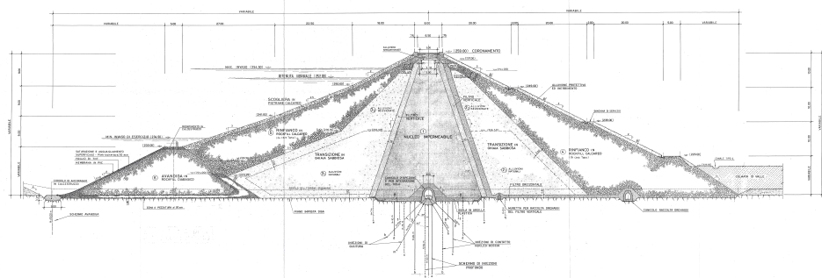
CAD model

Slide 3
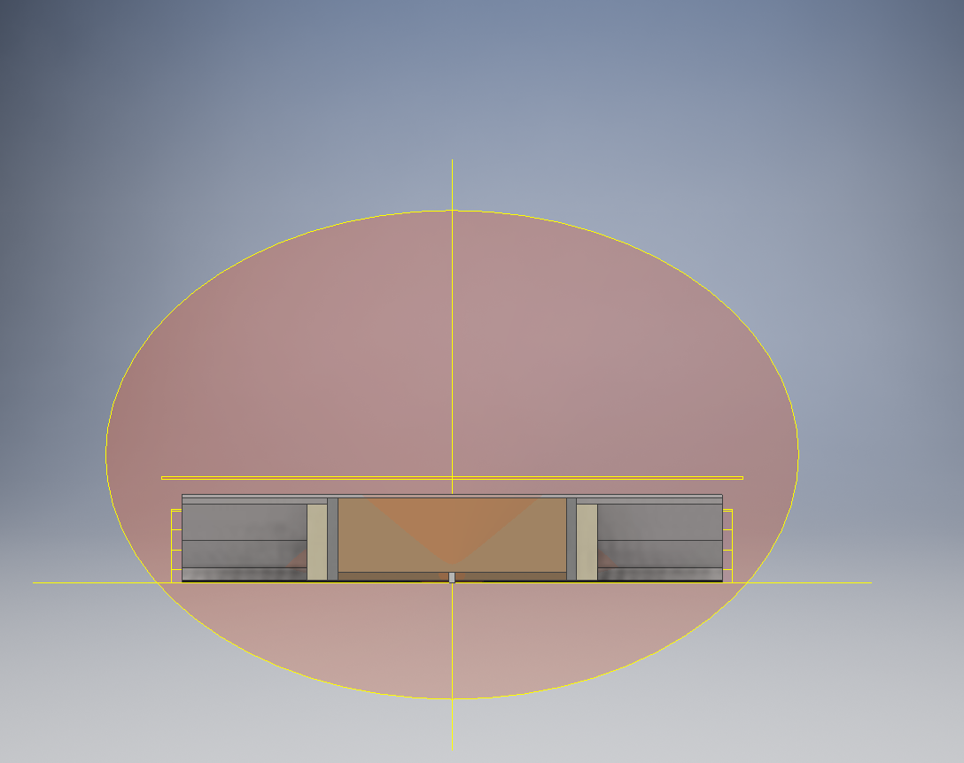
CAD model

Slide 4
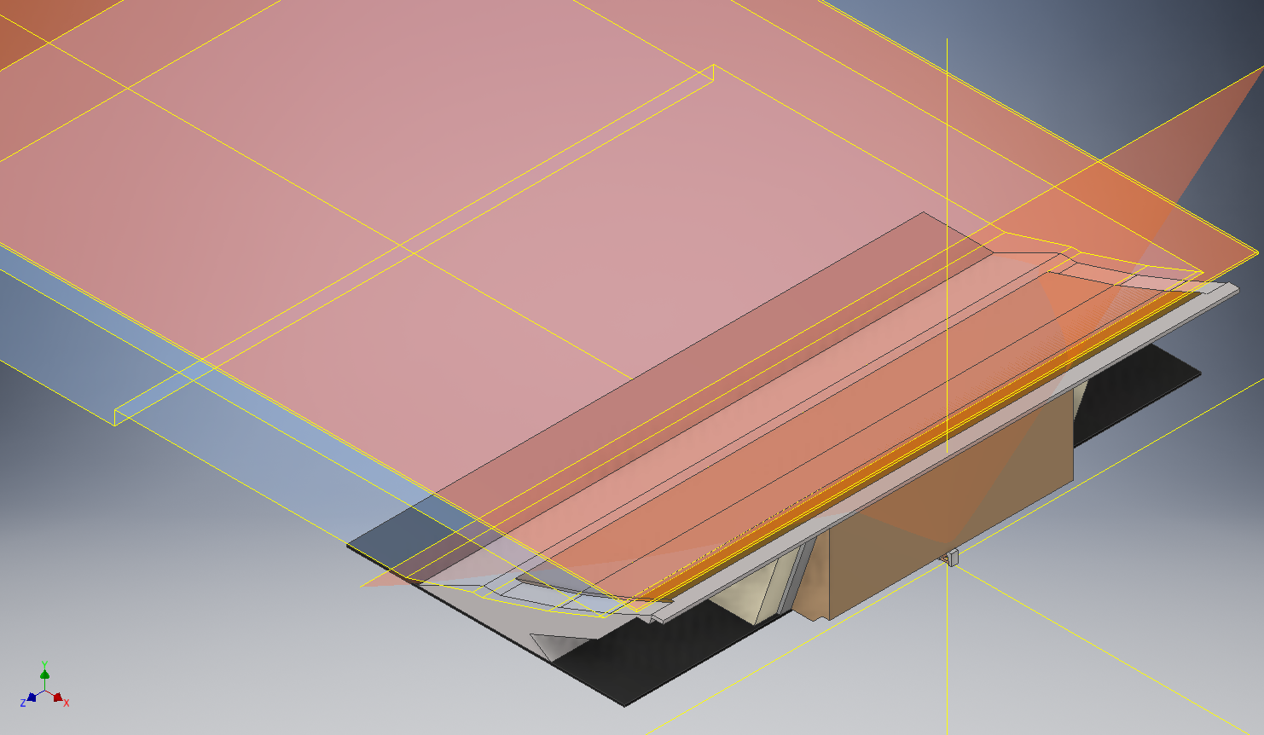
CAD model

Slide 5
GEANT geometry
Impossible to add anything!
Should be simplified

Slide 6
GEANT geometry

Slide 7
GEANT geometry

Slide 8
GEANT geometry
Structure | real material | simulated material | density (g/cm3) | density origin
Gallery, internal part | concrete | G4_concrete | 2.3 | standard value GEANT
Gallery, external part | Unknown | G4_concrete | 1.8 | assumption (typical lite concrete value)
Kernel | Clay | G4_silicon_dioxide | 1.875 | measured
Filter | unknown | G4_concrete | 1.755 | assumption
Sand (alluvioni) | sand | G4_silicon_dioxide | 2.2 | measured
Rock(rockfill calcareo + avandiga) | crushed stone | G4_calcium_carbonate | 2.1 | measured
Sandstone (scogliera) | sandrock | G4_calcium_carbonate | 1.2 | assumption (typical crushed sandstone value)
Notes:
Supposizioni

Slide 9
400 MM SCINTILLATOR TEST
40 mm SCINTILLATOR WITH MYLAR WRAPPING.
One side read out
First measurement in standard configuration
Second SiPM and mylar wrapping were removed and replaced by tedlar (black absorption material).
Amplitude and integral distributions were measured.

Slide 10
400 MM SCINTILLATOR TEST

Slide 11
400 MM SCINTILLATOR TEST

