Slide 1
Photodiodes
Large, small and new PD

Slide 2
Old large and small PD with LYSO
Standard assembling configuration
Measurements with Amptek
Two scintillators in coincidence
MIP is measurable with small PD

Slide 3
Old large and small PD with LYSO
Small PD

Slide 4
Old large and small PD with LYSO
Large PD

Slide 5
Old large and small PD with LYSO
Offset
PDS
Gain 92,55

Slide 6
Old large and small PD with LYSO
Offset
PDS
Gain 92,55

Slide 7
Old large and small PD with LYSO
Offset
PDSL
Gain 37,686

Slide 8
Old large and small PD with LYSO
MIP ratio
 | PD large | PD small
MIP | 572,363 | 24,757
Gain | 37,686 | 92,55
Offset | 6,189 | 2,964
MIP norm | 15,023 | 0,2355
MIP norm = (MIP-offset)/Gain
MIP ratio = 15,023/0,2355=63,93
Area ratio = 84,64/1,6=52,9

Slide 9
Old large and small PD with LYSO
LED

Slide 10
Old large and small PD with LYSO
LED

Slide 11
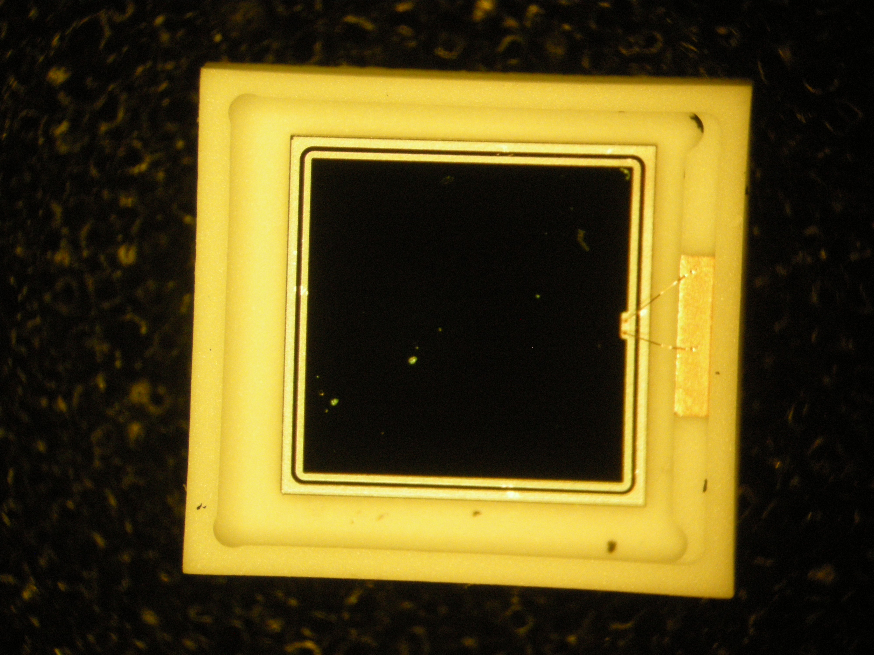
NEW PD 2 pieces
No protection!

Slide 12
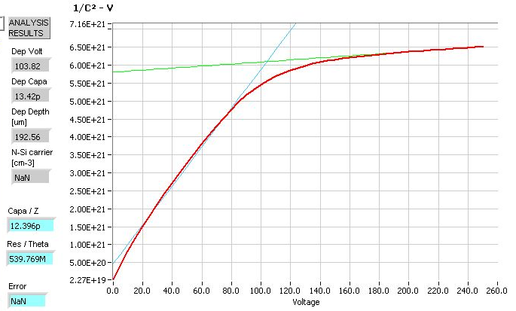
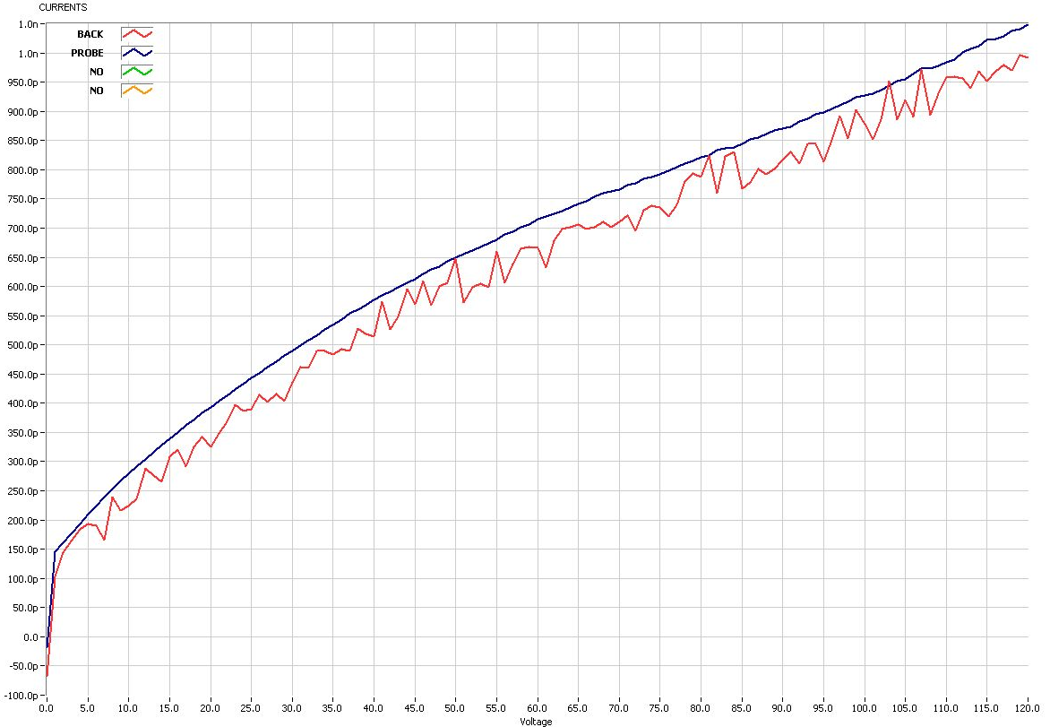
NEW PD
Electrical characterization
Vdep1=103,8
Vdep2=97,9
Ileak < 1nA

Slide 13
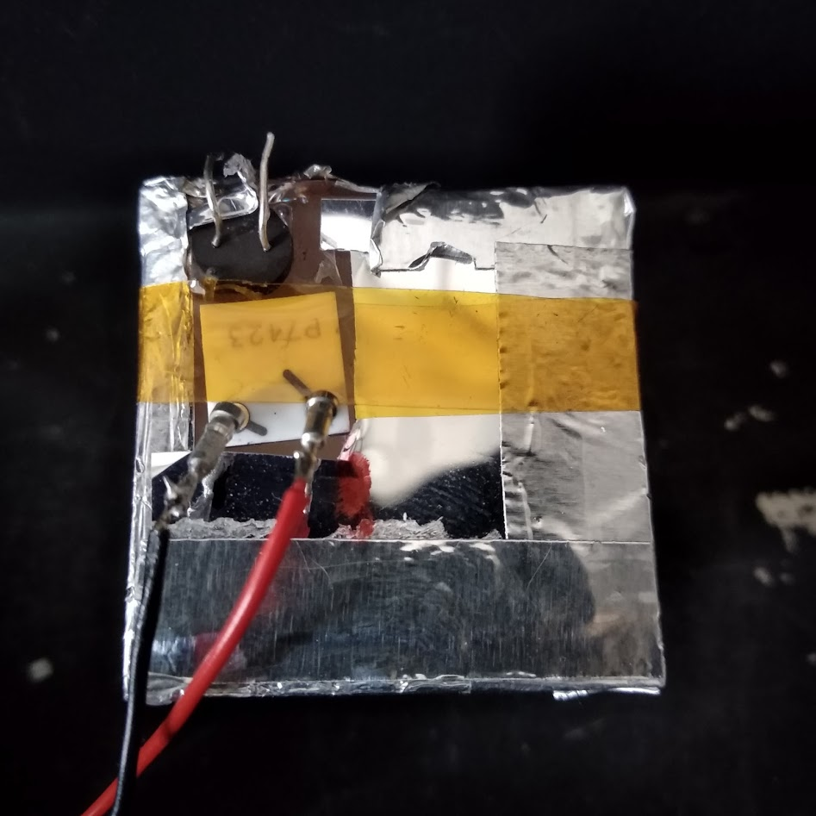
NEW PD
Spectral measurements with AMPTEK
First attempt no visible MIP signal with LYSO
Very noisy
High amplitude LED signal is only measurable
Strange dependence on bias voltage
Probably bad PD contact with preamp

Slide 14
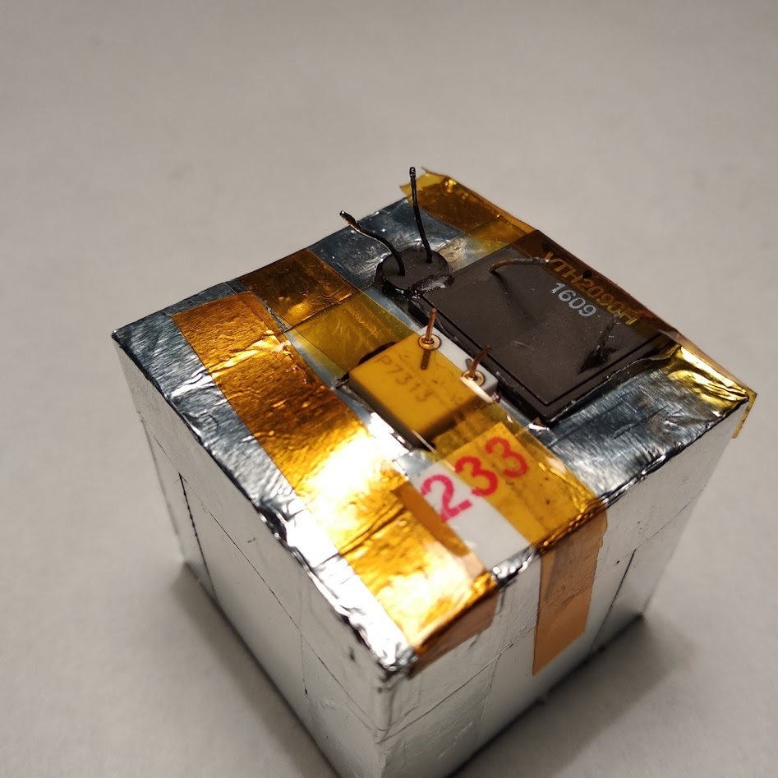
NEW PD
Spectral measurements with AMPTEK
First attempt no visible MIP signal with LYSO
New PD was mounted on CsI crystal

Slide 15

NEW PD
Spectral measurements with AMPTEK
First attempt no visible MIP signal with LYSO
New PD was mounted on CsI crystal
MIP measurement
Normalized signal ratio $=\frac{397∗37,68}{130∗12,69}=$ 9,07

Slide 16

NEW PD
Spectral measurements with AMPTEK
First attempt no visible MIP signal with LYSO
New PD was mounted on CsI crystal
LED measurement @ 415nm
Normalized signal ratio $=\frac{202∗37,68}{89∗12,69}=$ 6,7

Slide 17

NEW PD
Spectral measurements with AMPTEK
New PD QE is unknown
LED with collimator
D =1,2 mm
Signal ratio $=\frac{489}{543}=$ 0,9

Slide 18

NEW PD
Spectral measurements with AMPTEK
First attempt: no visible MIP signal with LYSO
Second measurement
Normalized signal ratio $=\frac{444∗74.13}{151∗37.67}=$ 5.78

Slide 19
NEW PD
Spectral measurements with AMPTEK
First attempt: no visible MIP signal with LYSO
Second measurement
~ 20% difference between two LPD

Slide 20
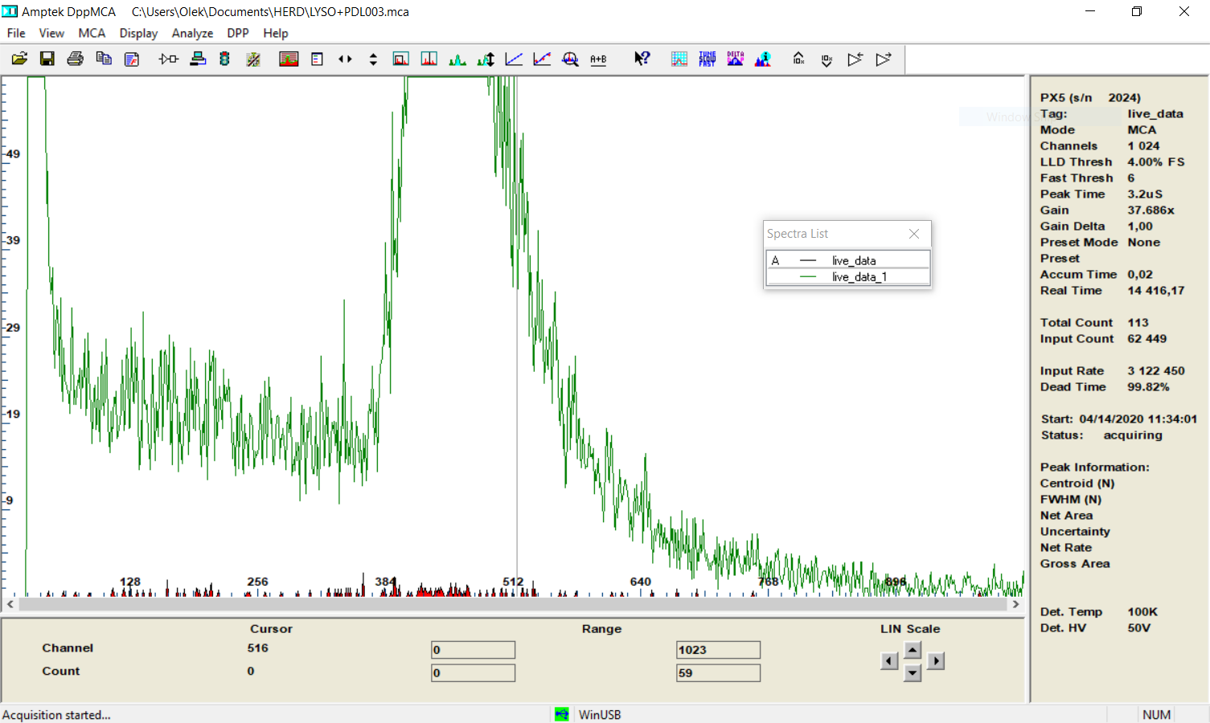
NEW PD
Spectral measurements with AMPTEK
First attempt: no visible MIP signal with LYSO
PX5 setup were different for first and second PDL’s acquisitions
Second PDL measurement with setup equal to first PDL measurements
Green curve - second PDL acquisition with original setup
Red curve - second PDL acquisition with PD5 setup equal to firs PDL

