Slide 1
CMS – Bari 3th meeting…in the time of COVID-19 G. Pugliese 19 marzo 2020

Slide 2
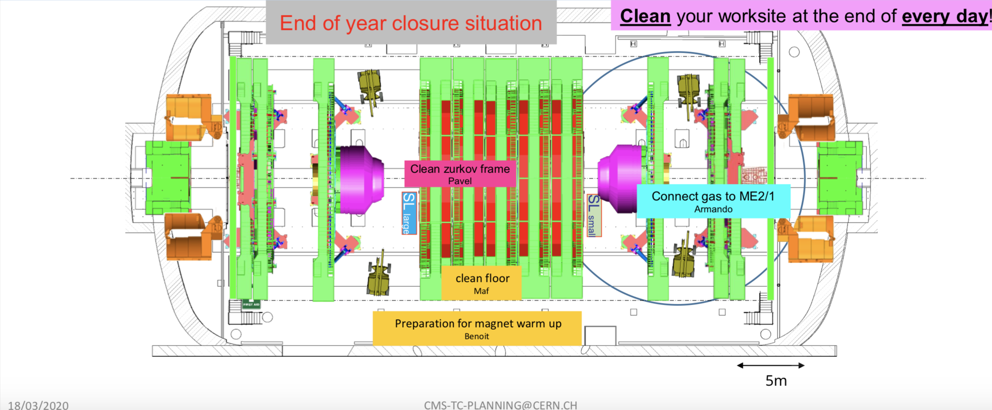
CERN Status
CMS is in "safe state” until further notice.
This means that CMS is off and by an extraordinary effort, configuration of the yoke elements was reached and the plan is to start Magnet warm-up ASAP.
Only Safety tours will be done .
Everybody is working in teleworking.
ALL activities @ CERN in GIF++ and all labs (904, etc) are stopped.
All facilities as Computing will stay on - fundamental for keeping the teleworking option credible.

Slide 3
What next…
There is no plan for when we will start again. Someone is speaking about 2-3 months.
Who is working on analysis should be able to continue working
All meetings (including CMS WEEK in March) are vydio only.
Who is working in-situ (as GIF++, 904) on the detectors, should try to consolidate the analysis on the data available. It is a good moment to finalize plots, ask for approval, write papers.
Among us, I can organize more frequent meetings dedicated on specific analysis (this can help everybody!)
I am sure we can transform this very difficult period into an occasion for thinking, planning, learning, helping those who are in need, and being supportive to each other (Fabiola, 17th march https://indico.cern.ch/event/898276/attachments/2004949/3348220/Covid-19-personnel-2020-03-17_Read-Only.pdf

Slide 4
Founds 2020 (1)
CMS
The missions have been STOPPED since last weeks.
Status of people in mission:
3 colleagues: Vincenzo Mastrapasqua, Franco Michele, Andriano Di Florio were able to return to Bari last week (just before CERN closing)!
Merlin, Jeremie is still at cern (with a long mission 1st of April) .. ?
Two missions cancelled (Lucia and Flavio)
NO big changes with respect to February

Slide 5
Founds 2020 (2)
CMS Phase 2
→ To be proccessed: Contribution for modules of the ME0prototype 5kCHF

Slide 6
Bari Paper review
CMS-HIG-19-013-001-COMMENT-006 ‬
Review done in January by Piet
http://cms.cern.ch/cds/HIG-18-024
Review done by Nicola (he will report on next time)

Slide 7
Varie (1)
l’avviso di selezione per "Associate presso il CERN’ è stato pubblicato sul sito
ttps://reclutamento.infn.it/ReclutamentoOnline/
(deadline … 07/04/2020 23:59 CEST)
Someone has information on this?

Slide 8
Varie (2)
Phd defence done on 17th March by Gelmi, Lezki and Soldani
Well done! Congratulation to all of them.
Unfortunatelly now one of them will continue with us... !
Terza missione (Fabio’s email): please check on INFN web page http://home.infn.it/it/eventi if all our events are there. If not please add
http://www.ba.infn.it/ login e poi Divulgazione --> Form Terza Missione
Summer students: who applied? So far, I know about Brunella D'Anzi.

Slide 9
Varie (3)
Programma Reaserch &Innovation in apertura nel 2020. Di seguito alcune informazioni sui bandi previsti:
In apertura il 16 Aprile 2020:
H2020-JTI-EuroHPC-2020-01: Advanced pilots towards the European exascale supercomputers
Il bando prevede 2 sotto-argomenti distinti:
EuroHPC-2020-01-a: Advanced pilots towards the European supercomputers – deadline prevista : 15 Settembre 2020
EuroHPC-2020-01-b: Pilot on quantum simulator – deadline prevista: 28 Luglio 2020
In apertura il 21 Luglio 2020:
H2020-JTI-EuroHPC-2020-02: Framework Partnership Agreement in European low-power microprocessor technologies (Phase 2) (Research and Innovation Action)
Il bando finanzia la Fase 2 dell'Iniziativa EPI (European Processor Initiative).
Deadline prevista: 12 Gennaio 2021
H2020-JTI-EuroHPC-2020-03: Training and Education on High Performance Computing (Coordination and Support Action)
Deadline prevista: 12 Gennaio 2021
Per maggiori informazioni consultare il work programme https://eurohpc-ju.europa.eu/documents/EuroHPC_JU_Decision_01.2020-Annual_Work_Plan_2020_amended.pdf

Slide 10
SPARES

