Slide 1
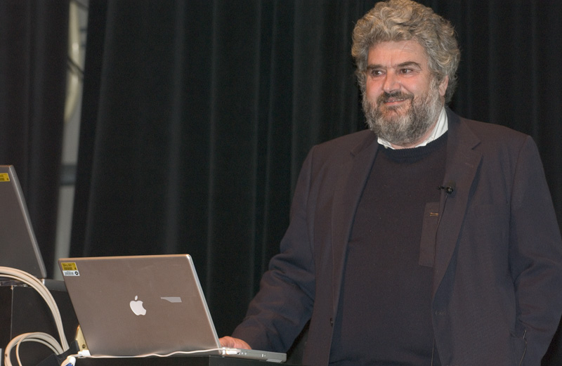
Frontier Detectors for Frontier Physics
15th Pisa Meeting on Advanced Detectors
22-28 May 2022 - La Biodola, Isola d’Elba (Italy)
In december 2012
we lost a
Aldo Menzione
In december 2014
The Executive Board of the
Frontier Detector for Frontier Physics
decided chorally the institution of
the "Aldo Menzione" Prize
colleague
scientist
inventor
The Prize is awarded
in coincidence with the
Pisa Meeting on Advanced Detectors,
to distinguished scientists
who have contributed to the
development of detector techniques,
Hard and Soft applications in Physics
with outstanding achievements.
founder of the Pisa meeting
friend

Slide 2
Before to proceed…
Giorgio Bellettini
will give us his personal memory of
Aldo

Slide 3
In Honor of Aldo
on the occasion of assigning the
Aldo Menzione Prize 2022
Giorgio Bellettini
15th Pisa Meeting on Advanced Detectors La Biodola, Elba Island May 26, 2022

Slide 4
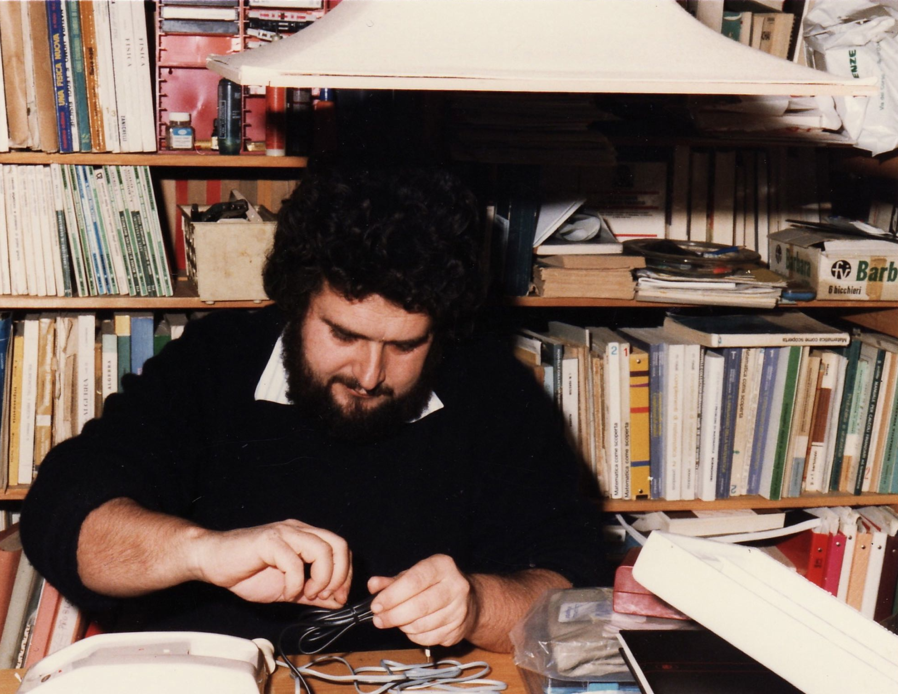
Aldo Menzione (1943-2012)
Aldo was 9 years younger than me and died 10 years ago.
I feel depressed and uneasy in celebrating deceased younger friends.

Slide 5
First approach with Aldo in 1970
The Pisa group was building the 4π R801 detector at the ISR.
Aldo Menzione was working for his PhD in Karlsruhe.
Lorenzo Foà told me:
“Aldo is very intelligent but a little messy. He is my cousin and married my sister…would you take him with us?”
No problem for me. Aldo became immediately a group member. Good for us, he was very intelligent.

Slide 6
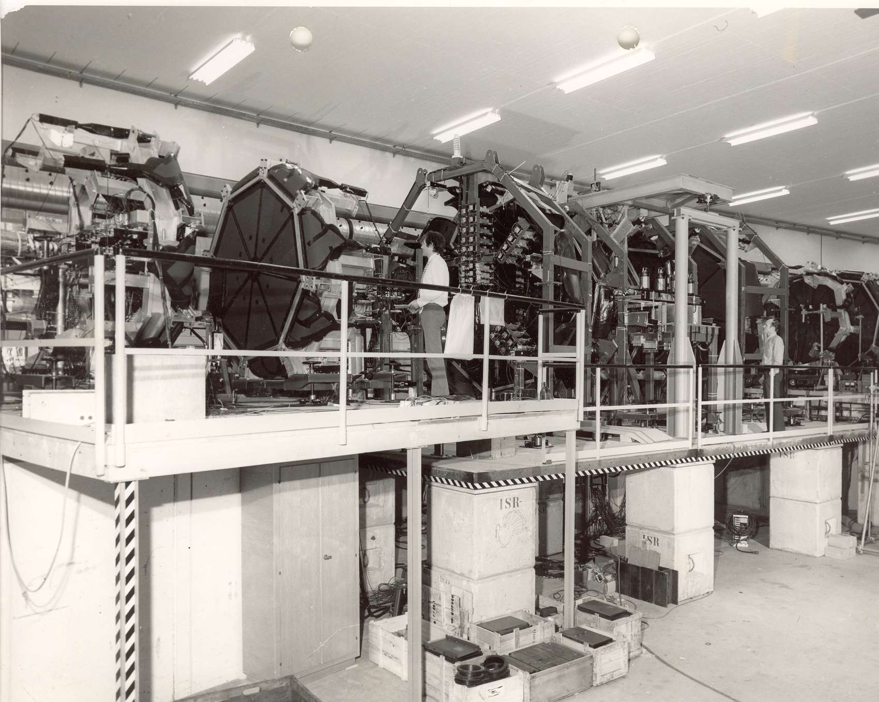
The R801 4π detector
Planes of plastic scintillator split into solid angle bins. The idea was to catch most prongs of all interactions and measure thereby the total cross section.
Aldo worked hard with the technicians to build this elegant detector.

Slide 7
R801 counters at very forward angles
To trace the small angle prongs the forward planes were split into smaller and smaller bins.
Aldo loved to close all holes to minimize the number of lost tracks.

Slide 8
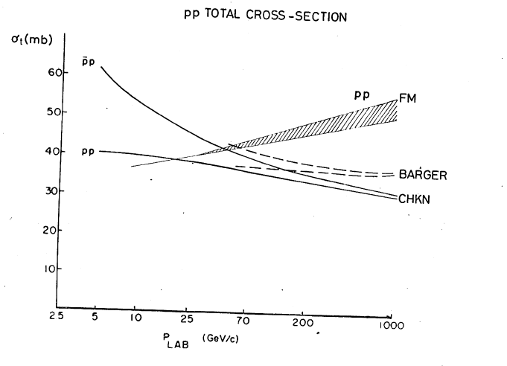
What was known about σ_{tot}
The general feeling was that asymptotically the cross sections of all hadronic processes would become constant.

Slide 9
The R801 discovery: σ_{t}(pp) grows with energy
S.R. Amendolia, et al., “Measurement of the Total Proton-Proton Cross Section at the ISR, Physics Letters 44B, 1, 1973.”

Slide 10
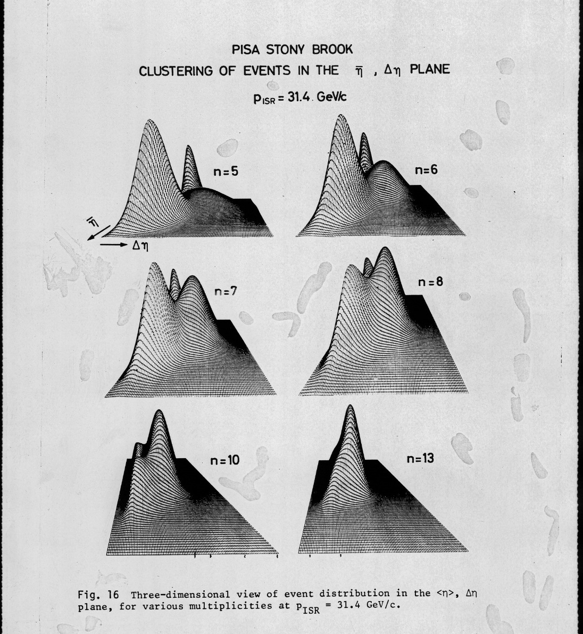
Exploring physics at forward angles
In a surprising presentation at a group meeting Aldo showed an appealing picture of forward diffraction.
Track dispersion δ₂(η) versus pseudorapidity showed the birth of large bumps, “puppe”, in events of low multiplicity within forward cones.
The so called “Puppe” were celebrated on the front page of CERN Courier

Slide 11
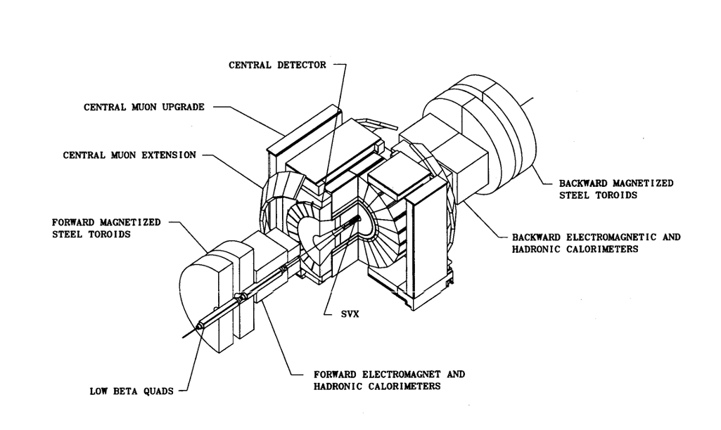
CDF1 was a calorimetric version of R801
Wire tracking chambers in B field were followed by projective calorimeter towers. Try to catch all prongs.
SVX

Slide 12
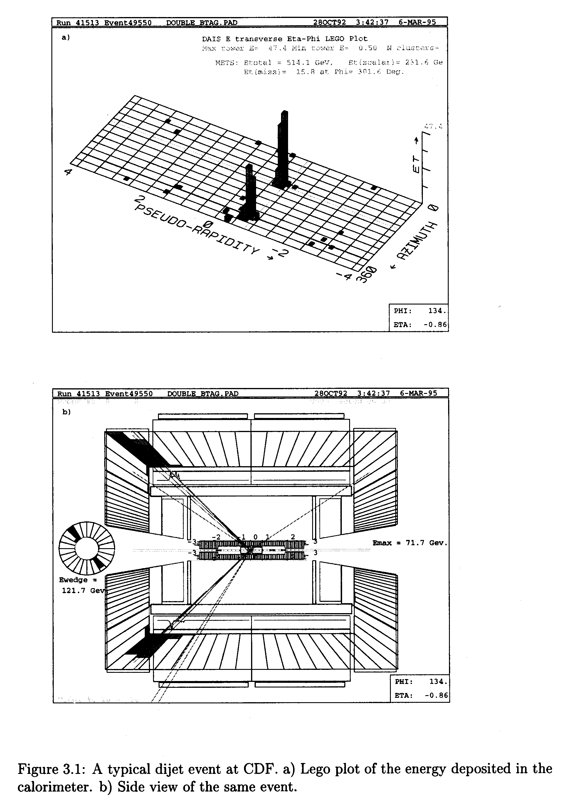
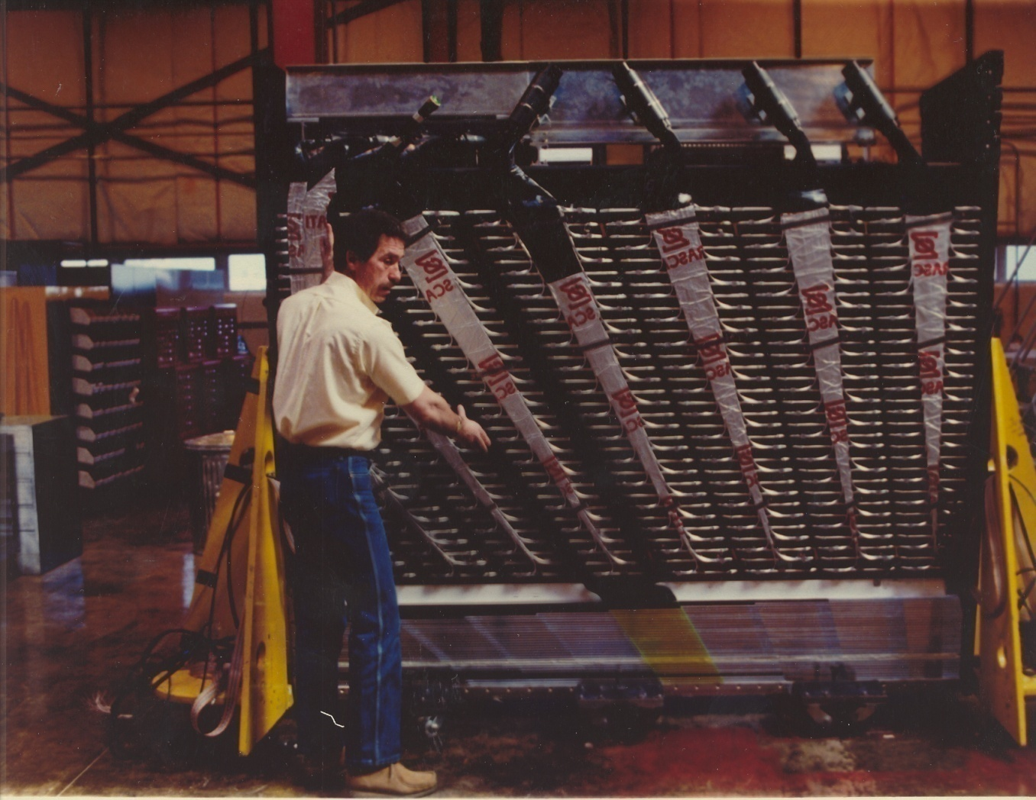
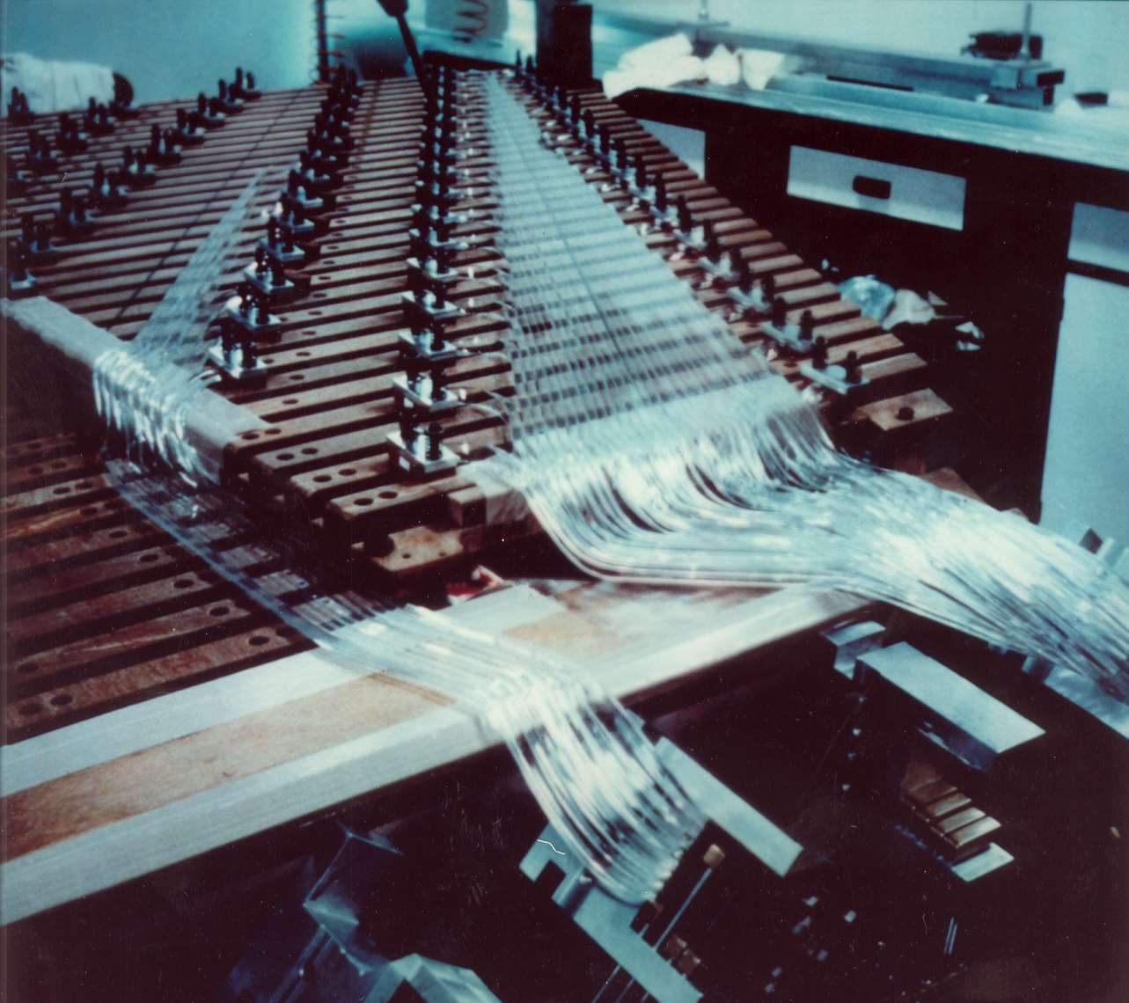
Light guides of the central towers
The tower signals provided a straight picture of the jets.

Slide 13
Assembling the light guides of the central calorimeters
Aldo Menzione
Aldo was a true experimentalist who loved working with his own hands.

Slide 14
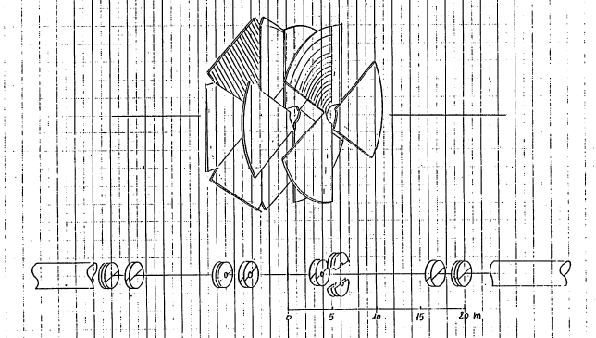
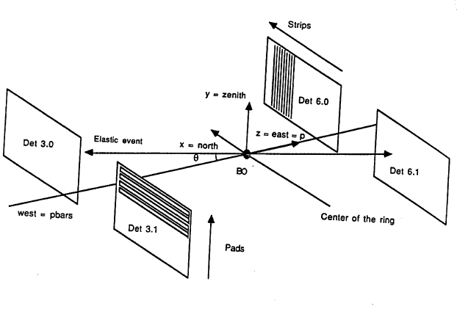
A strenuous sponsor of silicon detectors in CDF
In practice:
Silicon wafers with printed electrodes inside the beam pipes
Aldo`s drawing of the elastic scattering detector at the time of the 1981 Design Report

Slide 15
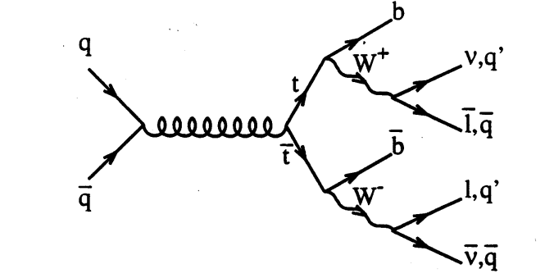
A powerful signature of top quark pairs
t-tbar → Wb-Wb, where M(Wb) = M(top)
An intrigued 6 body final state always with two b-jets.

Slide 16
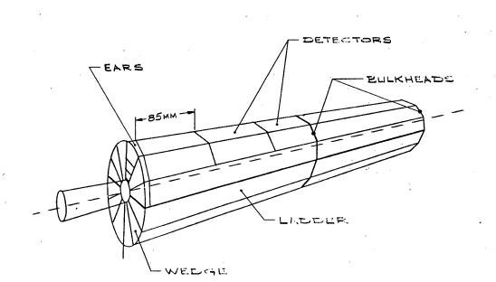
Aldo`s most important idea
Track the secondary vertices expected from b-jets in top quark events with cylinders of silicons surrounding the the interaction point
Silicon Vertex Detector

Slide 17
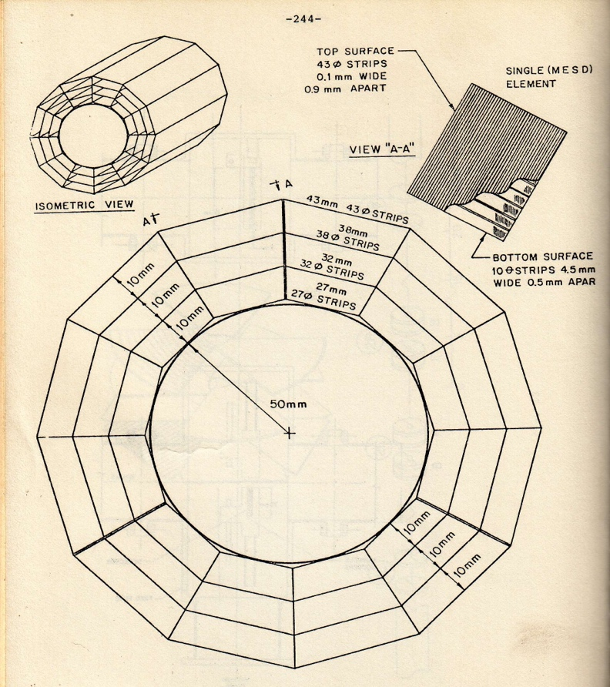
Aldo`s “minivertex” drawing in the 1981 Design Report
SVX 1 as drawn by Aldo in the
CDF Design Report

Slide 18
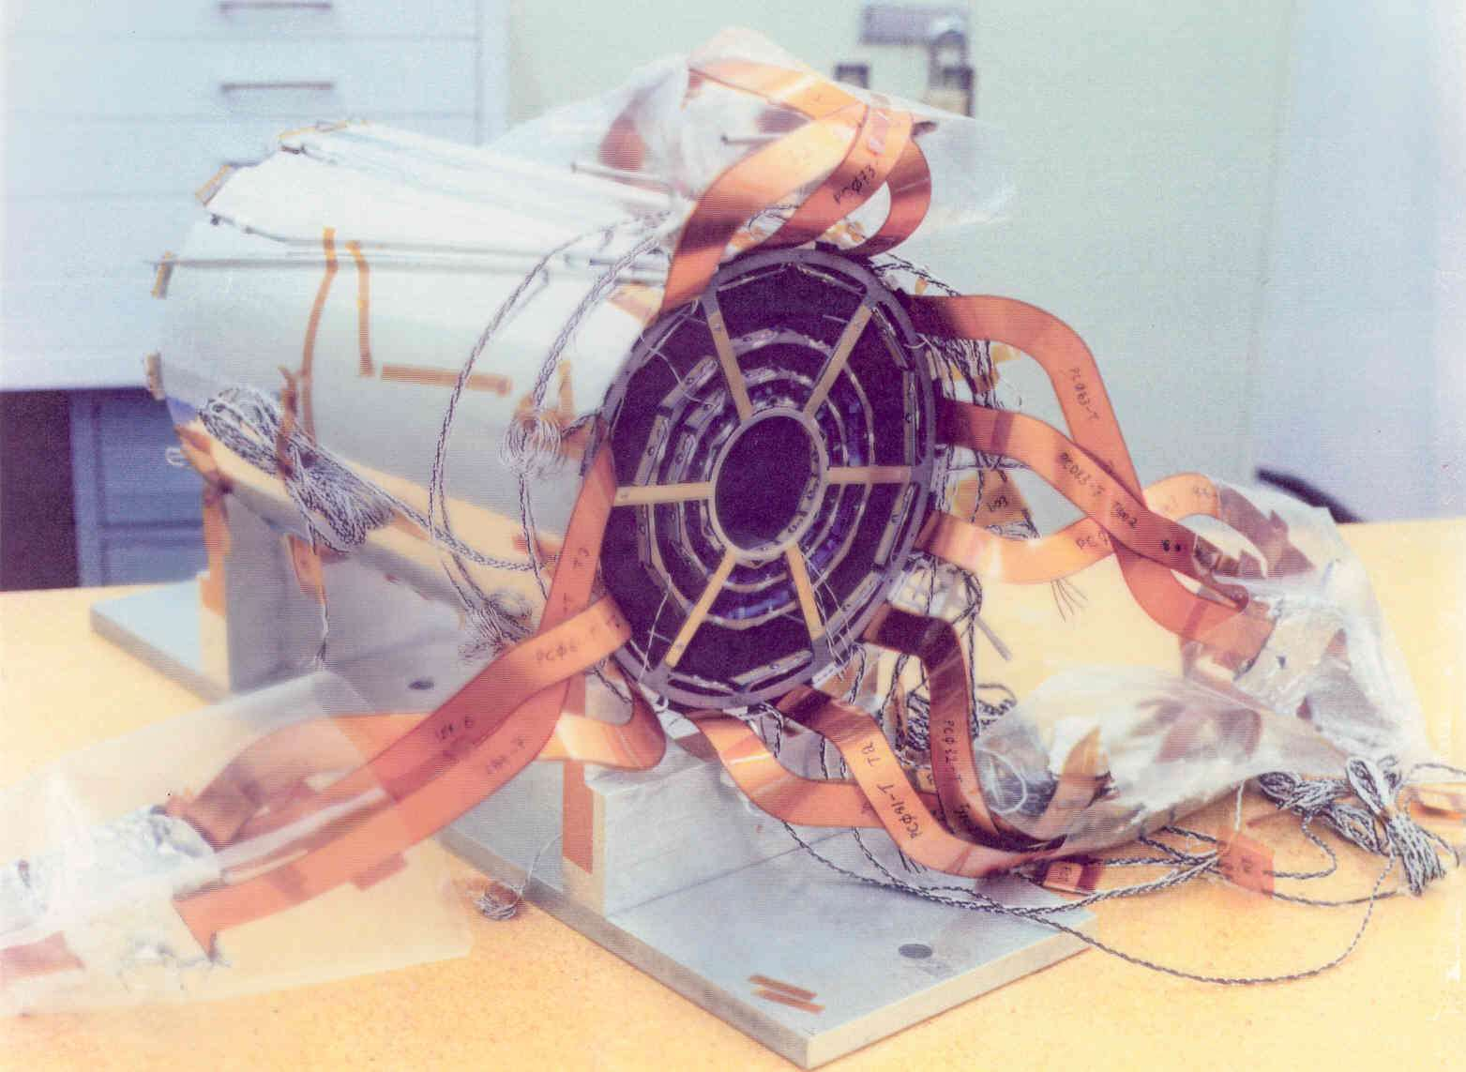
SVX1 in the Pisa museum
One of the first ever silicon detectors
in HEP experiments
Taking data
from 1992 to 1998.

Slide 19
Why this prize?
Aldo was an enthusiastic and very productive scientist, an original and creative experimentalist.
We want to inspire young scientists to follow his example and device “frontier detectors”. The future is in their hands.

Slide 20
Thank you

Slide 21
Selection Procedure
A Search Committee is appointed by the
Frontier Detectors for Frontier Physics Executive Board
in order to select a Research field and
to identify possible candidates in that field.
The final decision is taken during a plenary session of the
Frontier Detectors for Frontier Physics General Assembly.

Slide 22
Aldo Menzione Prize 1st edition - 2015
The Executive Board
of the Frontier Detector for Frontier Physics Association
is proud to announce that
the "Aldo Menzione" Prize for 2015
has been awarded to
David R. Nygren
for the Time Projection Chamber (TPC)
and
Fabio Sauli
for the Gas Electron Multiplier (GEM)

Slide 23
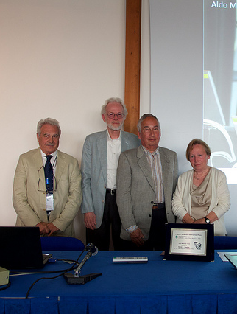
Notes:
The timetable is very tight. I ask

Slide 24
Aldo Menzione Prize 2nd edition - 2018
The Executive Board
of the Frontier Detector for Frontier Physics Association
is proud to announce that
the "Aldo Menzione" Prize for 2018
has been awarded to
Marcello Giorgi
for the silicon minivertex systems devoted to e+e- physics (ALEPH and BaBar)
and
Carl Haber
for the silicon minivertex tracking system in p-pbar collider (CDF)

Slide 25
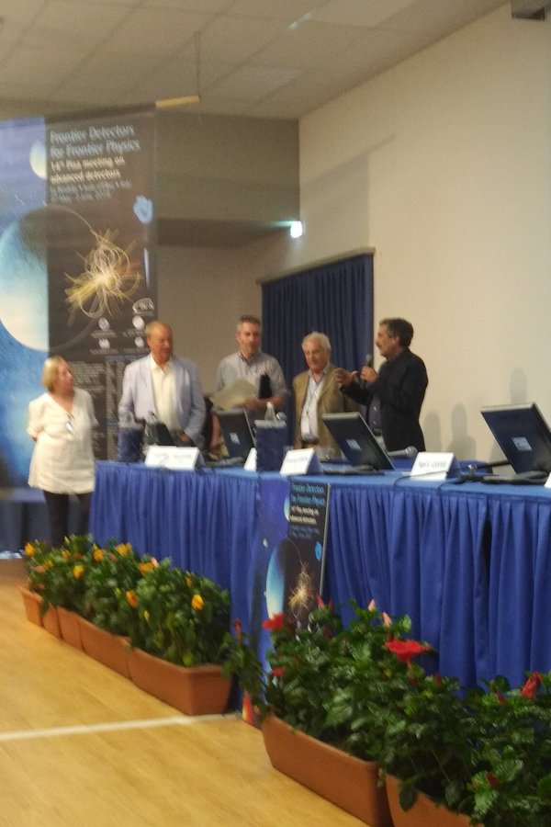
Notes:
This series of meetings started in 1985 in Tirrenia, near Pisa.

Slide 26
Aldo Menzione Prize 3rd edition - 2022
As per tradition,
Donata Foà (Bichina)
the wife of Aldo
will deliver the commemorative plaques
to the winners

Slide 27
Aldo Menzione Prize 3rd edition - 2022
The Executive Board
of the Frontier Detector for Frontier Physics Association
is proud to announce that
the "Aldo Menzione" Prize for 2022
has been awarded to
René Brun
for PAW & ROOT, fundamental tools for experimental data handling
and
Pantaleo Raimondi
for Crab Waist, a crucial tool for microbeams in e+ e- colliders

Slide 28
Frontier Detectors for Frontier Physics
13th Pisa Meeting on Advanced Detectors
24–30 May 2015 - La Biodola, Isola d’Elba (Italy)
Aldo Menzione

Slide 29
Aldo Menzione Prize
Thank you
Aldo

