Slide 1
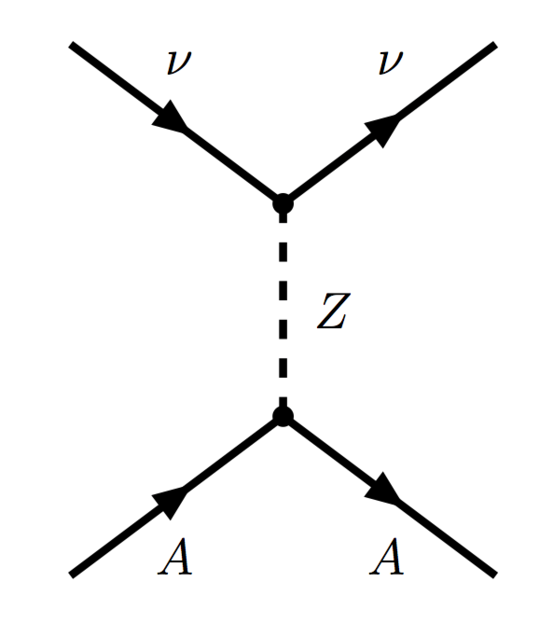
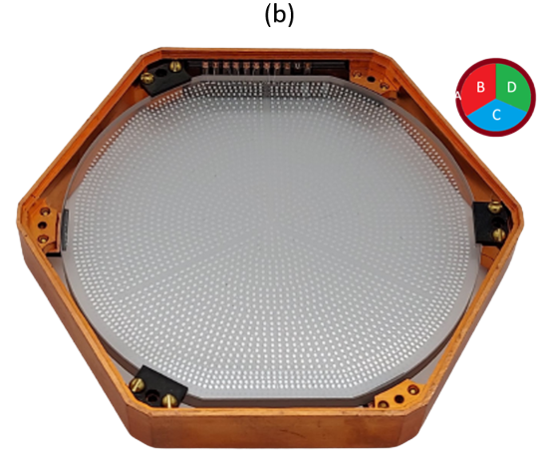
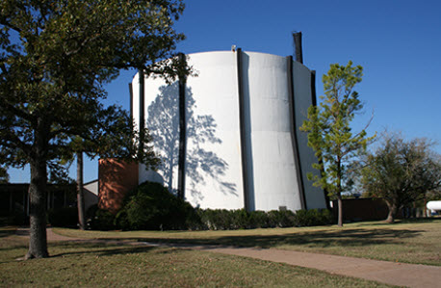
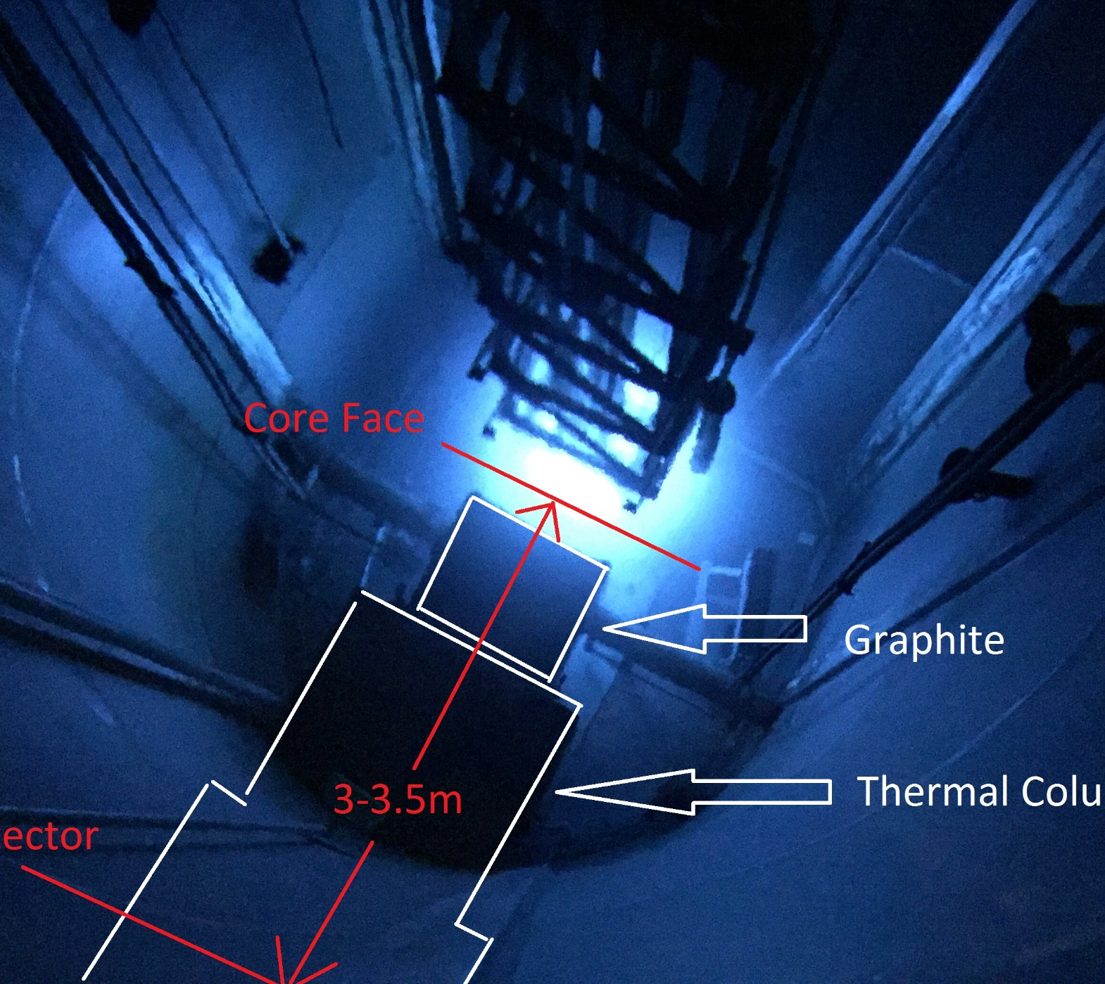
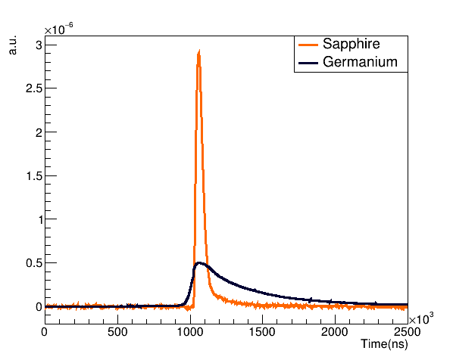
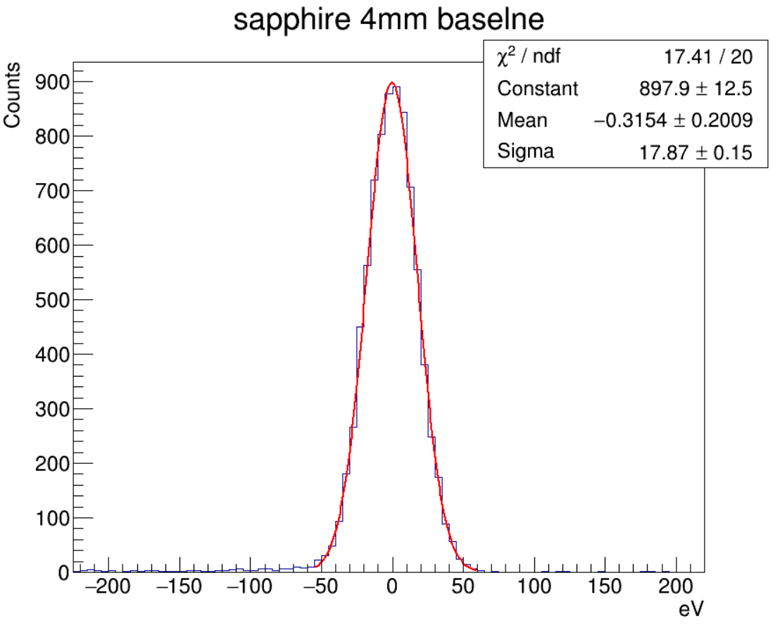
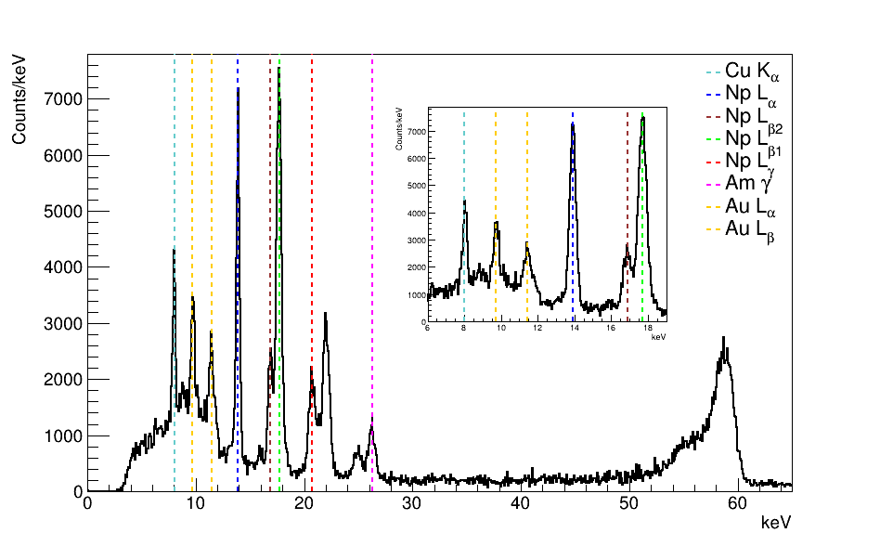
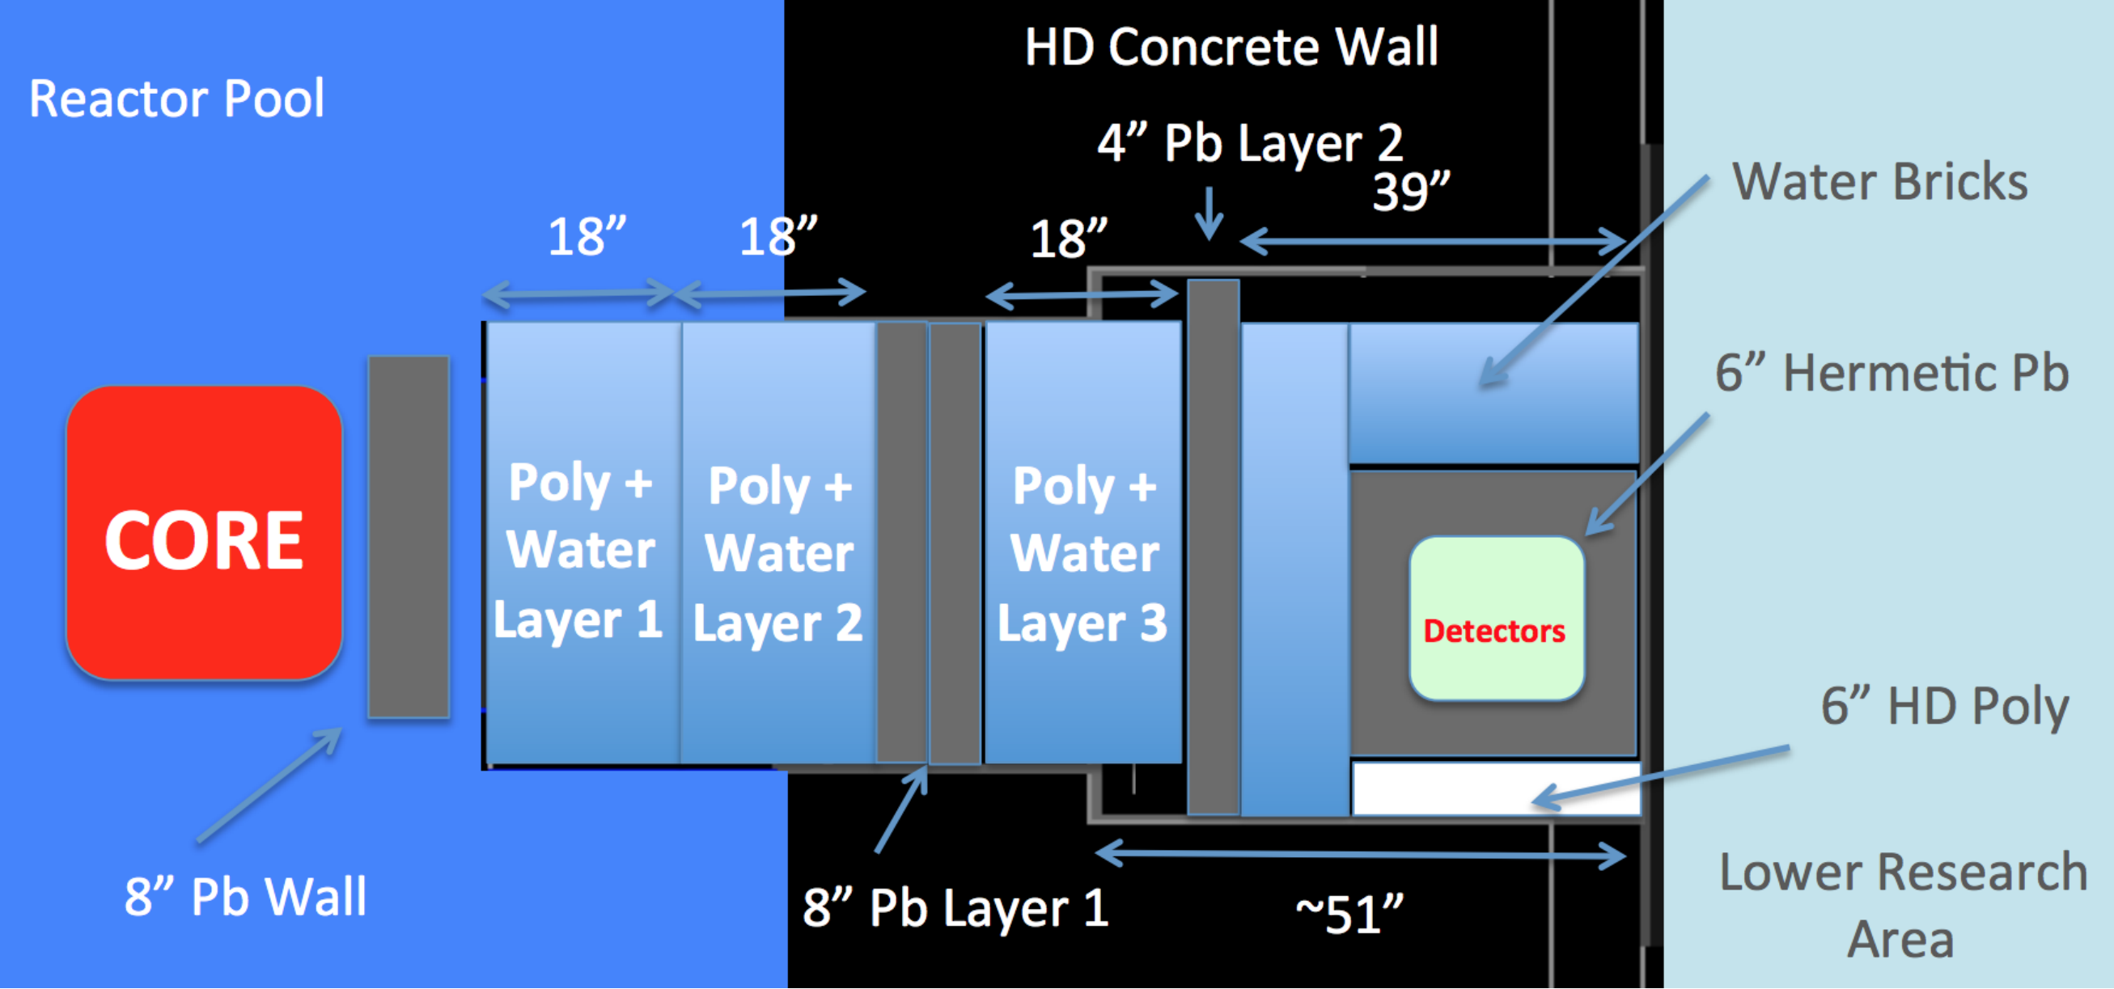
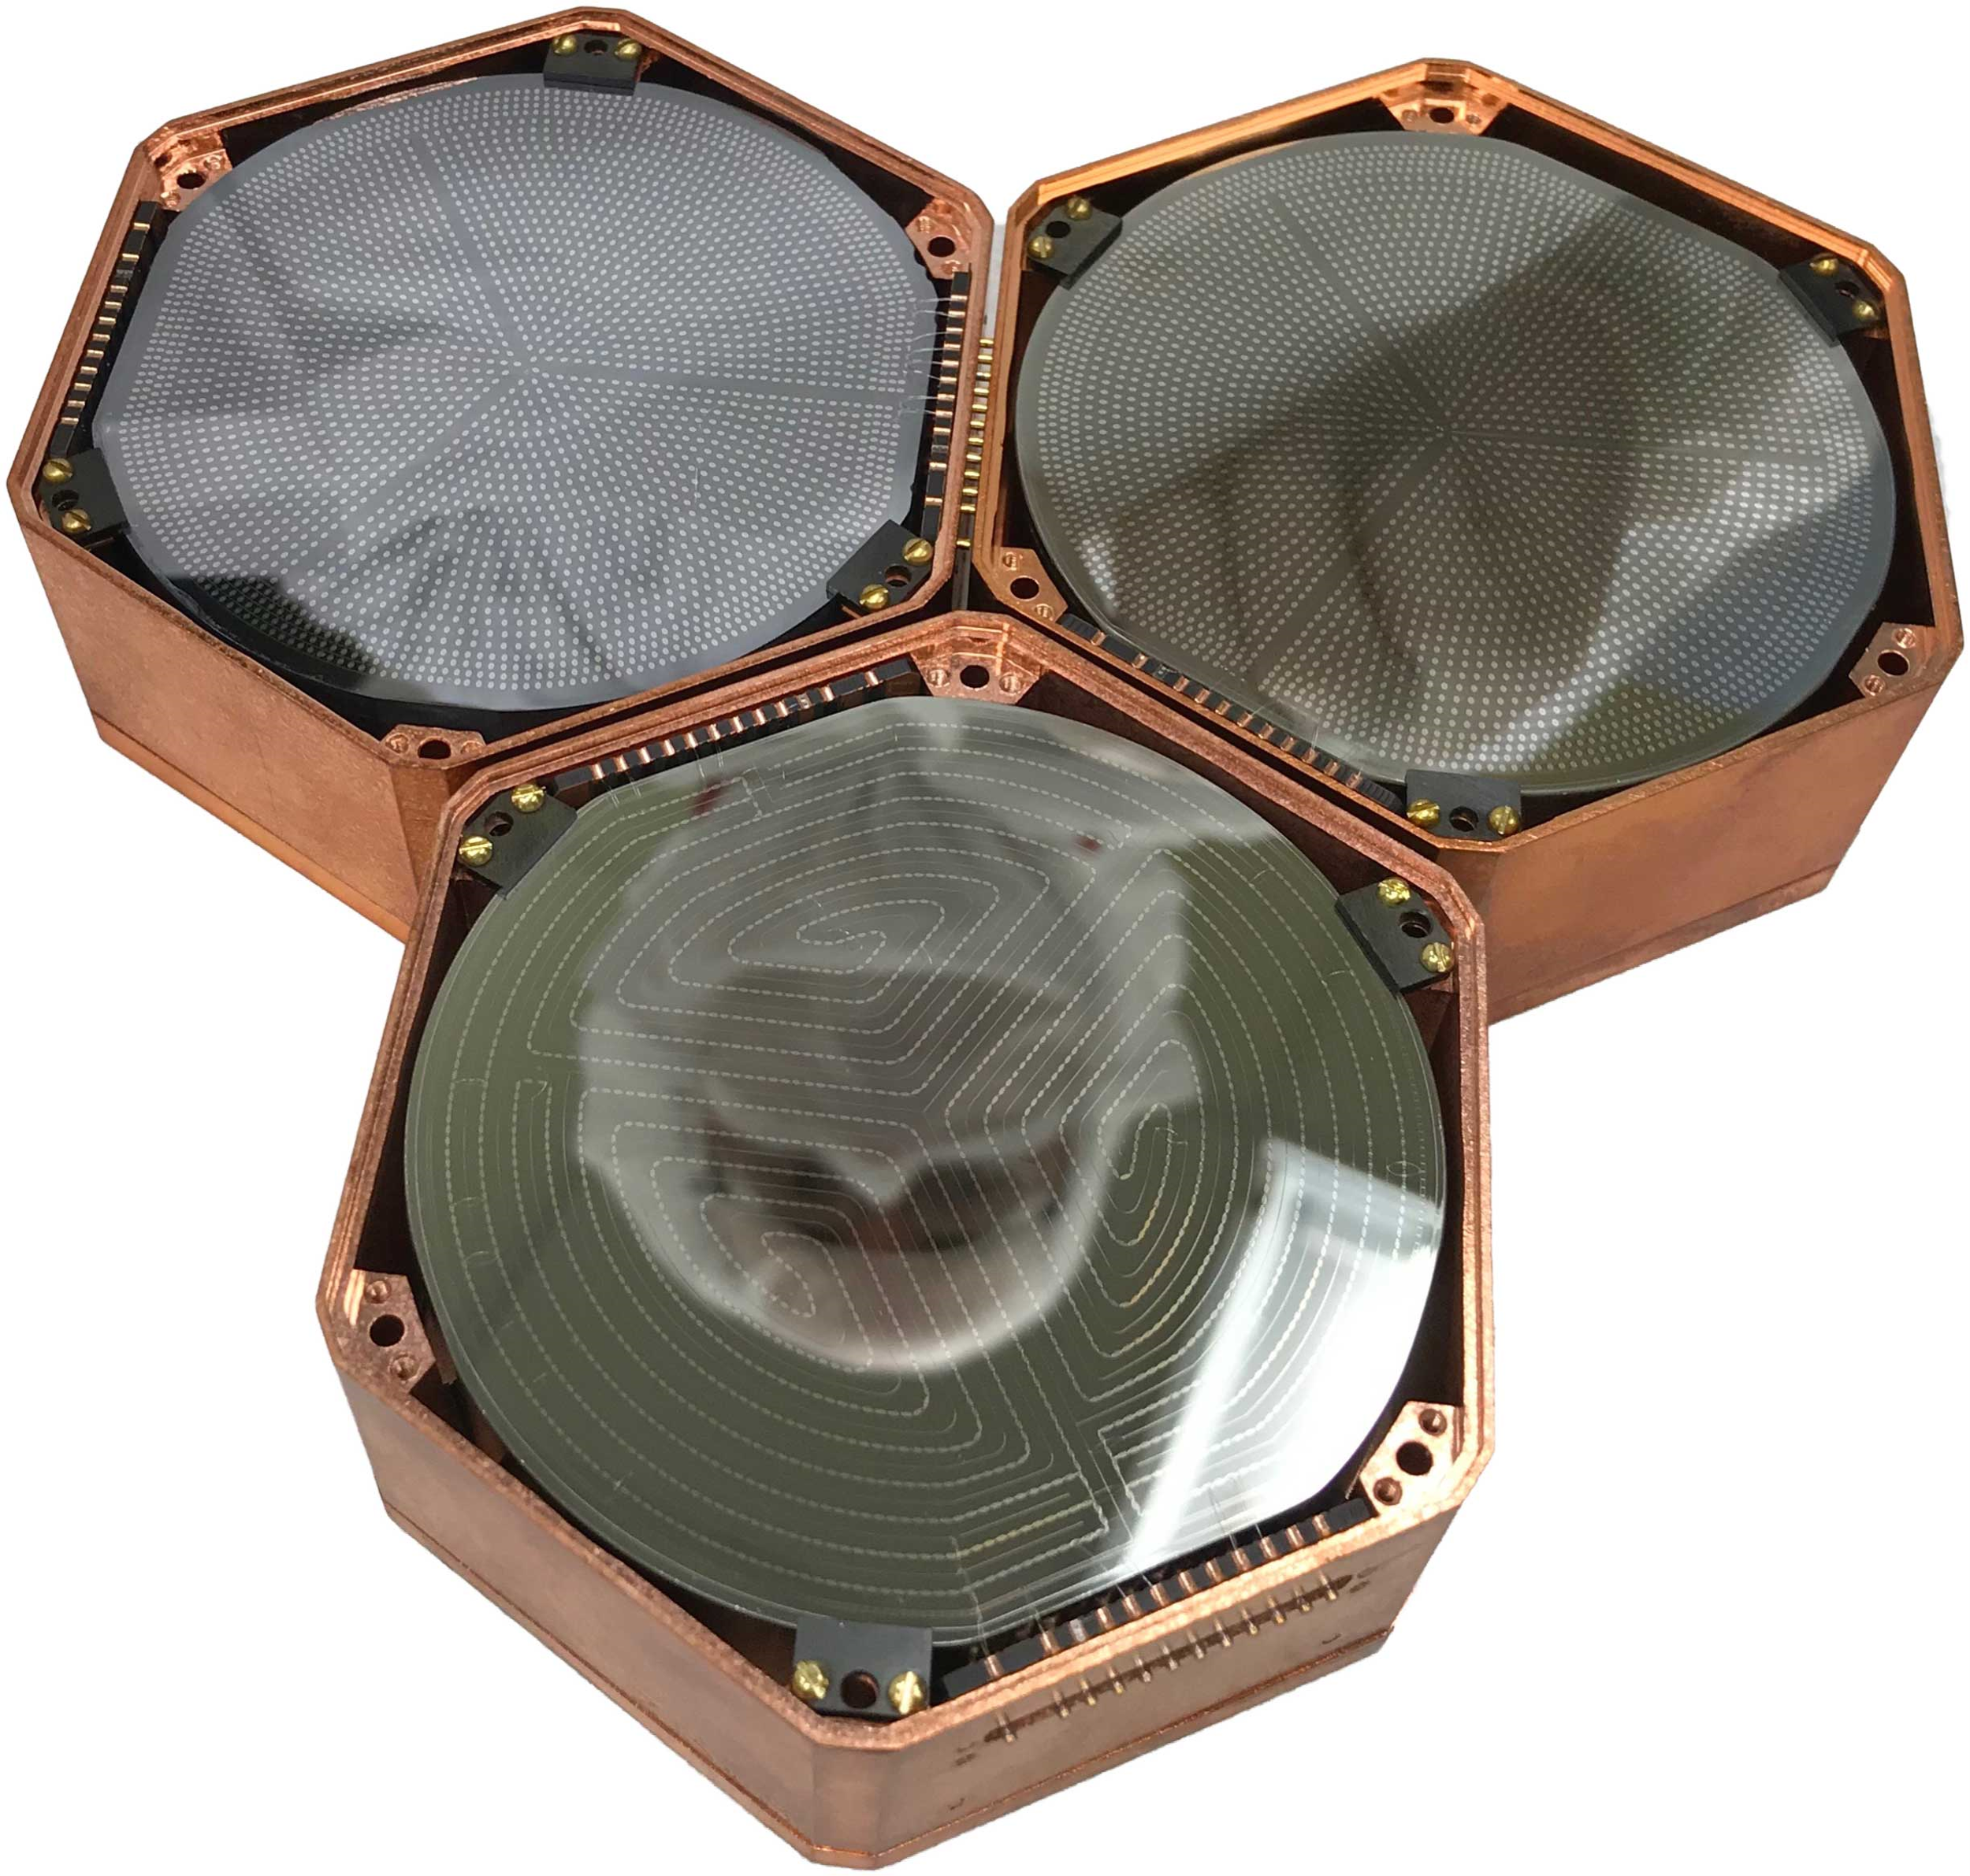
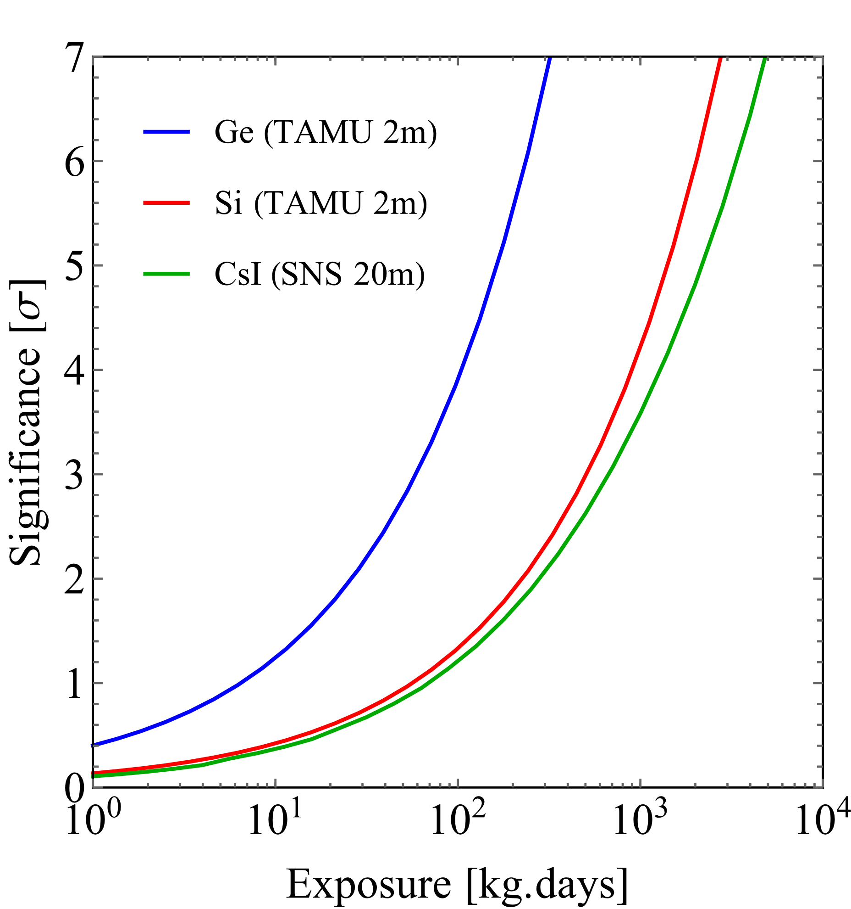
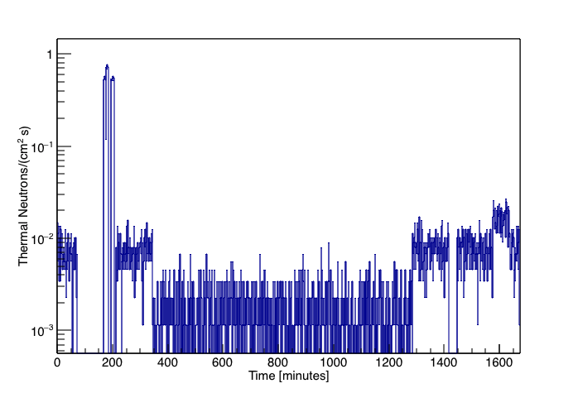
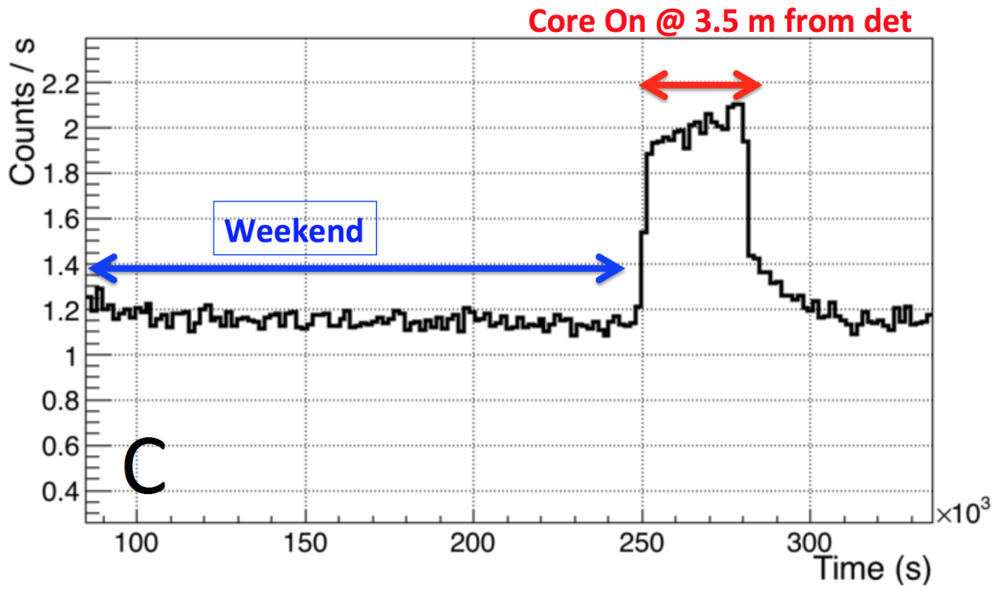
MINER: Mitchell Institute Neutrino Experiment at Reactor
Using coherent scattering of reactor neutrinos as a probe of new physics
R
Rupak Mahapatra
MINER at Texas A&M
NER experiment
Standard model CEνNS
The MINER experiment, is a reactor sourced CEνNS experiment which employs low-threshold cryogenic germanium and silicon detectors in close proximity to the research reactor at Texas A&M’s Nuclear Science Center (NSC, see Fig. 5). The high resolution detectors and movable core of the reactor are ideally suited to very short-baseline sterile neutrino oscillation studies, and other searches for physics beyond the standard model [3-6]. The NSC TRIGA (Testing, Research, Isotopes, General Atomics) reactor is capable of a steady state power output of 1MW, providing an anti-neutrino flux of 1.5x10¹² /cm²/s at 1 meter. The low power and off-grid nature ensures slow fuel evolution and steady operating power. These properties ensure MINER will be minimally affected by systematic uncertainties, and even enable a complementary measurement of the reactor anti-neutrino flux.
MINER detectors
Sapphire Detector
Coherent elastic neutrino-nucleus scattering (CEνNS) is a standard model (SM) process where a neutrino interacts with a nucleus through the weak neutral current (Z boson). The process was first predicted in 1974 by Freedman [1], and in 2017 the COHERENT experiment made the first observation of CEνNS [2], making use of neutrinos produced via stopped pion decay at the Spallation Neutron Source of Oakridge National Lab.
The cryogenic germanium and silicon detectors of the MINER experiment are based on the well tested design of the SuperCDMS detectors, manufactured by the Mahapatra group at Texas A&M [8]. These detectors have two main designs: iZIPs and high voltage (HV). Ge iZIPs can discriminate electron recoils (ER) from nuclear recoils (NR) down to 1 keV via simultaneous use of ionization and phonon sensors. HV detectors have a bias voltage applied, sacrificing discrimination for very low threshold ionization measurements via Neganov-Luke phonons. New sapphire detectors (Fig 9) (100-250 gm) have achieved resolutions of ~17 eV (Fig 10), providing a boost to the search. Sapphire also provides faster phonon pulse timing (Fig 11) than Ge.
Figure 1. Diagram for the neutral current
Scattering of a neutrino from a nucleus N
Figure 9. ER (blue) produce higher ionization yields than NR (green), allowing discrimination.
In this context ‘coherent’ refers to the fact that the neutrino, at sufficiently low momentum transfers, interacts with the entire nucleus. The amplitude for this process is then the coherent sum of the neutrino-nucleon amplitudes. The neutrino-nucleus cross section is thus enhanced by a factor that is approximately the number of neutrons squared (protons also contribute, but only around 3% of the neutron cross section). The differential cross section, with respect to recoil energy E_{R}, can be written as,
, with nuclear charge:
The form factor, F, encodes the loss of coherence with increasing recoil energy. Fortunately, due to their low energy, reactor neutrinos remain coherent up to the kinematic endpoint.
Figure 5. above: the NSC at Texas A&M,
right: the core and detector location
Figure 11: Faster phonon pulse timing than in Ge
Physics sensitivity
Figure 10: 17 eV baseline resolution achie
CEνNS has not yet been observed with reactor neutrinos, moreover, reactor neutrinos below the inverse beta decay threshold of 1.8 MeV (72% of the total flux) have never been observed. MINER will be able to detect neutrinos down to 1.2 MeV, and expects a total rate of ~20 events per day above 100 eV_{NR} (Fig. 2). The large CEνNS rate at MINER will allow for a high-statistics measurement with relatively short exposures. An observation of the standard model process at 5-σ can be reached in ~100 kg.days (Fig. 3).
Figure 12: Spectrum from a 241Am source
Parameters | Phase-1 (current phase) | Phase-2 (Larger phase)
Max payload | 4 kg | 30 kg
Baseline resolution | ~7 eV_{ee} | ~5 eV_{ee}
Lindhard | ~1/6 - 1/5 (Ge) ~1/20 (Si) | ~1/6 - 1/5 (Ge) ~1/20 (Si)
NR threshold | ~100 eV_{NR} in HV Ge/Si 300 eV in iZIP with discrimination | 100 eV_{NR} in HV Ge/Si New detectors with possible discrimination
Background | ~1000 events/kg/keV/day | ~100 events/kg/keV/day
ν Flux | 10¹¹/cm².sec | 10¹²/cm².sec
Distance from core | ~4 m – 10 m | ~2m – 10 m
Figure 6. Schematic of the current experimental setup, detailing the passive shielding
Background studies
Core on, outside lead shielding
Figure 2. Expected event rates for MINER, above a given threshold (power = 1MW, dist. = 2m)
To obtain feasible signal-to-background ratios of 0.1-0.2, the required background rate is 100 events/kg/day in the region of interest (<1 keV_{NR}). Passive and active shielding will be used to mitigate the backgrounds from core neutrons and gammas, cosmic ray muons, and environmental gammas.
In-situ measurements and simulation with GEANT4 have been used to characterize the background and iteratively improve the shielding design [7].
A precision measurement of CEνNS at a reactor will be capable of probing small contributions from beyond the standard model, e.g. a neutrino magnetic moment, or additional mediators such as a Z’ (Fig. 2).
Core on, inside lead shielding
Core off, overnight
Figure 12. Phase-1 detector deployment, top-left: 0.25 kg Si HV, top-right: 0.625 kg Ge HV, bottom: 0.625 kg Ge iZIP.
Collaboration members
Figure 7. measured core on/off neutron rates.
R. Mahapatra, G. Agnolet, B. Dutta, R. Harris, N. Mirabolfathi , L. Strigari, W. Teizer, B. Webb, Y. Gao, C. Hays, A. Jastram, A. Kubik, W. Baker, R. Beck, Z. Wetzel, F. Kadribasic, G. Rogchev, J. Hooker, C. Marianno, S. McDeavitt, J. Newhouse, J. Vermaak, K. Lang, M. Proga, J. Cesar, D. Phan, T. Carroll, S. De Rijick, R. Salazar, S. Yadavalli, K. Leonard, A. Rouhiainen, V. Mandic, P. Cushman, M. Fritts, A. Kennedy, N. Mast, A. Villano, D. Barker, J. Sander, J. Liu, J. Mammo, T. Oli, A. Khan, B. Li, J. Newstead, W. Flanagan, B. Mohanty, K. Senapati, V. Iyer, R. Martin, Y. Tamagawa, I. Ogawa, K. Nakajima, M. Shimada, J. Walker, J. Dent, J. Navarrete, C. Lanham, J. Manning, B. Sands, R. Ramos, A. Vilano
Core shielding consists of high-density polyethylene water bricks alternated with lead (see Fig. 5). Shielding from muons is provided by the concrete overburden (15 mwe). Measurements confirm this configuration reduces core gamma and neutron backgrounds to within a factor of 2 of core off values (see Fig. 7 and 8).
A CsI active veto will be utilized to reduce the residual background by an additional factor of 100.
Figure 3. Significance of standard model observation with a 100eV threshold, at a distance of 2m, and a 100dru background, compared with COHERENT.
CEνNS is flavor independent and is therefore blind to SM neutrino oscillations, but not sterile neutrino oscillations. The moveable core of MINER’s reactor makes for a unique place to study very short baseline oscillations. MINER will able to probe the reactor anomalies, and provide a complementary measurement (Fig. 4).
References:
[1] D. Z. Freedman, Phys. Rev. D 9, 1389 (1974). doi:10.1103/PhysRevD.9.1389
[2] D. Akimov et al. [COHERENT Collaboration], Science (2017), doi:10.1126/ science.aao0990, [arXiv:1708.01294 [nucl-ex]]
[3] B. Dutta, Y. Gao, R. Mahapatra, N. Mirabolfathi, L. E. Strigari, and J. W. Walker, Phys. Rev. D94, 093002 (2016), [arXiv:1511.02834 [hep-ph]]
[4] J. B. Dent, B. Dutta, S. Liao, J. L. Newstead, L. E. Strigari, and J. W. Walker, Phys. Rev. D 96, 095007 (2017)
[5] B. Dutta, R. Mahapatra, L. E. Strigari, and J. W. Walker, Phys. Rev. D 93, 013015 (2016)
[6] J. Dent, B. Dutta, S. Liao, J. Newstead, L. Strigari, J. Walker, Phys. Rev. D 97, 035009 (2017)
[7] G. Agnolet et al. [MINER Collaboration], Nucl. Instrum. Meth. A 853, 53 (2017), doi:10.1016/ j.nima.2017.02.024, [arXiv:1609.02066 [physics.ins-det]]
[8] R. Agnese et al. (SuperCDMS Collaboration), Phys. Rev. D 95, 082002
[9] P. N. Luke, J. Beeman, F. S. Goulding, S. E. Labov, and E. H. Silver, Nucl. Instrum. Meth. A289, 406–409 (1990).
Figure 4. Expected sterile neutrino reach for Ge (exp. = 10⁴ kg.days, power = 1MW, dist. = 2m), the star marks world avg. of reactor anomalies.
Figure 8. measured core on/off gamma rates.

