Slide 1
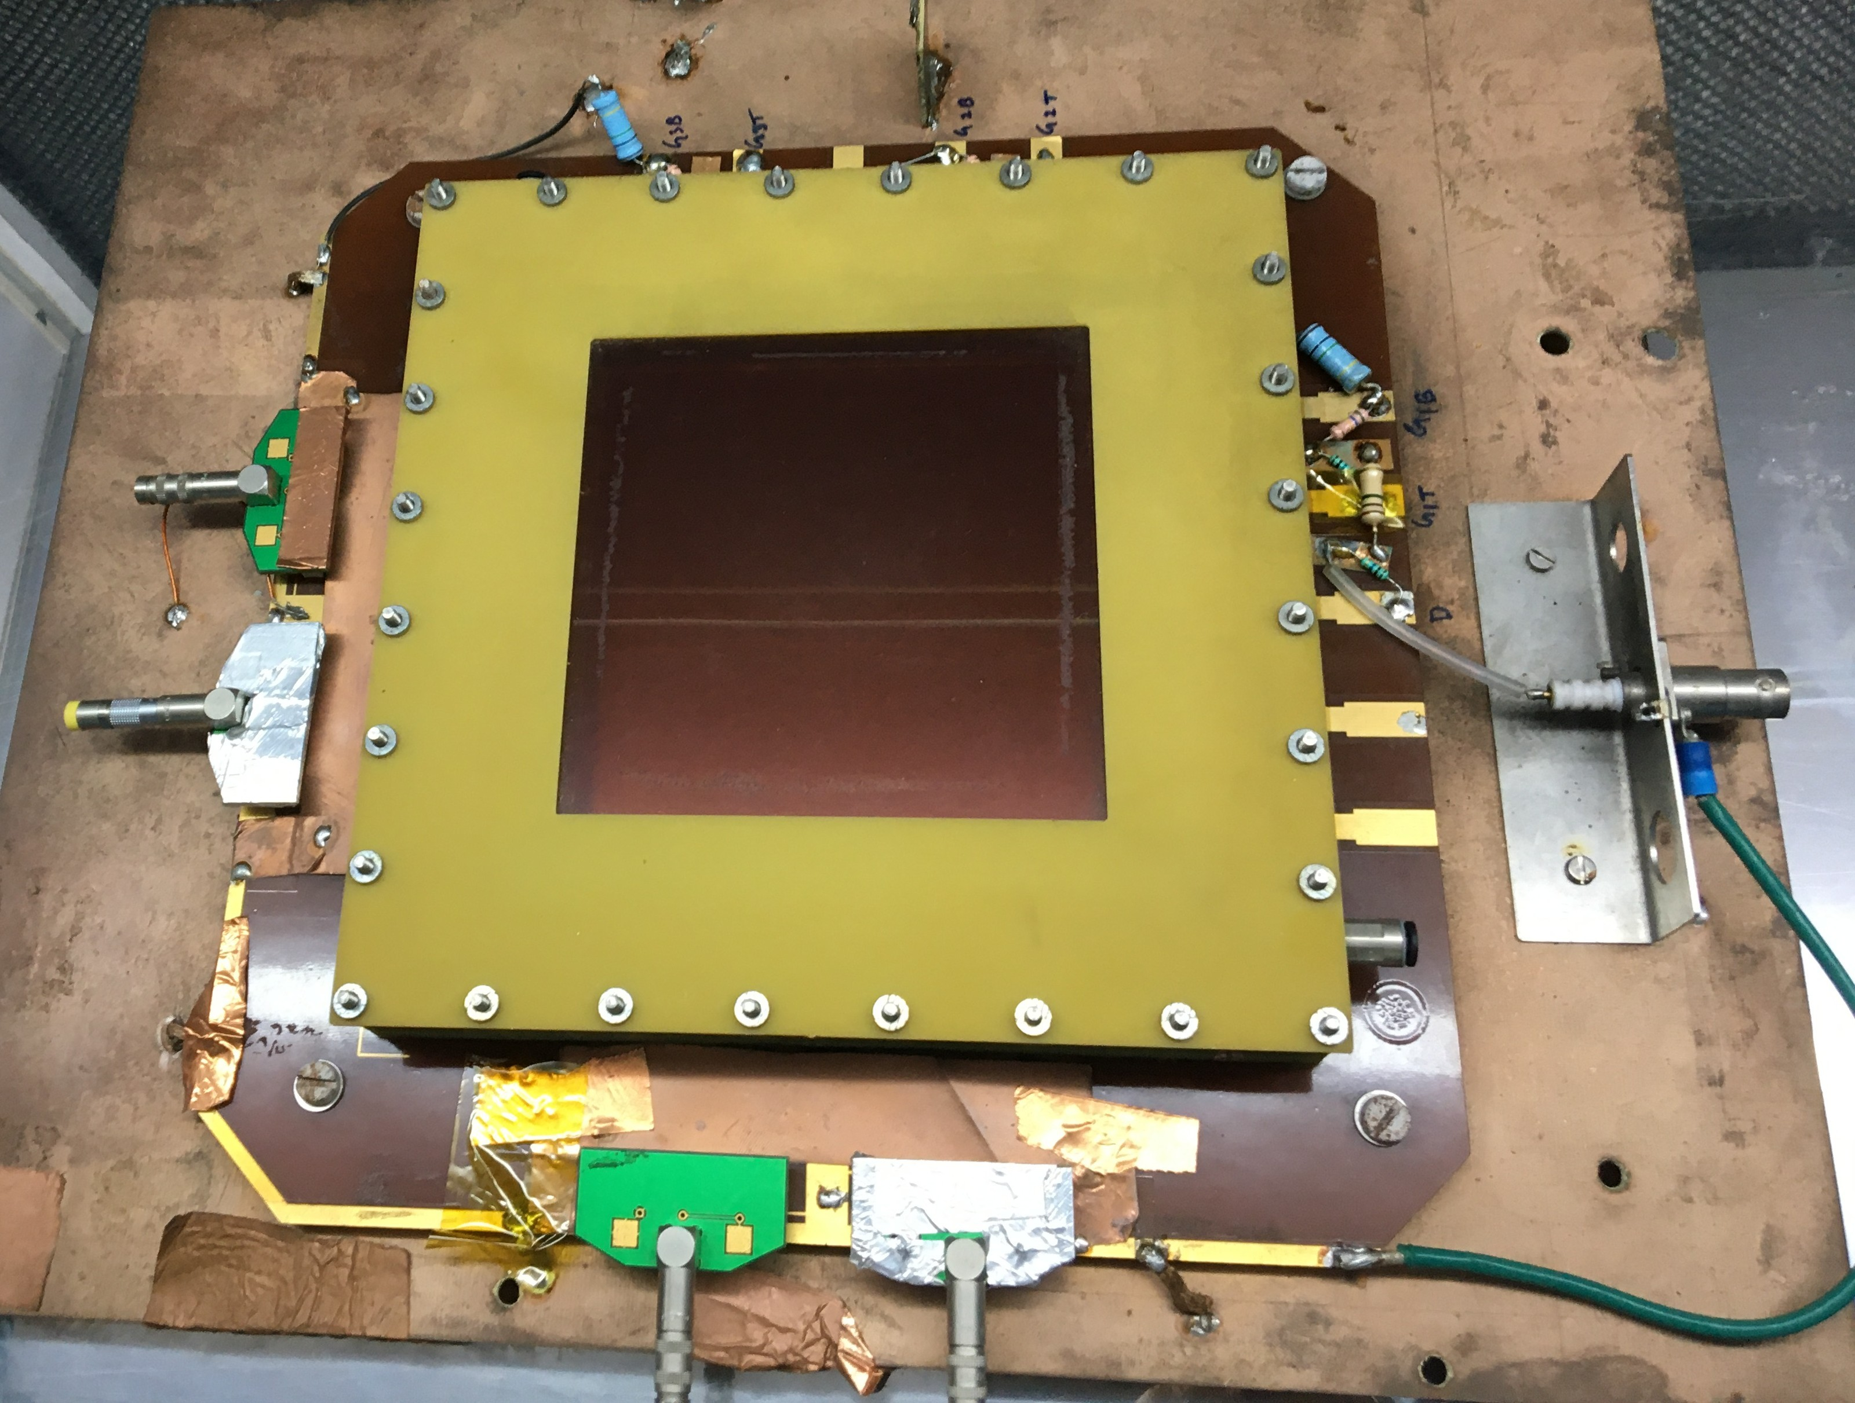
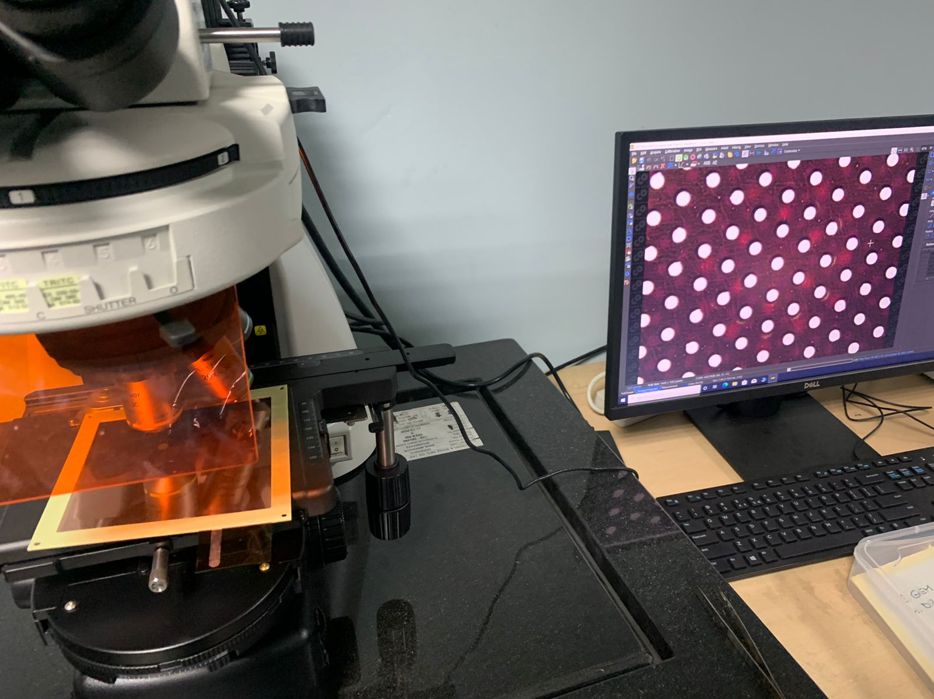
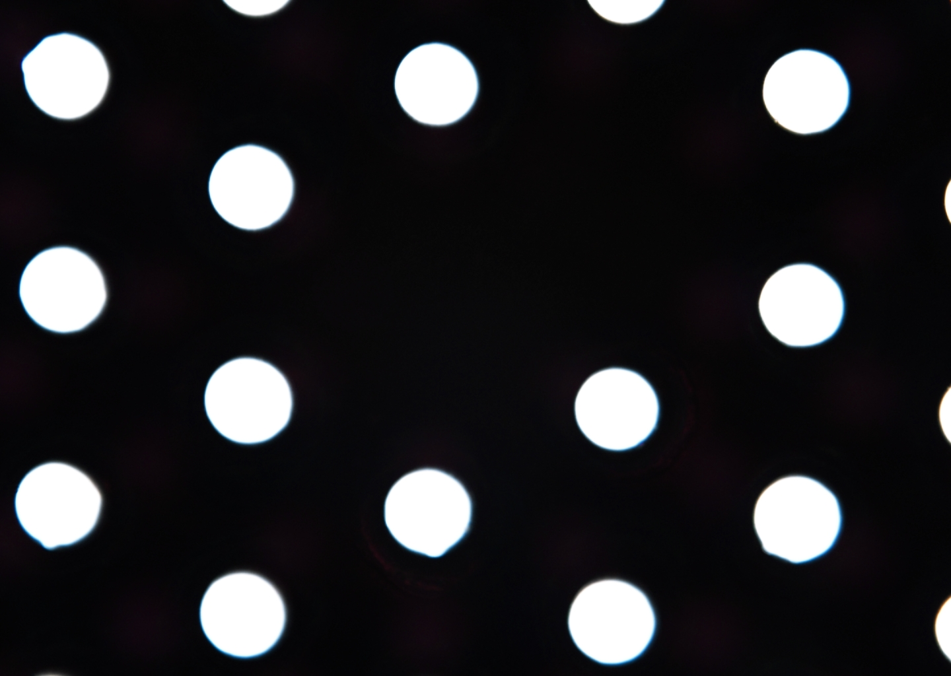
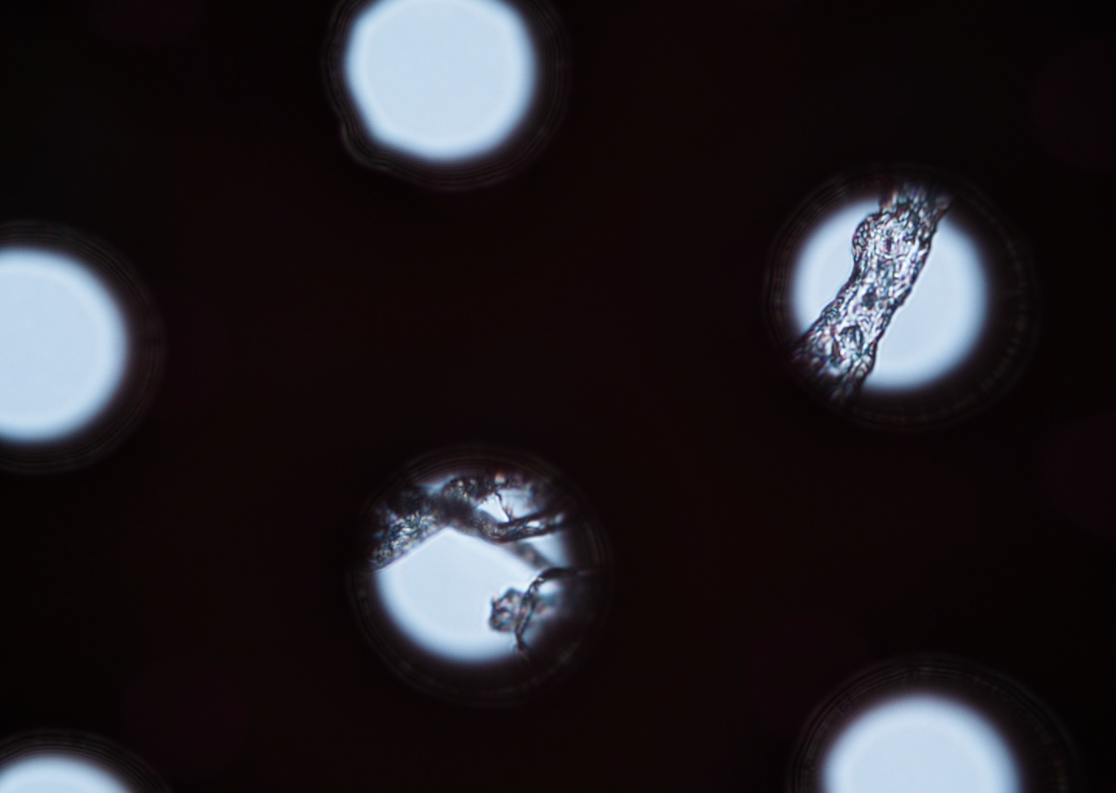
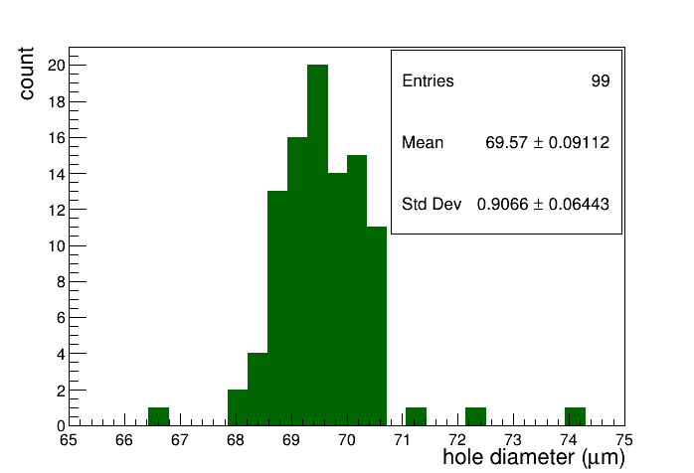
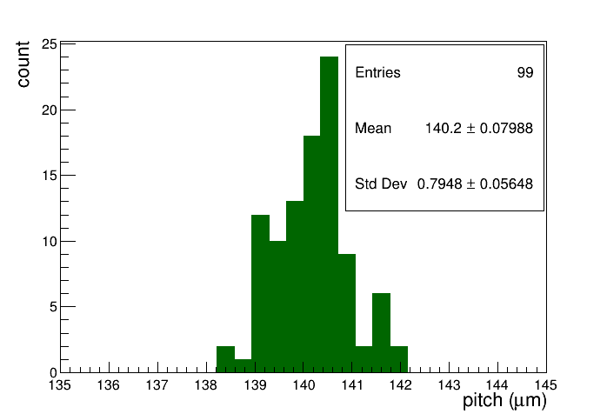
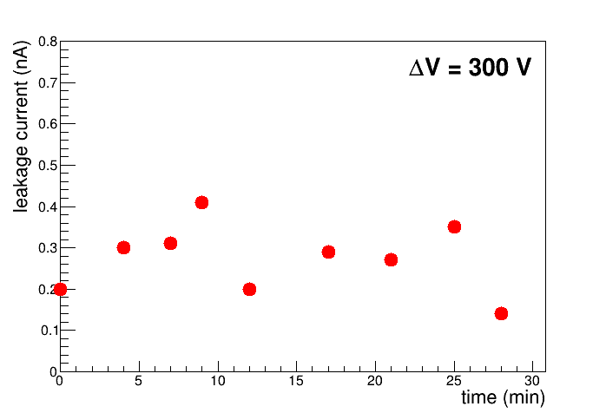
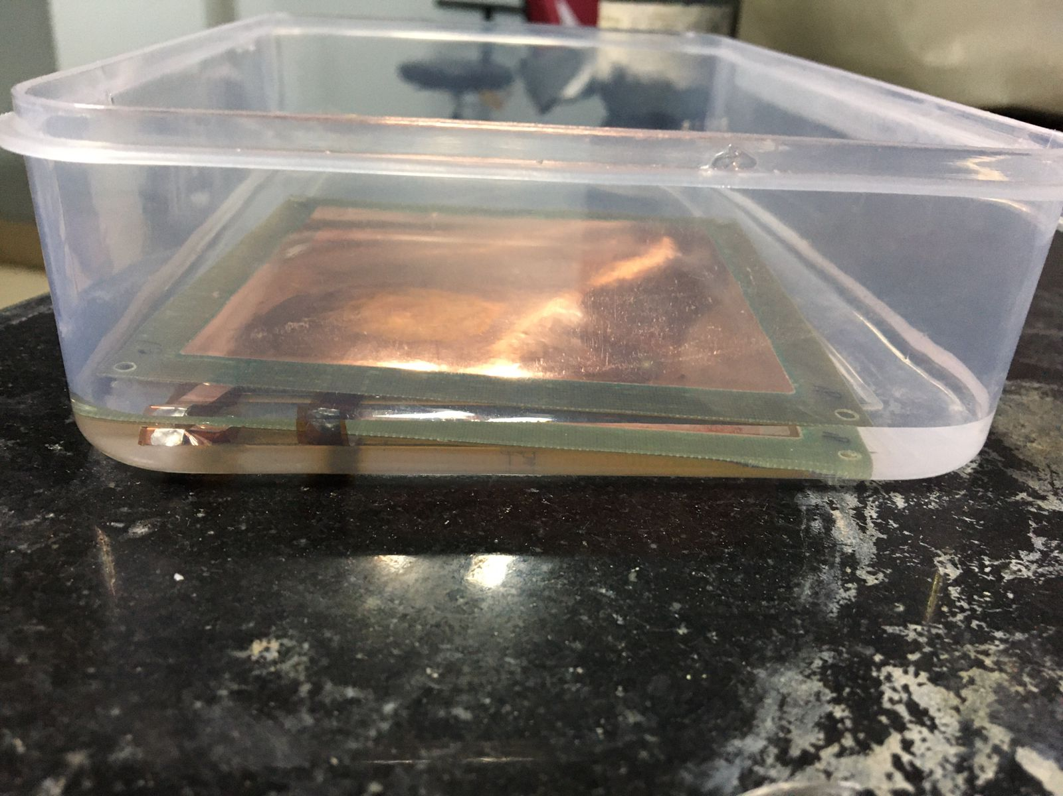
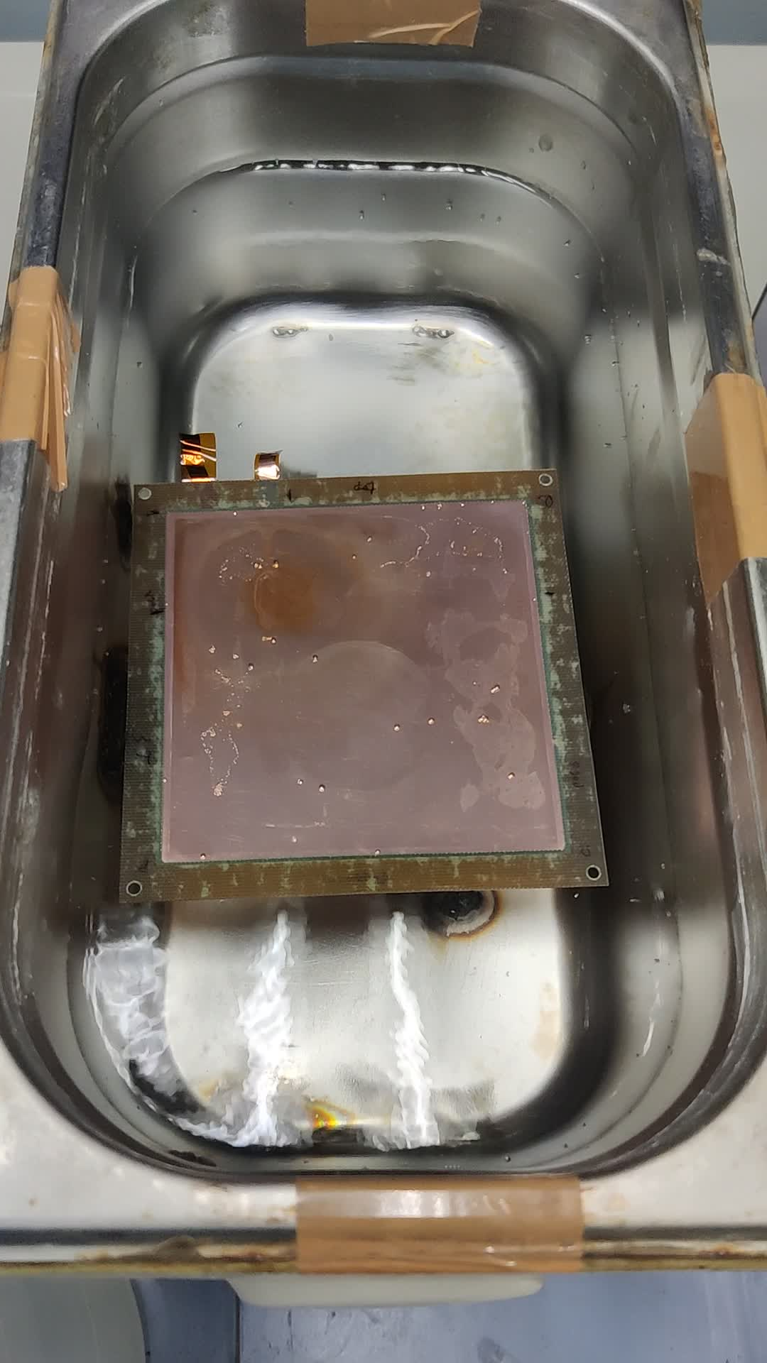
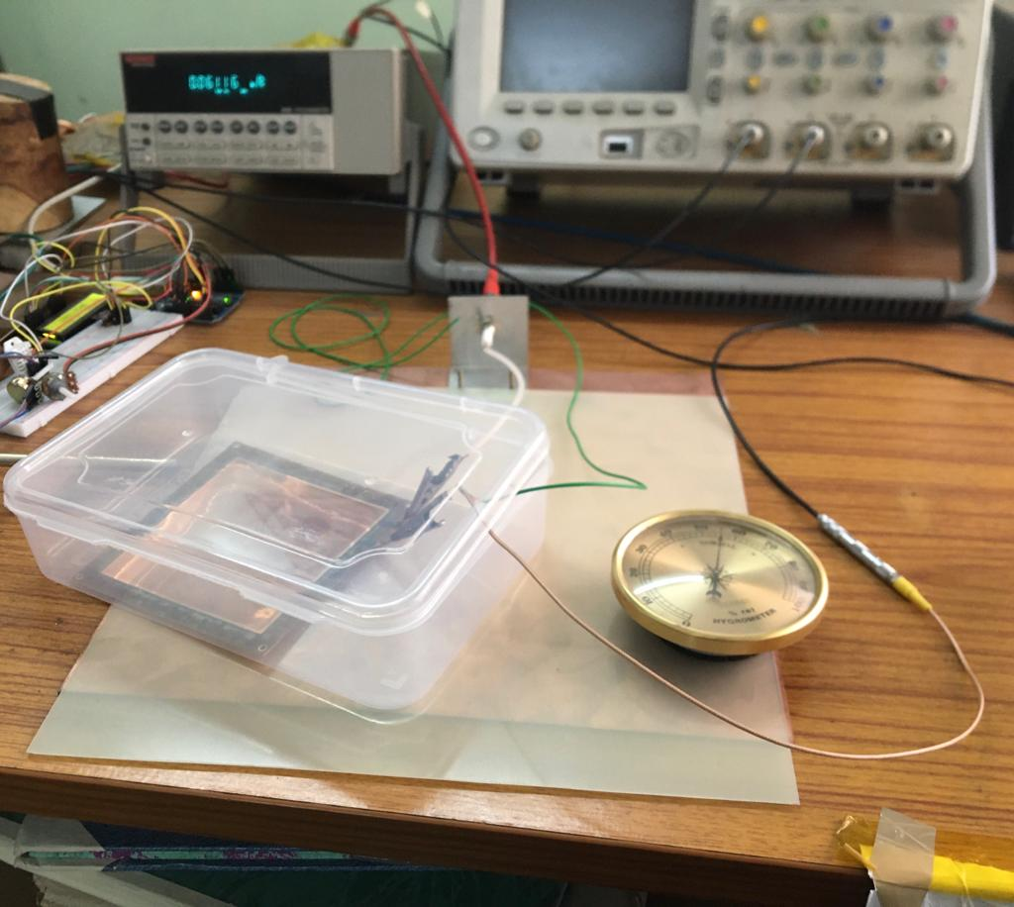
Visual investigation of possible degradation in GEM foil under test
S. Chatterjee*, A. Sen, S. Das, S. K. Ghosh, S. Biswas
Department of Physics, Bose Institute, Kolkata, India
During the long-term study of a Single Mask triple GEM chamber, the 3rd GEM foil of the chamber is found to be damaged
The measured resistance is found to be ~ 40 kΩ
Optical inspection of the GEM foil reveal imperfections in the GEM foil
The short paths in the GEM foil are removed by using an ultrasonic (~ 20 kHz) bath with millipore water
The foil is kept in the ultrasonic bath for ~ 5 minutes
The foil is dried for ~ 30 minutes under continuous heat flow and after that the resistance of the foil was found to be high
The leakage current of the GEM foil is measured and found to be reasonable (at ΔV ~ 300 V, RH ~ 50%; ~ 0.3 nA)
RH ~ 50%

