Slide 1
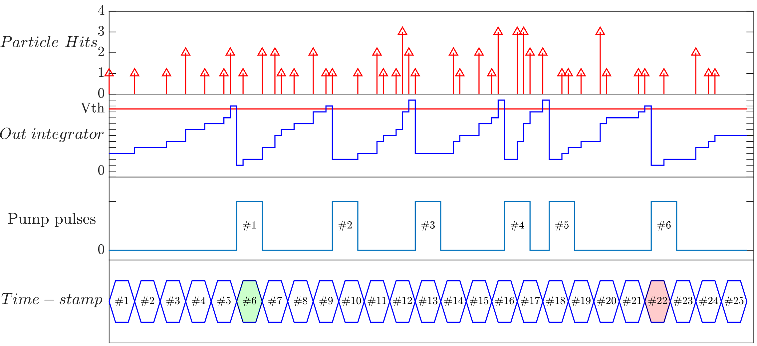
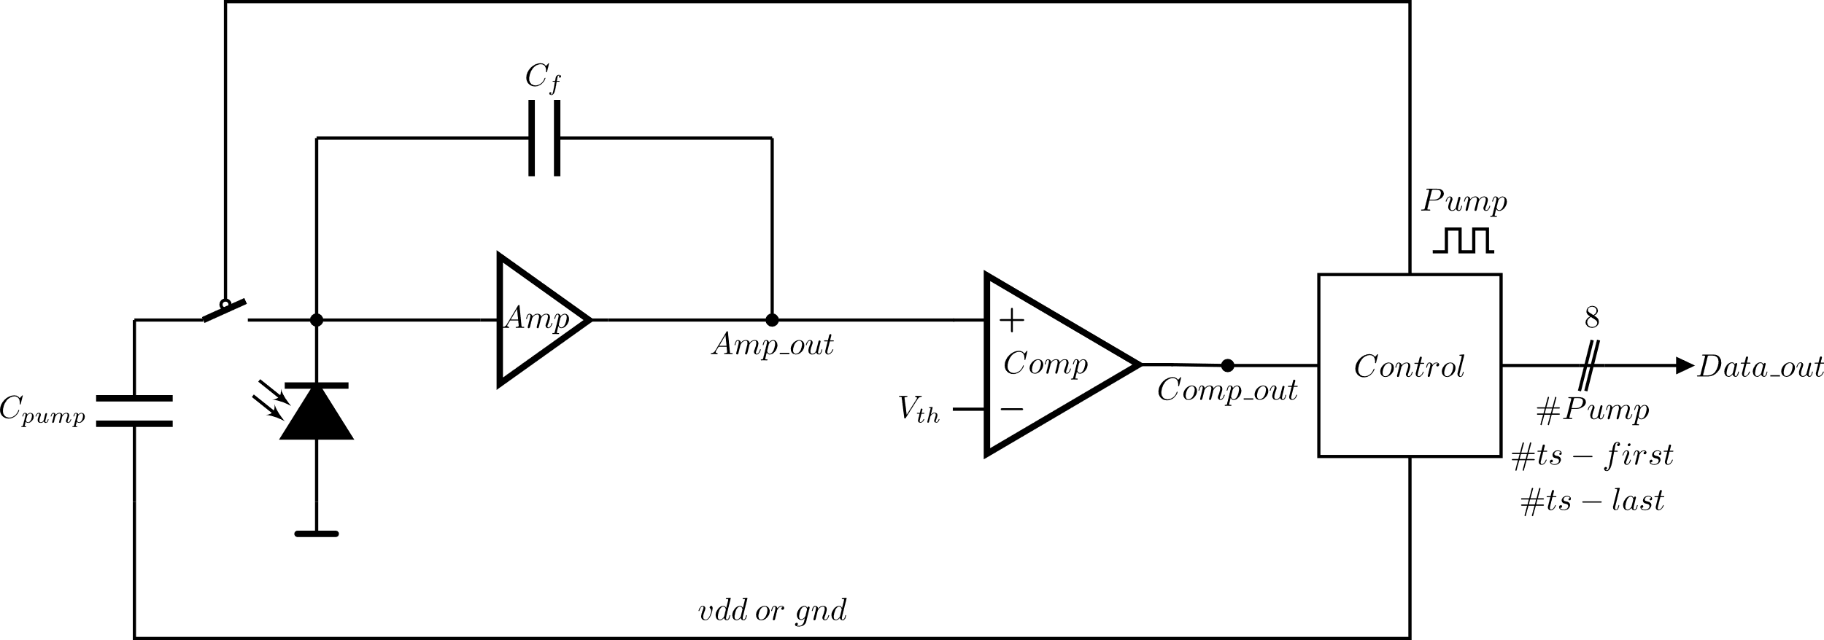
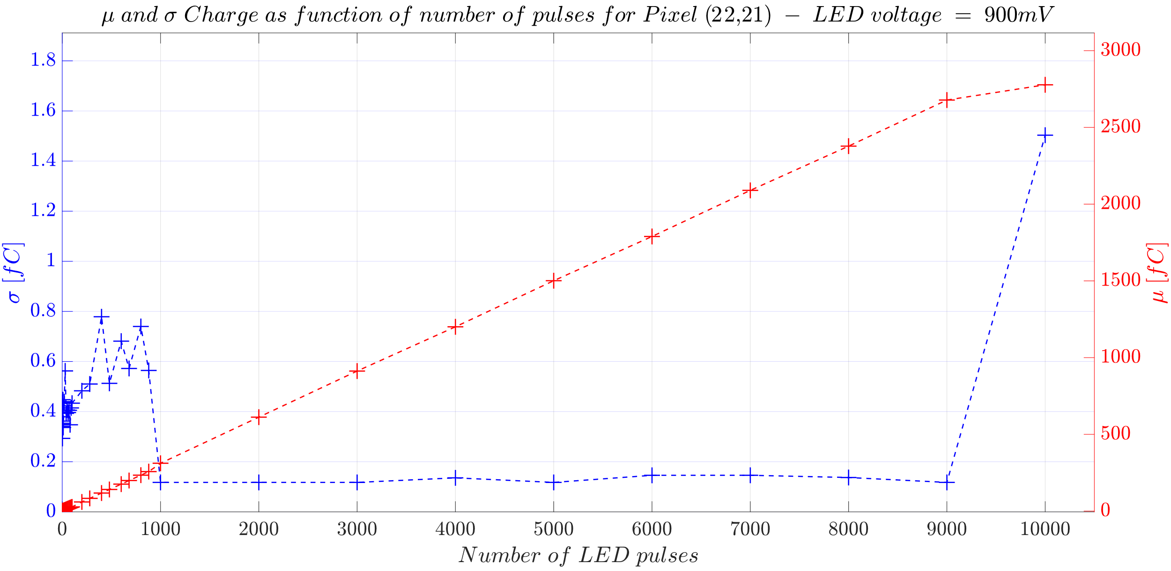
High dynamic range radiation detector H. Mateos, I. Perić, F. Ehrler, R. Schimassek
The chip was designed to be used in cancer treatment facilities, for Quality Assurance as well as for monitoring of the beam during irradiation.
The sensor integrates the charge generated by radiation. By counting how many times a known amount of charge is subtracted out of the integrator and the time difference between the first and last pump, the charge generated by the particle is calculated, and thus the energy of it.
A matrix of 24x24 pixels, with a pixel size of 200x200 μm was built with an 80% of fill factor.
The sensor presents a linear response along the whole dynamic range.
It shows a noise floor of 0.8 fC, equivalent to 5000e-, which decrease to 0.1 fC or 620e- at higher intensities.
Because the system is based on a discharge pump counter, the integrator will not be saturated, which makes possible to measure particles of high energy.
Future improvements:
Different discharge capacitor sizes.
Different capacitor voltage.
Bigger counters.
Bigger matrix size.
Read while measuring.
Other technology to achieve higher fill factor

