Slide 1
Skype meeting | 17 July 2014
LUNA at LNGS: Status and perspectives
Antonio Caciolli
University and INFN of Padova
Quinto Incontro Nazionale di Fisica Nucleare INFN 2022

Slide 2
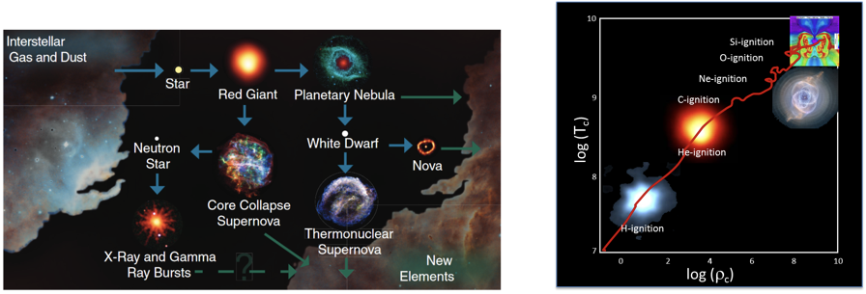
A. Caciolli
LUNA at LNGS: Status and perspectives
Nuclear astrophysics
Aim of nuclear astrophysics: understand nuclear reactions that shape much of the visible universe
Nuclear fusion is the engine of stars: it produces the energy that stabilises them against gravitational collapse and makes them shine
Among the key parameters (chemical composition, opacity, etc.) to model stars, reactions cross sections play an important role
The evolution of the stars is determined by fusion reactions
They determine the origin of elements in the cosmos, stellar evolution and dynamic
Many reactions ask for high precision data
Quinto Incontro Nazionale di Fisica Nucleare INFN 2022
Notes:
2

Slide 3

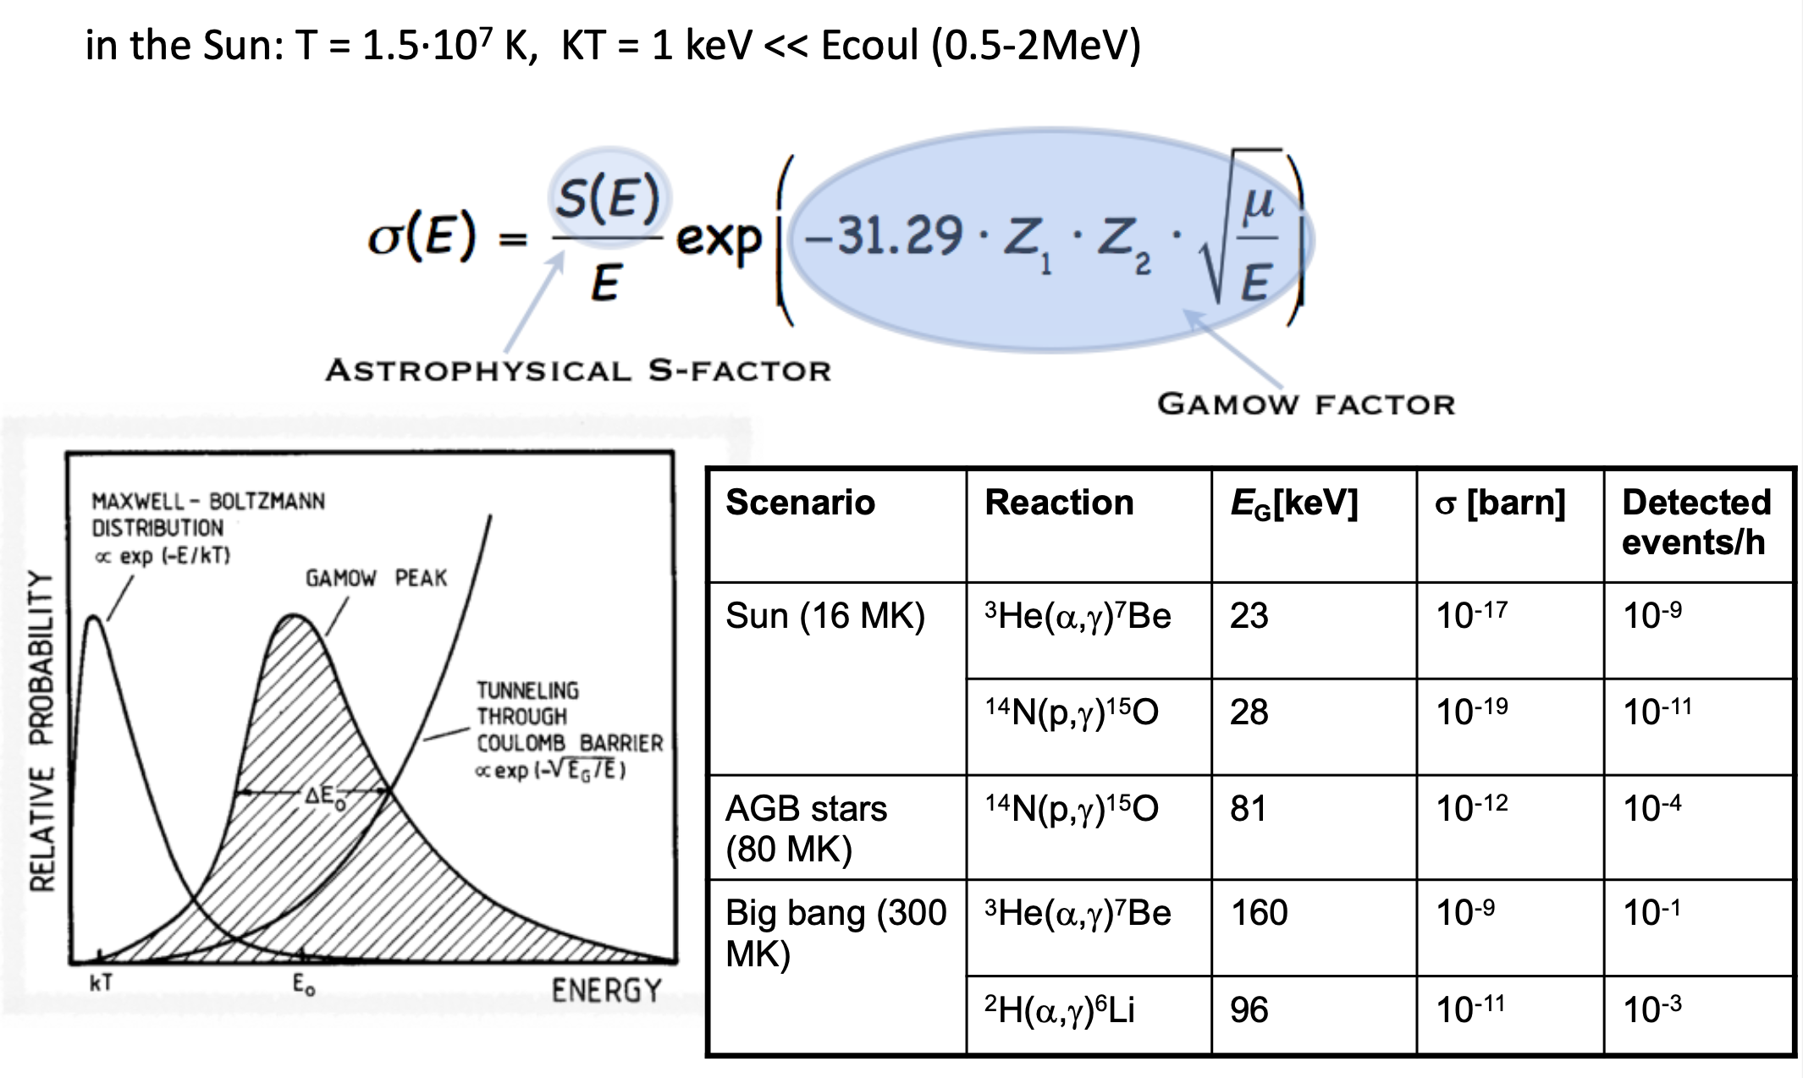
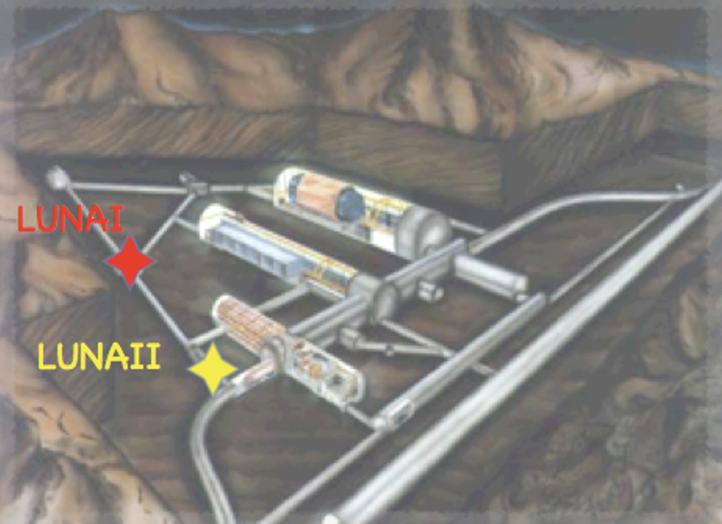
A. Caciolli
LUNA at LNGS: Status and perspectives
Charged particles induced reactions
Quinto Incontro Nazionale di Fisica Nucleare INFN 2022
Notes:
3

Slide 4
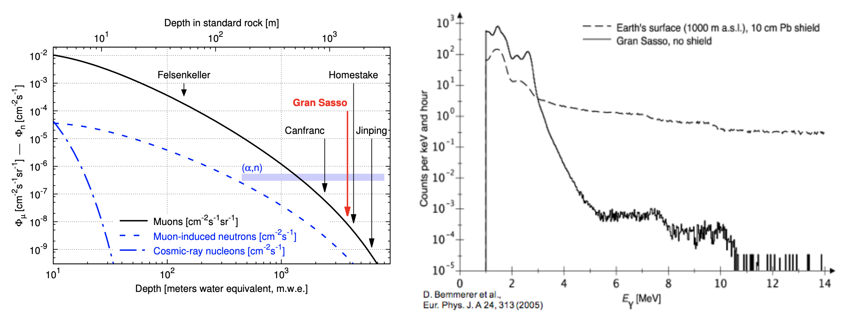
A. Caciolli
LUNA at LNGS: Status and perspectives
Charged particles induced reactions
Quinto Incontro Nazionale di Fisica Nucleare INFN 2022
Notes:
4

Slide 5
A. Caciolli
LUNA at LNGS: Status and perspectives
LUNA: more than 30 years of underground nuclear astrophysics
MV
Quinto Incontro Nazionale di Fisica Nucleare INFN 2022
Notes:
5

Slide 6
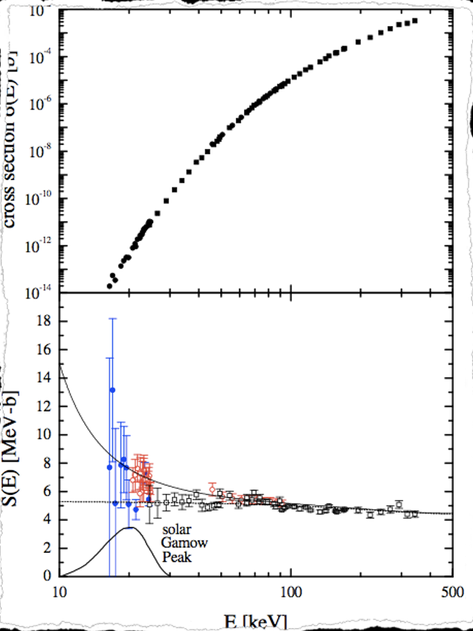
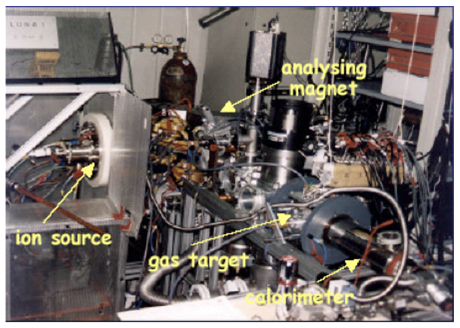
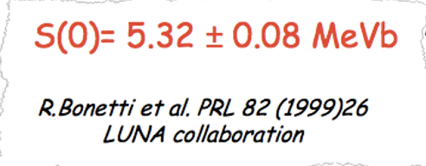
A. Caciolli
LUNA at LNGS: Status and perspectives
LUNA: more than 30 years of underground nuclear astrophysics
³He+³He
Quinto Incontro Nazionale di Fisica Nucleare INFN 2022
Notes:
6

Slide 7
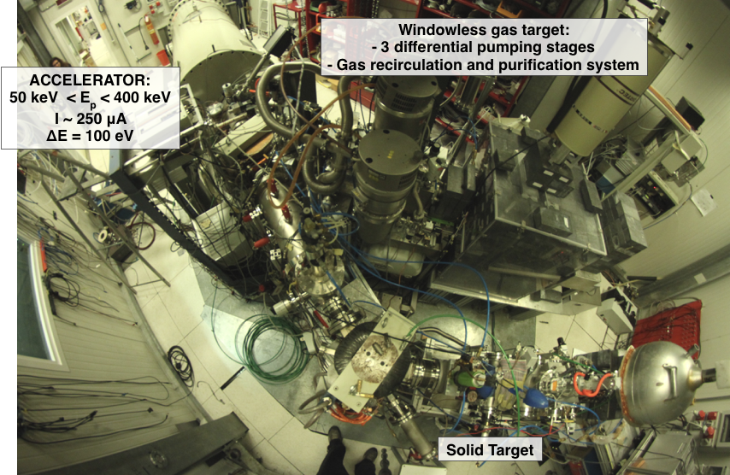
A. Caciolli
LUNA at LNGS: Status and perspectives
LUNA: more than 30 years of underground nuclear astrophysics
A new proposal has been submitted and approved by the scientific commission of LNGS and INFN CNS3 for the scientific activity
In this program the study of the ²³Na(p,α) and ²⁷Al(p,α) reactions are included in collaboration with the ERC StG project ELDAR
Quinto Incontro Nazionale di Fisica Nucleare INFN 2022
Notes:
7

Slide 8
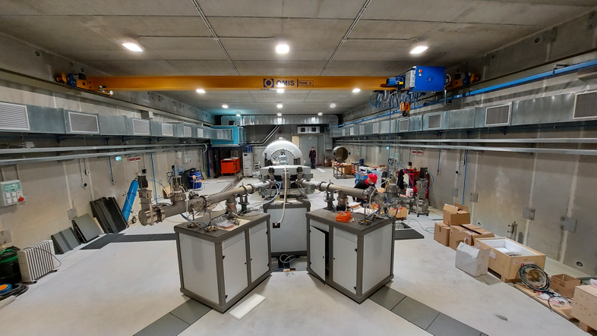
A. Caciolli
LUNA at LNGS: Status and perspectives
LUNA: more than 30 years of underground nuclear astrophysics
First Scientific program submitted to the LNGS scientific committee and to CSN3
¹⁴N(p,γ)¹⁵O (see A. Compagnucci poster)
¹³C(α,n)¹⁶O
²²Ne(α,n)²⁵Mg
in collaboration with ERC StG SHADES
¹²C+¹²C
MV
Quinto Incontro Nazionale di Fisica Nucleare INFN 2022
Notes:
8

Slide 9
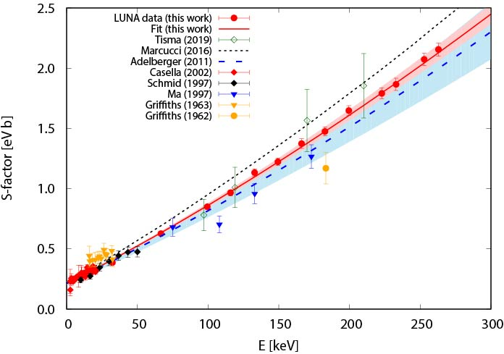
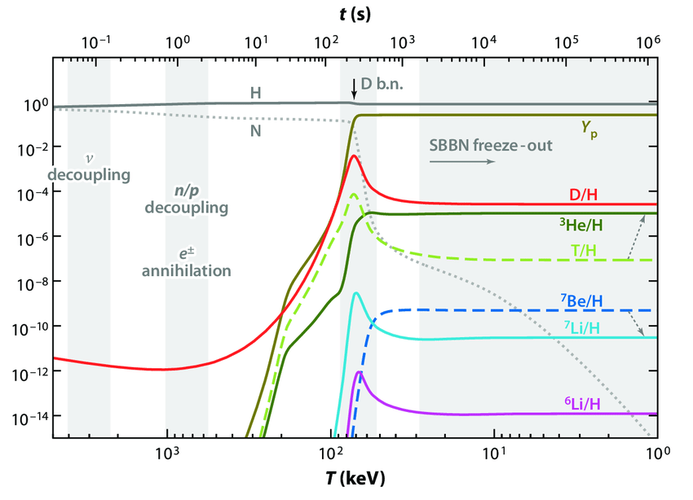
A. Caciolli
LUNA at LNGS: Status and perspectives
Recent results of the LUNA400
D(p,γ)³He
From BBN theory, knowing the cosmological parameters and the cross sections of the processes responsible for D creation and destruction [D/H]_{BBN}
The uncertainty on [D/H]_{BBN} is related to the knowledge of the reactions involved in the deuterium production and destruction
Mossa et al. Nature 587, 210 (2020)
Quinto Incontro Nazionale di Fisica Nucleare INFN 2022
Notes:
9

Slide 10
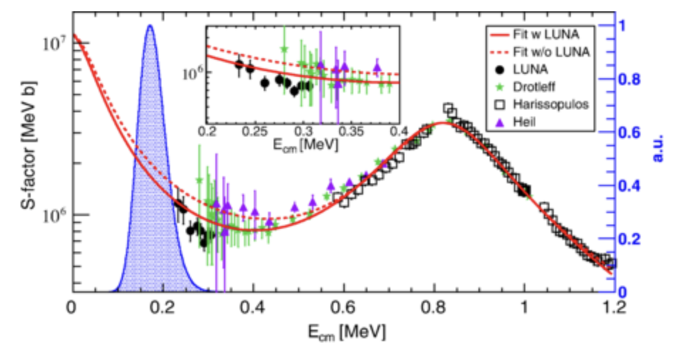
A. Caciolli
LUNA at LNGS: Status and perspectives
Recent results of the LUNA400
¹³C(α,n)¹⁶O
Main neutron sources during AGB phase
Data taken in 4 campaigns of 3 months each over about 2 years
Statistical uncertainty lower than 10% for our data, overall uncertainty lower than 20%
Lowest energy data ever achieved and inside the s process Gamow window
Covered 235 - 300 keV, 50 keV lower than before
~ 100 C for lowest energy point
Problem still the high-E normalisation, near-threshold state
Ciani et al. PRL 127, 152701 (2021)
Ciani et al. Phys Rev Lett 127, 152701 (2021)
Quinto Incontro Nazionale di Fisica Nucleare INFN 2022
Notes:
10

Slide 11
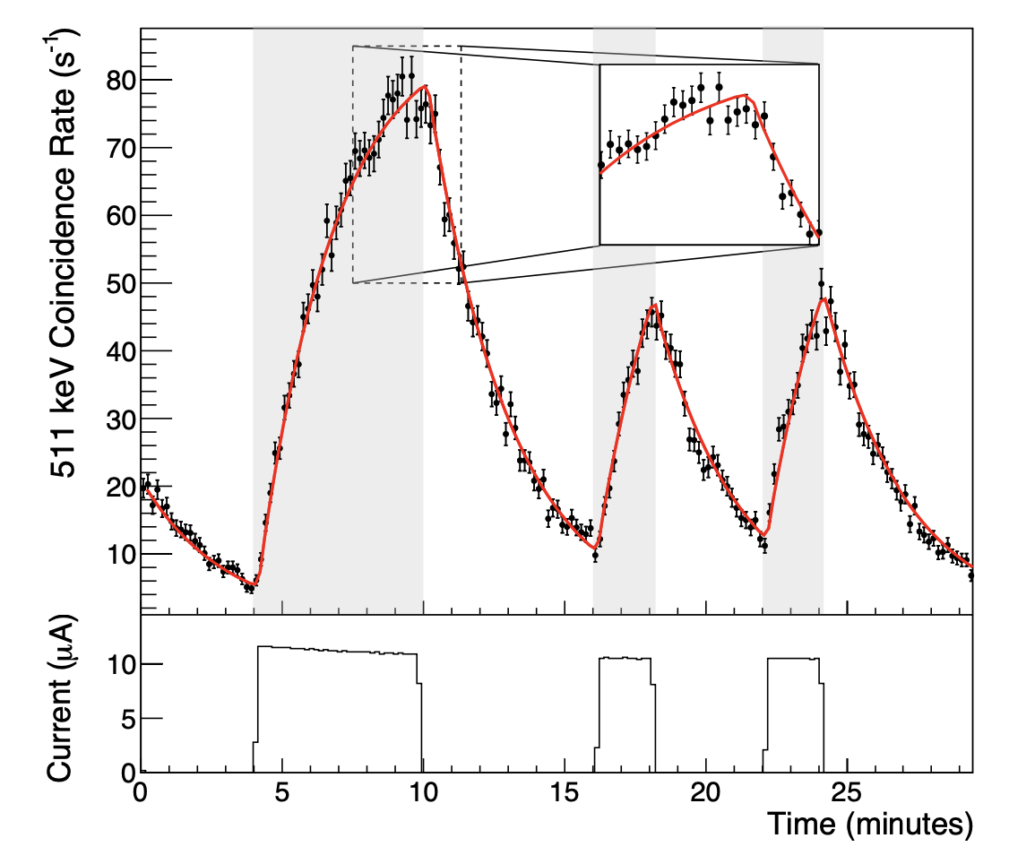
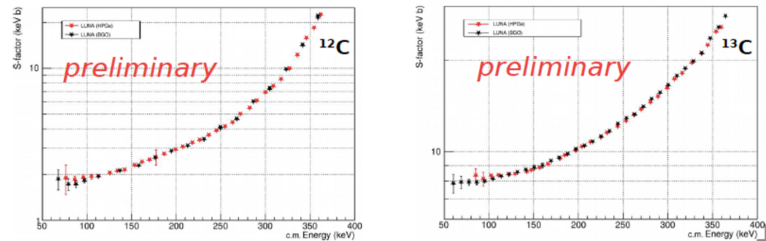
A. Caciolli
LUNA at LNGS: Status and perspectives
Current studies at the LUNA400
^{12/13}C(p,γ)^{13/14}N
The ratio of the reaction rates is important for mixing problems in RGB and AGB stars
Studied in the range E_{cm} = 70 – 380 keV
Two setups used: HPGe and BGO with both prompt gamma detection and activation method
Preliminary data lower than what reported in the literature
Quinto Incontro Nazionale di Fisica Nucleare INFN 2022
Notes:
11

Slide 12
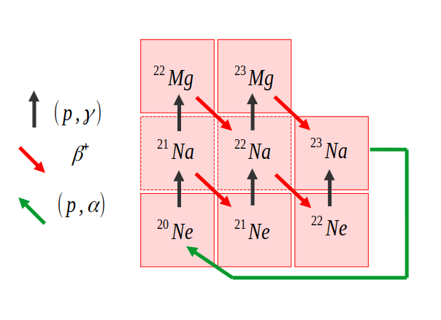
A. Caciolli
LUNA at LNGS: Status and perspectives
Current studies at the LUNA400
²⁰Ne(p,γ)²¹Na
386 keV < E_{p}< 400 keV
Natural Neon gas target (90.3% ²⁰Ne) P = 2 mbar
HPGe detecors:
Lead shielding (25 cm thick)
  RGB stars (Red Giant Branch)
  AGB stars (Asymptotic Giant Branch)
  Novae
  Massive stars
  2 goals: Direct capture below 400 keV
  366 keV resonance study
The ²⁰Ne(p,γ)²¹Na (Q = 2431.6 keV) reaction is the first and slowest reaction of the NeNa cycle
See Lucia Barbieri poster
Quinto Incontro Nazionale di Fisica Nucleare INFN 2022
Notes:
12

Slide 13
A. Caciolli
LUNA at LNGS: Status and perspectives
Other Reactions in the future of LUNA400
¹⁷O(p,g)¹⁸F data taking until summer 2022 (see poster from Riccardo Gesuè)
¹⁶O(p,g)¹⁷F data taking started
²¹Ne(p,g)²²Na data taking will start summer 2022
²⁷Al(p,α)²⁴Mg
²³Na(p,α)²⁰Ne
Many other reaction cases to be faced with this accelerator
This two reaction will be done in collaboration with the ELDAR project
Quinto Incontro Nazionale di Fisica Nucleare INFN 2022
Notes:
13

Slide 14
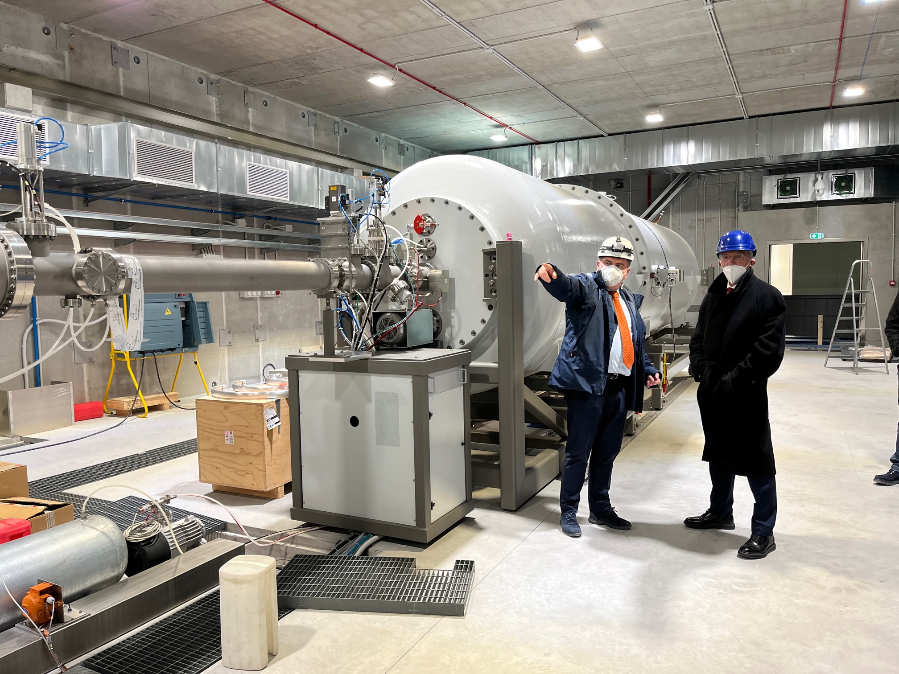
A. Caciolli
LUNA at LNGS: Status and perspectives
A MV Machine to explore He and C burnings
H, He, C⁺, C⁺⁺ beams with high intensity
3.5 MV terminal voltage
Commissioning summer 2022
Final authorizations end of 2022
First scientific beam planned in 2023
responsible of accelerator laboratories M. Junker
Age of Globular Clusters and AGB nucleosynthesis: ¹⁴N(p,γ)¹⁵O -> WG Leader G. Gyurky, Atomki, HU.
Main neutron sources: ¹³C(α,n)¹⁶O -> WG Leader A. Formicola, INFN Roma
²²Ne(α,n)²⁵Mg -> WG Leader A. Best (SHADES ERC project), UniNa, Napoli
Advaced burnings: ¹²C(¹²C, p)²³Na, ¹²C(¹²C,α)²⁰Ne -> WG Leader A. Guglielmetti, UniMi, Milano
Quinto Incontro Nazionale di Fisica Nucleare INFN 2022
Notes:
14

Slide 15
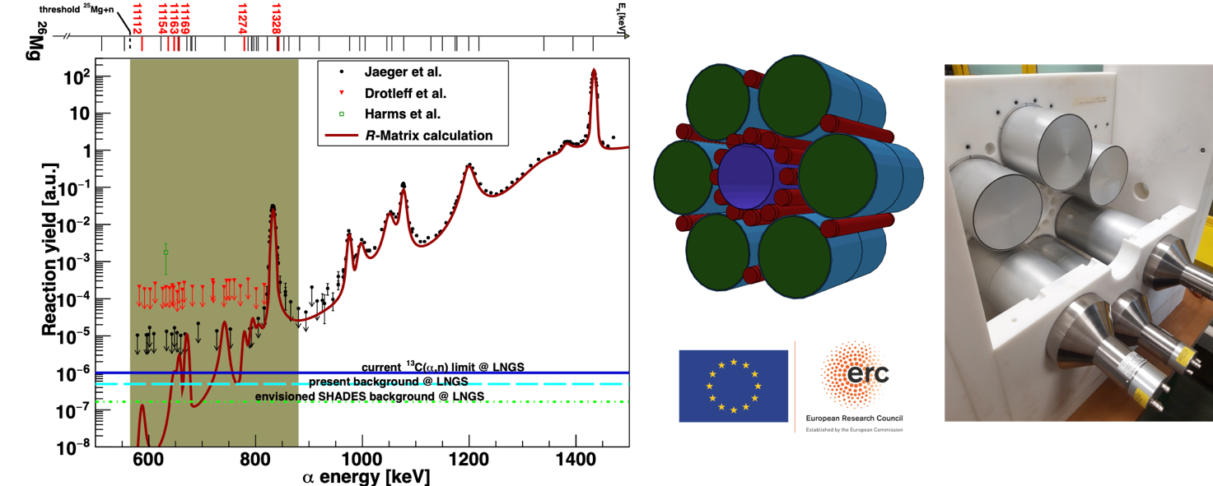
A. Caciolli
LUNA at LNGS: Status and perspectives
²²Ne(α,n)²⁵Mg
²²Ne(α,n)²⁵Mg neutron source for weak s process, minor source for main s process
Cross section in Gamow window unmeasured, many states that can contribute
Background on surface too high, no progress since ~20 years
Novel high-efficiency, energy sensitive detector array (³He+liquid scintillator)
Combined Scintillator-³He array
Scintillator moderates and (if neutron E is high enough) generates light
³He counter acts as trigger -> can reject events depending on energy
Recirculating extended gas target, no solid target hassle, long, uninterrupted beam times
Quinto Incontro Nazionale di Fisica Nucleare INFN 2022
Notes:
15

Slide 16
A. Caciolli
LUNA at LNGS: Status and perspectives
¹²C+¹²C
Its rate determines the value of “M_{up}”:
If M_{star}>M_{up}: quiescent Carbon burning→ core-collapse supernovae, neutron stars, stellar mass black holes
If M_{star}<M_{up}: no Carbon burning→ white dwarfs, nova, type Ia supernovae
The reaction produces protons and alphas in a hot environment→ nucleosynthesis in massive stars
Quinto Incontro Nazionale di Fisica Nucleare INFN 2022
Notes:
16

Slide 17
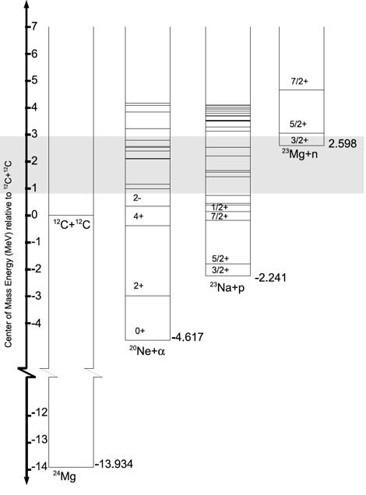
A. Caciolli
LUNA at LNGS: Status and perspectives
12C+12C
¹²C+¹²C→ ²⁰Ne + α Q = 4.62 MeV
¹²C+¹²C→ ²³Na + p Q = 2.24 MeV
¹²C+¹²C→ ²⁴Mg + γ Q = 13.93 MeV
¹²C+¹²C→ ²³Mg + n Q = -2.62 MeV
¹²C+¹²C→ ¹⁶O + 2α Q = -0.12 MeV
¹²C+¹²C→ ¹⁶O + ⁸Be Q= -0.21 MeV
Quinto Incontro Nazionale di Fisica Nucleare INFN 2022
Notes:
17

Slide 18
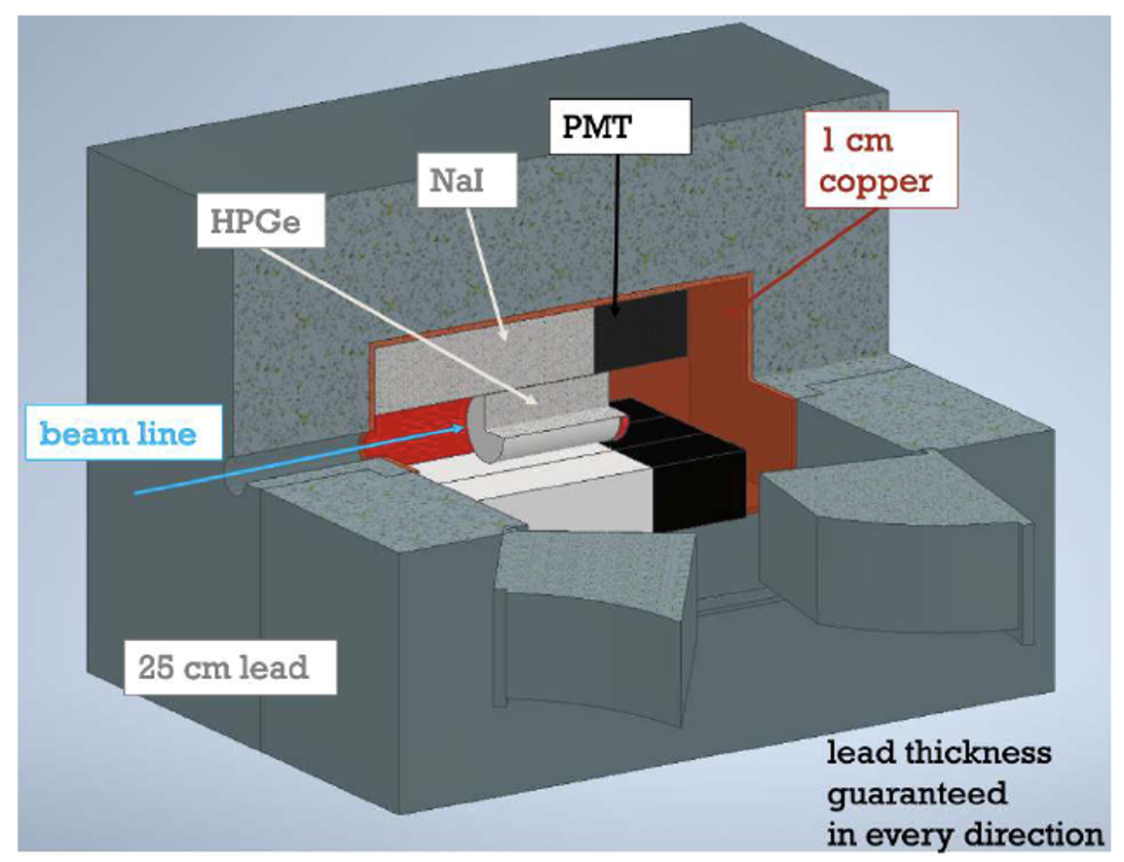
A. Caciolli
LUNA at LNGS: Status and perspectives
12C+12C
¹²C+¹²C→ ²⁰Ne + α Q = 4.62 MeV
¹²C+¹²C→ ²³Na + p Q = 2.24 MeV
¹²C+¹²C→ ²⁴Mg + γ Q = 13.93 MeV
¹²C+¹²C→ ²³Mg + n Q = -2.62 MeV
¹²C+¹²C→ ¹⁶O + 2α Q = -0.12 MeV
¹²C+¹²C→ ¹⁶O + ⁸Be Q= -0.21 MeV
2 different phases: Gamma detection
Goal: E_{cm} = 1.6 MeV
Quinto Incontro Nazionale di Fisica Nucleare INFN 2022
Notes:
18

Slide 19
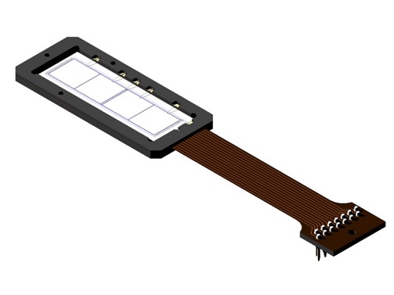
A. Caciolli
LUNA at LNGS: Status and perspectives
12C+12C
¹²C+¹²C→ ²⁰Ne + α Q = 4.62 MeV
¹²C+¹²C→ ²³Na + p Q = 2.24 MeV
¹²C+¹²C→ ²⁴Mg + γ Q = 13.93 MeV
¹²C+¹²C→ ²³Mg + n Q = -2.62 MeV
¹²C+¹²C→ ¹⁶O + 2α Q = -0.12 MeV
¹²C+¹²C→ ¹⁶O + ⁸Be Q= -0.21 MeV
2 different phases: particles detection
Two possible solutions:
- GASTLY detectors with ERNA group
- Si pads detectors (Edinburgh group)
Goal: E_{cm} = 1.6 MeV
Quinto Incontro Nazionale di Fisica Nucleare INFN 2022
Notes:
19

Slide 20
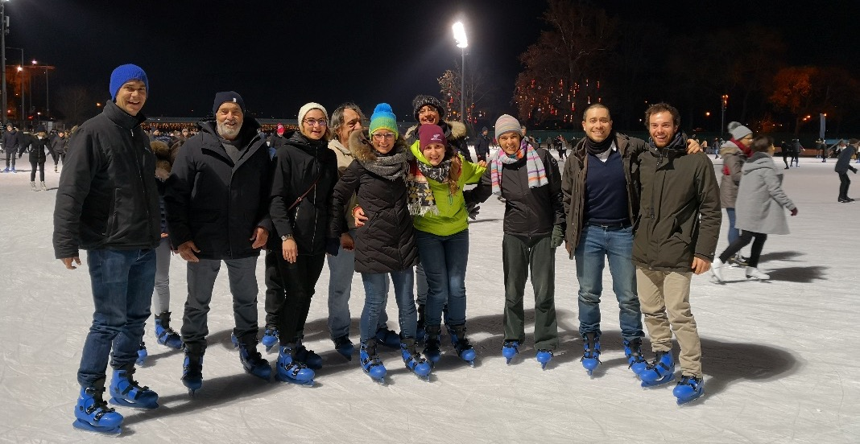
A. Caciolli
LUNA at LNGS: Status and perspectives
Conclusion
The Nuclear Astrophysics community is growing in Italy EU and worldwide
LUNA is a reference for nuclear astrophysics with direct processes in underground
The combination of different approaches and the results of different facilities helps in reaching the high precision required by the new stellar models
In the last 30 years LUNA faced several astrophysical puzzle and more exiting cases are now accessible with the new MV machine installed at LNGS
Many young researchers grown within the collaboration and took coordination responsibilities
Quinto Incontro Nazionale di Fisica Nucleare INFN 2022
Notes:
20

Slide 21

A. Caciolli
LUNA at LNGS: Status and perspectives
The LUNA collaboration
A. Compagnucci, M. Junker, R. Gesuè | INFN LNGS /*GSSI, Italy
C. Broggini, A. Caciolli, P. Marigo, R. Menegazzo, D. Piatti, J. Skowronski, L. Barbieri, Marvin Axness Ferrando | Università di Padova and INFN Padova , Italy
A. Formicola, C. Gustavino | INFN Roma 1, Italy
D. Bemmerer, A. Boeltzig, E. Masha | HZDR Dresden , Germany
L. Csedreki, Z. Elekes, Zs. Fülöp, Gy. Gyürky, T. Szücs | MTA-ATOMKI Debrecen, Hungary
M. Lugaro | Konkoly Observatory,n) and spallation Hungarian Academy of Sciences,n) and spallation Budapest, Hungary
O. Straniero | INAF Osservatorio Astronomico di Collurania, Italy
P. Corvisiero, P. Prati, S. Zavatarelli | Università di Genova and INFN Genova, Italy
R. Depalo, F. Ferraro, A. Guglielmetti, Ciapponi, De Gregorio | Università di Milano and INFN Milano, Italy
C. Ananna, A. Best, A. Di Leva, G. Imbriani, D. Rapagnani | Università di Napoli and INFN Napoli, Italy
F. Cavanna, G. Gervino, P. Colombetti | Università di Torino and INFN Torino, Italy
M. Aliotta, C. Bruno, T. Davinson | University of Edinburgh, United Kingdom
F. Barile, G.F. Ciani, V. Paticchio, L. Schiavulli | Università di Bari and INFN Bari, Italy
R. Perrino | INFN Lecce, Italy
M. Campostrini, V. Rigato | INFN LNL, Italy
Quinto Incontro Nazionale di Fisica Nucleare INFN 2022
Notes:
21

