Slide 1
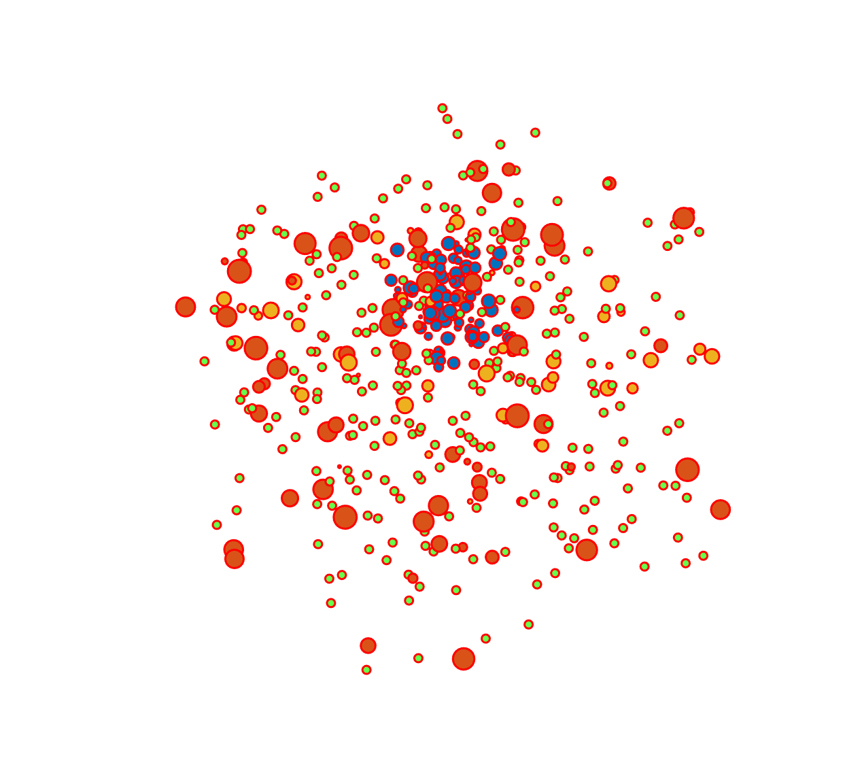


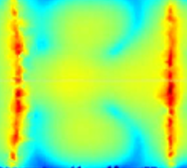

Numerical and experimental investigations on compact binary ejecta plasma opacity relevant for kilonova transient signals
Angelo Pidatella, INFN - LNS
on behalf of the PANDORA collaboration

Slide 2
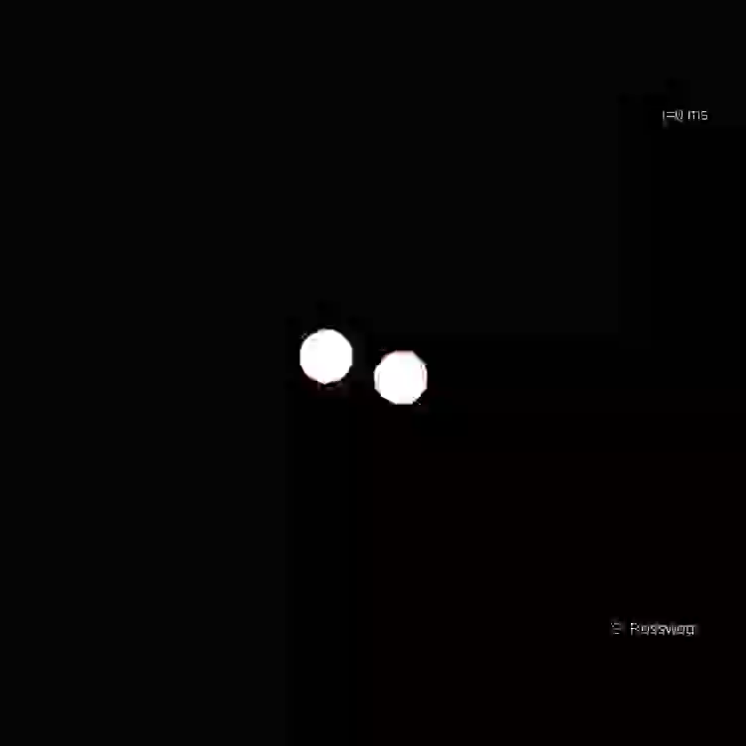
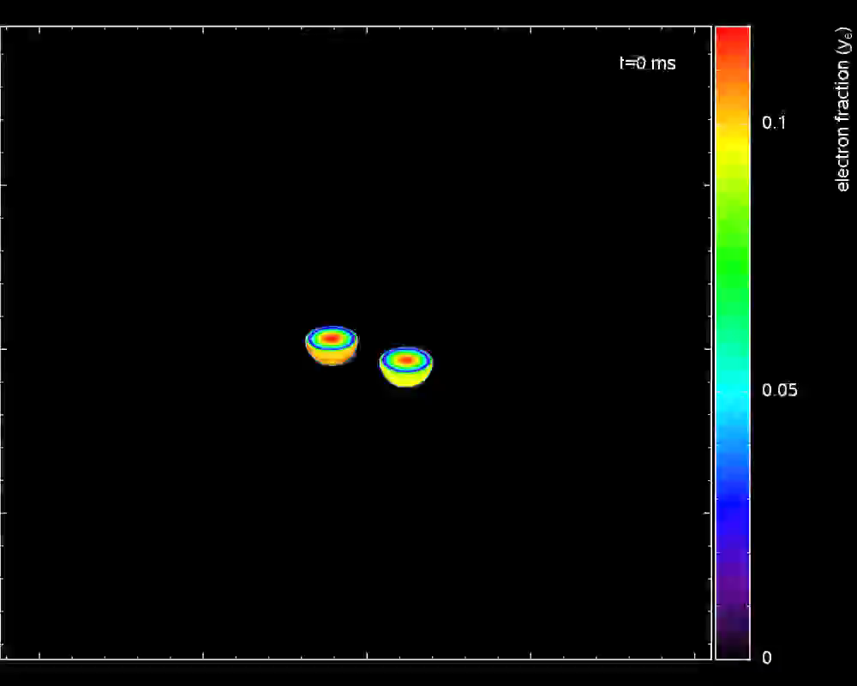
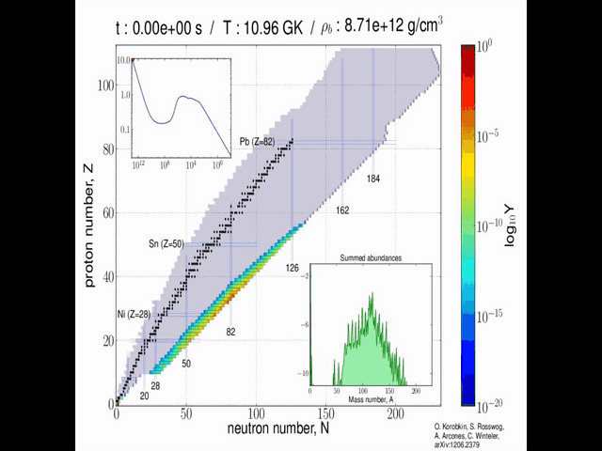
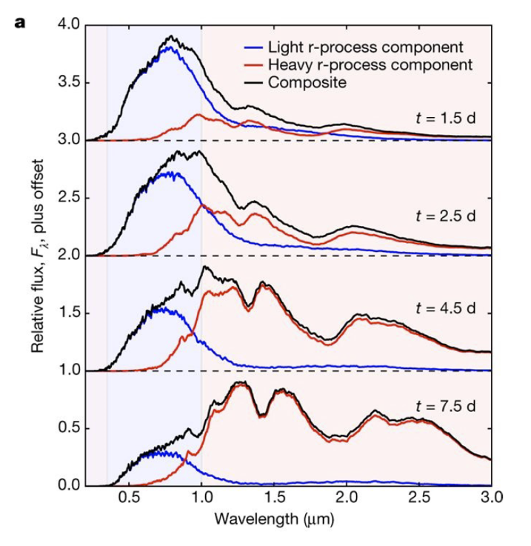
Motivation and introduction
Merger of binary neutron stars: ejection of n-rich matter, rapid neutron capture (r-process) nucleosynthesis
Radioactive decay of synthesized r-process nuclei power electromagnetic transient: kilonovae (KN)
Gravitational wave events (e.g., GW170817) from such merging detected along with KN counterpart AT2017gfo
Detection of AT2017gfo spectrum: first direct evidence that these sites are among the major producer of nuclei heavier than iron via r-process
Plasma opacity greatly impacts on energy transport and spectroscopic observations in many astrophysical environments
Role played by the opacity on KN emission, as it delivers information on the post-merging plasma ejecta composition (r-process multi-components)
Large theoretical uncertainty factor from an almost total ignorance on ejecta opacity at the typical conditions of a KN event
Trapped magneto-plasmas conceived in PANDORA may open the route to experimental in-laboratory measurements of opacities at n_{e} and T_{e} resembling ejecta plasma conditions: shed light on r-process generated metallic species at specific time-stages of KN diffusion
http://compact-merger.astro.su.se/Movies1/ns14_ns15_6mio_3D_density_v5.mov
http://compact-merger.astro.su.se/Movies1/ns14ns15-6Mio-irrot-3Dcut-Ye-v2.mov
http://compact-merger.astro.su.se/Movies1/rProcessMoviexdiv4-12000.mov
GOAL
Origin of the heavy elements in binary neutron-star mergers from a gravitational-wave event, D. Kasen et al., Nature 551, 80–84 (2017).
A. Pidatella – Quinto Incontro Nazionale INFN – 9 Maggio 2022

Slide 3
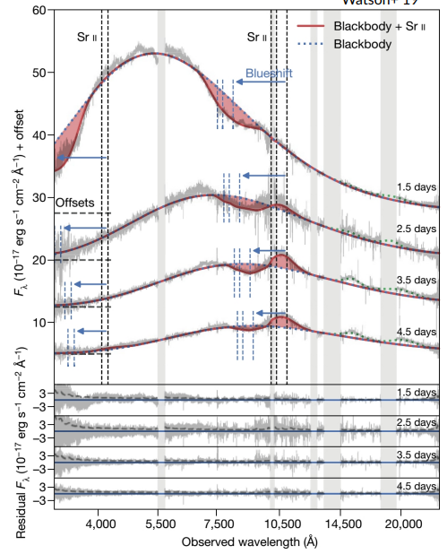


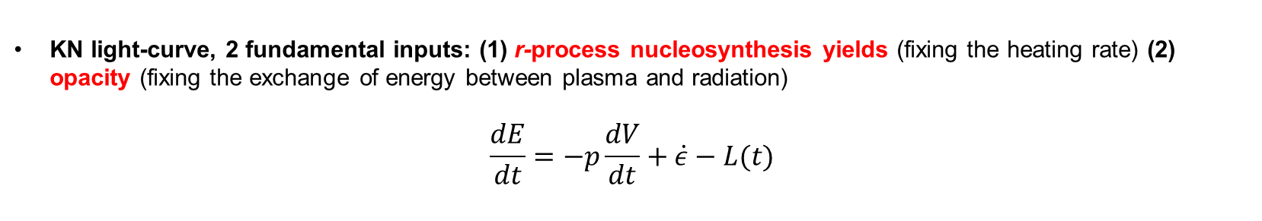
State-of-the-art on r-process and KN
Binary Neutron Stars (BNS) mergers are among major production sites of r-process elements
Ejecta from BNS systems: first evidence of r-process nucleosynthesis in kilonova (KN) AT2017gfo, from Gravitational-Wave event GW170817
KN light-curve, 2 fundamental inputs: (1) r-process nucleosynthesis yields (fixing the heating rate) (2) opacity (fixing the exchange of energy between plasma and radiation)
$$\frac{dE}{dt}=−p\frac{dV}{dt}+\dot{ε}−L(t)$$
(2)
(1)
Opacity from theoretical models: large uncertainty factor, blending of many millions atomic transition lines, experimental data are largely desired!
KN spectral analysis
● f-shell elements : strong blending of lines
● Relativistic velocity : broad lines (multi-components and different velocities of ejecta)
● Atomic data: incomplete and uncertain
➔ The analysis of the spectrum at 1.5 days suggested the presence of strontium (Watson +19)
A. Pidatella – Quinto Incontro Nazionale INFN – 9 Maggio 2022
Watson, D., et al. Nature 574497-500, (2019)

Slide 4
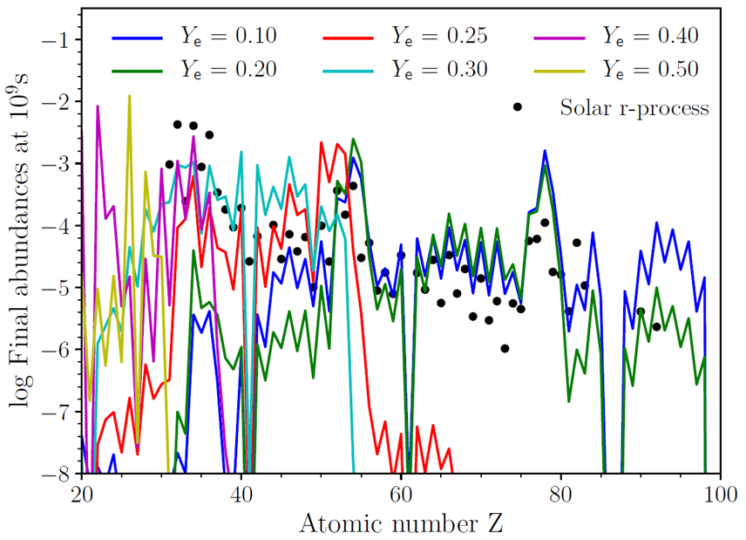
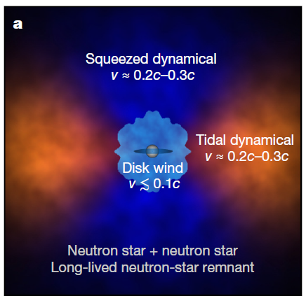
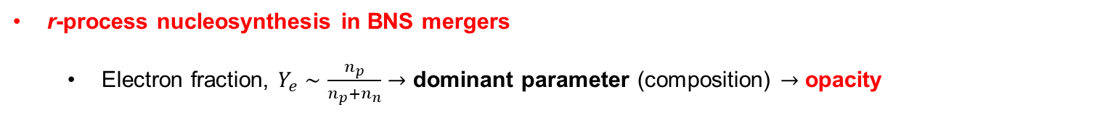
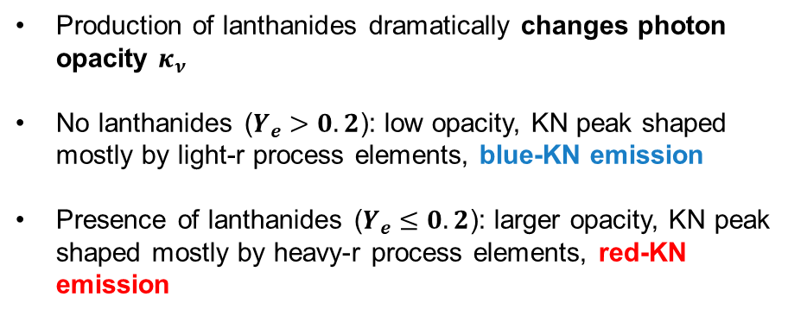
State-of-the-art on r-process and KN
r-process nucleosynthesis in BNS mergers
  Electron fraction, $Y_{e}∼\frac{n_{p}}{n_{p}+n_{n}}→$ dominant parameter (composition) $→$ opacity
Production of lanthanides dramatically changes photon opacity $κ_{ν}$
No lanthanides ($Y_{e}>0.2$): low opacity, KN peak shaped mostly by light-r process elements, blue-KN emission
Presence of lanthanides ($Y_{e}≤0.2$): larger opacity, KN peak shaped mostly by heavy-r process elements, red-KN emission
D. Kasen et al., Nature 551, 80–84 (2017)
Pidatella, A., et al. Nuovo Cimento 44 C (2021) 65
A. Pidatella – Quinto Incontro Nazionale INFN – 9 Maggio 2022

Slide 5
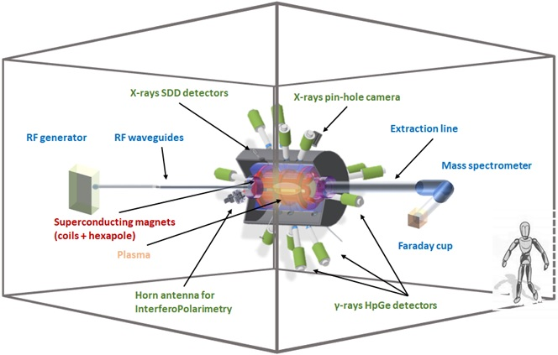
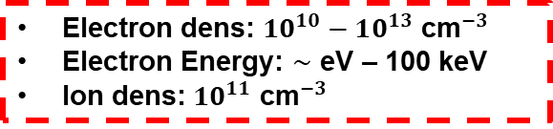
PANDORA: in-laboratory experimental measurements of NS² merger ejecta opacity
Trapped magneto-plasmas conceived in PANDORA: experimental in-laboratory measurements of opacities at electron densities and temperatures resembling some ejecta plasma conditions
PANDORA concept: compact plasma trap to magnetically confine ions of radioisotopes in a microwave-sustained plasma
Main Goal: nuclear decay measurements in a plasma resembling astrophysical conditions (temperature, ion charge state distribution)
Multi-diagnostic setup: monitoring diagnostics + detectors array
s-process nucleosynthesis + β-decay branching
r-process cosmic sites
Nuclear reaction rates in stars
Compact binary object spectroscopy (kilonova transient): to characterize composition and to identify GW events
Electron dens: $10^{10}−10^{13}$ ${\text{cm}}^{−3}$
Electron Energy: $∼$ eV – 100 keV
Ion dens: $10^{11}$ ${\text{cm}}^{−3}$
PHYSICS OF INTEREST FOR MMA AND NUCLEAR ASTROPHYSICS
CAN BE DONE?
A. Pidatella – Quinto Incontro Nazionale INFN – 9 Maggio 2022

Slide 6
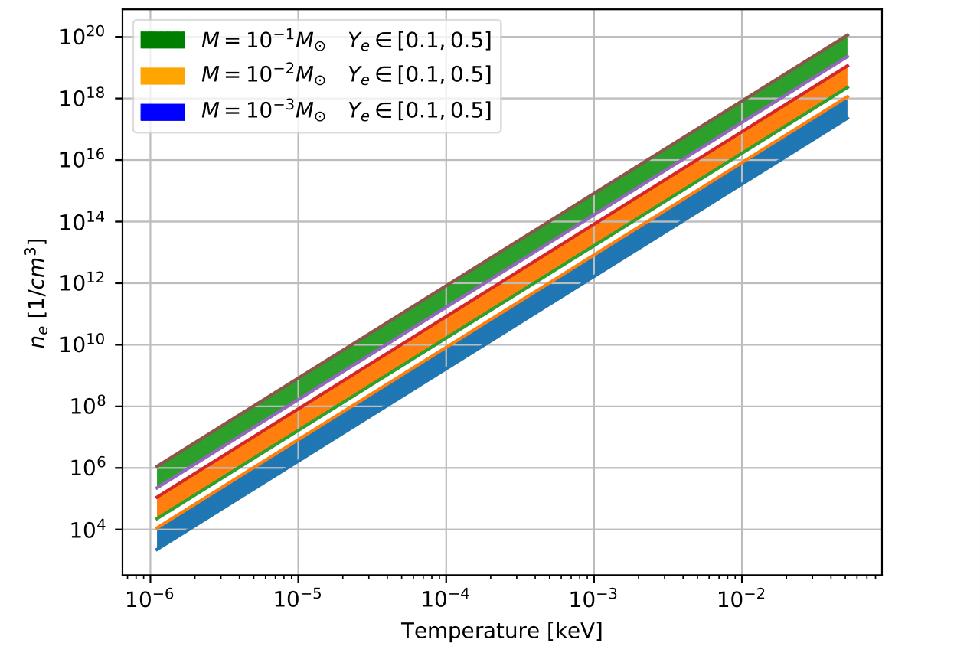
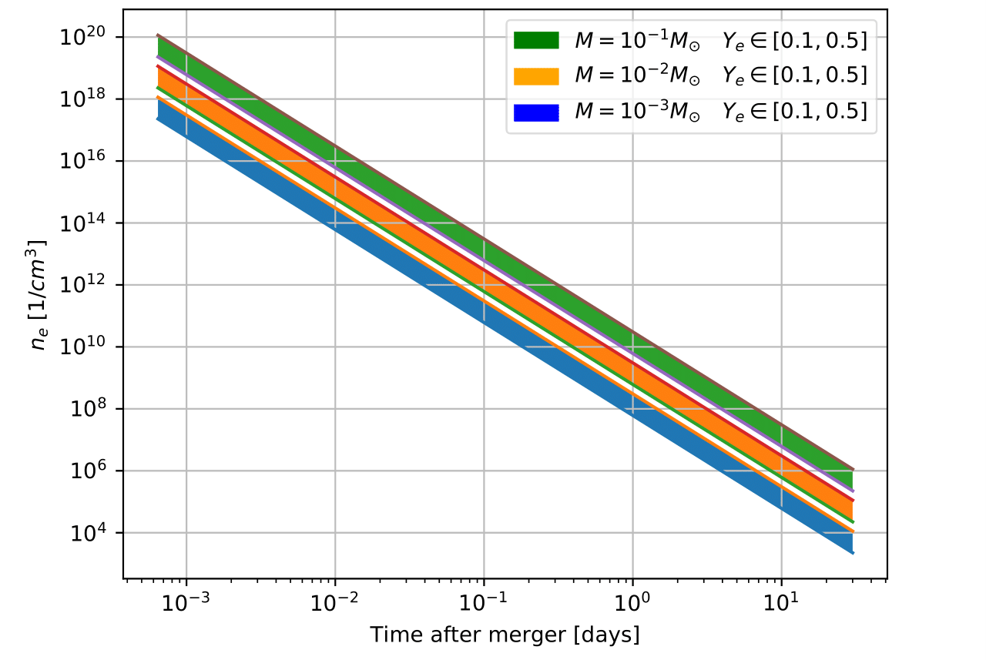
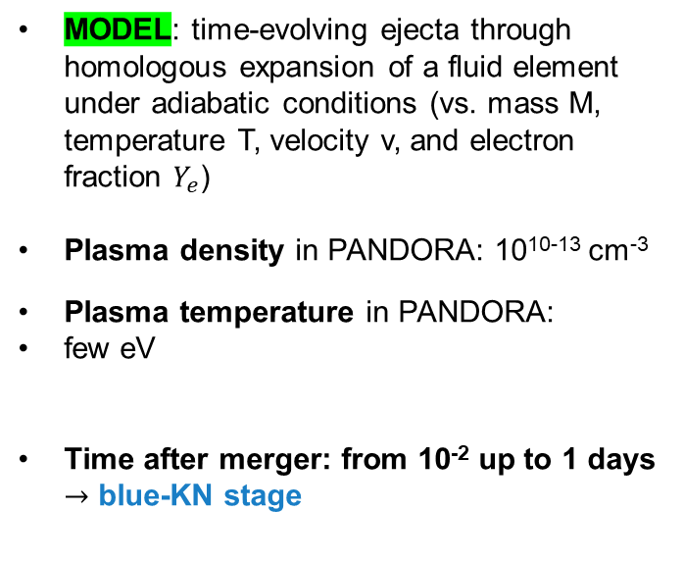
PANDORA: in-laboratory experimental measurements of NS² merger ejecta opacity
The KN emission is reprocessed by atomic opacities (mainly bound-bound transitions) to optical and infrared wavelengths. The emission in these wavelengths can probe the composition of the ejecta
Feasibility study: astrophysical modelling BNS ejecta, nuclear network for nucleosynthesis yields, and population kinetics code for synthetic spectra
MODEL: time-evolving ejecta through homologous expansion of a fluid element under adiabatic conditions (vs. mass M, temperature T, velocity v, and electron fraction $Y_{e}$)
Plasma density in PANDORA: 10¹⁰⁻¹³ cm⁻³
Plasma temperature in PANDORA:
few eV
Time after merger: from 10⁻² up to 1 days $→$ blue-KN stage
Pidatella, A., et al. Nuovo Cimento 44 C (2021) 65
O. Korobkin et al., Mon. Not. R. Astron. Soc., 426 (2012) 3-1940:1949
D. Radice et al., Astrophys. J., 869 (2018) 2-130
J. Lippuner et al., Astrophys. J. Supplements, 233 (2017) 18
A. Pidatella – Quinto Incontro Nazionale INFN – 9 Maggio 2022

Slide 7
PANDORA: in-laboratory experimental measurements of NS² merger ejecta opacity
The KN emission is reprocessed by atomic opacities (mainly bound-bound transitions) to optical and infrared wavelengths. The emission in these wavelengths can probe the composition of the ejecta
Feasibility study: astrophysical modelling BNS ejecta, nuclear network for nucleosynthesis yields, and population kinetics code for synthetic spectra
IDENTIFICATION OF PHYSICS CASES
Time-dependent r-process elements abundances from SKYNET, with distribution of ejecta properties (entropy, electron fraction and expansion timescale) from astrophysical simulations → LIGHT R-PROCESS ELEMENTS, LOW NEUTRON RICHNESS
MEAN OPACITY vs. T, weighted with abundances from SKYNET: synthetic spectra of opacity from FLYCHK → Selenium, Strontium, Zirconium most suitable for experiments
Opacity weighted on abundances from SKYNET
cm ² g ⁻¹
Pidatella, A., et al. Nuovo Cimento 44 C (2021) 65
Chung H.-K. et al., High Energy Density Phys., 1 (2005) 3
A. Pidatella – Quinto Incontro Nazionale INFN – 9 Maggio 2022

Slide 8
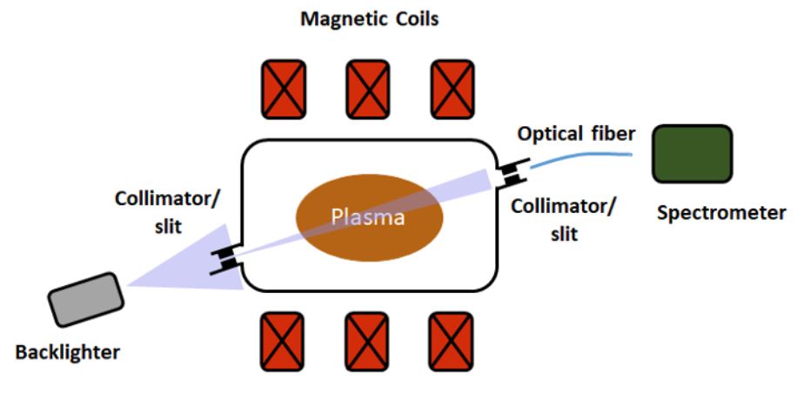
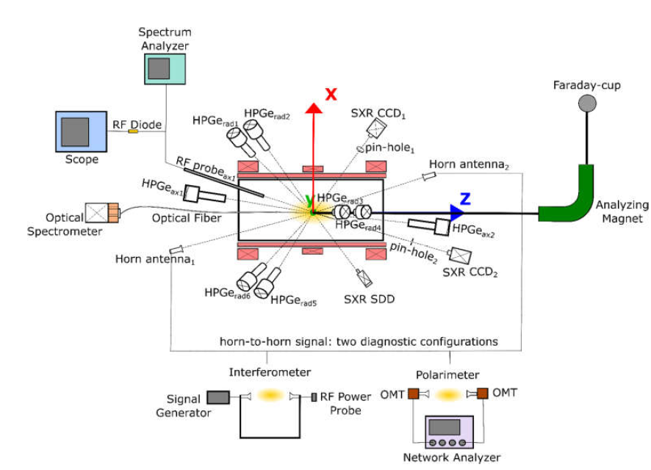



PANDORA: in-laboratory experimental measurements of NS² merger ejecta opacity
PANDORA is a multi-diagnostic facility: optical emission spectroscopy (OES) to probe plasma emission in the blue-KN stage, supported by ancillary non-invasive diagnostics
Monitoring/measuring plasma parameters, plasma stability
Experimental setup and measurement design
Opacity direct measurement: TRANSMISSION
$$T\left(λ\right)=\frac{I\left(λ\right)}{I_{0}\left(λ\right)}=e^{−τ\left(λ\right)}=e^{−∫κ\left(λ,T_{e}\left(x\right),n_{e}\left(x\right)\right)ρ\left(x\right)dx}$$
$$\frac{{I_{abs}\left(λ\right)−I}_{se}^{p}\left(λ\right)}{I_{0}\left(λ\right)}$$
$$κ_{s}\left(λ,T,n\right)+κ_{abs}(λ,T,n)$$
CHALLENGING
Transmission measurements: plasma active medium
Self-emission from plasma + radiation attenuation led by opacity
Spurious contribution: (i) reflection at chamber wall, (ii) effect of cavity on wave propagation
A. Pidatella – Quinto Incontro Nazionale INFN – 9 Maggio 2022

Slide 9
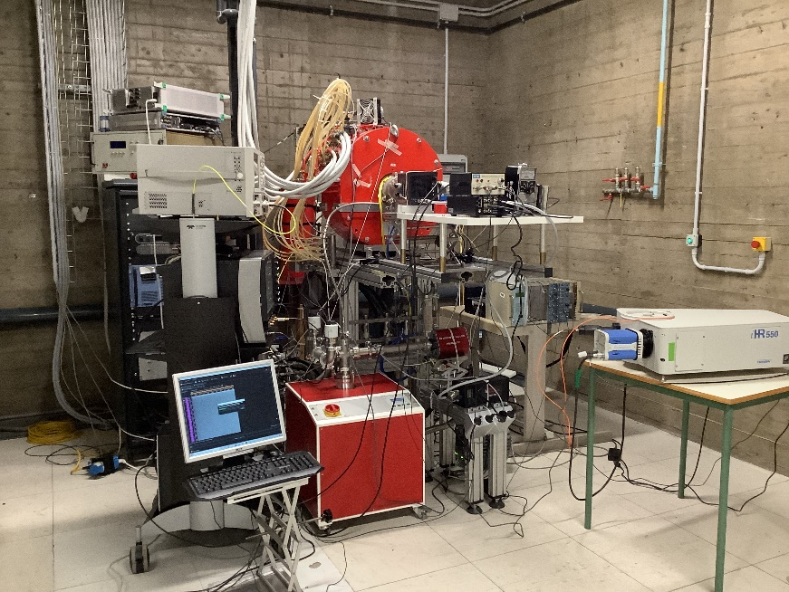
PANDORA: in-laboratory experimental measurements of NS² merger ejecta opacity
PANDORA is a multi-diagnostic facility: optical emission spectroscopy (OES) to probe plasma emission in the blue-KN stage, supported by ancillary non-invasive diagnostics
Monitoring/measuring plasma parameters, plasma stability
Experimental setup and measurement design: w.i.p. on the Flexible Plasma Trap, first campaign of OES measurements
Flexible Plasma Trap @ LNS (setup Feb 2022)
A. Pidatella – Quinto Incontro Nazionale INFN – 9 Maggio 2022

Slide 10
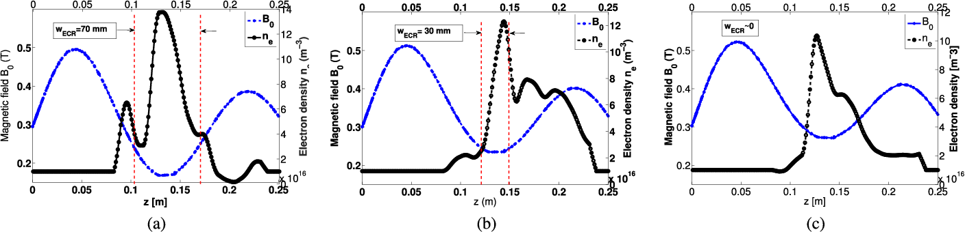
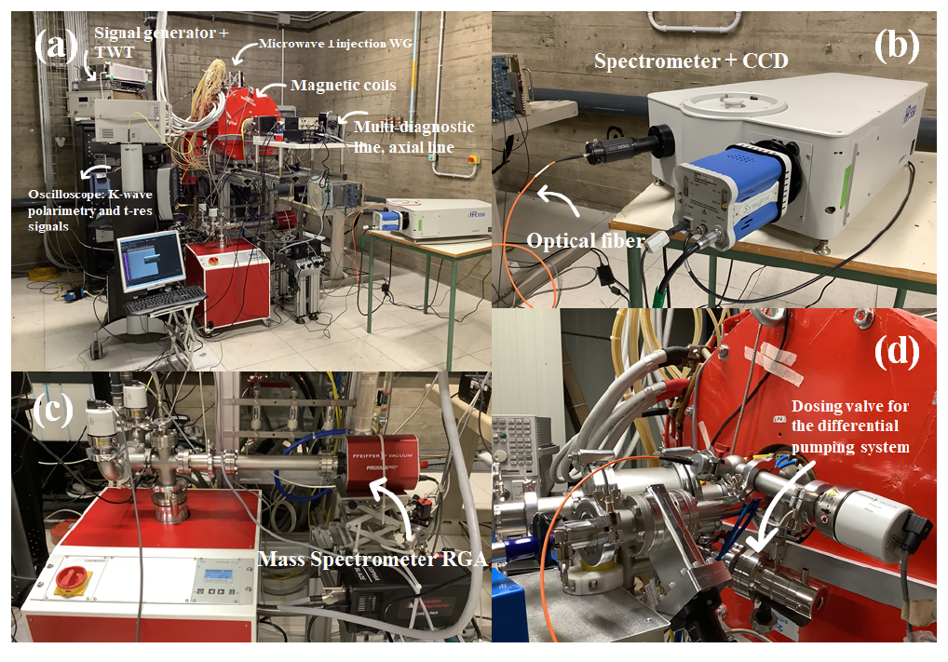
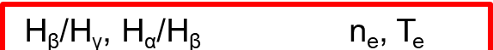




FPT: diagnostic and theory for plasma characterization and opacity measurements
PLASMA TRAP CONFIGURATION (FPT vs. PANDORA):
  Simple mirror field, magnetic bottle (min-B field)
  RF power : 50÷450 W (up to 6 kW)
  Heating RF frequency: 3÷4 GHz (18÷21 GHz)
G. Torrisi et al., IEEE Transactions on Antennas and Propagation, vol. 67, no. 4, pp. 2142-2149, April 2019
Experimental H₂/Ar plasma characterization performed on FPT: commissioning with radial injection and high-power
The comparison between the theoretical and experimental line ratios allows to evaluate the plasma parameters (electron density and temperature)
Hydrogen spectrum
  $$H_{α}$$
RF power: from 40 W to 450 W
RF frequency: 3.76, 6.78 GHz
Gas pressure: 1 · 10⁻³ and 1 · 10⁻² mbar
  $\frac{I_{α}}{I_{β}}=\frac{η_{α}}{η_{β}}\frac{χ_{α}\left(ρ,T\right)}{χ_{β}\left(ρ,T\right)}→\left\langle ρ\right\rangle ,⟨T⟩$
  $$H_{γ}$$
  $$H_{β}$$
Pidatella, A.,et al. Frontiers in Astronomy and Space Sciences
Nuclear Physics​ (submitted)
A. Pidatella – Quinto Incontro Nazionale INFN – 9 Maggio 2022

Slide 11
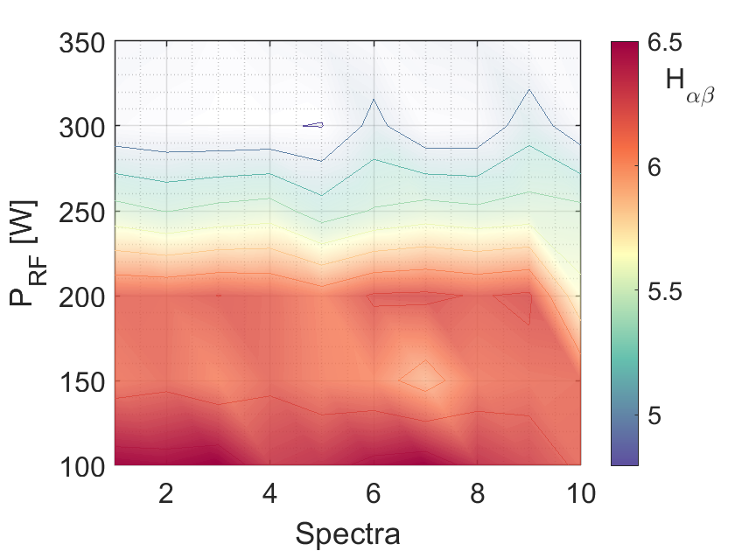
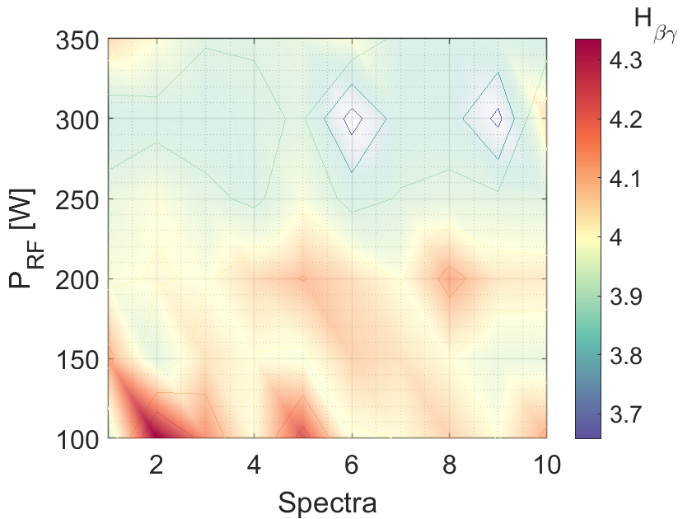





FPT: diagnostic and theory for plasma characterization and opacity measurements
Monitoring plasma stability from emission line ratios
  $$H_{αβ}$$
  $$H_{βγ}$$
  $$H_{α}$$
Lamp-calibrated (relative, not absolute) spectra
  $$H_{γ}$$
  $$H_{β}$$
Horiba iHR550 Spectrometer with CCD detector
Grating: 2400 g/mm
Spectral range: 300-750 nm
Spectral resolution: 0.035 nm (experimentally measured).
Pidatella, A.,et al. Frontiers in Astronomy and Space Sciences
Nuclear Physics​ (submitted)
A. Pidatella – Quinto Incontro Nazionale INFN – 9 Maggio 2022

Slide 12
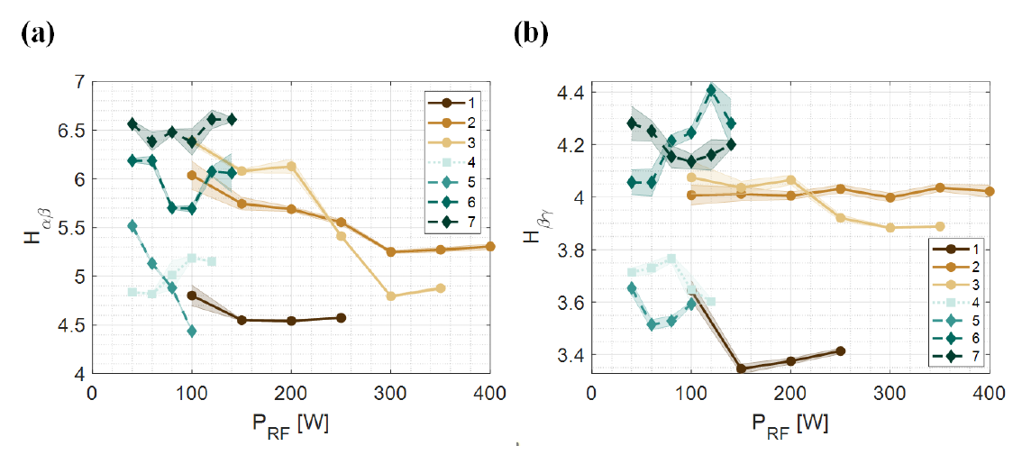
FPT: diagnostic and theory for plasma characterization and opacity measurements
Monitoring plasma stability from emission line ratios
  $$H_{α}$$
Lamp-calibrated (relative, not absolute) spectra
  $$H_{γ}$$
  $$H_{β}$$
Horiba iHR550 Spectrometer with CCD detector
Grating: 2400 g/mm
Spectral range: 300-750 nm
Spectral resolution: 0.035 nm (experimentally measured).
Pidatella, A.,et al. Frontiers in Astronomy and Space Sciences
Nuclear Physics​ (submitted)
A. Pidatella – Quinto Incontro Nazionale INFN – 9 Maggio 2022

Slide 13
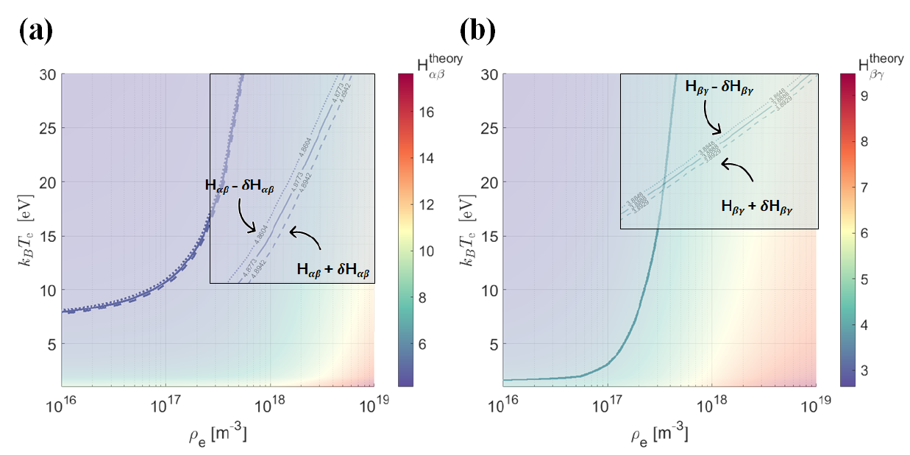


FPT: diagnostic and theory for plasma characterization and opacity measurements
ESTIMATES : Average density and temperature proportional to the effective emission coefficients $χ_{λ}$.
Solving non-linear two-variables equation system from two-lines integrated ratios → cross point! Unique solution for $\left\langle ρ\right\rangle ,⟨T⟩$
Characterizing plasma density and temperature from line ratios
  $\frac{I_{α}}{I_{β}}=\frac{η_{α}}{η_{β}}\frac{χ_{α}\left(ρ,T\right)}{χ_{β}\left(ρ,T\right)}→\left\langle ρ\right\rangle ,⟨T⟩$
Thanks to the collaboration of colleagues from MPI für Plasmaphysik and UNI-Augsburg
Theory: YACORA CR model line ratios (n,T) isosurface
Collisional Radiative (CR) model
Balance eqs. are solved considering the different mechanisms of population and de-population of atomic levels (Rate eqs.)
Exp: measured line ratios, isoline on theoretical isosurface
Pidatella, A.,et al. Frontiers in Astronomy and Space Sciences
Nuclear Physics​ (submitted)
A. Pidatella – Quinto Incontro Nazionale INFN – 9 Maggio 2022

Slide 14
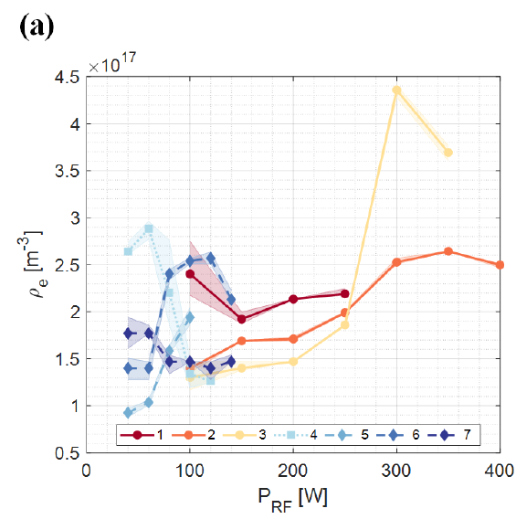
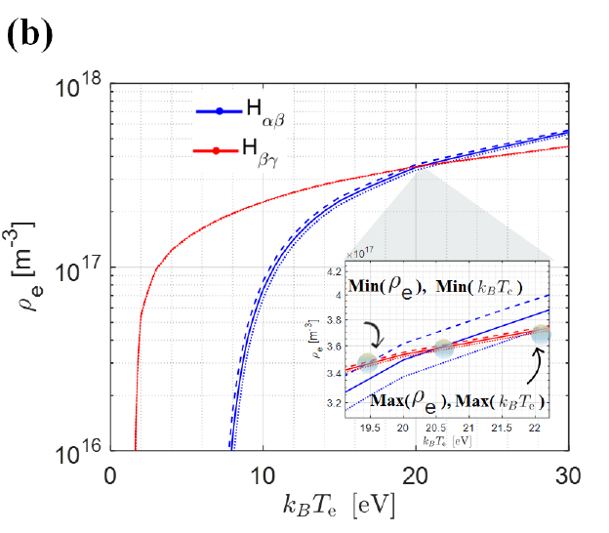
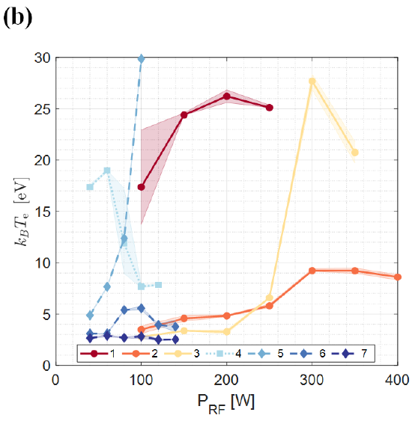
FPT: diagnostic and theory for plasma characterization and opacity measurements
ESTIMATES : Average density and temperature proportional to the effective emission coefficients $χ_{λ}$.
Solving non-linear two-variables equation system from two-lines integrated ratios → cross point! Unique solution for $\left\langle ρ\right\rangle ,⟨T⟩$
Characterizing plasma density and temperature from line ratios
  $\frac{I_{α}}{I_{β}}=\frac{η_{α}}{η_{β}}\frac{χ_{α}\left(ρ,T\right)}{χ_{β}\left(ρ,T\right)}→\left\langle ρ\right\rangle ,⟨T⟩$
Thanks to the collaboration of colleagues from MPI für Plasmaphysik and UNI-Augsburg
Theory: YACORA CR model line ratios (n,T) isosurface
Collisional Radiative (CR) model
Balance eqs. are solved considering the different mechanisms of population and de-population of atomic levels (Rate eqs.)
Exp: measured line ratios, isoline on theoretical isosurface
Pidatella, A.,et al. Frontiers in Astronomy and Space Sciences
Nuclear Physics​ (submitted)
A. Pidatella – Quinto Incontro Nazionale INFN – 9 Maggio 2022

Slide 15
Summary and perspectives on KN opacity measurements
Triggered by the astrophysical problem, a feasibility study to measure for the first-time plasma opacity in ECR plasma has been performed. PANDORA offers the conditions for reproducing blue-KN peculiar environment
PANDORA is a multi-diagnostic facility: optical emission spectroscopy (OES) to probe plasma emission in the blue-KN stage, supported by ancillary non-invasive diagnostics
Monitoring/measuring plasma parameters, plasma stability
Pidatella, A.,et al. Frontiers in Astronomy and Space Sciences
Nuclear Physics​ (submitted)
Test-bench measurements and experimental setups have been attempted on the Flexible Plasma Trap @ LNS
Plasma characterization towards densities and temperatures suitable
Experimental difficulties: active medium, resonant cavity, structured density and temperature profiles
First data: using line-ratio method, H-plasma + Ar-H mixtures, estimate plasma parameters
Experimental setup and measurement design: w.i.p. on the Flexible Plasma Trap, first campaign of OES measurements, closely reproducing KN conditions – few eV, and 10¹¹ cm⁻³
Perspectives: absolute calibration, light-r process elements plasmas (Se, Sr, Zr) opacity measurements via OES.
A. Pidatella – Quinto Incontro Nazionale INFN – 9 Maggio 2022

Slide 16
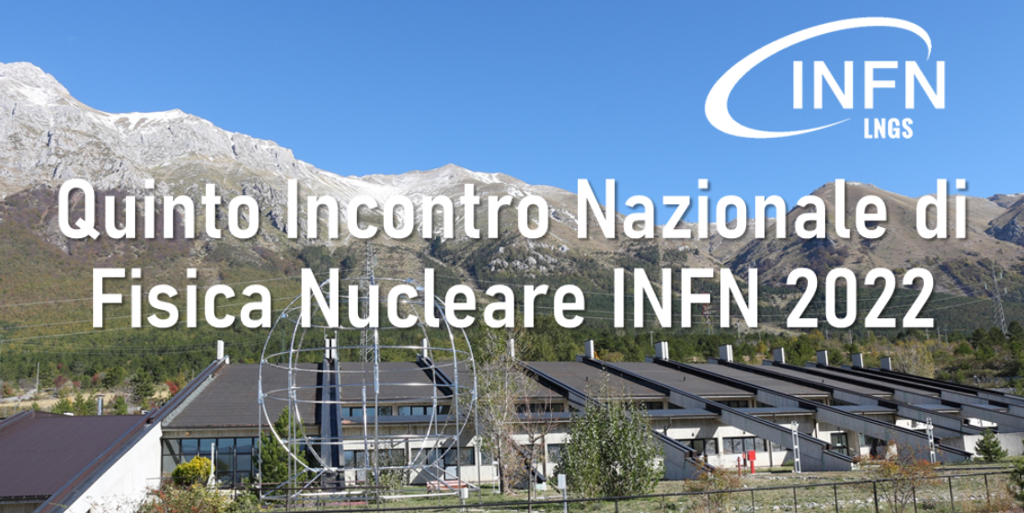

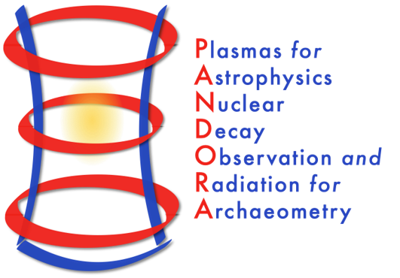














Thank you for your attention!
Also collaborating in the nuclear fusion research programme for the Divertor Tokamak Test (DTT) project
A. Pidatella – Quinto Incontro Nazionale INFN – 9 Maggio 2022

Slide 17
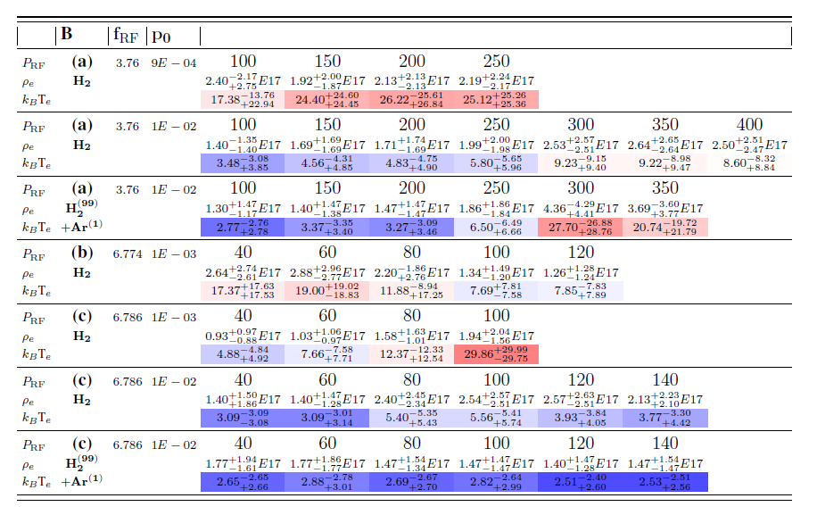
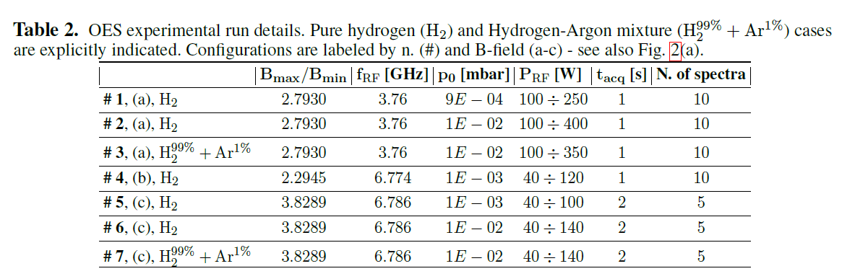
Backup I
Pidatella, A.,et al. Frontiers in Astronomy and Space Sciences
Nuclear Physics​ (submitted)
A. Pidatella – Quinto Incontro Nazionale INFN – 9 Maggio 2022

Slide 18
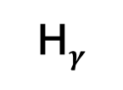
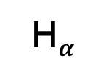
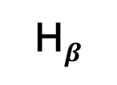
Backup 2
(b)
H$α$
(a)
H$β$
Fulcher band
H$γ$
(c)
Pidatella, A.,et al. Frontiers in Astronomy and Space Sciences
Nuclear Physics​ (submitted)
A. Pidatella – Quinto Incontro Nazionale INFN – 9 Maggio 2022

Slide 19
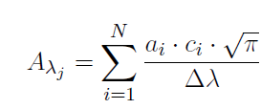

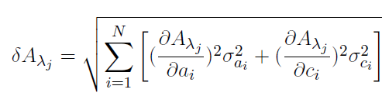
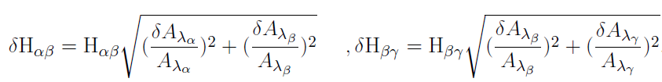
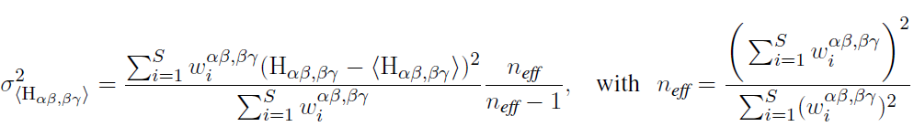
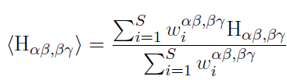
Backup 3
Pidatella, A.,et al. Frontiers in Astronomy and Space Sciences
Nuclear Physics​ (submitted)
A. Pidatella – Quinto Incontro Nazionale INFN – 9 Maggio 2022

Slide 20
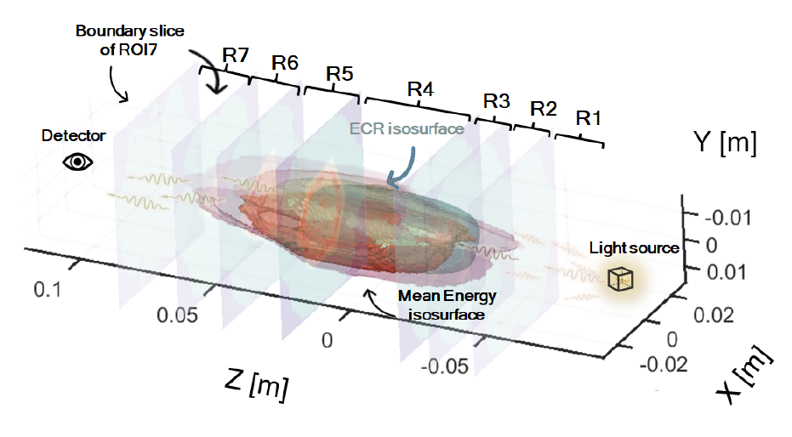

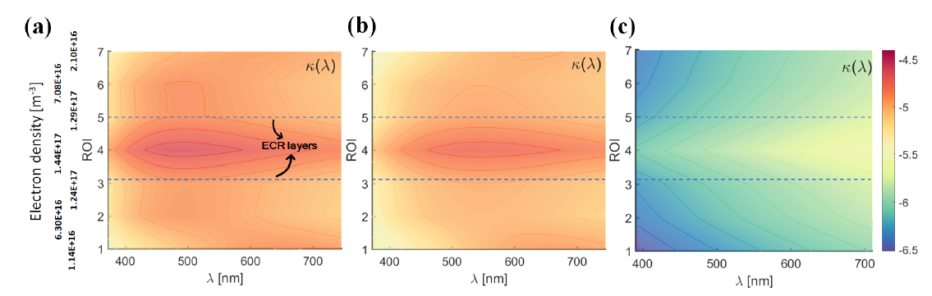
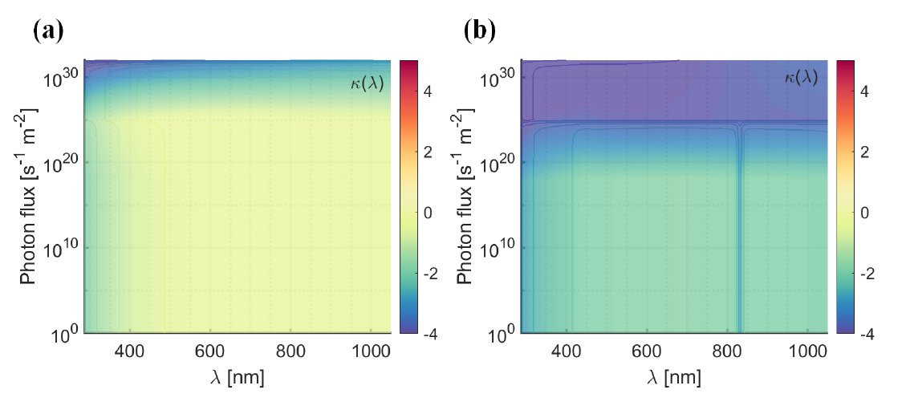
Backup 4
Pidatella, A.,et al. Frontiers in Astronomy and Space Sciences
Nuclear Physics​ (submitted)
A. Pidatella – Quinto Incontro Nazionale INFN – 9 Maggio 2022

