Slide 1
Kaonic atoms beyond SIDDHARTA-2:
future measurements and perspectives at DAΦNE
“ Quinto Incontro Nazionale di Fisica Nucleare INFN 2022"
A. Scordo, Laboratori Nazionali del Gran Sasso, 10/05/2022

Slide 2
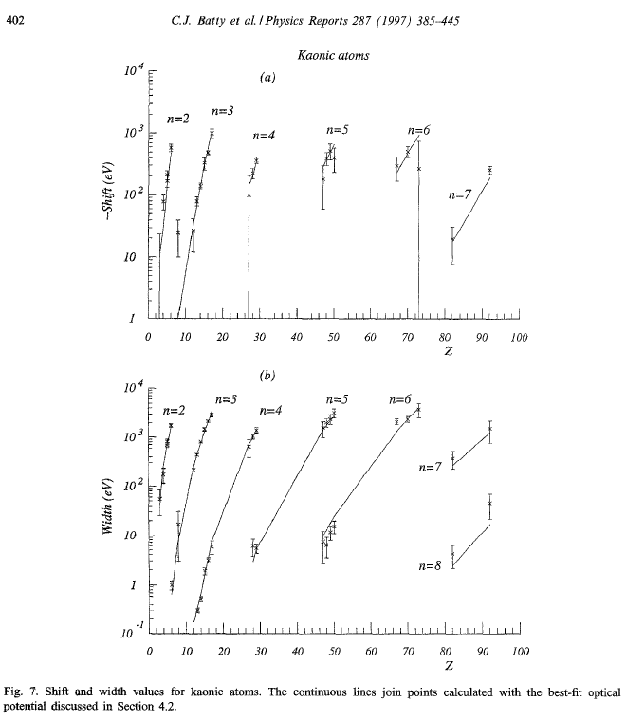
Why (again and still) kaonic atoms?
Except for the most recent measurements at DAΦNE and JPARC on KHe and KH, the whole knowledge on kaonic atoms dates back to 1970s and 1980s
These data are the experimental basis for all the developed theoretical models
These theoretical models are used to derive, for example:
KN interaction at threshold
KNN interaction at threshold
Nuclear density distributions
Possible existence of kaon condensates
Kaon mass
Kaonic atoms cascade models
“ Quinto Incontro Nazionale di Fisica Nucleare INFN 2022", A. Scordo, Laboratori Nazionali del Gran Sasso 10/05/2022

Slide 3
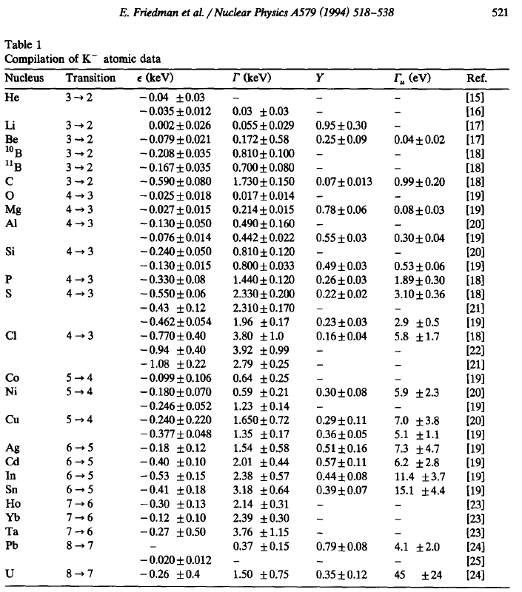
Why (again and still) kaonic atoms?
The available data on “lower levels” have big uncertainties
Many of them are actually UNmeasured
Many of them are hardly compatible among each other
Relative yields with upper levels are not always measured
Absolute yields are basically unknown (except for few transitions)
The REmeasured ones have been proved WRONG
This situation would already be a proper justification for new measurements
“ Quinto Incontro Nazionale di Fisica Nucleare INFN 2022", A. Scordo, Laboratori Nazionali del Gran Sasso 10/05/2022

Slide 4
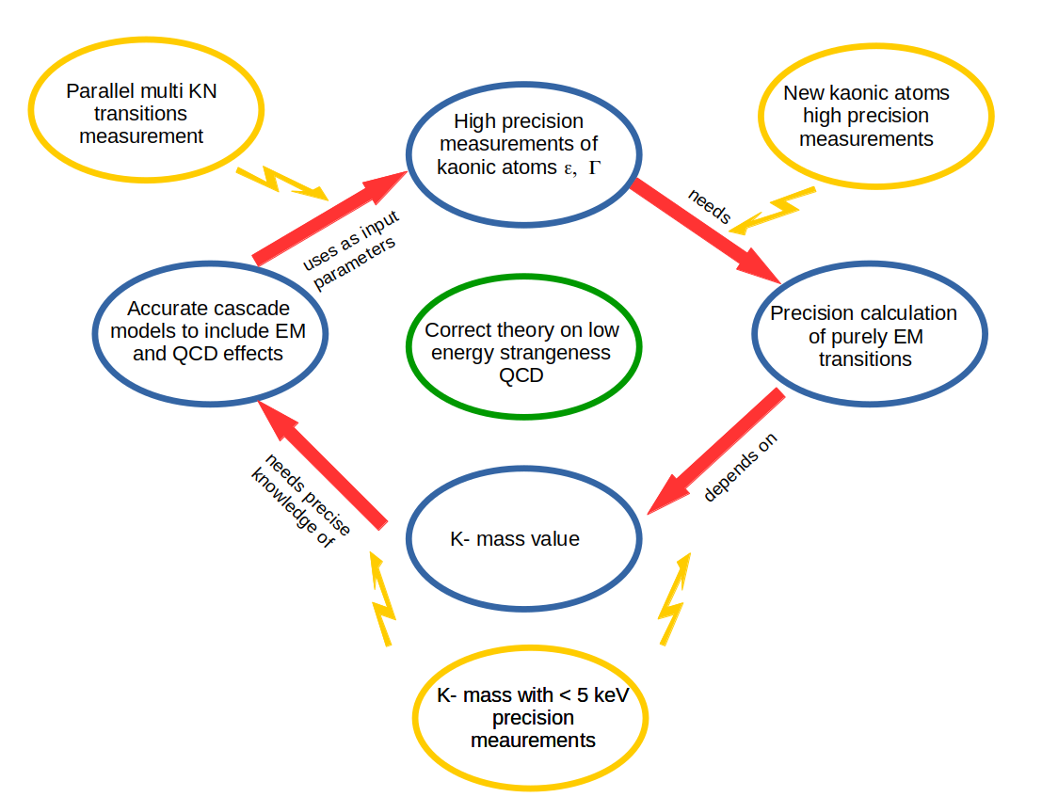
What more can we learn from new measurements?
Multi-transition parallel measurements
“ Quinto Incontro Nazionale di Fisica Nucleare INFN 2022", A. Scordo, Laboratori Nazionali del Gran Sasso 10/05/2022

Slide 5
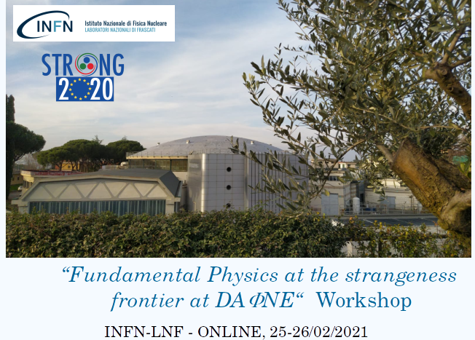
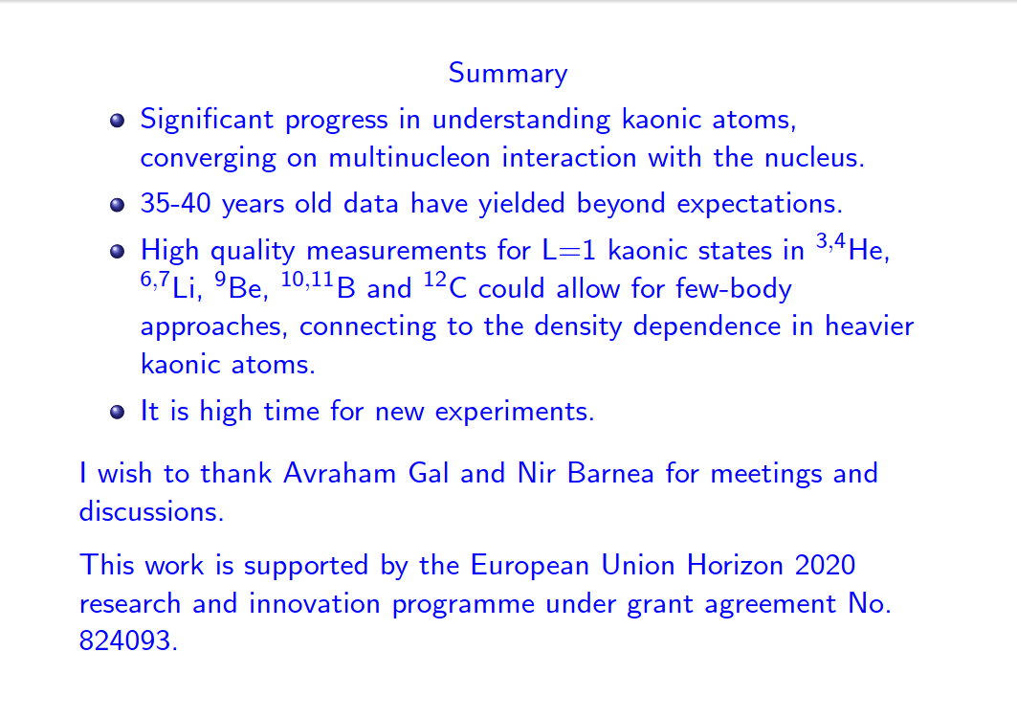
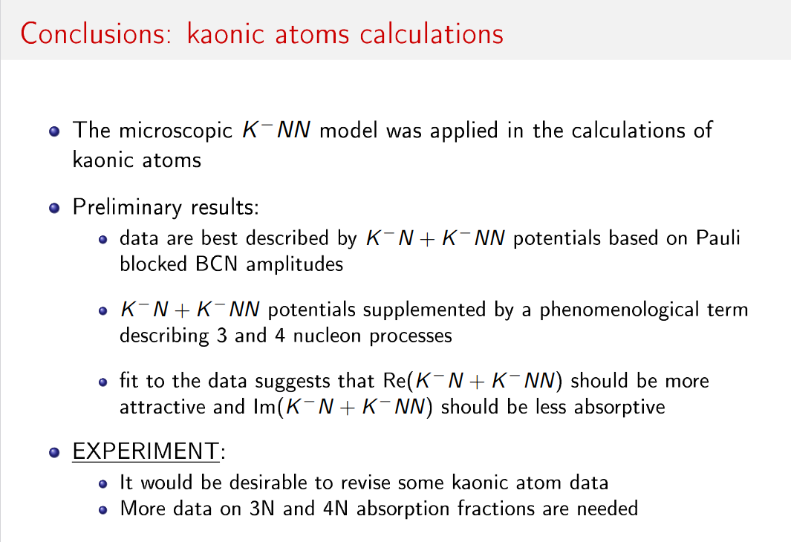
What more can we learn from new measurements?
80 participants from more than 20 different institutes
Several "strange" topics covered and intense discussion showing that the physics case and the community are strong and sparkling
Focused on DAΦNE, the BEST facility in the world for low energy strangeness experiments
“ Quinto Incontro Nazionale di Fisica Nucleare INFN 2022", A. Scordo, Laboratori Nazionali del Gran Sasso 10/05/2022

Slide 6
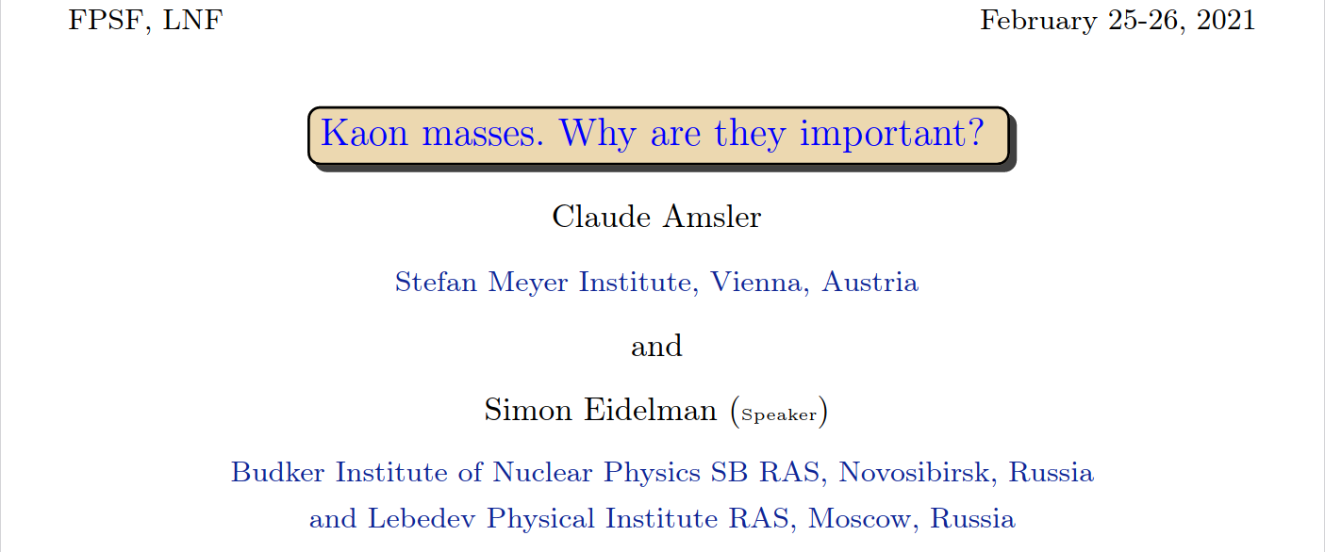
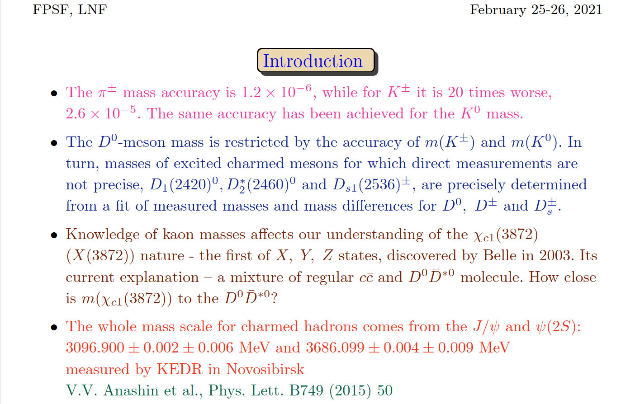
What more can we learn from new measurements?
The most precise (incompatible) measurements date back to 1988 and 1991
Kaon mass precision impacts not only in low energy strangeness QCD
For example, D and J/ψ is affected
Errors can be improved with high precision measurements of "high n levels" of kaonic atoms
“ Quinto Incontro Nazionale di Fisica Nucleare INFN 2022", A. Scordo, Laboratori Nazionali del Gran Sasso 10/05/2022

Slide 7
Transitions: energies and widths…which detector?
Crystal spectrometers:
High resolution
Low efficiency
0-20 keV range
Energy
SDDs
100 eV max resolution
4-40 keV range
High efficiency
300 keV
100 keV
Cd(Zn)Te
20-300 keV range
FWHM / E ~ %
High efficiency
Room Temperature
40 keV
20 keV
HPGe
100-1000 keV range
FWHM / E ∼ %
High efficiency
Cooling needed
5 keV
10 eV
100 eV
Γ
“ Quinto Incontro Nazionale di Fisica Nucleare INFN 2022", A. Scordo, Laboratori Nazionali del Gran Sasso 10/05/2022

Slide 8
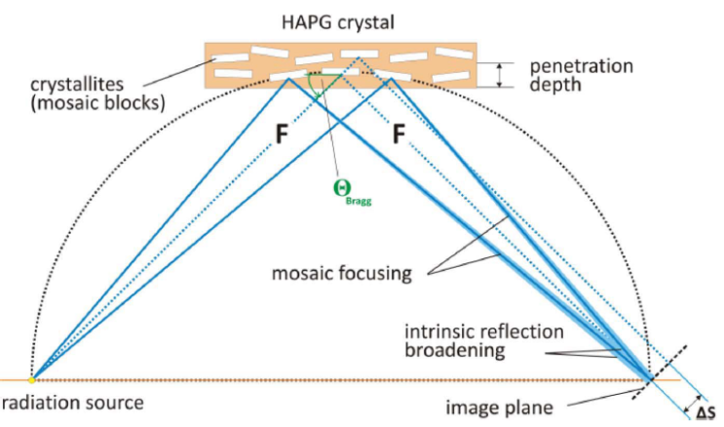
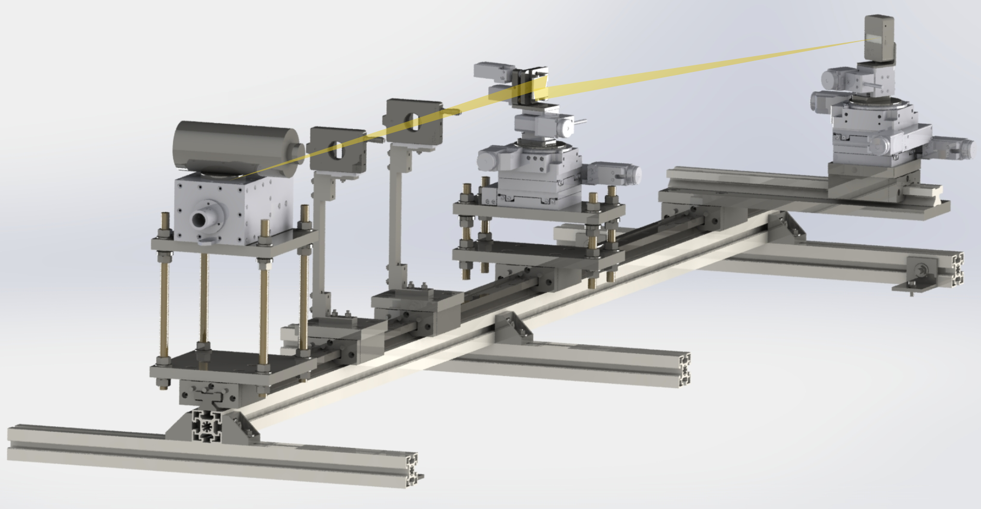
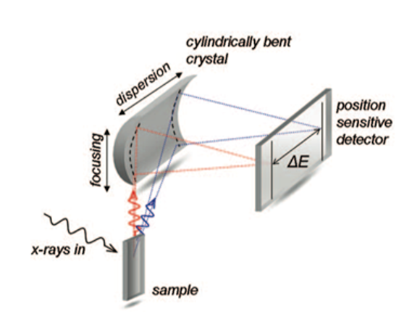
Crystal spectrometers: VOXES
Spectrometer developed under CSN5 Young Researcher Grant (2016-2018)
HAPG mosaic crystals in Von Hamos configuration:
- Higher intrinsic reflectivity wrt standard crystals
- VH configuration to exploit sagittal focusing
- Optical optimisation to work with milli/centimetric sources
“ Quinto Incontro Nazionale di Fisica Nucleare INFN 2022", A. Scordo, Laboratori Nazionali del Gran Sasso 10/05/2022

Slide 9
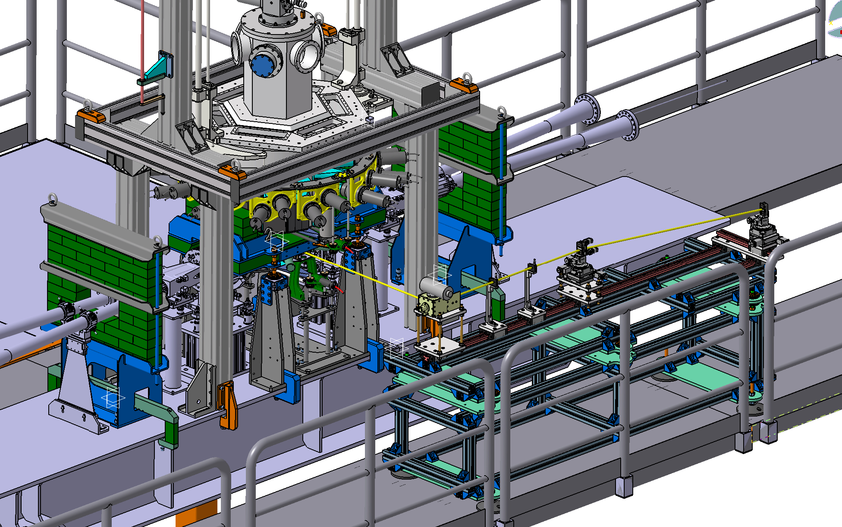
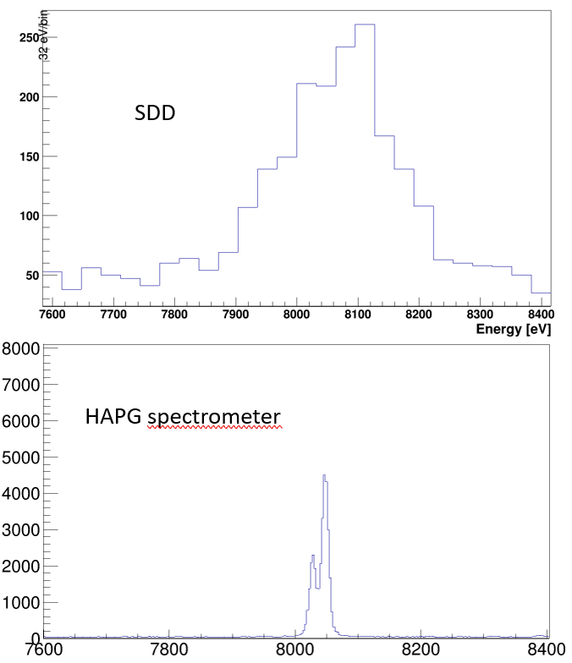
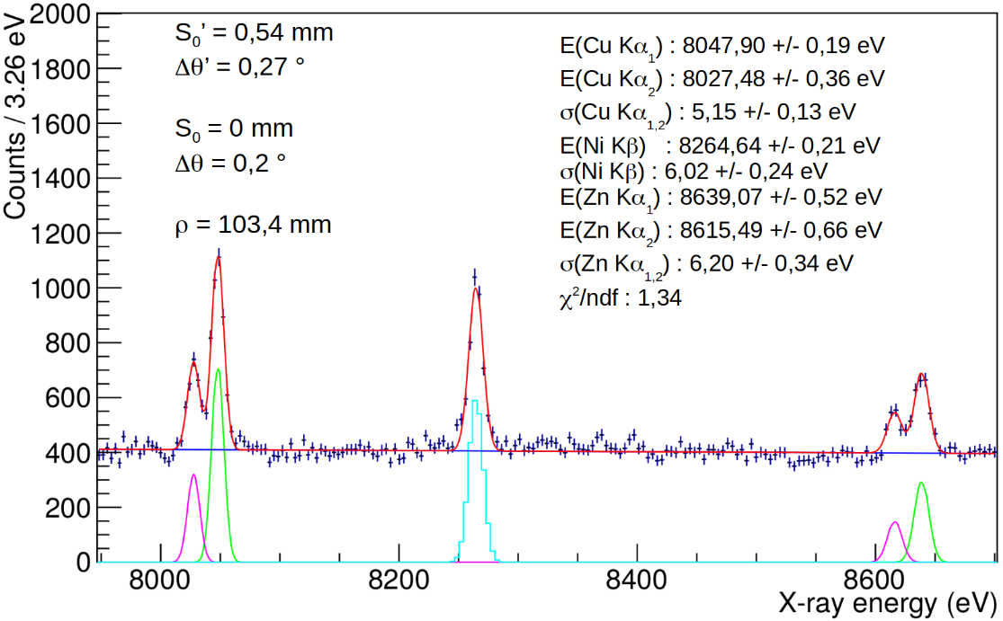
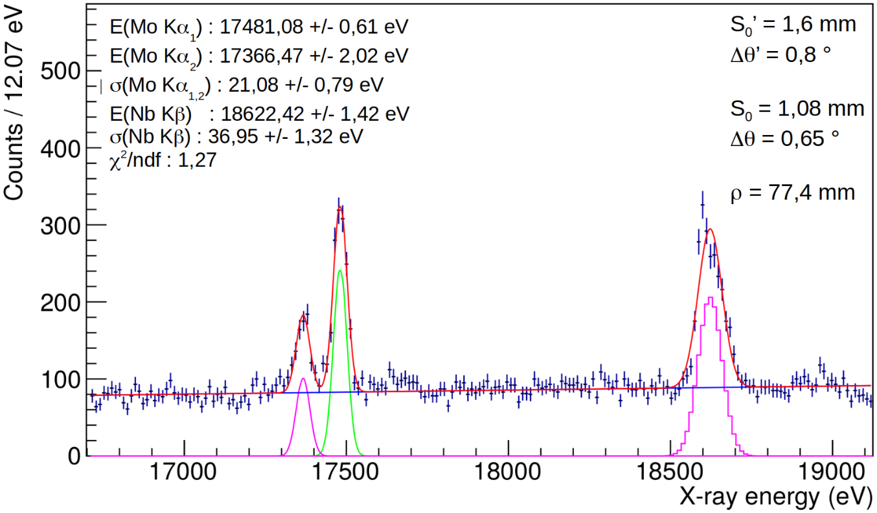
Crystal spectrometers: VOXES
High precision measurements with VOXES in LNF Lab
Possible feasibility test to be done in parallel with SIDDHARTA-2
Main goal: assess background and on beam behaviour of crystals and strip detector
“ Quinto Incontro Nazionale di Fisica Nucleare INFN 2022", A. Scordo, Laboratori Nazionali del Gran Sasso 10/05/2022

Slide 10
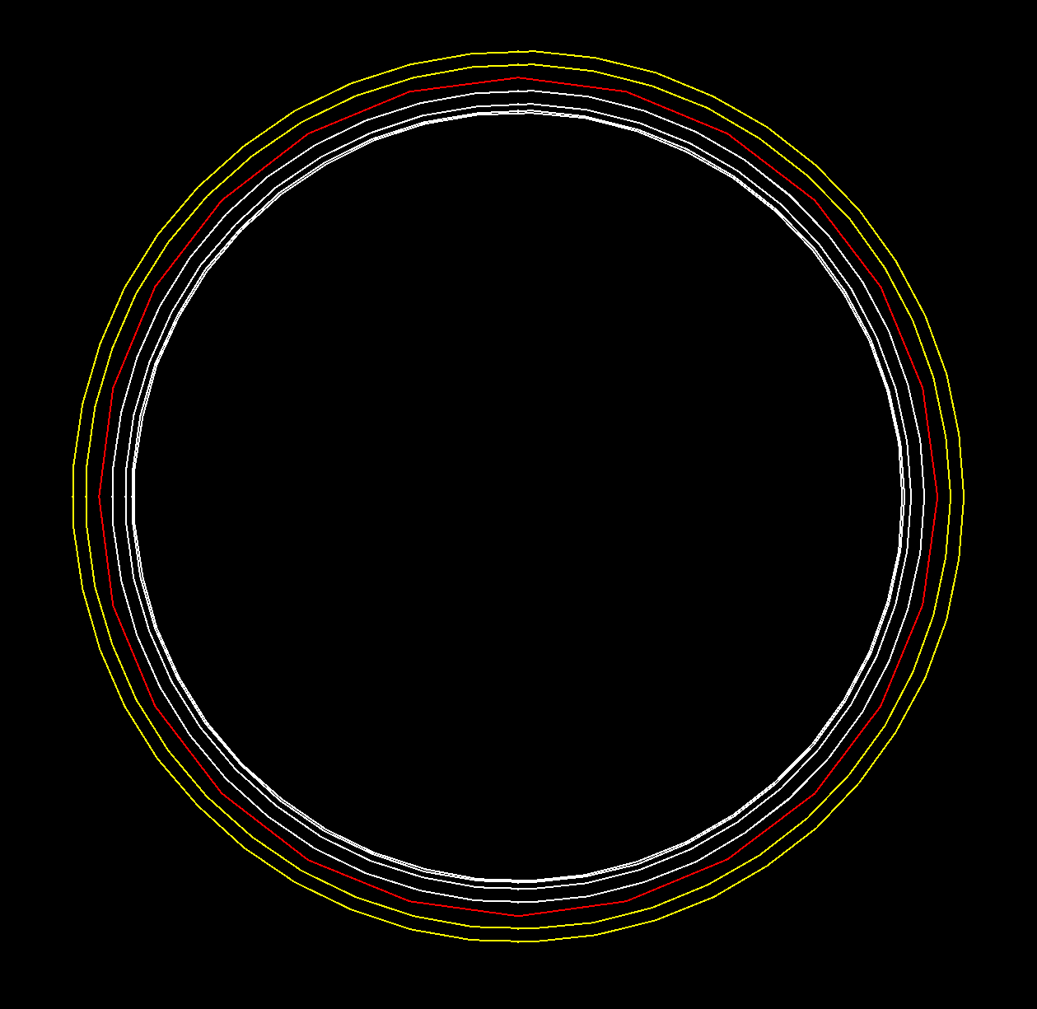
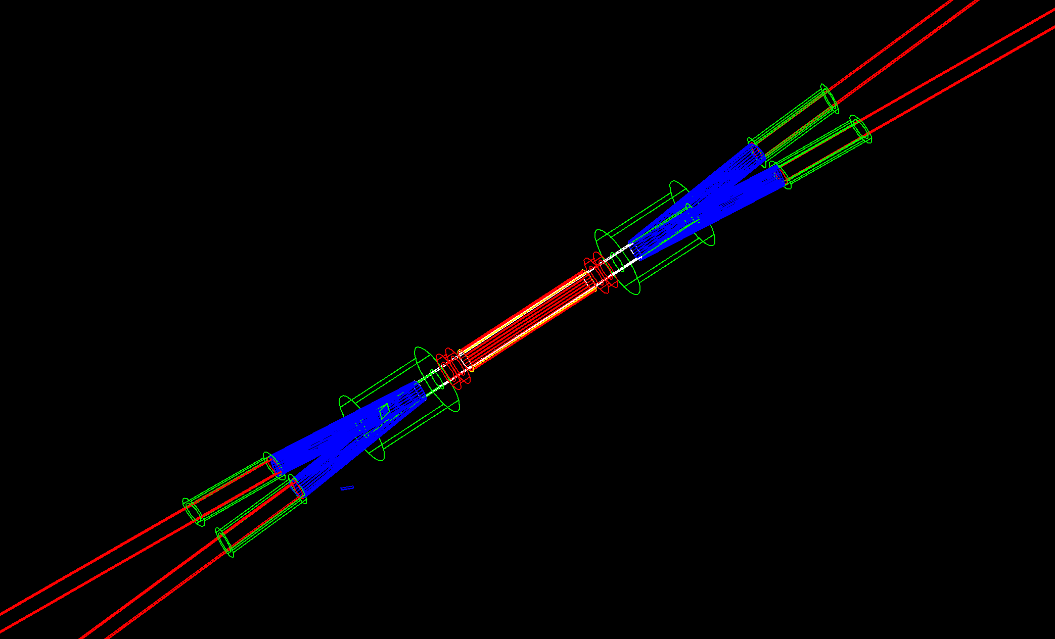
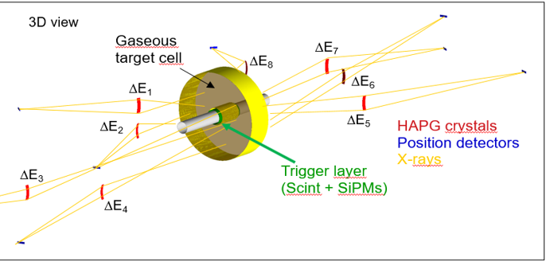
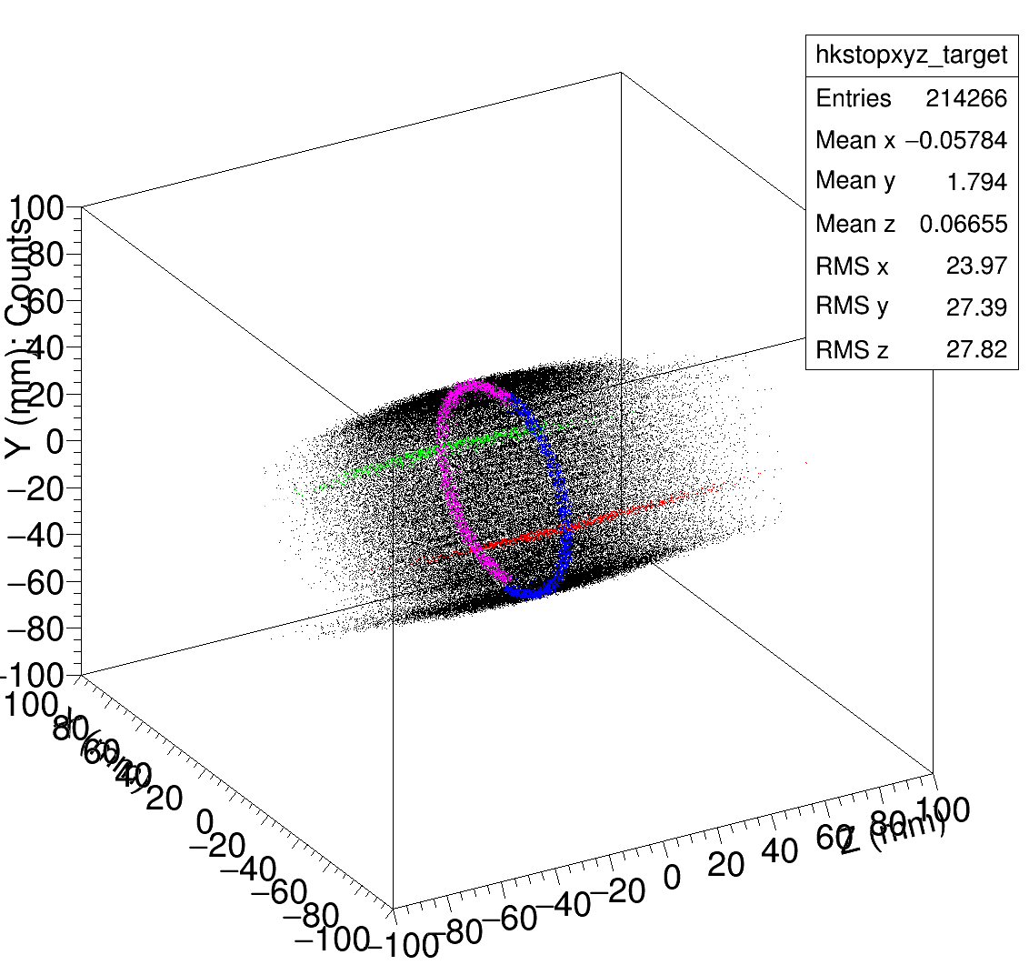
VOXES: possible scenarios on DAΦNE
Solid targets
Degrader
(mylar)
Trigger
(Scint + SiPMs / PMTs)
Target (solid)
Gaseous targets
“ Quinto Incontro Nazionale di Fisica Nucleare INFN 2022", A. Scordo, Laboratori Nazionali del Gran Sasso 10/05/2022

Slide 11
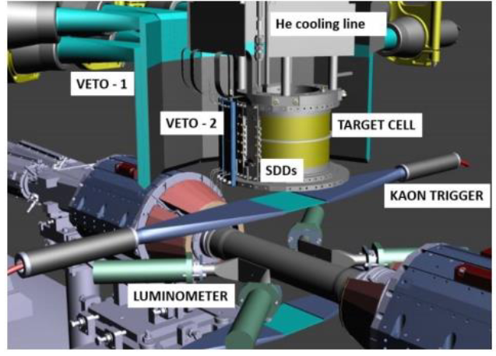
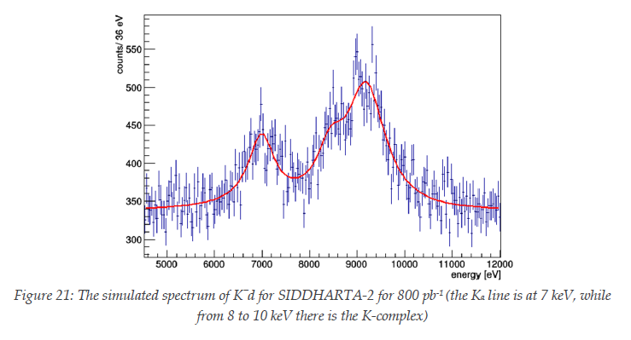
SDDs: present and future at DAΦNE
Assumptions
signal: shift - 800 eV
width 750 eV
density: 5% (LHD)
detector area: 246 cm²
Kα yield: 0.1 %
yield ratio as in K⁻p
SIDDHARTA-2 is now running with 450 μm thick SDDs
Expected:
Δε(1s) = 30 eV
ΔΓ(1s) = 70 eV
Previous talk
F. Sgaramella
“ Quinto Incontro Nazionale di Fisica Nucleare INFN 2022", A. Scordo, Laboratori Nazionali del Gran Sasso 10/05/2022

Slide 12
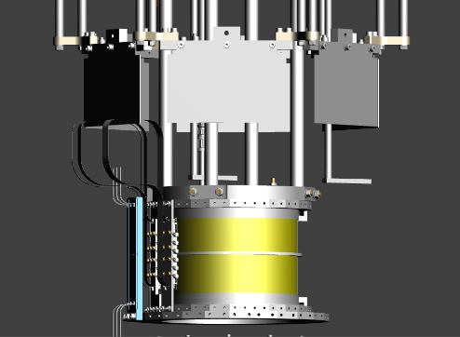
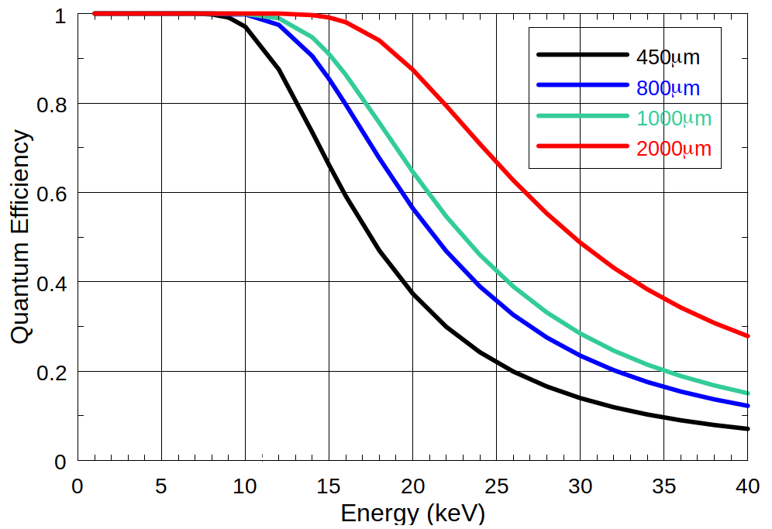
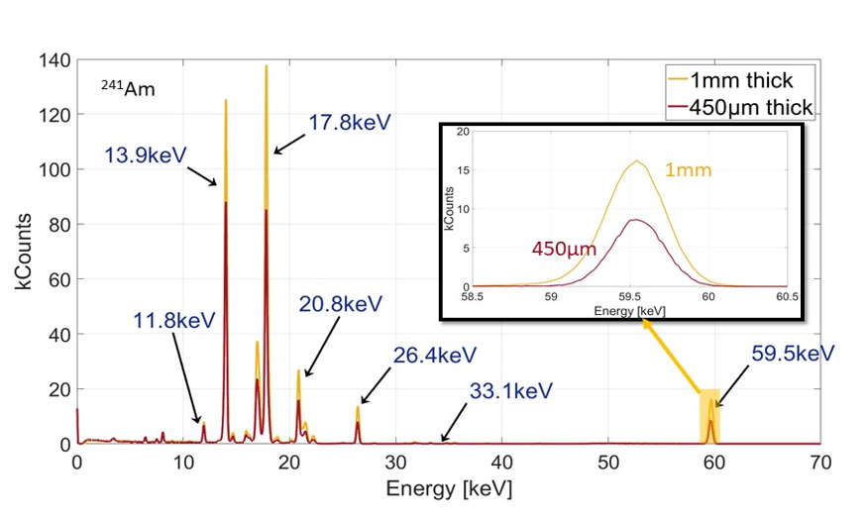
SDD: present and future at DAΦNE
Kaonic Helium transitions on 1s level would be accessible (very difficult):
K³He(2→1) : 33 keV
K⁴He(2→1) : 35 keV
SIDDHARTA-2 – like setup with 1-2 mm thick SDDs
Feasibility:
1-2 mm SDDs already financed by INFN CSN3
Electronics is similar to SIDDHARTA-2 SDDs
800μm and 1mm SDDs prototypes already produced by FBK for ARDESIA (INFN)
“ Quinto Incontro Nazionale di Fisica Nucleare INFN 2022", A. Scordo, Laboratori Nazionali del Gran Sasso 10/05/2022

Slide 13
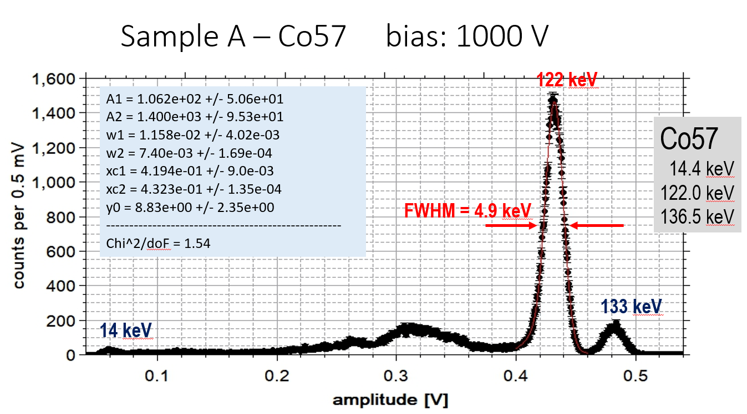
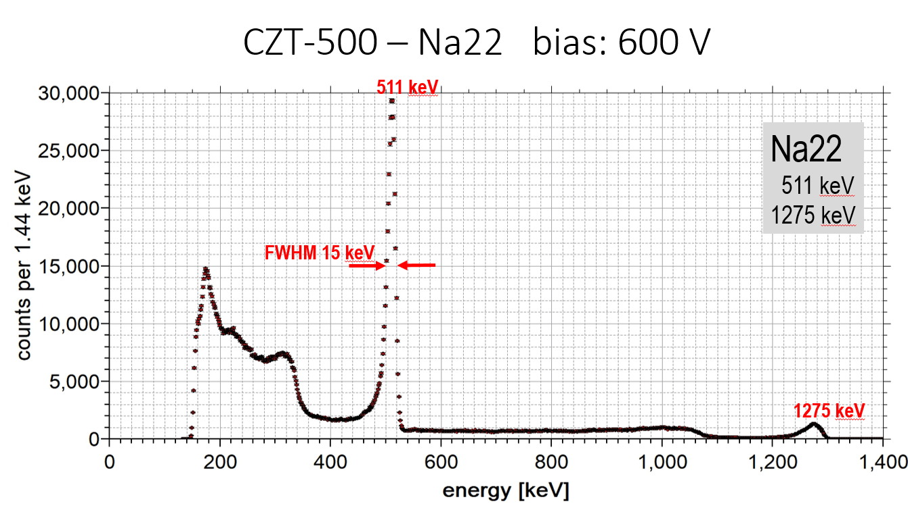
CZT: proposal for new measurements at DAΦNE
Detector Key Points:
High efficiency in the 20-100 keV region
Reasonable efficiencies up to 300 keV
Good resolution (FHWM/E ∼ %)
Fast response and time resolution (< 50 ns)
Precisions < 10 eV (ε) and <20 eV (Γ) are reachable in few months
First prototypes of Cd(Zn)Te delivered by JRA8-ASTRA (STRONG-2020) and tested
“ Quinto Incontro Nazionale di Fisica Nucleare INFN 2022", A. Scordo, Laboratori Nazionali del Gran Sasso 10/05/2022

Slide 14
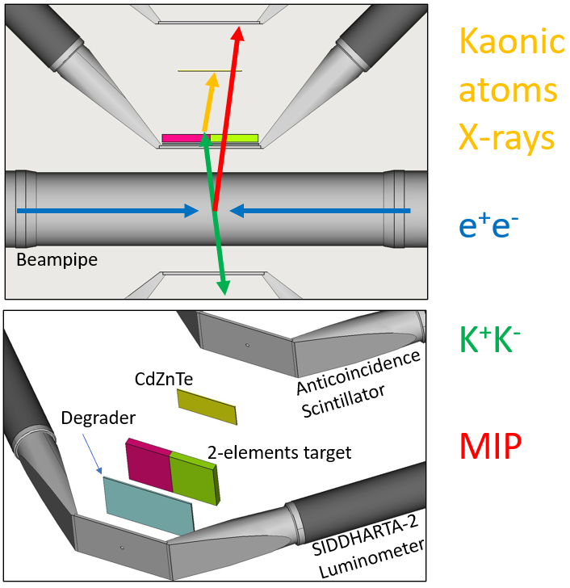
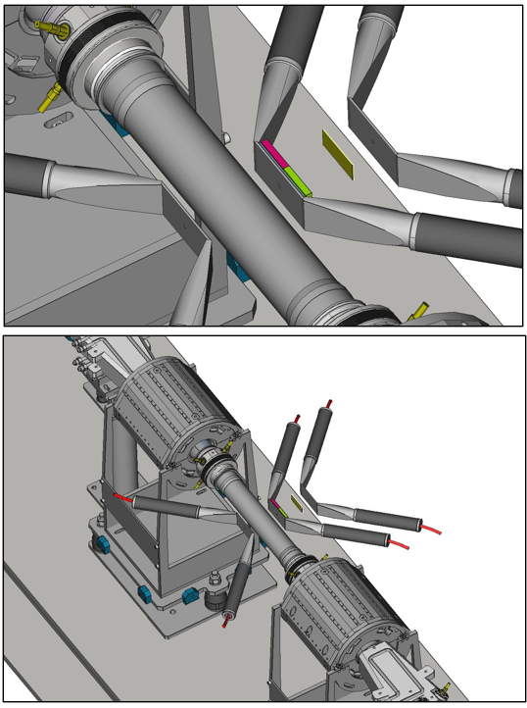
CZT: proposal for new measurements at DAΦNE
“ Quinto Incontro Nazionale di Fisica Nucleare INFN 2022", A. Scordo, Laboratori Nazionali del Gran Sasso 10/05/2022

Slide 15

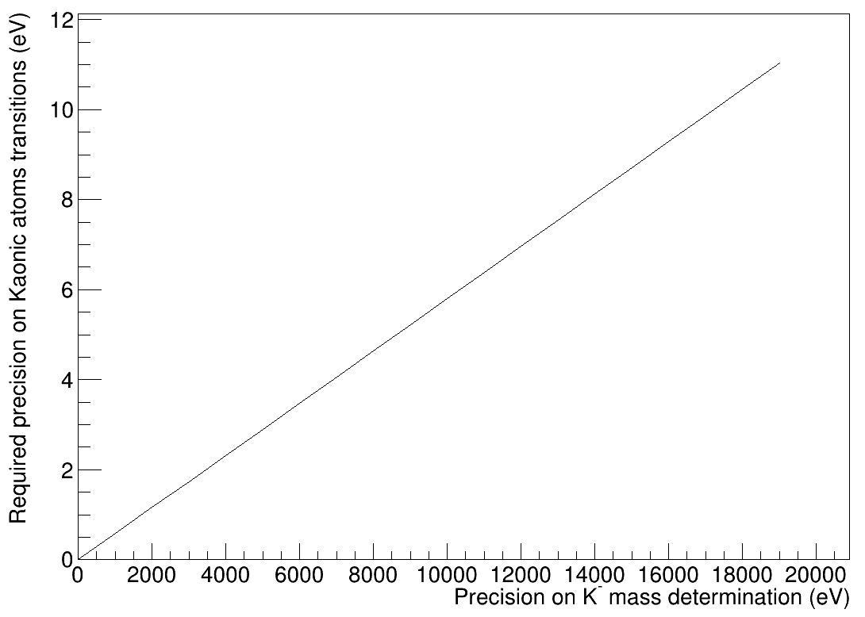
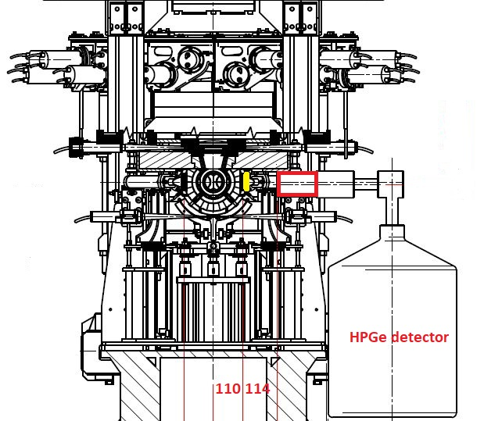
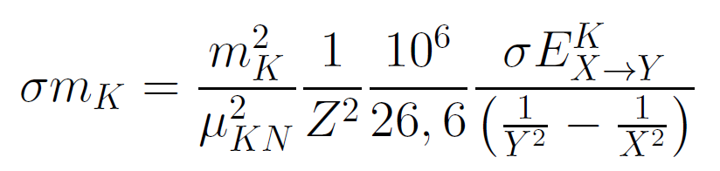
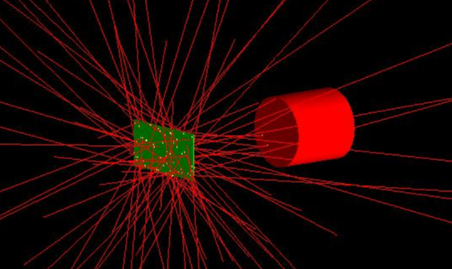
New Kaon Mass measurement with HPGe
Parallel run with SIDDHARTA-2: (already installed)
δE ~ 3 eV needed for δm_{K} = 5 keV
KPb(9→8) : 290 keV
Resolutions (FWHM)
obtained with ⁶⁰Co, ¹³³Ba sources :
0.870 keV @ 81 keV
1.106 keV @ 302.9 keV
1.143 keV @ 356 keV
1.167 keV @ 1330 keV
Pb target just behind
the SIDDHARTA-2 luminometer,
which is used as trigger
HPGe detector available,
Croatian Science Foundation project 8570
“Giornata di discussione sulle prospettive per la Fisica Fondamentale a Frascati (FFF)” , A. Scordo, Frascati (LNF), 13/01/2021

Slide 16
CONCLUSIONS
Kaonic atoms measurements are still strongly demanded in the nuclear physics (and not only) community
DAΦNE is a unique facility in the world to perform such kind of measurements
There is a plethora of fundamental kaonic atoms transition lines to be measured, with different detectors and techniques
Many measurements and tests can be carried on in parallel with SIDDHARTA-2
New experiments with new setups can be proposed (some already have)
Joint efforts between thereticians (ask, calculate, support, approve, endorse) and experimentalists (build strong teams and improve know-how) is crucial
“ Quinto Incontro Nazionale di Fisica Nucleare INFN 2022", A. Scordo, Laboratori Nazionali del Gran Sasso 10/05/2022

