Slide 1
The Search for Electric Dipole Moments of Charged Particles Using Storage Ring G. Tagliente on behalf of JEDI collaboration

Slide 2
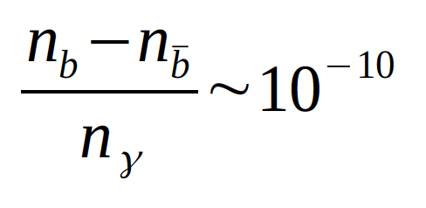
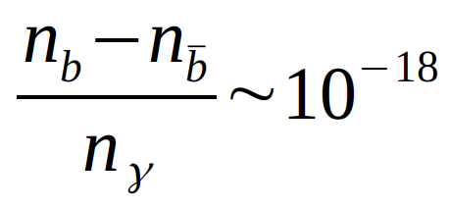
Matter-Antimatter Assimetry
Why current universe is mater dominated?
Big Bang produced the same amount of matter – antimatter
Comparing the experiment: (V. Barger et al., Phys- Lett. B566, 8(2003))
expectation from SCM : (W. Bernreuther, Lect. Notes Phys 591,237 (2002))
Preponderance of matter over antimatter
C, CP violation
There is CP violation in SM, but not of sufficient magnitude. EDM

Slide 3
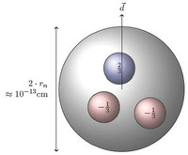
Electric Dipole Moment
The Electric Dipole Moment (EDM) of a particle is determined by the separation of positive and negative charge distributions within the particle itself
The water molecule can have an electric dipole moment because it doesn’t violate any fundamental symmetry of nature.
Fundamental particle has a well defined parity state and cannot have an electric dipole moment because it would violate one of the nature fundamental symmetries: parity. This symmetry is conserved by three of the nature fundamental interactions.

Slide 4
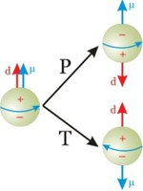
EDM of fundamental particle
EDM violates both T, P symmetries
EDM violates CP symmetry (if CPT conserved)
EDM is a probe for CP violation beyond the SM

Slide 5
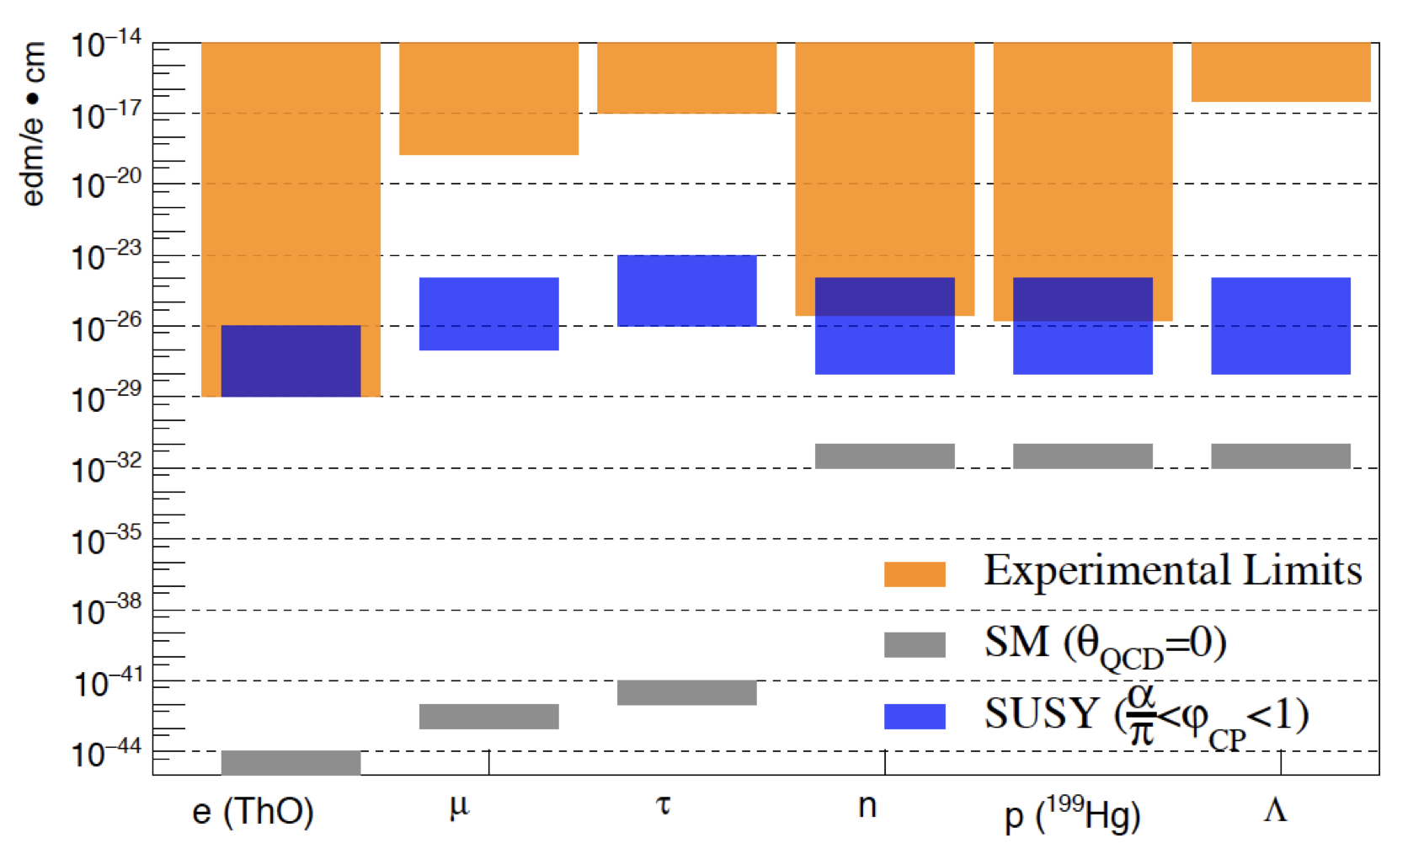
Static EDM: Current upper limits

Slide 6
Static EDM: Measurements
Paramagnetic Atoms
Diamagnetic Atoms
Bare Nucleons

Slide 7
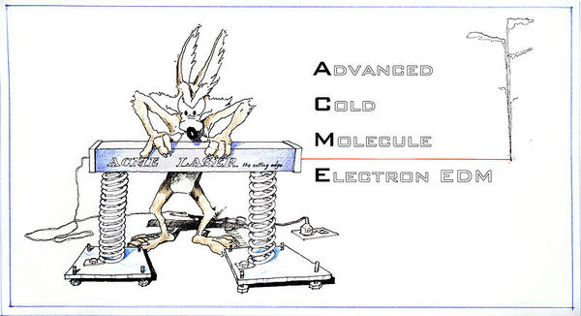
Static EDM: Paramagnetic Atoms
Upper bound on the electric dipole moment of the electron
|d_{e}| < 1.1 × 10⁻²⁹ e cm
90% confidence level.
https://projects.iq.harvard.edu/jdoyle/tho-electron-edm

Slide 8
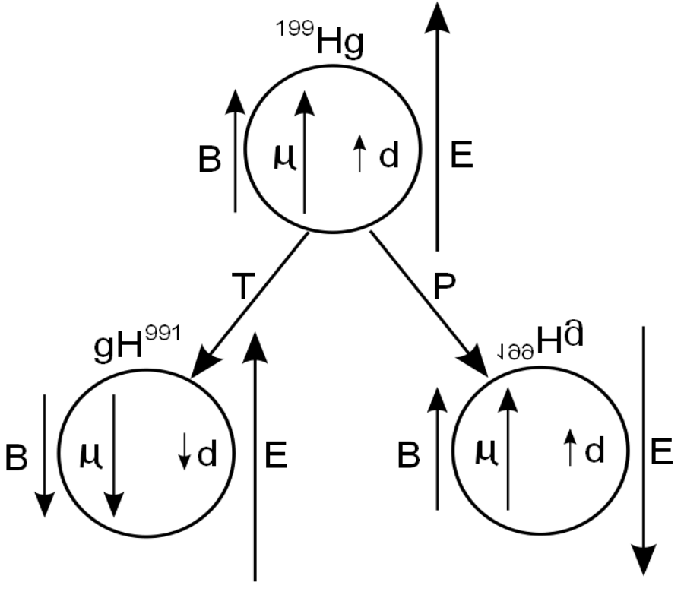
Static EDM: Diamagnetic Atoms
https://indico.frib.msu.edu/event/13/contributions/231/attachments/81/386/FRIB_2019_Jennie.pdf
|d_{Hg}| < 7.4 × 10⁻³⁰ ecm (95% C.L.).
Using nuclear and atomic theory this result implies a constraint on the nEDM and pEDM
|d_{n}| < 1.6×10⁻²⁶ ecm.
|d_{p}| < 2×10⁻²⁵ ecm.

Slide 9
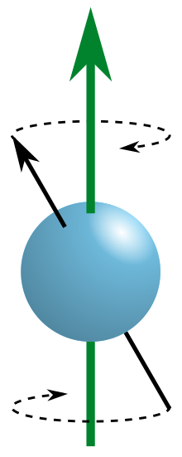
nEDM
The experimental technique used to determine the nEDM is to measures the Larmor procession frenquecy of the neutron spin in the presence of parallel and antiparallel magnetic and electric fields.
hν± = 2µ_{n}B ± 2d_{n}E

Slide 10
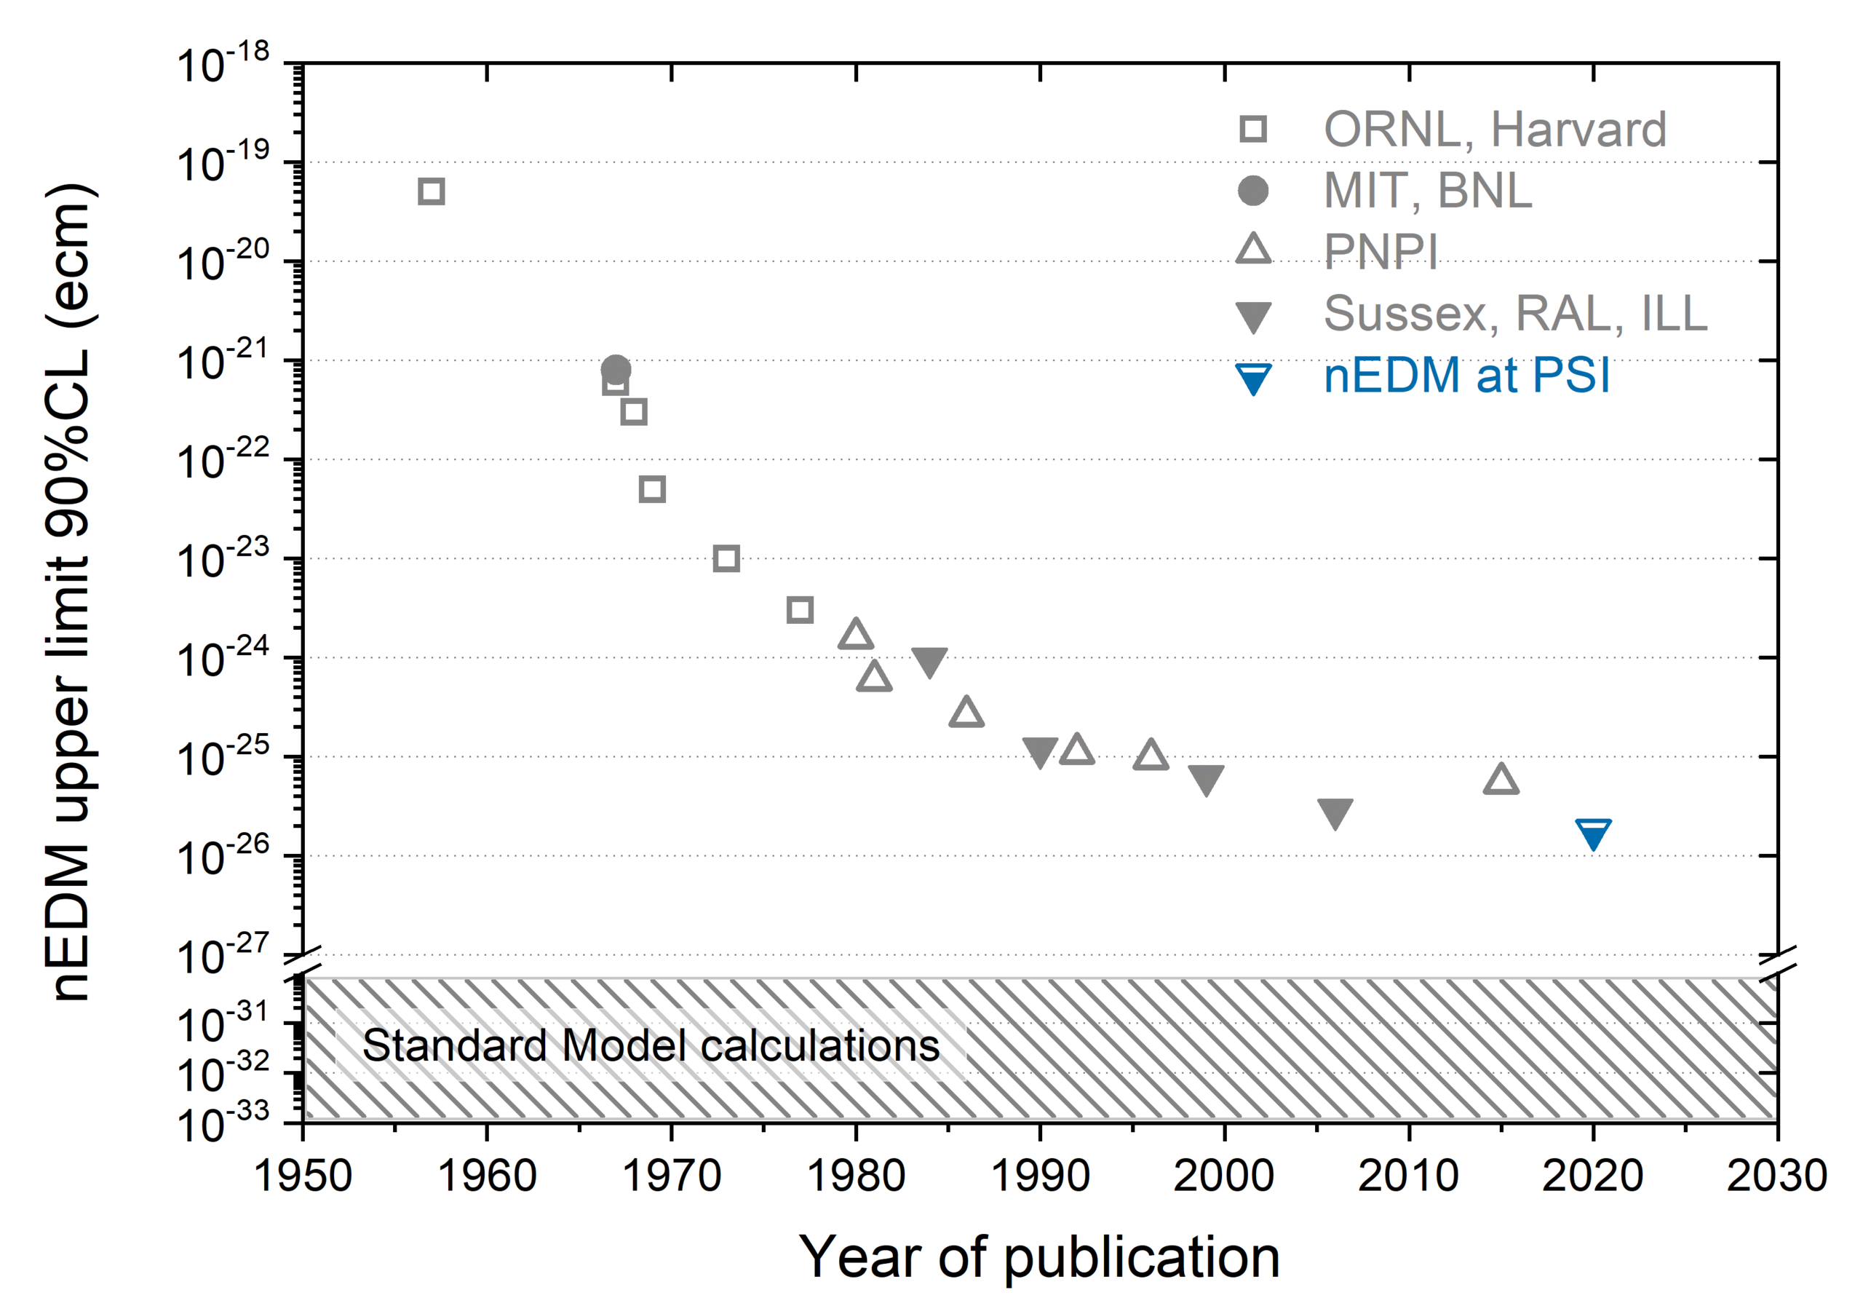
d_{n} ∼ 1 × 10⁻²⁶ ecm

Slide 11
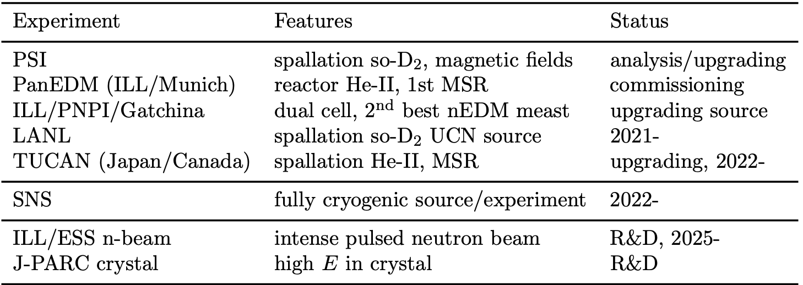
nEDM

Slide 12
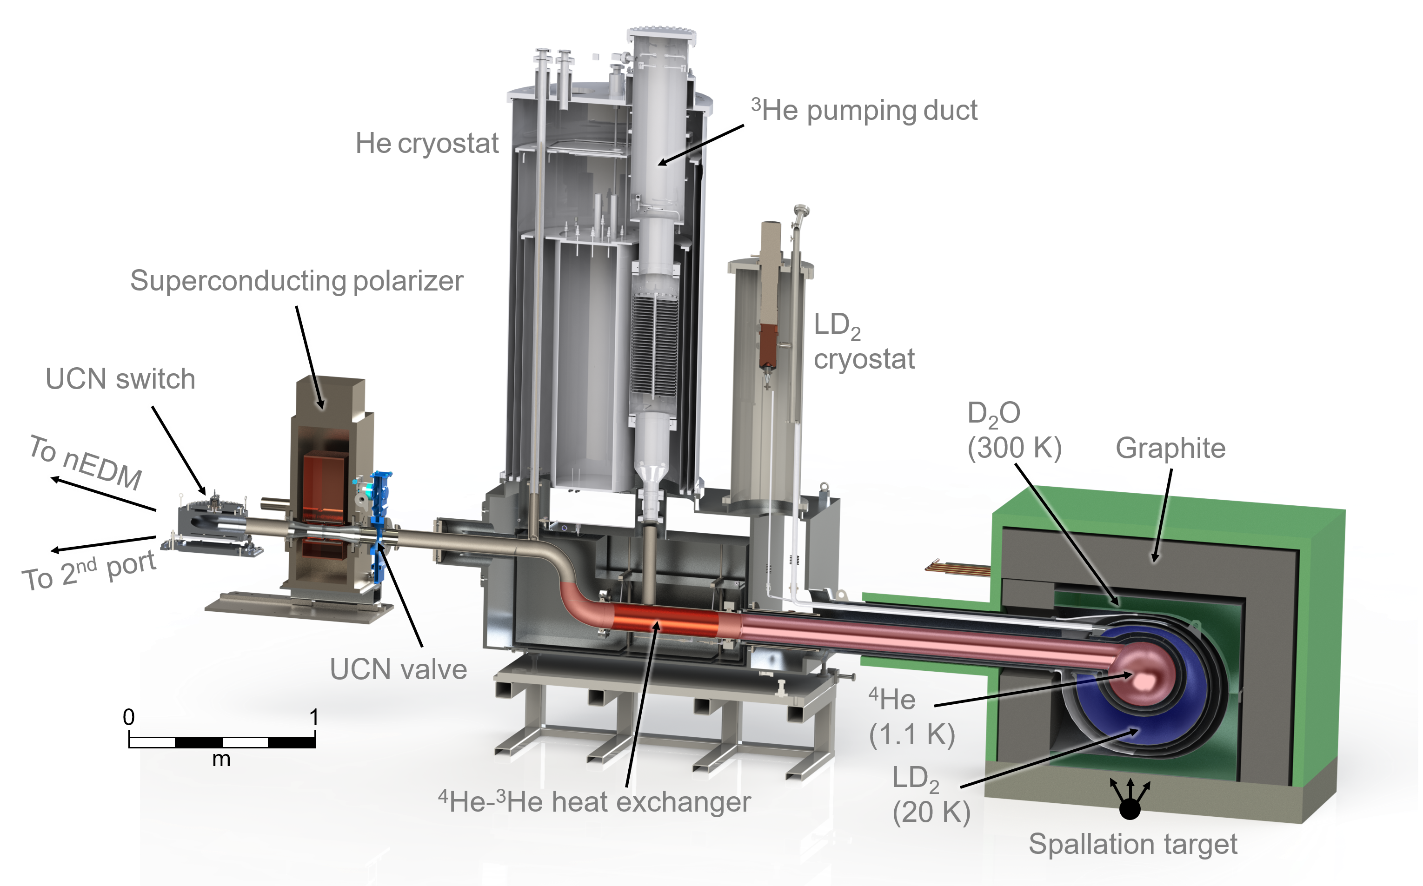
The most precise measurement to date used ultracold neutrons (UCN). UCN are valuable experimentally because they can be stored in material traps.
Actual limit d_{n} = 1 × 10⁻²⁶ ecm
Key experimental parameters in nEDM experiments are the number of neutrons sampled, the strength of the electric field that can be achieved, and the coherence time of the precessing neutron spins, which should all be maximized for the best sensitivity.
https://www.triumf.ca/node/39465

Slide 13
Charge Particle EDM – cpEDM
No direct measurement for charged hadron EDMs
Potentially hgher sensitivuty for charged hadrons (compared to neutrons):
longer lifetime
more stored polarazied protons/deuteron
possibility to apply larger electric fields in storage rings
EDM of single particle type not sufficient to identify CP violation

Slide 14
EDM AT STORAGE RINGS
$$\frac{d\vec{S}}{dt}=[{\vec{Ω}}_{MDM}−{\vec{Ω}}_{cycl}+{\vec{Ω}}_{EDM}]$$
THOMAS - BMT EQUATION:
$${\vec{Ω}}_{MDM}−{\vec{Ω}}_{cycl}=−\frac{q}{m}[G\vec{B}−(G−\frac{1}{γ^{2}−1})\frac{\vec{β}×\vec{E}}{c}$$
$${\vec{Ω}}_{EDM}=−\frac{ηq}{2mc}[\vec{E}+c\vec{β}×\vec{B}]$$
At storage rings: vertical B field, radial E field
Frozen spin case
$${\vec{Ω}}_{MDM}−{\vec{Ω}}_{cycl}=0$$
Momentum and spin in the absence of EDM would stay aligned.

Slide 15
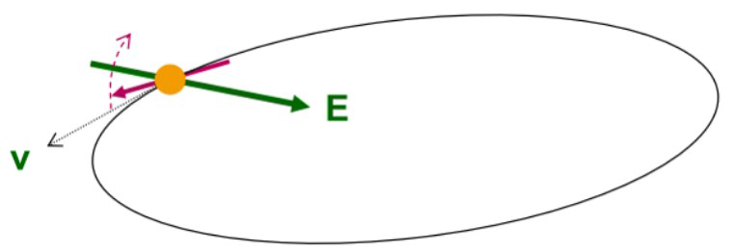
EDM AT STORAGE RINGS
In case of purely electric ring:
$${\vec{Ω}}_{MDM}−{\vec{Ω}}_{cycl}=−\frac{q}{m}[G\vec{B}−\left(G−\frac{1}{γ^{2}−1}\right)\frac{\vec{β}×\vec{E}}{c}]$$
X
X
$${\vec{Ω}}_{EDM}=−\frac{ηq}{2mc}[\vec{E}+c\vec{β}×\vec{B}]$$
$$\left(G−\frac{1}{γ^{2}−1}\right)=0$$
Frozen spin case
works only for G > 0, e.g. proton

Slide 16
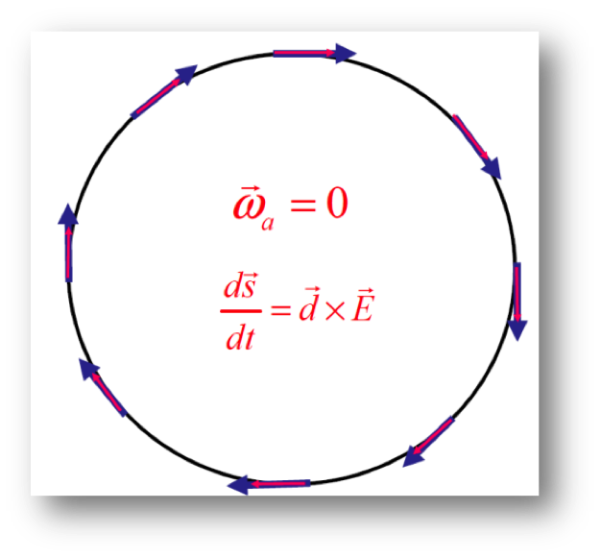
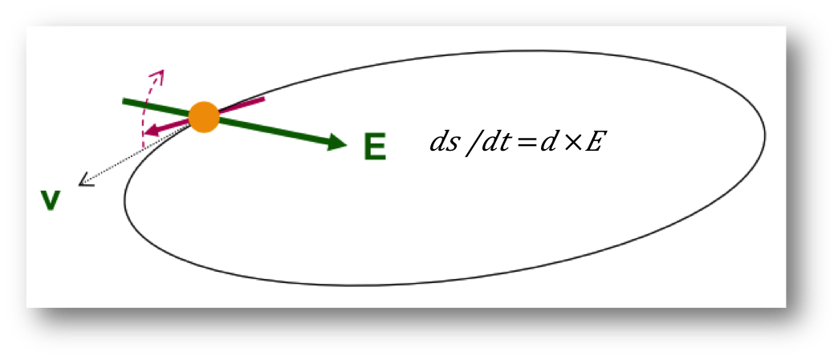
EDM AT STORAGE RINGS
Measurement concept
Inject particles in storage ring
Align spin along momentum (-> freeze horiz. Spin procession)
Search for time develepment of vertical polarization
Frozen-spin condition:
For pure E ring for p
Combined E/B ring: special combination of E, B fields and γ for d and ³He

Slide 17
cpEDM: Strategy

Slide 18
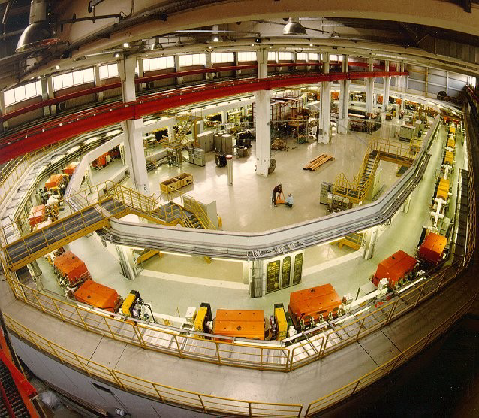
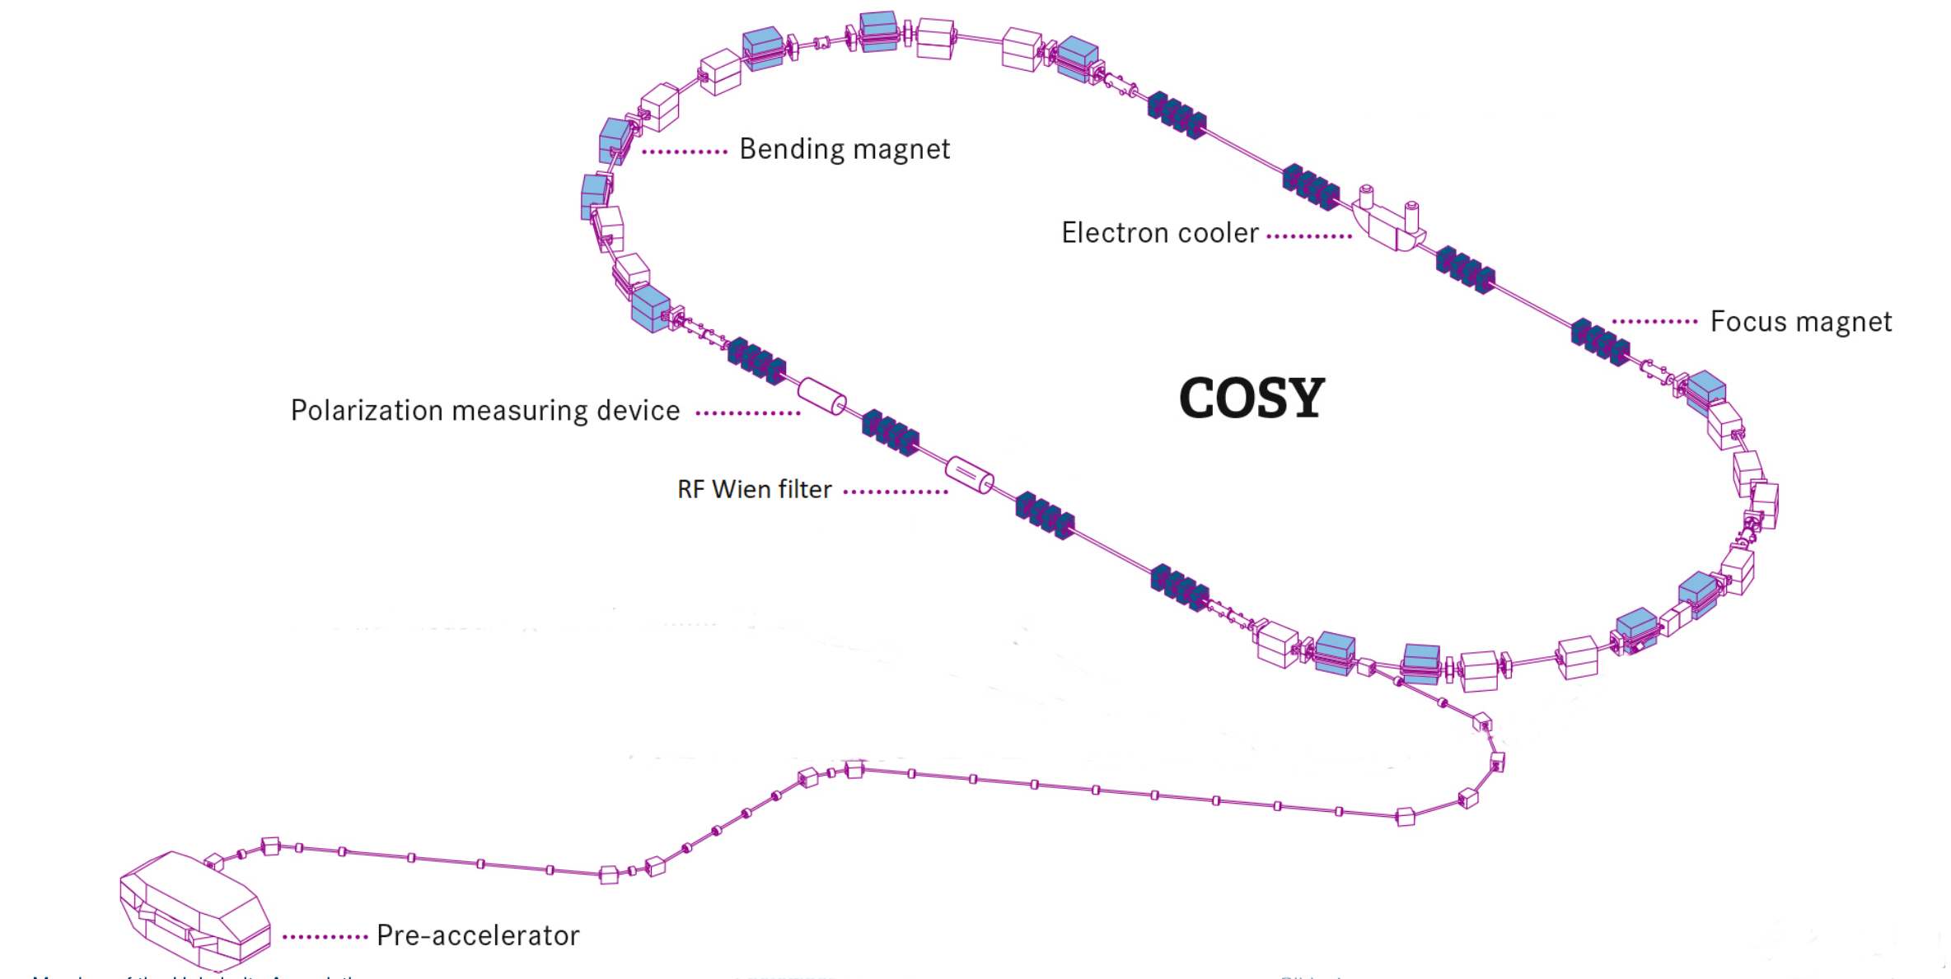
Precursor Experiment at COSY
COSY (Jülich, Germany)
● magnetic storage ring
● polarized protons and deuterons
● Momenta p = 0.3 – 3.7 GeV/c

Slide 19
EDM AT MAGNETIC RING
In case of purely magnetic ring:
$${\vec{Ω}}_{MDM}−{\vec{Ω}}_{cycl}=−\frac{q}{m}[G\vec{B}−\left(G−\frac{1}{γ^{2}−1}\right)\frac{\vec{β}×\vec{E}}{c}]$$
X
$${\vec{Ω}}_{EDM}=−\frac{ηq}{2mc}[\vec{E}+c\vec{β}×\vec{B}]$$
X
At storage rings: vertical B field, radial E field
MDM causes fast spin precession in horizontal plane
$$c\vec{β}×\vec{B}$$
In pure magnetic ring motional electric field term
access to EDM

Slide 20
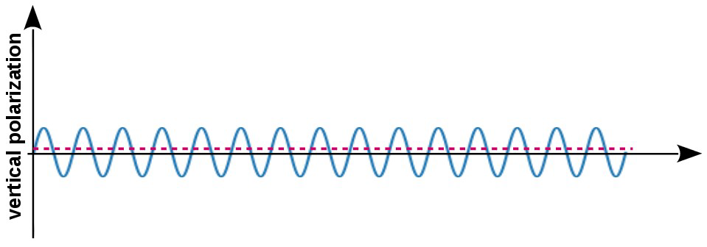
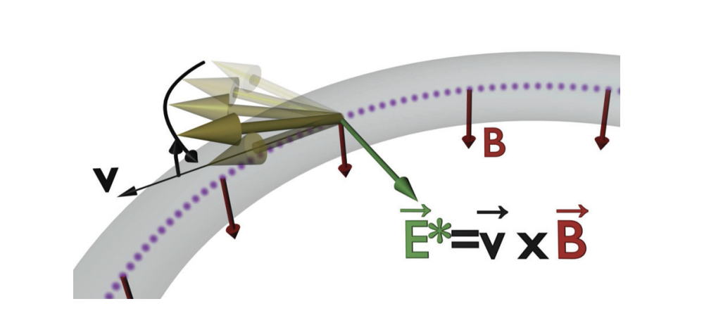
EDM AT MAGNETIC RING
tiny oscillations of vertical polarization
In the magnetic ring
momentum ↑↑ spin spin kicked up
momentum ↑↓ spin spin kicked down
no accumulation of vertical asymmetry
A radiofrequency system synchronized with the spin precession frequency, restores the parallelism between spin and momentum

Slide 21
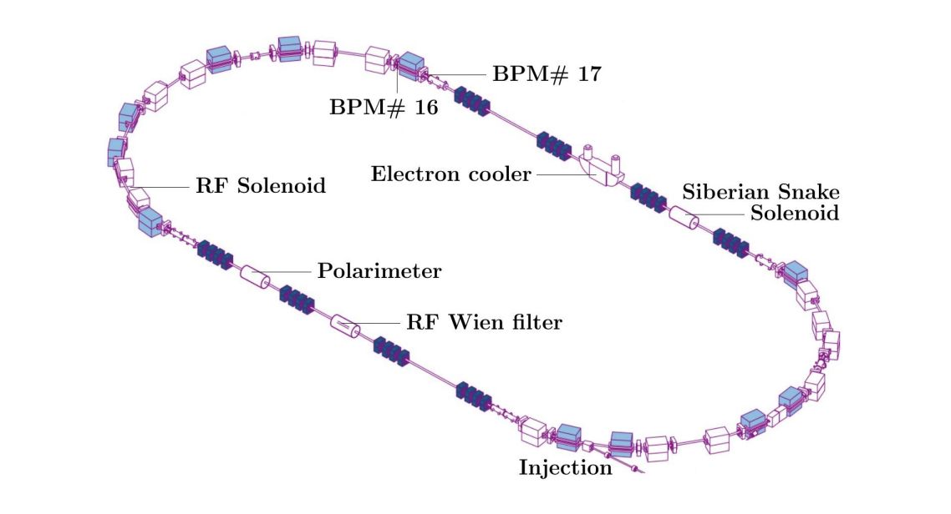
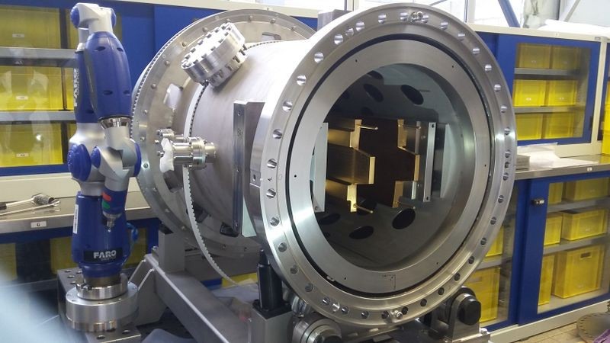
RF WIEN FILTER
● Lorentz force ${\vec{F}}_{L}=q\left(\vec{E}+\vec{v}×\vec{B}\right)=0$
● $\vec{B}=\left(0,B_{y},0\right) and \vec{E}=(E_{x},0,0)$

Slide 22
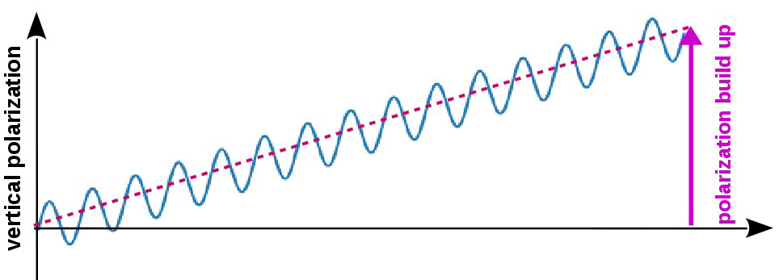
EDM AT MAGNETIC RING
tiny oscillations of vertical polarization
In the magnetic ring
momentum ↑↑ spin spin kicked up
momentum ↑↓ spin spin kicked down
no accumulation of vertical asymmetry
phase lock between spin
precession and RF Wien filter

Slide 23
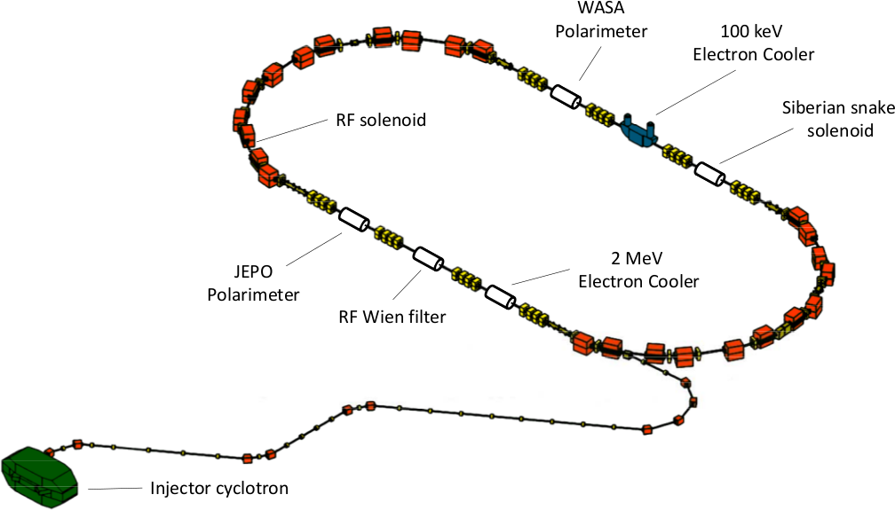
Precursor Experiment at COSY
COSY circumference
deuteron momentum
β(γ)
magnetic anomaly G
revolution frequency f_{rev}
cycle length
nb. of stored particles/cycle
183m
0.970 GeV/c
0.459 (1.126)
-0.143
752543 Hz
100-1500 s
10⁹

Slide 24
Precursor Experiment at COSY
The precursor experiment requires several additional prerequisites:
a long spin-coherence time
precise monitoring of the fs = 120 kHz precession in the horizontal plane
a feedback system controlling the relative phase of the polarization vector and the RF Wien filters fields
a good understanding of the effects other than EDM that may lead to a tilt of the invariant spin axis

Slide 25
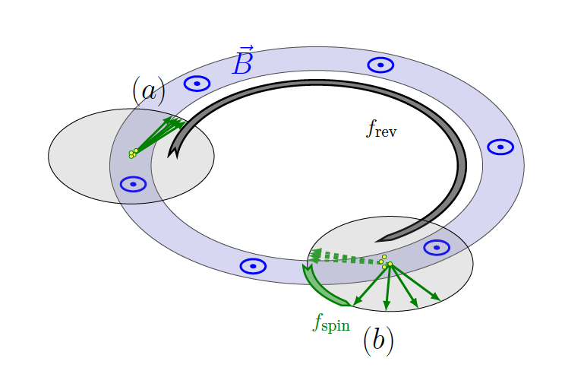
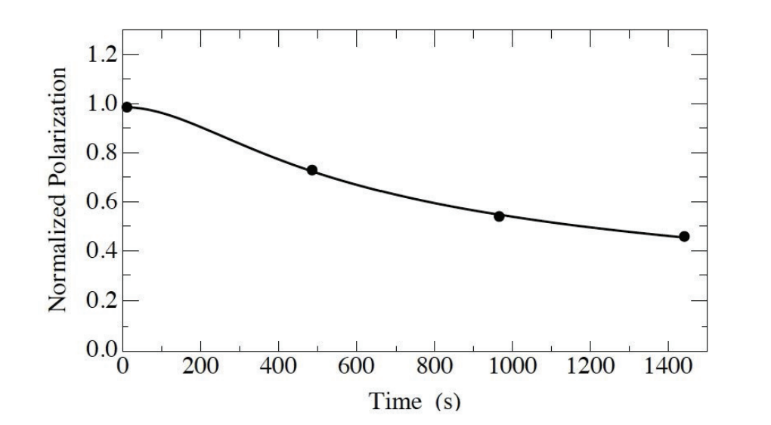
Spin-coherence time
One of the longest polarization lifetimes recorded for the COSY ring.
The half-life of the polarization is 1173 ± 172 s, which is three orders of magnitude longer than previous results using electron beams.

Slide 26
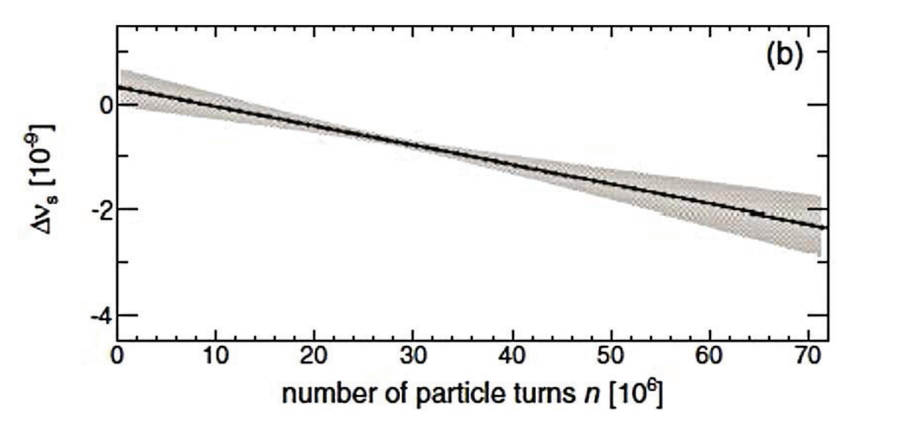
Measurement of the spin-tune
It was possible to unfold for the first time the rapid rotation of the polarization in the ring plane (≈ 120 kHz) arising from the gyromagnetic anomaly. The spin tune (i.e. the number of spin precessions per turn) has been measured with a precision better than 10⁻¹⁰ in a cycle of 10 seconds
It represents the most precise measurement ever performed in a storage ring

Slide 27
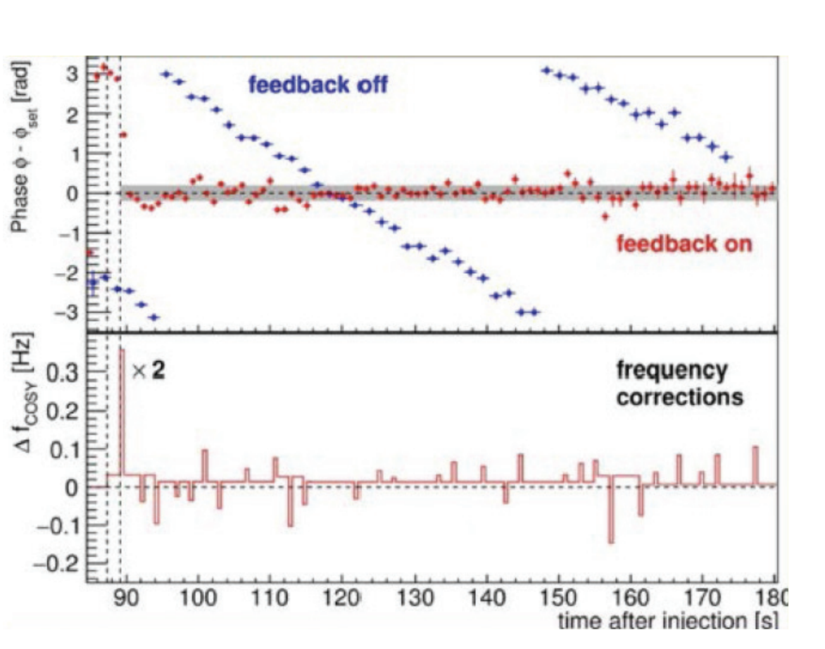
Phase-locking the spin precession
Phase-locking is necessary, making sure that phase between the spin precession and the device RF is maintained throughout the measurement. To this end, a feedback system has been developed that stabilizes the phase of the spin precession relative to the phase of an RF devices, providing a so-called phase-lock.

Slide 28
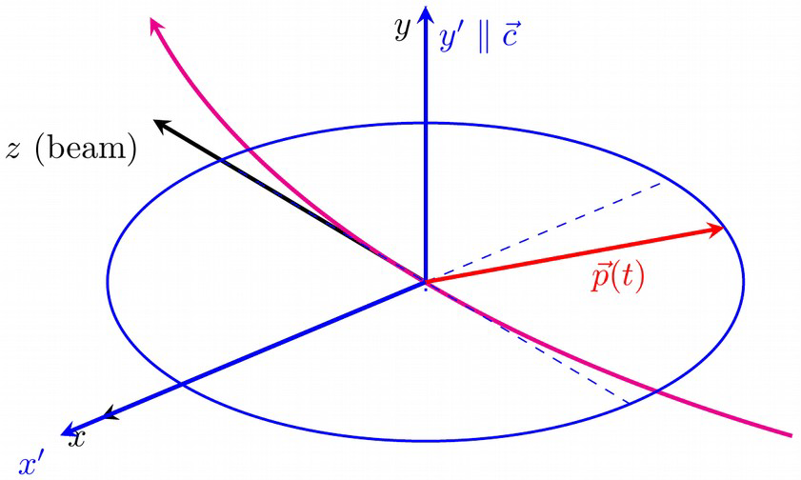
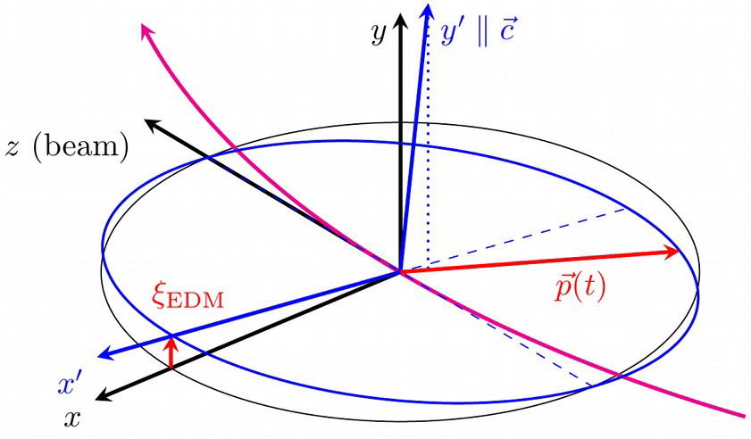
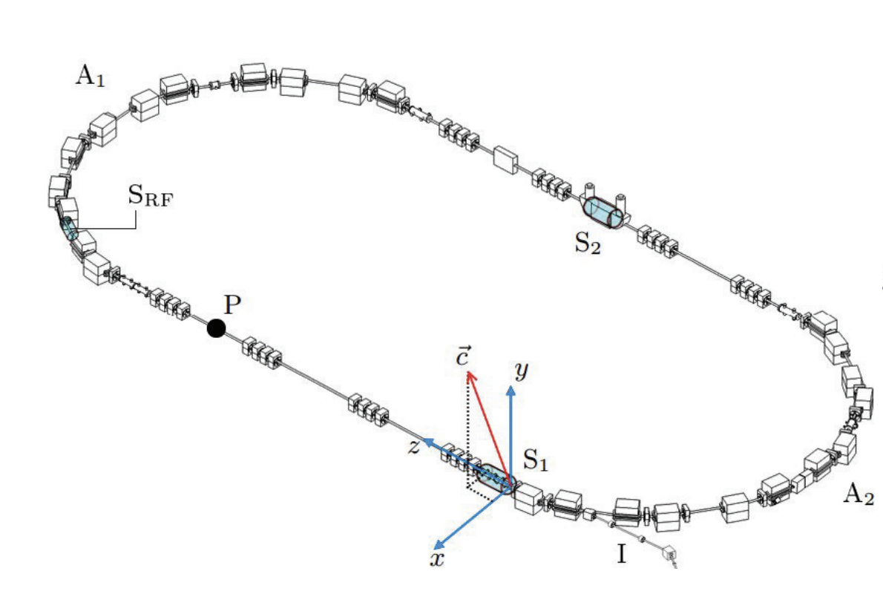
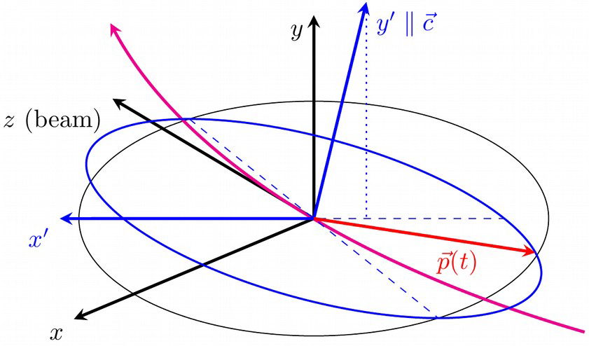
Spin-tune mapping
JEDI developed a new method to investigate magnetic machine imperfections based on the highly accurate determination of the spin-tune
EDM absence case
EDM effect
Magnetic misalignment effect

Slide 29
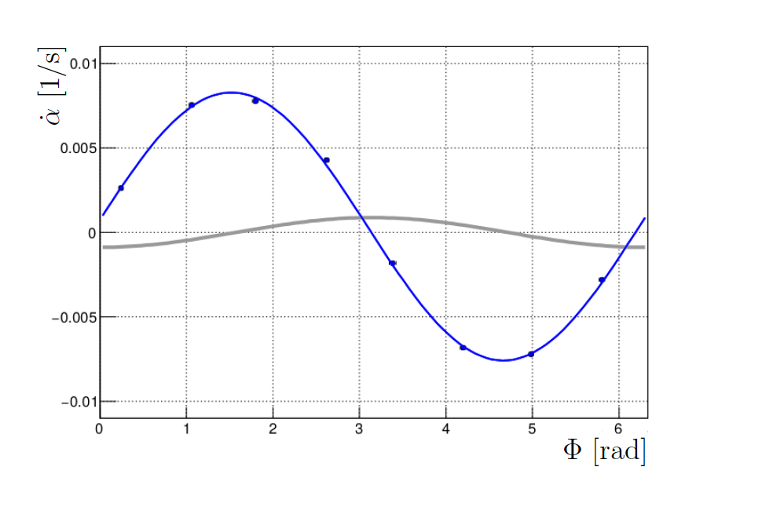
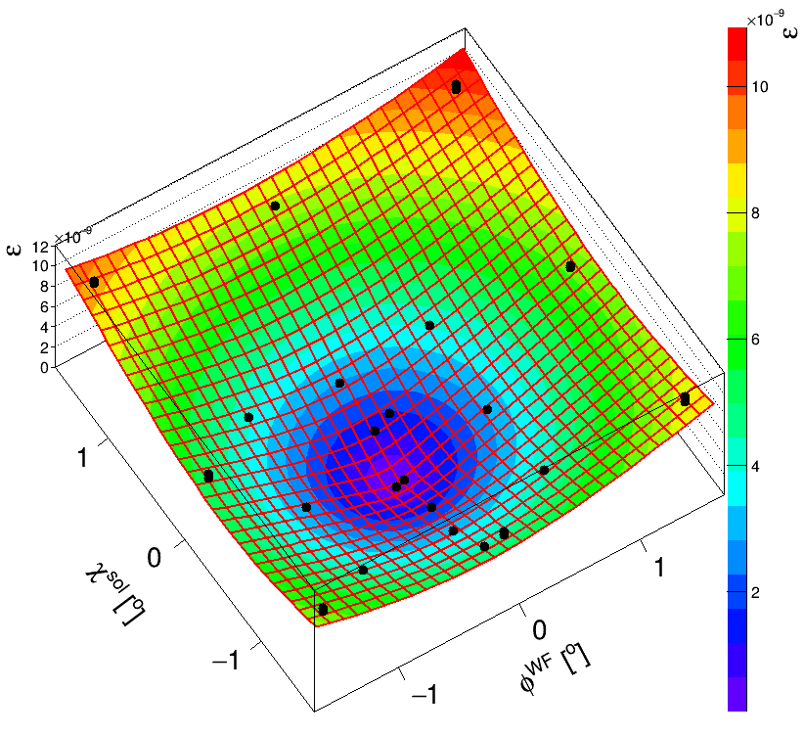
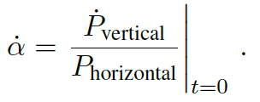
First Results
$$Φ_{0}^{WF}=−3.80 ±0.05 mrad$$
$$Χ_{0}^{SOL}=−5.51 ±0.05 mrad$$

Slide 30
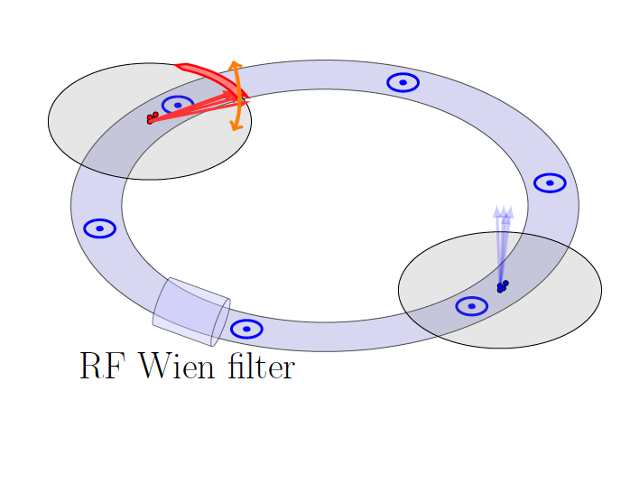
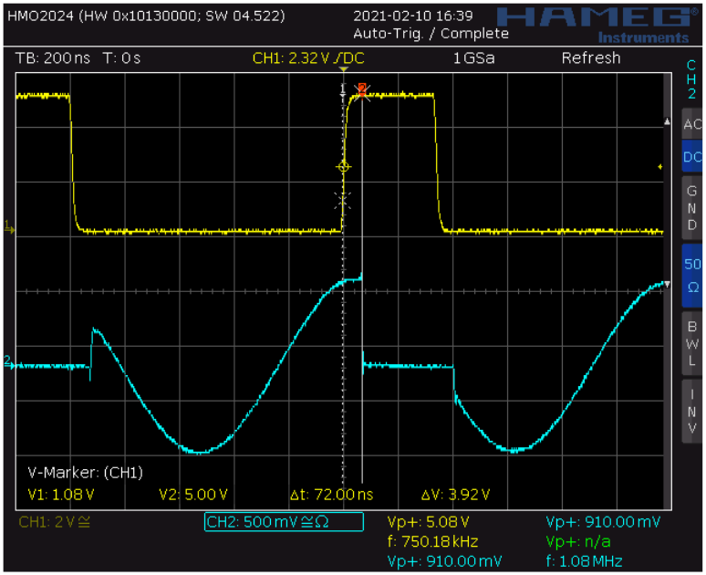
First Results
Pilot bunch method:
● 8 high-speed RF switchers to gate the WF power for one of two bunches
● Capable of short switch time ~ few ns
● Bunch 2 feels the power and oscillate
● Bunch 1 is used as pilot bunch for phase locking

Slide 31
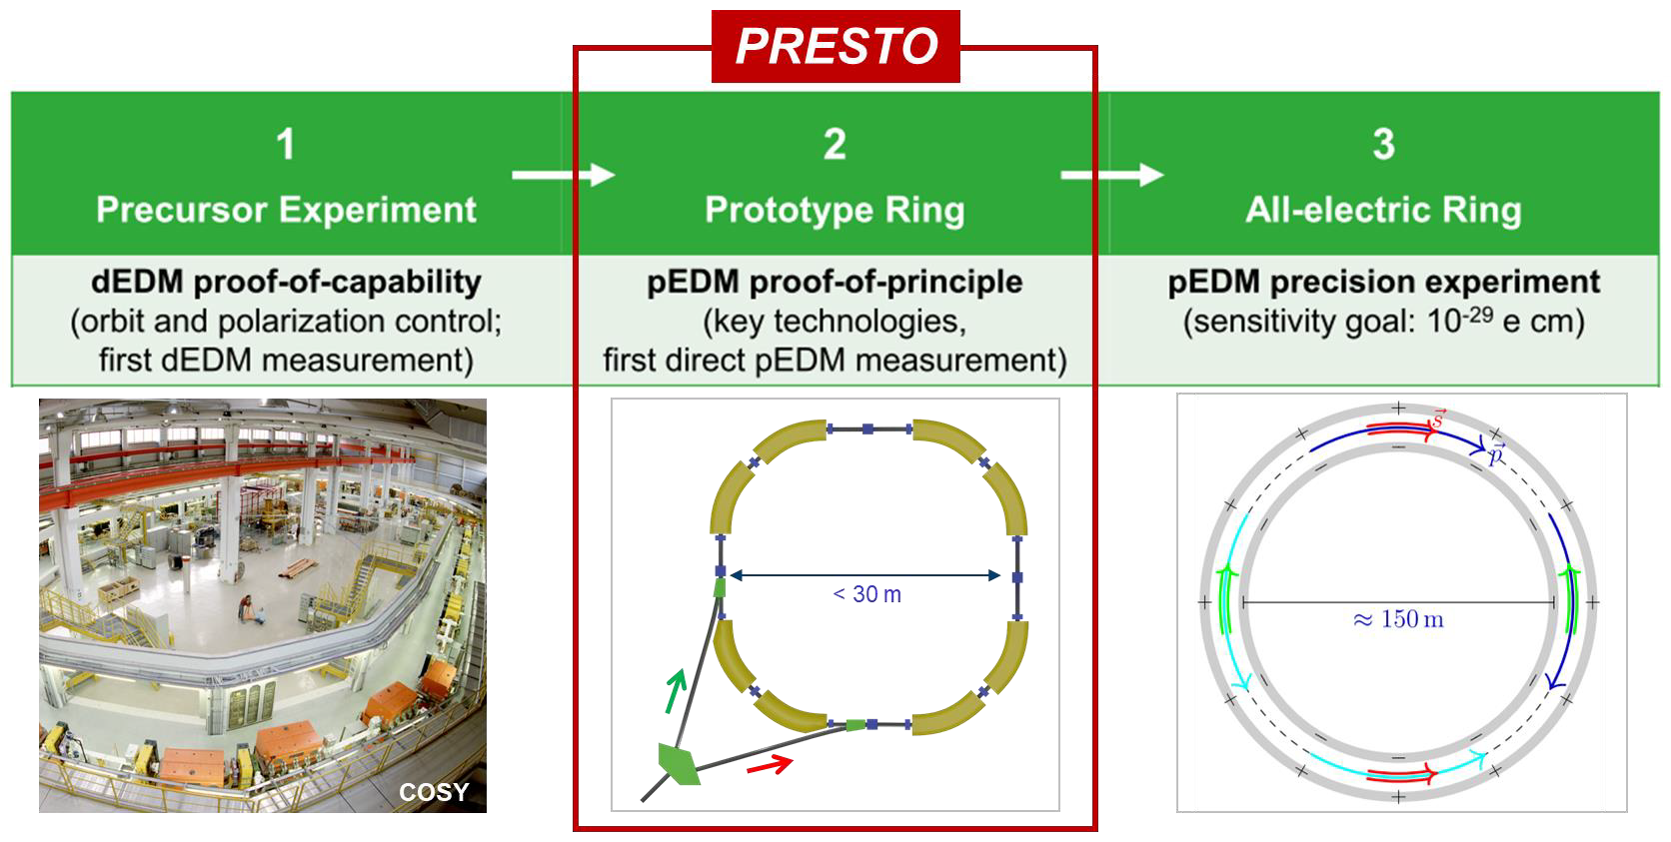

Slide 32
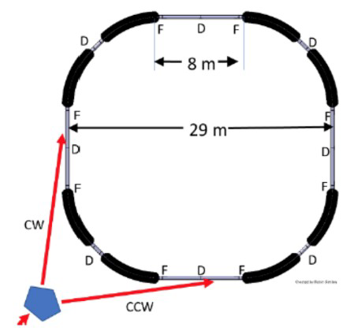
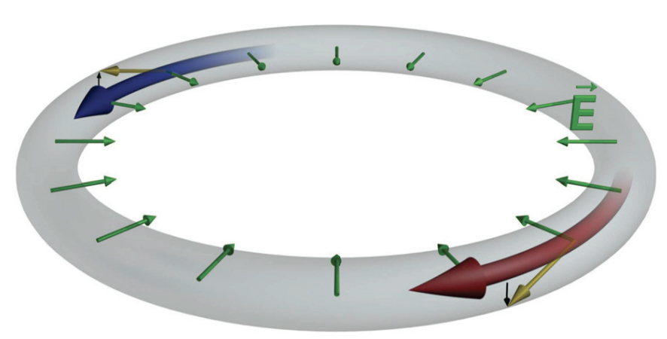
Stage 2: Prototype Ring
● All electric E & combined E/B deflectors
● 100 m circumference
● protons of 30 MeV – all-electric beam operation
● protons of 45 MeV – frozen spin with additional
vertical magnetic fields
Challenges:
● Only E & combined E+B deflection
● Storage time
● CW-CCW operation
● Spin coherence time
● Polarimetry

Slide 33
