Slide 1
ASTENA
HPXM2021 Conference
Advanced Surveyor of Transient Events and Nuclear Astrophysics
M. Moita⁽¹⁾, L. Ferro⁽¹⁾, E. Virgilli⁽²⁾, P. Rosati⁽¹⁾, F. Frontera⁽¹⁾, E. Caroli⁽²⁾,
N. Auricchio⁽²⁾, J. B. Stephen⁽²⁾, S. del Sordo⁽³⁾
1 – University of Ferrara, Dept. of Physics and Earth Science 2 – INAF/OAS Bologna 3– INAF/OAS Palermo

Slide 2
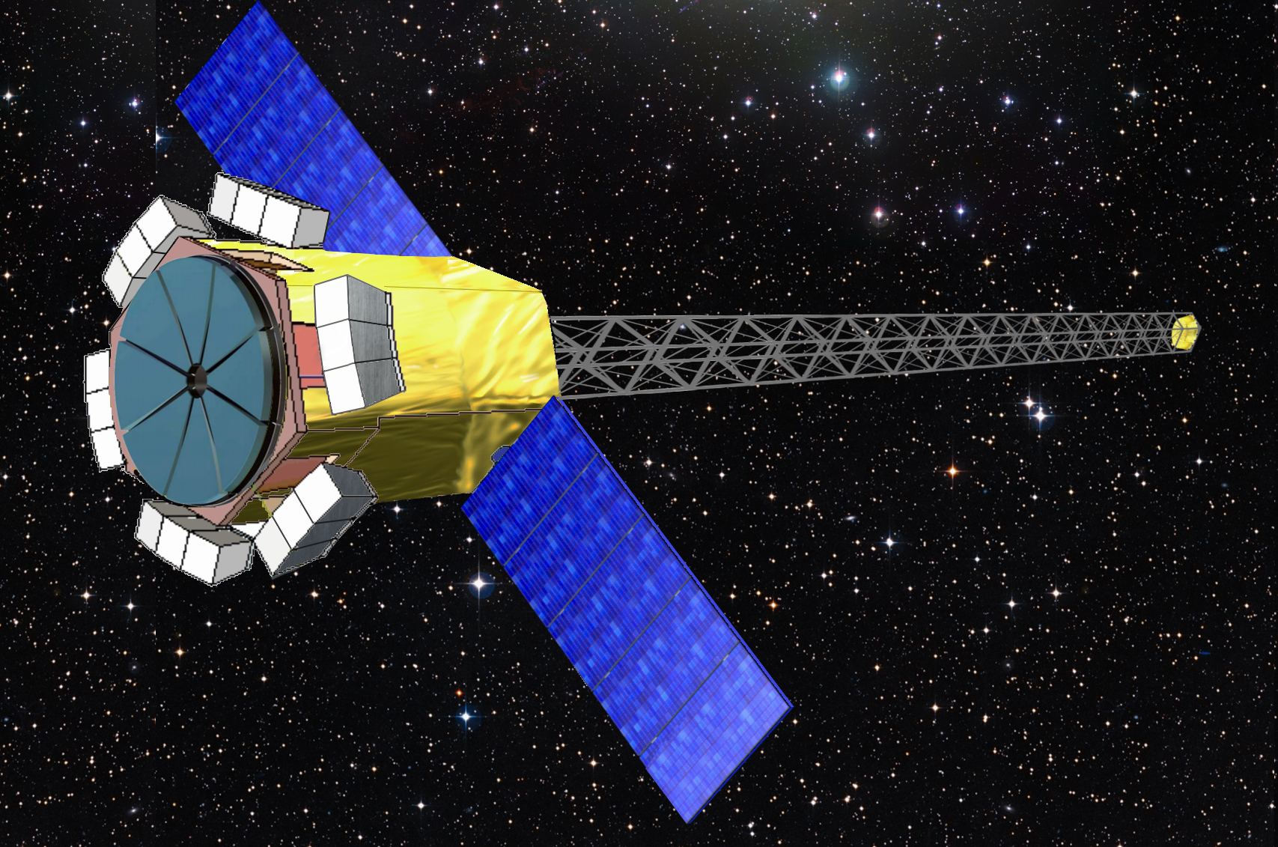
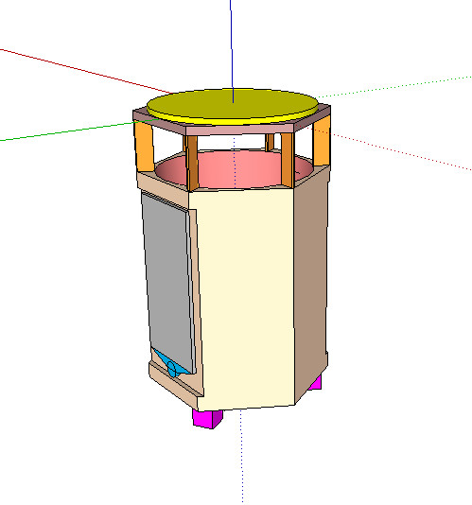
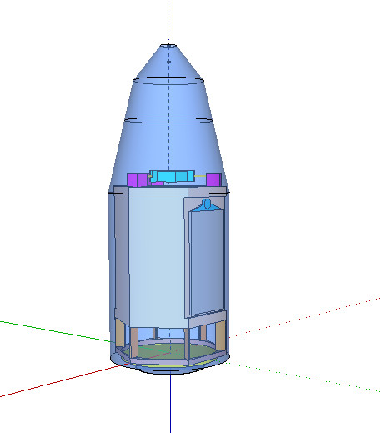
Advanced Surveyor of Transient Events and Nuclear Astrophysics (ASTENA)
ASTENA is a new high energy mission concept that has been proposed within the context of the European project AHEAD.
Submitted to ESA for the Voyage 2050 long-term plan
Narrow Field Telescope:
Board band (60-600 keV)
Large collection Area
Focusing optics: LAUE lens
Wide Field Monitor
Imager; Spectomer
Broad energy passband (1keV - 20 MeV)
Notes:
that aims the promotion of synergies between the distinct national efforts in high-energy astrophysics and propose the next generation of gamma-ray observatories.
A view of the inner accommodation of the ASTENA payload before the launch. Right panel: ASTENA spacecraft in the fairing of the Soyuz launcher. Also the fairing of the Vega C launcher can host ASTENA.

Slide 3
NFT – Laue Lens
Hard X-soft Gamma ray optics based on Bragg’s Law of Diffraction
Large number of crystals disposed in a spherical cup that concentrate the incident radiation onto a common focal spot
Inner crystals – higher energies
Outmost crystals – lower energies
Notes:
A Laue lens is made of a large number of crystal tiles in transmission configuration, that are disposed in such a way that they concentrate the incident radiation onto a common focal spot.
Thus the highest energies are diffracted from the nearest crystals and the lowest energies from the farest crystals to the lens axis.

Slide 4
NFT – Laue Lens ASTENA Configuration
∼19500 bent crystal tiles of Si(111) and Ge(111)
20 m focal length
Crystal dimensions: 30 x 10 mm²
43 Rings (R in/out: 18 cm /149 cm)
Total Geometric Area ~ 7 m²
Pass-band: 60 – 600 keV
FOV ~ 4 arcmin
Angular Resolution ~ 0.5 arcmin
Notes:
A Laue lens is made of a large number of crystal tiles in transmission configuration, that are disposed in such a way that they concentrate the incident radiation onto a common focal spot.
Thus the highest energies are diffracted from the nearest crystals and the lowest energies from the farest crystals to the lens axis.

Slide 5
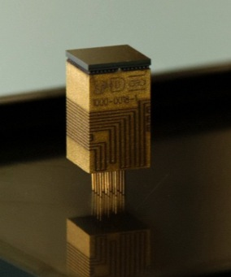
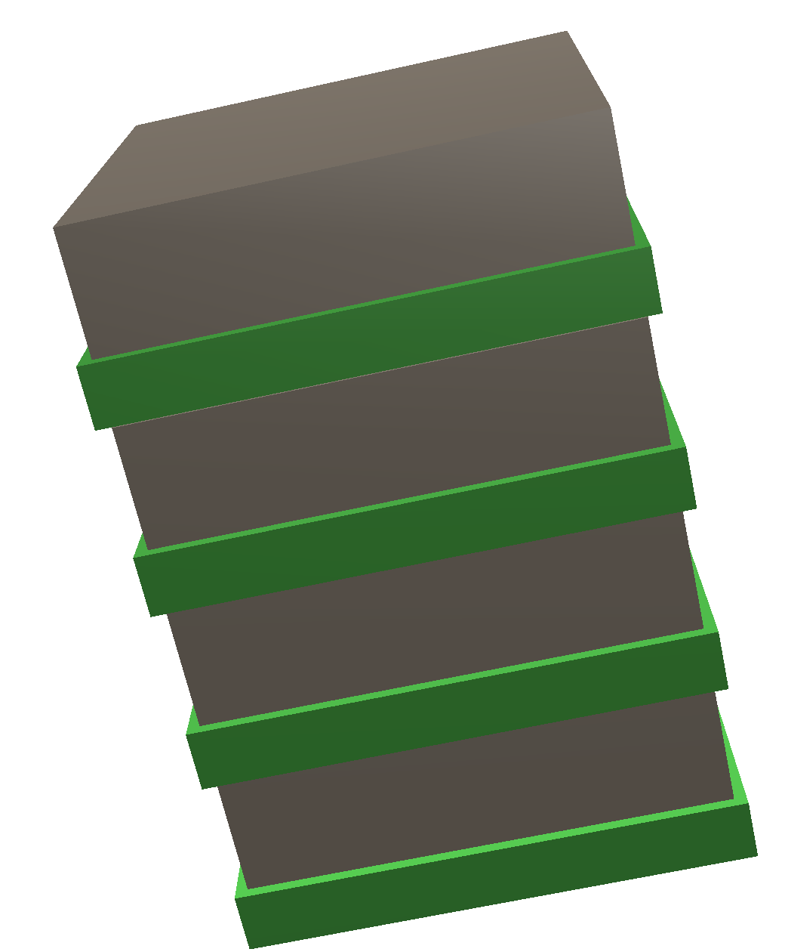
NFT – Focal Plane Detector
4 layers of CZT
Layer dimensions: 80 mm x 80 mm x 20 mm
Detection efficiency: > 80% @ 600 keV
Fine spectroscopy response: 1% @511 keV
3-D position resolution: 300 μm (x, y, z direction)

Slide 6
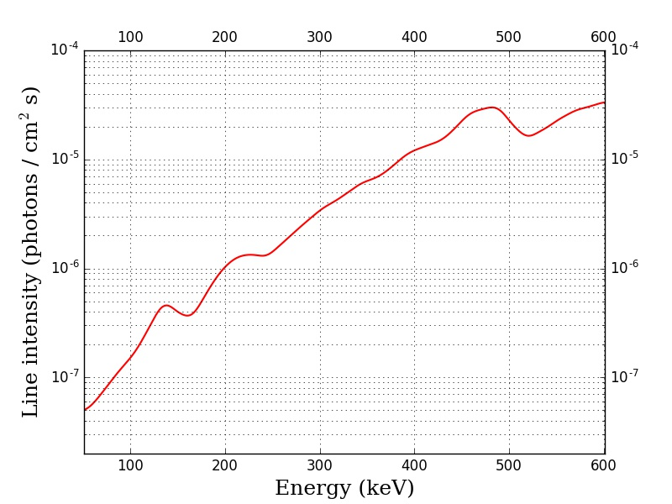
NFT – Expected Performances
NFT continuum sensitivity at 3 σ confidence level 10⁵s observation time, with ∆E = E/2
Expected line sensitivity at 3 σ confidence level 10⁵s observation time
Unprecedented sensitivity - up to two orders of magnitude better than that of NuSTAR in the common energy band
One order of magnitude better then the SPI at 511 keV

Slide 7
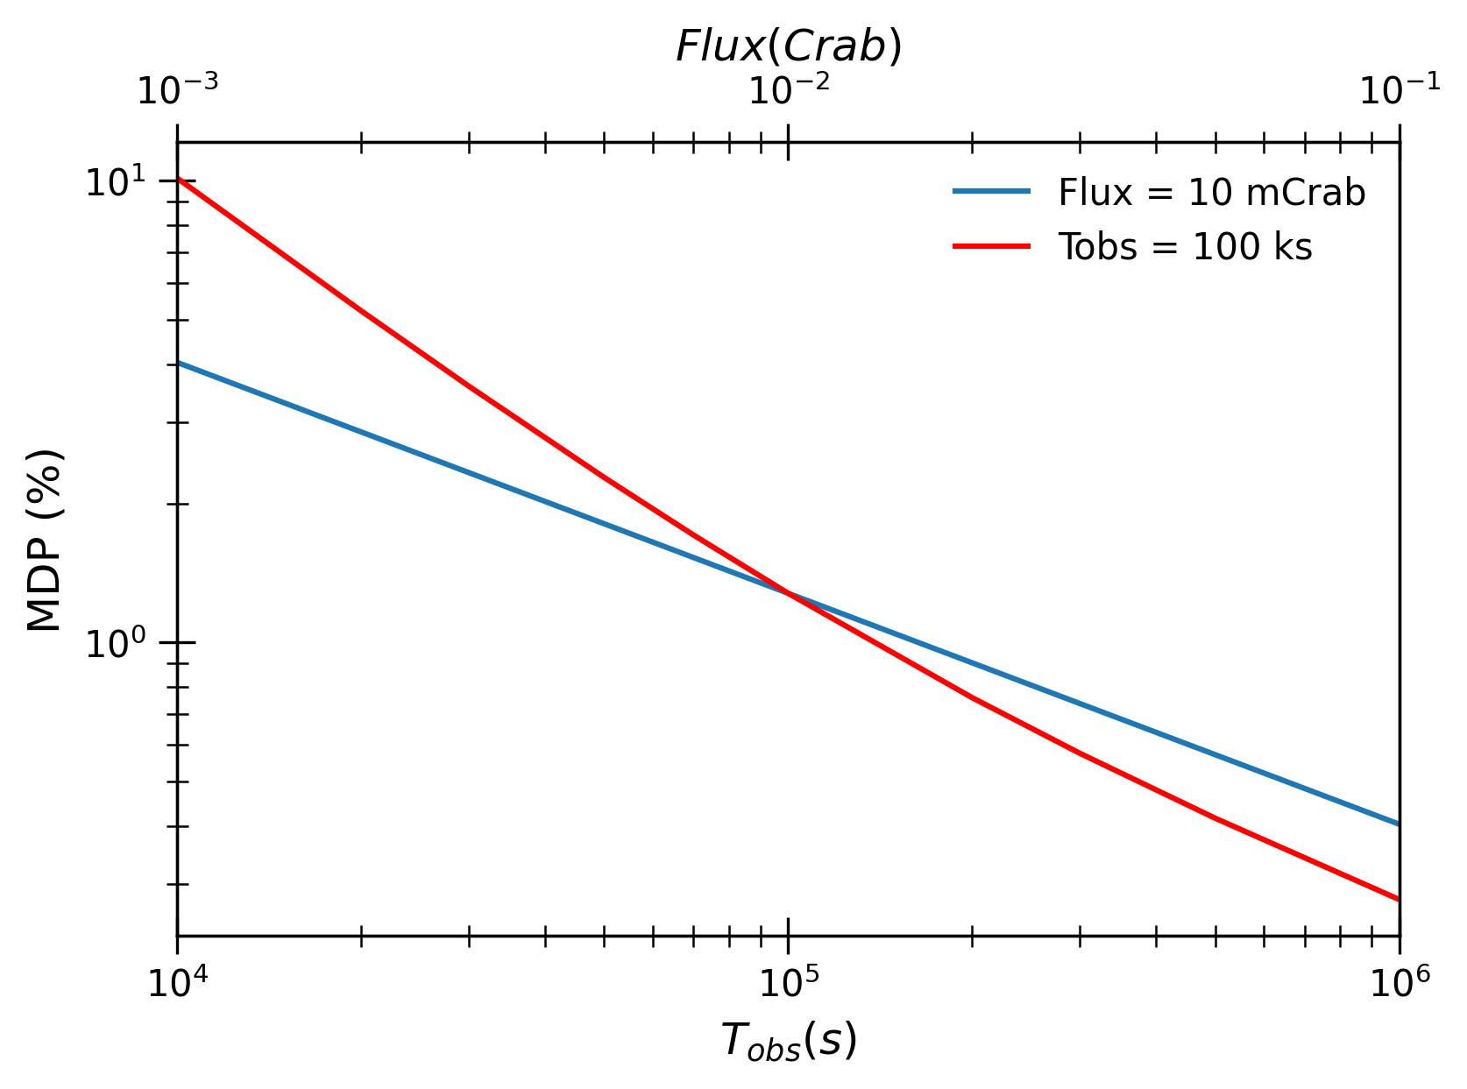
NFT – Polarization
Minimum Detectable Polarization (MDP)
6 energy ranges
Tobs: 100 ks; 1Ms
Flux: 100 mCrab; 1 Crab
Full Band (65 - 600 keV)
MDP ~1.3%, 100 ks, 10mCrab

Slide 8
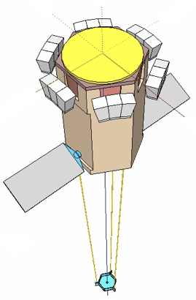
Wide Field Monitor (WFM-IS)
Array of 12 units
2 units on each side of the hexagon surrounding the NFT
15 deg offset
Position Sensitive Detector (PSD)
4 x 8 Modules
43 × 42 cm cross section
Square coded mask

Slide 9
WFM-IS Module
10 rows of hexagonal scintillator bars CsI
Distance between hexagon flat sides of 5 mm;
5 cm length
205 bars total
Top - Linear multi-anode SDDs
Bottom - Hexagonal single anode SDDs
Notes:
working principle of a SDD coupled with a CsI scintillator crystal. The soft X-rays interact directly in the SDD while high energy photons pass through the SDD and are absorbed in the scintillator. Secondary photons are then detected with the SDD.
﻿The operating principle (see Fig. 32 right) is the following. The top SDD-PD, facing the X-/gamma-ray entrance window, is operated both as X-ray detector for low energy X-ray photons interacting in Silicon and as a read-out system of the scintillation light resulting from X-/gamma-ray interactions in the scintilla- tor. The bottom SDD-PD at the other extreme of the crystal bar operates only as a read-out system for the
scintillators. The

Slide 10
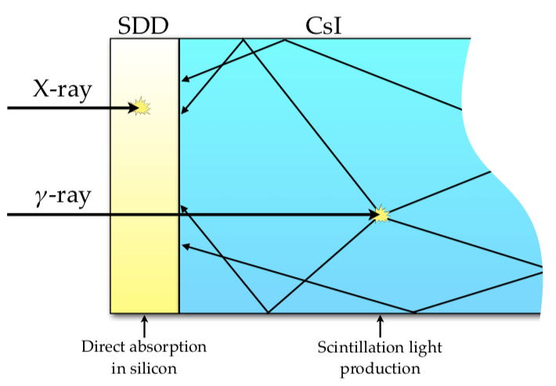
WFM-IS Module Operating Principle
Similar to that adopted for the X-Gamma-ray Imaging Spectrometer (XGIS) aboard the THESEUS mission
Top SDD-PD
X-ray detector for low energy X-ray photons
Read-out system of the scintillation light
Bottom SDD-PD
Read-out system for the scintillators
Broad passband (2 keV–20 MeV)
3-D position sensitivity
Hexagonal cross section – improve polarimetric capabilities
Notes:
working principle of a SDD coupled with a CsI scintillator crystal. The soft X-rays interact directly in the SDD while high energy photons pass through the SDD and are absorbed in the scintillator. Secondary photons are then detected with the SDD.
﻿The operating principle (see Fig. 32 right) is the following. The top SDD-PD, facing the X-/gamma-ray entrance window, is operated both as X-ray detector for low energy X-ray photons interacting in Silicon and as a read-out system of the scintillation light resulting from X-/gamma-ray interactions in the scintilla- tor. The bottom SDD-PD at the other extreme of the crystal bar operates only as a read-out system for the
scintillators. The

Slide 11
WFM-IS - Image Capabilities
Lateral passive shield for the imager system (1–30 keV) and as a FOV delimiter at energies >150 keV.
Double scale coded mask
Low energy photons (mainly < 30 keV) that lose their energy in the SDD alone.
Point Source Location Accuracy (PSLA): 1 arcmin
High energy photons (30–150 keV) that lose their energy in the scintillator bars
79×79 elements
Fully Coded Field of View: 0.27 sr
Point Source Location Accuracy: 5 arcmin
Compton Imager (>150 keV)
Compton kinematics reconstruction
Source location accuracy @ 1 MeV:10 - 35 deg
Use total number of units – triangulation

Slide 12
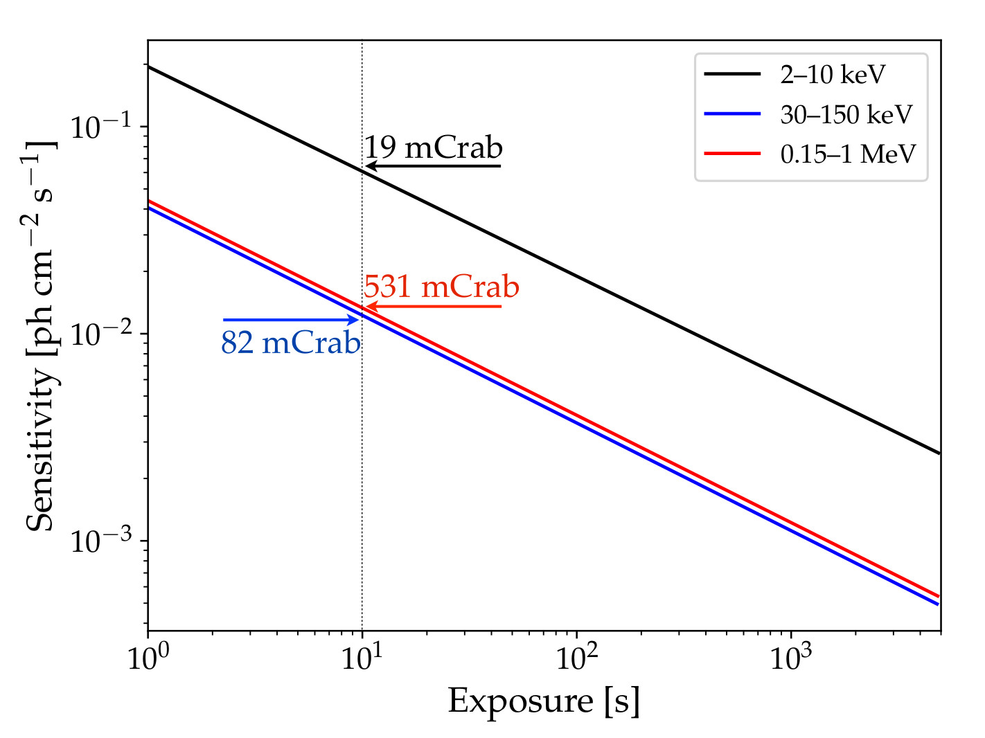
WFM-IS – Expected Performances
Energy pass-band | 2 keV – 20 MeV
Total useful area | ~ 5800 cm² (<30 keV) ∼ 6700 cm² (30–150 keV) ∼ 13800 cm² (>200 keV)
Field of View | 2 sr
Angular resolution | 6 arcmin
Point source localization accuracy | 1 arcmin (<30 keV) 5 arcmin (30–150 keV)
Continuum sensitivity of the WFM-IS in three energy bands

Slide 13
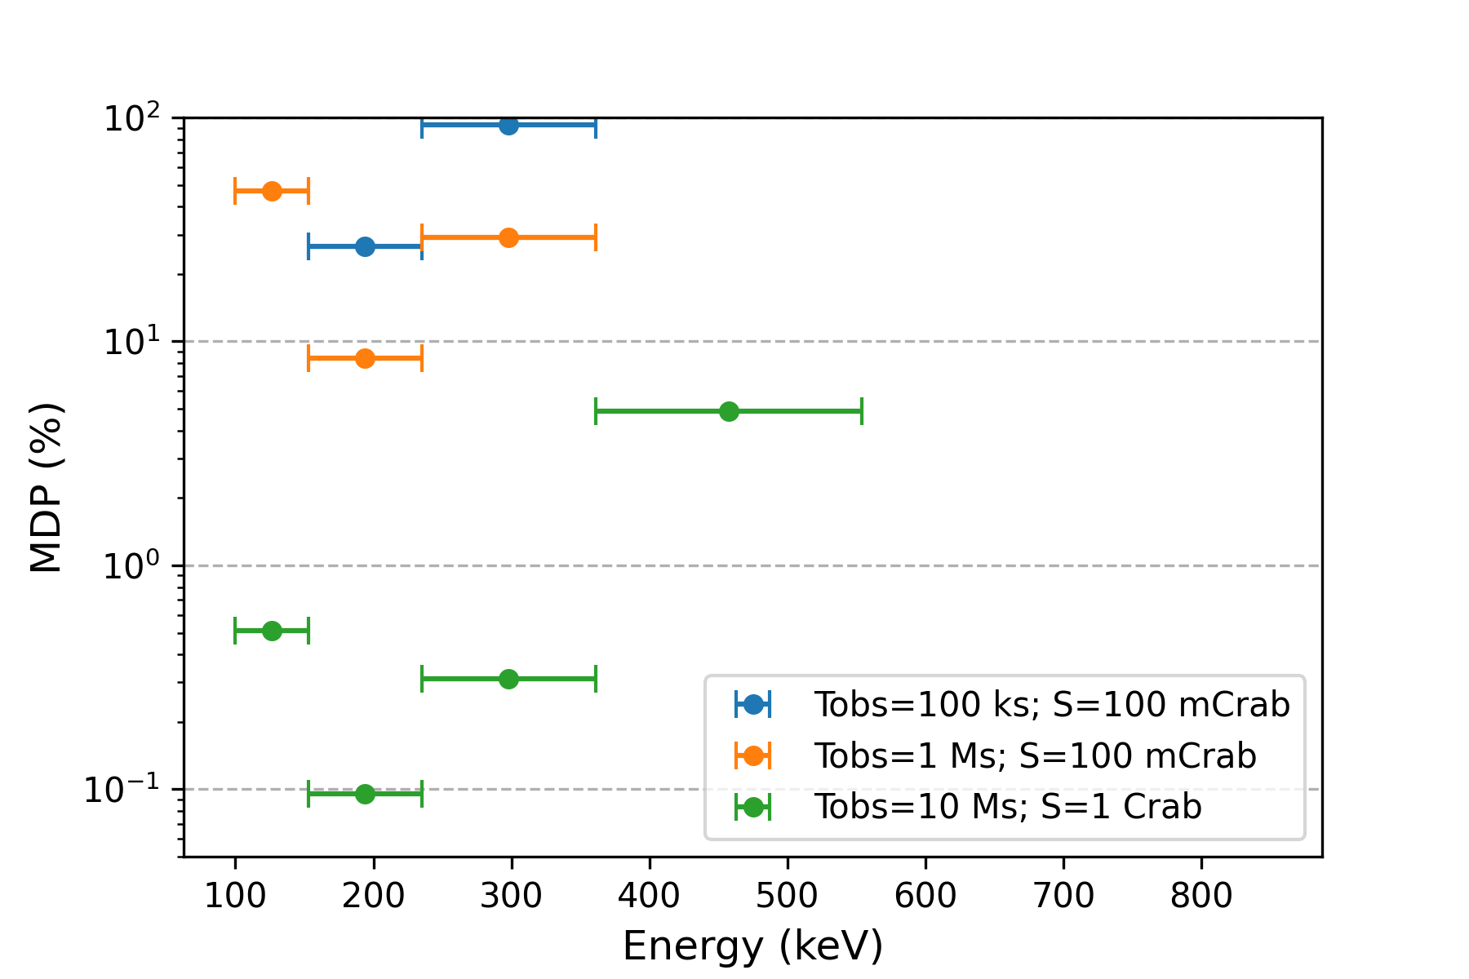
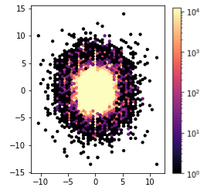
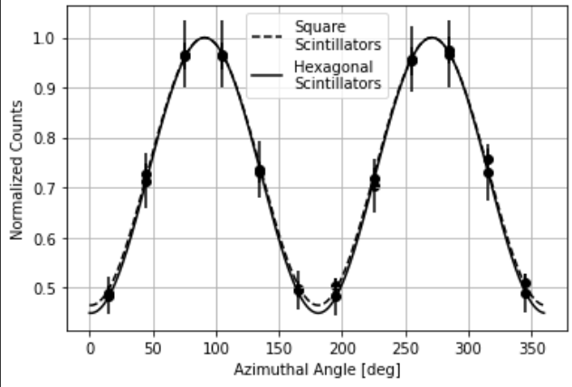
WFM-IS – Polarimetric Capabilities
Left: Scattering map obtained with a 500 keV, 100% polarized far field source, using the WFM-I/S Monte Carlo model.
Right: Comparison of the modulation curve obtained with a hexagonal shape and square shape scintillators for the same source characteristics.
Minimum Detectable Polarization (MDP)
6 energy ranges
Tobs: 100 ks; 1Ms
Flux: 100 mCrab; 1 Crab

Slide 14
ASTENA Scientific Cases

Slide 15
Gamma-ray Bursts
WFM-IS - Unprecedented performances for the detection, characterization and localization within few arcmin of all classes of GRBs
GRB spectra, light curves and polarization over an energy band (2 keV – 20 MeV)
Large effective area and excellent energy and time resolution
NFT: High energy spectrum and polarization of the GRB afterglow emission
Multi-messenger Astrophysics: Electromagnetic counterparts of Gravitational Wave events (NS–NS merging)
Notes:
The ASTENA WFM-IS, thanks to its specific capability as a polarimeter (see below), its very large detection area and broad passband, is expected to provide secure information about the polarization level of a large sample of GRBs, also determining its temporal and energy dependence.
thanks to the unprecedented sensitivity of the Narrow Field Telescope (NFT) (see below), will be capable to measure the high energy spectrum and the polarization of the afterglow emission of a large sample of GRBs, and thus to establish the underlying physics and the emission mechanisms at play (e.g., synchrotron photon energy, presence of a Compton or pair pro- duction component in addition to the synchrotron) and the cor- responding parameters.

Slide 16
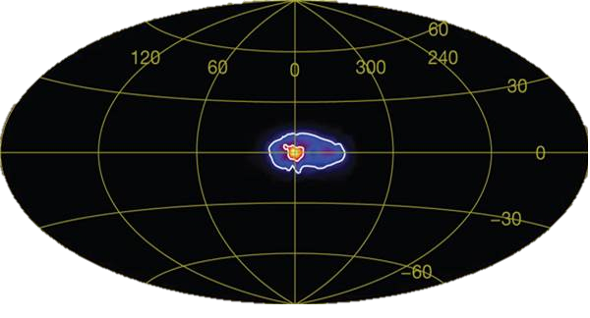
Nuclear Astrophysics
NFT Measurements with unprecedented sensitivity and angular resolution of the 511 keV annihilation line from the Galatic Center
Difuse emission made up of a population of discrete unresolved sources?
Line emission from radioactive nuclei produced in Type-Ia supernovae and core-collapse SN explosions
Weidenspointner et al. 2018
Notes:
The ASTENA WFM-IS, thanks to its specific capability as a polarimeter (see below), its very large detection area and broad passband, is expected to provide secure information about the polarization level of a large sample of GRBs, also determining its temporal and energy dependence.
thanks to the unprecedented sensitivity of the Narrow Field Telescope (NFT) (see below), will be capable to measure the high energy spectrum and the polarization of the afterglow emission of a large sample of GRBs, and thus to establish the underlying physics and the emission mechanisms at play (e.g., synchrotron photon energy, presence of a Compton or pair pro- duction component in addition to the synchrotron) and the cor- responding parameters.

Slide 17
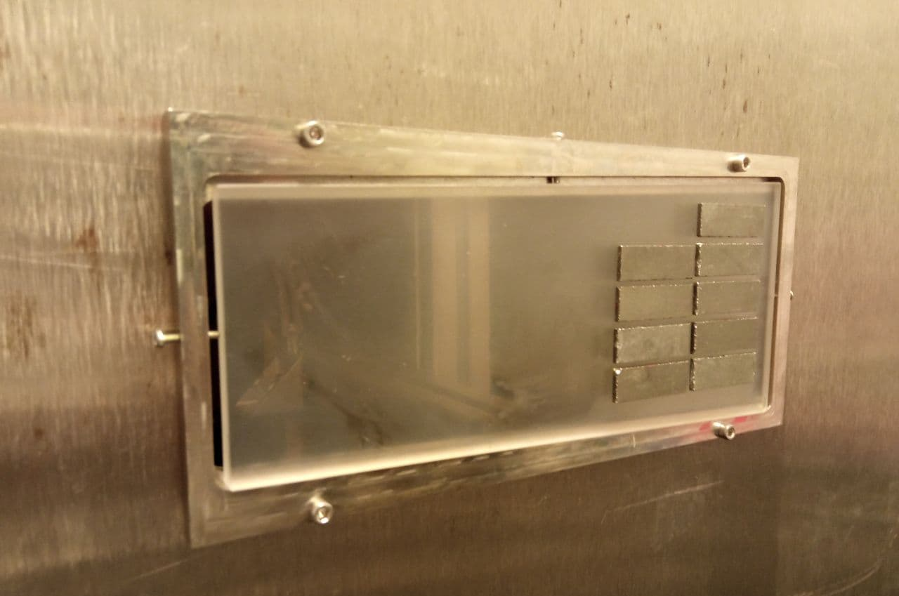
Optimisation & Performance evaluation
NFT Laue Lens
Ray tracing program to optimise mainly the PSF, the efficiency, and the FOV of the Laue Lens optics
The TRILL project: building a first prototype of broadband Laue lens.
Lisa Ferro, 10/07, 11h
NFT Focal Plane detector
MEGAlib model of the CZT 3D spectro-imager focal plane

Slide 18
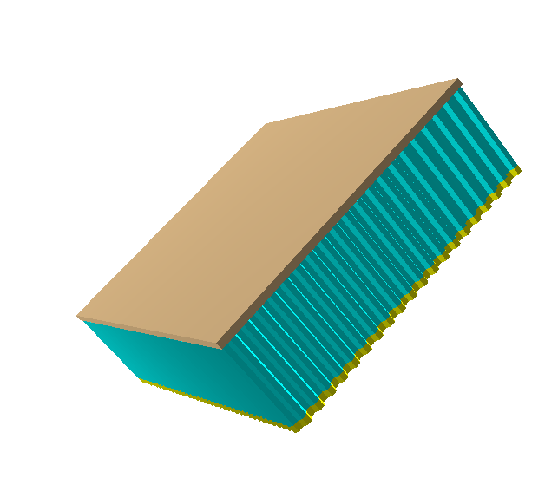
Optimisation & Performance evaluation
WFM
Development of a MEGAlib model of one WFM
Evaluate performance
Sensitivity
Polarimetric capabilities
Mask design
Operating parameters (e.g. spatial and energy resolution, background)
Optimization detector geometry & material
THESEUS Mission

Slide 19
Thank you for your attention!
Contact us!
Dott. Miguel Moita: mmoita@fe.infn.it
Dott. Lisa Ferro: lisa.ferro@unife.it
Dott. Enrico Virgilli: enrico.virgilli@inaf.it
Prof. Piero Rosati: rosati@fe.infn.it
Prof. Filippo Frontera: frontera@fe.infn.it

