Slide 1
Study of multi-pixel scintillator detector configurations for measuring polarized gamma radiation
Ana Marija Kožuljević*
With D. Bosnar*, Z. Kuncic**, M. Makek*, S. Parashari* and P. Žugec*
*Faculty of Science, University of Zagreb
**School of Physics, University of Sydney
High Precision X-ray Measurements, June 10th 2021

Slide 2
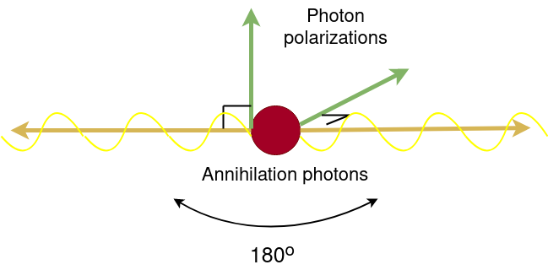
Motivation
Measure polarization correlations of annihilation quanta
Medical Imaging
Additional handle to reduce background in PET
Fundamental Research
Test the phenomenon of quantum entanglement in positronium decay

Slide 3
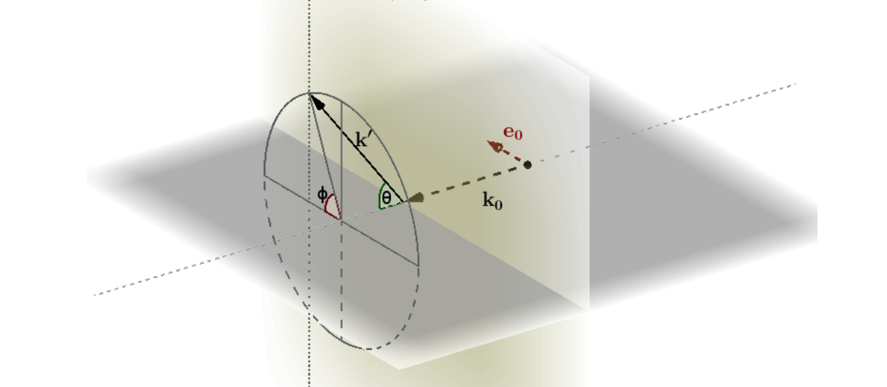
COMPTON SCATTERING OF LINEARLY POLARIZED single GAMMA PHOTON
Klein-Nishina differential cross-section for scattering of linearly polarized gamma photon

Slide 4
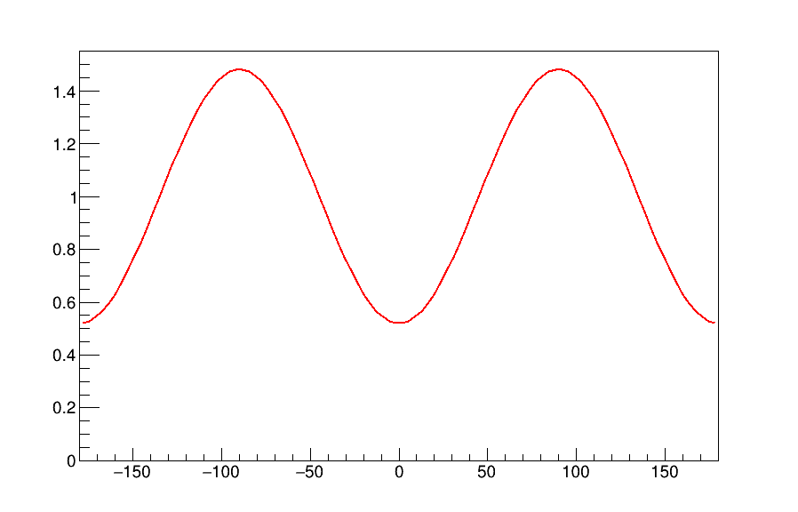
AZIMUTHAL CORRELATIONS OF ANNIHILATON QUANTA
a.u.
Double Klein-Nishina differential cross section:​
Δφ (deg)
Maximum at |φ₁-φ₂|=90°
Polarimetric modulation factor ​
In silico studies (McNamara et al, Proc. of SPIE Vol. 8668 (2013))
These correlations have potential to reduce background for PET image reconstruction
Max for Θ₁= Θ₂= 82°: μ = 0.48

Slide 5
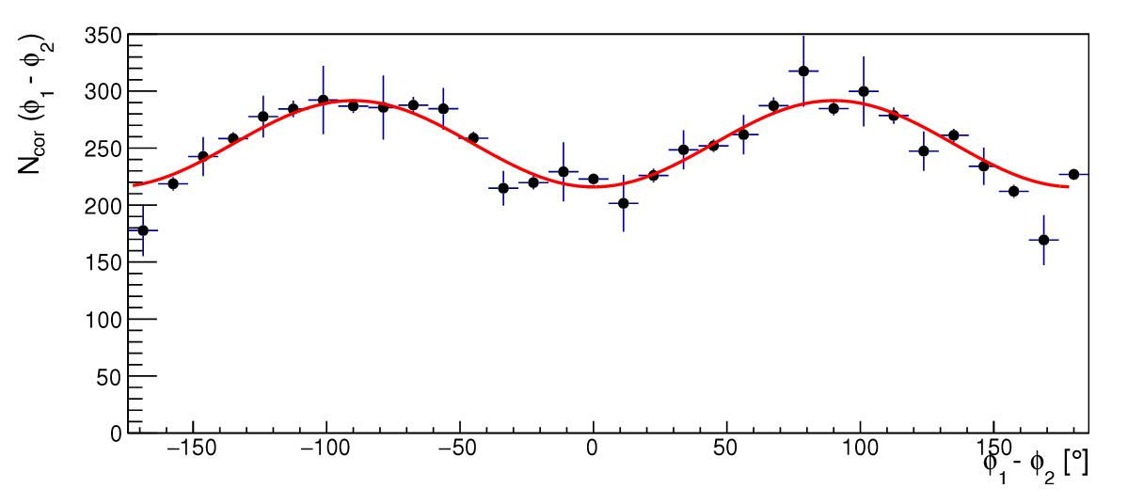
PROOF OF CONCEPT MEASUEMENTS
4x4 Lutetium Fine Silicate (LFS) matrices
3.2 mm pitch​
Coincidence set up, Na-22 source​
Results indicate moderate sensitivity to
azimuthal modulations​
How to get better sensitivity?​
Improve energy resolution​
Improve angular resolution​
Goal of the Silgap project!
Makek et al. , Nucl. Instrum. Methods Phys. Res. A (2019) 16283

Slide 6
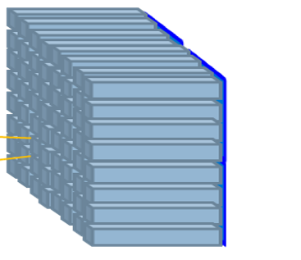
The SiLGaP project Single Layer Gamma-ray Polarimeter
http://www.phy.pmf.unizg.hr/~makek/SiLGaP
Aim:
Investigate the use of azimuthal correlations of annihilation quanta:
in Positron Emissison Tomography
for probing the fundamental concept of quantum entanglement
Methods:
Investigate optimal detector configuration by simulation
Construct and test the modular detector system
Detector modules:
Single scintillator matrix read out by a matching SiPM array, processed by fast digital electronics

Slide 7
AIM
Test the sensitivity of different detector configurations for detecting azimuthal correlations by simulating different:
Dimensions of pixels in a detector
Detector material

Slide 8
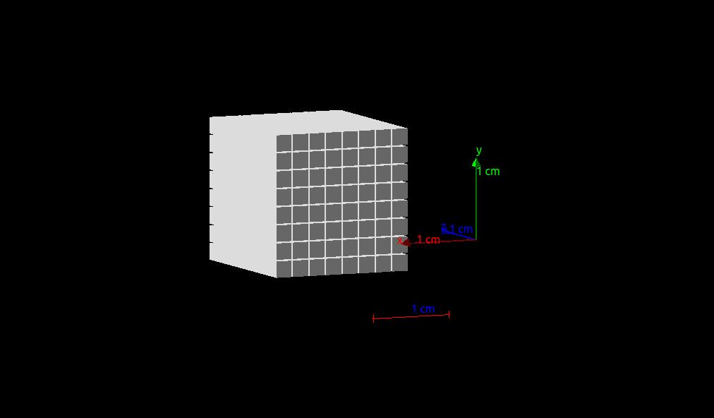
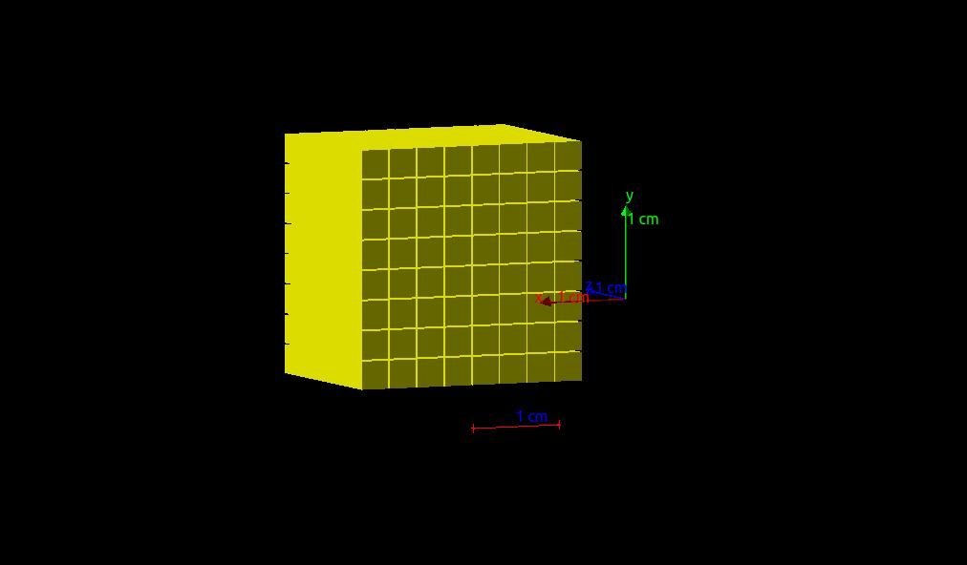
GEANT4 SIMULATIONs
Materials: LYSO:Ce and GaGG:Ce
64 pixels in 8x8 matrix
LYSO:Ce : 2.2 mm pitch
pixel size 2x2x20 mm³
GaGG:Ce : 3.2 mm pitch
pixel size 3x3x20 mm³
Geant4 toolkit version 10.06.p03
Physics model: G4EmLivermorePolarizedPhysics + PIXE/Auger/AugerCascade
Data Handling and Analysis: Root 6.22/09

Slide 9
why did we choose these materials?
LYSO:Ce :
Standard in PET
light yield (33 200 ph/MeV)
decay time (36 ns)
Z_{eff} = 66
GaGG:Ce :
Significantly higher light yield than LYSO (~55 000 ph/MeV)
No intrinsic radioactivity
decay time (88 ns)
Z_{eff} = 54.4

Slide 10
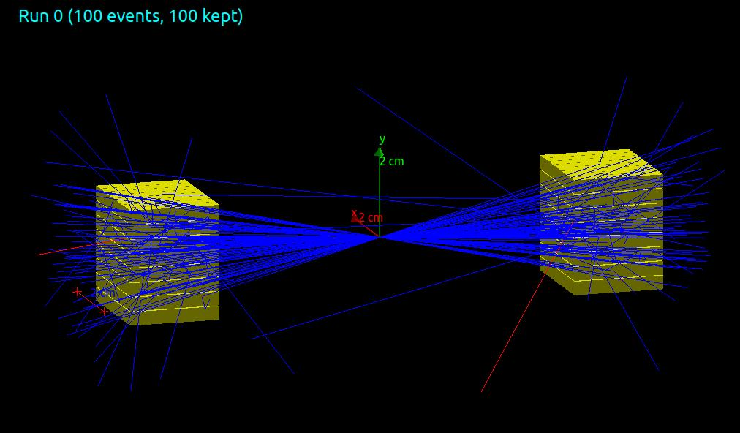
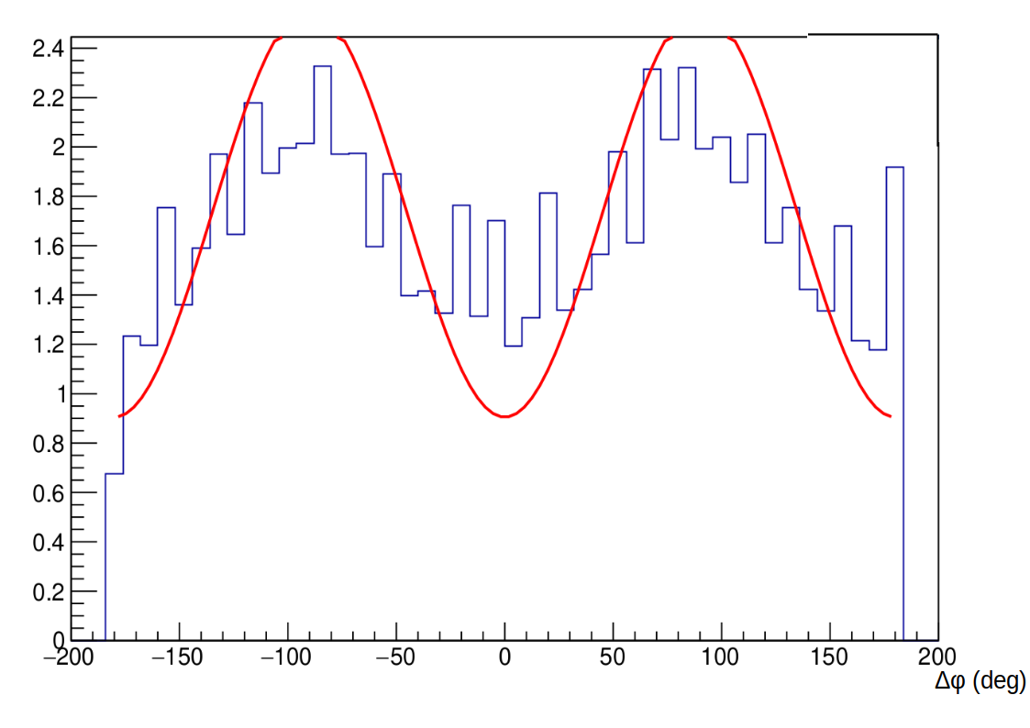
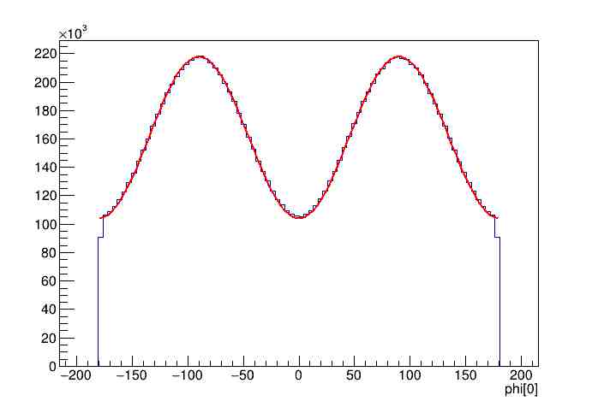
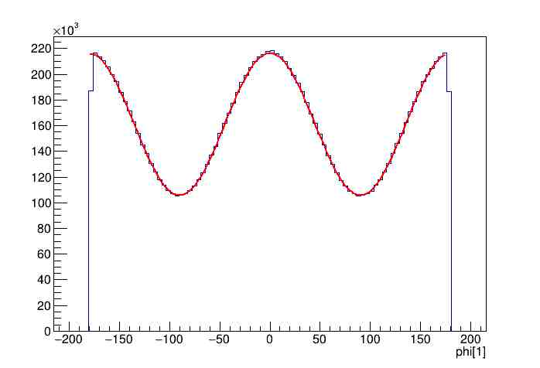
Geant4 simulation specifications
Two modules 10 cm apart
Source:
Isotropic point source
Two 511 keV photons emitted back-to-back
Orthogonal polarizations
set by hand
φ[deg]
φ[deg]
Simulation
Klein-Nishina

Slide 11
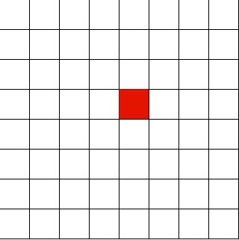
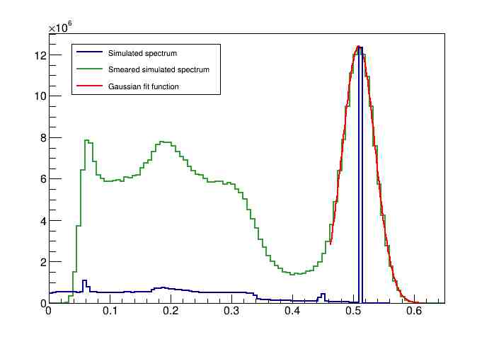
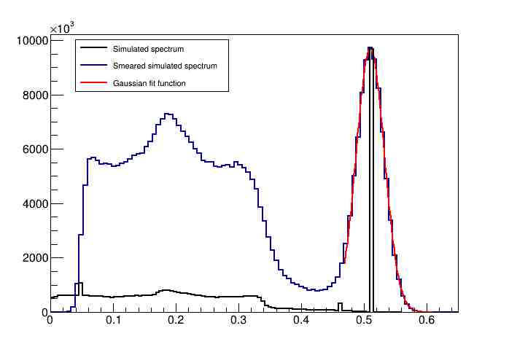
SImulated energy spectra
Experimentally measured energy resolution at 511 keV:
LYSO:Ce : 12.4 % ± 0.4 %
GaGG:Ce : 9.8 % ± 0.6 %
Makek et al, Crystals 10(12), 2020, 1073
LYSO:Ce: 12% at 511 keV
GaGG:Ce: 10% at 511 keV
E [MeV]
E [MeV]

Slide 12
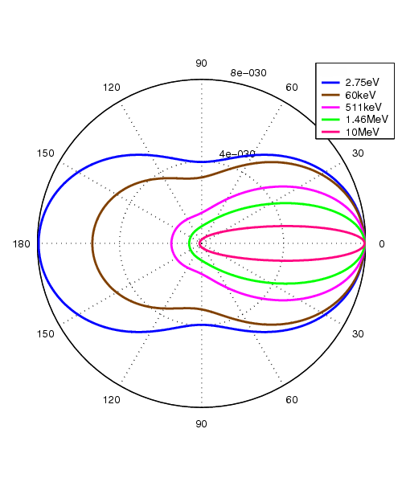
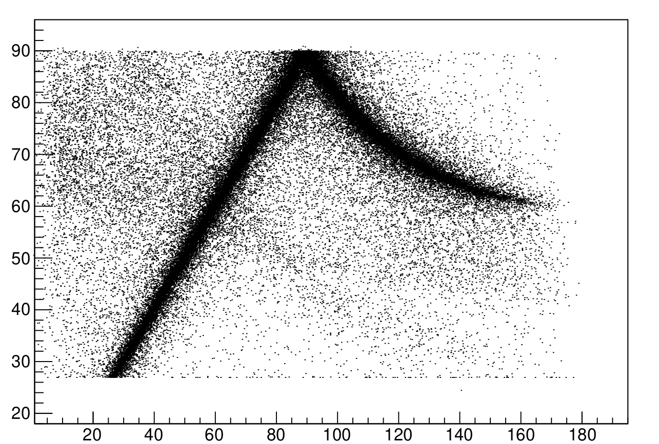
Compton events reconstruction
As applied in measured data analysis
(Makek et al, Condens. Matter 2019, 4(1), 24)
For each module individually
Select pixels with E_{px}>50 keV
Select events with:
Only two pixels fired
Full energy ~511 keV in a module
First pixel - lower energy deposition
Θ_{Rec} (deg)
Θ_{Sim} (deg)

Slide 13
Results

Slide 14
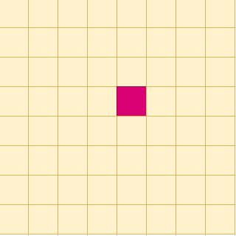
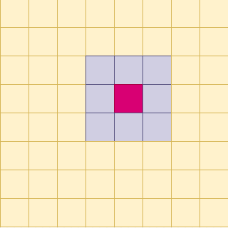
Reconstructed Δφ - Simulation results
LYSO:Ce
Simulation
Fit function: k(1-cos(μ(2Δφ )))
Total selected events
1st neighbors omitted
1st + 1st diagonal neighbors omitted
a.u.
a.u.
a.u.
Θ=82°±10°
Δφ (deg)
Δφ (deg)
Δφ (deg)
a.u.
a.u.
a.u.
Θ=70°±10°
Δφ (deg)
Δφ (deg)
Δφ (deg)
Δφ (deg)
Δφ (deg)
Δφ (deg)

Slide 15
Reconstructed Δφ - Simulation results
GaGG:Ce
Simulation
Fit function: k(1-cos(μ(2Δφ )))
Total selected events
1st neighbors omitted
1st + 1st diagonal neighbors omitted
a.u.
a.u.
a.u.
Θ=82°±10°
E [MeV]
E [MeV]
E [MeV]
Δφ (deg)
Δφ (deg)
Δφ (deg)
a.u.
a.u.
a.u.
Θ=70°±10°
E [MeV]
E [MeV]
E [MeV]
Δφ (deg)
Δφ (deg)
Δφ (deg)

Slide 16
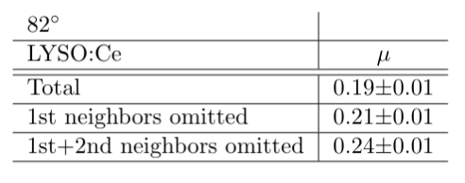
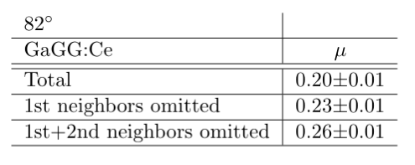
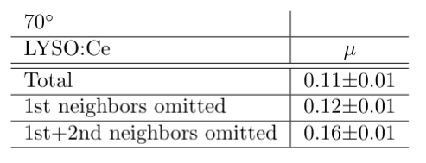
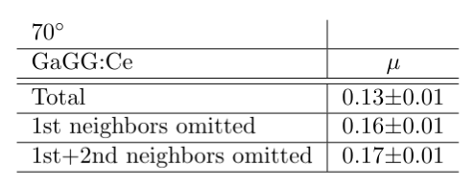
Polarimetric azimuthal factors

Slide 17
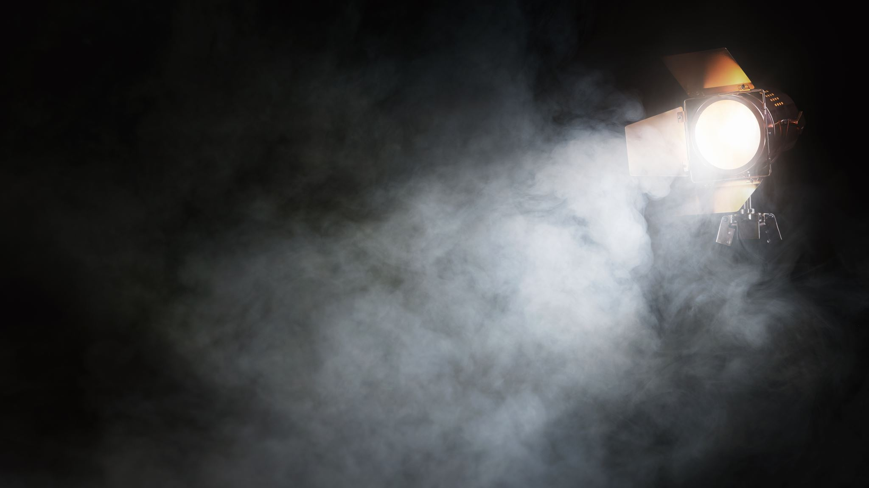
STUDY OF ESCAPE X-RAY INFLUENCE OF
DETECTOR PERFORMANCE

Slide 18
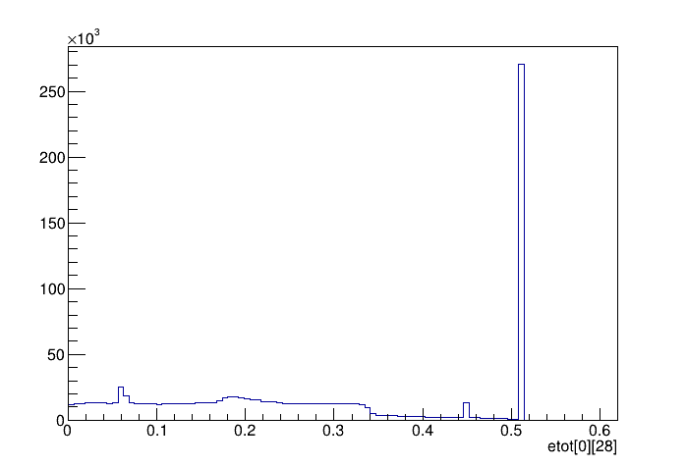
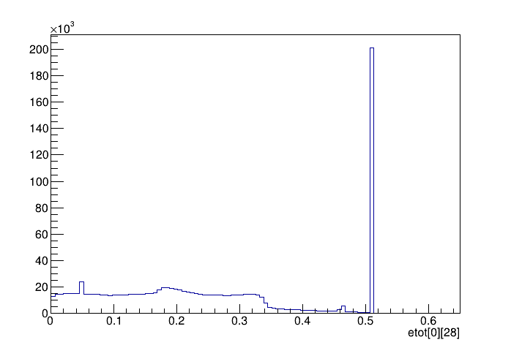
Crosstalk contamination from escape X-rays
LYSO:Ce
GaGG:Ce
a.u.
a.u.
E [keV]
E [keV]
Escape X-rays: 4,6% of total PE events
Escape X-rays: 2,8% of total PE events

Slide 19
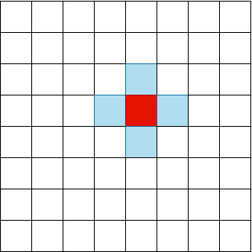
1st neighboring pixels

Slide 20
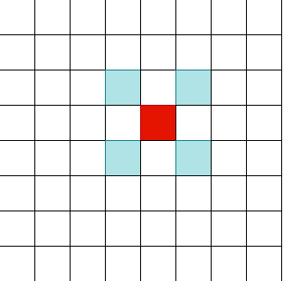
1st neighboring diagonal pixels

Slide 21
2nd neighboring pixels

Slide 22
conclusion
AIM: Test the sensitivity of different detector configurations
Two materials: LYSO:Ce and GaGG:Ce
Two crystal sizes: 2x2x20 mm³ and 3x3x20 mm³
GaGG:Ce with 3x3x20 mm³ demonstrates:
More pronounced polarimetric modulation, increasing with better angular resolution
Smaller crosstalk due to escape X-ray compared to LYSO:Ce 2x2x20 mm³
GaGG:Ce 3x3x20 mm³ is the more promising approach for SiLGaP

Slide 23
THANK YOU!
Acknowledgements
This work was supported by the “Research Cooperability” Program of the Croatian Science Foundation funded by the European Union from the European Social Fund under the Operational Programme Efficient Human Resources 2014–2020, Grant number PZS-2019-02-5829.

