Slide 1

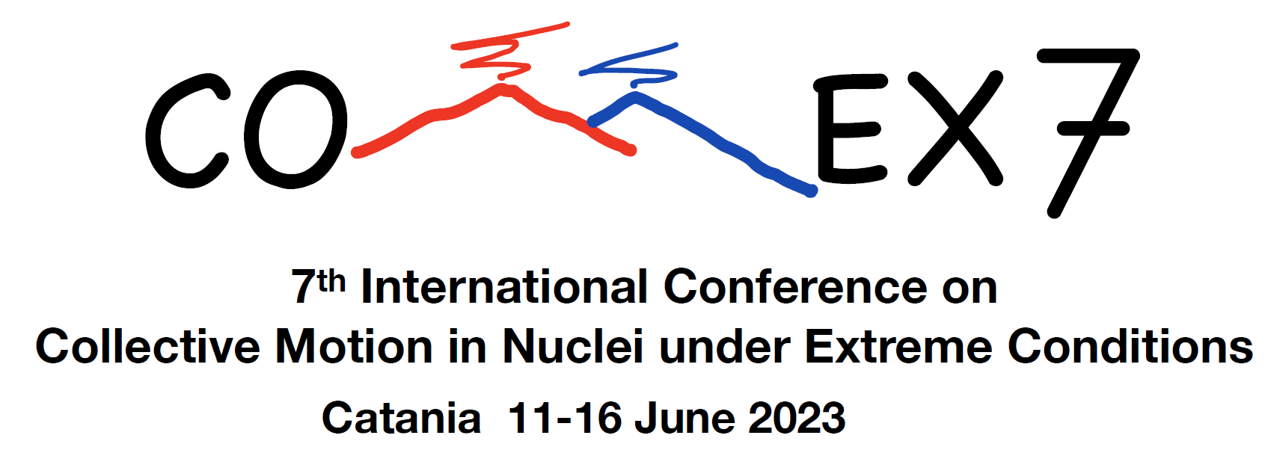



FARCOS detector in the CHIFAR experiment
C. Zagami⁽¹⁾⁽²⁾⁽³⁾, E.V. Pagano⁽¹⁾, P. Russotto⁽¹⁾, E. De Filippo⁽⁴⁾, L. Acosta⁽⁵⁾⁽⁶⁾, T. Cap⁽⁷⁾, G. Cardella⁽⁴⁾, F. Fichera⁽⁴⁾, E. Geraci⁽²⁾⁽⁴⁾, B. Gnoffo⁽²⁾⁽⁴⁾, C. Guazzoni⁽⁵⁾⁽⁸⁾, G. Lanzalone⁽¹⁾⁽⁹⁾, C. Maiolino⁽¹⁾, N.S. Martorana⁽⁴⁾, T. Matulewicz⁽¹⁰⁾, A. Pagano⁽⁴⁾, M. Papa⁽⁴⁾, K. Piasecki⁽¹⁰⁾, S. Pirrone⁽⁴⁾, M. Piscopo⁽¹⁾, R. Planeta⁽¹¹⁾, G. Politi⁽²⁾⁽⁴⁾, F. Risitano⁽⁴⁾⁽¹²⁾, F. Rizzo⁽¹⁾⁽²⁾⁽³⁾, G. Saccà⁽⁴⁾, G. Santagati⁽⁴⁾, K. Siwek-Wilczynska⁽¹⁰⁾, I. Skwira-Chalot⁽¹⁰⁾ and M. Trimarchi⁽⁴⁾⁽¹²⁾
(1) INFN, Laboratori Nazionali del Sud - Catania, Italy (2) Dipartimento di Fisica e Astronomia ”Ettore Majorana”, Università di Catania, Italy (3) CSFNSM-Centro Siciliano di Fisica Nucleare e Struttura della Materia, Catania, Italy (4) INFN, Sezione di Catania, Italy (5) INFN, Sezione di Milano, Italy (6) Instituto de Física. Universidad Nacional Autónoma de México, Mexico (7) National Centre for Nuclear Research, Otwock-Swierk, Poland (8) Dip. di Elettronica, Informazione e Bioingegneria, Politecnico di Milano, Italy (9) Facoltà di Ingegneria e Architettura, Università Kore, Italy (10) Faculty of Physics, University of Warsaw, Warsaw, Poland (11) M. Smoluchowski Institute of Physics, Jagiellonian University, Krakow, Poland(12) Dipartimento di Scienze MIFT, Univ. di Messina, Messina, Italy

Slide 2
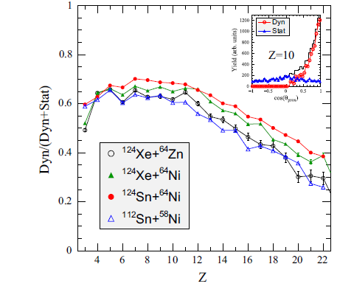
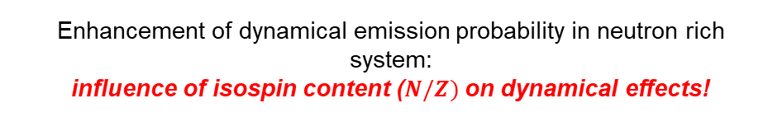
From previous experiments…
Enhancement of dynamical emission probability in neutron rich system:
influence of isospin content ($N/Z)$on dynamical effects!
@35 A.MeV
P. Russotto et al., Eur. Phys. J. A. 56, 12 (2020).
CHIMERA
…to the CHIFAR experiment @ LNS-INFN
3 nuclear reactions @ 20 A.MeV incident beam energy:
“neutron rich” system: ¹²⁴Sn+⁶⁴Ni
“neutron poor” system: ¹¹²Sn+⁵⁸Ni
“isobaric” system: ¹²⁴Xe+⁶⁴Zn
Experimental goals at low Fermi energy regime:
Study of emission mechanism: dynamical/statistical;
IMFs production;
Isospin role in HI collisions;
FARCOS

Slide 3
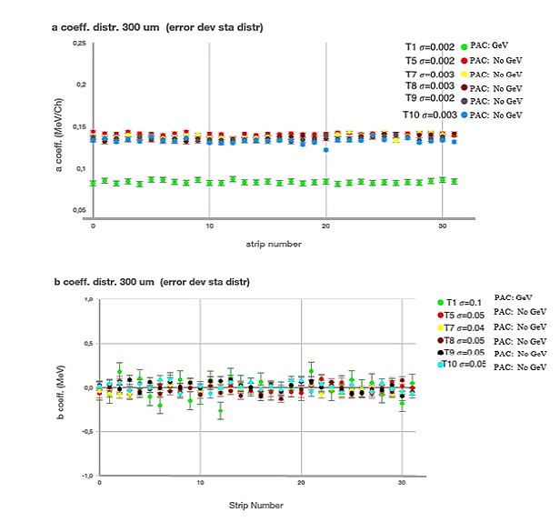
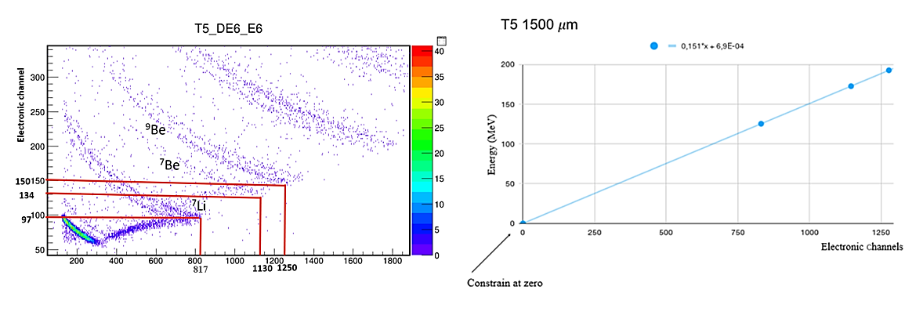
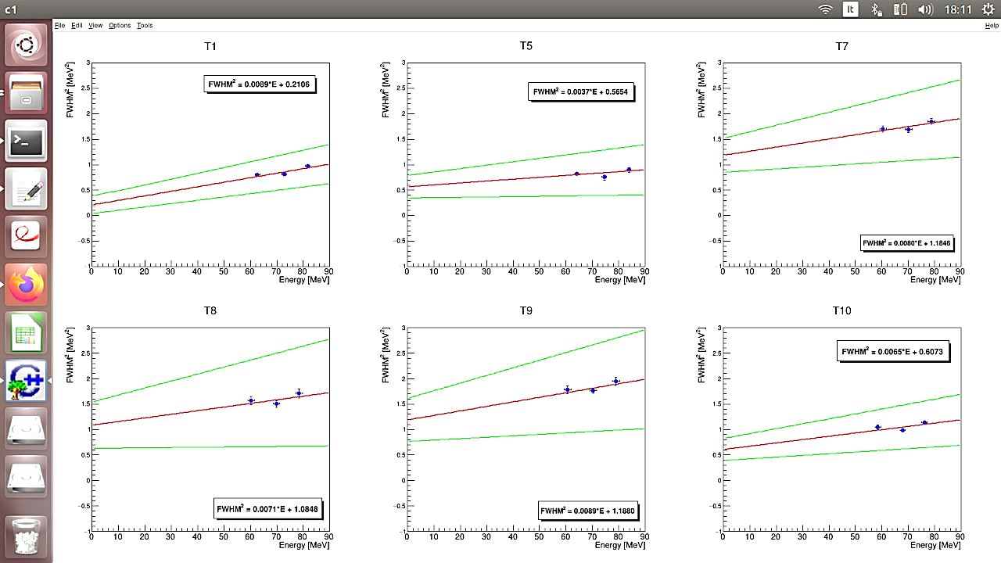
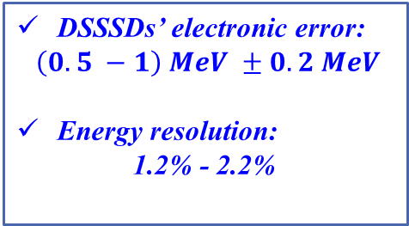
Energy calibration and resolution of DSSSDs
Punch-through technique
a coeff. [MeV/Ch]
Electronic channel
Energy [MeV]
strip number
Electronic channel
b. coeff. [MeV]
strip number
Elastic scattering: O + Au @ 85 MeV
Telescope | FWHM [MeV] | Electronic error [keV] | Electronic error [%] | Detector error [keV] | Detector error [%]
T1 | 0,99 ± 0,02 | 459 ± 187 | 47 | 528 ± 202 | 53
T5 | 0,95 ± 0,02 | 752 ± 149 | 79 | 196 ± 171 | 21
T7 | 1,36 ± 0,02 | 1088 ± 154 | 80 | 271 ± 176 | 20
T8 | 1,31 ± 0,03 | 1042 ± 220 | 80 | 266 ± 253 | 20
T9 | 1,40 ± 0,03 | 1090 ± 195 | 78 | 306 ± 224 | 22
T10 | 1,07 ± 0,02 | 779 ± 140 | 73 | 286 ± 156 | 27
Evaluation of elastic scatterings:
O + Au @ 85 MeV
C + Au @ 75 MeV
C + Au @ 65 MeV
FWHM² [MeV²]
FWHM² [MeV²]
FWHM² [MeV²]
Energy [MeV]
Energy [MeV]
Energy [MeV]
DSSSDs’ electronic error:
$\left(0.5 −1\right) MeV ±0.2 MeV$
Energy resolution:
1.2% - 2.2%
FWHM² [MeV²]
FWHM² [MeV²]
FWHM² [MeV²]
Energy [MeV]
Energy [MeV]
Energy [MeV]

Slide 4
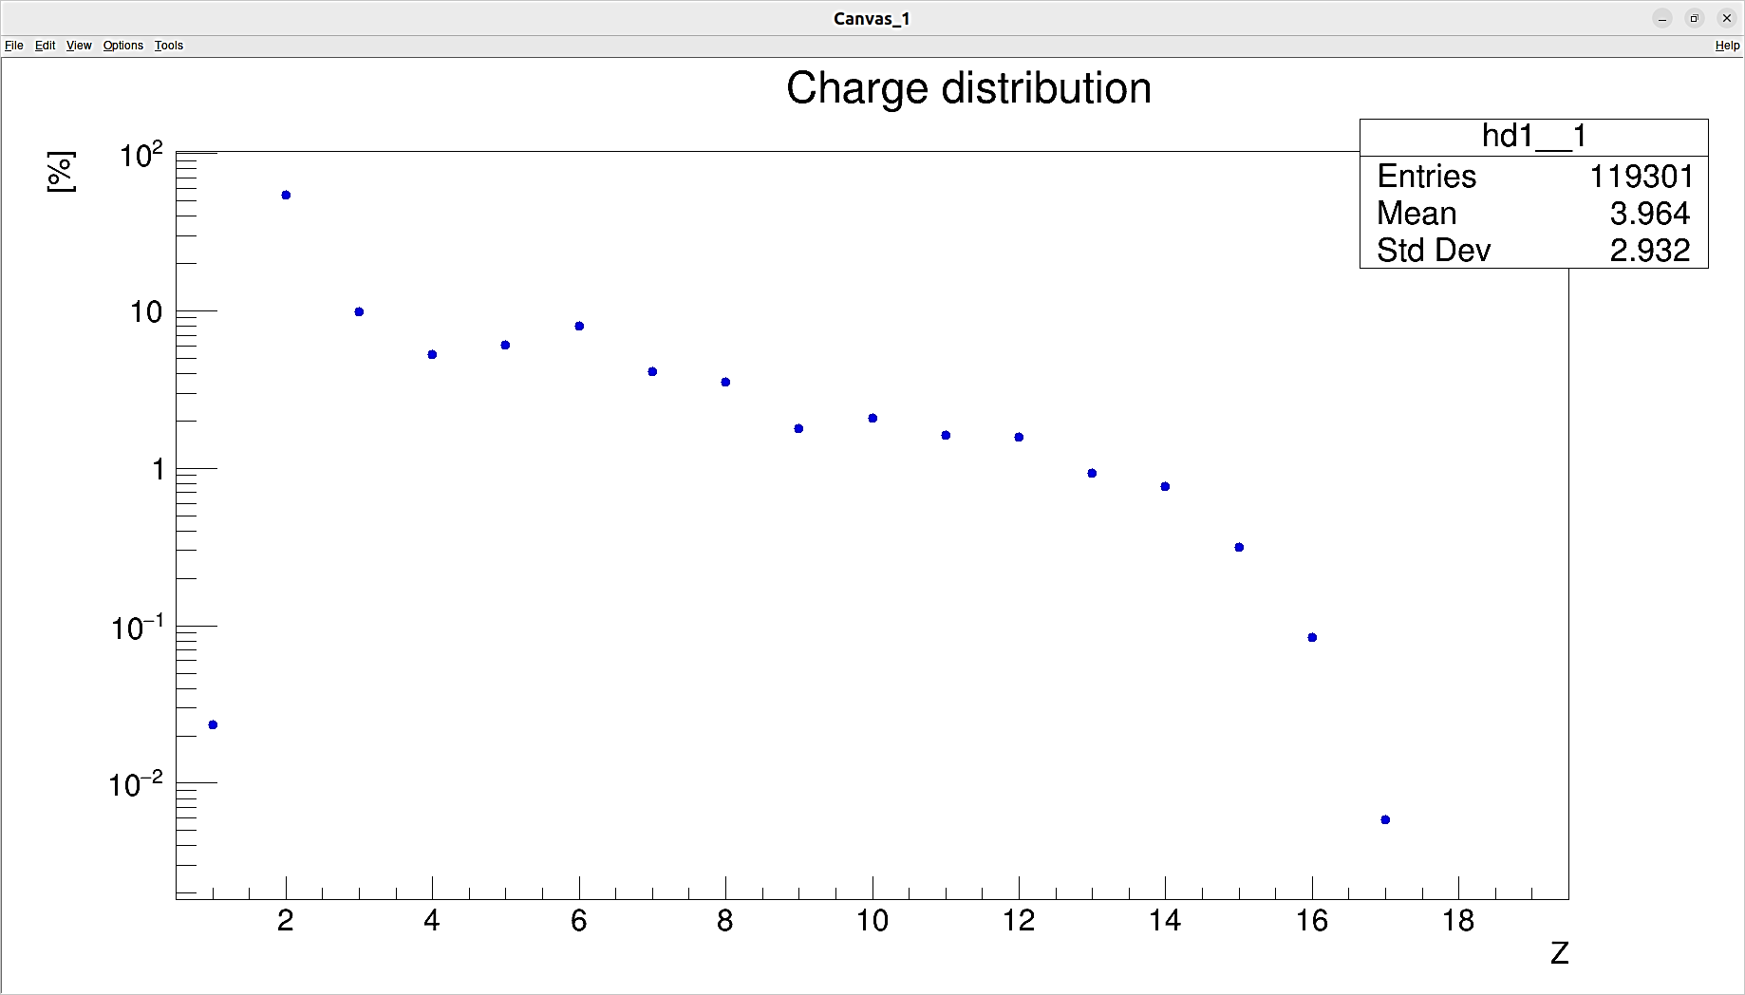
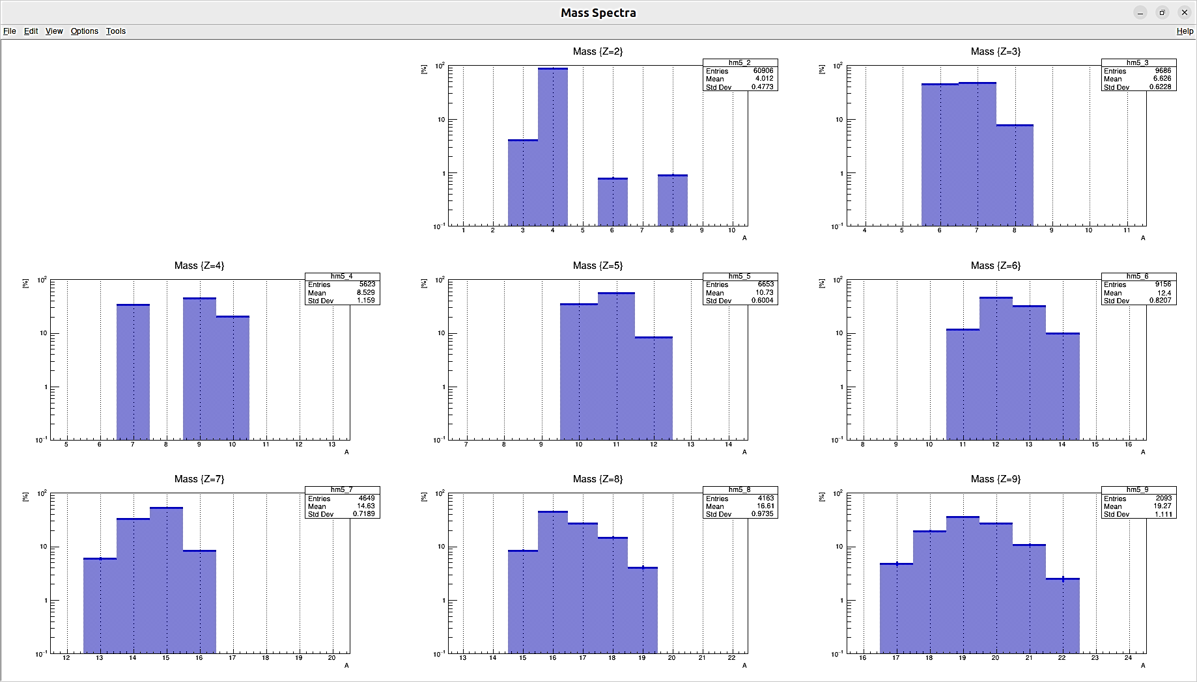
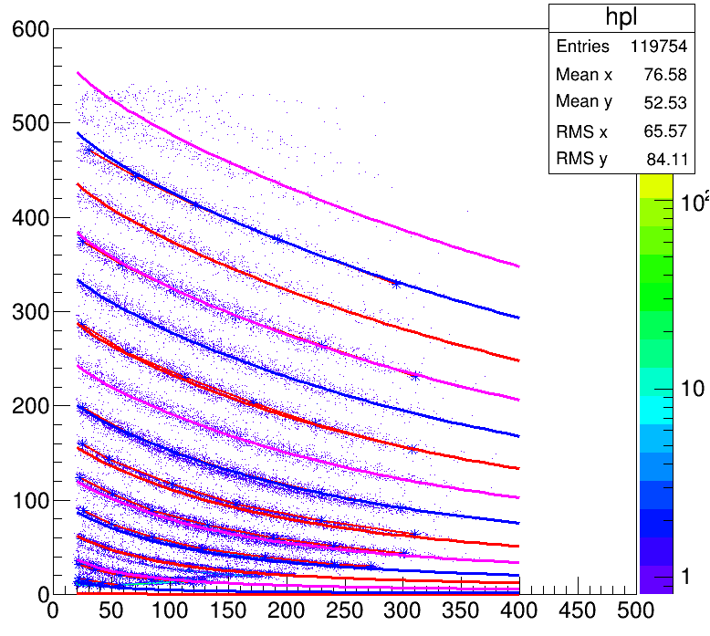
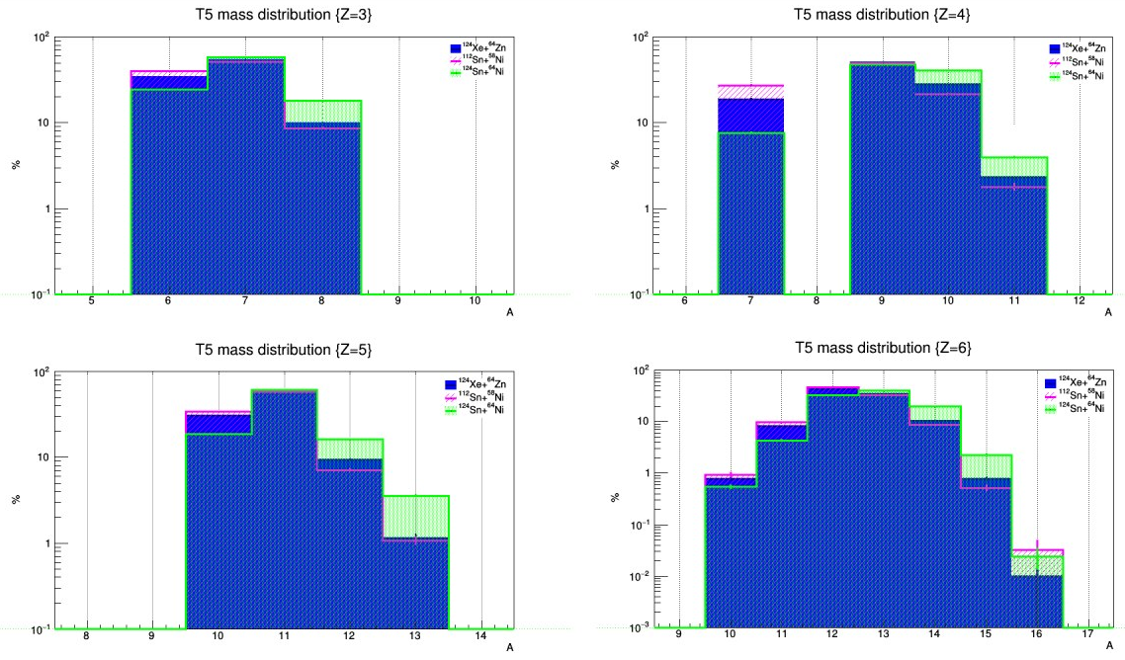
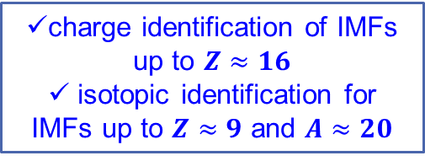
Particle identification and Isospin role in HI collisions
¹¹²Sn+⁵⁸Ni
@ 20 AMeV
[%]
[%]
ΔE [MeV]
Z
charge identification of IMFs up to $Z≈16$
isotopic identification for IMFs up to $Z≈9$ and $A≈20$
E [MeV]
Preliminary analysis from FARCOS data, without selection of global variables (future analysis)
[%]
[%]
IMFs isospin distribution follows initial Isospin content: memory of initial conditions is not lost
effect of neutrons enrichment!
A
A
[%]
[%]
For more information, let’s visit the poster.
Thanks!
A
A

