Slide 1

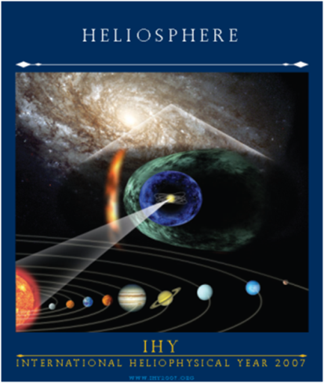
Solar modulation theory and models
Essence of charge-sign dependent modulation in the heliosphere
Marius Potgieter
Guest Researcher, IEAP, CAU in Kiel, Germany
Part 1: Theory & Concepts
Part 2: Applications & Predictions
What is this all about (what we need)
Theory.. to be tested
Comprehensive numerical models
Proxies for solar activity; wavy HCS.
Heliospheric magnetic field, HMF
Heliospheric boundaries; TS, HP and more.
Heliopause spectra (HPS = very LIS = VLIS)
And good observations of GCRs …
Workshop, IFPU, Trieste, 15-19 Nov 2021

Slide 2
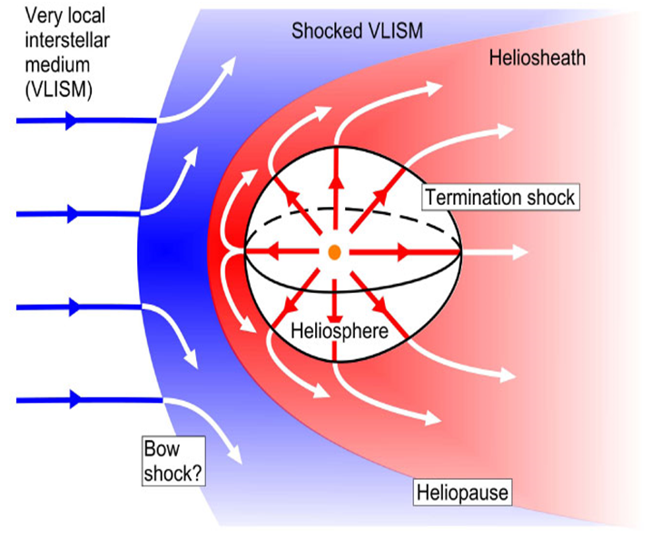
Theory & Concepts
Conceptual Heliosphere
Termination shock observed at : 94 AU (V1) and 84 AU (V2)
Heliopause observed at : 121.7 AU (V1) and 119.0 AU V2)

Slide 3
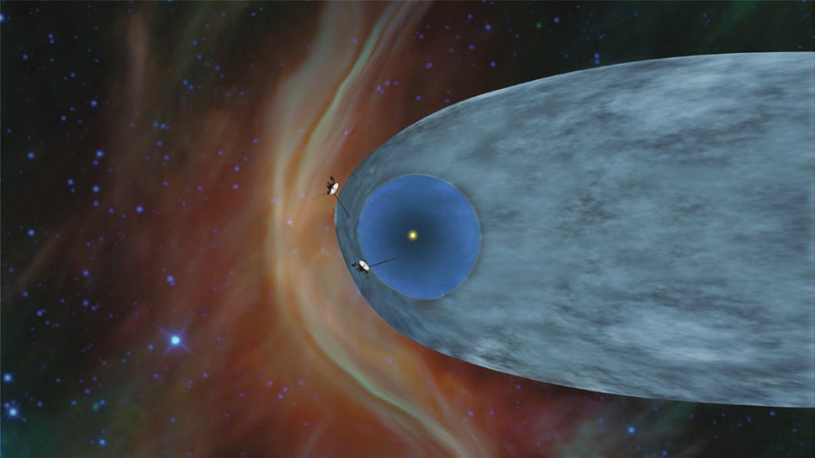
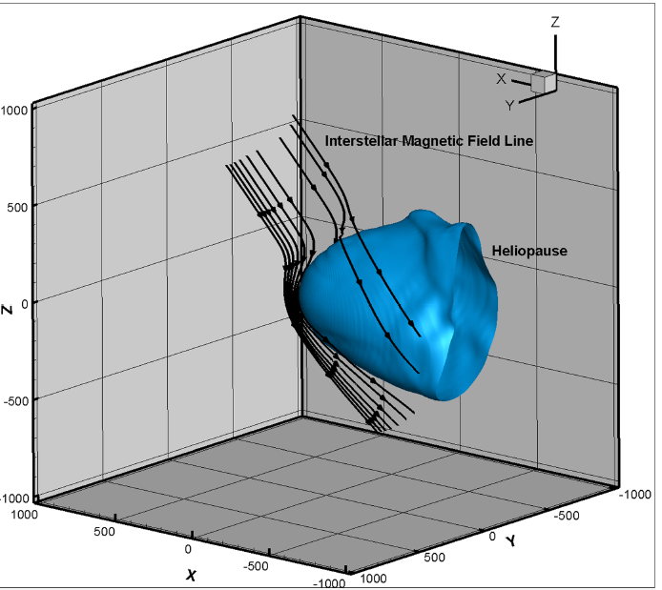
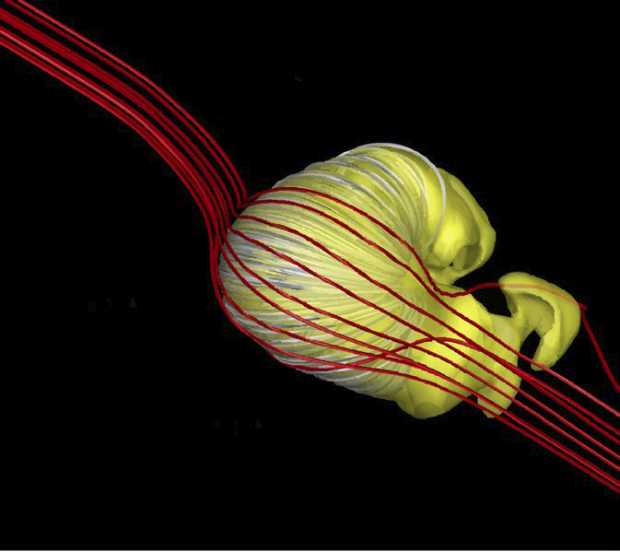
Simulated Heliosphere
Standard MHD view
V1
V2
Opher et al. (Nature Astron. 2020)
Xi Lou et al. (ApJ. 2015, 2016); studies of GCRs at and just beyond the HP; how do they come in…?
Does this imply that the VLIS at the HP could be somewhat different depending on the direction of the Interstellar Magnetic Field.
See also Pogorelov et al. (SSR, 2017)
Small and almost round heliosphere

Slide 4
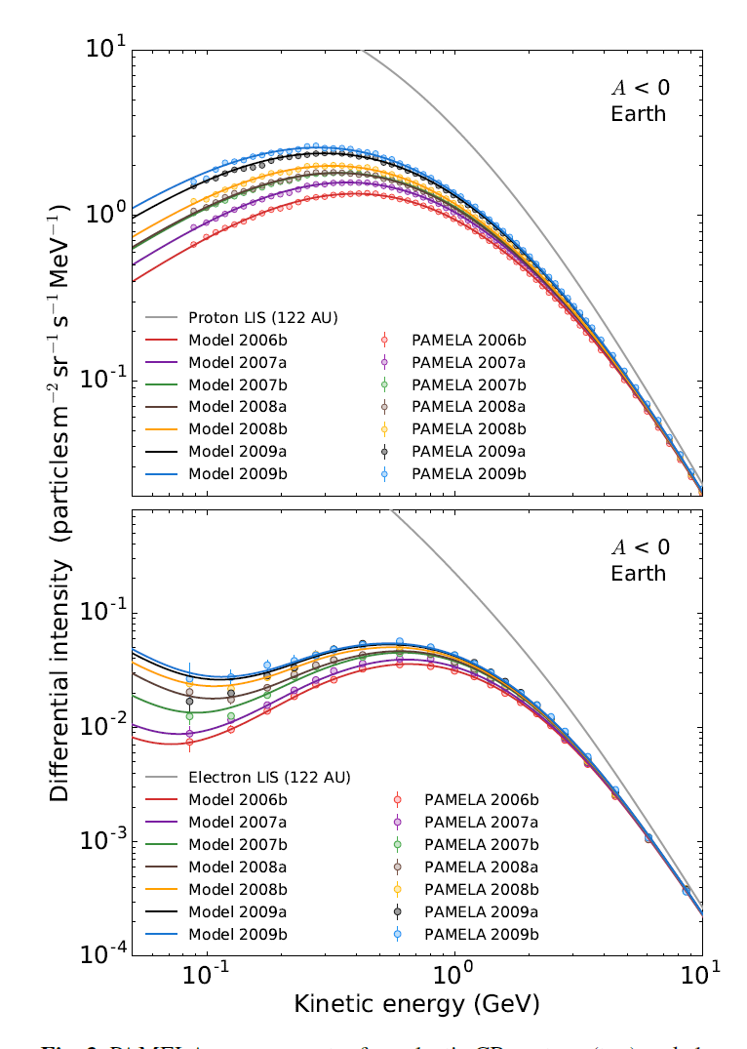
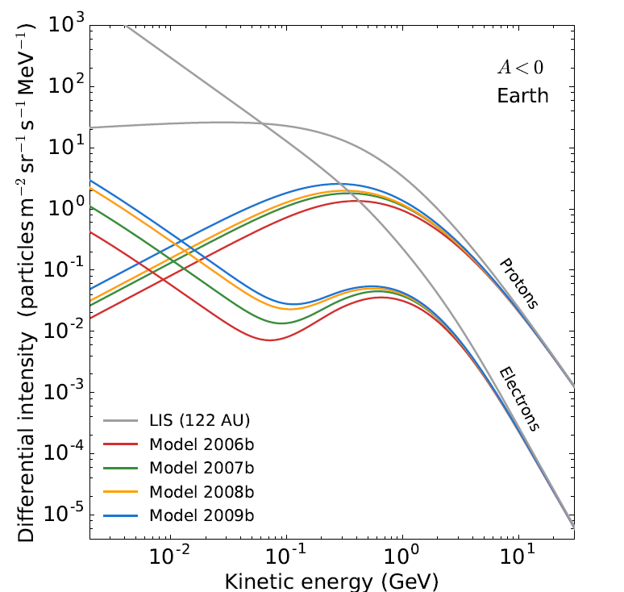
Illustrative examples of solar minimum observations and modeling
Main features of proton and electron modulation from PAMELA at the Earth
(as introduction for those of us not working on this everyday)
Protons
VLIS
Electrons
Potgieter et al. (SolP, 2014, ApJ 2015); Potgieter & Vos (A&A, 2017).
What is needed for this type of modelling?

Slide 5
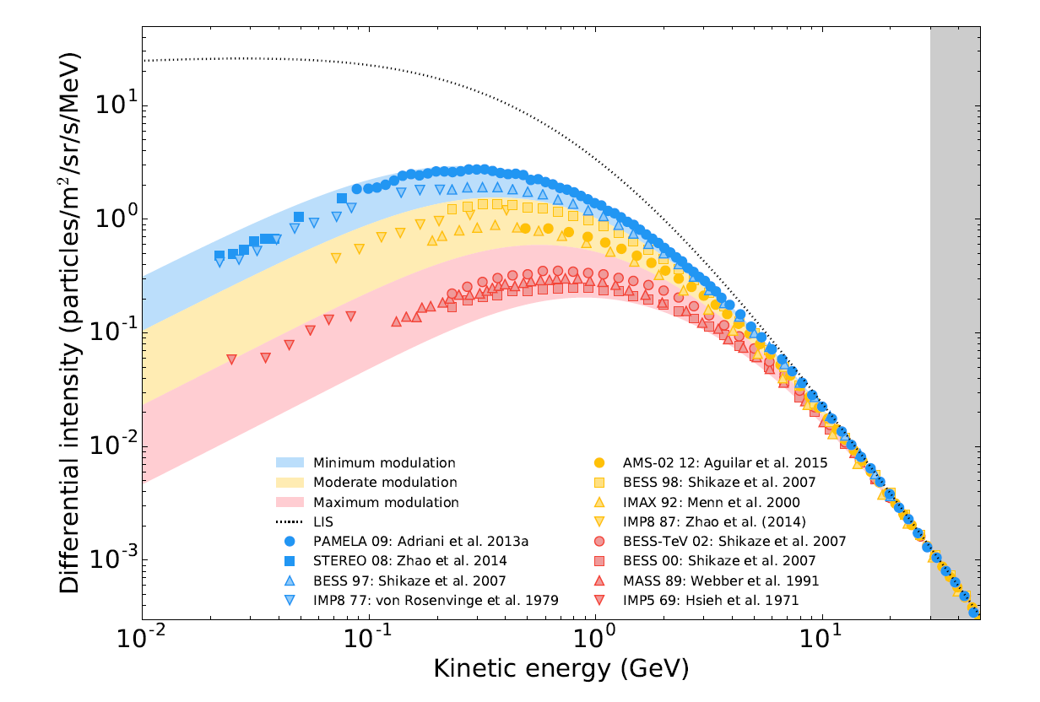
Concepts of solar min. & max. modulation for protons
Vos & Potgieter (ApJ., 2015)

Slide 6
Theory as in Parker’s TPE
Two versions of Parker’s (1965) transport equation (TPE) is:
f is the distribution function with differential intensity: I = p²f,
with p momentum (or rigidity if preferred).
V is the solar wind velocity
K is the propagation tensor, containing three diffusion coefficients and the particle drift coefficient.
Assumption of small anisotropies; cannot be used effectively if particles stream mainly along magnetic field lines.
There is a third version of this TPE…popular one.. But first the simplifications!

Slide 7
Simplified solutions of the TPE
Convection-diffusion approach
Modulation parameter; quite elegant…

Slide 8
Simplified solutions of the TPE
Force-Field approach
This resembles an energy loss without considering the adiabatic process
Approximated Force-Field approach

Slide 9
Spherically symmetric 1D steady-state TPE
Much better than the Force-Field approach

Slide 10
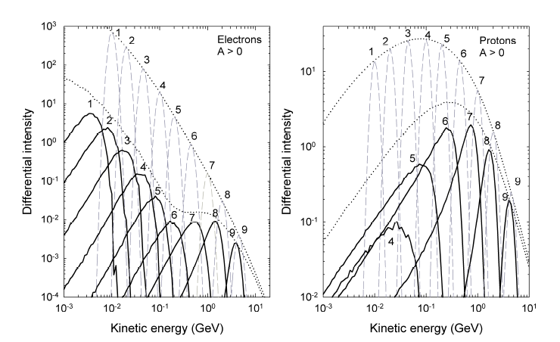
Focus on adiabatic energy loss mechanism
e.g. Moraal & Potgieter (1982); Strauss & Potgieter (2011)

Slide 11
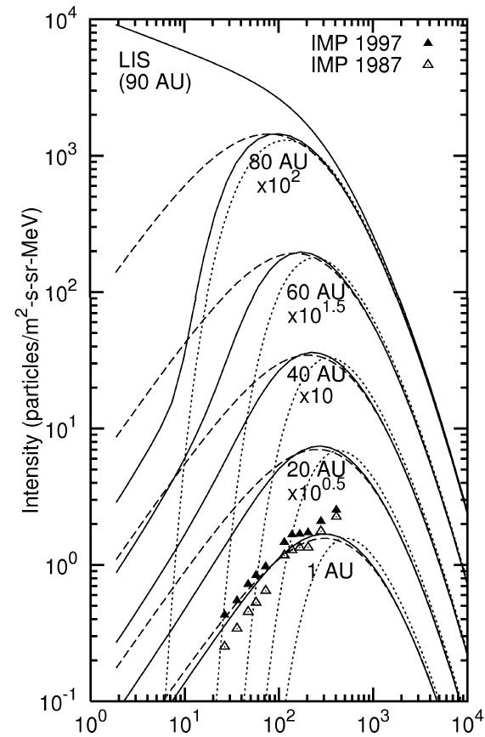
Comparison of the three 1D modeling approaches
Dotted lines: Diff&Conv
Dashed lines: FF-approach
Solid lines: 1D numerical model
Caballero et al. (2004)
MeV

Slide 12
Transport equation for the transport, modulation and
acceleration of cosmic rays in the heliosphere
Time-dependent, pitch-angle-averaged distribution function
Diffusion
Convection with solar wind
Particle Drifts
Adiabatic energy changes
Any local source
e.g. Jovian electrons
This TPE is generally good enough except for processes inside the heliosheath such as:
Diffusion in momentum space/
second order Fermi acceleration
Which seems required to describe the origin of ACRs beyond the TS…
Or close to the Sun or where ever an almost isotropic distribution cannot be assumed…
Parker (Planet. Space Science, 13, 9, 1965)

Slide 13
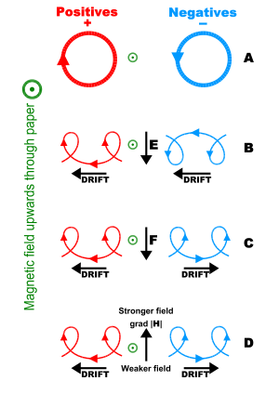
Two processes/mechanisms that can
cause the phenomenon of charge-sign dependent modulation
Basic concepts of how differently positively and negatively charged particles behave with respect to external fields
Gradient and curvature drifts
First introduced by Jokipii et al. in the late 1970’s; first generation numerical models followed in1980’s, the second generation in 1990’s and the third generation after 2000; SDE 3D approach since 2010.
For a proper reference list, see ASR reviews by Potgieter (2014, 2017).
This process causes a 22-year modulation cycle related to the direction of the heliospheric magnetic field (HMF) and with the wavy heliospheric current sheet (HCS) as a crucial solar activity proxy.
Magnetic helicity
Mostly work done by Bieber et al. in the 1990’s.
This mechanism was shown to be effective at lower energies (100 MeV range); but cannot explain 22-year cycle observed at higher KE.

Slide 14
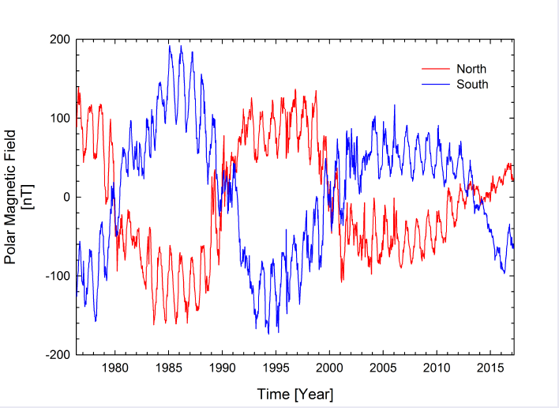
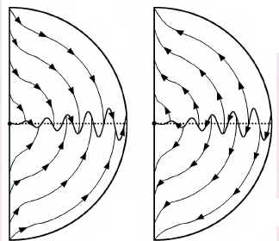
Conceptual drift directions of oppositely charged particles
Drift direction of protons in
A < 0 cycles
Drift direction of electrons in
A < 0 cycles
B
HMF directions in blue
During A < 0 ‘polarity’ cycles, protons drift inwards mainly along the HCS and get therefore modulated according to the till angle but less so during A > 0 cycles. This gives a 22-year cycle…!
S
Wavy HCS
S
Drift direction of electrons in
A > 0 cycles
Drift direction of protons in
A > 0 cycles
B
Jokipii & Thomas (1981)
Reversal of HMF’s ‘polarity’
HMF switches its direction about every 11 years around maximum solar activity…!

Slide 15
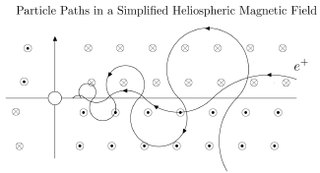
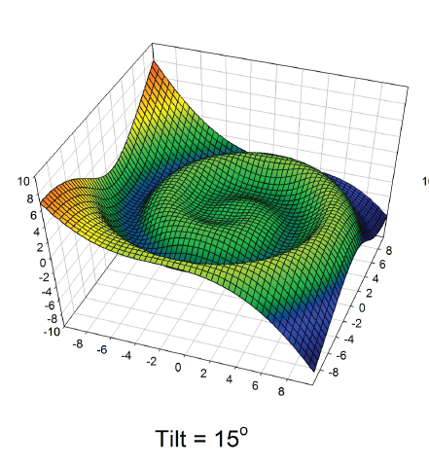
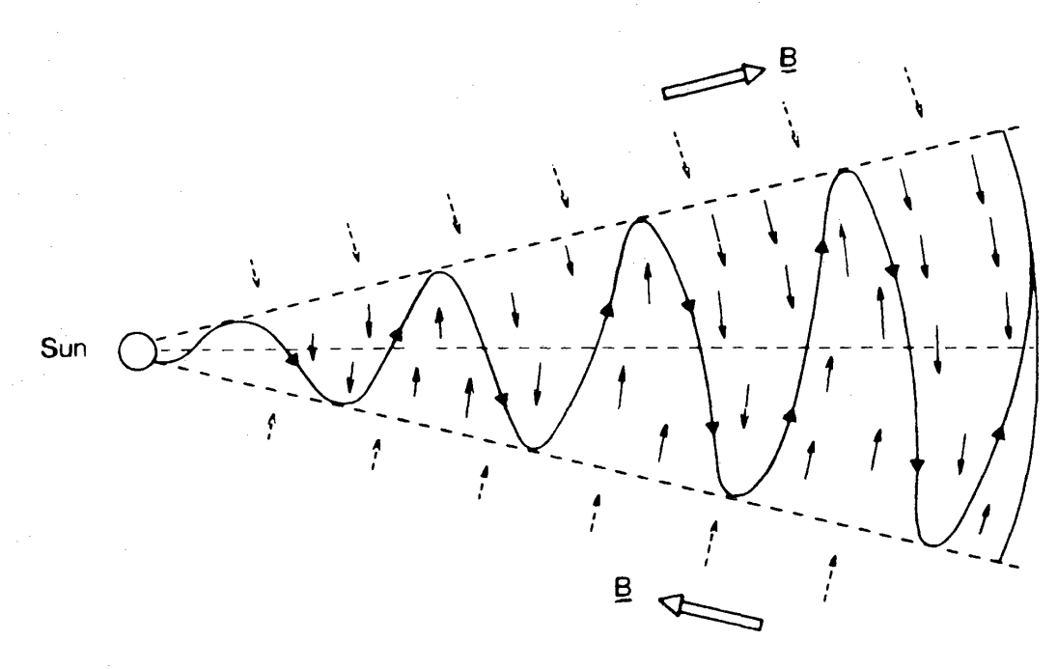
Conceptual wavy HCS and how particles drift
Charged particles drift along any current sheet , with the important characteristic that the divergence of the drift-velocity field MUST be equal to zero.
Particles drifting into a region must drift out of this region…!
B
B
Wavy HCS
Raath (2015)
B
Tilt angle
From a modulation point of view, tilt angles are a good proxy for solar activity; see Wilcox Solar Observatory’s website for how it is defined and calculated.
B

Slide 16
Based on these concepts, what are predicted for GCRs…?
A clear 22-year modulation cycle should be caused by particle drifts…
The wavy HCS should shape the GCR intensity-time profiles with changing HCS tilt angles, much more during A < 0 than during A > 0 cycles.
A charge-sign dependent effect following a 22-year cycle.
Other GCR features which should then have a 22-year cycle:
Radial intensity gradients.
Latitudinal intensity gradients.
Diurnal anisotropies even at NM energies.
dN/dP’s of NMs obtained with geo-latitude surveys.
Recovery times and amplitude of Forbush decreases.
A cross-over in the energy spectra of A > 0 and A < 0 cycles which has been the most difficult prediction to find conclusively…!
Challenge that had turned out was that none of these predicted effects were observed as large as predicted by original drift modulation models; later known as drift dominated models. The Ulysses mission had played an important role in establishing this…and continued by PAMELA and AMS02.

Slide 17
Spatial distribution of GCR intensities illustrating drift effects
Side view
HP
TS
S
Protons (A < 0)
In equatorial plane: really large radial gradients in the inner heliosphere but smaller ones in the outer heliosphere and heliosheath.
Protons (A > 0)
In equatorial plane: very small radial gradients in the inner heliosphere but steep ones in the outer heliosphere and very steep at HP.
Langner, Potgieter & Webber (2003)

Slide 18
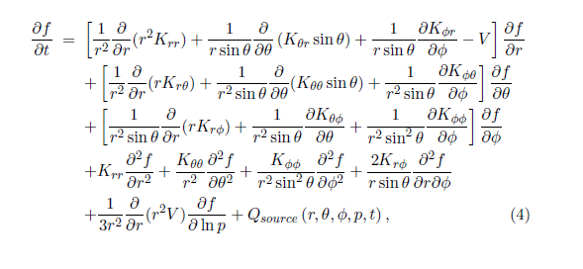
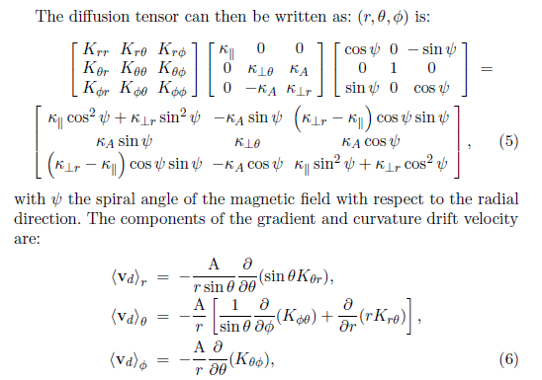
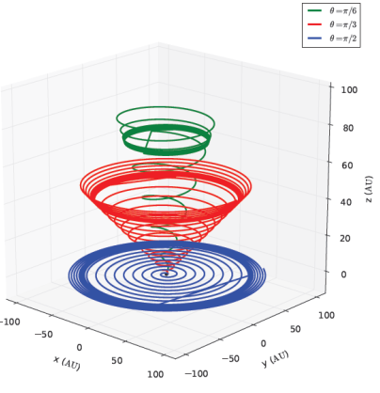
TPE in spherical coordinates with related tensor including drifts
Need to specify these three diffusion coefficients and the drift coefficient to solve TPE; can get very complicated if turbulence theory is used…
Only when the HMF has no latitudinal component e.g. Parker’s field shown here below.

Slide 19
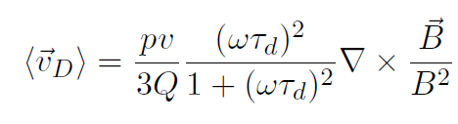

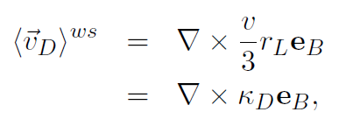


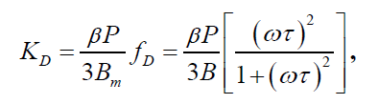
Basic particle drift theory (and the trouble with it)
Generalized averaged drift velocity can be written as:
with B the HMF, p is momentum, v is particle velocity, Q is particle charge; ω the gyro radius and τ the time between scatterings (here’s the trouble)..
If weak scattering is assumed
With the drift coefficient in the propagation tensor of the TPE
Weak scattering (Forman et al. 1974) was
assumed for many years, producing maximum drift effects in modulation models. First modifications were required to explain Ulysses observations and more modifications followed afterwards.
ωτ = constant value: e.g. ωτ =10 (Potgieter et al. 1989)
ωτ = constant value x rigidity (Burger et al. 2000)
ωτ has a complicated spatial and rigidity dependence (Engelbrecht 2019)
In literature: κ_{D} = κ_{A} = κ_{T}

Slide 20

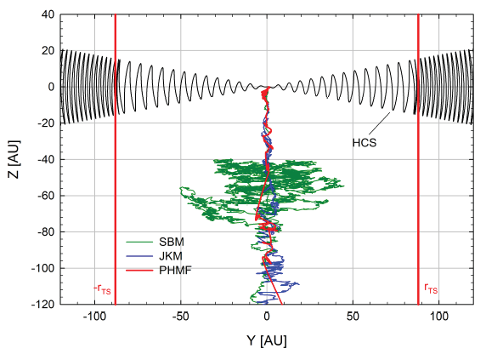
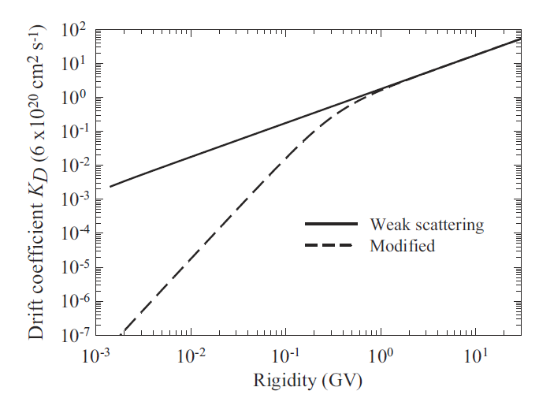
Modification of the drift coefficient (drift velocity) in models
Direct or explicit reduction as on the previous slide, with some theoretical motivation but usually related to reproducing observations; then, the drift coefficient usually applied is:
Reduction through the modification of the global HMF geometry and its magnitude (B)
Burger et al. (2000); Ngobeni et al. (2015); Nndanganeni & Potgieter (2016) and many more
Indirect or implicit reduction related to reproducing observations.
Much more subtle because it involves changing the three major diffusion coefficients with diffusion in the heliospheric polar direction the most ‘powerful’ drift reducer.
JKM: Jokipii & Kota modification (1989)
SBM: Smith & Bieber modification (1991)
Raath et al. ASR (2016)

Slide 21
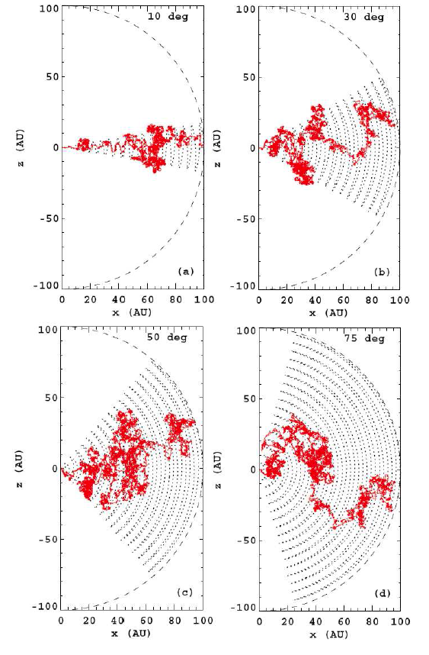
Implicit reduction of HCS drifts
Proton trajectories in the heliosphere along the HCS; Insights from of SDE models
Increasing HCS tilt angle for A < 0 from 10º to 75º
Decreasing diffusion coefficient, 10 times for each example, causes stronger drifts but the drift coefficient and the tilt angle (at 45⁰) have remained unchanged
45º
45º
10º
30º
Clustering is caused by 3D effects
50º
75º
45º
45º
Strauss, Potgieter, Kopp & Büsching, A&SS, 2012.

Slide 22
Theory and dimensional complexity (1D to 2D to 3D)
Analytical solution of basic TPE (1960’s)
Convection-diffusion approach
Force-Field approach
Steady-state numerical models
1D approach (early 1970’s) One DC (diffusion coefficient)
2D approach (late 1970’s) Two DC’s
3D approach (early 1980’s) Particle drifts and two DC’s
3D approach (early 1990’s) Particle drifts and three DC’s
Time-dependent models
1D approach (early 1980’s)
2D approach (early 1990’s)
3D approach NOT DOABLE IN INFINITE-DIFFERENCES METHODS
Need approach of Stochastic Differential Equations

Slide 23
End of Part 1
Questions?
Next:
Predictions & observations
of
charge-sign dependence

Slide 24
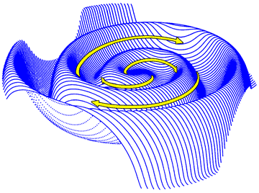
Modulation of Galactic Cosmic Rays observed at sea-level
compared to two solar activity proxies
GCRs at sea-level
Hermanus NM
A < 0
A > 0
A < 0
A > 0
A < 0
A > 0
A < 0
A > 0
A < 0
A > 0
A < 0
A > 0
Monthly avg.
sunspot numbers
WSO
Tilt angle

Slide 25
Part 2: Models, Applications and Predictions
Explaining numerous GCR observations
Conventions and assumptions
GCR modulation in terms of energy/rigidity spectra always w.r.t. an assumed VLIS (or HPS),
specified at the heliopause (HP;122 AU) as modulation boundary.
Illustrates
How new HPS from Voyager 1 & 2 deviates from a computed GALSPROP LIS.
Total modulation between HP and the Earth.
Radial dependence of GCR protons.
Role and effects of adiabatic energy loss for protons, and why the Force-Field approach cannot be used to calculate the VLIS below about 500 MeV based on observations at Earth.
Progressively less modulation with increasing KE; tricky above 10 GeV.

Slide 26
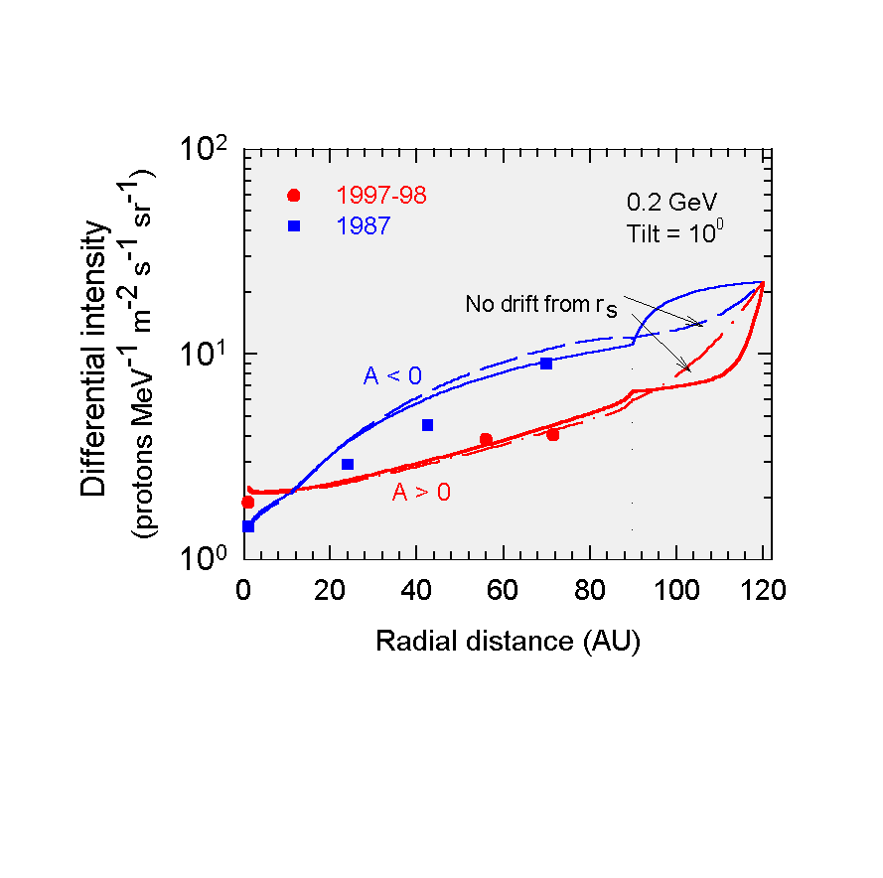
GCR proton radial profiles; 22-year pattern
LIS at 120 AU; TS at 90 AU.
Characteristics
Radial gradient during A < 0 varies from large to small with increasing AU.
Radial gradient during A > 0 varies from small to large with increasing AU.
Speculation about drifts in the heliosheath…? Strong TS effect.
Filled circles represent A > 0 data, the squares represent A < 0 data from IMP, Pioneer 10, Voyager 1 and 2 (Webber & Lockwood, 2001a).
Langner, Potgieter & Webber (JGR, 2003)

Slide 27
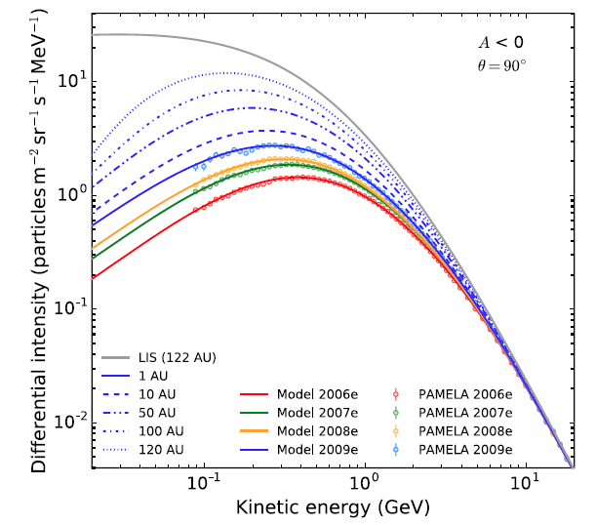
Global Modeling of Cosmic Protons
PAMELA proton observations from 2006 to 2009;
A < 0. Model simulations from 1 AU to 120 AU in equatorial plane; LIS at HP at 122 AU.
Vos & Potgieter (Solar Phys. 2016).
PAMELA protons at Earth; Voyager 1 protons from Aug 2006 to Aug 2012;
A < 0; model simulations from 1 AU to 120 AU in equatorial plane;
LIS at HP at 122 AU. TS moves with solar cycle.
Vos & Potgieter (Solar Phys. 2016).

Slide 28
Major features of the role of drifts for observations near Earth:
Required as validation for ALL numerical models
A > 0
A < 0
Computed and observed proton spectra at Earth,
For A< 0 and A > 0 solar minima, with a spectral crossing.
Tilt angle = 10⁰
LIS (solid black line) at 120 AU; TS at 90 AU
Observations from: McDonald et al. (1998)
Computed latitudinal gradients compared to Ulysses-KET observations, for A > 0 solar minimum (tilt angle =10⁰ ) to maximum (tilt angle = 75⁰ ).
Ulysses observations: Heber et al. (1996, 1997).
Model reproduction only possible when the drift coefficient is modified at lower KE; first major modification…
Langner, Potgieter & Webber (JGR, 2003; ASR, 2004)

Slide 29
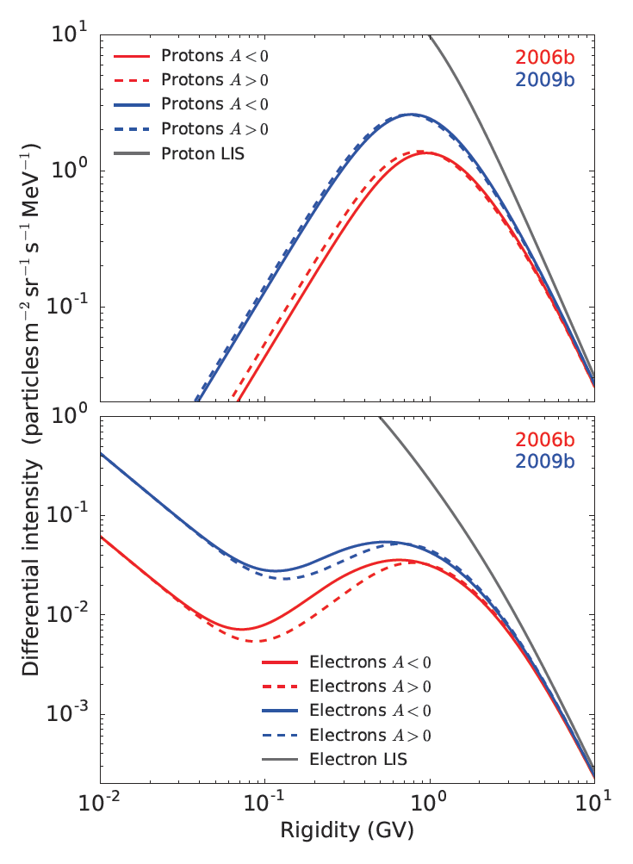
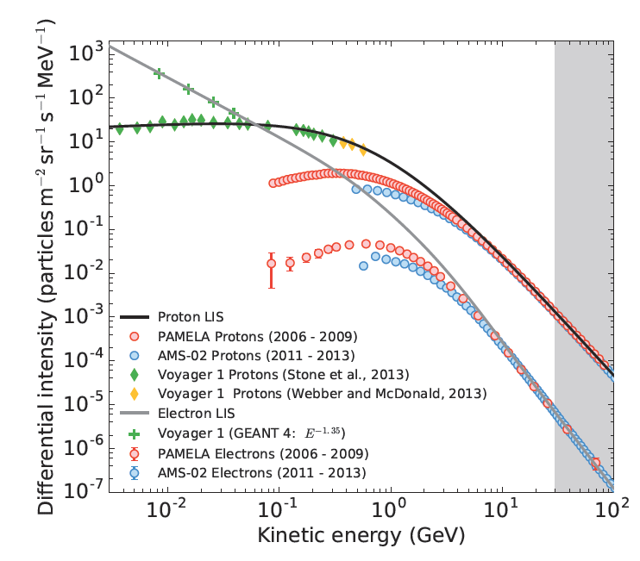
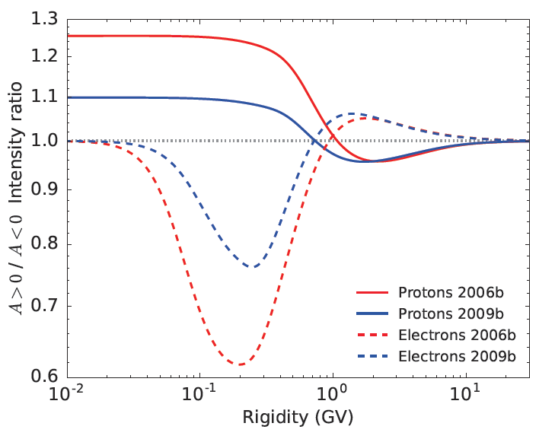
Drift effects: Cross-over of A < 0 & A > 0 spectra
We now need to see what AMS02 observed in minimum of 2020-2021?
Potgieter & Vos (2017)

Slide 30
Highest every recorded cosmic ray protons in 2009; form PAMELA
and quite unexpected…
Red data points: A < 0 cycles
Blue data points: A > 0 cycles
Strauss R.D., Potgieter M.S. Is the highest cosmic rays yet to come? Solar Physics, 2014

Slide 31
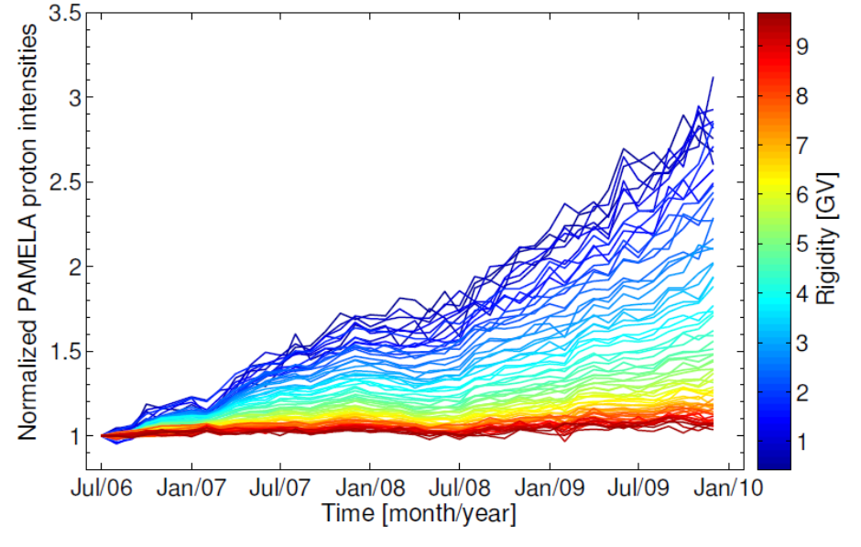
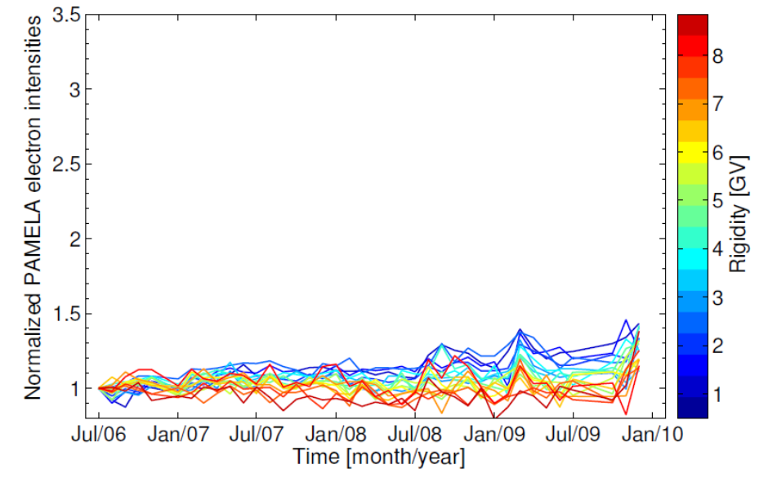
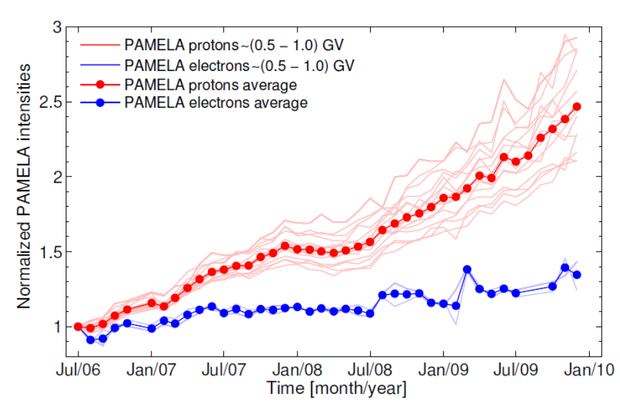
PAMELA Observations and Charge-sign Dependence
Protons
Electrons
New evidence of charge-sign-dependent (drift) modulation for 2006-2009 from PAMELA…!
But, much smaller than anticipated from modelling of previous solar minimum activity periods….!
The 2009 minimum was different from those ones before…
Protons
Electrons

Slide 32
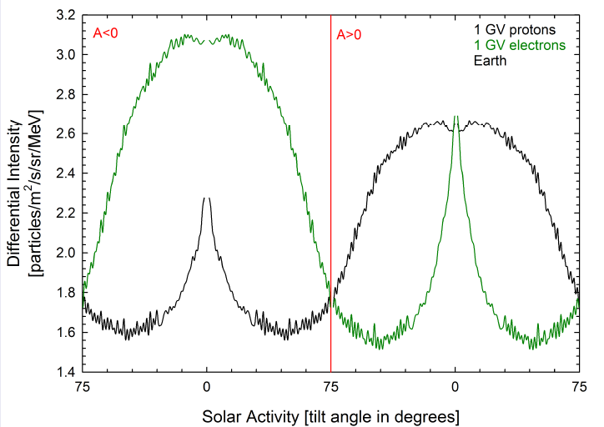
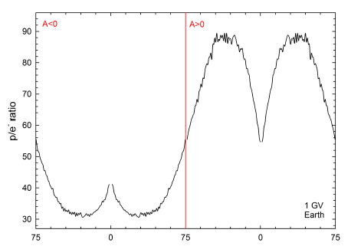
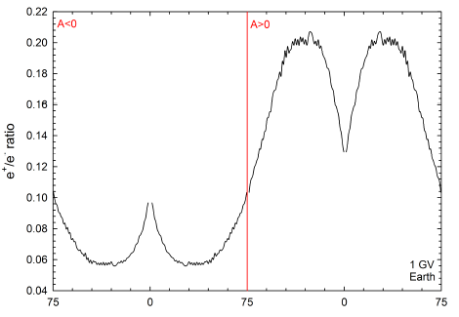
Drift & HCS effects in electron, positron and proton modulation
Predictions of a drift dominated model when the tilt angle is the only time-dependent parameter
Proton to electron ratio
A < 0
A > 0
A < 0
A < 0
Positron to electron ratio
These very clearly predicted patterns had turned out to be too idealistic; the wavy HCS is not the only time-dependent parameter of importance !
This was again first modified by Ulysses observations…and lately by PAMELA and AMS02 observations – more on this follows…!
Raath (2015)

Slide 33
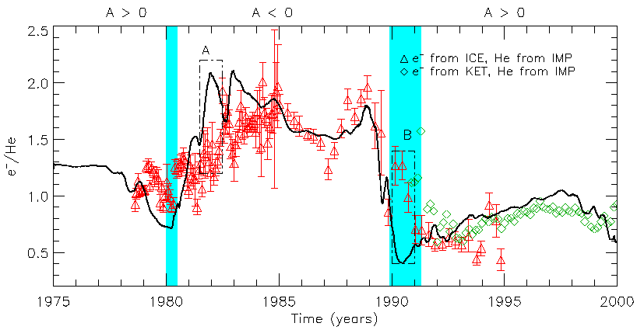
Observed charge-sign dependent modulation over two solar maxima
Electron measurements form ISEE/ICE (Clem et al., 1996; Evenson, 1998) and KET (Heber et al. 1996, 1999, 2001, 2002; Clem et al. 2002).
He measurements from IMP (McDonald, 1998, 2001).
W
Model
Solid line: Time-dependent model from Ferreira et al. (2003a,b)
M
Based on 2D time-dependent modelling of cosmic ray intensities along the Ulysses trajectory.
Ndiitwani, Ferreira, Potgieter & Heber (AG, 2005).
Conclusion: Heliospheric particle drifts reaches a maximum during the years of solar minimum modulation, then follows trend in solar activity, reducing to a few % during extreme solar maximum activity.
Any doubts? Yes, how robust is thus? Will it be the same with a 3D model? Problem: 3D-time with ADI numerics not possible…

Slide 34
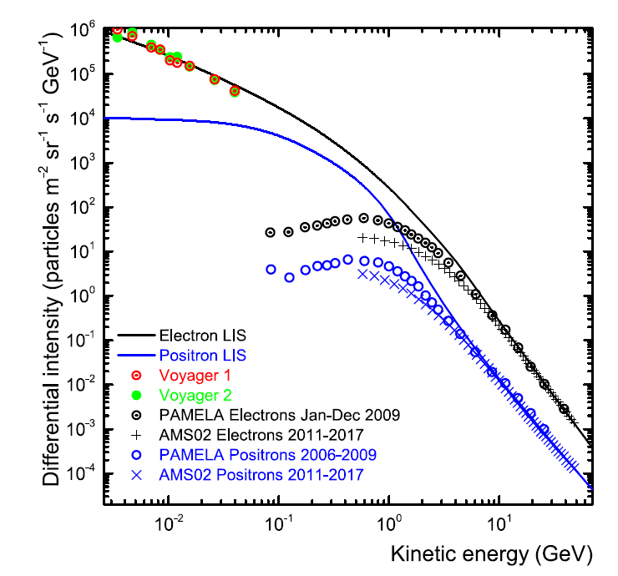
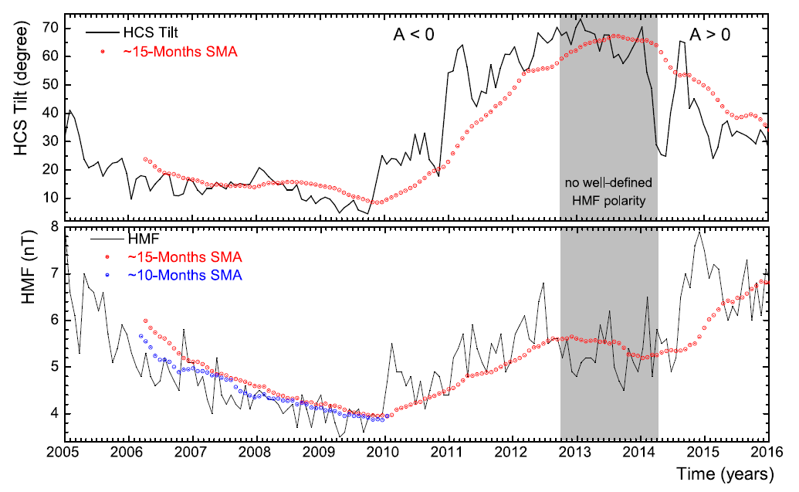
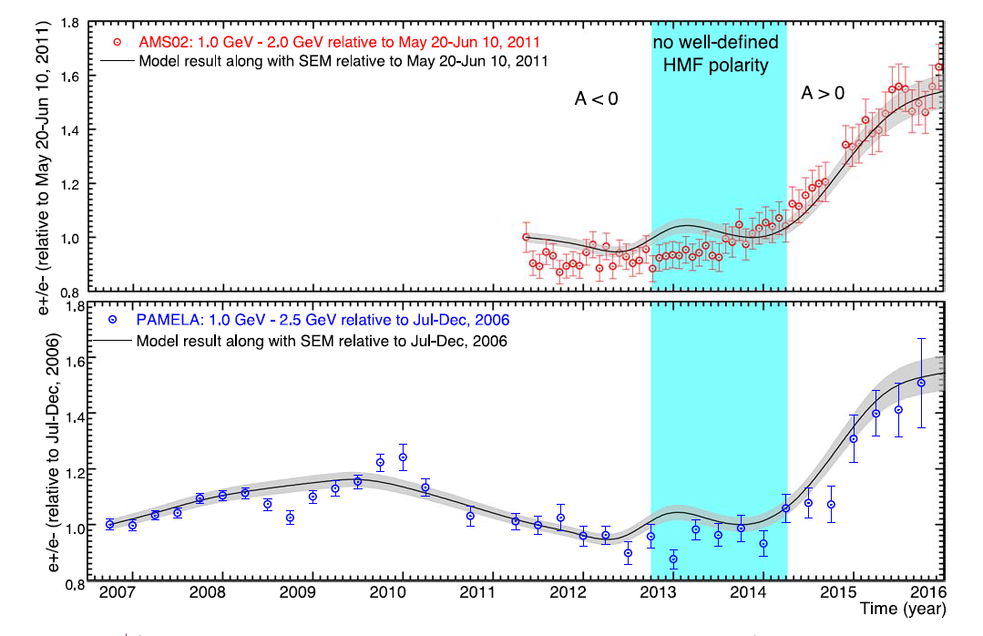
Numerical model for e⁺ & e⁻ modulation from 2006 to 2015
Aslam O.P.M., Bisschoff D., Ngobeni M. D., Potgieter M. S., Munini R., Boezio M., Mikhailov V. V. Time and charge-sign dependence of the heliospheric modulation of cosmic rays. Astrophys. J. 909, 215:1-13, 2021.

Slide 35
Detailed modeling of GCR positrons and their drift dependent modulation
Aslam O.P.M., Bisschoff D., Potgieter M. S., Boezio M., Munini R. Modeling of heliospheric modulation of cosmic ray positrons in a very quiet heliosphere. Astrophys. J. 873, 70:1-11, 2019.

Slide 36
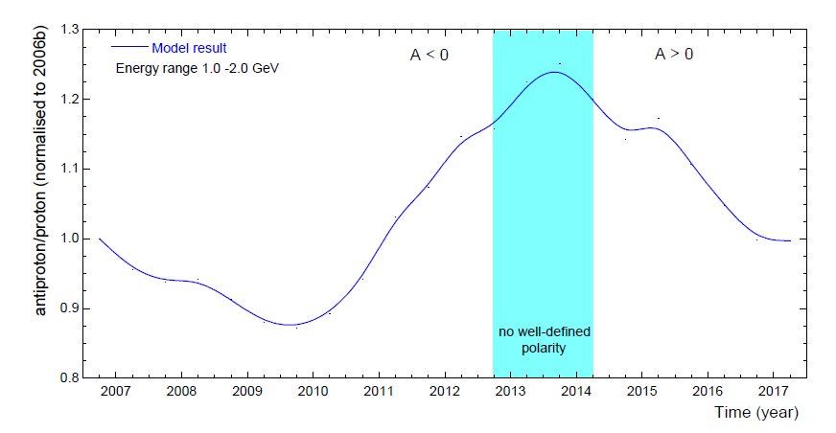
Detailed modeling of GCR anti-protons
Aslam O.P.M. et al. (ICRC2019)

Slide 37
The diffusion and drift MFP’s required for 2006 to 2017

Slide 38
The END

