Slide 1
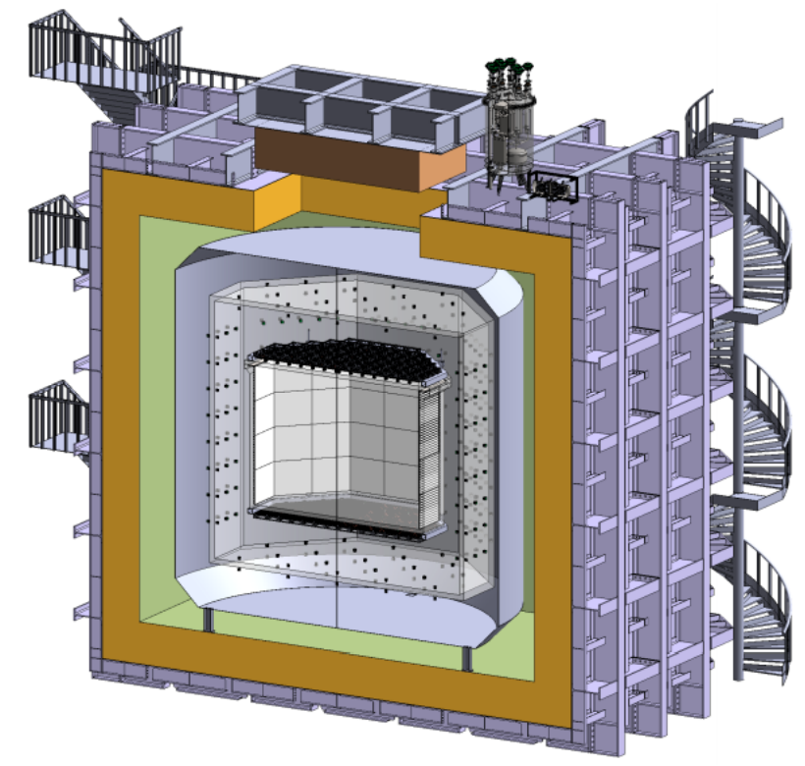
Surface Treatments Protocols for DarkSide:
Copper
Stainless Steel
Acrylic
Others????
Cleaning Protocols Evaluation

Slide 2
Cleaning Protocols Evaluation
Materials:
  Copper (motherboards)
  Acrylic (Veto)
  Stainless steel (?)

Slide 3
Cleaning Protocols Evaluation
Copper (Mother boards): CUORE Protocol Reduced
  Tumbling
  Electro Polishing (100 microns)
  Chemical etching SUBU
  Manipulation with double gloves
  Transport in triple bags under vacuum

Slide 4
Cleaning Protocols Evaluation
Acrylic Veto: (at least 100 k€ for a plant that treats dimensions 2mx2m with one torch), radioactive tests are needed
  Atmospheric plasma
  Manipulation with double gloves
  Transport in triple bags under vacuum

Slide 5
Cleaning Protocols Evaluation
Stainless Steel: new chemical plant is needed (at least 100 k€ for a plant that treats dimensions like motherboards), radioactive tests are needed
  Tumbling
  Electro Polishing
  Chemical etching
  Manipulation with double gloves
  Transport in triple bags under vacuum

