Slide 1
Material Screening and the Database
Krzysztof Pelczar, UJ for the Materials WG
11th February 2020

Slide 2
Database entry/Request structure…
is meant for grouping samples from the same „device” of the detector (e.g. PDM module) or samples being candidates of materials/components.
Request
Resistors (functionally the same candidates)
Sample 1
Resistor from manufacturer #1
Sample 2
Resistor from manufacturer #2
etc.
Resistor from manufacturer #3
Important! A sample is defined by all its properties – not only generic „type”, i.e. even a production date (batch) matters. If an amount of material is split (in a clean way) for assays in different labs – we must assume it is the same sample.

Slide 3
Assays since Fall 2019 (Q4 2019/Q1 2020)
Institution Nov – Now (all)
BHSU (3)
Carleton U (4)
CIEMAT/LSC 5 (24)
Jagiellonian U 5 (37)
MSU 2 (7)
LNGS 6 (47)
PNNL (9)
Princeton U (2)
SNOLAB (7)
Temple U (9)
14 samples screened:
Gadolinium compounds (sulfate, oxide)
Electronic components (HV3418, HV5523, LMH6629, LTC6820, OPA356, capacitors, resistors, inductors)
PIP CCL PCB, Pyralux Motherboard strip
HV Sami Cables (finished jacket)

Slide 4
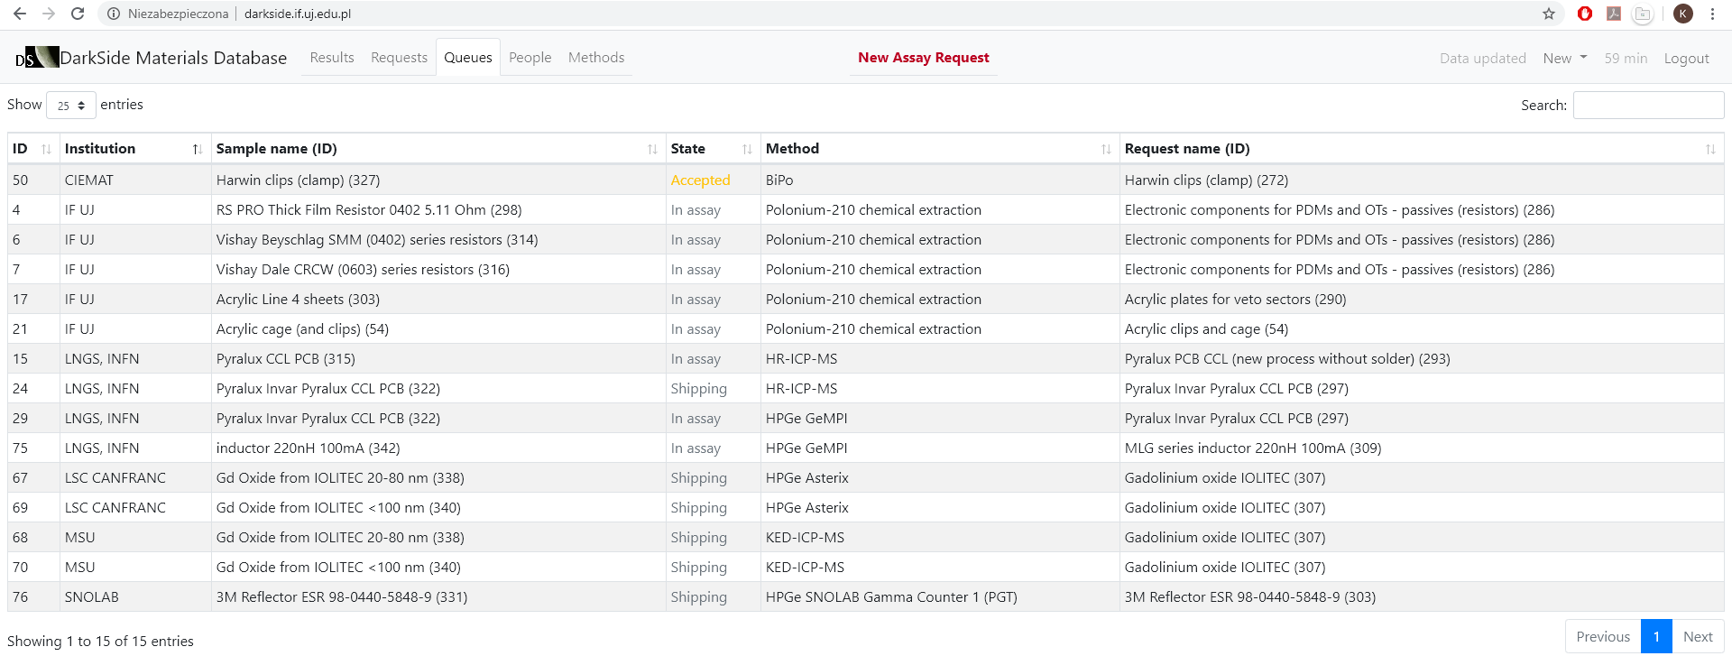
Assays since Fall 2019 (Q4 2019/Q1 2020)
A few samples in the queues:
Gadolinium compounds – other suppliers
CMOS readout ASIC, 3M reflector foil
Clevios conductive polimer – Rn emanation, PCBs for Rn emanation

