Slide 1
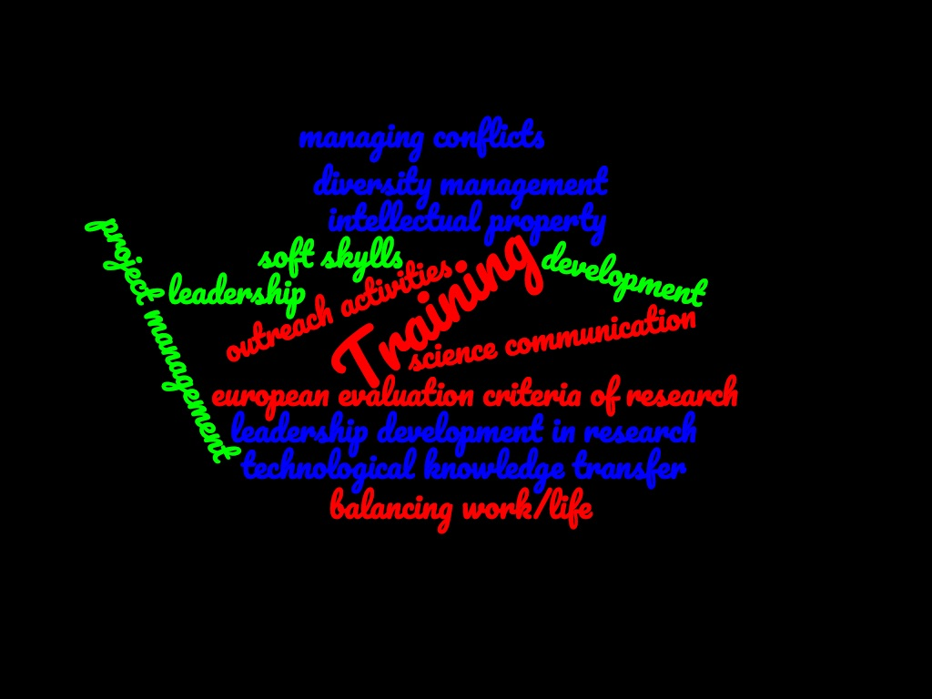
Training and mentoring possibilities
24/25 February 2020
First general meeting of the Fellini programme
Maria Rosaria Masullo (Na unit) Coordination Board
masullo@na.infn.it

Slide 2
Personal Career Development Plans (CDP)
Fellini is not only a research programme, but also « provide all Fellows with an
ideal basis for their future careers, preparing them for a wide range
of career options »
In this context the Personal Career Development Plan is an important tool
Fellows are required to define it at beginning of their programme, with input also from supervisors and the CB, according to their needs. CDPs will be formally updated annually.
The CDP will comprise fellows’ scientific objectives and training needs, including complementary skills:
primarily on scientific and technological knowledge through research on individual, personalised projects;
management and financing of research projects and programmes;
intellectual property rights;
entrepreneurship, how to create spin-off companies;
science communication, dissemination skills
soft skills
public engagment

Slide 3
The training inside FELLINI
Desirable competences to be developed for being a researcher in Europe:
Communicate with the wider community, and with society generally, about your areas of expertise
Coach PhD researchers, helping them to be more effective and successful in their R&D trajectory
Understand the value of your research work in the context of products and services from industry and other related employment sectors

Slide 4
The training inside FELLINI
Train young researchers in their field of research
Improve the young researcher employement perspective
Strengthening of researchers' skills and career development
Strengthen the creative and innovative potential of researchers through intersectoral mobility
Interdisciplinary research training
Provide the researchers with organizational and soft skills necessary for team-based research work
Intellectual Property and Technology Transfer
Work-life balance, time management

Slide 5
The training inside FELLINI
Provide opportunities for increasing managerial experience through access to the INFN internal training programme, and to enhance the multi-disciplinarity of training, increasing the level and quality of interaction with other excellent research centres and with private companies.
Improve soft skills of the fellows with their admission to the existing internal training programme and with ad hoc format.

Slide 6
Which kind of useful expertise can you find inside INFN ……….
A national Committee on the «Third Mission» (outreach, dissemination): CC3M ( in each INFN division there is a local contact person)
The primary objective of the Committee is to coordinate local initiatives for the dissemination of scientific culture with an impact on a national level
A National External Funds unit for supporting the INFN researchers (in some INFN division there is a local contact person….work inprogress) :
https://fondiesterni.infn.it/index.php/it/
fondiesterni@lists.infn.it
A National Committe for Technological Transfer (CNTT) and a Central Office in Frascati ( in each INFN division there is a local contact person)
https://web.infn.it/TechTransfer/index.php/en/
Technology licensing, fostering innovation
A central Communication Office that takes care of INFN communication towards the external world and also national outreach events
http://home.infn.it/en/media-outreach
Comunicazione@presid.infn.it

Slide 7
INFN national training programme (https://www.ac.infn.it/personale/formazione/pf2020/PIANO_FORMATIVO_NAZIONALE_2020.pdf)
The national programme includes different technical and scientific courses, which change from one year to the other on the base of employees and administration requirements.
Some examples:
National training for Horizon EUROPE
Physics and Communication: Dissemination and Communication of european project
Physics and Communication: the scientist on the stage. The format and the activities
Normally the training language is Italian, but we can ask for English or organize courses for English speaking people

Slide 8
An example of Training course on «Funding & Grants»
How to write a successful application, as an ERC proposal
How many CV you can write ?
Update your CV
Funding programmes in Europe and in Italy
……….

Slide 9
An example of Training course on Project Management
Introduction to Project management
organization, communication, documentation and management
Project Quality Management
verification and validation processes
Project Risk Management
risks and uncertainties

Slide 10
INFN Physics Schools
Examples
XXXII INTERNATIONAL SEMINAR of NUCLEAR and SUBNUCLEAR PHYSICS "Francesco Romano"
https://agenda.infn.it/event/21318/
Course on Innovative detector (theory and experiment)
https://agenda.infn.it/event/15095/program
XVII Seminar on Software for Nuclear, Subnuclear and Applied Physics and official Geant4 School
https://agenda.infn.it/event/20606/
https://www.facebook.com/SoftwareandGeant4School/?ref=aymt_homepage_panel

Slide 11
Training at companies
Fellows can opt for the opportunity to develop a part of their research project in the industrial environment through a long secondment period they will spend at the companies, working at targeted projects defined such as to allow them to apply to their academic research the acquired experience at the company. The company could help them to find industrial and interdisciplinary applications of their work output.
Companies can provide training on:
project management, technological processes, quality assurance methodology, product development
product lifecycle management, complex project coordination
financial planning of R&D activities
industrial development of R&D results in the microelectronic field

Slide 12
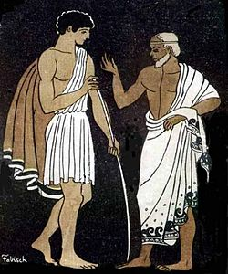
A Mentoring Programme (MP)
The word itself was inspired by the character of Mentor in Homer's Odyssey. In ancient Greek (Μέντωρ) he is a character of Greek mythology, son of Alcimo. Though the actual Mentor in the story is a somewhat ineffective old man, the goddess Athena takes on his appearance in order to guide young Telemachus in his time of difficulty.
Mentor is different from a supervisor/tutor
Mentoring is multidimensional and involves more than the academic part of a person the way tutoring does—it concerns a persons’life. A tutor assists someone with learning a new process or concept, whereas a mentor goes far beyond the role of a tutor.
A mentor intentionally focuses on building quality relationships, sharing life experiences and positive views on making the most out of a person’s future. Tutors focus on short term outcomes whereas mentoring improves the young person’s capabilities for life long learning.

Slide 13
A Mentoring Programme (MP)
The MP will last 10/12 months and will be organised in the second year of the fellowship. It will be a female-female, male-male, male-female mentoring aimed to achieve the own professional development goals of the mentee and to develop their wider career skills.
The pilot programme will be supported by other activities (such as seminars, contact with SME, etc.) that will contribute to sustain the programme.
The main goal of MP is to transfer to young researchers all the expertise needed
to achieve leadership positions in research management, both in academia and in other public or private research centres
to develop personal skill and potential.
In addition, in an attempt to make a real impact on the careers of female researchers, great attention will be devoted to training courses on gender diversity management.

Slide 14
A Pilot Mentoring Programme (MP)
The mentors will belong to Italian and International research community (University and research centres), to SMEs and in any case in fields different from the mentees discipline (transdisciplinary mentoring)
The role of the mentor is:
to provide advice on career paths,
to help navigate organizational politics,
to be a sounding board about office politics,
to prevent isolation at work,
to help create a culture that better supports gender diversity.
A model of relationship centered on mentees.

Slide 15
A Pilot Mentoring Programme (MP)
The objective of MP is to support young researchers in the acquisition of the following skills:
Leadership development in research
Diversity management
National evaluation criteria of research
European evaluation criteria of research
Ability to apply as leader for funding programmes in research
Liaising between the university and private industry
Balancing work/life and leisure
Inclusive communication
Fundamental concepts of diversity and inclusion

Slide 16
QUESTIONS ?
Thanks for the attention

Slide 18
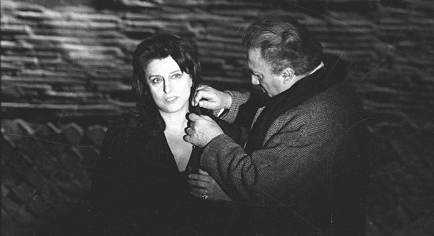
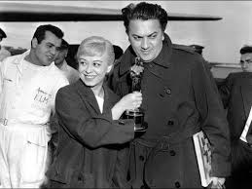
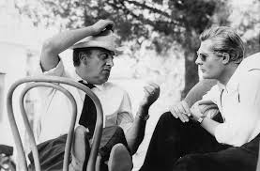
A Hundred Years of Fellini

Slide 19
https://news.fnal.gov/2019/07/luisella-lari-receives-doe-award-for-project-leadership/
https://events.ego-gw.it/indico/conferenceOtherViews.py?view=standard&confId=43
scuola gestita in maggior parte da una sola docente, Luisella Lari che ora dovrebbe essere al Fermilab, project manager in ESS e alla NASA
Occasioni di scambio

