Slide 1
What about your payslip….
Veronica Colautti, AC
25/02/2020

Slide 2
Annual Amount before taxes and social security and insurance withholding, including costs incurred by INFN (Living allowance € 45.540,00 plus Mobility allowance € 4.980,00)
Annual amount
€ 50.520,00
€ 10.498,47
Annual Social security costs incurred by INFN
€ 40.030,53
Employee annual salary before taxes and social security

Slide 3
Employee annual salary before taxes and social security
€ 36.084,53
€ 33.837,41
€ 2.247,12
ANNUAL LIVING ALLOWANCE
Annual Basic payment
Annual Additional payment
€ 3.946,00
ANNUAL MOBILITY ALLOWANCE
€ 40.030,53

Slide 4
Employee annual salary before taxes and social security
Estimated net annual salary
(Case 1: no Tax benefits under Art.44 of Italian law decree78/2010)
€ 40.030,53
€ 3.693,62
Annual Social security costs due by employee
(9,227% calculated on € 40.030,53)
Annual Taxable Income
€ 36.336,91
About 90% to National Government and 10% to Local Government
€ 10.505,80
Annual taxes due by employee
(about 29% calculated on € 36.336,91 )
€ 25.831,11
Estimated net annual salary

Slide 5
Employee annual salary before taxes and social security
Estimated net annual salary
(Case 2: Tax benefits under Art.44 of Italian law decree78/2010)
€ 40.030,53
€ 3.693,62
Annual Social security costs due by employee
(9,227% calculated on € 40.030,53)
€ 36.336,91
Theoretical Annual Taxable Income
€ 3.633,69
Actual Annual Taxable Income
(10% calculated on € 36.336,91)
€ 835,75
There are no local taxes because national taxes are equal to 0
Theoretical Annual taxes due by employee
(23% calculated on € 3.633,69)
€ 1.880,00
Annual value of Deductions
-€ 1.044,25
€ 0,00
Actual Annual taxes due by employee
€ 36.336,91
Estimated net annual salary

Slide 6
Art.44 of Italian law decree 78/2010 (“Rientro cervelli”)
Tax benefit: exclusion of 90% of the amounts received by researchers in the form of work income.
Conditions to be fulfilled: – possession of a university degree or equivalent; - having been a “not occasional resident” abroad; –– carried out documented research activities abroad at public or private research centers or universities for at least two consecutive years; – carry out research activity in Italy; - tax residence in Italy.
Duration of tax benefits for researchers - tax residence in Italy before 2020: year in which the researcher obtains tax residence in Italy plus the following 3 years: TOTAL 4 years. Provided that the tax residence in Italy is still valid.
Duration of tax benefits for researchers - tax residence in Italy from 2020: year in which the researcher obtains tax residence in Italy plus the following 5 years: TOTAL 6 years; in the case of the purchase of a property or where there is a dependent child: TOTAL 8 years; in the case of two dependent children: TOTAL 11 years; in the case of three dependent children: TOTAL 13 years. Provided that the tax residence in Italy is still valid.
Required documentation for tax benefits application: - certificate attesting university degree or equivalent; - certificate of effective acquisition of tax residence abroad, proven by a certificate of residence by the Administration of the foreign State, or by a lease contract, or by receipts certifying the payment of domestic utilities and local taxes; - certification of research activity, deriving from work contracts abroad at public or private research centers or universities, carried out for at least two consecutive years; - certificate proving the transfer of residence to Italy issued by the “Ufficio Anagrafe” of the relevant municipality; - tax deduction form “Modulo detrazioni di imposta”.

Slide 7
Employee monthly salary
Two payments are made in December, one of these called “tredicesima” is equivalent to € 2.602,88*N/12, where N is the number of months worked during the year
€ 2.602,88
€ 187,26
MONTHLY LIVING ALLOWANCE
Monthly Basic payment
(€ 33.837,41/13)
Monthly Additional payment (theoretical value)
(€ 2.247,12/12)
The actual monthly value may vary slightly since it is based on some collective labor agreement parameters
€ 328,83
MONTHLY MOBILITY ALLOWANCE
(€ 3.946,00/12)

Slide 8
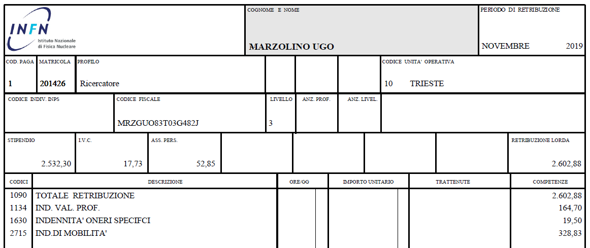
PAYSLIP ITEMS (1)
additional portion of salary to reach the agreed Monthly Basic payment
Annual Severance pay
Taken from collective labor agreement:
Total: 187,26
Theoretical Monthly Additional payment

Slide 9
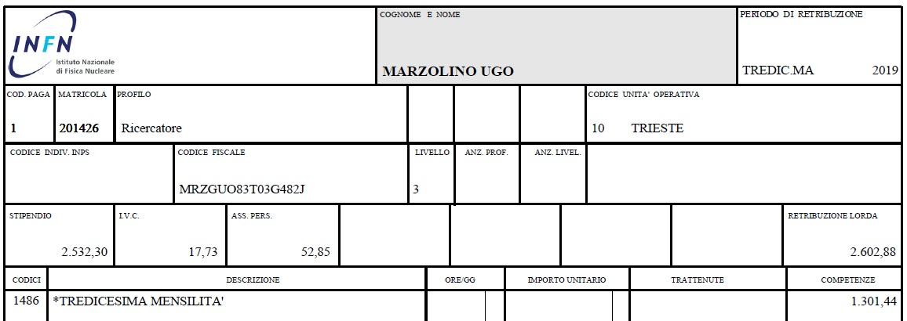
PAYSLIP ITEMS (2)
1
2
3
1
Monthly Basic payment
2
Actual Monthly Additional payment
3
Monthly Mobility Allowance

Slide 10
Other possible items in payslip
«trasferta estero lorda»: sums, net of tax-free quotas, which contribute to the formation of revenue for missions abroad
«trasferta italia lorda»: sums, net of tax-free quotas, which contribute to the formation of revenue for missions in Italy
«ticket restaurant IMP soggett»: sums, net of tax-exempt dues, which constitute income as food supply by the employer
«ass. rischi extraprofessionali rit.»: insurance premium voluntarily subscribed by the employee for extra-professional accidents
«calcolo conguaglio IRPEF 2»: tax adjustment, at the end of the year or at the end of the employment relationship: if the amount is positive it is a deduction, if the amount is negative it is a refund of greater amounts already withheld in the current fiscal year
«maternità facoltativa»: reduction of the salary for abstention from work in the periods following compulsory maternity; said absences are paid at 30%
«trat. IRPEF.REG.A.P.»: regional tax; normally it is paid in 11 installments from January to November in the fiscal year following the year of reference.
«irpef add com»: municipal tax, paid as the above-mentioned regional tax.

Slide 11
Total Amount before taxes (€ 2.274,77X3) i.e. annual amount multiplied by 3 years
Severance pay
€ 6.824,31
Taxes due by employee (about 25%)
€ 1.706,08
Estimated net amount paid upon termination of employment
€ 5.118,23
?

