Slide 1

Simulation of ⁴He events @ 700 MeV/u
Milano group

Slide 2
Motivations
(see slides from Meeting of March 4th)
In view of the call of GSI BioPac for 2021/2022 beam time, FOOT we are reiterating and improving the proposal already presented in 2017.
One of the major points is to apply for ion beams which are difficult to obtain outside GSI: in particular ⁴He and ¹⁶O.
The case of ⁴He 0.7 GeV/u is considered for space radioprotection

Slide 3
Physics Channels
(see slides from Meeting of March 4th)
Using ⁴He projectiles, the only final state channels (excluding target fragmentation) are:
n + ³He + X’
p + t + X’
d + d + X’
n + p + d + X’
n + n + p + p + X’
⁴He + X*
X* → X + γ
X* → target fragm. channels
~as many 3He as t are expected
Favourable case study for both Z & A identification
Maximum overlap of ECC and Electronic Apparatus
⁴He + X →

Slide 4
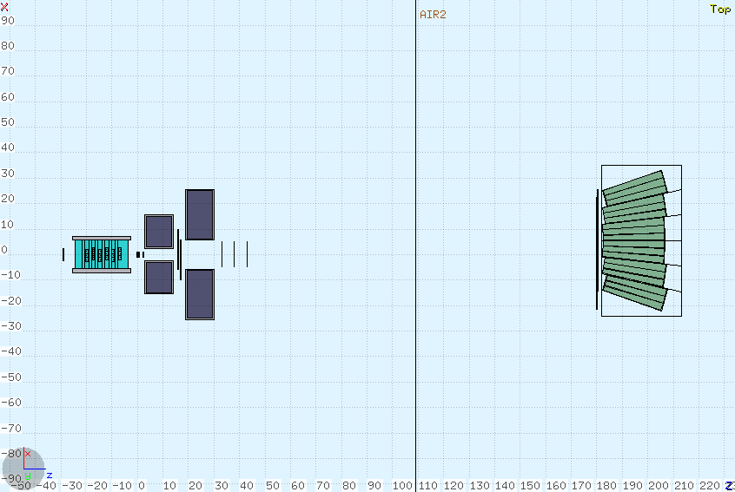
Proposed Geometry
Longer level arm to allow a better resolution for ToF measurement.
The higher energy also allows a narrower angular cone to contain secondary products.
In view of a run at GSI Cave A, the same Taget-TW distance used in GSI 2019 has been considered
shift of TW+Calo to compensate for bending
180.25 cm
C target
5 mm
Also a small shift in the non-bending view to avoid particles sailing through the space between crystals
Setup produced within SHOE master branch using –exp HE_MC

Slide 5
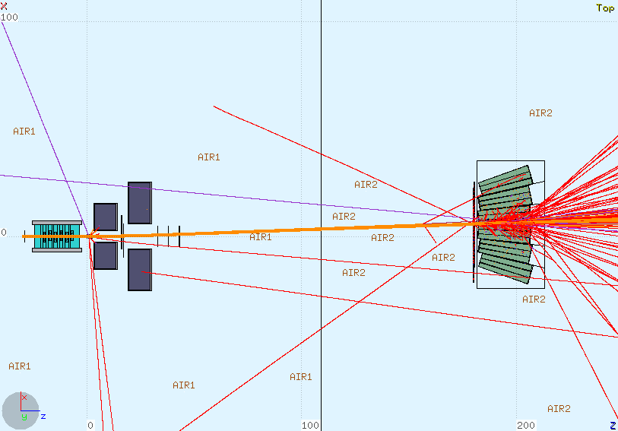
Compensation for bending
In geomaps/HE_MC/FOOT_geo.map:
TofWallBaseName: "TW"
TofWallPosX: 5.5 TofWallPosY: 0.5 TofWallPosZ: 180.25
TofWallAngX: 0. TofWallAngY: 0. TofWallAngZ: 0.
CaloBaseName: "CA"
CaloPosX: 5.5 CaloPosY: 0.5 CaloPosZ: 194.55
CaloAngX: 0. CaloAngY: 0. CaloAngZ: 0.
As expected, at this energy, calorimeter cannot achieve full containment. Furthermore, hadronic showering takes place

Slide 6
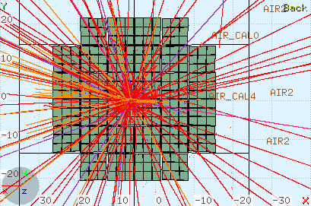
Transv. view

Slide 7
Simulated Data
(FLUKA pro Version 2020.0)
/gpfs_data/local/foot/Simulation/newgeom_v1.0/HE_MC
4He_C_270_1.root (5 10⁶ primaries, 46689 ev.)
4He_C_200_2.root (5 10⁶ primaries, 46178 ev.)
As usual, a «software trigger» in implemented to write only events in which there was at least one inelastic interaction of primary in target

Slide 8
A few very preliminary plots: multiplicity per event at TW
All charged, produced everywhere
Multiplicity of charged particles arriving at TW
Charged from primary fragmentation on target

Slide 9
Multiplicity per event at TW - 2
produced everywhere
Multiplicity including neutrons
(no energy cuts)
from primary fragmentation on target: ~no low energy neutrons

Slide 10
(Total) Energy of secondaries from projectile fragm. arriving at TW
p
d
t
³He

Slide 11
(Total) Energy of secondaries from projectile fragm. arriving at TW - 2
These processes also are tagged in MC as inelastic interactions
⁴He
C* → C + γ
¹²C* → ¹¹C + n
¹²C* → ⁴He+ ⁴He+ ⁴He
…..
Target excited to 1st excited nuclear energy level.
Charged fragments usually not escaping from target
C* → more complex target fragm. channels where projectile excites a higher energy level in target nucleus

Slide 12
(Total) Energy of secondaries from projectile fragm.: neutrons arriving at TW
n from everywhere

Slide 13
(Total) Energy of secondaries from projectile fragm.: neutrons arriving at TW
n from everywhere
n from fragmentation of primary (~ as p)

Slide 14
Arrival time at TW of neutrons
n from everywhere

Slide 15
Arrival time at TW of neutrons
n from fragmentation of primary (~ as p)
n from everywhere

Slide 16
The end

