Slide 1
Explaining Explanation Methods: Overview and Applications
Riccardo Guidotti

Slide 2
Definitions
Oxford Dictionary of English
Notes:
Two basic concepta

Slide 3
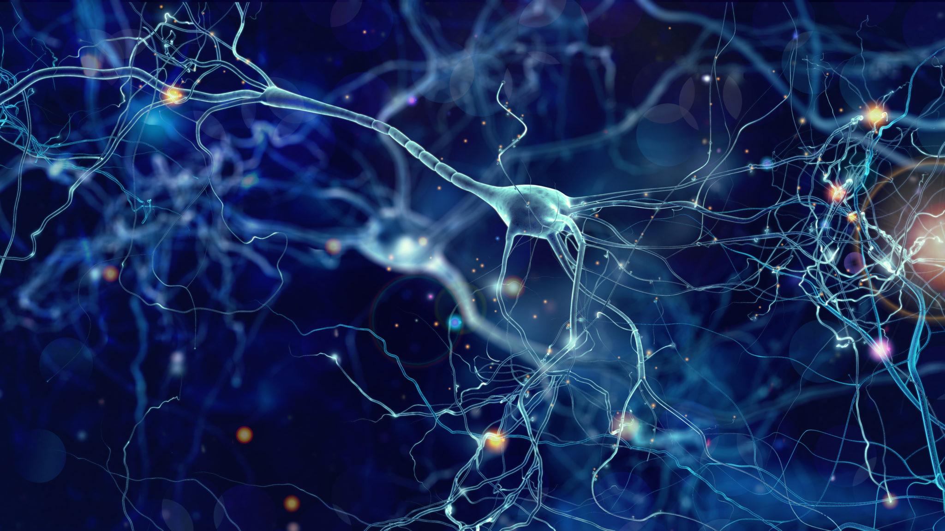
Needs For Explanation Methods
Notes:
A risk of the usage of black boxes is the possibility of inadvertently making wrong decisions, learned from artifacts or spurious correlations in the training data, such as recognizing an object in a picture by the properties of the background or lighting, due to a systematic bias in training data collection. How can companies trust their products without understanding and validating the underlying rationale of their machine-learning components? Gartner predicts that “by 2018 half of business ethics violations will occur through the improper use of Big Data analytics.” Explanation technologies are an immense help to companies for creating safer, more trustable products, and better managing any possible liability they may have. This is especially important in safety critical applications like self-driving cars and medicine, where a possible wrong decision could even lead to the death of people. The availability of transparent machine-learning technologies would lead to a gain of trust and awareness on the fact that it is always possible to know the reasons of a decision or an event.

Slide 4
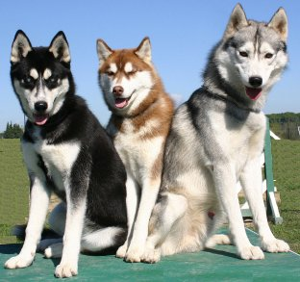
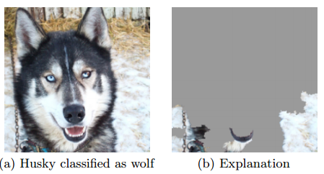
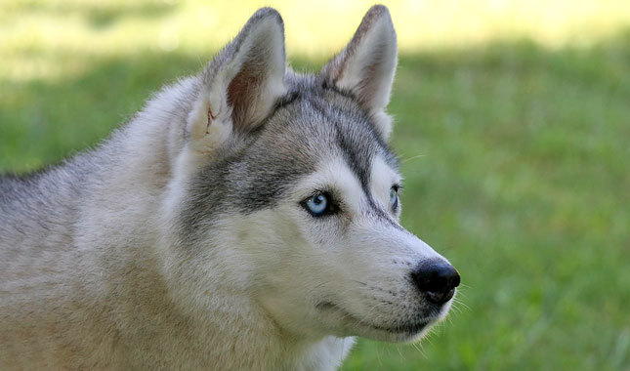
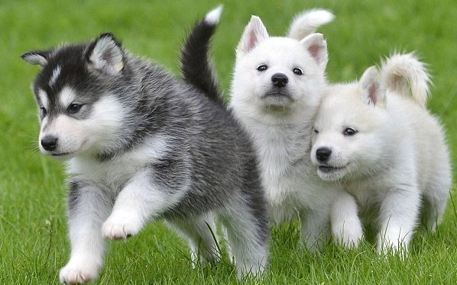
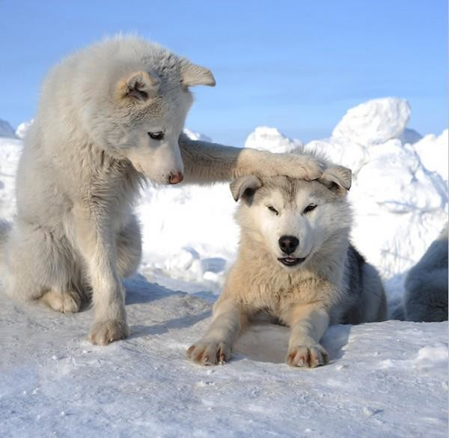
H
H
W
W
The Background Bias
W
W
H
H
H
W
W

Slide 5
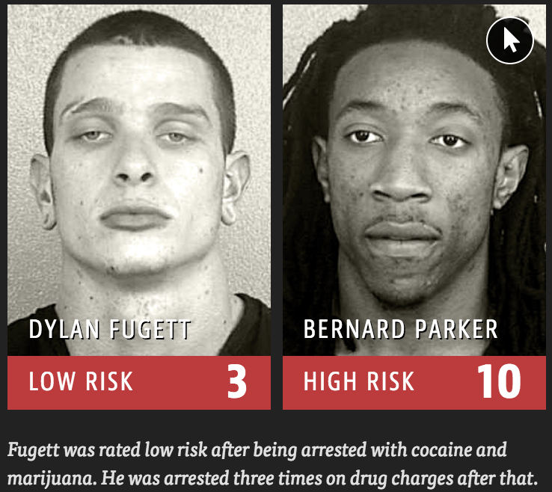
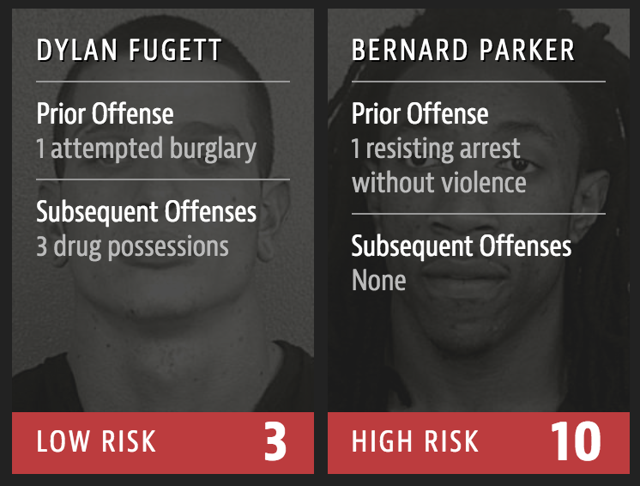
COMPAS recidivism black bias
Notes:
The COMPAS score for predictig the “risk of crime recidivism”, has a strong ethnic bias as a black who did not re-offend was classified as high risk twice as much as whites who did not re-offend.
The journalists of propublica. org have shown that the COMPAS score, a predictive model for the “risk of crime recidivism” (proprietary secret of Northpointe), has a strong ethnic bias. Indeed, according to this score, a black who did not re-offend was classified as high risk twice as much as whites who did not re-offend,and white repeat offenders were classified as low risk twice as much as black repeat offenders.
The COMPAS score for predictig the “risk of crime recidivism”, has a strong ethnic bias as a black who did not re-offend was classified as high risk twice as much as whites who did not re-offend.

Slide 6
Right of Explanation
Since 25 May 2018, GDPR establishes a right for all individuals to obtain “meaningful explanations of the logic involved” when “automated (algorithmic) individual decision-making”, including profiling, takes place.
Notes:
Since 25 May 2018, GDPR establishes a right for all individuals to obtain “meaningful explanations of the logic involved” when “automated (algorithmic) individual decision-making”, including profiling, takes place.
The European Parliament recently adopted the General Data Protection Regulation (GDPR), which has become law in May 2018. An innovative aspect of the GDPR are the clauses on automated decision-making, including profiling, which for the first time introduce, to some extent, a right of explanation for all individuals to obtain “meaningful explanations of the logic involved” when automated decision making takes place. Despite divergent opinions among legal scholars regarding the real scope of these clauses [36, 74, 126], there is a general agreement on the need for the implementation of such a principle is urgent and that it represents today a huge open scientific challenge.

Slide 7
What is “Explainable AI” ?
Explainable-AI explores and investigates methods to produce or complement AI models to make accessible and interpretable the internal logic and the outcome of the algorithms, making such process understandable by humans.
Explicability, understood as incorporating both intelligibility (“how does it work?”) for non-experts, e.g., patients or business customers, and for experts, e.g., product designers or engineers) and accountability (“who is responsible for”).
5 core principles for ethical AI:
beneficence, non-maleficence, autonomy, and justice
a new principle is needed in addition: explicability

Slide 8
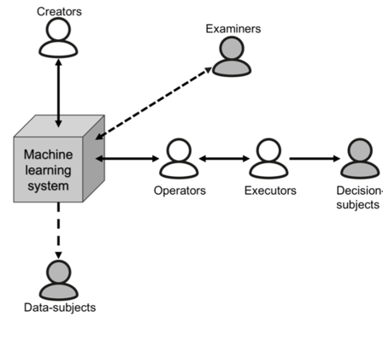
Role-based Interpretability
“Is the explanation interpretable?” → “To whom is the explanation interpretable?”
No Universally Interpretable Explanations!
End users “Am I being treated fairly?”
“Can I contest the decision?”
“What could I do differently to get a positive outcome?”
Engineers, data scientists: “Is my system working as designed?”
Regulators “ Is it compliant?”
An ideal explainer should model the user background.
[Tomsett et al. 18]
[Tomsett et al. 2018, Weld and Bansal 2018, Poursabzi-Sangdeh 2018, Mittelstadt et al. 2019]

Slide 9
Explanation as Machine-Human Conversation
[Weld and Bansal 2018]
Humans may have follow-up questions
Explanations cannot answer all users’ concerns

Slide 10
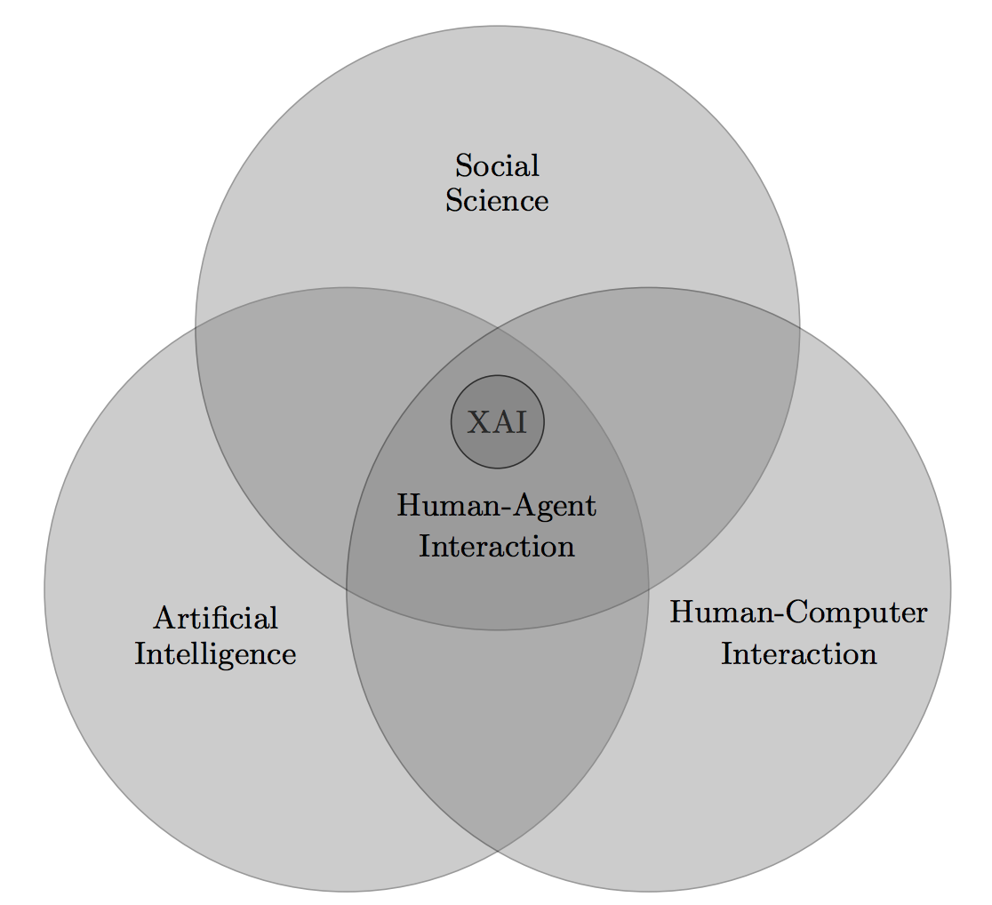
XAI is Interdisciplinary
For millennia, philosophers have asked the questions about what constitutes an explanation, what is the function of explanations, and what are their structure
[Tim Miller 2018]

Slide 11
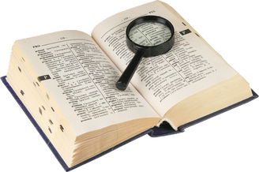
Interpretability
To interpret means to give or provide the meaning or to explain and present in understandable terms some concepts.
In DMML, interpretability is the ability to explain or to provide the meaning in understandable terms to a human.
https://www.merriam-webster.com/
Finale Doshi-Velez and Been Kim. 2017. Towards a rigorous science of interpretable machine learning. arXiv:1702.08608v2.

Slide 12
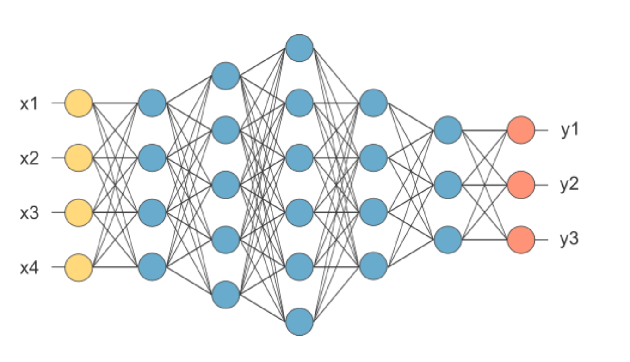
What is a Black Box Model?
A black box is a model, whose internals are either unknown to the observer or they are known but uninterpretable by humans.
R. Guidotti, A. Monreale, S. Ruggieri, F. Turini, D. Pedreschi, and F. Giannotti. A survey of methods for explaining black box models. ACM CSUR, 51(5):93:1–93:42, Aug. 2018

Slide 13
Dimensions of Interpretability
Global and Local Interpretability:
Global: understanding the whole logic of a model
Local: understanding only the reasons for a specific decision
Time Limitation: the time that the user can spend for understanding an explanation.
Nature of User Expertise: users of a predictive model may have different background knowledge and experience in the task. The nature of the user expertise is a key aspect for interpretability of a model.
e
Notes:
Global and Local Interpretability: A model may be completely interpretable, i.e., we are able to understand the whole logic of a model and follow the entire reasoning leading to all the different possible outcomes. In this case, we are speaking about global interpretability. Instead, we indicate with local interpretability the situation in which it is possible to understand only the reasons for a specific decision: only the single prediction/decision is interpre
Time Limitation: An important aspect is the time that the user is available or is allowed to spend on understanding an explanation. The user time availability is strictly related to the scenario where the predictive model has to be used. Therefore, in some contexts where the user needs to quickly take the decision (e.g., a disaster is imminent), it is preferable to have an explanation simple to understand.While in contexts where the decision time is not a constraint (e.g., during a procedure to release a loan) one might prefer a more complex and exhaustive explanation.table.
Nature of User Expertise: Users of a predictive model may have different background knowledge and experience in the task: decision-makers, scientists, compliance and safety engineers, data scientists, and so on. Knowing the user experience in the task is a key aspect of the perception of interpretability of a model. Domain experts may prefer a larger and more sophisticated model over a smaller and sometimes more opaque one.

Slide 14
Desiderata of an Interpretable Model
Interpretability (or comprehensibility): to which extent the model and/or its predictions are human understandable. Is measured with the complexity of the model.
Fidelity: to which extent the model imitate a black-box predictor.
Accuracy: to which extent the model predicts unseen instances.
Alex A. Freitas. 2014. Comprehensible classification models: A position paper. ACM SIGKDD Explor. Newslett.

Slide 15
Desiderata of an Interpretable Model
Fairness: the model guarantees the protection of groups against discrimination.
Privacy: the model does not reveal sensitive information about people.
Respect Monotonicity: the increase of the values of an attribute either increase or decrease in a monotonic way the probability of a record of being member of a class.
Usability: an interactive and queryable explanation is more usable than a textual and fixed explanation.
Andrea Romei and Salvatore Ruggieri. 2014. A multidisciplinary survey on discrimination analysis. Knowl. Eng.
Yousra Abdul Alsahib S. Aldeen, Mazleena Salleh, and Mohammad Abdur Razzaque. 2015. A comprehensive review on privacy preserving data mining. SpringerPlus .
Alex A. Freitas. 2014. Comprehensible classification models: A position paper. ACM SIGKDD Explor. Newslett.

Slide 16
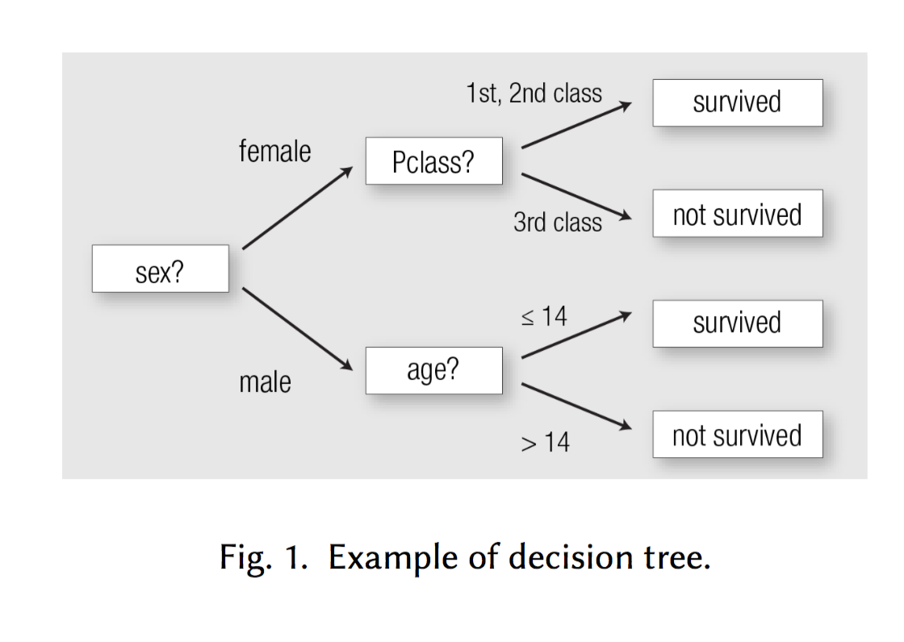
Recognized Interpretable Models
Linear Model
Decision Tree
Rules
Notes:
In the state of the art a small set of existing interpretable models is recognized: decision tree, rules, linear models. These models are considered easily understandable and interpretable for humans.

Slide 17
Complexity
Opposed to interpretability.
Is only related to the model and not to the training data that is unknown.
Generally estimated with a rough approximation related to the size of the interpretable model.
Linear Model: number of non zero weights in the model.
Rule: number of attribute-value pairs in condition.
Decision Tree: estimating the complexity of a tree can be hard.
Marco Tulio Ribeiro, Sameer Singh, and Carlos Guestrin. 2016. Why should i trust you?: Explaining the predictions of any classifier. KDD.
Houtao Deng. 2014. Interpreting tree ensembles with intrees. arXiv preprint arXiv:1408.5456.
Alex A. Freitas. 2014. Comprehensible classification models: A position paper. ACM SIGKDD Explor. Newslett.

Slide 18
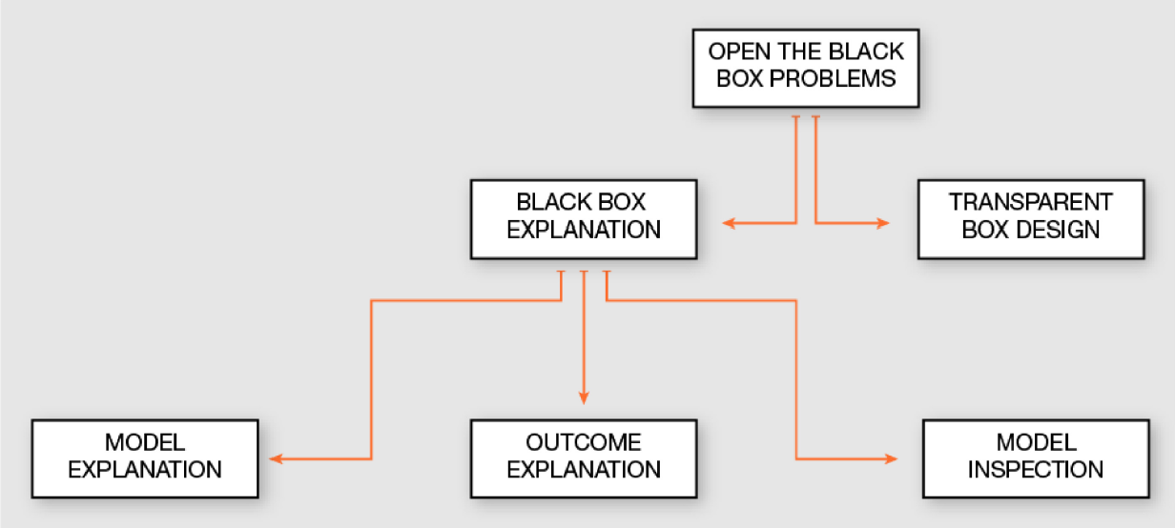
Problems Taxonomy
Notes:
The Open the Black Box Problems for understanding how a black box works can be separated from one side as the problem of explaining how the decision system returned certain outcomes (Black Box Explanation) and on the other side as the problem of directly designing a transparent classifier that solves the same classification problem (Transparent Box Design). Moreover, the Black Box Explanation problem can be further divided among Model Explanation when the explanation involves the whole logic of the obscure classifier, Outcome Explanation when the target is to understand the reasons for the decisions on a given object, and Model Inspection when the target to understand how internally the black box behaves changing the input.

Slide 19
XbD – eXplanation by Design
Black-box System
$$\hat{y}$$
Input Data
Interpretability
Transparent System
Notes:
Given a dataset of training decision records the task consists in developing an interpretable predictor model together with its explanations

Slide 20
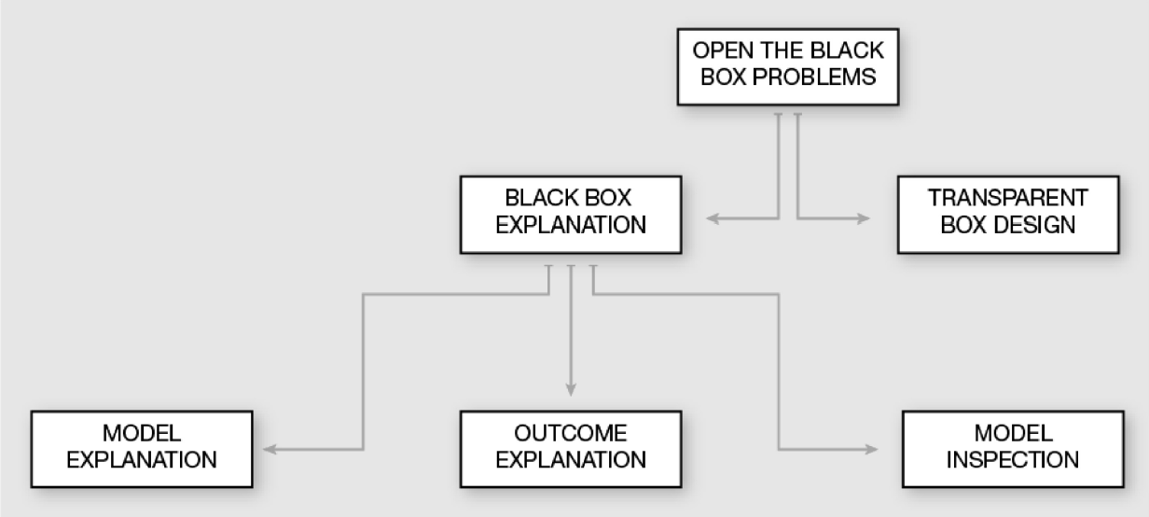
BBX - Black Box eXplanation
Black-box
AI System
$$\hat{y}$$
Input Data
Explanation
Explanation Sub-system
Notes:
The model explanation problem is aimed at understanding the overall logic behind the black box, while the outcome explanation problem is more related to the correlation between the data of a record and the outcome decision, the model inspection problem is somehow in the middle and depends on the motivation of the specific paper under analysiT

Slide 21
Classification Problem
X = {x₁, …, x_{n}}

Slide 22
Model Explanation Problem
Provide an interpretable model able to mimic the overall logic/behavior of the black box and to explain its logic.
X = {x₁, …, x_{n}}

Slide 23
Outcome Explanation Problem
Provide an interpretable outcome, i.e., an explanation for the outcome of the black box for a single instance.
x

Slide 24
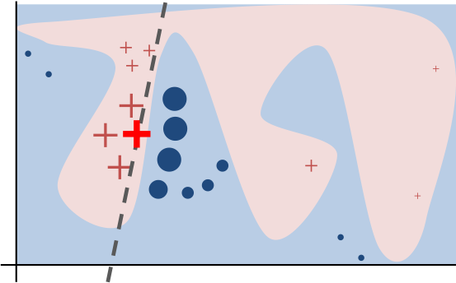
Background - Local Explanation
The overall decision boundary is complex.
In the neighborhood of a single decision, the boundary is simple.
A single decision can be explained by auditing the black box around the given instance and learning a local decision.
M. T. Ribeiro, et. al. Why should i trust you?: Explaining the predictions of any classifier. In KDD, pages 1135–1144. ACM, 2016.

Slide 25
Model Inspection Problem
Provide a representation (visual or textual) for understanding either how the black box model works or why the black box returns certain predictions more likely than others.
X = {x₁, …, x_{n}}

Slide 26
Transparent Box Design Problem
Provide a model which is locally or globally interpretable on its own.
X = {x₁, …, x_{n}}
x

Slide 27
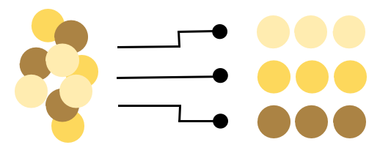
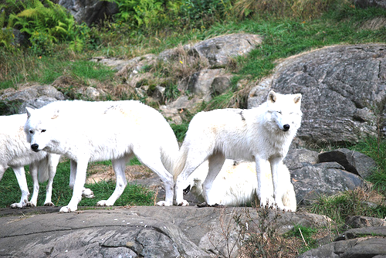
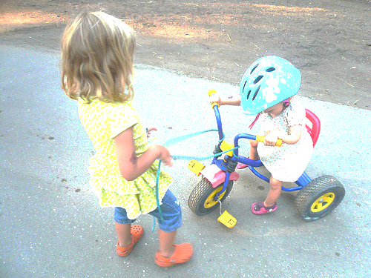
Categorization
???
The type of problem
The type of black box model that the explanator is able to open
The type of data used as input by the black box model
The type of explanator adopted to open the black box

Slide 28
Reverse Engineering
The name comes from the fact that we can only observe the input and output of the black box.
Possible actions are:
choice of a particular comprehensible predictor
querying/auditing the black box with input records created in a controlled way using random perturbations w.r.t. a certain prior knowledge (e.g. train or test)
It can be generalizable or not:
Model-Agnostic
Model-Specific
Input
Output

Slide 29
Model-Agnostic vs Model-Specific
independent
dependent

Slide 30
Black Box Explanation by Learning Image Exemplars in the Latent Feature Space
Riccardo Guidotti, Anna Monreale, Stan Matwin, Dino Pedreschi

Slide 31
Open The Black Box Problems
for Image Classification
R. Guidotti, A. Monreale, S. Ruggieri, F. Turini, D. Pedreschi, and F. Giannotti. A survey of methods for explaining black box models. ACM CSUR, 51(5):93:1–93:42, Aug. 2018
Notes:
We investigate the problem of black box explanation for image classification.
Explaining the reasons for a certain outcome can be particularly important.
For example, when dealing with medical images for diagnosing, how we can validate that a very accurate image classifier built to recognize cancer actually focuses on the malign areas and not on the background for taking the decisions?

Slide 32
State-of-the-Art and Limitations
Gradient-based attribution methods that reveal saliency maps highlighting the parts of the image that most contribute to its classification (e.g. DeepExplain).
They are model specific.
Model agnostic approaches can explain, yet through a saliency map, the outcome of any black box (e.g. LIME).
They do not consider existing relationships between features.
The neighborhood does not contain “meaningful” images.
Transaprent prototype-based selects existing instance from which it should be clear why a certain decision is taken (e.g. MMD).
Cannot be used to explain a trained black box.
K. Simonyan, et al. Deep inside convolutional networks: Visualising image classification models and saliency maps. arXiv:1312.6034, 2013.
M. T. Ribeiro, et. al. Why should i trust you?: Explaining the predictions of any classifier. In KDD, pages 1135–1144. ACM, 2016.
B. Kim et al. Examples are not enough, learn to criticize! In NIPS, pages 2280–2288, 2016.
Notes:
In the literature the problem is addressed by producing explanations through different approaches.
These methods are model specific and can be employed only to explain specific deep neural networks.
Model agnostic approaches generate a local neighborhood of the instance to explain and mime the behavior of the black box using an interpretable classifier.
However, these methods exhibit drawbacks that may negatively impact the reliability of the explanations.
They do not consider existing relationships between features (or pixels) during the neighborhood generation.
The neighborhood generation does not produce “meaningful” images since, e.g., some areas of the image to explain are obscured.
Transparent-by-design approaches produce prototypes from which it should be clear to the user why a certain decision is taken by the model [21, 22]. Nevertheless, these approaches cannot be used to explain a trained black box, but the transparent model has to be directly adopted as a classifier, possibly with limitations on the accuracy achieved.

Slide 33
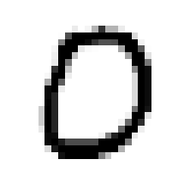
Adversarial Black box Explainer generating Latent Exemplars
https://github.com/riccotti/ABELE

Slide 34
Saliency Map from Exemplars
Red/Blue means consistent difference “variable area”
The saliency map s highlights areas of x that contribute to b(x) and that push it to ≠ b(x).
It is obtained as follows:
pixel-to-pixel-difference between x and each exemplar in H
each pixel of s is the median value of the differences calculated for that pixel.
͠
Yellow means no difference “no change area”

Slide 35
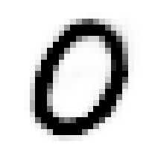
Adversarial Autoencoder
.1 | .2 | .2 | .5

Slide 36
Latent Local Rule Extraction
0
4
0
0
.1 | .2 | .2 | .5
.2 | .1 | .3 | .6
.2 | .2 | .3 | .5
.1 | .3 | .1 | .4
.1 | .2 | .2 | .5
r = if x₁ > 0.1 and x₃ ≤ 0.5 then ‘0’
ȹ = {if x₁ ≤ 0.1 then ‘4’,
if x₃ > 0.5 then ‘8’}
Guidotti, R., Monreale, A., Giannotti, F., Pedreschi, D., Ruggieri, S., & Turini, F. (2019). Factual and Counterfactual Explanations for Black Box Decision Making. IEEE Intelligent Systems.

Slide 37
Adversarial Black box Explainer generating Latent Exemplars
https://github.com/riccotti/ABELE

Slide 38
Saliency Map Comparison
mnist
fashion
Notes:
Saliency maps are derived from the difference between the image and its exemplars,
We indicate with yellow color the areas that are common between x and the exemplars, with red color the areas contained only in the exemplars and blue color the areas contained only in x.
This means that yellow areas must remain unchanged to obtain the same label b(x), while red and blue areas can change without impacting the black box decision.
In other words, blue and red areas express the boundaries that can be varied, and for which the class remains unchanged.
A nine may have a more compact circle, a zero may be more inclined.
a coat may have no space between the sleeves and the body, and that a boot may have a higher neck.
Moreover, we can notice how, besides the background, there are some “essential” yellow areas within the main figure that can not be different from x: e.g. the leg of the nine, the crossed lines of the four, the space between the two trousers.
Competitors: red areas contribute positively to the black box outcome, blue areas contribute negatively.
For LIME’s explanations, nearly all the content of the image is part of the saliency areas. In addition, the areas have either completely positive or completely negative contributions. These aspects can be not very convincing for a LIME user.
The DEX methods return scattered red and blue points which can also be very close to each other and are not clustered into areas.
It is not clear how a user could understand the black box outcome decision process from this kind of explanation.

Slide 39
Exemplars and Counter-Exemplars
mnist
fashion
Notes:
Exemplars and counter-exemplars can be visually analyzed by a user for understanding which are possible similar instances leading to the same outcome or to a different one.
We can notice how the label nine is assigned to images very close to a four but until the upper part of the circle remains connected, it is still classified as a nine.
On the other hand, looking at counter-exemplars, if the upper part of the circle has a hole or the lower part is not thick enough, then the black box declares these images to be a four and a seven, respectively.
We highlight similar phenomena for other instances: e.g. a boot with a neck not well defined is labeled as a sneaker.

Slide 40
From Image to Counter-Exemplar
T. Spinner et al. Towards an interpretable latent space: an intuitive comparison of autoencoders with variational autoencoders. In IEEE VIS 2018, 2018.
mnist
fashion
Notes:
We exploit the latent representations to visually understand how the black box labeling changes with respect to real images.
We show how they can be changed to move from the original label to the counter-factual label.
We realize this change in the class through the latent representations of the image to explain x and of the counter-exemplar ehc, respectively.
Given z and hc, we generate through linear interpolation in the latent feature space intermediate latent representations respecting the latent decision or counter-factual rules. Finally, using the decoder, we obtain the intermediate images.
This convincing and useful explanation analysis is achieved thanks to ABELE’s ability to deal with both real and latent feature spaces, and to the application of latent rules to real images which are human understandable and also clear exemplar-based explanations for the black box outcomes.

Slide 41
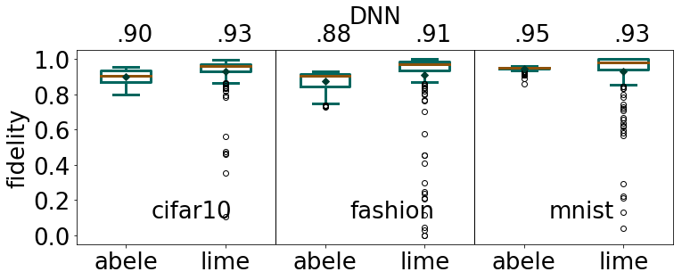
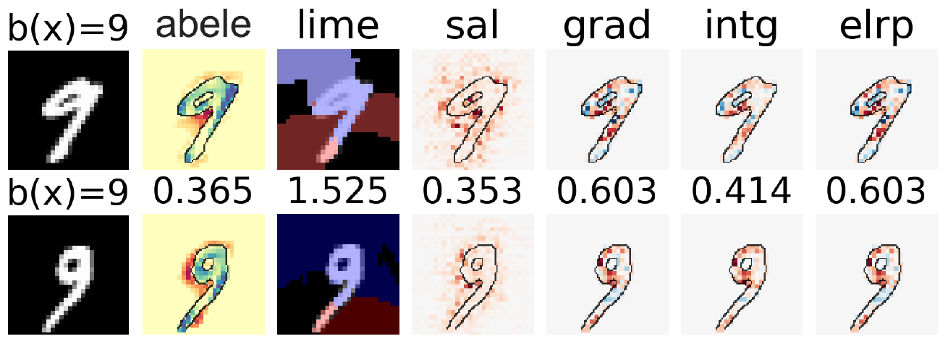
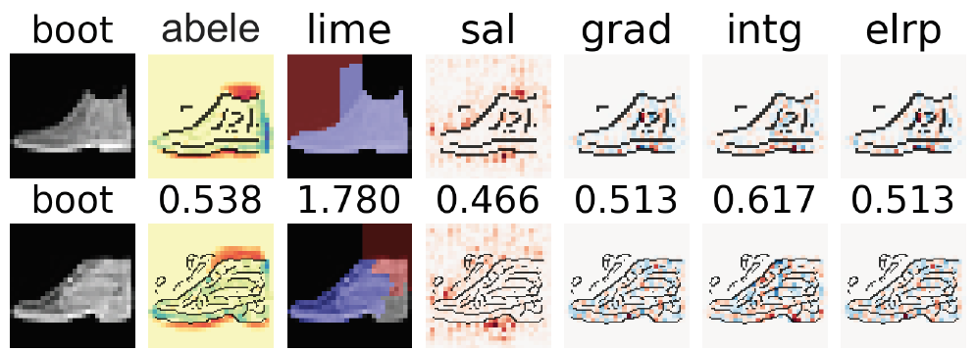
Results
Experiments show that ABELE provides explanations which are
Faithful
Useful
Relevant
Coherent
Robust

Slide 42
Future Research Directions
Investigate the effect of changing some aspect of the AAE:
the latent dimensions k,
the rigidity of the discriminator in admitting latent instances,
the type of autoencoders.
Extend ABELE to make it work on text.
Employ ABELE in a case study generating exemplars and counter-exemplars for explaining medical imaging tasks, e.g. radiography and fMRI images.
Conduct extrinsic interpretability evaluation of ABELE with a human decision-making task driven by ABELE explanations.

Slide 43
Thank you riccardo.guidotti@unipi.it
https://github.com/riccotti/ABELE

