Slide 1
Deep Learning implementation of MRF data reconstruction
Luca Peretti
Università di Pisa

Slide 2
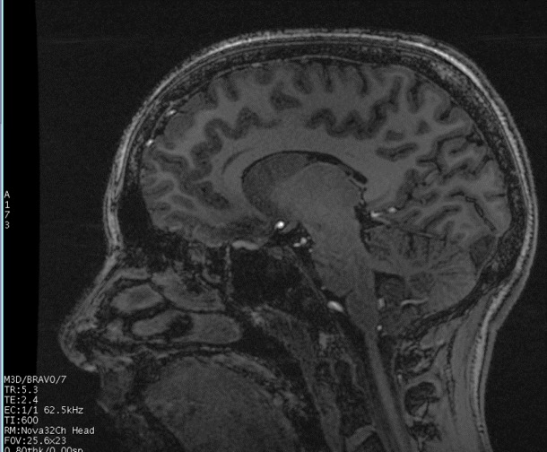
Quantitative MRI
Conventional MRI allows to obtain contrast images. No absolute on tissue parameters.
There is the need for quantitative measures, that can be used to improve diagnosis
Quantification is time and resource costly
Magnetic Resonance Fingerprinting (Dan Ma)
Notes:
Conventional MRI methods allow to obtain qualitative contrast images like the one in the figure, weighted on particular parameters, so no information is obtained on the tissue parameters.
The knowledge of quantitative parameters (like relaxation times t1, t2 and others) can be used to improve and enable more objective diagnosis.
For this reason the last few years have seen an increasing emphasis on quantitative imaging techniques. Despite this, those techniques are limited by their time inefficiency and can typically measure only one tissue property at a time.
In this scenario recently was introduced the Magnetic Resonance Fingerprinting (MRF), quantitative technique that allows measurement of multiple tissue properties in a single acquisition and in efficient time.

Slide 3
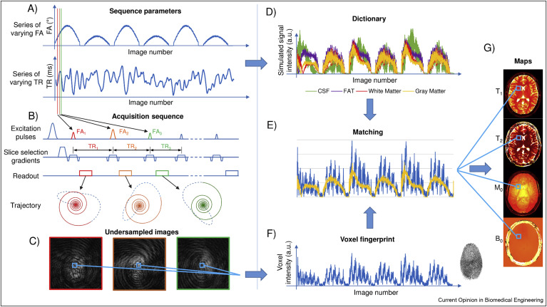
Magnetic Resonance Fingerprinting
Image from Magnetic Resonance Fingerprinting. Panda et al. 2017
Notes:
MRF uses a variable schedule to induce differential signal evolution in tissue of differing types.
The acquisition of the parameters varied in a pseudo-random pattern so that each tissue generates a unique signal. (FIngerprinting)
On one hand the data are then acquired in the k-space in a strongly undersampled way (C). So the scan will be fast.
On the other hand, we simulate a dictionary of all the possible evolutions of the signals using Bloch's equations. (D)
Then, after the resonance acquisition, a pattern matching algorithm is used to find the dictionary entry that best describes the signal acquired on a voxel.(E-F)
At least, along with the best matched simulated signal we obtain the parameters previously used to generate it. Repeating the matching process for each voxel permits to compute the quantitative maps as in (G).
Therefore, MRF is made up of three different phases: dictionary simulation, data acquisition and the matching.

Slide 4


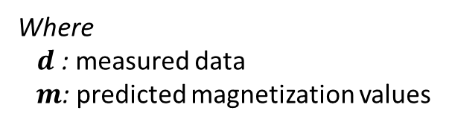

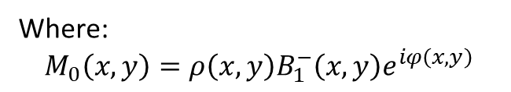
Pattern Matching
Where:
$$M_{0}\left(x,y\right)=ρ\left(x,y\right)B_{1}^{−}\left(x,y\right)e^{iφ\left(x,y\right)}$$
$M_{j}\left(θ\left(x,y\right)\right)=M_{0}\left(x,y\right)m\left(θ\left(x,y\right),t_{j}\right)$ (1)
in L2-space vectors
Where
$d$: measured data
$m$: predicted magnetization values
$$\left(\hat{M_{0}},\hat{θ}\right)=arg{\min_{M_{0},θ}{{\left\|M_{0}m\left(θ\right)− d\right\|}^{2}} } \left(2\right)$$
under the assumption of Gaussian noise:
$\hat{θ}= \arg{\max_{θ}{\frac{〈d,m\left(θ\right)〉}{{\left\|d\right\|}_{2}{\left\|m\left(θ\right)\right\|}_{2}}}}$ (3)
Notes:
We now concentrate on the Pattern matching step to better understand the problems related to it.
Given the local magnetization M in eq. 1, we can consider it composed by the static magnetization M0 and the dynamic magnetization m.
Where M0 can be written as the multiplication of the local proton density $ρ\left(x,y\right)$, the real-valued receiver sensitivity profile $B_{1}^{−}\left(x,y\right)$ and the transceiver phase $e^{iφ\left(x,y\right)}$
It’s possible to write a local estimation in L2-space vectors as in equation 2. where d is measured data and m the predicted magnetization values
The problem obtained is equivalent to a Maximum Likelihood Estimation (MLE) in eq.
This can be written as a Maximum Inner Product Search (MIPS), looking at the maximum correlation between the measured data d, and the simulated signal values, m(ϑ).

Slide 5

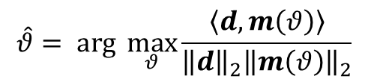
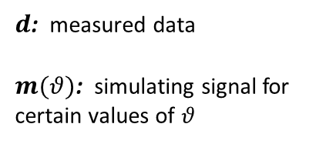
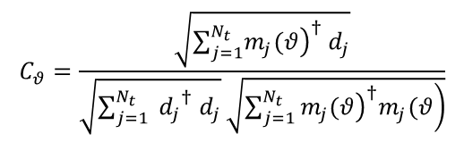
Pattern Matching with MIPS
$$\hat{θ}= \arg{\max_{θ}{\frac{〈d,m\left(θ\right)〉}{{\left\|d\right\|}_{2}{\left\|m\left(θ\right)\right\|}_{2}}}}$$
(4)
$$C_{θ}=\frac{\sqrt{\sum_{j=1}^{N_{t}}{{\left.m_{j}(θ\right)}^{†}{ d}_{j}}}}{\sqrt{\sum_{j=1}^{N_{t}}{{{ d}_{j}}^{†}{ d}_{j}}}\sqrt{\sum_{j=1}^{N_{t}}{\left.{\left.m_{j}(θ\right)}^{†}m_{j}(θ\right)}}}$$
$d$: measured data
$m(θ)$: simulating signal for certain values of $θ$
Maximum Inner Product Search (MIPS)
(5)
$$\hat{M_{0}}=\frac{{m\left(\hat{θ}\right)}^{H} d}{{\left\|m\left(\hat{θ}\right)\right\|}^{2}}$$
(6)
Notes:
So the problem will be solved with an exhaustive search over a pre-computed dictionary obtained simulating $m(θ)$ for certain values of $θ$, where $θ$ is evaluated over a grid of physically-acceptable parameters.
For every signal d we compute the scalar products C for each theta. The dictionary entry that achieve the highest C is considered the best match. Using the index of that entry and the precomputed lookup table, we can achieve the Theta parameters.
M0 can then be estimated with ne equation (6)

Slide 6
Considerations
Dictionary is typically computed with fine granularity over the entire range of possible tissue values, to avoid errors in the reconstructed tissue maps
Dictionary size grows exponentially as the number of tissue parameters is increased.
Pattern matching requires extensive computational resources to process.
115s for a 3D inference (in GPU) with 60k dictionary entries
Neural Network approach
Notes:
Now that we know how pattern matching is done.
We need to make some consideration about the Maximum inner product search.
This tecqnique is in fact streactly related to the dictionary size, in the sense that if we want to achieve a good results for the quantitative maps, we need to precompute a large fine graned dictionary that contains all the possible permutation of parameters.
The dictionary size will grow exponentially with the number of parameters. Using too many parameters can easily lead to unmanageable huge dictionaries.
Furthermore the Maximum inner product search require a huge amount of computational resources. For example a matching of a 3D image will take 115s.
Forh those reasons has been introduced a neural network approch. Our goal is to map each signal of a voxel to the theta parameters.

Slide 7
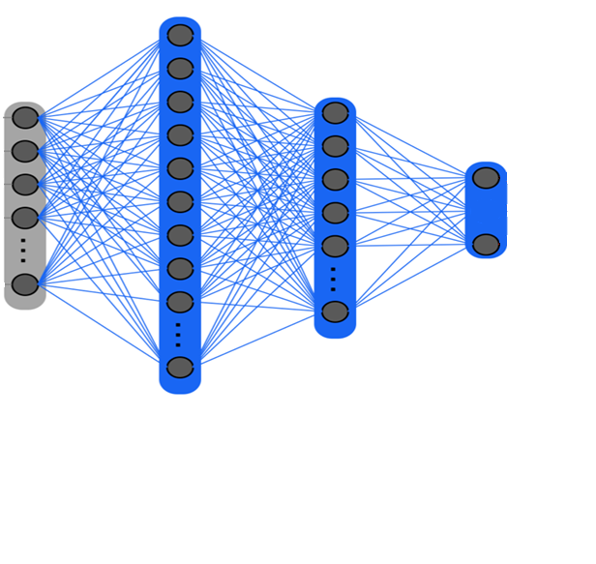


Parameter inference with NN
$θ$ = (T1, T2)
sigmoid
GRADIENT DESCENT ALGORITHM
reLu
$$LOSS FUN=\frac{\left|θ−y\right|}{y}$$
reLu
Notes:
As we can see in the figure, instead of using a dictionary, the signal (b) is dimensionality reduced via Singular value decomposition (c). In the next layers take place the gridding, the FFT, coil estimation and combination . From the layer e we used the obtained compressed signal as the input of a FFNN (in blue) composed by 2 hidden layers with rectifier activation functions and sigmoid activation function for the output layer.
The output nodes contain T1, T2 times and the norm of the corresponding simulated signals used for training.
We simulated ~60k samples using Bloch equations and added random Gaussian noise to each sample.
As a loss function, we used the mean absolute error, determined as shown, where $θ∈ ℝ^{3}$ is the output vector of the network and $y∈ ℝ^{3}$ is the corresponding ground truth.
During parameter inference on real data we computed the PD scaling factor $ρ_{n}$ at voxel $n$ with
$$ρ_{n}=\frac{{\left\|x_{n}\right\|}_{2}}{θ_{n,3}}$$
It’s important to notice that in this implementation, the dictionary it’s used only for the initial training of the network.

Slide 8
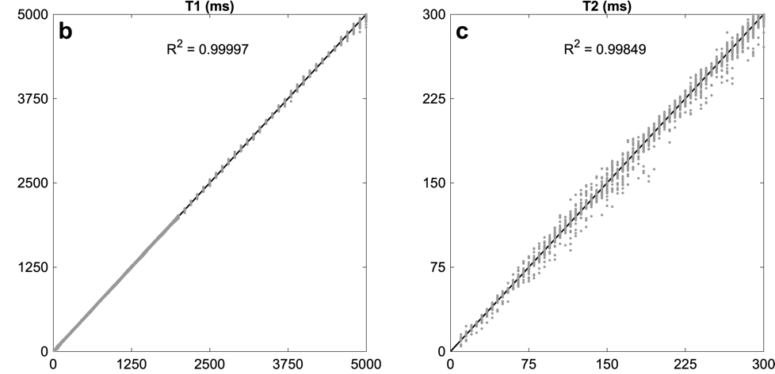
Validation of the network
Predicted
Predicted
Reference
Reference
Notes:
After training the network, it outputs parameters with an R² score > 0.99 for all three parameters.
In words, R² is a measure of how much of the variance in y is explained by the model, f.

Slide 9
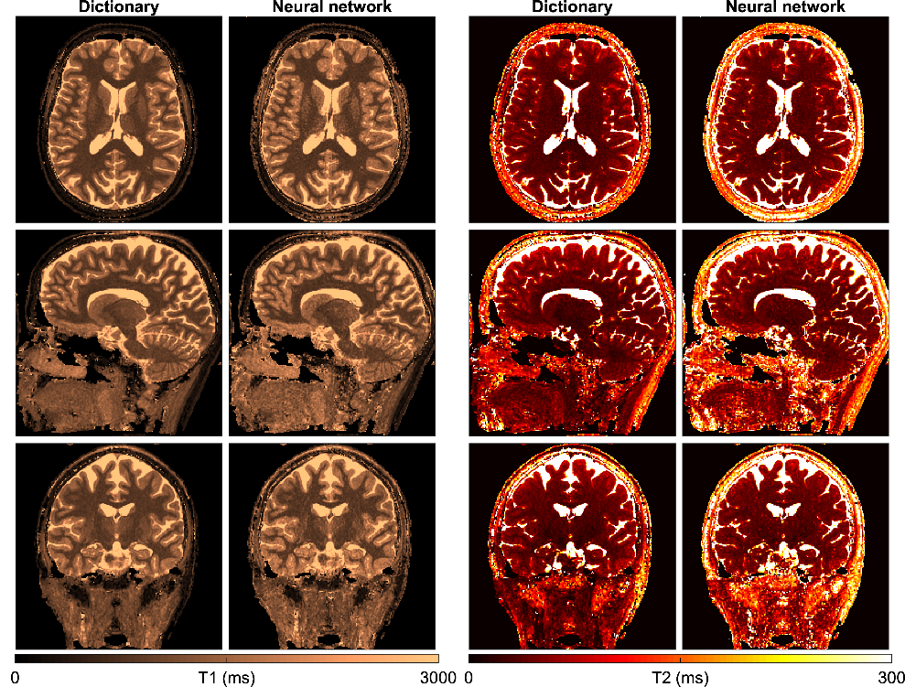
Inference results
The trained neural network produces comparable results for T1, T2
Notes:
In the figure we can see the parameters maps inferenced with dictionary matching and neural networks.
We can the T1 in the center and T2 on the right. As we can see, infering parameter maps with a high-resolution dictionary and a trained neural network produces comparable results for T1, T2 but not for the proton density.
The key difference that the network is not limited by dictionary discretization grid.

Slide 10



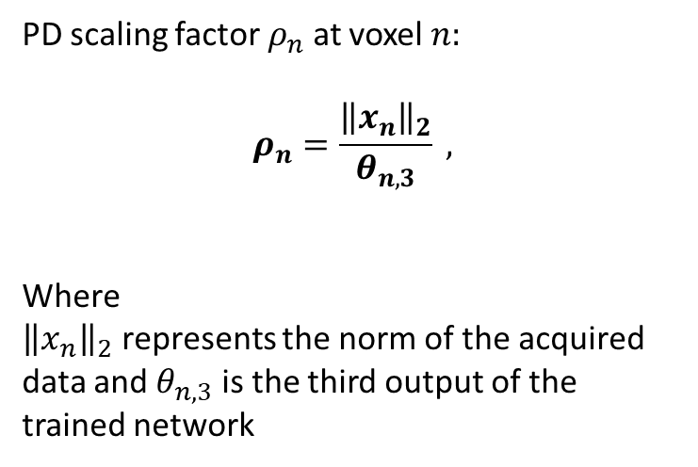
PD inference
$$θ$$
$θ$ = (T1, T2, norm(D))
PD scaling factor $ρ_{n}$ at voxel $n:$
$$ρ_{n}=\frac{{\left\|x_{n}\right\|}_{2}}{θ_{n,3}} ,$$
Where
${\left\|x_{n}\right\|}_{2}$ represents the norm of the acquired data and $θ_{n,3}$ is the third output of the trained network
Notes:
We can infere PD using the third element of the otput vector, which is the norm of the simulated signal with physical parameters T1, T2

Slide 11

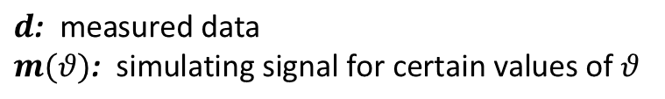

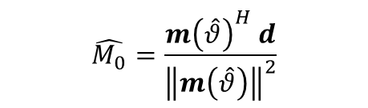
PD inference with autoencoder
$$(T1, T2)$$
$$m\left(\hat{θ}\right)$$
$$\hat{M_{0}}=\frac{{m\left(\hat{θ}\right)}^{H} d}{{\left\|m\left(\hat{θ}\right)\right\|}^{2}}$$
$$d\text{: }\text{measured} \text{data}$$
$$m(θ)\text{: }\text{simulating} \text{signal} \text{for} \text{certain} \text{values} \text{of} θ$$
(7)
Notes:
In order to improve the estimation of proton density, we created a second network architecture by reversing the direction of the first.
The net which is now an autoencoder is again the one in blue. The latent space contains T1 and T2.
The backward part of the network is trained separately with the dictionary. The net learned to reproduce a simulated dictionary entry starting from a vector of parameters (T1,T2 in our case).
The output of the network has the size of the input and is again a vector of compressed SVD coefficients. This correspond to the simulated signal $m\left(\hat{θ}\right)$.
In this way we can use the equation 7 to infer PD in an identical manner than done with dictionary matching techniques. Where we used the MIPS for finding $m\left(\hat{θ}\right)$.

Slide 12
Results
Notes:
The results of the two network architectures and the dictionary matching are compared in the figure.
In the fist row we compare the PD maps and we can say that the autoencoder (forth and fifth column) estimates PD closer to dictionary matching than the inference.with the first proposed network.
Notice in the second and third rows that in both cases, T1 and T2 inference results remain identical.

Slide 13
 | Inference time [s]
 | 2D | CPU | Dictionary | 9.5
 |  |  | Neural Network | 0.1
 |  | GPU | Dictionary | 6.6
 |  |  | Neural Network | <0.1
 | 3D | CPU | Dictionary | 618
 |  |  | Neural Network | 10
 |  | GPU | Dictionary | 115
 |  |  | Neural Network | <10
Notes:
Furthermore a dictionary can occupies GBs of memory while the proposed net will be less than 2MB.

Slide 14
Conclusions
Using the Neural Network produces results comparable with the MIPS
The inference time using the NN is more than an order of magnitude faster compare to MIPS
The Network occupies ~1Mb while the dictionary can need GBs of space
The Neural network can speed up iterative MRF methods for denoising

Slide 15
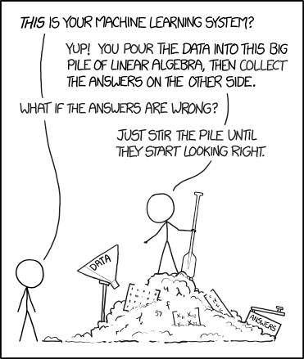
THANK YOU

Slide 16
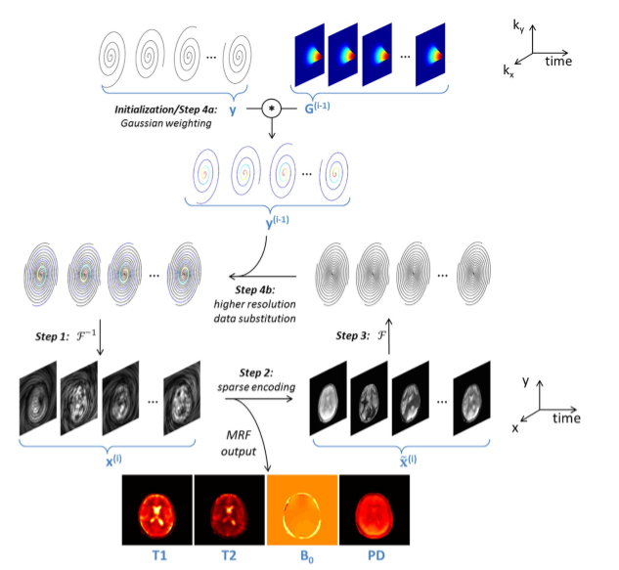
Multiscale reconstruction with Neural Network
Pierre EY, Ma D, Chen Y, Badve C, Griswold MA. Multiscale reconstruction for MR fingerprinting
Notes:
Found that the results of the quantitative maps are acceptable, the proposed neural network can be used for speed up iterative methods that use MRF inference.
The Multiscale Reconstruction method proposed by Pierre for denoising MRI images is one of them.
The iterative algorithm is initialized by reconstructing the MRF image series at low image resolution. For subsequent iterations, the method enforces pixel-wise fidelity to the best-matching dictionary template. Then enforces fidelity to the acquired data at slightly higher spatial resolution.
In case of 3D scans, the algorithm takes too much time to converge due to the MIPS. We’re currently implementing a new version of the algorithm that uses the Neural Network to avoid MIPS, and we expect it to be much more faster.

