Slide 1
Status of the FTMv4t2 foil characterization in Ghent
Christos Roskas

Slide 2
So far
Linearity of collected current on the Anode wrt to X-ray flux
Effective gain measurement attempts, 2 setups
Keithley 6487 Pico-ammeter
High-res power supply CAEN 1471H
Performed simulations with ANSYS & Garfield++

Slide 3
To re-cap – Prototype design
The prototype right now is a fully resistive μRWELL

Slide 4
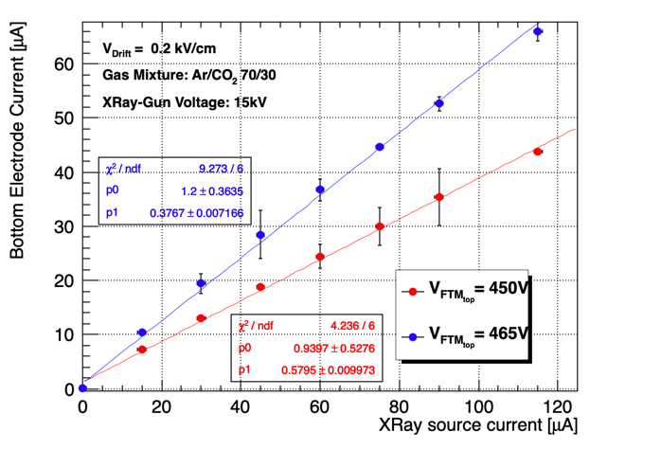
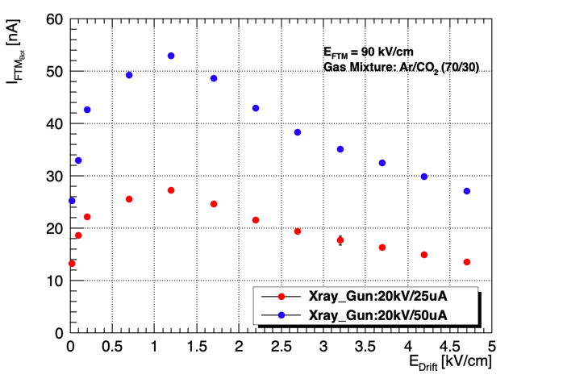
Re-cap
Linearity plot and the first drift scan
Anode
Linearity observed. Proceeded to signal observation
Effective gain measurement.

Slide 5
Signal observation – Failed
The setup used for this output was
Not able to observe rate
Not able to observe spectrum
Not able to justify the bipolar character
Panasonic-to-LEMO
scope
Preamplifier
ORTEC 142PC
Amplifier
ORTEC 474
Possibly amplified reflections

Slide 6
Gain measurements
First attempts and measurements failed as the gun was too far away from the prototype ~ 1m
Placed the gun closer
Kept track of the Anode current in the beginning

Slide 7
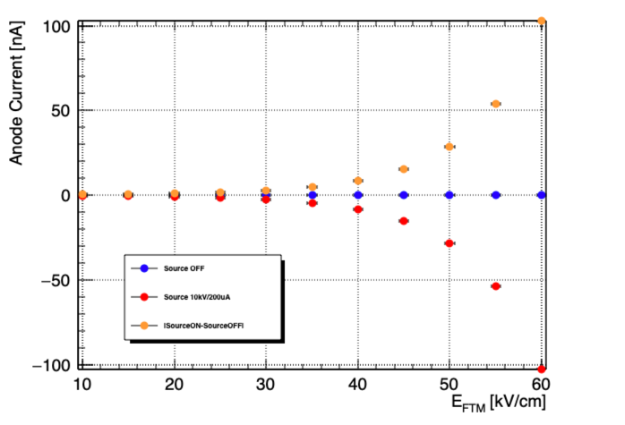
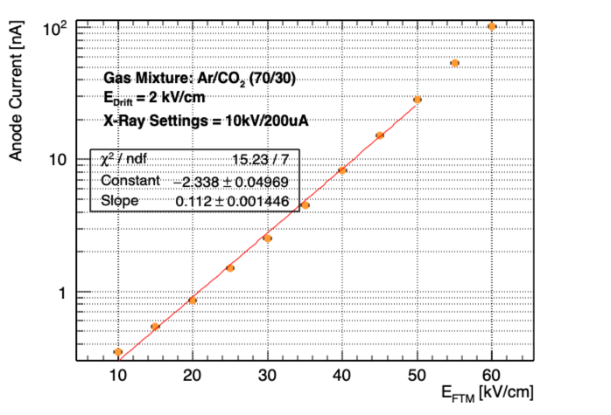
Gain measurements
Moved the source as close as possible to the prototype
Compared to previous work i.e. Federica’s work in Bari
We expect a flatter region – an ionization region. Does not seem to be the case…

Slide 8
Gain Measurements
Keep track of the current collected to all layers
Drift, FTM_{TOP} (DLC), Anode foil (DLC).
Scanned the amplification voltages 10 – 60 kV/cm
Made use of the high-res PS as the pico-ammeter measurements were biased

Slide 9
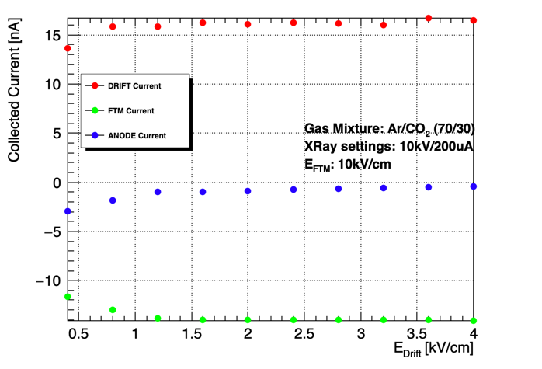
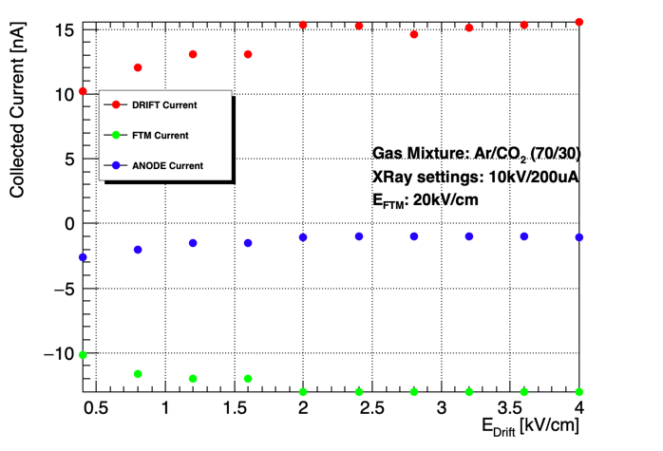
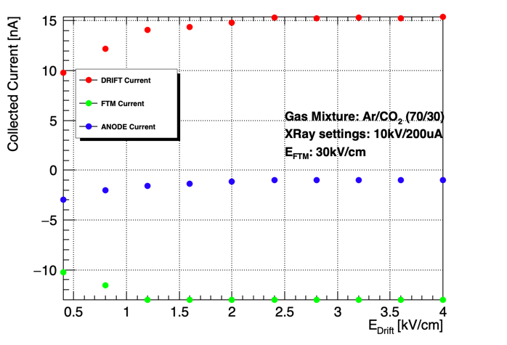
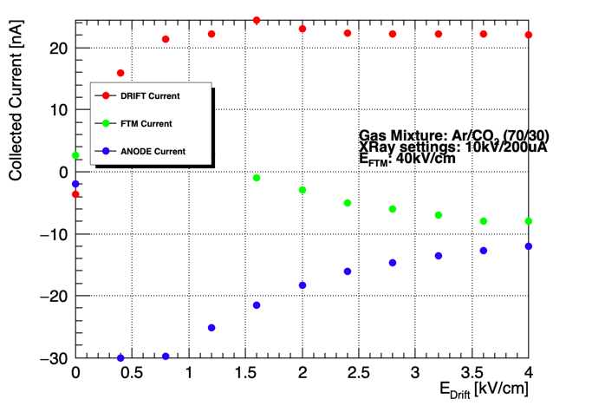
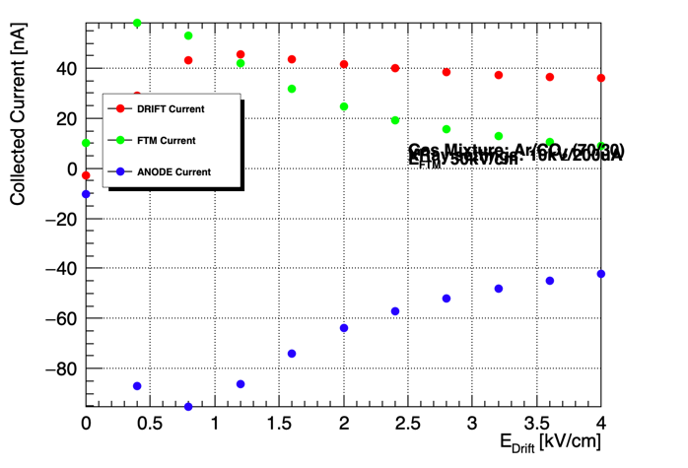
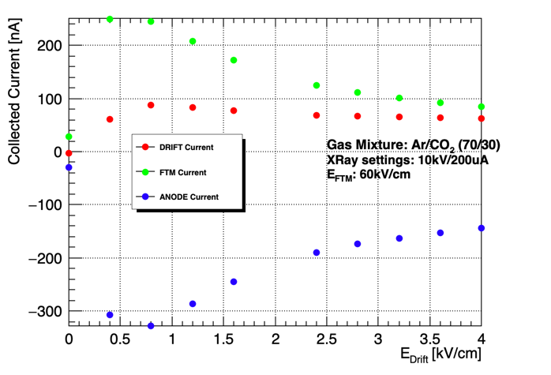
Gain Measurements

Slide 10
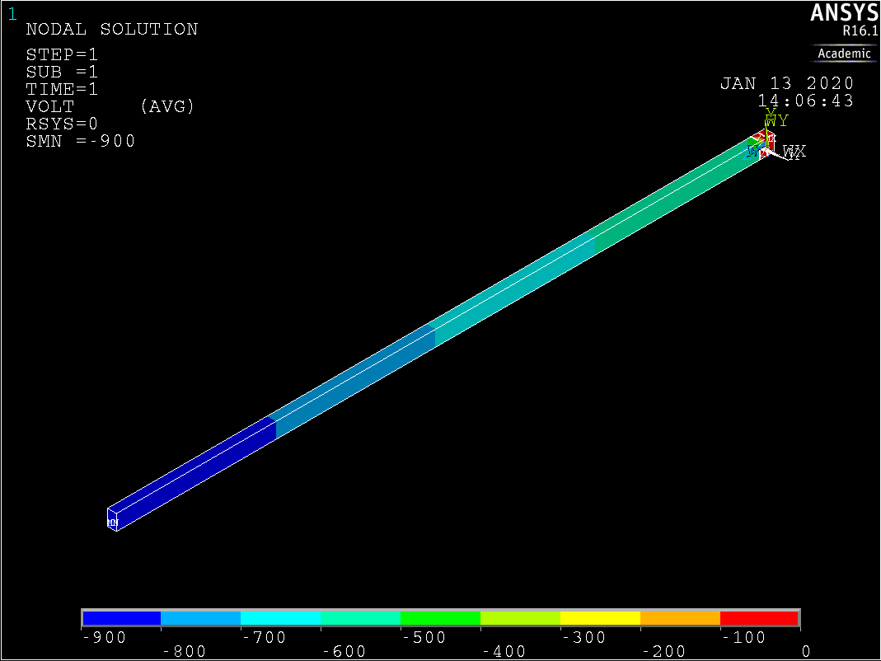
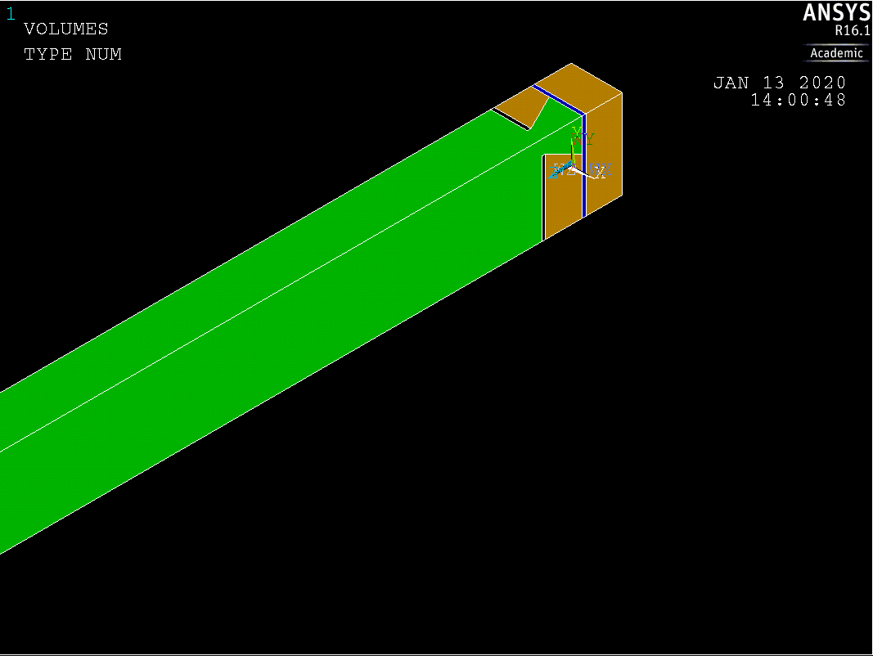
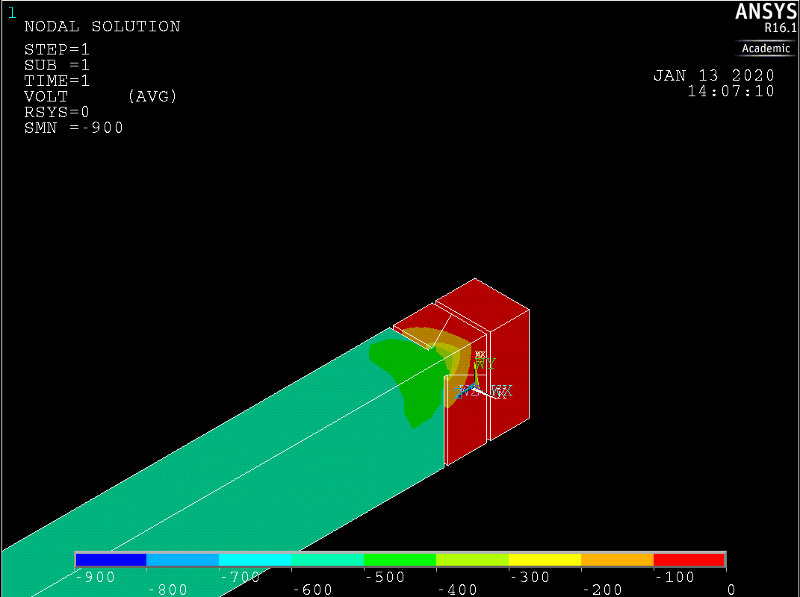
FTM – Prototype Simulation
Simulate the foil FTMv4t2 created/used
kapton2
DLC top
DLC anode
kapton1
Gas Volume

Slide 11
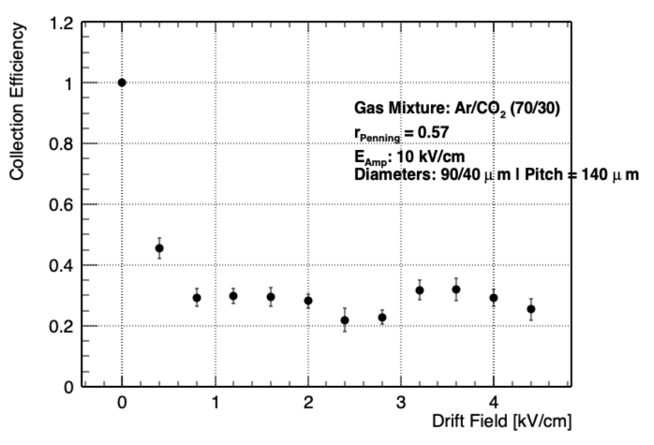
Measured collection efficiency and Eff. Gain
Compare the collection efficiency with the data for the Current collected on the layers

Slide 12
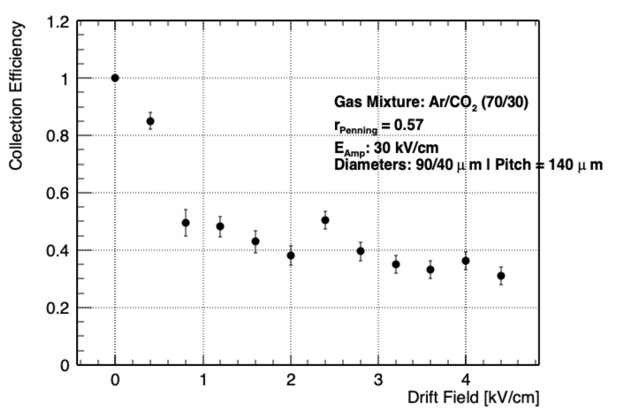
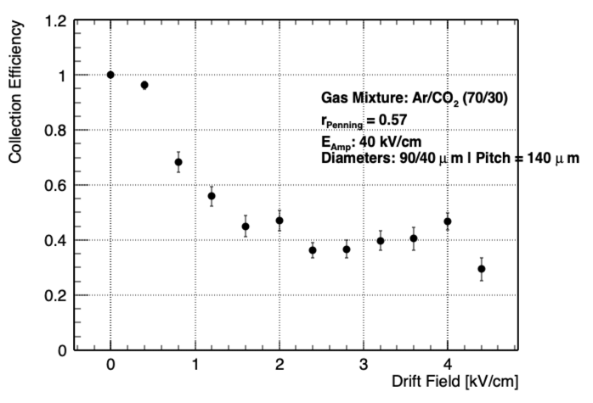
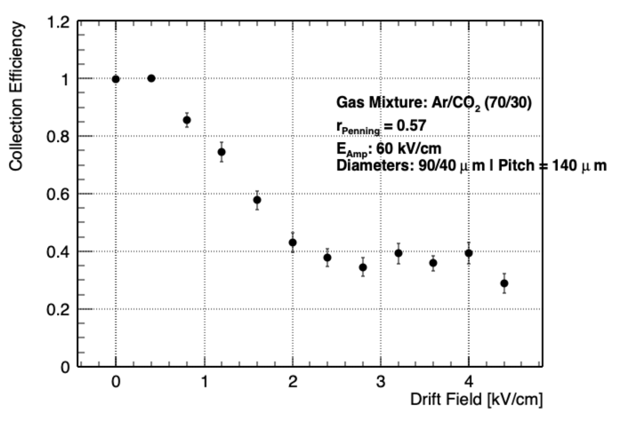
Measured Collection efficiency and Eff. Gain

Slide 13
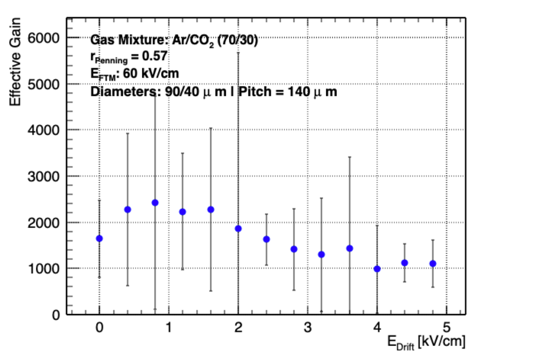
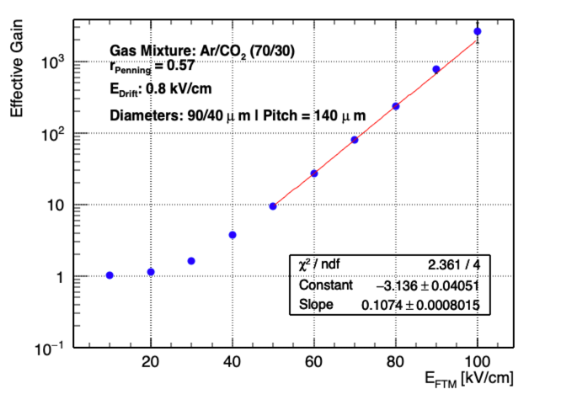
Measured Collection efficiency and Eff. Gain
100

Slide 14
Future plans
I will be at CERN for the RD51 week (present the work there maybe ?)
We still have a Cu cladded WELL foil which was not tested (50μm – 100μm diameters)

