Slide 1
Testing NIT (Nano Imaging Trackers) films at CNAO
Giovanni De Lellis
University Federico II and INFN, Naples

Slide 2
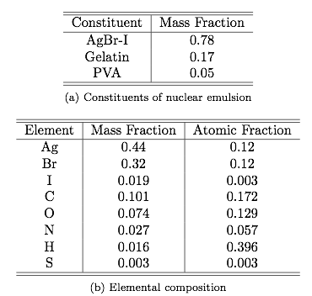



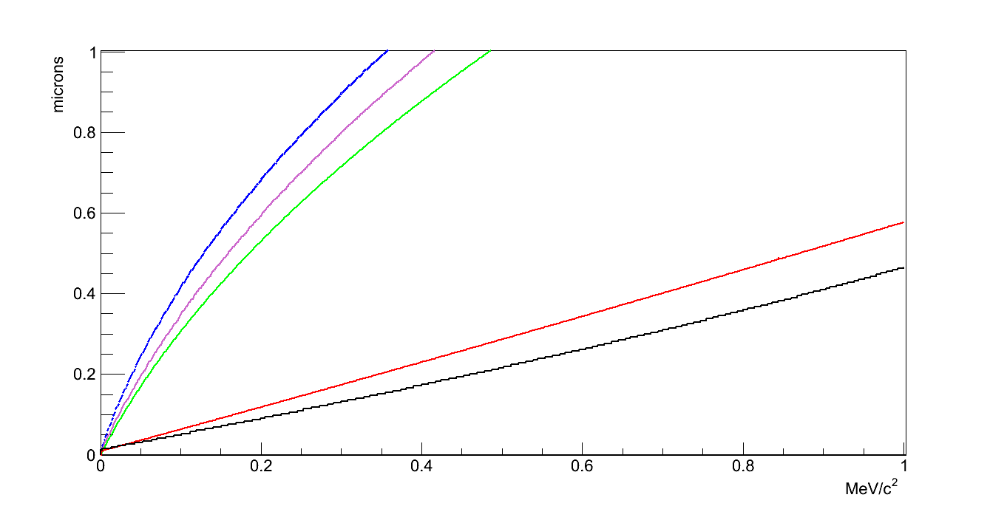


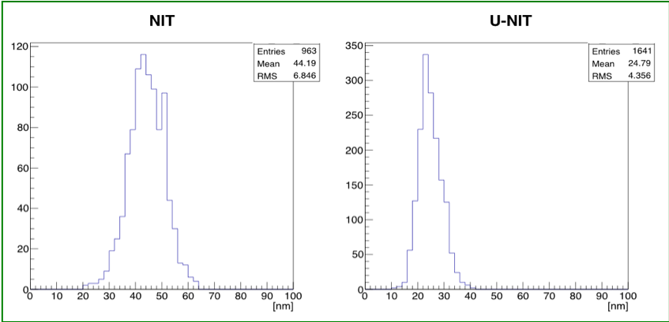
NIT EMULSIONS
2
AgBr-I: sensitive elements
Organic gelatine: retaining structure
PVA to stabilise the crystal growth
N
O
heavy nuclei
C
light nuclei
Track length (micron)
Br
Ag
Crystal size
Recoil energy (MeV)
40 nm
25 nm

Slide 3
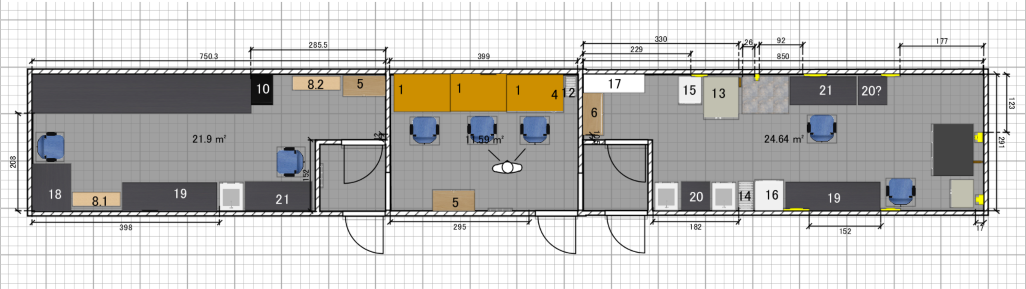
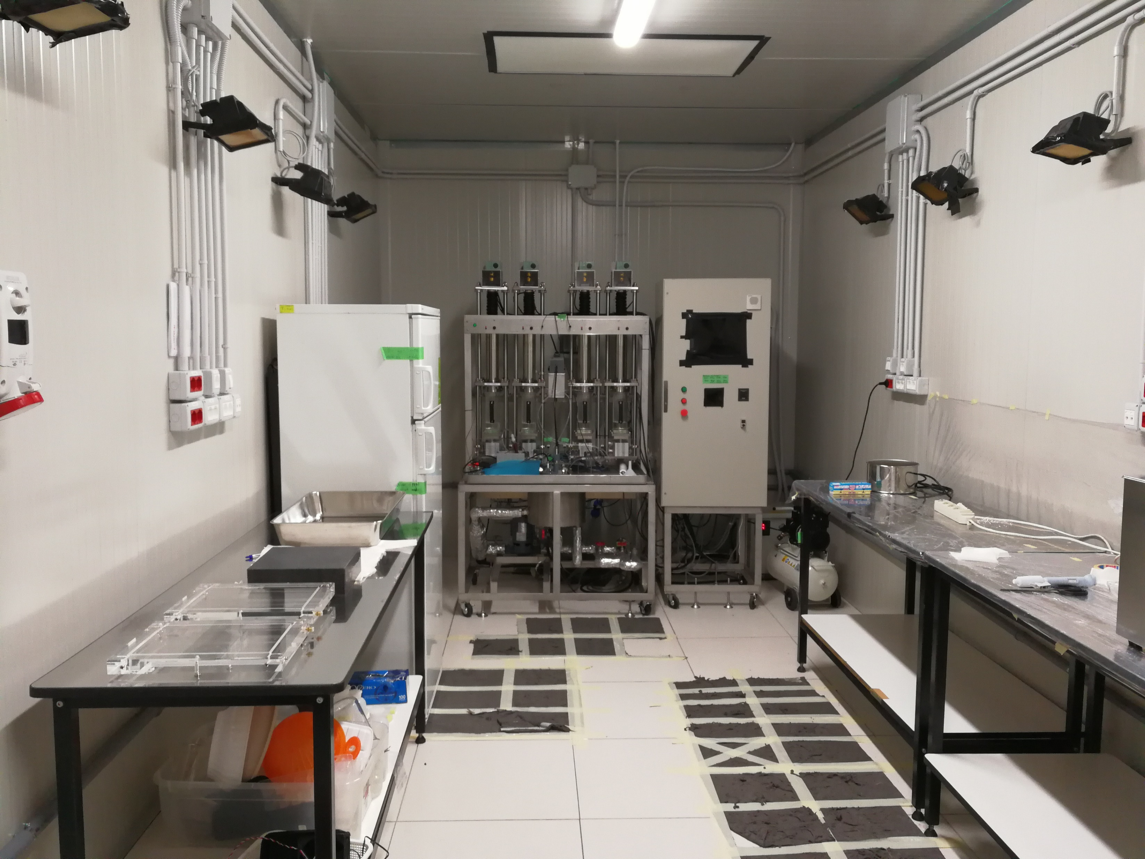
NIT PRODUCTION MACHINE AT LNGS
3
3
Production machine
Pouring stages
Chemical preparation desk

Slide 4
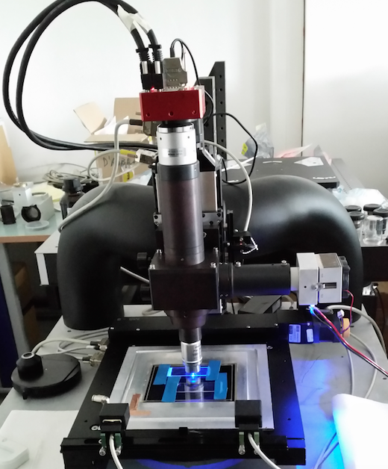
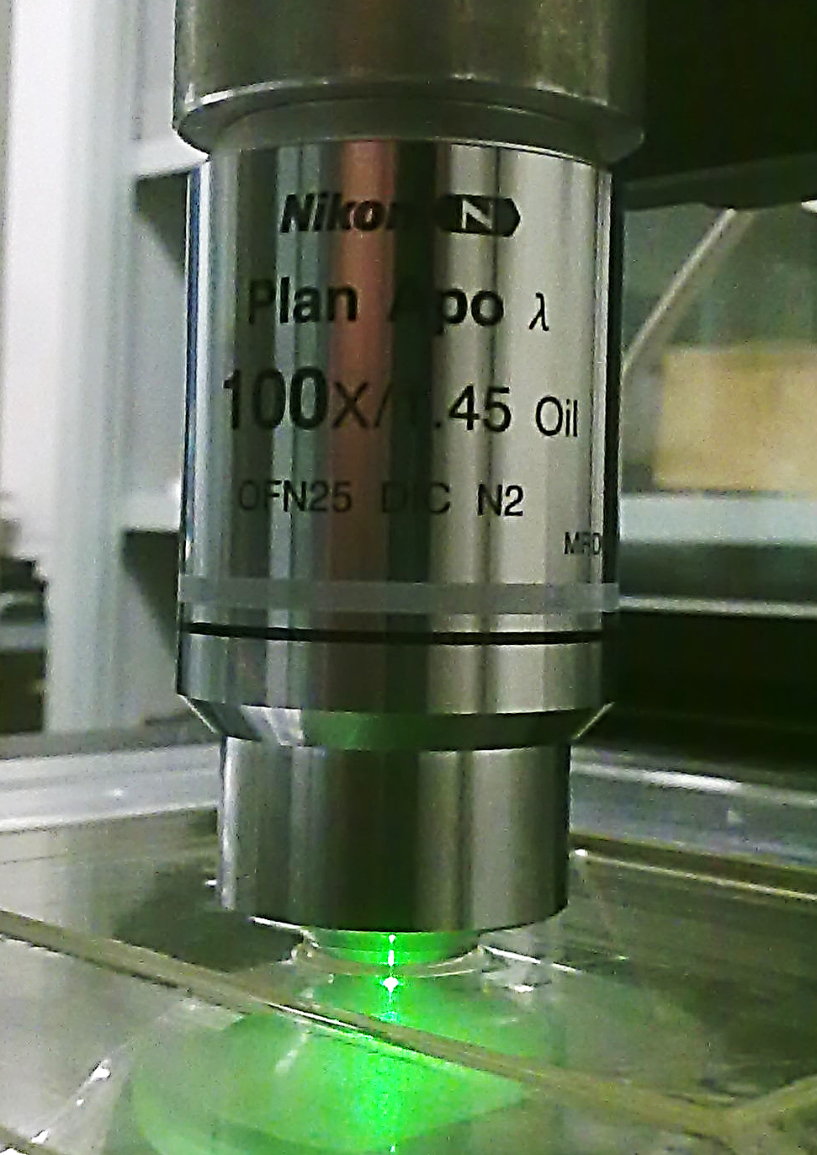
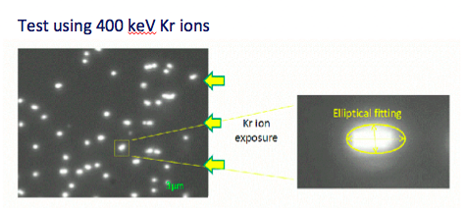
Optical Microscope Read-out: Step 1
4
100x objective lens with high N.A.
Bonito CL/CMC-4000
CMOS Camera
4 Mpix, @100 fps
Magnifying lens,
Nikon VM C-2.5x
LED
Lamp
Resolution: 28 nm/pixel
View Size: 65.2 x 48.3 µm²
Nikon Oil Objective
100x, 1.45 N.A., Plan Apo
Scanning with optical microscope and shape recognition analysis

Slide 5
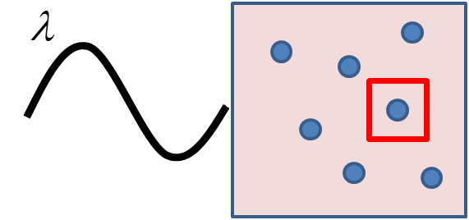

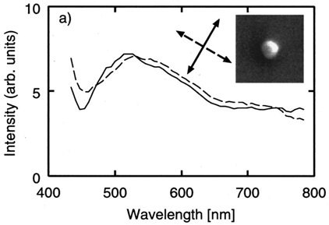
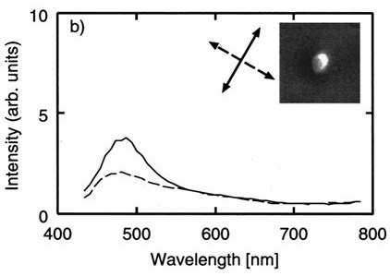
Resonant Light Scattering From Ag Nanoparticles
5
λ_{l}
E_{l} intensity of inside metal
Nano-metal in medium ε_{d}
Oscillation of e-cloud
E_{l} is resonance enhanced
Scattering spectrum depends on the light polarization and on the grain shape
H.Tamaru et al ., Applied Phys Letters 80, 1826 (2002)
SEM image
SEM image
Ag 100 nm spheroidal
polarizing property
Ag 100 nm spherical
no polarizing property
The polarization dependence of the resonance frequencies strongly reflects the shape anisotropy

Slide 6
6
Resonant light scattering: silver grains
Resolving two grains closer than 𝛌/2
polarization direction
30keV Carbon ion
implanted
Scattering intensity
Surface of
emulsion
500nm
polarization direction of incident light
Optical response strongly depends
on the polarization of incident light
Different orientation
TEM image of Carbon track after development

Slide 7
7
Resonant light scattering: silver grains
Resolving two grains closer than 𝛌/2
polarization direction
30keV Carbon ion
implanted
Scattering intensity
Surface of
emulsion
500nm
polarization direction of incident light
Optical response strongly depends
on the polarization of incident light
Different orientation
TEM image of Carbon track after development
PTEP (2019) 063H02

Slide 8
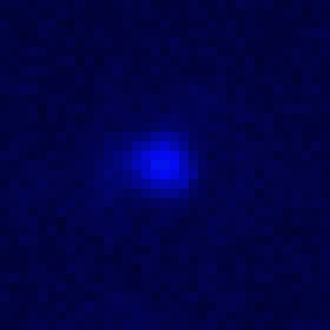
A Track Made Of Two Grains
8
e = 1.49
without polarizer
Track validated by
elliptical shape analysis
1μm
1μm
dx ●
dy ○
Linear fit slope = track direction
Angle of polarization (degree)
PTEP (2019) 063H02

Slide 9
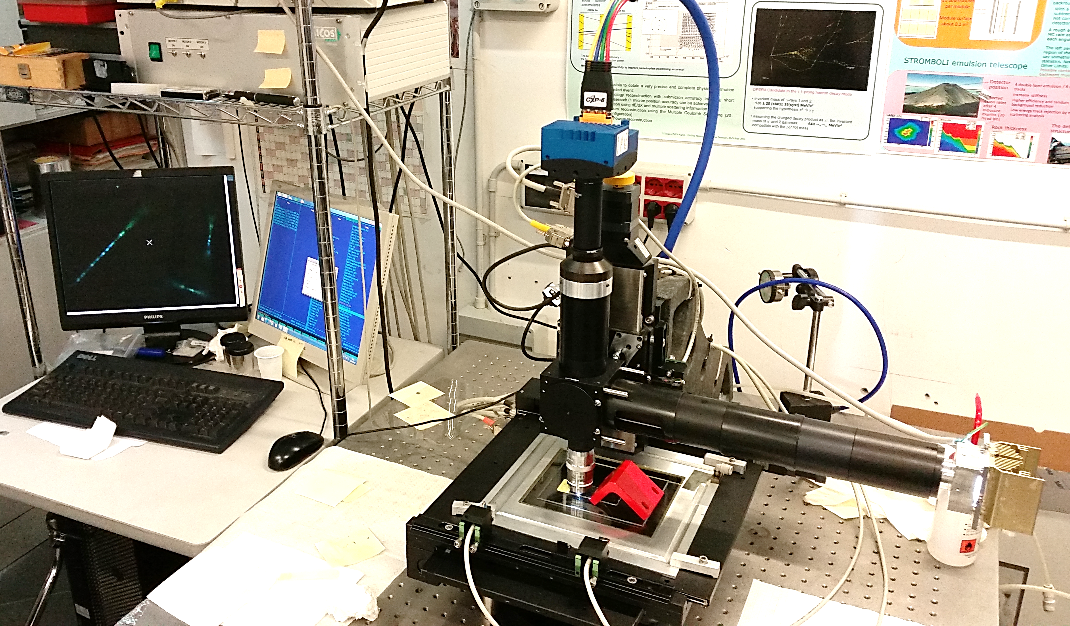
Colour Camera and Extension of the Plasmon Resonance Analysis
9
Colour camera
Particle tracks
displayed in colour
White LED
source
Sample illuminated
with white light

Slide 10
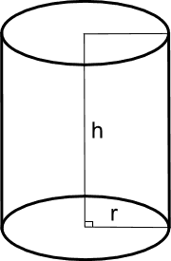
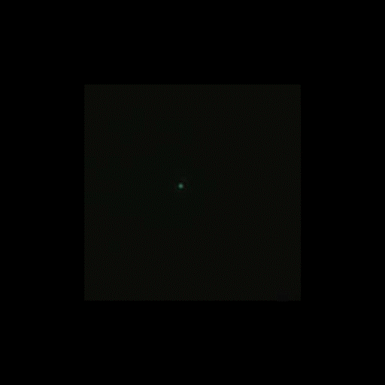
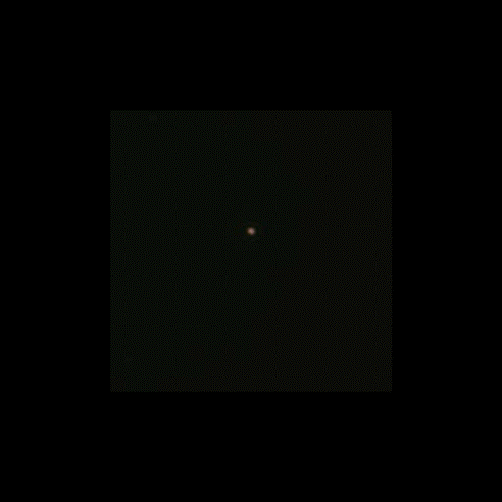
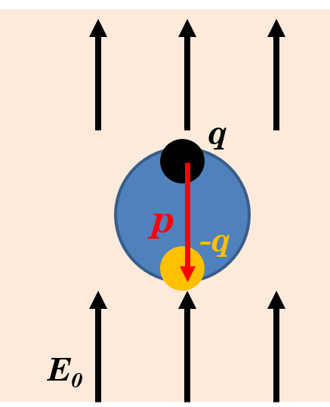
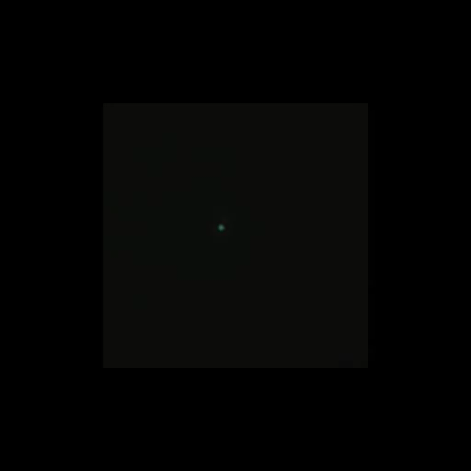
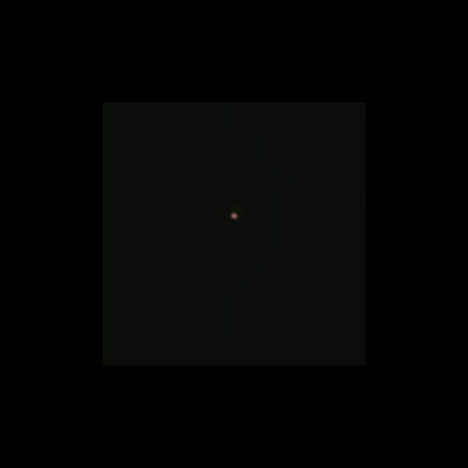
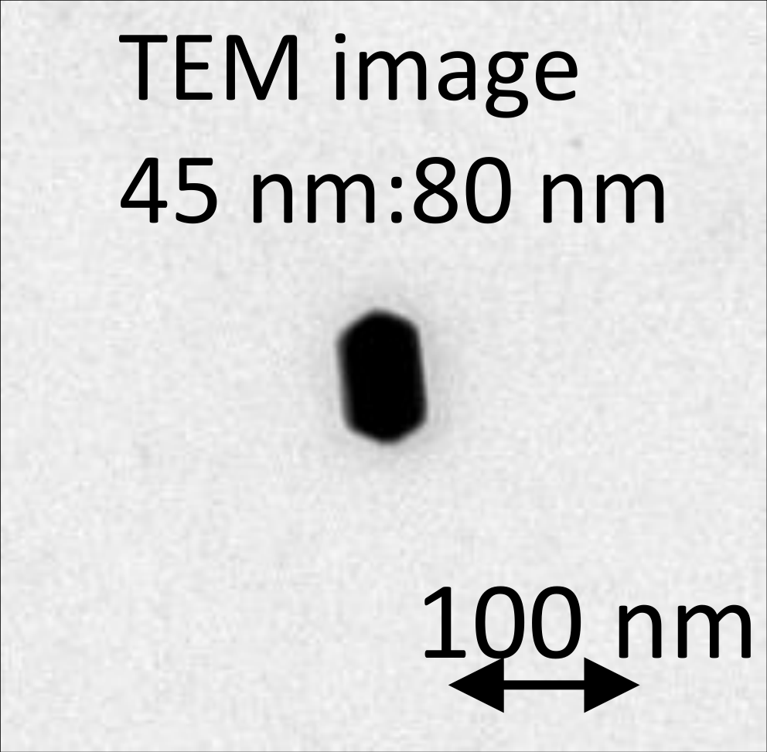
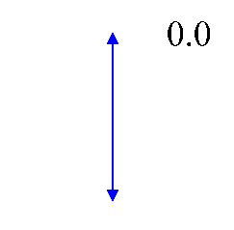
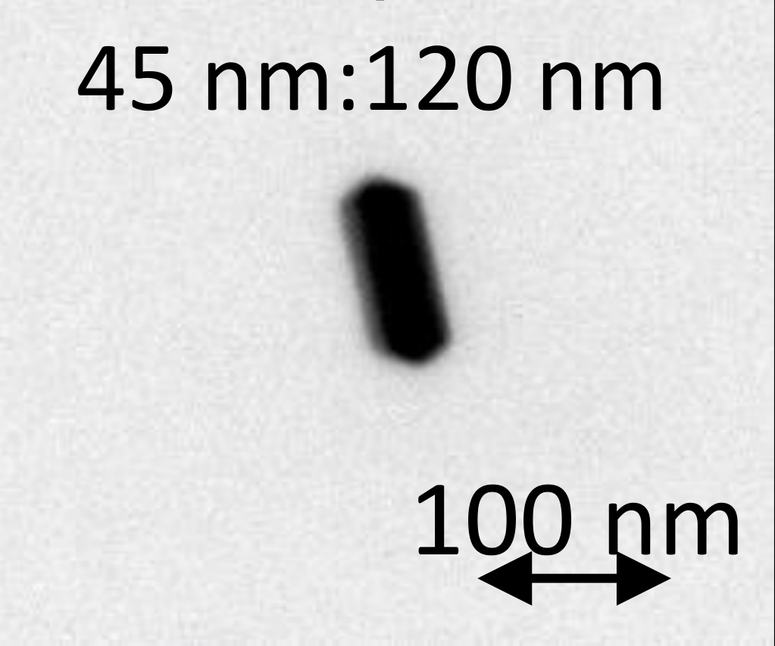
LSP (Localized Surface Plasmon) resonance
R = 45 nm → blue
H = 80 (120) nm → green (red)
45x80
45x80
45x120
45x120
Annu. Rev. Phys. Chem. 58 (2007) 267-297
dipole in metallic particle
dipole moment
100 nm
100 nm
resonance
Appl. Phys. Lett. 80, 1826 (2002)
Ag grain size → resonance wavelength
metallic particle

Slide 11
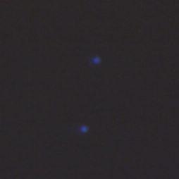
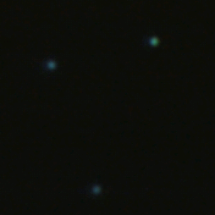
Silver Nanoparticles for calibration
11
40 nm diameter
60 nm diameter
NP-40
NP-60
7.5 µm x 7.5 µm
7.5 µm x 7.5 µm

Slide 12
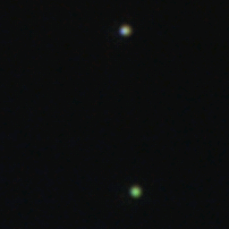

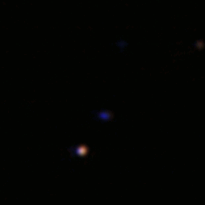
Silver Nanorods for calibration
12
40 nm diameter, 80 nm height
40 nm diameter, 120 nm height
NR-40x80
NR-40x120
7.5 µm x 7.5 µm
7.5 µm x 7.5 µm

Slide 13
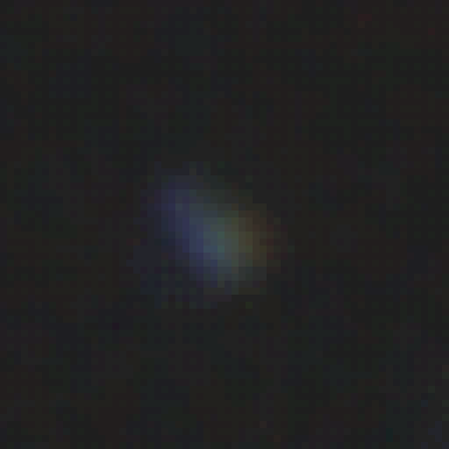
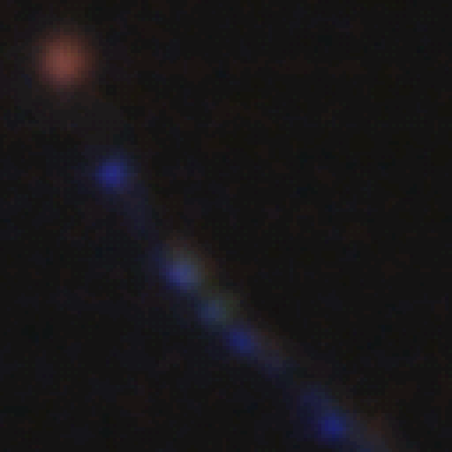
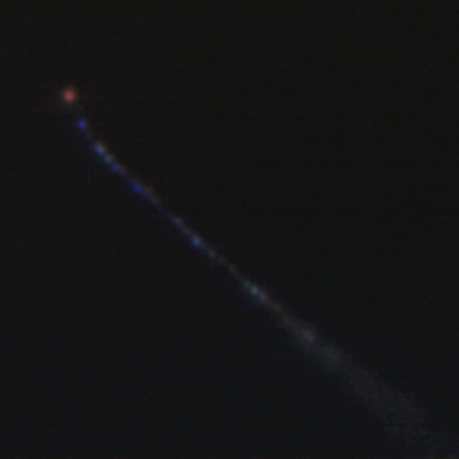
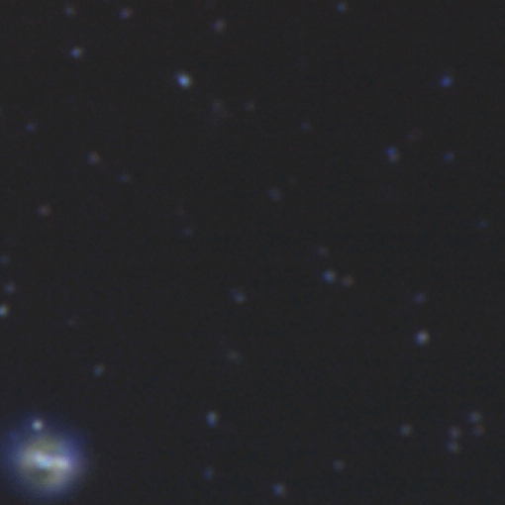
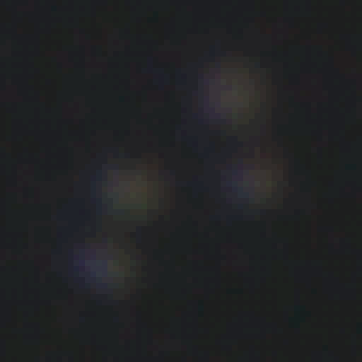

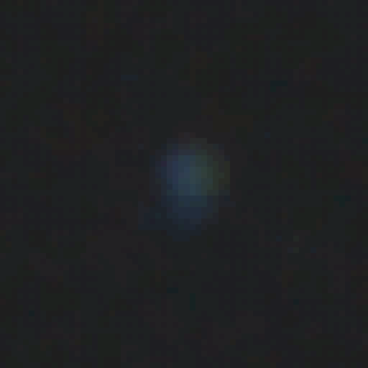
Colour camera
Localized Surface Plasmon Resonance
13
Alpha track
100keV C-ions
Image size 15 µm x 15 µm
Image size 15 µm x 15 µm
Head/tail discrimination!

Slide 14
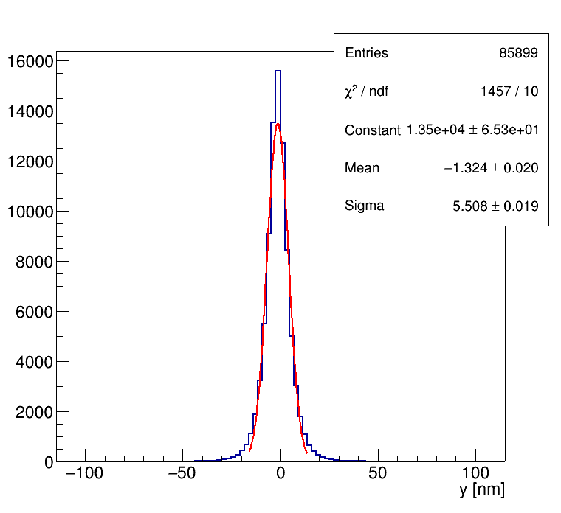
Testing NIT Films at CNAO (1)
100-300 𝛍m
Fragmentation of target (polystyrene) induced by proton collision
protons
σ ~ 6 nm!
Glass or Plastic (polystyrene) support, 70 to 200 𝛍m
Sensitive layers (tunable, few tens of 𝛍m)
being crystals so small → Large dE/dx is required to sensitize them
→ These films are insensitive to mip (cosmic-rays)

Slide 15
Testing NIT Films at CNAO (2)
Produce the films at Gran Sasso a (few) weeks before
Technical test: check the sensitivity of these films to Carbon ions and protons
Physics goal: use protons to study the fragmentation of the target (emulsions, polystyrene, …?)
Identification of different fragments (charge) through the colour analysis? to be tested
We could expose a few films to test some of the above features

