Slide 1
Overview of ongoing activities @ SBAI
A. Sarti

Slide 2
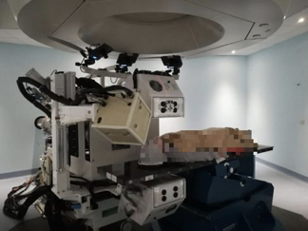
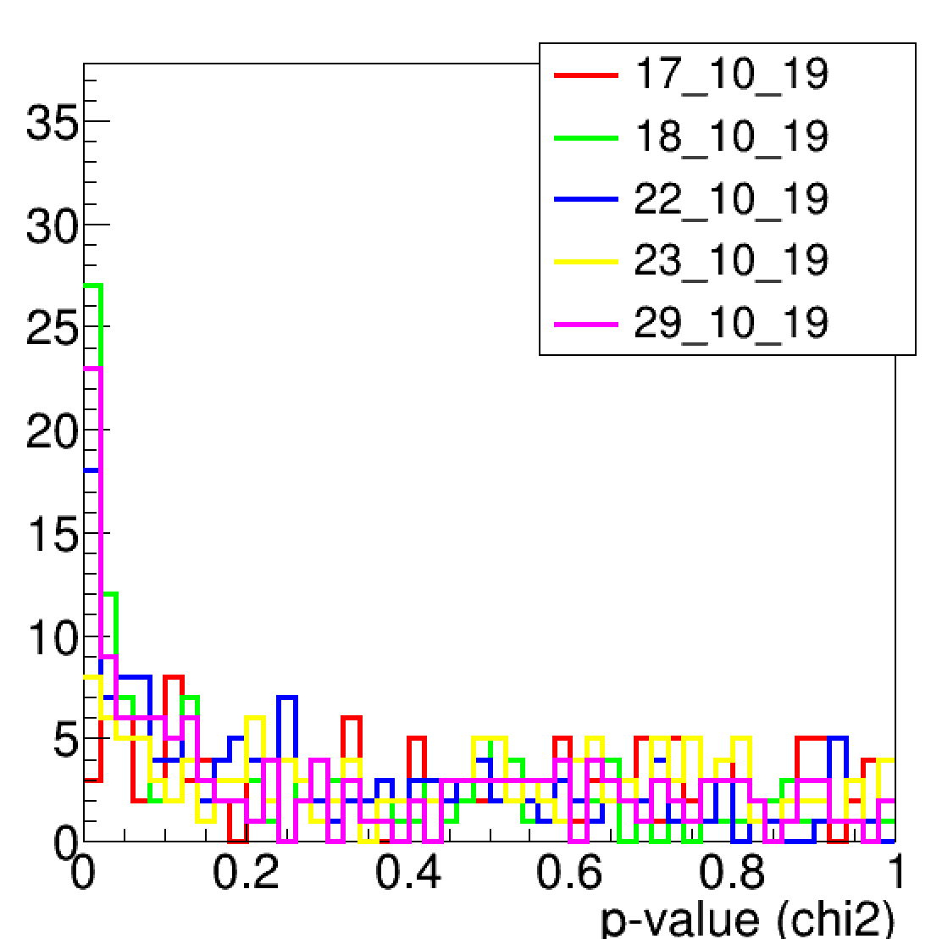
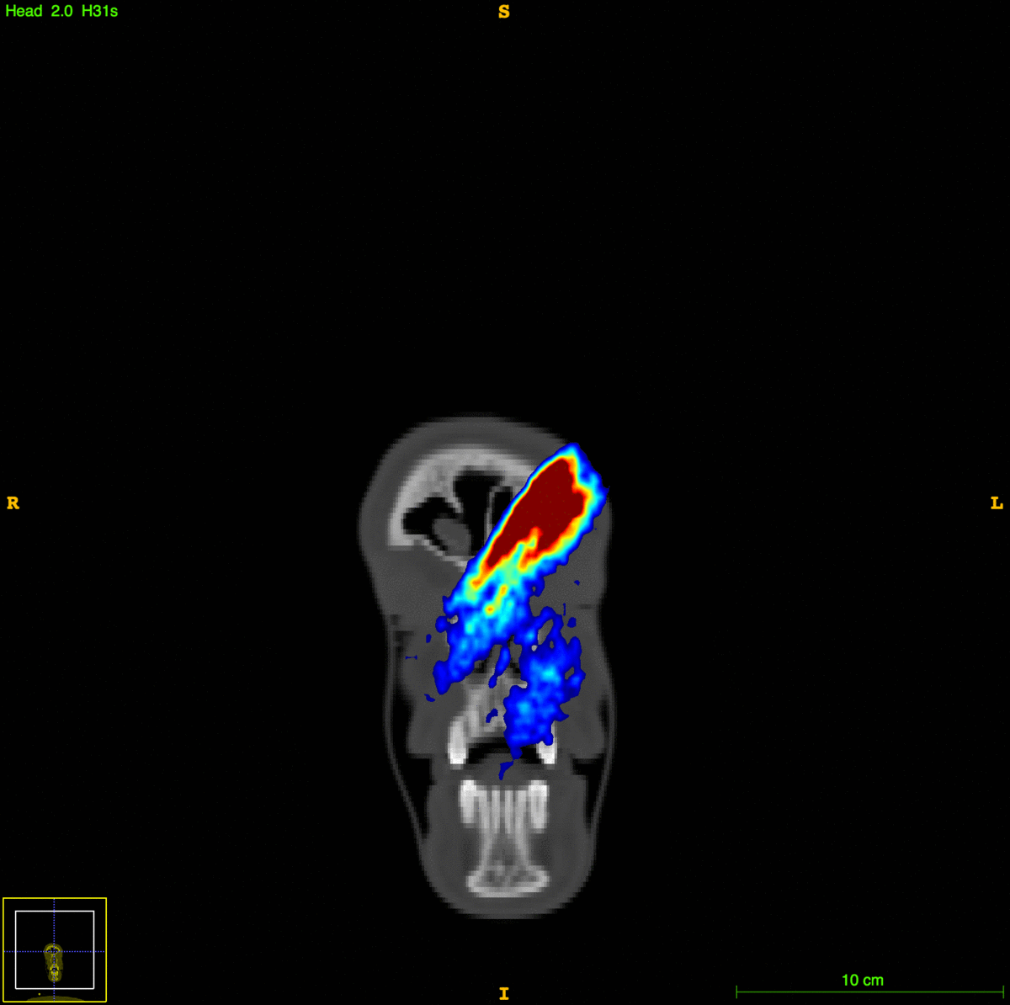
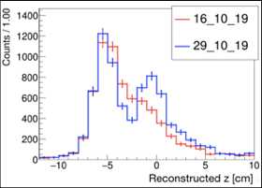
Dose Profiler
People involved: B. Di Lullo, M. Fischetti, A. Sarti, G. Traini
Ongoing Activities:
HW: DDS optical interface
SW: Data analysis. Trial data & data/MC comparisons are ongoing. 3D approach is under development with help from V. Bruni (mat - SBAI)

Slide 3
Dose Profiler
More details next talk from
F. Galante
Time Plan:
Finalize article on technique exp. + trial preliminary
Finalize trial (exp. end in early 2021)
2 other articles: 3D approach, PB monitoring.
Opportunities [Physicists / Bio-Engineer]:
Data collection @ CNAO (trial 2nd step, starting next sept.)
Data analysis: PB monitoring, Trial analysis, Range monitoring?
DP interface improvements in view of routine operation during treatments
Collaborations:
CNAO – INFN Mi, Pi, To – CF

Slide 4
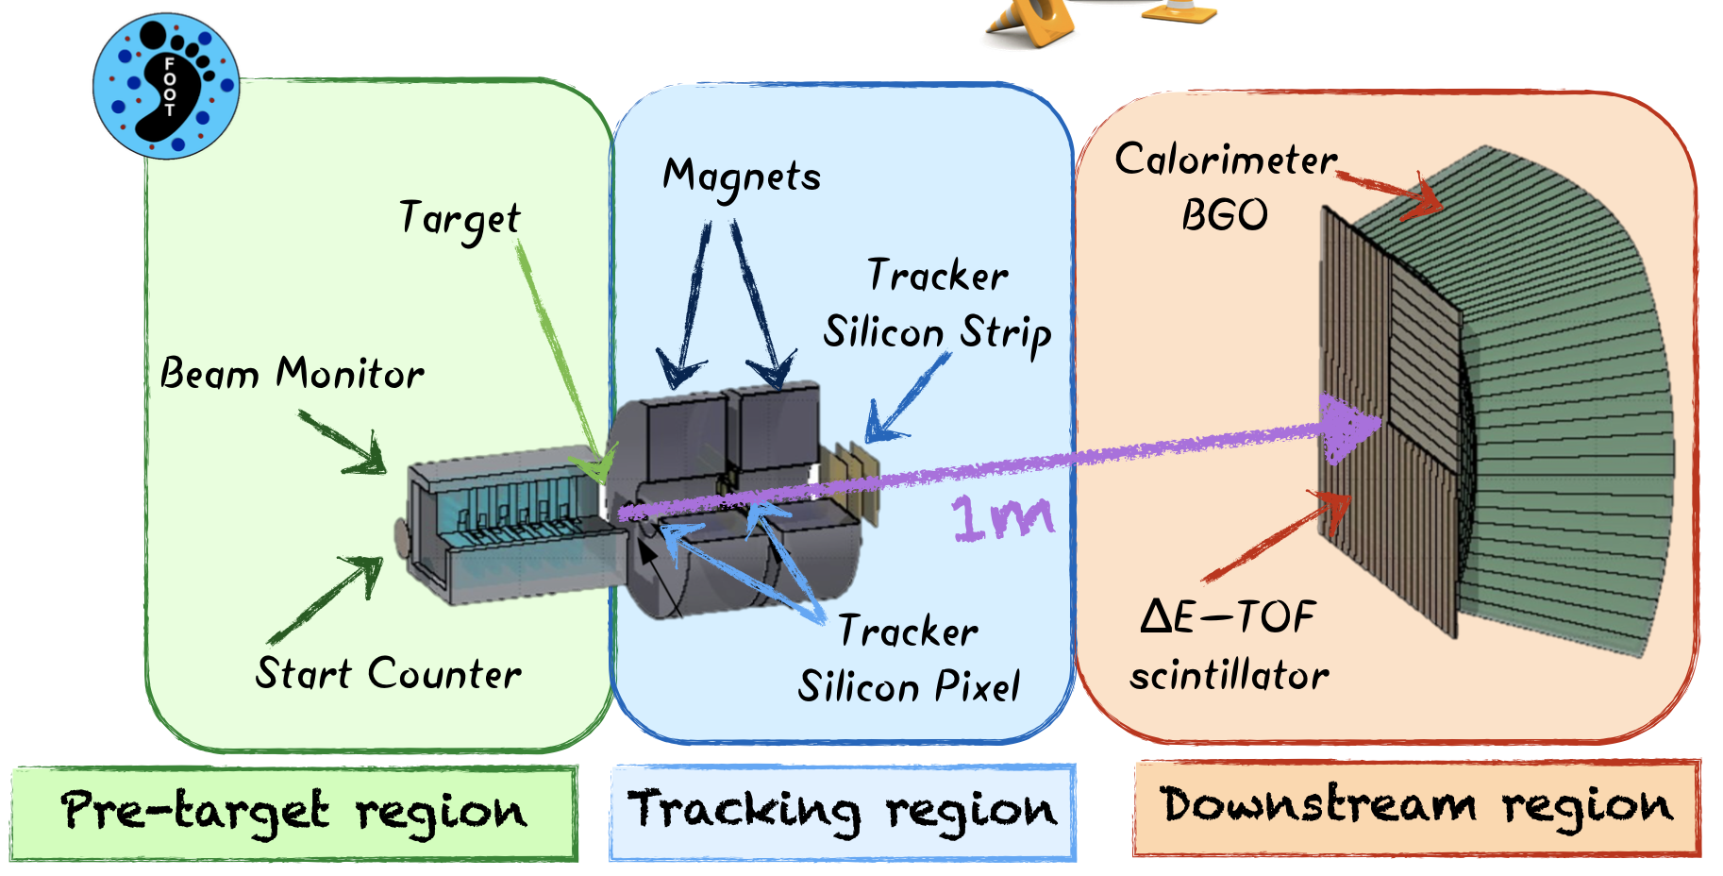
FOOT
People involved: G. Franciosini, M. Marafini, V. Patera, A. Sarti, A. Sciubba, M. Toppi, G. Traini (+ F. Murtas, laureanda, @ marzo?)
Ongoing Activities:
HW: Start counter
SW: ToF reco, Trigger, Global reconstruction
Next February: Data Taking with emulsions and test beam with star counter at GSI (Darmstadt).

Slide 5
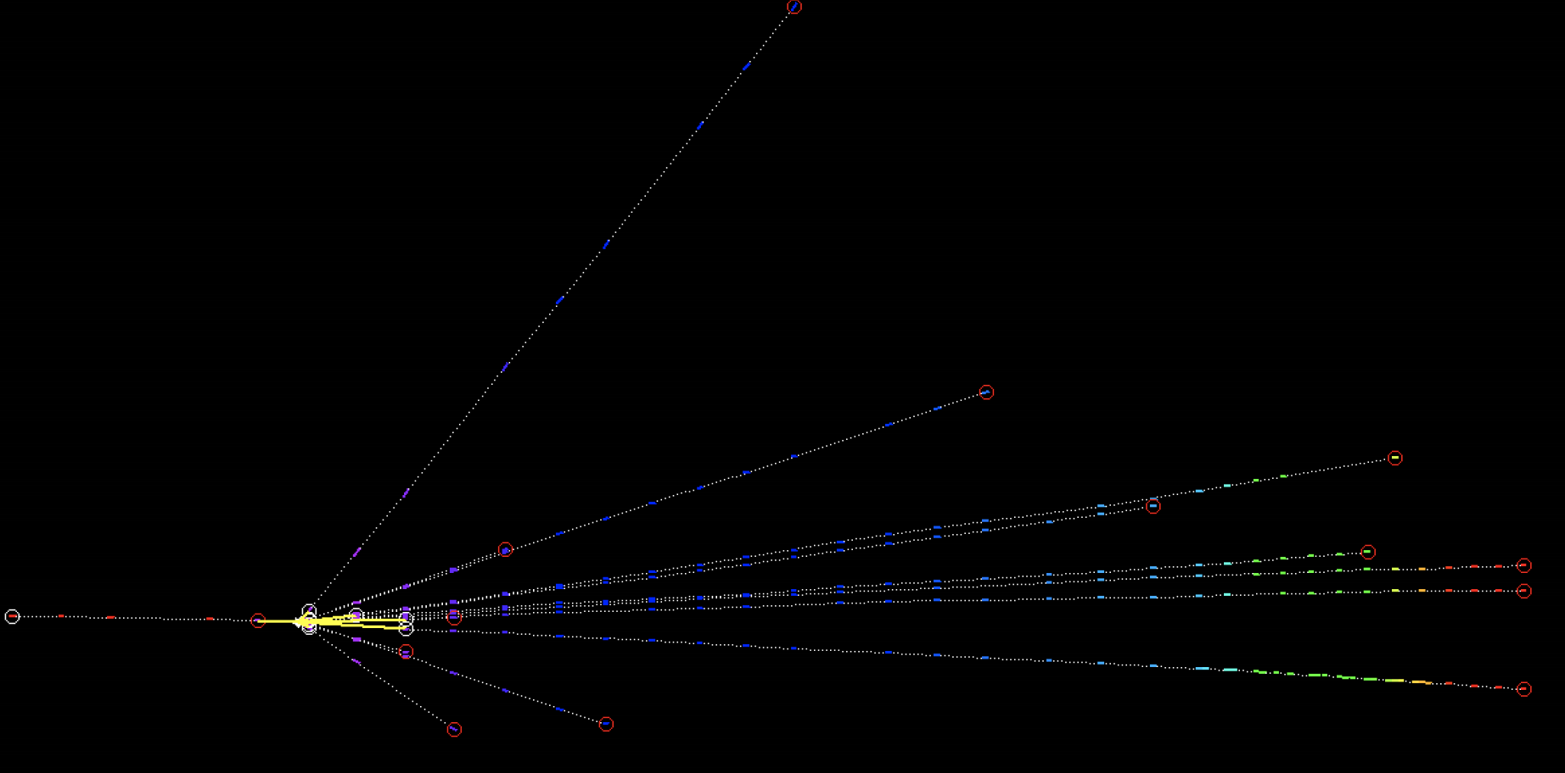
FOOT
Time Plan:
Article in preparation.
Next data taking will take place in end 2020 early 2021.
Opportunities [Physicists]:
HW: New start counter detector (optimised for Radiation in Space applications: higher energies). Test beams of ToF system.
SW: data analysis, global reconstruction studies.
Collaborations:
INFN experiment (Na, To, Pi, Mi, LNF, PG, Bo, TIFPA, ..) + Strasbourg + Jap [emulsions] + …

Slide 6
FRED
People involved: P. De Maria, M. De Simoni, G. Franciosini, F. Salvati, V. Patera, A. Schiavi
Ongoing Activities:
Ions: energy-scaling of production cross-sections for fragmentation of Carbon ions; validation against commissioning data at CNAO; patient QA and plan recalculation (for CNAO); LET-based optimization of treatment plans (Medaustron)
EM: testing and validation of electron, positron and photon interaction in the clinical energy range; laying out dose report for IORT
patient QA at Maastro (Netherlands): commissioning and introduction in the clinical routine
plan recalculation and LET-based RBE dose report at CCB (Krakow)

Slide 7
FRED
Time Plan:
commission at Maastro: first quarter 2020
Carbon ion beam treatments: before Summer 2020
EM transport and new GPU engine: late Spring 2020
paper on beam model and commissioning at CCB: second quarter 2020
Opportunities [Physicists / Bio-Engineer]:
modelling radioactive sources; particle decays
LET-based optimization of plans wrt dose-based optimization (devel on GPU)
Collaborations:
very active with CCB proton centre (Krakow) and Maastro clinic (Netherlands)
opening up with PSI (Swiss)
J-PET detector data reconstruction using MC simulations (Jagellonian Univ. - Krakow)

Slide 8
Monitor di fascio @ CNAO
[beams of low intensities]
People involved: G. Franciosini, A. Sarti, A. Sciubba, M. Toppi
Ongoing Activities:
HW: test of CAEN DT5702 - 32 Channel SiPM readout Front-End Board, detector construction
SW: DAQ implementation
Time Plan
Build and test the monitor @ CNAO exp. room within this year
Opportunities [Physicists]:
Construction and test of the device
Collaborations: CNAO

Slide 9
MONDO
People involved: A. Bochetti, (R.Mirabelli), M. Marafini, G. Traini, A. Sarti, A.Sciubba, V.Patera
Ongoing Activities:
HW: matrix and prototypes realisation with Arianna (Filatrice), measurements with the new SBAM1 sensors
SW: data analysis
Time Plan:
SBAM 2 design
Data taking with protons CNAO/Trento
Opportunities [Physicists]:
SW: collaboration with FBK in the firmware implementation of SBAM 2, event reconstruction, MC developments
HW: SBAM 1 and 2 tests
Collaborations:
I.Mattei, G.Battistoni, new possible cooperation with TIFPA/UniTn

Slide 10
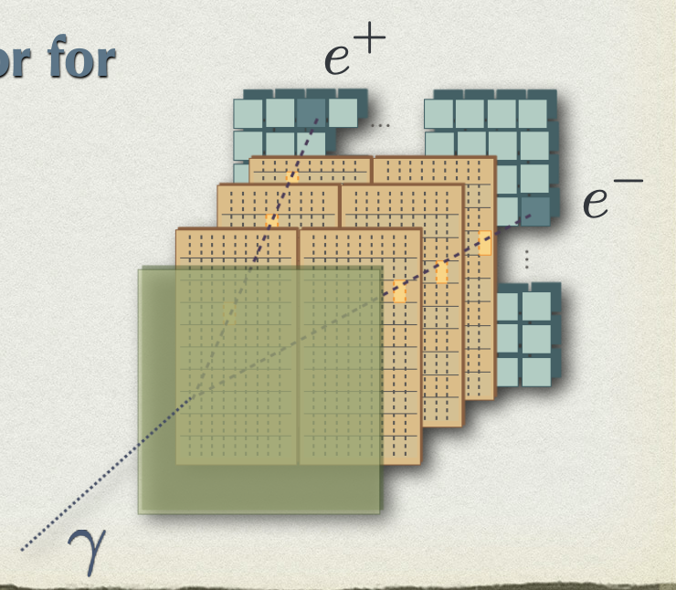
Paprica [I. Mattei project @ CSN5]
People from SBAI involved: M. Toppi, G. Traini, (M. Marafini, V.Patera, A.Sarti, A.Sciubba)
Ongoing Activities:
HW:
Alpide Setup @ LNF
converter & calo assembly @ SBAI
SW:
Detector simulation for layout optimization
LYSO converter, ALPIDE tech for tracking + plastic scint calo

Slide 11
Paprica [I. Mattei project @ CSN5]
Time Plan:
Article documenting technique potential in 1 year (MC based)
Opportunities [Physicists]:
MC studies.
tracking implementation with alpide
Collaborations: if you want to help, ask Ilaria, PI of the project (ilaria.mattei@mi.infn.it)

Slide 12
TOPS
Time Of flight Plastic Scintillators
People involved: (A. Bochetti), M. Marafini, A.Sciubba, V. Patera
Ongoing Activities:
HW: test with cosmic rays and sources of 4 samples of new plastic scintillators
SW: raw analysis for time and light output evaluations wrt EJ-200
Time Plan:
Article in preparation (TNS).
Opportunities [Physicists]:
HW/SW: measurements with protons at CNAO/Trento.
HW: new polymer based samples, developments and test
Collaborations:
SBAI reserchers: Chemistry and optical spectrometry divisions

