Slide 1

Proposal for a new evaluation of the Erbium capture cross sections
ENEA, INFN and UNIBO
(n_TOF collaboration)
A. Guglielmelli, F. Rocchi, C. Massimi, D.M. Castelluccio
n_TOF Italian Meeting, 04/05/2020

Slide 2
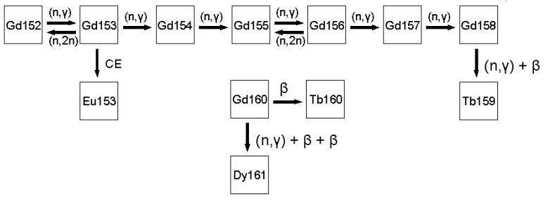

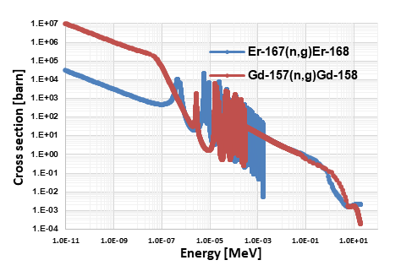
Background – Erbia concept
One of the research efforts in the field of nuclear design is to search burnable absorber to be directly mixed in UO2 fuel power matrix;
The burnable absorber improves: safety, cost, wastes, proliferation;
Since 1980’s Erbia (Er2O3) was considered as an alternative absorber to Gadolinia (Gd2O3) [1]:
Low therm. abs. cross sections (Er: 162 b; Gd: 2.5E+05 b) not downgrade the power distribution;
More negative temperature feedback coefficient (α=δk/δT) higher reactor core safety;
Higher and more energy extensive resonance integrals better control of transient phases;
Rather short nuclides chain evolution nearly linear poison’s efficiency with the number of Er-rods.
Is. | NA %
¹⁶²Er | 0.14
¹⁶⁴Er | 1.60
¹⁶⁶Er | 33.50
¹⁶⁷Er | 22.87
¹⁶⁸Er | 26.98
¹⁷⁰Er | 14.91
Is. | NA %
¹⁵²Gd | 0.120
¹⁵⁴Gd | 2.18
¹⁵⁵Gd | 14.80
¹⁵⁶Gd | 20.47
¹⁵⁷Gd | 15.65
¹⁵⁸Gd | 24.84
¹⁶⁰Gd | 21.86

Slide 3
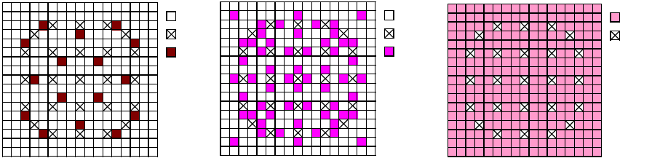
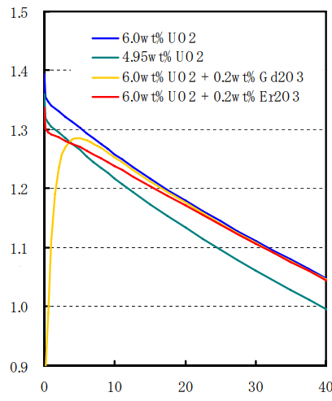
Background – Er-SHB concept
Since the 1980s several studies were conducted to promote erbium as an alternative burnable absorber to gadolinium [1];
Since the 1990s neutronic analyses were performed in Erbia-doped Fuel Assembly (FA) with a distribution strategy analogous to the Gadolinia-doped one [2];
UO2
UO2
Er-SHB
GT
GT
GT
Gd
Er
Since the 2000s the Er-Super High Burnup (Er-SHB) fuel concept (BU>70 GWd/MTU, erbia>0.2 wt%, U-235> 5 wt%) was adopted in some experimental campaigns [3]:
  Low content of Erbia is add into all UO2 (>5 wt%) powder just after the re-conversion process;
  Fuel enrichment is greater than 5 wt% but at BOL is equivalent to 5 wt%;
  Fuel can be handle with existing fabrication facilities with an improvement of the criticality safety and a reduction of the fuel cost
k-inf [-]
Burnup [GWd/t]

Slide 4
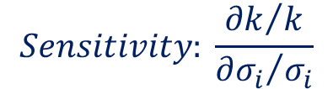
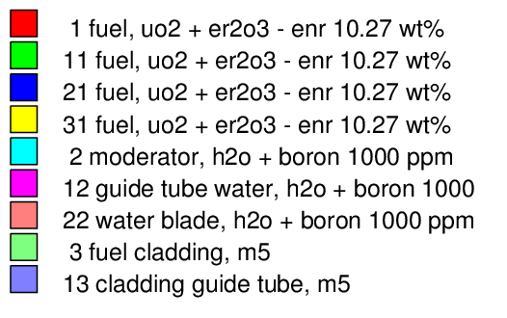
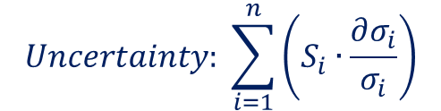
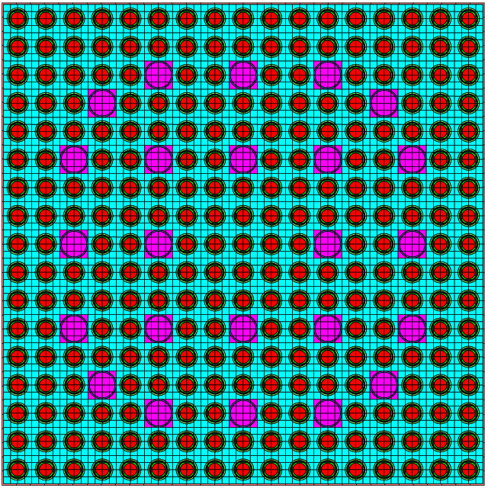
S&U analysis – Code
A S&U analysis on k for a Er-SHB Fuel Assembly (FA) at BOL, hot-full Power (HFP) conditions, was performed with the TSUNAMI-2D module of the US-NRC reference SCALE 6.2.3 code system developed at ORNL;
Parameter | Data
Enrichment | 10.27 wt%
Erbia content | 1.0 at%
Boron content | 1000 ppm
Water density | 0.702 g/cc
Xs MG library | V7-252 (based on ENDF/B-VII.1)
Xs COV library | 56group7.1 (based on ENDF/B-VII.1)
Critical Flux – Scale 6.2.3 [4]
Er-SHB PWR 17x17 Fuel Assembly
PWR17x17 FA main parameters [4]
Proposal for a revaluation of Erbium capture Xs data, n_TOF Italian Meeting, 04/05/2020

Slide 5
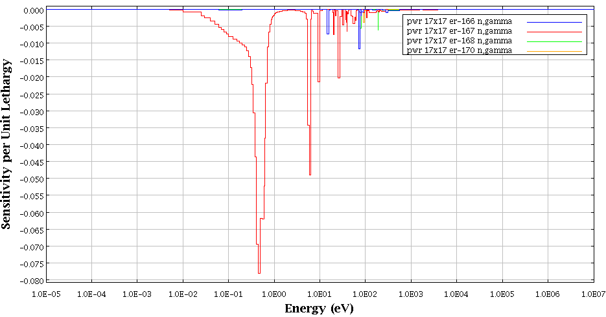
S&U analysis ‒ Results
k | dk/k | dk
(-) | (%) | (pcm)
1.32856 | 0.518 | 688
nuclide-reaction with nuclide-reaction |  |  |  | Δk/k | Rank
 |  |  |  | (%) | (-)
u-235 | nubar | u-235 | nubar | 3.23E-01 | 1.00
u-235 | n,gamma | u-235 | n,gamma | 2.32E-01 | 0.72
u-238 | n,gamma | u-238 | n,gamma | 1.88E-01 | 0.58
u-235 | chi | u-235 | chi | 1.65E-01 | 0.51
u-238 | n,n' | u-238 | n,n' | 1.12E-01 | 0.35
u-235 | fission | u-235 | n,gamma | 1.02E-01 | 0.32 |  | dk/k (-) | dk (pcm)
er-167 | n,gamma | er-167 | n,gamma | 9.25E-02 | 0.29 |  | 9.25E-04 | 123
u-235 | fission | u-235 | fission | 8.37E-02 | 0.26
u-238 | nubar | u-238 | nubar | 6.42E-02 | 0.20
u-238 | elastic | u-238 | elastic | 2.49E-02 | 0.08
u-238 | chi | u-238 | chi | 2.41E-02 | 0.07
h-1 | n,gamma | h-1 | n,gamma | 2.27E-02 | 0.07
zr-91 | n,gamma | zr-91 | n,gamma | 1.94E-02 | 0.06
u-238 | elastic | u-238 | n,gamma | 1.89E-02 | 0.06 |  | dk/k (-) | dk (pcm)
er-166 | n,gamma | er-166 | n,gamma | 1.72E-02 | 0.05 |  | 1.72E-04 | 23
o-16 | elastic | o-16 | elastic | 1.48E-02 | 0.05
u-238 | fission | u-238 | fission | 1.44E-02 | 0.04
zr-92 | n,gamma | zr-92 | n,gamma | 1.29E-02 | 0.04
u-235 | fission | u-238 | n,gamma | -1.24E-02 | -0.04
u-235 | fission | u-238 | fission | 1.24E-02 | 0.04
h-1 | elastic | h-1 | elastic | 1.21E-02 | 0.04
u-238 | n,n' | u-238 | elastic | -1.18E-02 | -0.04
zr-90 | n,gamma | zr-90 | n,gamma | 9.73E-03 | 0.03 |  | dk/k (-) | dk (pcm)
er-168 | n,gamma | er-168 | n,gamma | 8.48E-03 | 0.03 |  | 8.48E-05 | 11
o-16 | n,alpha | o-16 | n,alpha | 8.44E-03 | 0.03
u-238 | n,2n | u-238 | n,2n | 7.05E-03 | 0.02 |  | dk/k (-) | dk (pcm)
er-170 | n,gamma | er-170 | n,gamma | 7.01E-03 | 0.02 |  | 7.01E-05 | 9
nb-93 | n,gamma | nb-93 | n,gamma | 6.88E-03 | 0.02
u-235 | elastic | u-235 | n,gamma | -6.66E-03 | -0.02
Erbium Xs uncertainty gives the largest contribution to the uncertainty on k after U-235 and U-238
~ 18 %
The most important energy region for reactor applications is between 100 meV and 10 eV
Most of the cross sections with a rank factor greater than Er have already been measured at n_TOF.
~ 3.3 %
Er-167: The highest absorber and the only resonance isotope in the thermal range
Erbium Capture (n, γ) Cross Sections – ENDF/B-VIII.0
Proposal for a revaluation of Erbium capture Xs data, n_TOF Italian Meeting, 04/05/2020

Slide 6
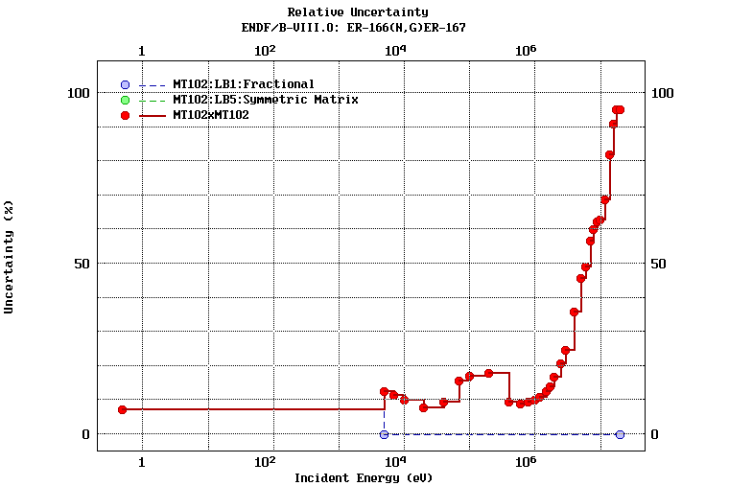
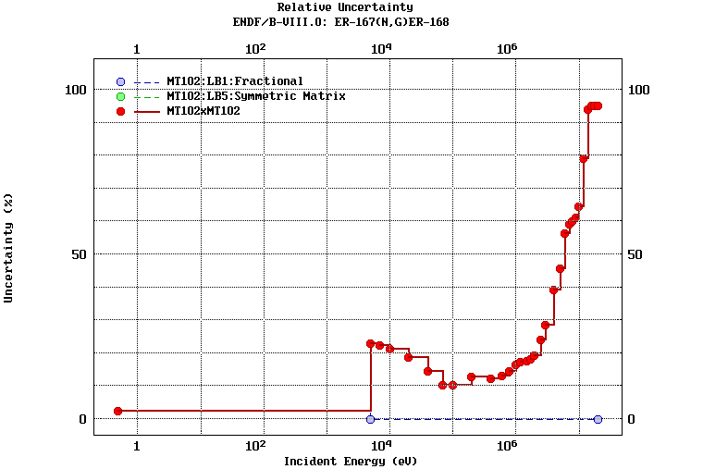
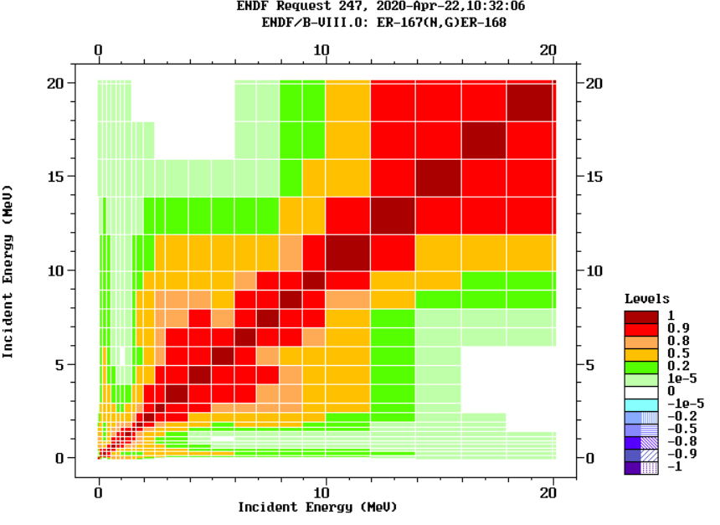
Erbium Eval. data – Thermal point
Erbia cross sections evaluated data (ENDF/B-VII.0):
Er-166
X | Y
eV | %
0.5 | 7.25
Er-167
X | Y
eV | %
0.5 | 2.35
Er-168
X | Y
eV | %
0.5 | 12.00
Er-170
X | Y
eV | %
0.5 | 15.28
Evaluated Relative uncertainty – Er-166(N,G)Er-167
Evaluated Relative uncertainty – Er-167(N,G)Er-168
Evaluated library | Data | Data- Error | Energy
[-] | [b] | [%] | [eV]
ENDF/B-VIII.0 | 649.812 | 2.3515 | 0.5
ENDF/B-VII.1 | 649.812 | 2.3515 | 0.5
JEFF3.3 | 649.845 | 3.74E-21 | 0.0253
JEFF3.2 | 649.844 | 3.74E-21 | 0.0253
JENDL-4.0u2 | 644.197 | No data | No data
CENDL-3.1 | No data | No data | No data
ROSFOND-2010 | 649.812 | No data | No data
BROND-3.1 | 649.812 | 2.3515 | 0.5
Only one evaluated uncertainty point in the Xs high sensitivity region, namely between 0.5 and 5 keV!
No or too low uncertainty data for JEFF, JENDL and CENDL Er-167(n,g) evaluation library.
Evaluated data Er-167(N,G)Er-168 – thermal point
E-167(N,G) covariance matrix – ENDF/B-VIII.0
Proposal for a revaluation of Erbium capture Xs data, n_TOF Italian Meeting, 04/05/2020

Slide 7
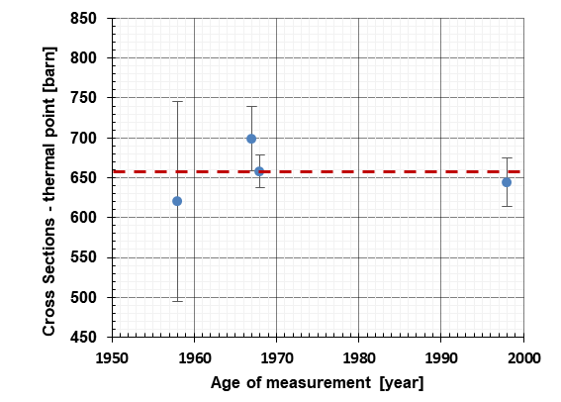
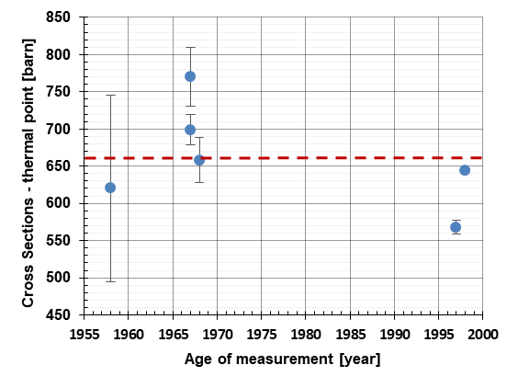
Erbium Exp. data – Thermal point
Experimental data (EXFOR database, Er-167 thermal point):
 | Age | Data | Data Error | Data Error | Dev from average
 | [year] | [b] | [b] | [%] | [%]
 | 1958 | 620.0 | 125 | 20.2 | -6.0
 | 1967 | 770.0 | 40 | 5.2 | 16.7
 | 1967 | 699.0 | 20 | 2.9 | 5.9
 | 1968 | 658.0 | 30 | 4.6 | -0.3
 | 1997 | 568.0 | 9.0 | 1.6 | -13.9
 | 1998 | 644.4 | 2.4 | 0.4 | -2.3
Average: | 1958-1998 | 659.9 | - | - | -
Only data below of 10% from the average:
Age | Data | Data Error | Data Error | Dev from average
[year] | [b] | [b] | [%] | [%]
1958 | 620.0 | 125 | 20.2 | -6.0
1967 | 699.0 | 20 | 2.9 | 5.9
1968 | 658.0 | 30 | 4.6 | -0.3
1998 | 644.4 | 2.4 | 0.4 | -2.3
1958-1998 | 655.4 | STD: 33.1 b | STD: 5.1% | -
Age | Data | Data error | Data error | Var [%]
[year] | [b] | [b] | [%] | [%]
1967 | 699 | 20 | 2.9 | 8.5
1997 | 568.0 | 9.0 | 1.6 | -11.9
1998 | 644.4 | 2.4 | 0.4 | Ref.
Average measured data with a STD major than 5%!
Difference between close in time measured data (1997-1998) major than 10%!
Proposal for a revaluation of Erbium capture Xs data, n_TOF Italian Meeting, 04/05/2020

Slide 8
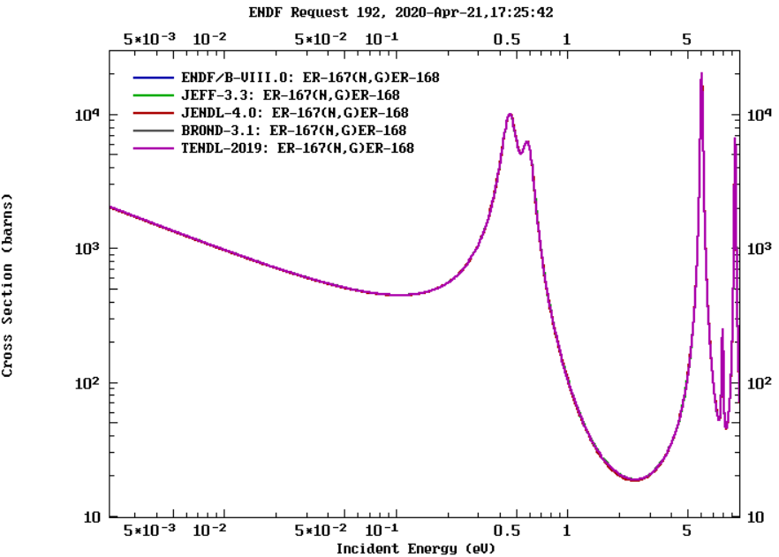
Erbium Res. Data – Thermal range
Er-167 Resonance data in the thermal range:
Reference | Eres (eV) | Unc (eV) | Γγ (meV) | Unc (meV) | gΓn (meV) | Unc (meV)
T. Wang et al. | 0.4638 | 0.0004 | 94.72 | 0.94 | 0.1527 | 0.0015
Danon et al. | 0.4595 | 0.0001 | 87.12 | 0.16 | 0.1515 | 0.0003
Mughabghab | 0.46 | 0.002 | 87.12 | 0.16 | 0.1516 | 0.0005
Landolt-Bornstein | 0.46 | - | 88 | 1 | 0.155 | 0.015
ENDF/B-VII.0 | 0.46 | - | 87.12 | - | 0.1515 | -
ENDF/B-VII.1 [5] | 0.46 | - | 87.12 | - | 0.1515 | -
Average | 0.4605 |  | 88.53 |  | 0.1523
STD [%] | 0.348 |  | 3.45 |  | 0.92
Er-167 resonance data (~ 0.46 eV) [6]
Reference | Eres (eV) | Unc (eV) | Γγ (meV) | Unc (meV) | gΓn (meV) | Unc (meV)
T. Wang et al. | 0.5907 | 0.0006 | 89.864 | 2.133 | 0.002
Danon et al. | 0.5834 | 0.0002 | 86.2 | 0.33 | 0.1082 | 0.0015
Mughabghab | 0.584 | 0.002 | 86.2 | 0.33 | 0.1082 | 0.0003
Landolt-Bornstein | 0.584 | - | 86.3 | 1 | 0.12 | 0.0005
ENDF/B-VII.0 | 0.584 | - | 86.2 | - | 0.1082 | 0.015
ENDF/B-VII.1 [5] | 0.584 | - | 86.2 | - | 0.1082 | -
Average | 0.585 |  | 86.8 |  | 0.0925
STD [%] | 0.478 |  | 1.71 |  | 48.20
Only one evaluated resonance data used for several Er-167(N,G) evaluation!
Average value of some resonance parameter are major than 3%
All ENDF/B resonance data are based on Mughabghab evaluation.
Er-167 resonance data (~ 0.58 eV) [6]
Proposal for a revaluation of Erbium capture Xs data, n_TOF Italian Meeting, 04/05/2020

Slide 9
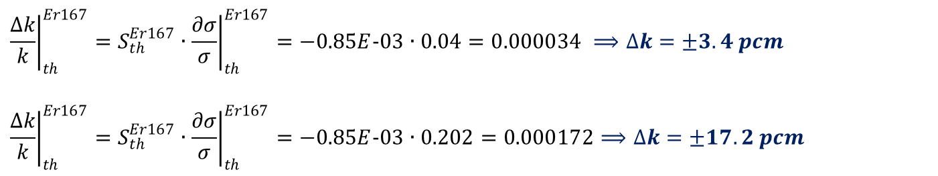
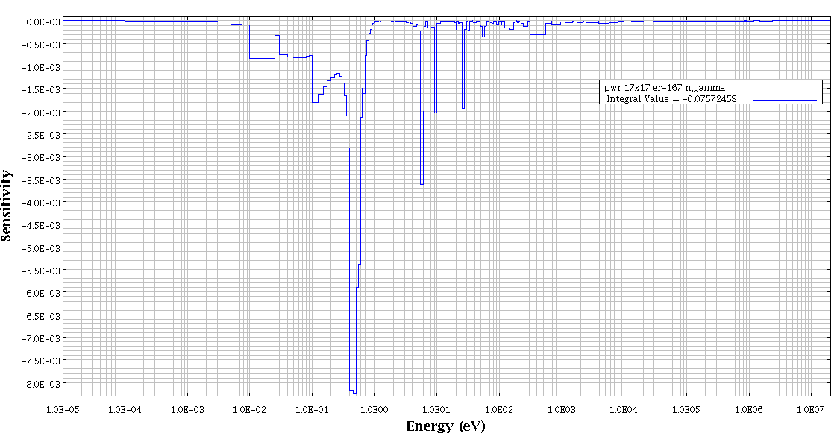
Impact on system criticality – Er-167
The evaluation of the impact of the maximum and minimum uncertainty values of the experimental Er-167 thermal point on the system criticality provides:
The only thermal point uncertainty range (14 pcm) is equal to the 11% of the overall contribute on k of the Er-167(n,g) uncertainty (123 pcm)!
If the same uncertainty data are applied to the thermal resonance peak (0.46 eV), the uncertainty range is equal to more than 100% of the overall Er-167(n,g) uncertainy…
Proposal for a revaluation of Erbium capture Xs data, n_TOF Italian Meeting, 04/05/2020

Slide 10
Summary
Background: Research on Er-SHB aimed at improving safety, cost, waste and proliferation in a reactor system. This new technology will be implemented in commercial NPP in the next future.
Idea: A S&U analysis on a Er-SHB Fuel Assembly showed an erbium uncertainty on criticality of 164 pcm equal to 24% of the total one. The most sensitivity zone was found in the thermal-epithermal energy range.
Proposal: New evaluation of the erbium resonances in the thermal region and accurate determination of the erbium cross sections (at least Er-167 and Er-166) with an overall uncertainty below 3% in the energy range of interest (0.1 ÷ 100 eV) for nuclear system.
Erbium cost: pure $540 per 100g; bulk $65 per 100g [7]; Er-166 (95.33%) 4.10 €/mg, Er-167 (91.49%) 4.87 €/mg [8].
Proposal for a revaluation of Erbium capture Xs data, n_TOF Italian Meeting, 04/05/2020

Slide 11
References
J. Porta, M. Asau, “Erbium: Alternative poison? Stabilisation additive? What future?”, Progress in Nuclear Energy, Vol. 38, No. 3-4, pp. 347-350, 2001;
R. Pergreffi, D. Mattioli, F. Rocchi “Neutronics characterization of an erbia fully poisoned PWR assembly by means of the APOLLO2 code”, EPJ Nuclear Sci. Technol. 3, 8 (2017);
M. Yamasaki, “Current Status of a Development Project on Erbia Credit Super High Burnup Fuel”, Technical Meeting on ‘Advanced Fuel Pellet Materials and Fuel Rod Design for Water Cooled Reactors’, 2009, NFK-MN-0908016;
A. Guglielmelli, F. Rocchi, R. Pergreffi, “SCALE 6.1.3 evaluation of the erbia effect on the control rod worth of an Er-SHB PWR assembly”, 26th International Conference Nuclear Energy for New Europe, Bled-Slovenia, 11-14 September 2017;
D.E. Cullen, Point2007: A temperature dependent ENDF/B-VII.0 Cross-section Library (UCRL-TR-228089), University of California and Lawrence Livermore National Laboratory, 2007. Available on-line from: http://www-nds.iaea.org/point2007/;
T. Wang, M. Lee, K. Kim et alt., “Measurement of neutron cross-sections and resonance parameters of erbium at the Pohang Neutron Facility”, Nuclear Instrument and Methods in Physics Research B 268 (2010) 106-113;
Erbium cost available on-line from: https://www.chemicool.com/elements/erbium.html
Erbium cost of pure isotopes available on-line from: https://it.institut-seltene-erden.de/unser-service-2/metall-preise/preise-fuer-stabile-isotope/
Proposal for a revaluation of Erbium capture Xs data, n_TOF Italian Meeting, 04/05/2020

Slide 12
Grazie per l’attenzione!
Antonio Guglielmelli
antonio.guglielmelli@enea.it
Proposal for a revaluation of Erbium capture Xs data, n_TOF Italian Meeting, 04/05/2020

