Slide 1
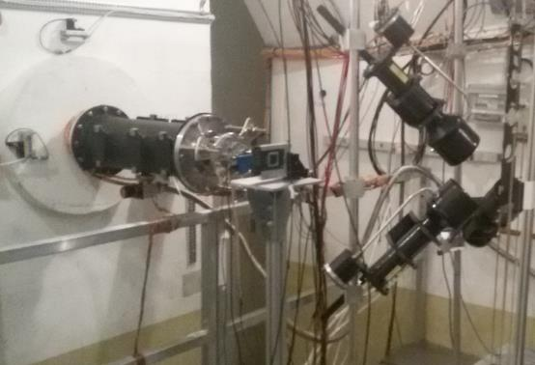
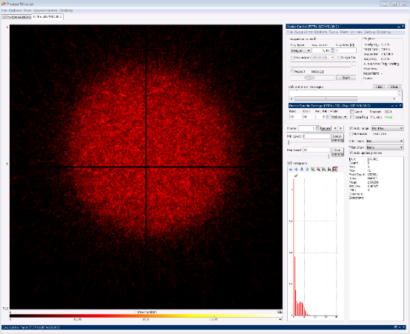
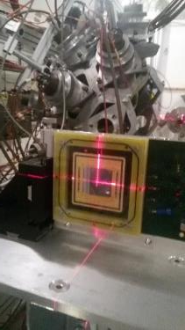
Timepix Neutron Beam Monitor at nTOF
nTOF EAR1
Beam image
In 2018 a beam monitor based on 2 Quad Timepixes
has been installed in nTOF EAR1
It as been used for the beam alignment and will be used for flux measurements in 2021
We propose to realize a second system in EAR2 for beam alignment

Slide 2
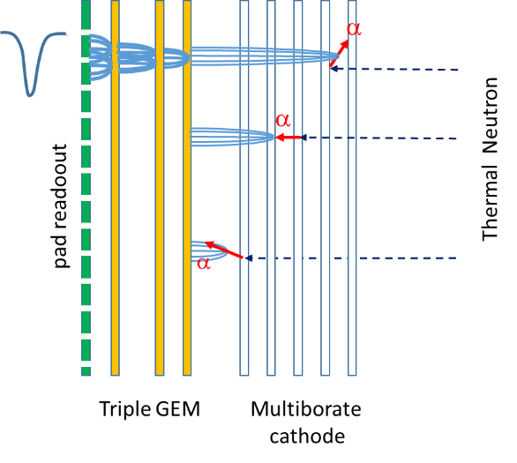
Borated GEM: multiborated head-on converter
The borated GEM was proposed for the first time by Cascade project
but problems on boron deposition stability
and GEM reliability.
In three years several attempts have been made in collaboration with Milano Bicocca, CERN and ESS Liopking
and now a new etching and Boron deposition procedure has been defined
We are assembling a detector for the first characterization.
Good prospective for high efficiency thermal neutron imaging for nTOF.

Slide 3
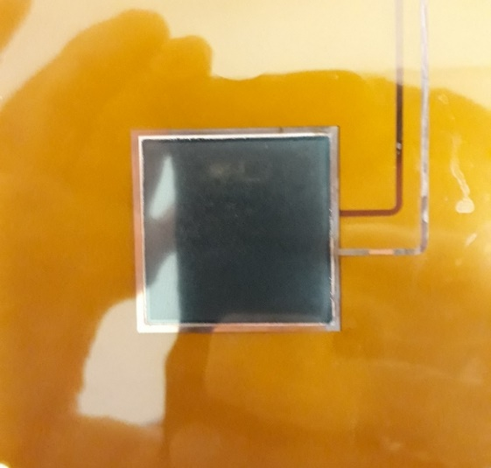
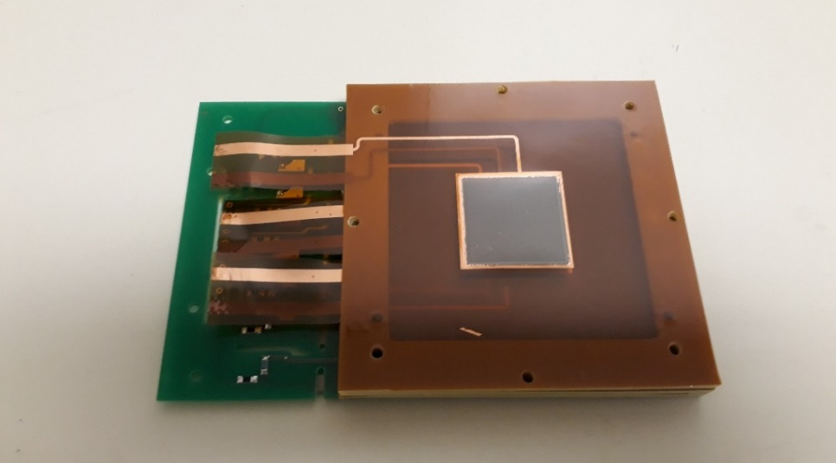
Borated GEM for high efficiency thermal neutrons detector
The GEMPix detector allows to develop and optimize a new thermal neutron detector based on GEM technology.
A collaboration between CERN ESS INFN has recently develop a new procedure to realize borated GEM.
A detector efficiency 7 times the single foil has be reached on a uniform big surface (3x3 cm²)
with high time (10 ns) and spatial resolution (50 μm) with Timepix electronics.
F.Murtas, R.De Oliveira, C.Lai, G.Croci, A.Muraro

Slide 4
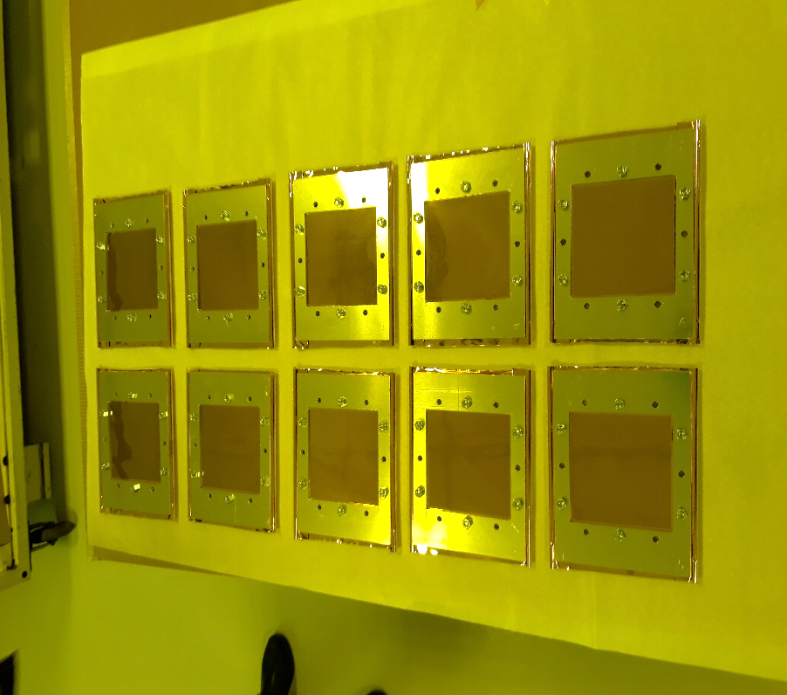
Production of 10 Borated GEM foils 10x10 cm²
10 GEM foils (10x10 cm²) have been borated
in Sweden on February 15th
They are at CERN ready for
the final etching (Rui’s Laboratory)
Two detectors we’ll be built in Frascati
before September.
Electronics readout ready :
- 256 pads 6x6 mm²
- Gemini32 boards and FPGA board

Slide 5
Financial requests
1 FTE
50 % FM
20 % Tonino Pietropaolo ENEA
30 % Gerardo Claps ENEA
Financial requests :
9 Keuro Beam Monitor (for 2 quad Timepix, 2 readout system, 2 movable stage)
6 Keuro Thermal neutron detector for new 10x10 cm2 Borated GEM
Missions :
5 Keuro for installations and collaboration meetings
LNF Facility : clean room

