Slide 1



Neutron capture cross section
of ⁸⁸Sr(n,γ), ⁸⁹Y(n,γ) @EAR1
G. Tagliente, P.M. Milazzo, L.A. Damone, M. Mastromarco, N. Colonna, A. Mazzone, M. Barbagallo, S. Cristallo, A.C. Larsen, M. Lugaro, C. Massimi, F. Mingrone , C. Paradela, P. Schillebeeckx and the n_TOF collaboration.

Slide 2
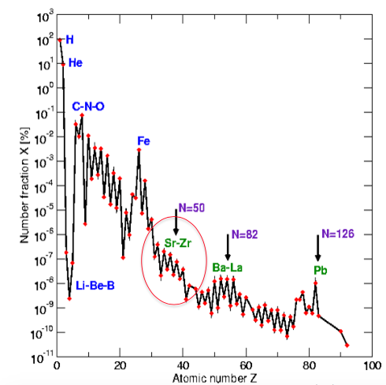
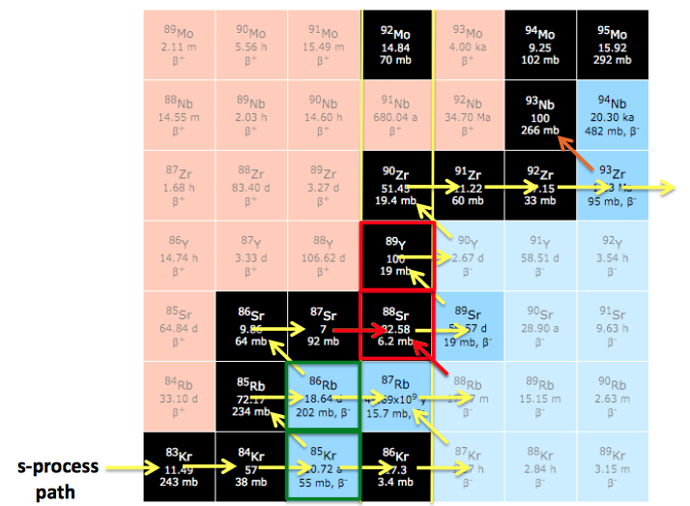
MOTIVATIONS
Big discrepancy in the MACS.
⁸⁸Y: 13 - 21 mb @ 30 keV
⁸⁸Sr: 5 – 9 mb @ 30 keV

Slide 3
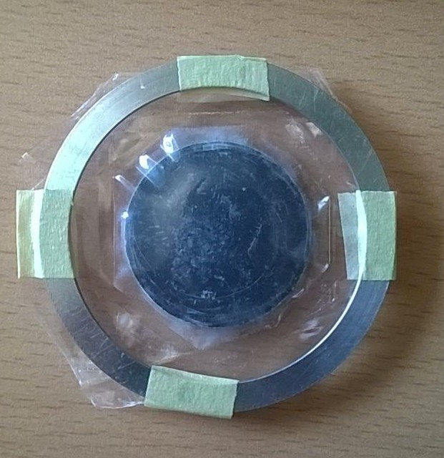
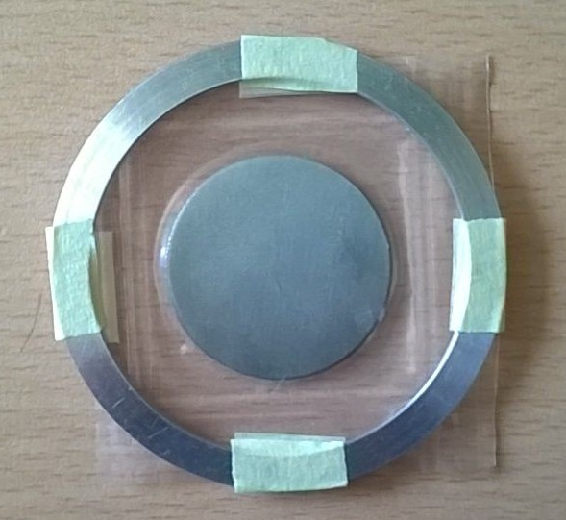
⁸⁹Y and ⁸⁸Sr Samples
⁸⁸Sr is the most abundant Sr isotope
⁸⁹Y is the only stable isotopes of Y
3 cm
3 cm
ISOFLEX
Metal disk enrichment > 99.9%
Goodfellow
metal disk with a purity of 99,9%

Slide 4
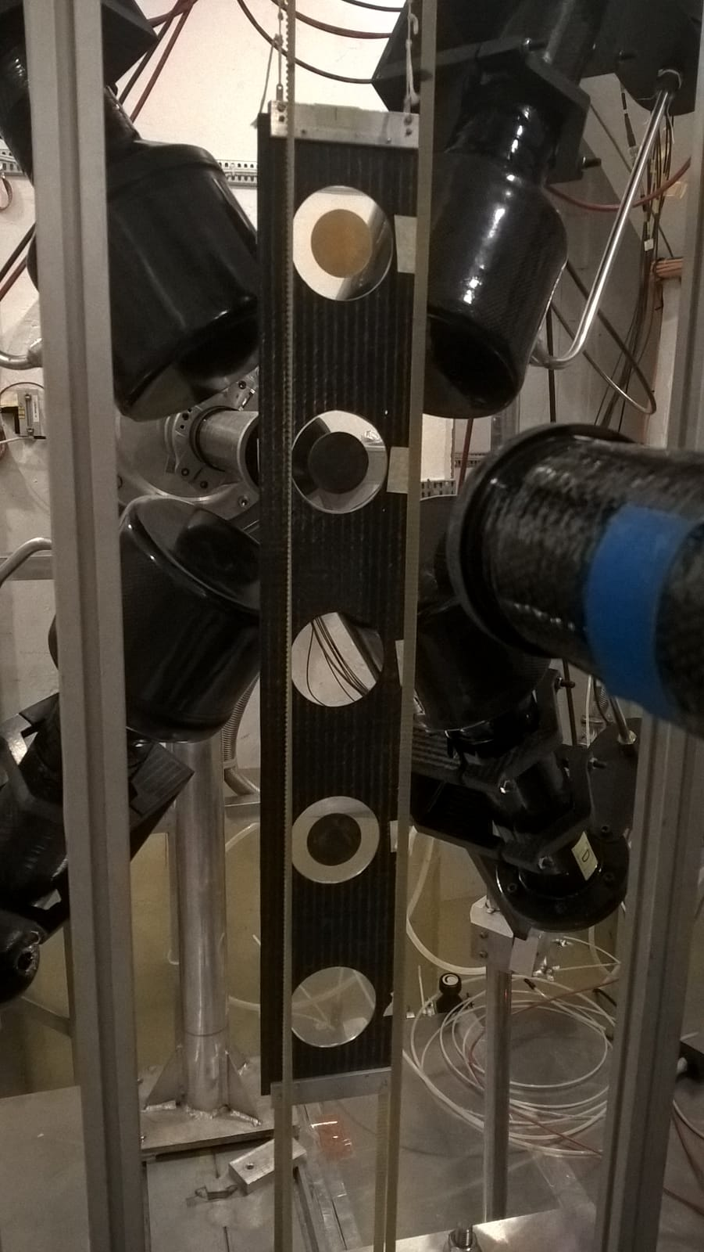
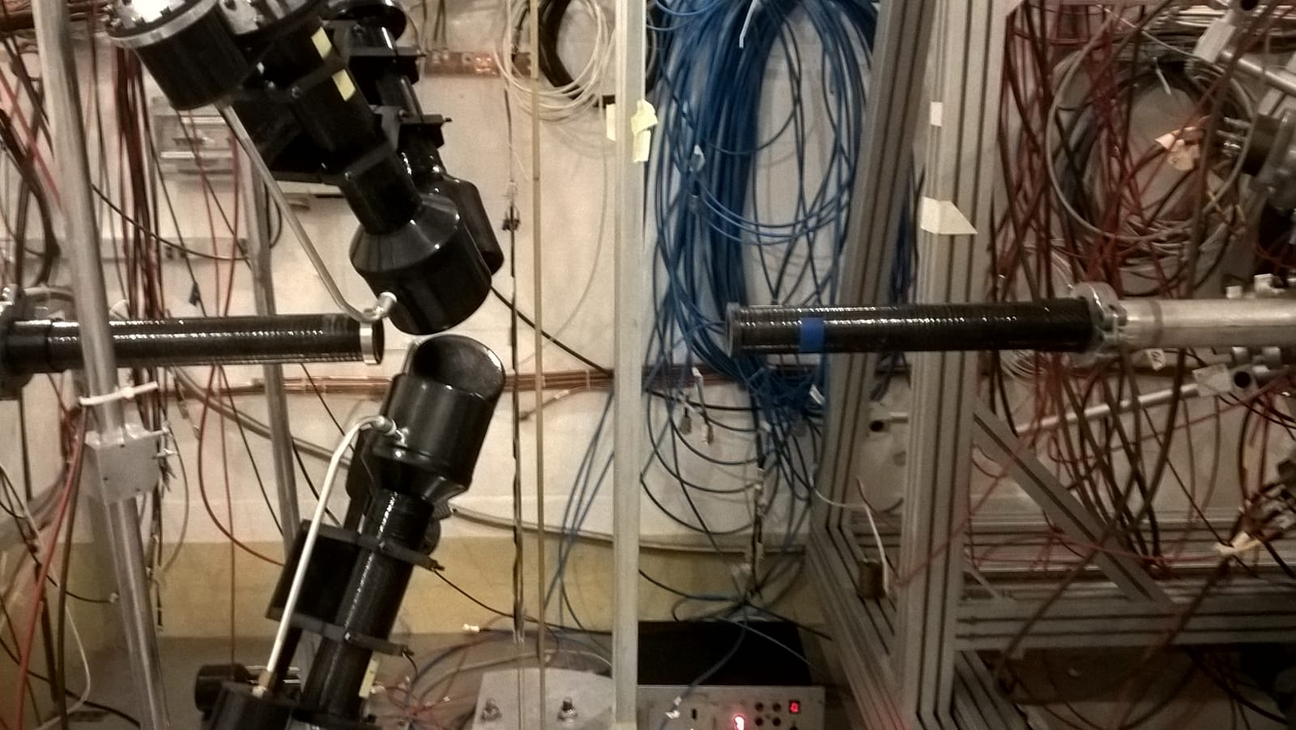
EXPERIMENTAL SET-UP
G
C
neutrons
L
D

Slide 5
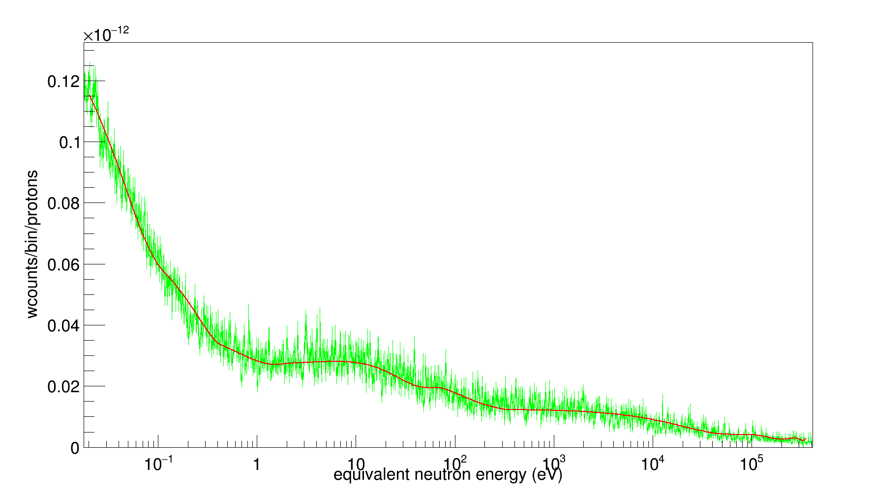
⁸⁹Y Analysis - Background
Parametrization of the background
seven functions

Slide 6
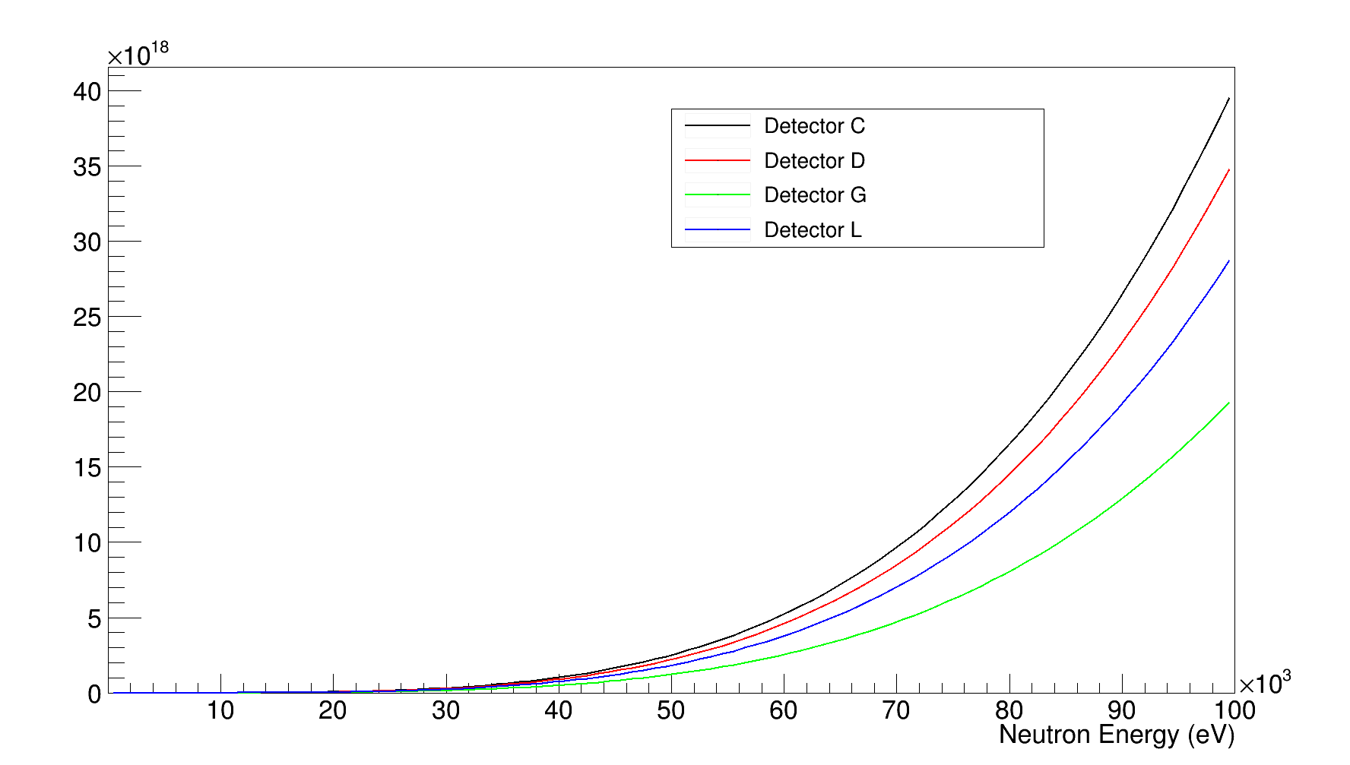
⁸⁹Y Analysis - WF
Anna Maria Mazzone

Slide 7
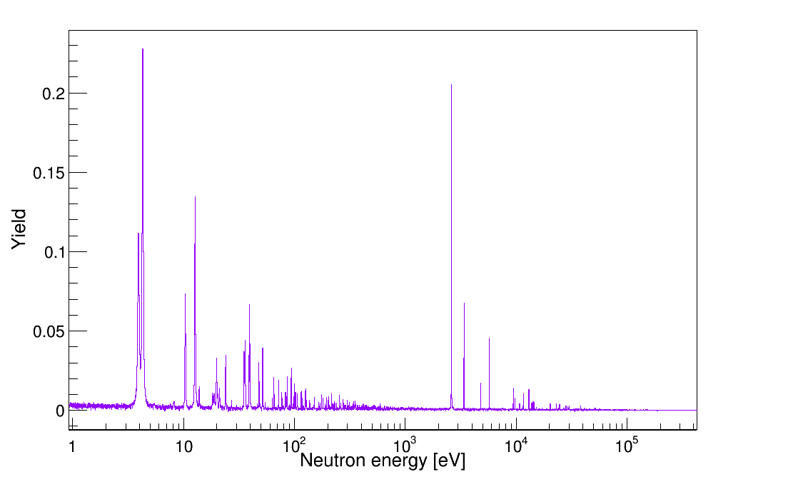
⁸⁹Y Analysis - Yield

Slide 8
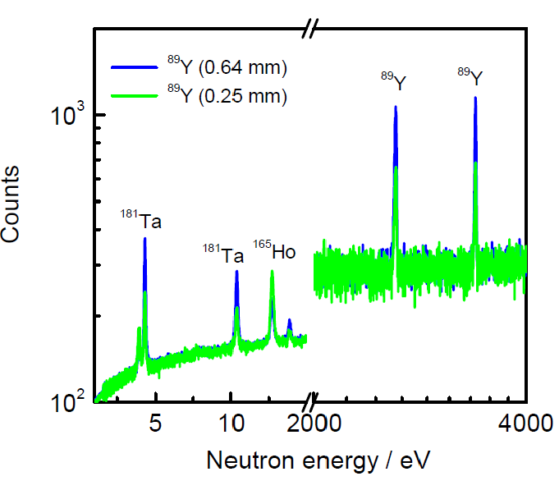
⁸⁹Y Analysis – Contaminants

Slide 9
⁸⁹Y Analysis – Contaminants

Slide 10
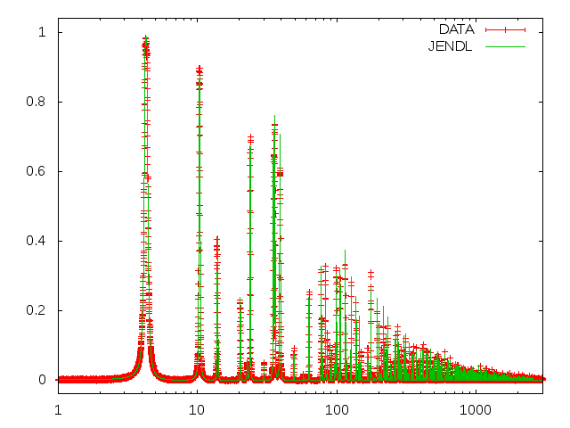
⁸⁹Y Analysis – Contaminants
YIELD
En (eV)

Slide 11
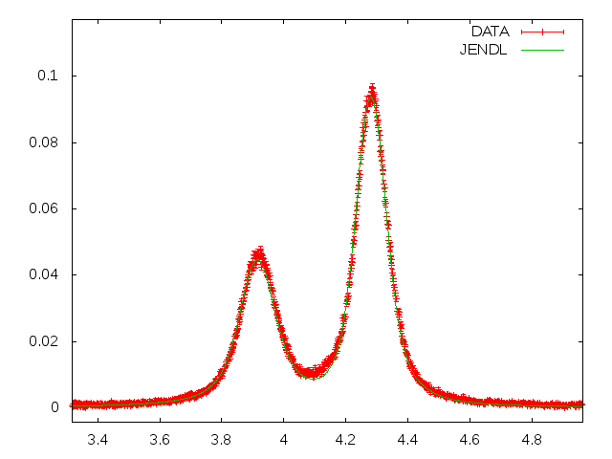
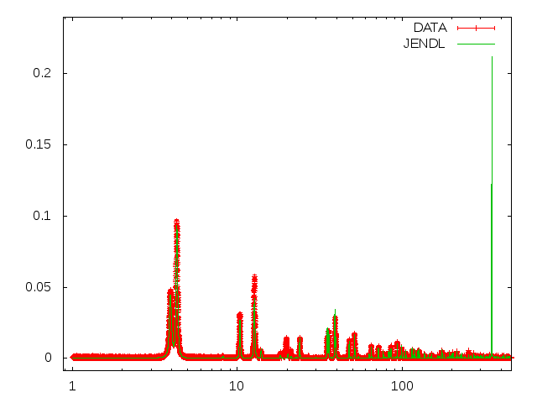
⁸⁹Y Analysis – Contaminants
Ta
Ho
Ho
YIELD
Ho
Ta
En (eV)
Ho
Ho
Ta
Ho
Ta = 0.295%
Ho = 0.226%
Ta
Ta
Ta
Ta
Ho
Ta
Ta
Ta
En (eV)

Slide 12
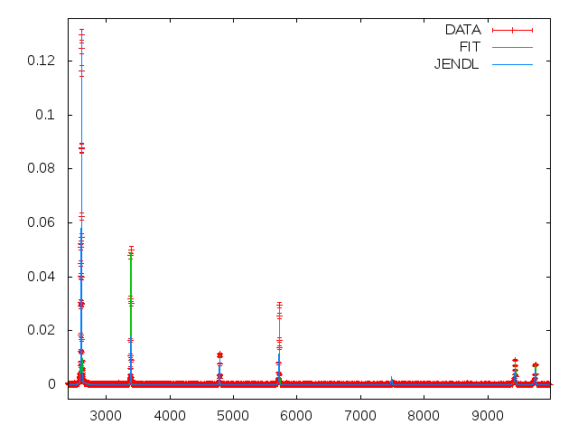
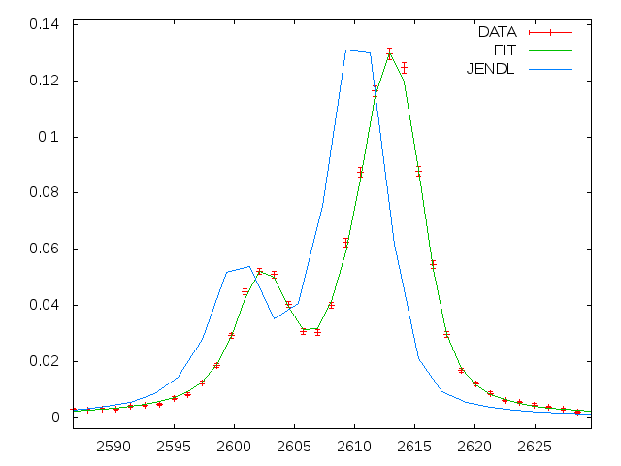
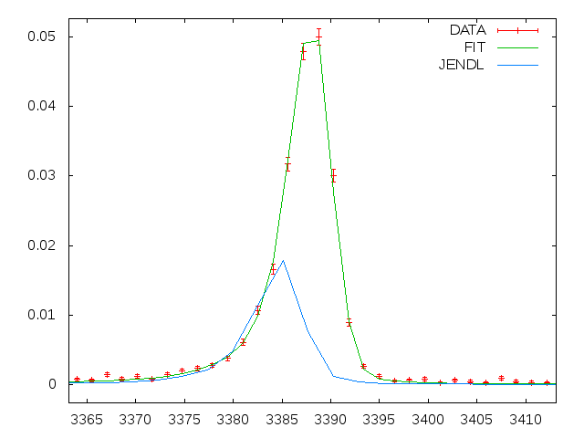
⁸⁹Y Analysis – Resonance analysis
YIELD
YIELD
YIELD
En (eV)
YIELD
En (eV)
En (eV)
En (eV)

Slide 13
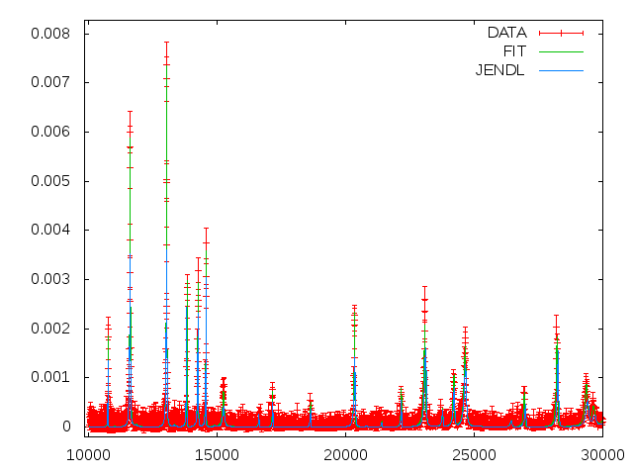
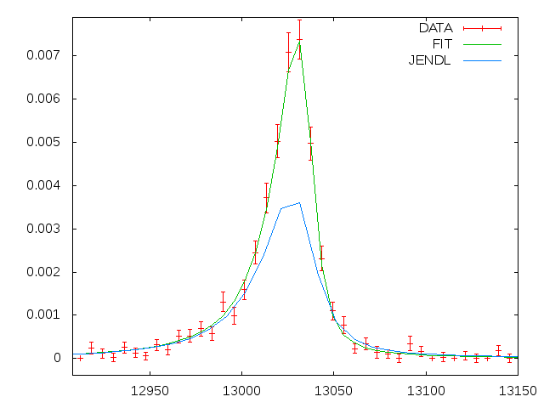
⁸⁹Y Analysis – Resonance analysis
YIELD
YIELD
En (eV)
En (eV)

Slide 14
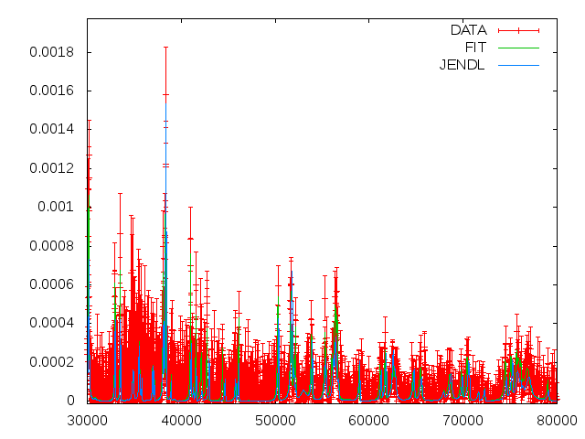
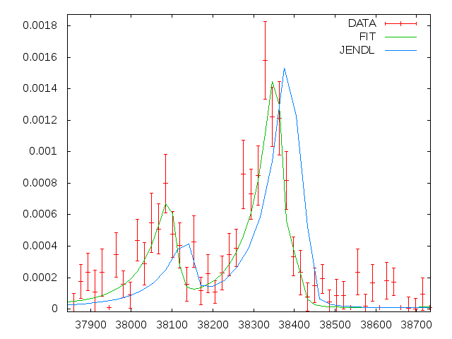
⁸⁹Y Analysis – Resonance analysis
YIELD
YIELD
En (eV)
En (eV)

Slide 15
⁸⁹Y Analysis – Transmission
The transmission and capture measurements were performed at GELINA facility, by Carlos Paradela and Stefan Kopecky. Three ⁸⁹Y samples of different thickness were used.
Yield
E_{n} (eV)

Slide 16
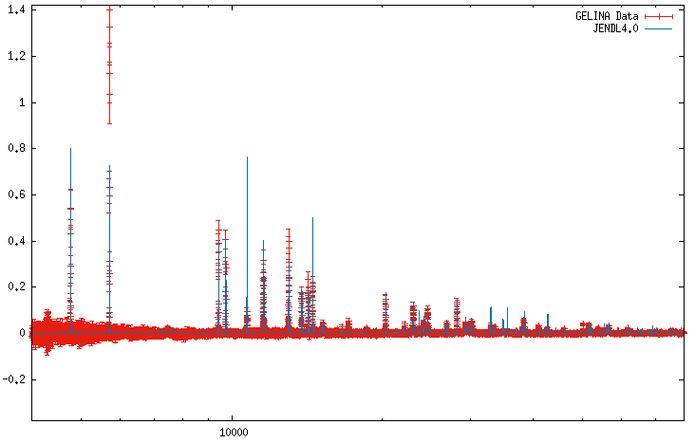
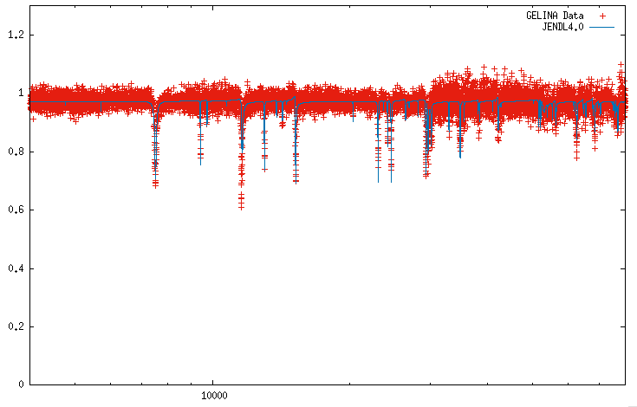
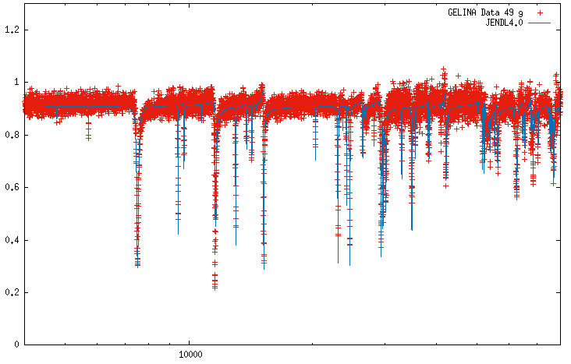
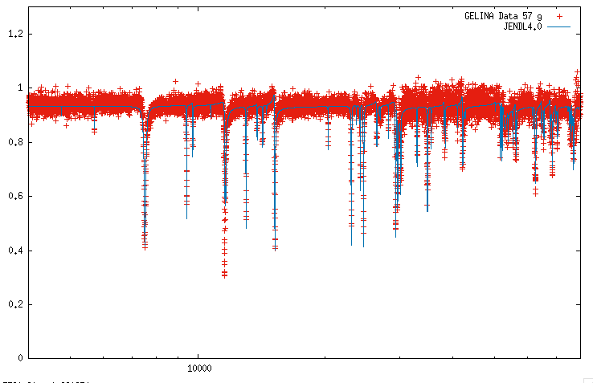
⁸⁹Y– GELINA

Slide 17
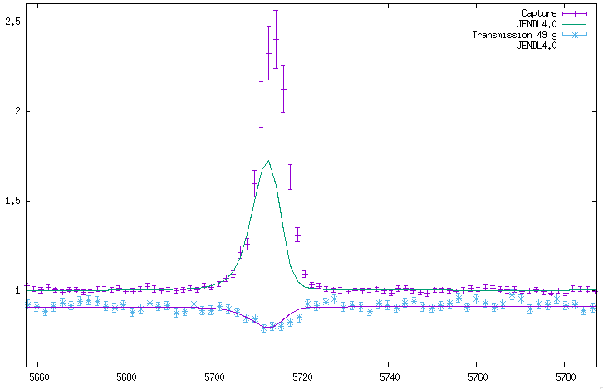
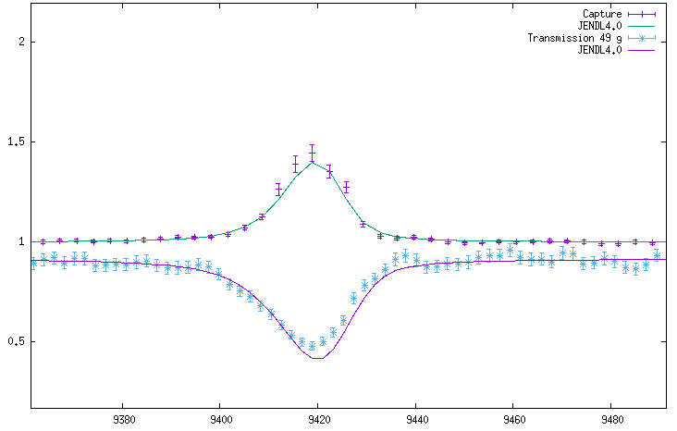
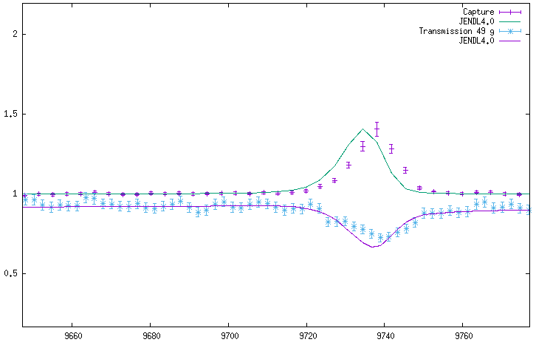
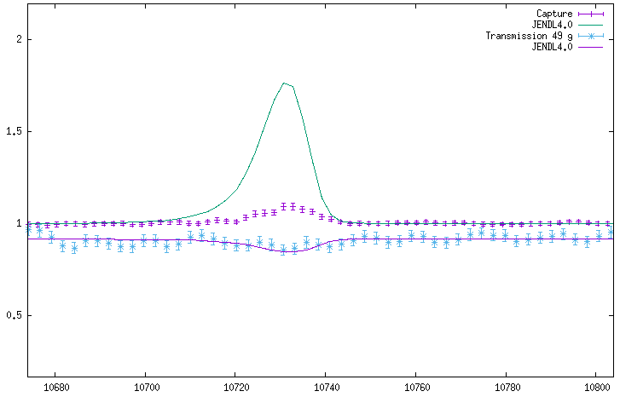
⁸⁹Y – Resonance Analysis

Slide 18
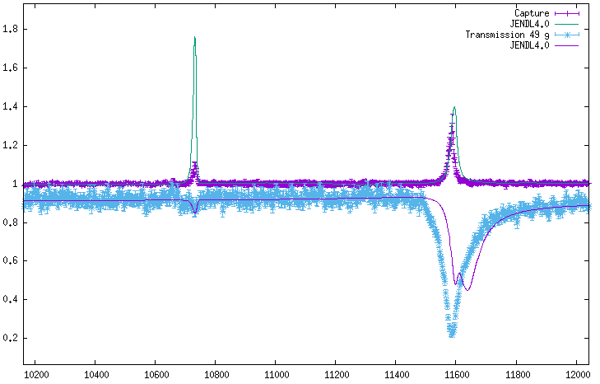
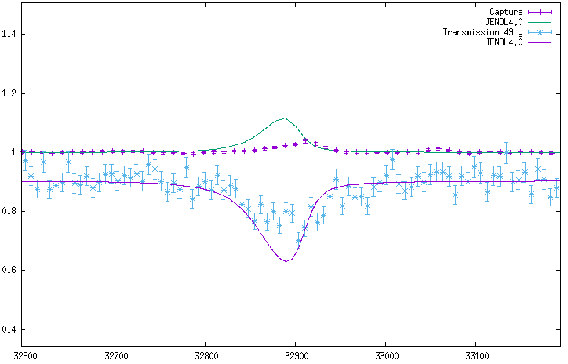
⁸⁹Y – Resonance Analysis

Slide 19
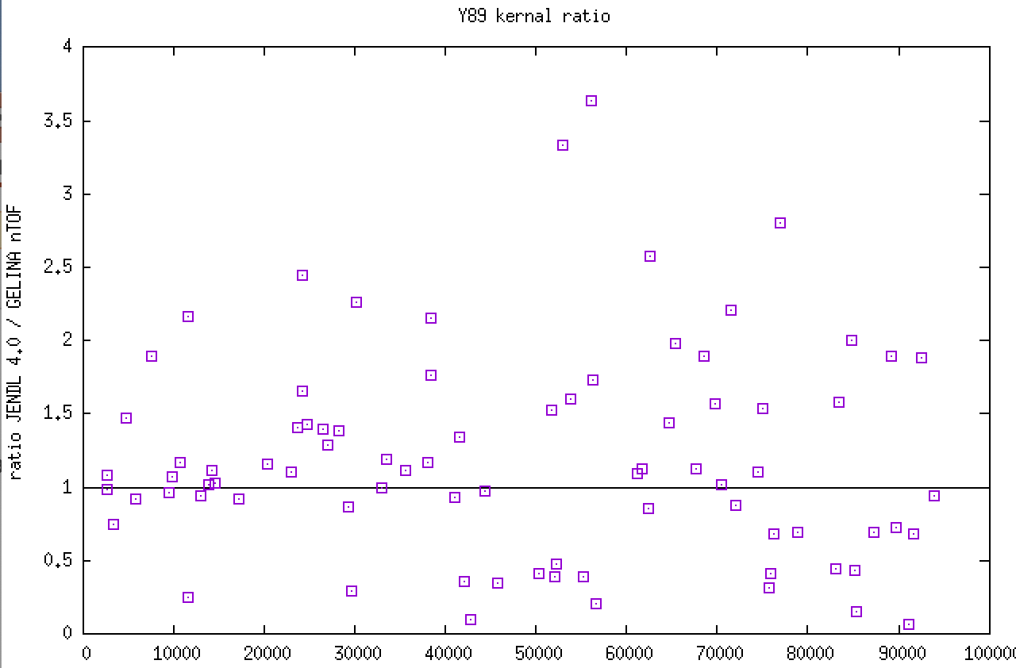
⁸⁹Y – Kernel ratio

Slide 20
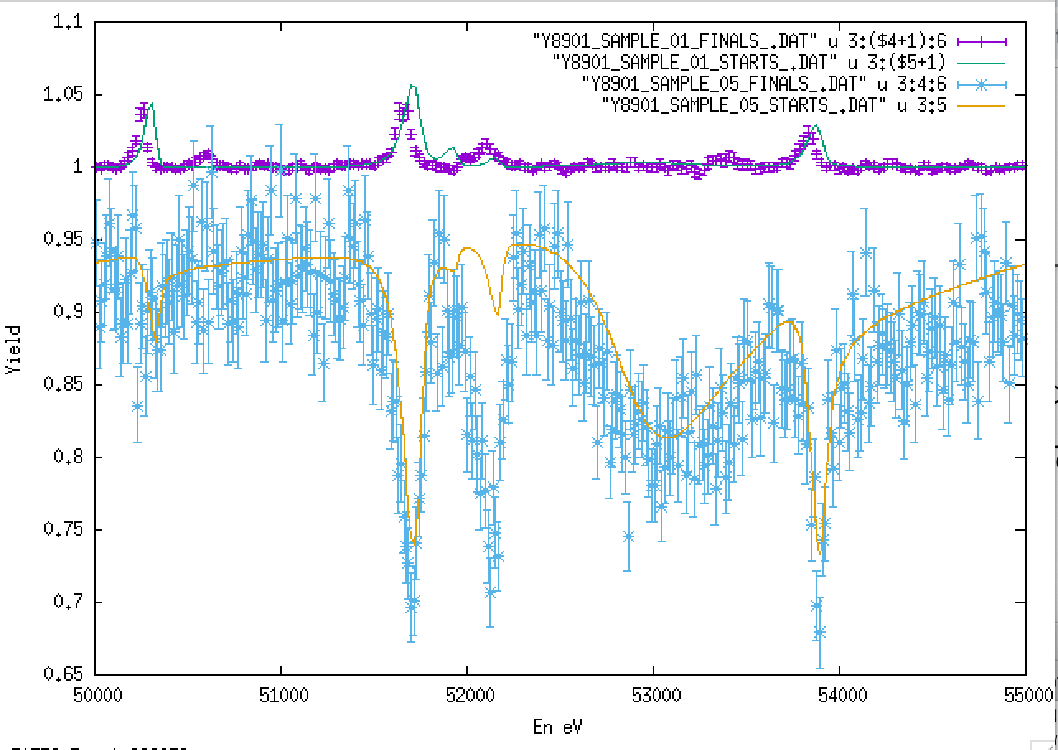
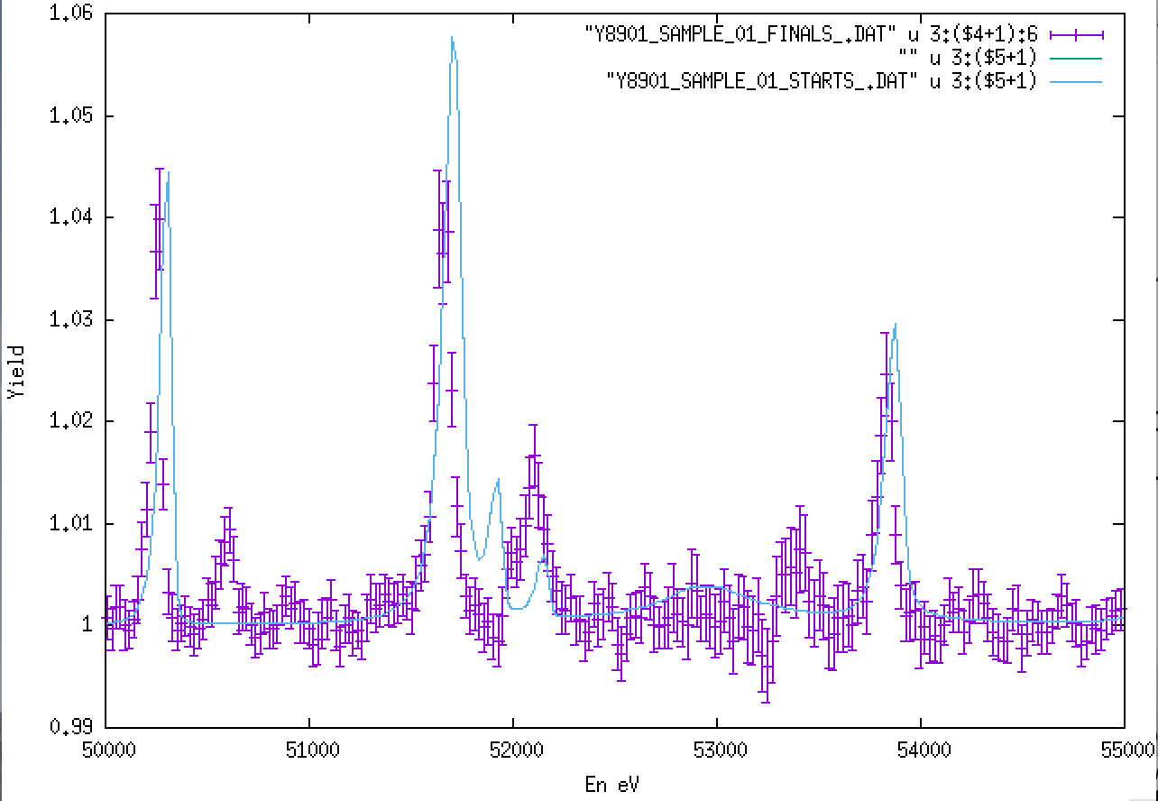
⁸⁹Y – Resonance Analysis

Slide 21
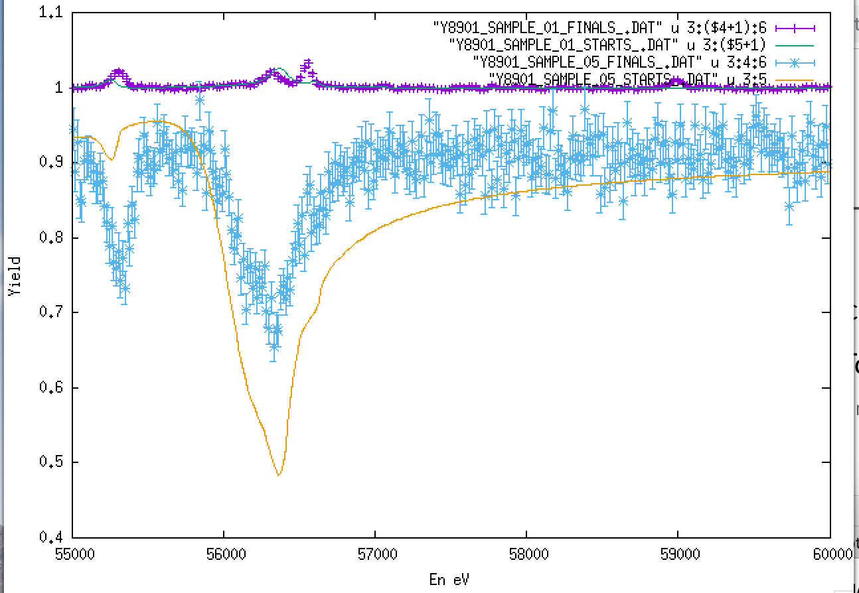
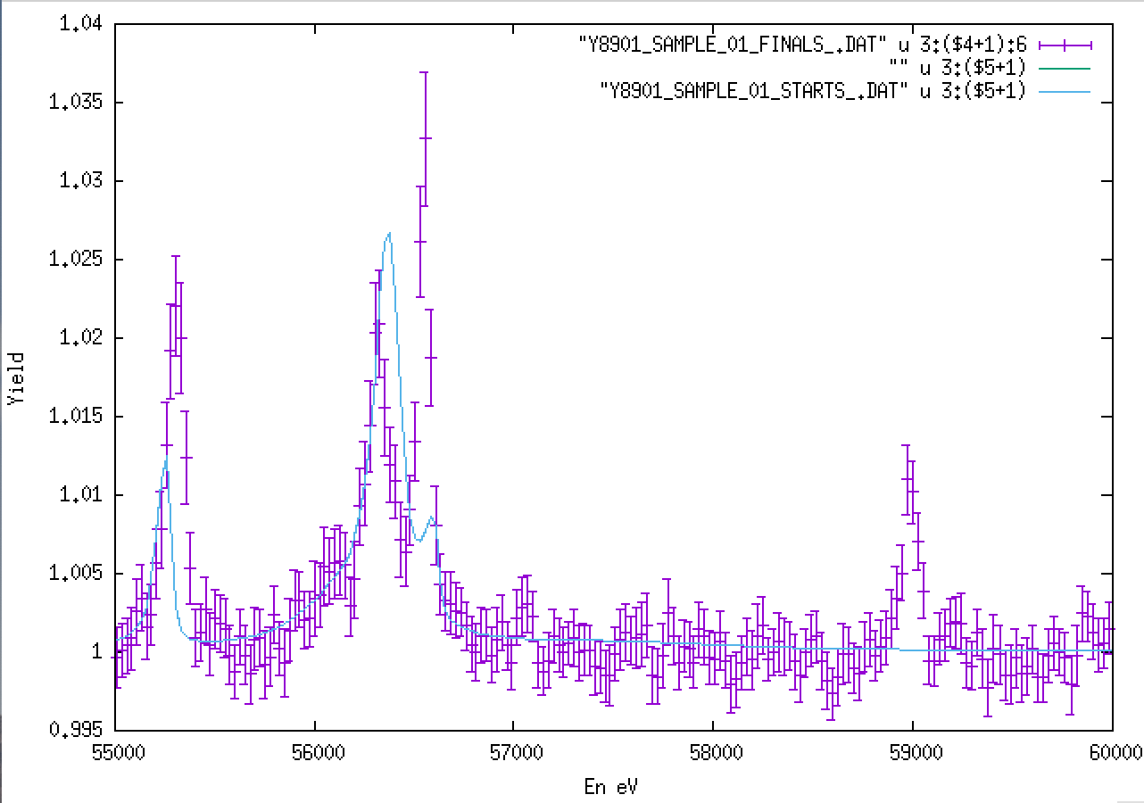
⁸⁹Y – Resonance Analysis

Slide 22
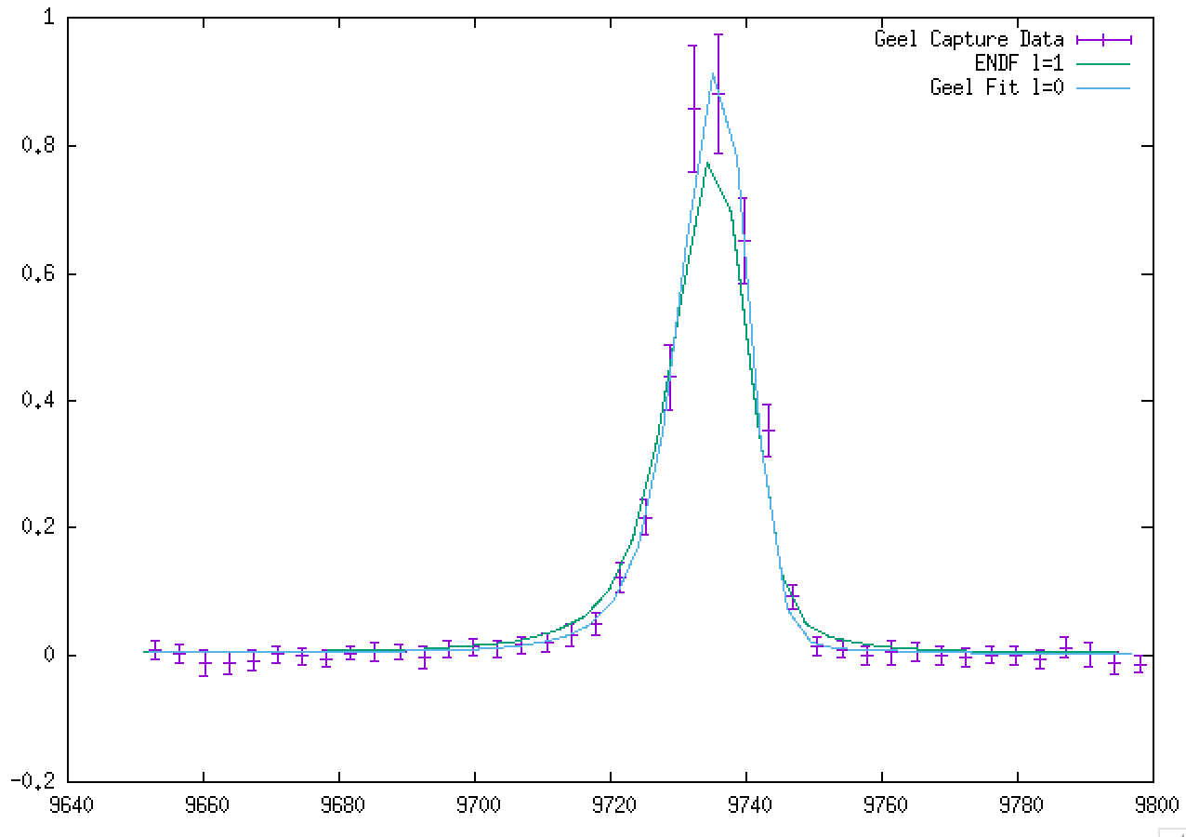
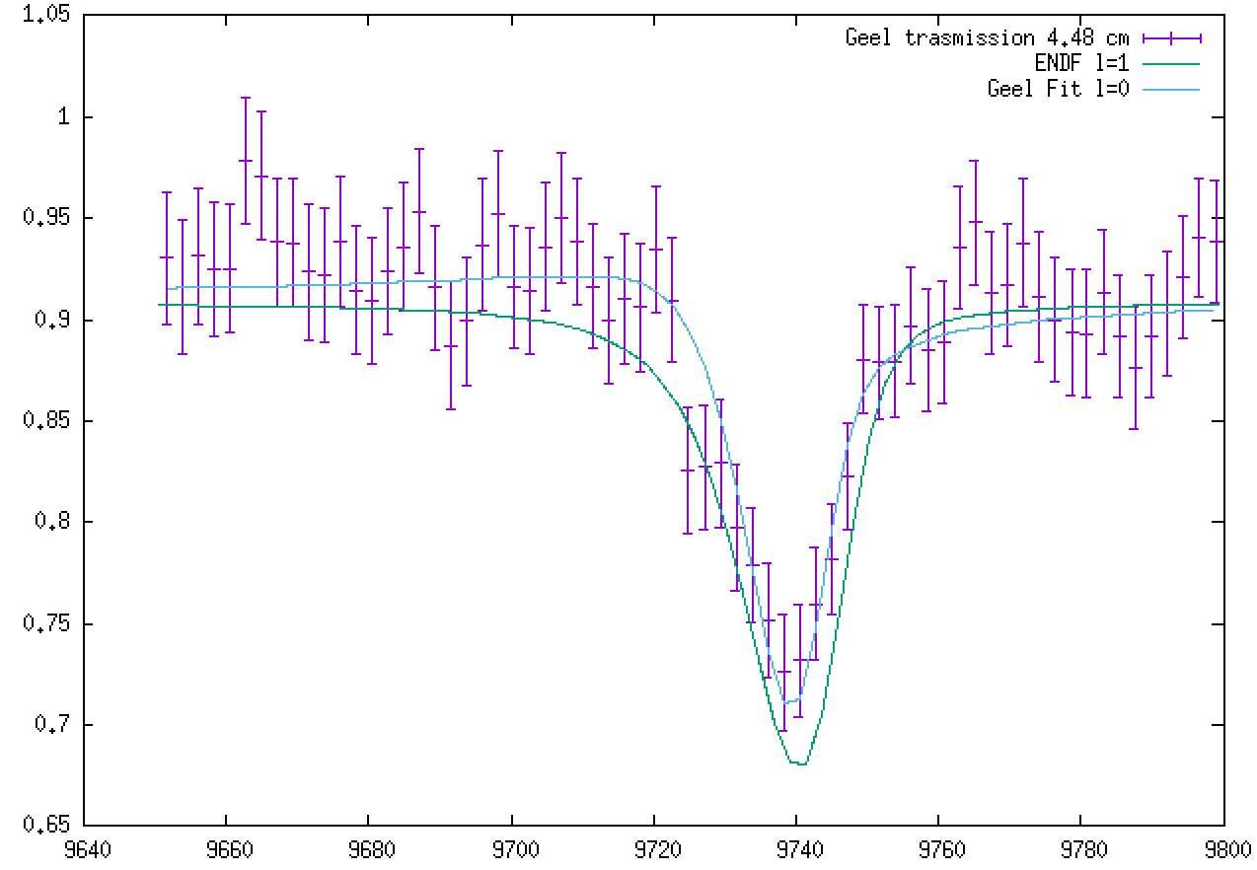
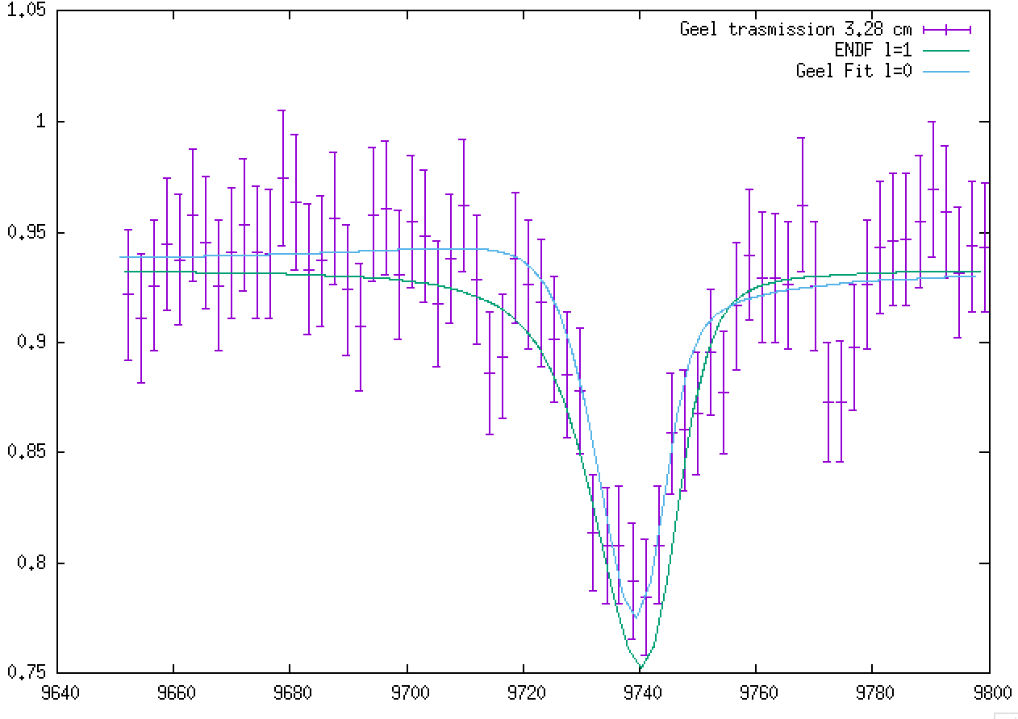
⁸⁹Y – Spin assignment

Slide 23
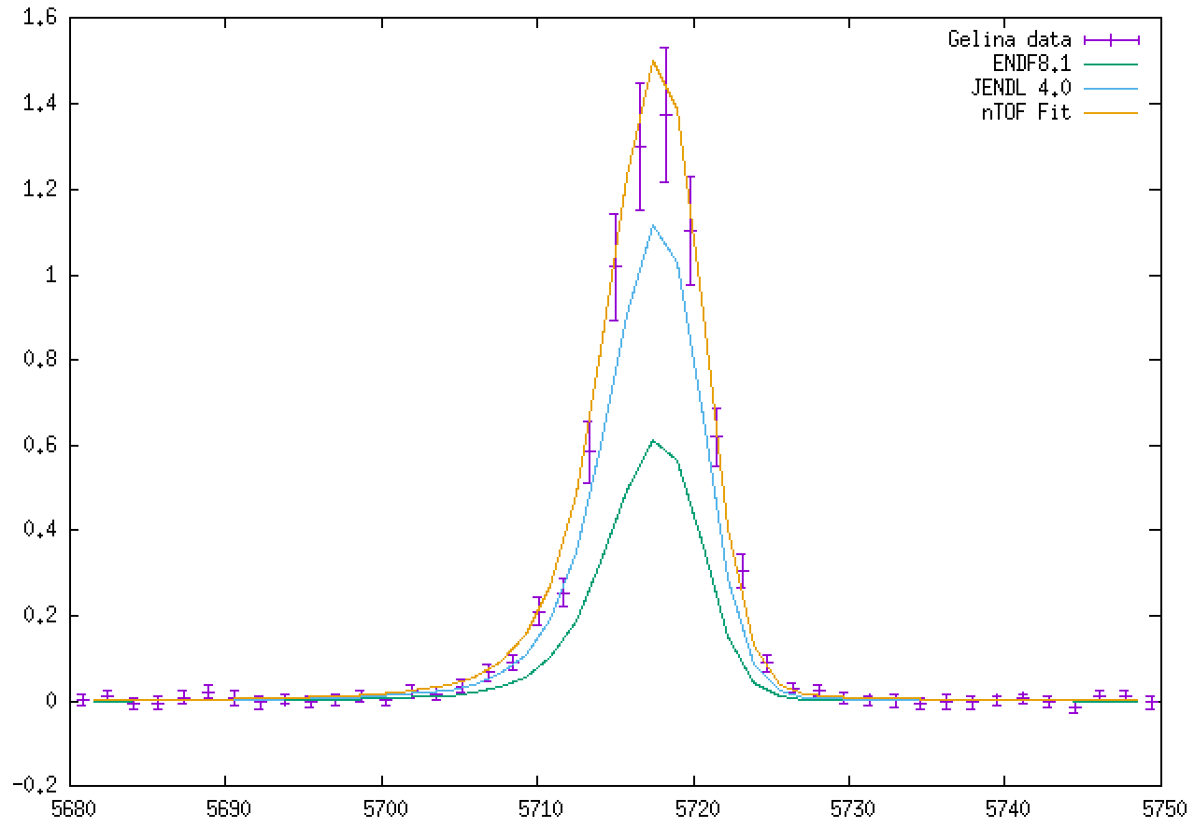
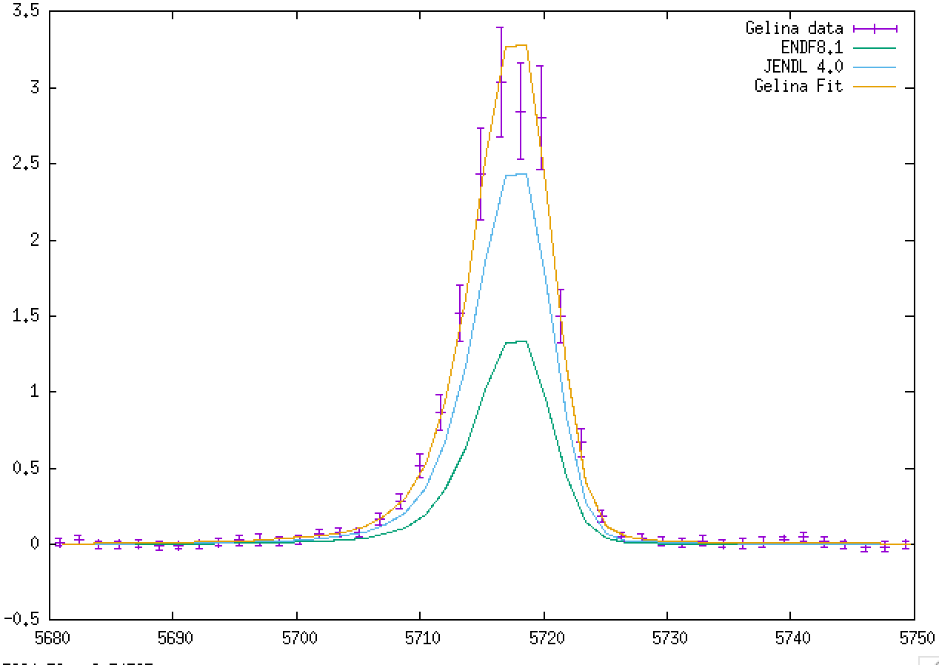
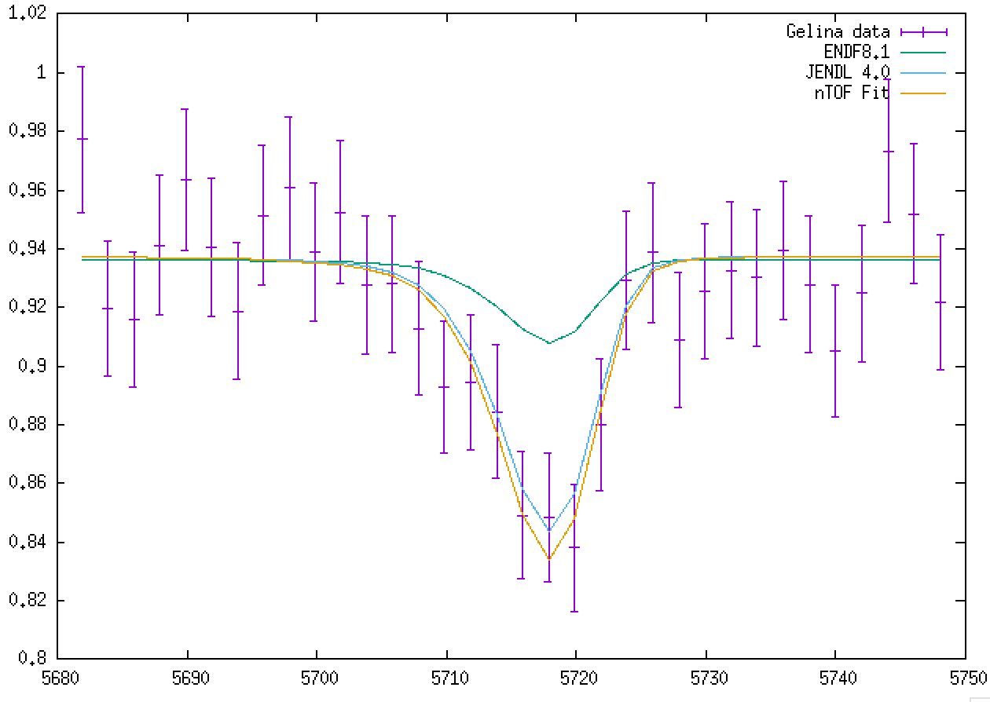
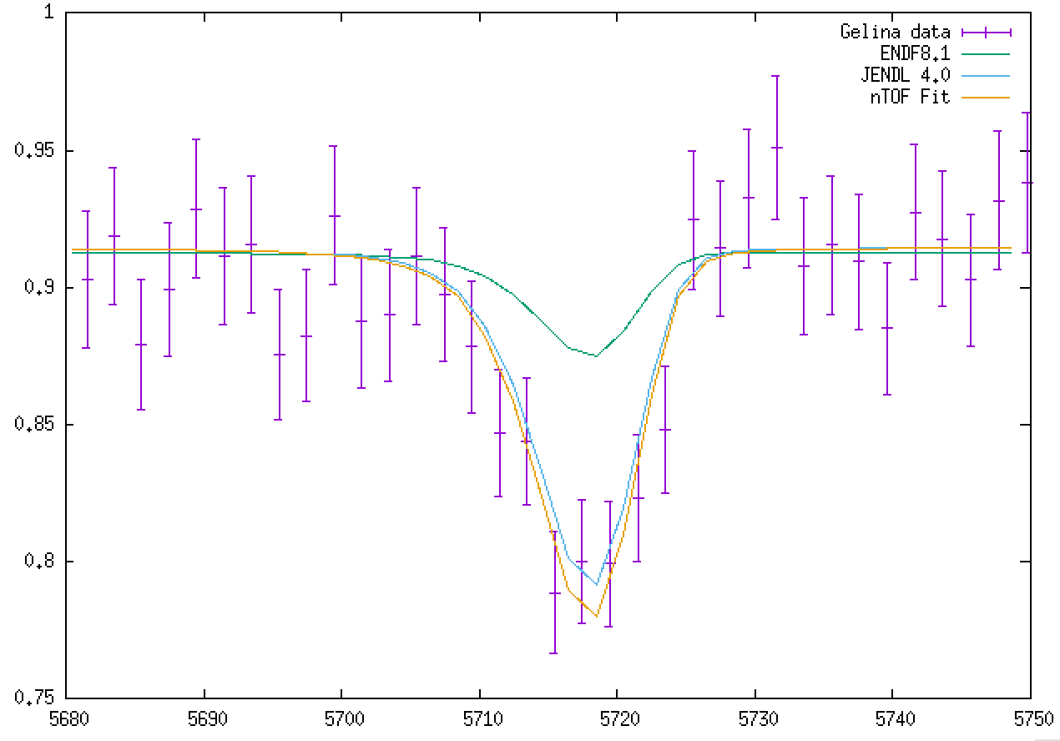
⁸⁹Y – Spin assignment
JENDL j=1
ENDF j=2

Slide 24
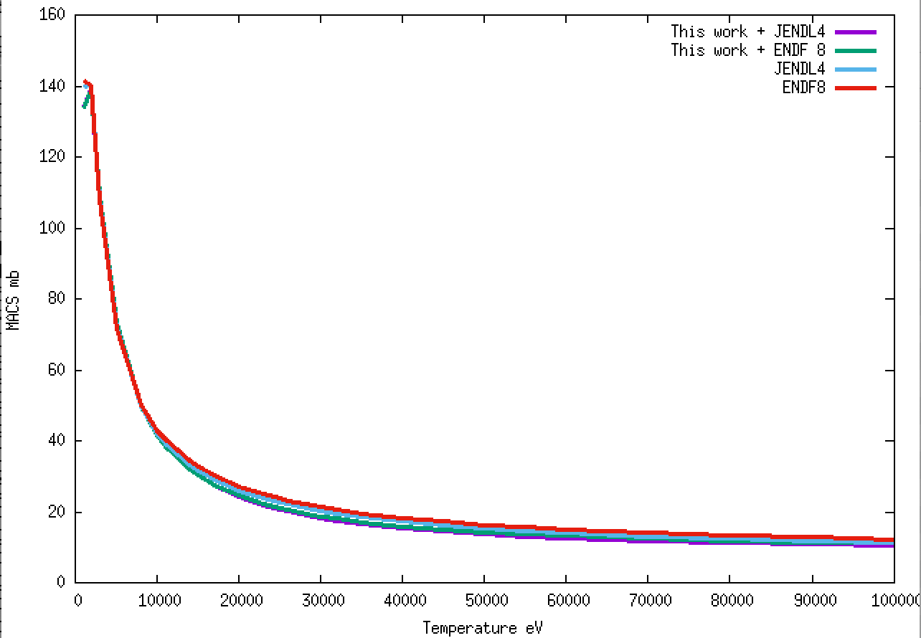
⁸⁹Y – MACS

Slide 25
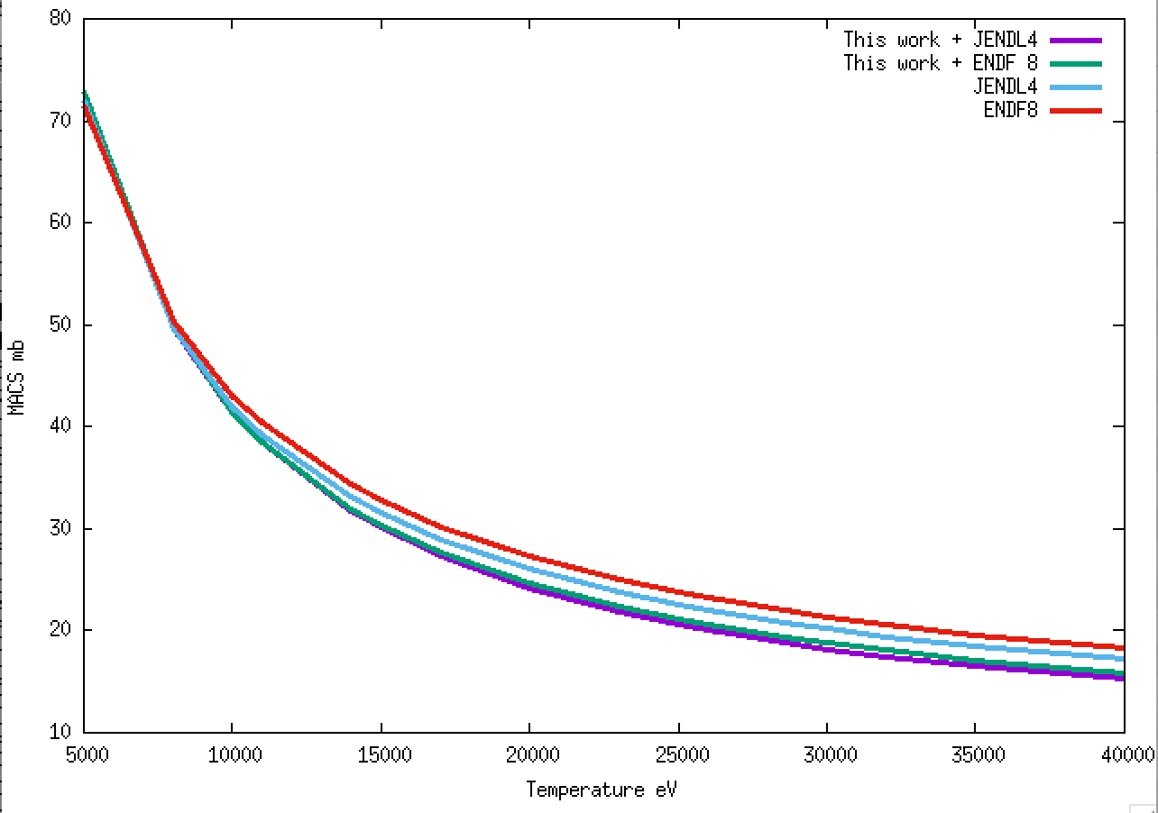
⁸⁹Y – MACS
Macs @ 30 keV 18.2 mb

Slide 26
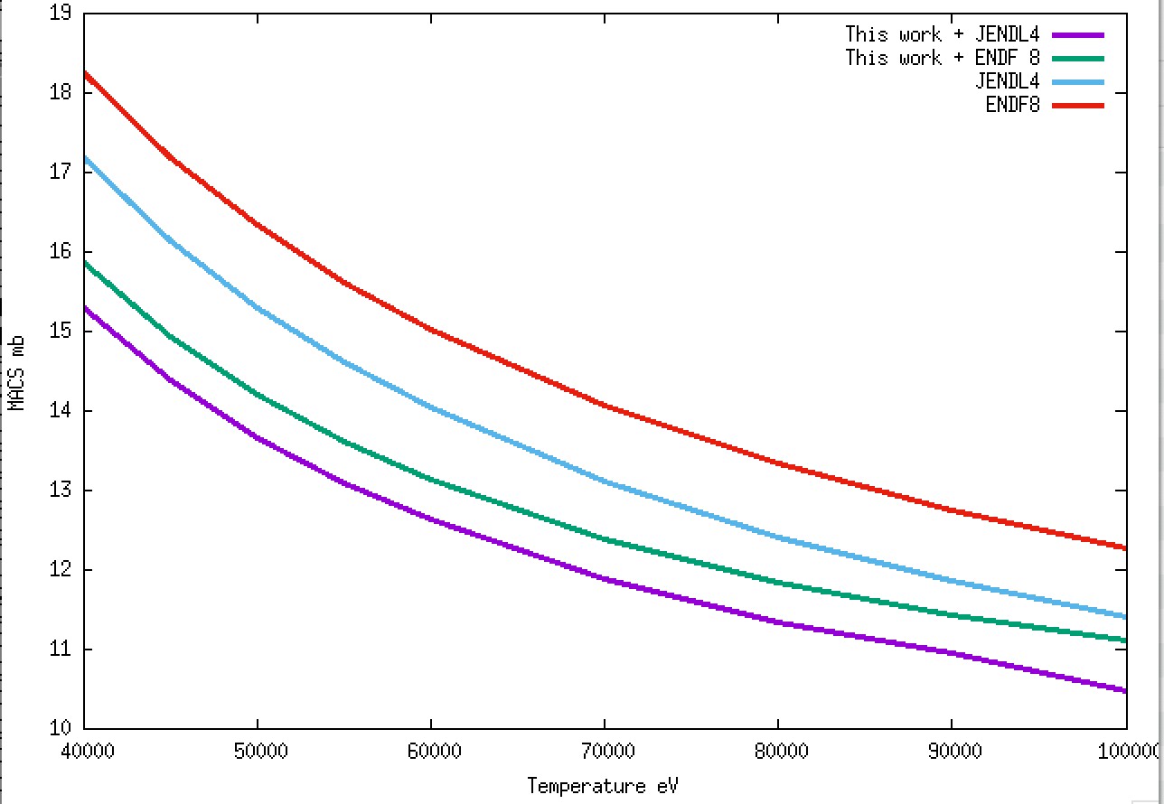
⁸⁹Y – MACS

Slide 27
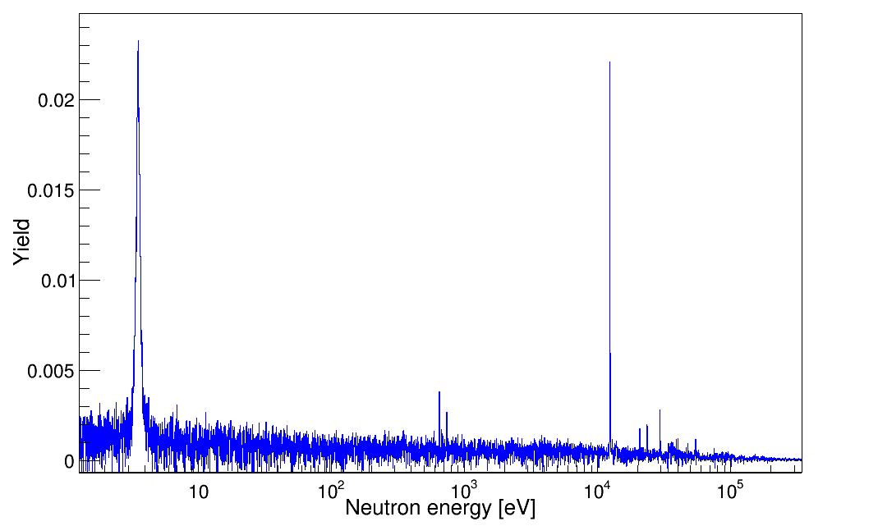
⁸⁸Sr Analysis - Yield
⁸⁸Sr
⁸⁷Sr

Slide 28
Conclusions
The capture cross section of ⁸⁹Y and ⁸⁸Sr have been measured in the energy range (1meV - 100keV)
The capture measurements have been completed with transmission measurements performed at GELINA Facility
The analysis of the ⁸⁹Y is completed, resonances from 2 -100 keV were analyzed
Large deviation with respect to literature have been observed
For the ⁸⁸Sr, in order to quantify the impurity, a measurement of ^{nat}Sr will be done in GELINA, capture and transmission will be measured

