Slide 1

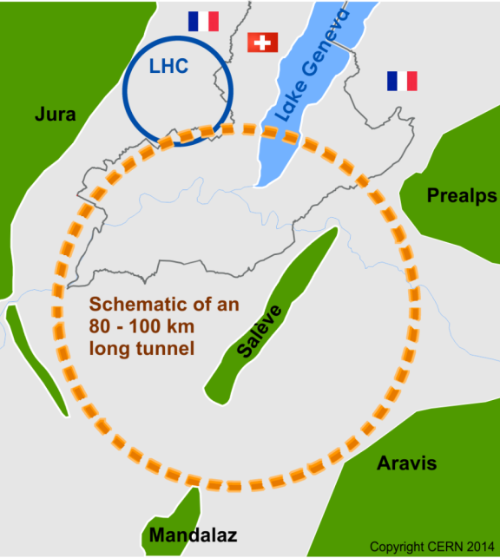
The FCC integrated program
inspired by successful LEP – LHC programs at CERN
Project Status
Comprehensive cost-effective program maximizing physics opportunities
Stage 1: FCC-ee (Z, W, H, tt) as first generation Higgs factory, EW and top factory at highest luminosities.
Stage 2: FCC-hh (~100 TeV) as natural continuation at energy frontier, with ion and eh options.
Complementary physics
Integrating an ambitious high-field magnet R&D program
Common civil engineering and technical infrastructures
Building on and reusing CERN’s existing infrastructure.
FCC integrated project plan is fully integrated with HL-LHC exploitation and provides for seamless continuation of HEP.
Overall goal:
Perform all necessary steps and studies to enable a definitive project decision by 2025/26, at the anticipated date for the next ESU, and a subsequent start of civil engineering construction by 2028/29.
This requires successful completion of the following four main activities:
Develop and establish a governance model for project construction and operation
Develop and establish a financing strategy, including in-kind contributions
Prepare and successfully complete all required project preparatory and administrative processes with the host states (debat public, EIA, etc.)
Perform site investigations to enable CE planning and to prepare CE tendering..
In parallel development preparation of TDRs and physics/experiment studies:
Machine designs and main technology R&D lines
Establish user communities, work towards proto experiment collaboration by 2025/26.

Slide 2
Collaboration Status -EU proposals
Collaboration framework with INFN-LNF
MoU for the FCC study (signed in 2014 by the LNF director)
Addendum signed between FCC and LNF Accelerator Division
  (coordination FCC-ee Machine detector interface study)
EuroCirCol (FCC-hh) EU-2020 funded (start 1/6/2015, this week 17/Jan./2020 audit certification at LNF)
New proposal submitted to EC: FCC-IS (Innovation Study) presently under evaluation!
Goal of the FCC-IS study: Carry out the technical design study for a 100 km long luminosity frontier circular collider infrastructure at CERN that will extend Europe’s leadership in the domain of fundamental physics research until the end of the 21st century.
The study focuses on the high priority topics to prepare the ground for a construction project by 2026:
optimisation of the particle collider design, which leads to the
invariants of the infrastructure project
planning and necessary investigations for a sustainable civil engineering construction project including the requirements of a circular economy,
implementation and public participation processes in France and Switzerland (CERN host states) including transnational topics such as environmental impact assessment, management of excavation materials and access to shared resources (electricity, water, communication, transport),
definition and implementation of a project exploitation plan considering the need to create a committed user community that exploits the RI from the beginning onwards and to engage every member of the society,
Socio-economic impact assessment with a plan to design the facility for impact creation, including the regional impacts and potential synergies for all participating stakeholders in Europe.
INFN participation
Scientific Responsible: M. Boscolo

Slide 3
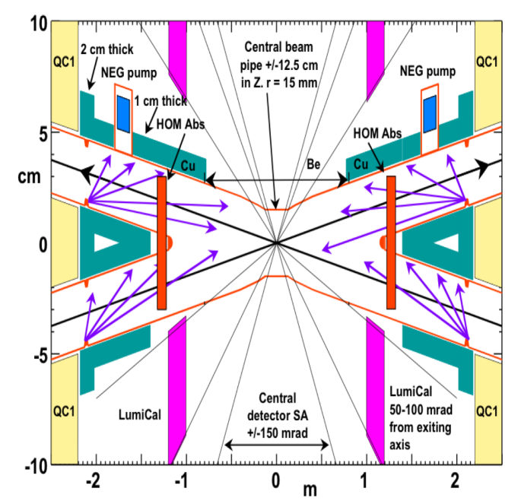
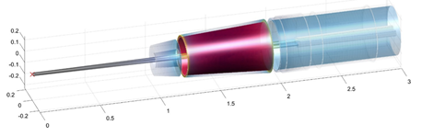
FCC-ee Interaction Region Design
M. Boscolo convener working group (since 2015)
Nell’ INFN: attività finanziata da CSN1 ((WP2-RD_FA)
M.Boscolo convener WP2(MDI per collider futuri) in RD_FA
Attività inclusa nella domanda europea FCC-IS (next slide)
Mandate for the FCC-ee MDI WG: study the integration of beams, machine elements and detectors able to produce/exploit the very high luminosity and come up with a design and,if needed, a set of necessary technical R&D or measurements. High priority list of topics to be addressed:
  Synchrotron radiation and masking
  other accelerator backgrounds
  magnetic integration
  Integration of luminosity measurements and other detectors in the IR
The MDI group has developed a feasible and flexible design for the Interaction Region that fulfils all constraints and requirements at all energies with the crab-waist collision scheme.
  Synchrotron Radiation is one of the main driver of the design
  Most relevant beam and IP backgrounds estimated
  High order modes absorbers to suppress wakefields included in the IR design
  Luminometer designed
  Final focus quad design prototyping (CCT design inspired from SuperB)
3D sketch of key IR systems over ﬁrst 3 m from IP
luminometer
Q1 with shielding
solenoid
IP
compensation
solenoid
CDR done!
3 MDI workshops:
  1st edition (Jan. 2017): revisit/validate the layout for the CDR: link
  2nd edition (January 2018): mechanical optimisation: link
  3rd ed. (Sept. 2019): progress in the design after the CDR publication: link
Preprints available on http://fcc-cdr.web.cern.ch/
CDRs accepted for publication EPJ ST
Monthly meetings: https://indico.cern.ch/category/5665/

Slide 4
INFN participation in FCC Innovation study
proposal still under evaluation, response expected around May 2020
LNF Acceleration Division involved in the collider design working package
Interaction Region design: machine detector interface, final focus magnets, background control, luminosity measurements: M. Boscolo (task leader) and L. Pellegrino for the 3D mechanical design of the IR
Impedance and collective effects: M. Migliorati (task leader, Sapienza) and M. Zobov
Scientific Responsible: M. Boscolo
(Administrative Responsible: T. Ferro, C. Conti)
FCC-IS participants
Partners
D.R.R.T. (F)
Etat de Geneve (CH)
DOE (US)
BINP (Ru)
U Oxford (UK)
Richieste servizi div acc LNF per il 2020:
servizio meccanica 1 mese uomo (1PM)

Slide 5
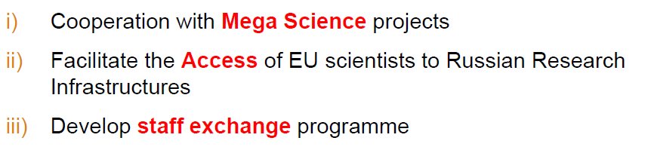
Project CREMLIN+
1. Scientific and Research Reactor Complex PIK
2. Nuclotron-based Ion Collider Facility NICA
3. 4th Generation Synchrotron Radiation Source USSR (LNF)
4. Super Charm-Tau Factory SCT (LNF, Ferrara, Lecce, Bari)
5. Exawatt Center for Extreme Light Studies XCELS
Allocated 1130 kEuro
to INFN
Call INFRASUPP-01-2018-2019 (Horizon 2020)
Project Start: 1 Febbruary 2020

Slide 6
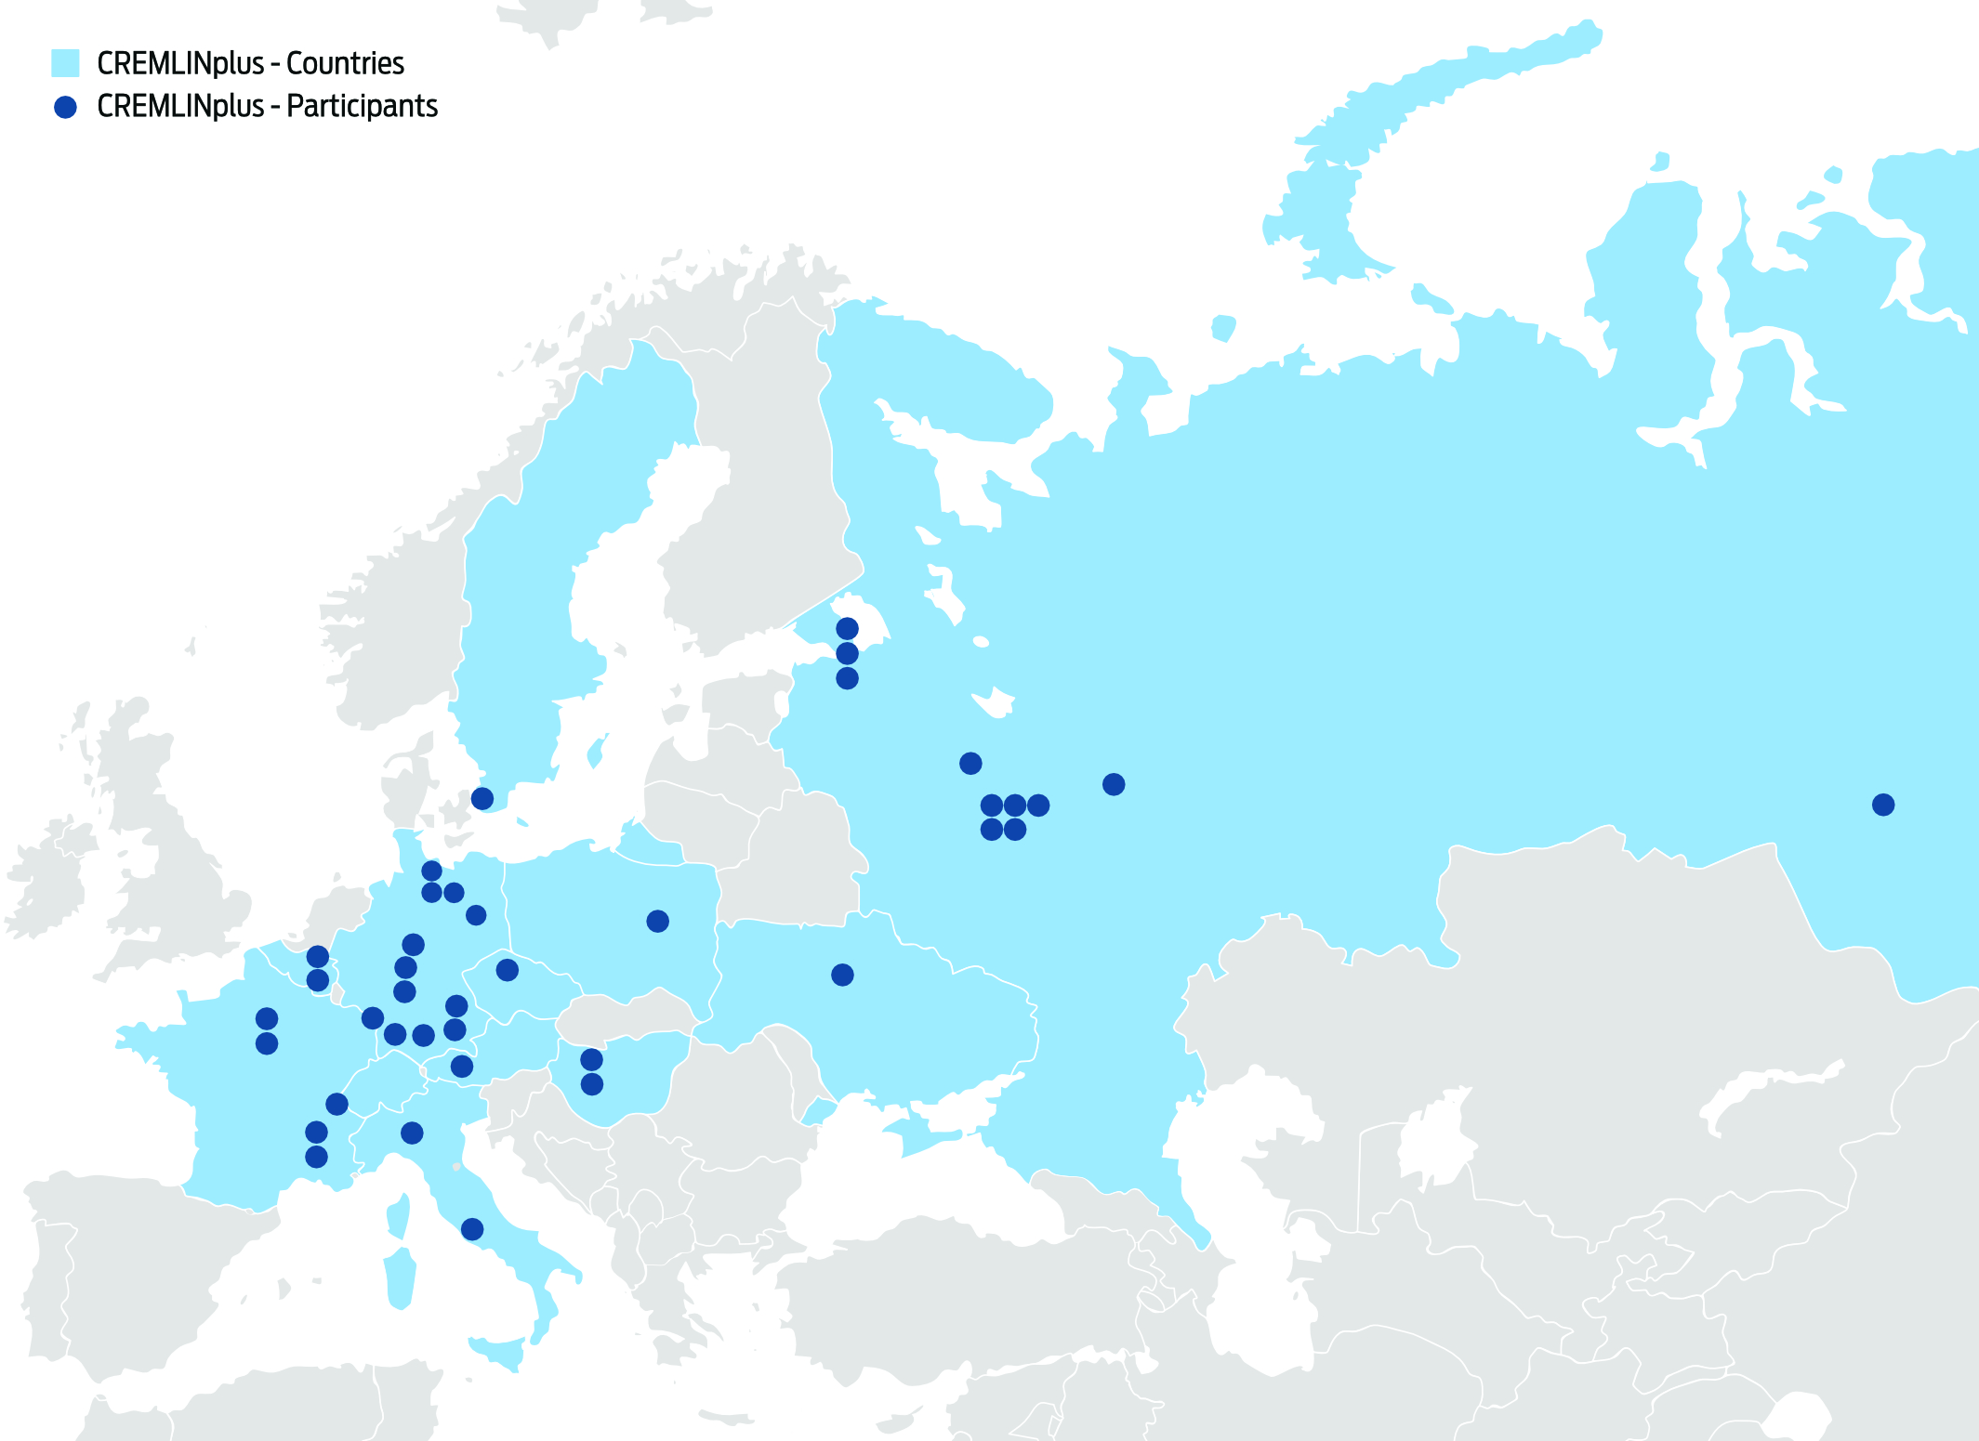
Participating Countries

Slide 7
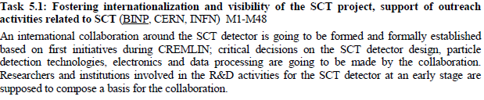


INFN participation in WP5 – SCT
Allocated EU contribution
(LNF, Ferrara, Lecce, Bari) - 730 kEuro

Slide 8
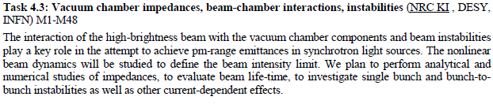

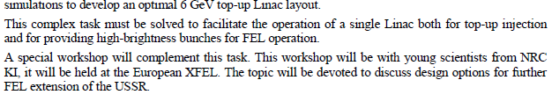
INFN participation in WP4 – USSR
Allocated EU contribution (LNF) – 400 kEuro

Slide 9
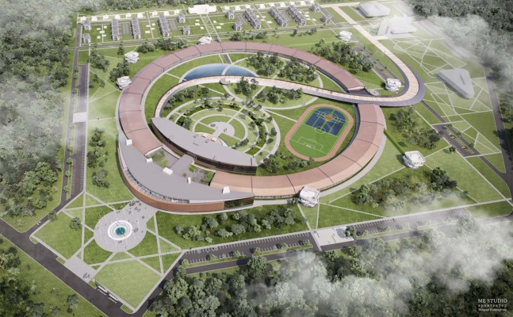
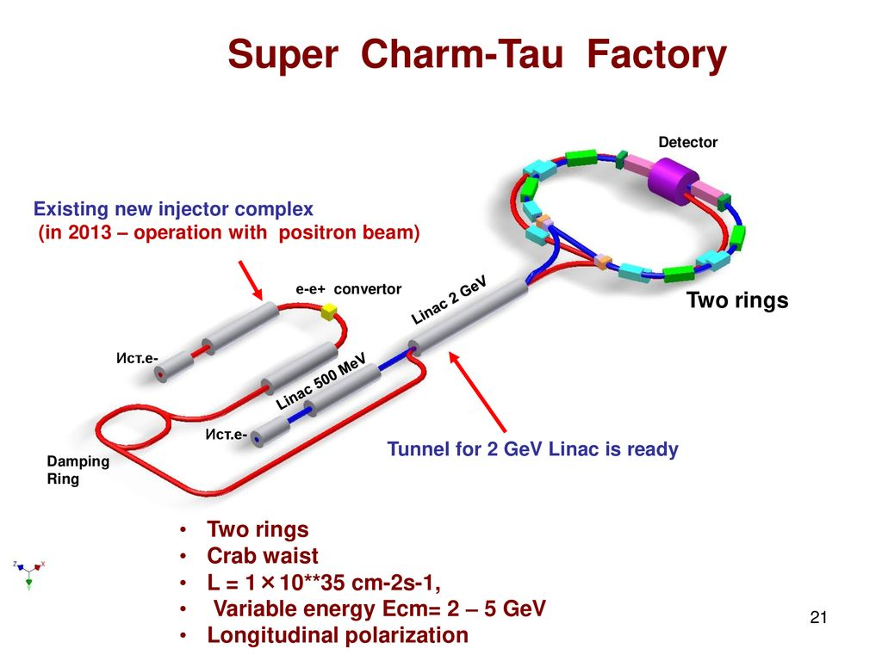
USSR
one of the
options

Slide 10
Estimated work load in 2020
1-2 Assegni di ricerca to be requested
3 senior scientists contributions with an average FTE of 25-30% (to be yet discussed)
since only theoretical and simulaton work is foreseen there are no special requests for the DA services. However, we will need a help of the DA secretaries for documents preparation

Slide 11
ARIES
Accelerator Research and Innovation for European Science and Society
Objectives
develop, demonstrate novel concepts and further improve the European particle accelerators;
provide European researchers and industry with access to top-class accelerator research and test infrastructures;
enlarge and further integrate the accelerator community in Europe;
develop a joint strategy for securing sustainable accelerator Science & Technology;
transfer the benefits and applications of accelerator technology to both science and society.
ARIES brings together a consortium of 41 beneficiaries from 18 countries
EC Contribution 10 M€
Start: 1 May 2017 End: 30 April 2021
1st annual meeting: Riga 22-25 May 2018 https://indico.cern.ch/event/699219/
2rd annual meeting: Budapest 8-12 April 2019 https://indico.cern.ch/event/756346/
3rd annual meeting: Lisbon 20-24 April 2020 https://indico.cern.ch/event/861604/

Slide 12
ARIES Work Packages
WP1 (Management, dissemination and ensuring sustainability)
Network Activities
WP2 (Training, Communication and Outreach for Accelerator Science)
WP3 (Industrial and Societal Applications)
WP4 (Efficient Energy Management)
WP5 (European Network for Novel Accelerators)
WP6 (Accelerator Performance and Concepts)
WP7 (Rings with Ultra-Low Emittance)
WP8 (Advanced Diagnostics at Accelerators)
Transnational Access
WP9 (Magnet Testing)
WP10 (Material Testing)
WP11 (Electron and proton beam testing)
WP12 (Radio Frequency Testing)
WP13 (Plasma beam testing)
Joint Research Activities
WP14 (Promoting Innovation)
WP15 (Thin Film for Superconducting RF Cavities),
WP16 (Intense, RF modulated E-beams)
WP17 (Materials for extreme thermal management)
WP18 (Very High Gradient Acceleration Techniques)

Slide 13
Partecipazione INFN
WP5: European Network for Novel Accelerators (EuroNNAC)
  Task 5.4. Organization European Advanced Accelerator Concepts Workshop (EAAC) (DESY, INFN-LNF), M. Ferrario, E. Chiadroni
WP6: Accelerator Performance and Concepts (APEC)
  Task 6.4. Improved Beam Stabilization (Roma1 + LNF), M. Migliorati, A. Drago, Assegno di Ricerca a Roma1
  Deliverable: Summary of novel methods to reduce accelerator impedance
  Task 6.6. Far Future Concepts & Feasibility (CERN, INFN-PD), M. Zanetti, Assegno di Ricerca a Padova
  Workshop sul ‘Muon Collider’ a Padova luglio 2018
  Deliverable: White list of ranked far future accelerator options
WP7: Rings with Ultra-Low Emittance (RULE)
  Task 7.3. Beam dynamics and technology for ultra-low emittance rings (CERN, INFN, SOLEIL), M. E. Biagini
  Organizzazione ”8th Loe Emittance Rings Workshop” a Frascati, Marzo 2020
WP15: Thin Film for Superconducting RF Cavities SRF (TF-SRF)
  Task 15.2. Substrate surface preparation (LNL)
  Task 15.3. Thin film deposition and analysis, (LNL), C. Pira, Art. 36a LNL
Responsabile scientifico: S. Guiducci dal 1/06/2017; M.E. Biagini dal 1/12/2019
Responsabile finanziario: T. Ferro
Costo Totale 539 k€ ; Contributo EC 295 k€

Slide 14
Impegni
Primo report finanziario fatto 31 ottobre 2018
Secondo report 30 aprile 2020
Report finale 30 aprile 2021
Gli AR e l’art. 36 sono già stati assegnati
Workshops EuroNNAC fatti nel 2017 e 2019
L’impegno principale ora per la DA è l’organizzazione del workshop sui Low Emittance Ring a Frascati

Slide 15
SITUAZIONE MONTAGGI @ STAR 17/1/2020 CSDA
L. Pellegrino
(coordinatore per LNF)

Slide 16
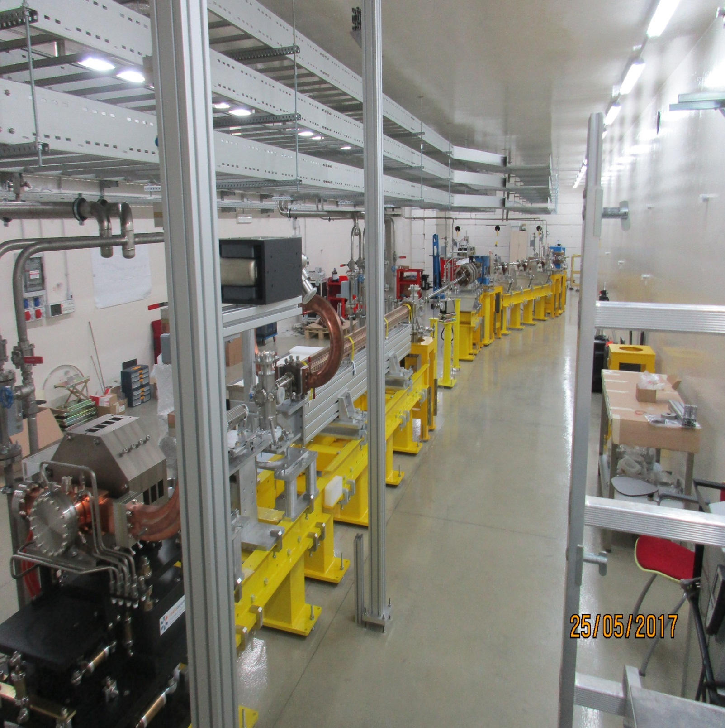
ultimo intervento di montaggio 25 maggio 2017

Slide 17
SITUAZIONE
ultimo intervento di montaggio 25 maggio 2017.
Aprile 2019 meeting @LNF con UNICAL per ripresa attività, aggiornato piano attività per i montaggi.
In stallo il permesso di accesso all’acceleratore: è stato interessato Vescovi che si è interfacciato con l’organizzazione locale.
Poca reattività di UNICAL.
Resta comunque molto da fare.

Slide 19
External project MoU and Collaboration agreements
BEATS – SESAME: study and project of the synchrotron radiation source for the Tomogaphy beam lines in the Giordanian light source (almost done).
X-band: collaboration agreement with CERN on development X-band technology
HITRI-SEEIIST: Project for Gantry magnet for hadrotherapy accelerators CNAO-CERN (solo consulenza)
SPS Extraction: 5 tanks production for diagnostics of channeling extraction in SPS (progetto fatto, in fase di costruzione )
e-cloud: collaboration with CERN on experimental study of Secondary Emission Yeld of FCC and HL-LHC vacuum chamber (almost done).

