Slide 1
DAFNE run for SIDDHARTA-2
C. Milardi
January 17th 2020

Slide 2
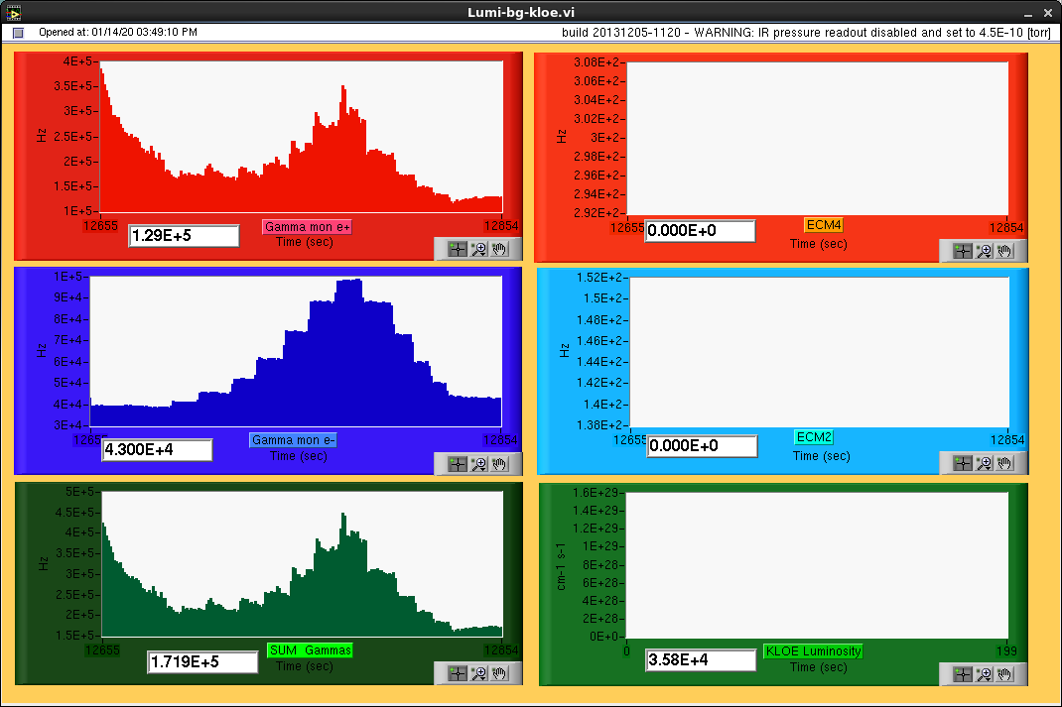
STATUS
2019
Dec 16th low-beta optics applied
Dec 18th ÷ 20th
optics measurements
Linear and non-linear beam dynamics optimization
2020
Jan 14th luminosity tests
Gamma monitor signals

Slide 3
Main Activities in the next months
Operations
Luminosity measurements
Mechanical and Alignment

Slide 4
Operations
Support from all the Services in order to guarantee a reasonable collider uptime
Fluid Systems
Hoses of the wiggler magnets are still an issue they cause:
frequent stops
damage of machine equipment
a final solution of the problem would be desirable
Electronics and Diagnostics
full diagnostics operability
understanding jitter in the DR kickers
Control System
Implementation of the new Linux consoles
debugging
porting of the control application
Finalization of the Luminosity monitor interfaces (gamma monitor, CCALT)
Optimization of the Applications assuring data exchange between the collider and the experiment

Slide 5
Operations
Injection System
Full operability and reproducibility
Electronics and Diagnostics
LINAC
Control System
Completing the frame grabber application for the TLs would be desirable

Slide 6
Luminosity Monitor
Electronics and Diagnostics
Support for hardware diagnostics and possible development
Control System
Finalization of the Luminosity monitor interfaces (gamma monitor, CCALT)

Slide 7
Mechanical and Alignment
Completing Measurements of BPM offsets
Crab-Waist Sestupoles alignment
Assembly and measurements of the new PMQFs
After SIDDHARTINO run
Installation and alignment of the new PMQFs

Slide 8
SPARE SLIDES

Slide 10
Linux console Applications problems (Jan 2020)
Mag terminal
Global Load (bad file access), file loaded
Global Save (bad file access), file saved
Response Matrix Acquisition
error saving files (wrong privileges), file not saved
Orbit Monitor
only one window can be opened
Grab does not save the orbit file in the proper directory
orbit difference does not work

