Slide 1


Solid state detectors part 2
G. Casse
XXXII INTERNATIONAL SEMINAR of NUCLEAR and SUBNUCLEAR PHYSICS "Francesco Romano" June 7-11, 2021

Slide 2
Lecture 1:
Solid-state tracking detectors (2 hours)
Lecture 2:
Solid-state photon detectors (1 hour)

Slide 3
Lecture 1:
Solid-state tracking detectors (2 hours)
Lecture 2:
Solid-state photon detectors (1 hour)

Slide 4
OUTLINE:
Low intensity light (single photon) detection with silicon
Principle of operations
Structure of SiPM
Gate, PDE, Noise
Developments for Physics experimentys

Slide 5
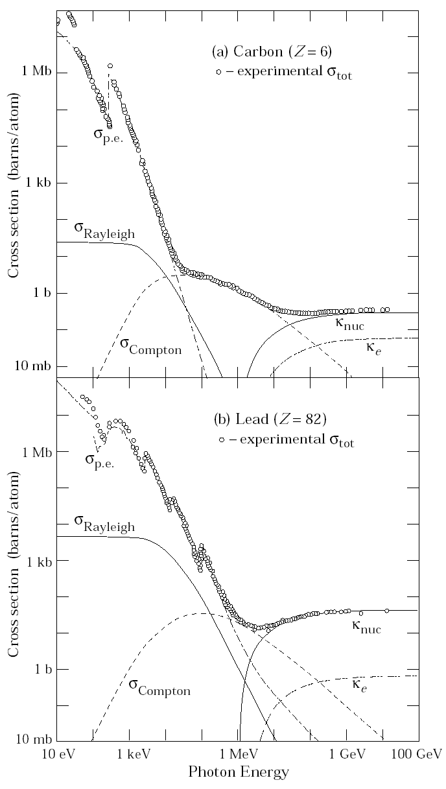
Energy loss by photon:
Photo-electric effect: Aγ ⇒ A⁺e (E <10-100 keV)
(discontinuities due to ionisation thresholds)
Compton scattering: e γ A⇒ e γA
Pair-production: γ A⇒ e⁺ e⁻A (E >1-10 MeV)
(due to E-field nuclei)
Pair-production
e⁺
(Topologically similar to Bremsstrahlung!)
γ
e⁻
γ
e
e
A
A
PDG 2001
A
A
Mean-free-path for photons is 9/7*X₀ ( ∝ 1/σ ), very similar to that for electrons!

Slide 6
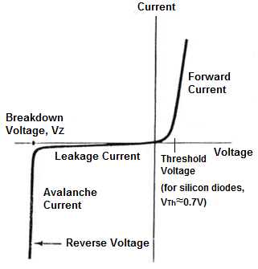
Detecting single photons
A mip in a 300μm thick Si-detector releases 24ke, and need low noise amplification. Here we talk about 1 electron.
Need a different mechanism:
Internal amplification multiplication.
Remember the diode IV characteristic:

Slide 7
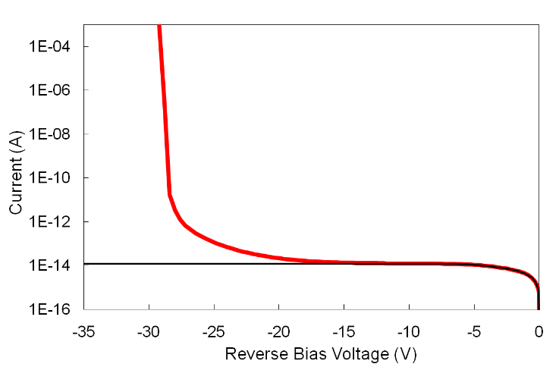
Solid-state low-light detectors
7
SOLID-STATE DETECTORS WITH INTERNAL GAIN
- process: multiplication of carriers via impact ionization
- Advantages: low-bias, compact, rugged, insensitive to magnetic field.
SPAD (Single-photon avalanche diode)
(GEIGER-MODE APD)
Gain ~10⁶ or more
Timing ~ 20÷50 ps.
Bias voltage <100V
Sensitivity ~1 ph. e.
SPAD
APD
PD
V_{BD}

Slide 8
SPAD: working principle
cathode
anode
Biased (V_{a}) ABOVE breakdown voltage (with excess bias Vex)
Single photon or thermally generated carrier switches on avalanche process (with a certain probability) → macroscopic current
Avalanche has to be quenched by external circuit → quenching circuit:
    Passive quenching in SiPMs (large resistance: usually > 300 kOhm)
Bias reset above breakdown voltage → dead time.

Slide 9
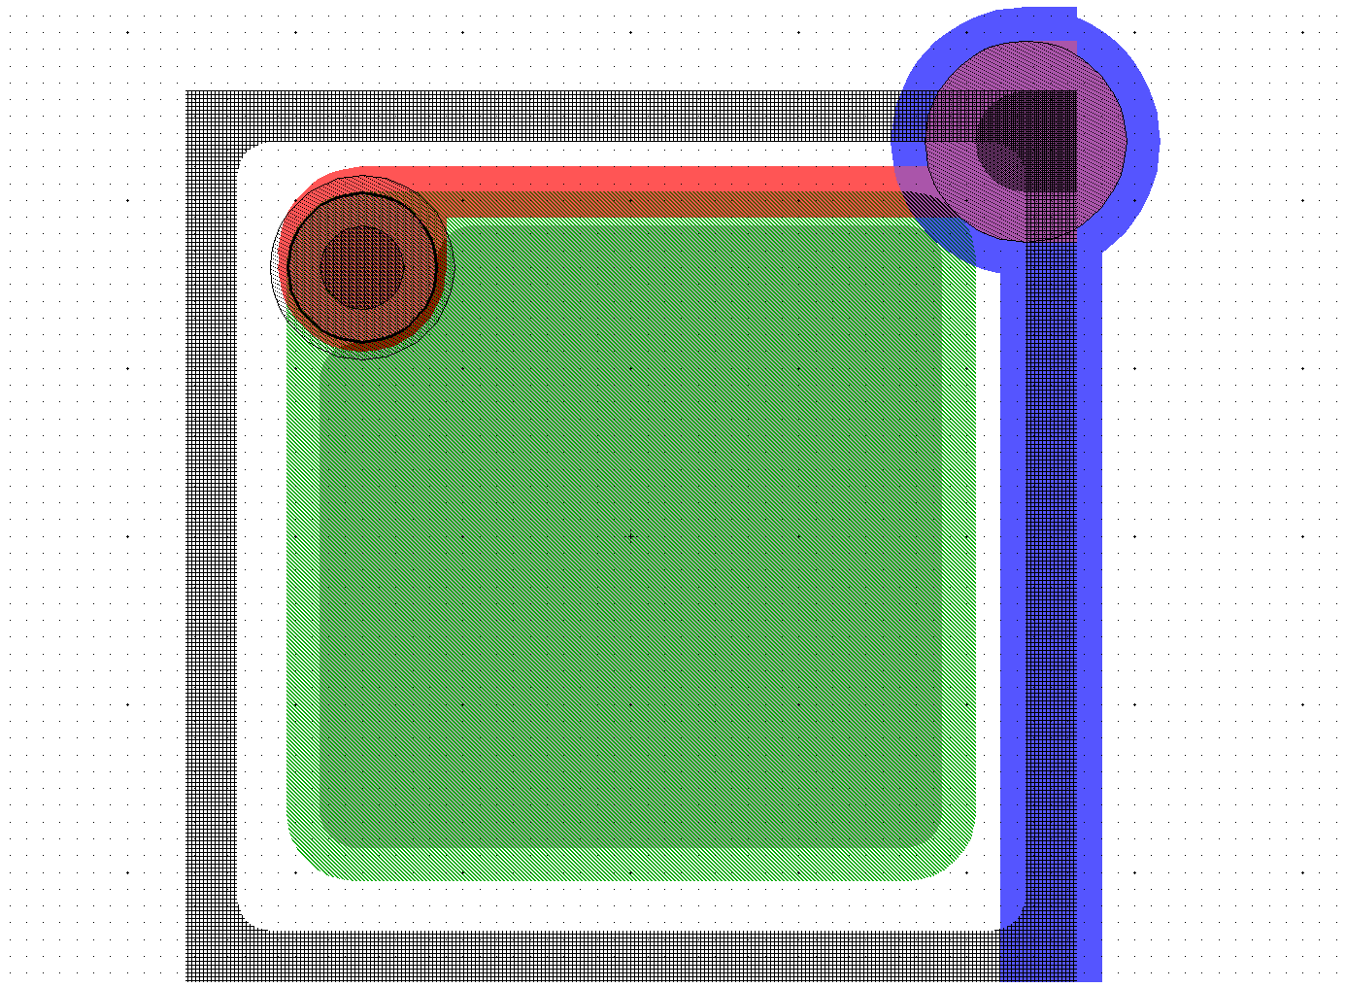
SPAD: drawbacks
Limited active area: 20µm ÷ 200µm
Cannot count the number of photons
avalanche
propagates
all over the
diode
avalanche
Current
time
1 photon
5 photons

Slide 10
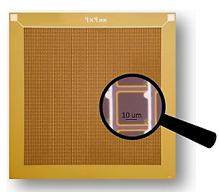
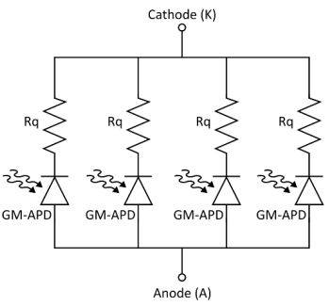
The Silicon Photomultiplier (SiPM)
SiPMs are arrays of small SPADs connected in parallel.
Each SPAD employs a passive quenching mechanism.
SPAD
SPAD
SPAD
SPAD
SiPM size:
1x1 mm² to 10x10 mm²
Microcell (SPAD) pitch:
12 um to 40 um
(typical)

Slide 11
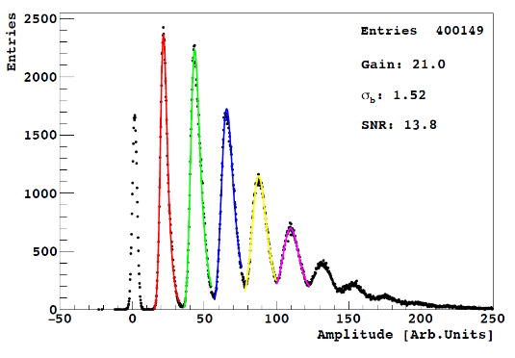
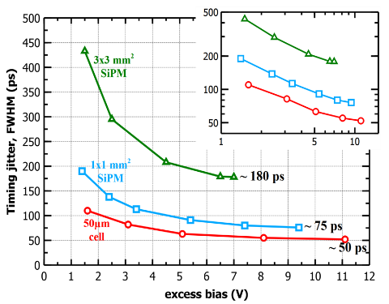
The Silicon Photomultiplier
A SiPM is a single-photon detector, with internal signal amplification, fabricated on CMOS-compatible silicon wafers.
Capabilities of SiPMs:
Detection of single photons in the visible / NIR range with simple (low power) readout electronics.
Excellent timing performance: down to 50 ps FWHM.
Few-photon or many-photon counting capabilities, depending on design.
λ = 425 nm
Example of few-photon counting
Single photon time resolution (SPTR)

Slide 12
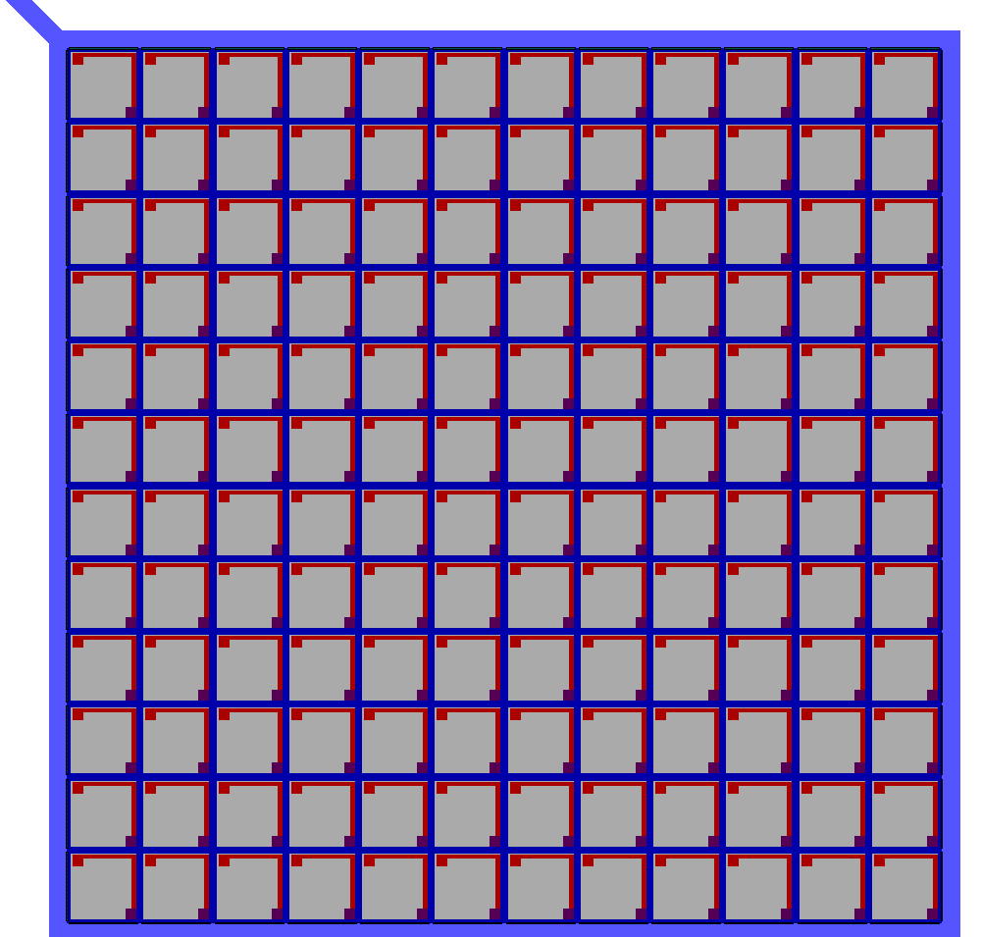
The Silicon Photomultiplier (SiPM)
Flash of
photons
Each element is independent and gives the same signal when fired.
Q = Q₁ + Q₂ = 2*Q₁
Output amplitude (and charge)
→ proportional to the number of triggered cells → proportional to the number of photons.

Slide 13
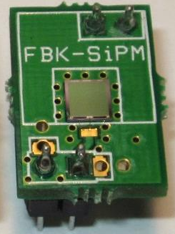
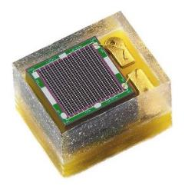
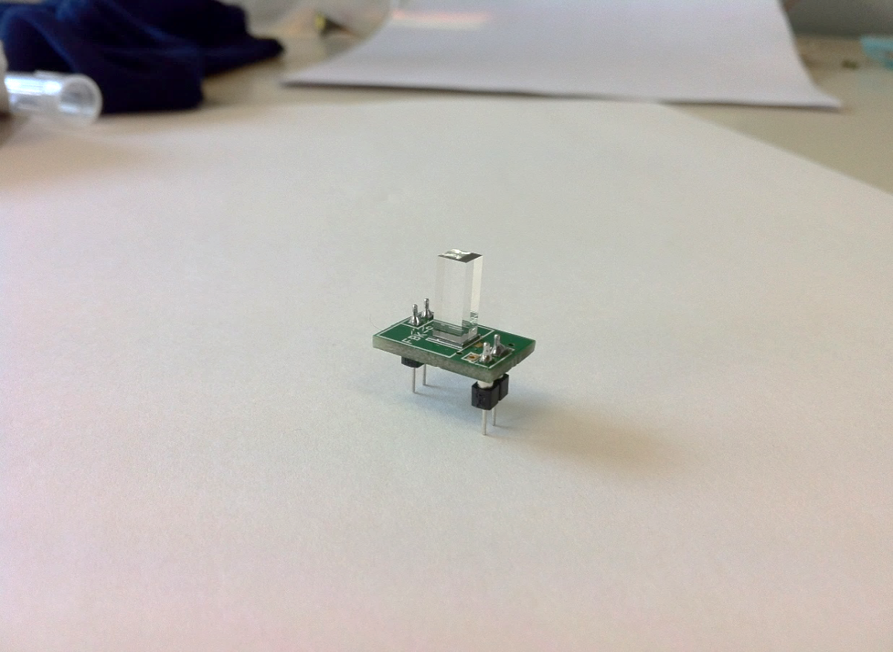
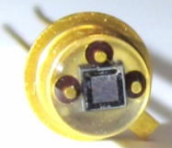
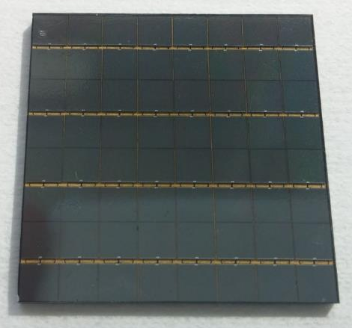
Silicon Photomultiplier (SiPM)
http://www.ketek.net/
http://advansid.com/
composed of square SPAD e.g. 40x40 µm²
Active area of 1x1mm² up to 10x10mm²
Different package and connections.
TILE of SiPMs to cover big areas.
Typically coupled to scintillators for gamma-ray detection (e.g. medical imaging, physics experiments)
8x8
3.23 cm

Slide 14
Typical SiPM Structure with trenches
Superficial implant:
Very thin, constitutes the entrance window for the light into the SPAD
High-dose, partially undepleted.
Microcell (SPAD) of SiPM
Metal
Connections
Quenching resistor
Deep trenches:
are used to isolate adjacent microcells electrically. Optical isolation depends on filling material.
High-field region:
is defined with a high-energy ion implant. Avalanche multiplication takes place here.
High-field region
~ few µm
Epitaxial layer:
The region on which the SiPM cells are built.
Usually fully depleted at breakdown. Close to the interface with the bulk, part of it is undepleted.
Bulk:
(Very) high-doping region upon which the epitaxial layer is built. Never depleted.

Slide 15
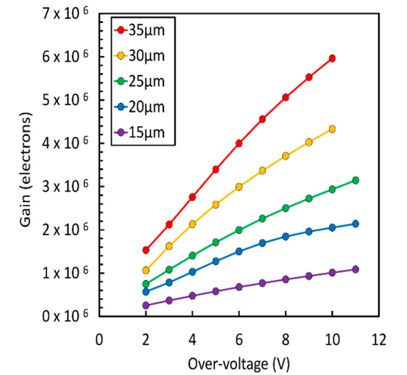


SiPM Gain
The Gain in a SiPM is a measure of the number of carriers that pass through the high field region of one microcell during an avalanche.
It can be measured as the integral of the output current of the SiPM when an avalanche is triggered.
$$Gain=OV∙\left(C_{d}+C_{q}\right)$$
$$τ_{recharge}≈R_{q}∙\left(C_{d}+C_{q}\right)$$
Recharge time constant
Parameter | Typical values
R_{q} | 500 kOhm – 1.5 Mohm
C_{d} | 15 fF – 150 fF
C_{q} | 5 fF – 10 fF
Tau | 8 ns – 100 ns
Gain
7

Slide 16

Photon Detection Eff<iciency
Photon Detection Efficiency (PDE) is a measurement of the probability that a photon impinging on the SiPM surface starts an avalanche.
$$PDE=FF ∙QE ∙P_{t}$$
Fill Factor
Quantum Efficiency
Avalanche Triggering Probability

Slide 17
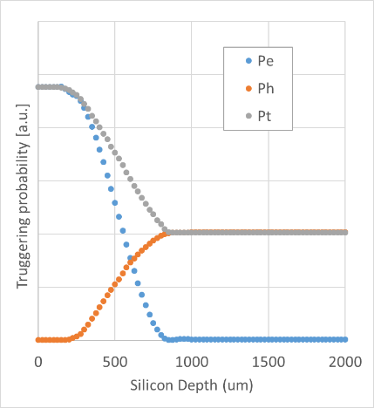
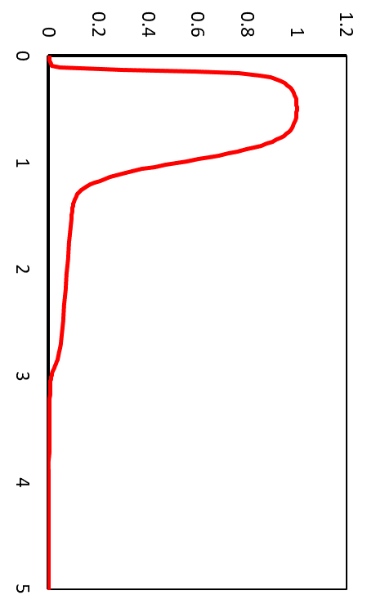
Avalanche triggering probability: Pt
Avalanche triggering probability increases with overvoltage, from zero at V_{BD} to 100% at high bias.
At the same level of bias and peak electric field, electrons have a higher probability of initiating an avalanche compared to holes.
Red photon
Blue photon
Red photon
Blue photon
Electric Field
High-field region
Qualitative plot of avalanche triggering probability for holes, electrons and total vs. depth in an p-on-n junction similar to the one used in NUV-HD SiPMs.
Oldham, W. G., Samuelson, R. R., & Antognetti, P. (1972). Triggering phenomena in avalanche diodes. IEEE Transactions on Electron Devices, 19(9), 1056–1060. doi:10.1109/t-ed.1972.17544

Slide 18
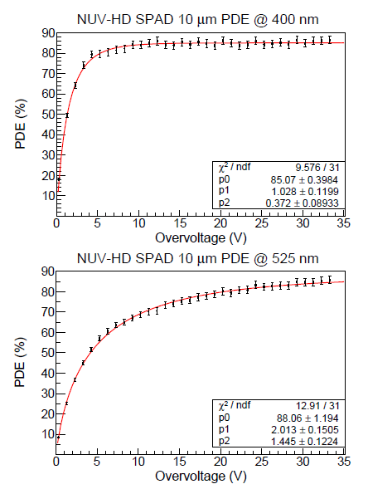
NUV-HD technology: effect of overvoltage on avalanche trigger probability (Pt)
Fast increase of Pt with over-voltage:
→ avalanche is initiated by electrons
Slower increase of Pt with over-voltage:
→ avalanche is initiated by holes (and electrons)

Slide 19
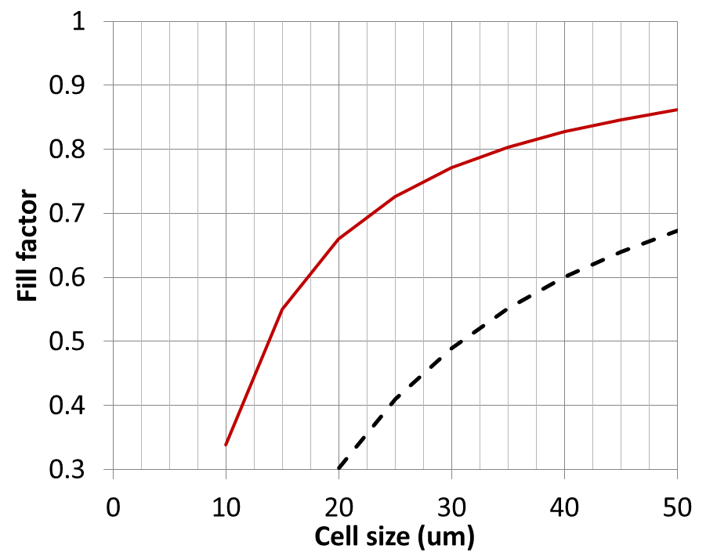
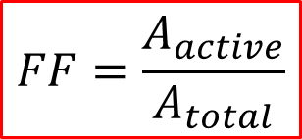
Effect of geometry on PDE
SPAD size
active area
SiPM NUV-HD
NUV
$$FF=\frac{A_{active}}{A_{total}}$$
SPAD pitch (μm)
SPAD Pitch | 15 µm | 20 µm
Fill Factor (%) | 55 | 66
SPAD/mm² | 4444 | 2500
25 µm | 30 µm | 35 µm | 40 µm
73 | 77 | 81 | 83
1600 | 1111 | 816 | 625

Slide 20
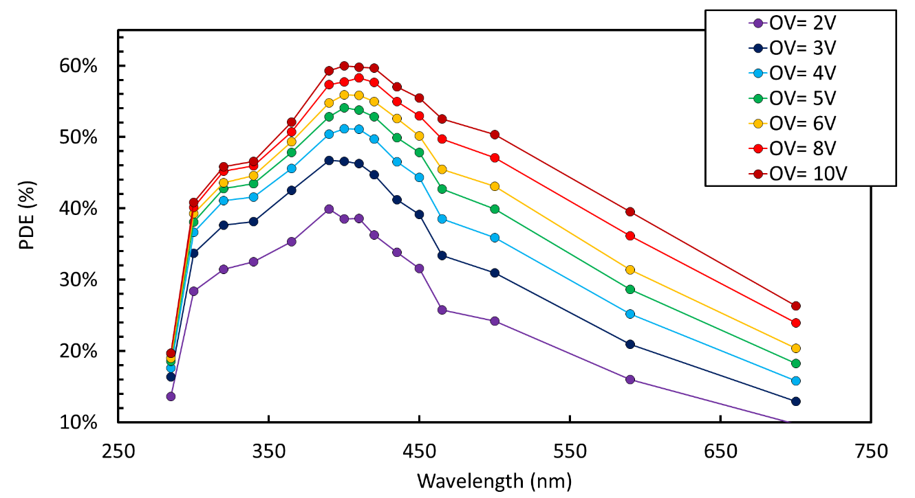
Effect of OV PDE
35 um cell pitch
~60% !
P_{e}
P_{h}
Reduction of PDE because of limited thickness of epitaxial layer (few um)
Cutoff because of protective resin
Gola, A et al. (2019). “NUV-Sensitive Silicon Photomultiplier Technologies Developed at Fondazione Bruno Kessler.” Sensors, 19(2), 308.

Slide 21

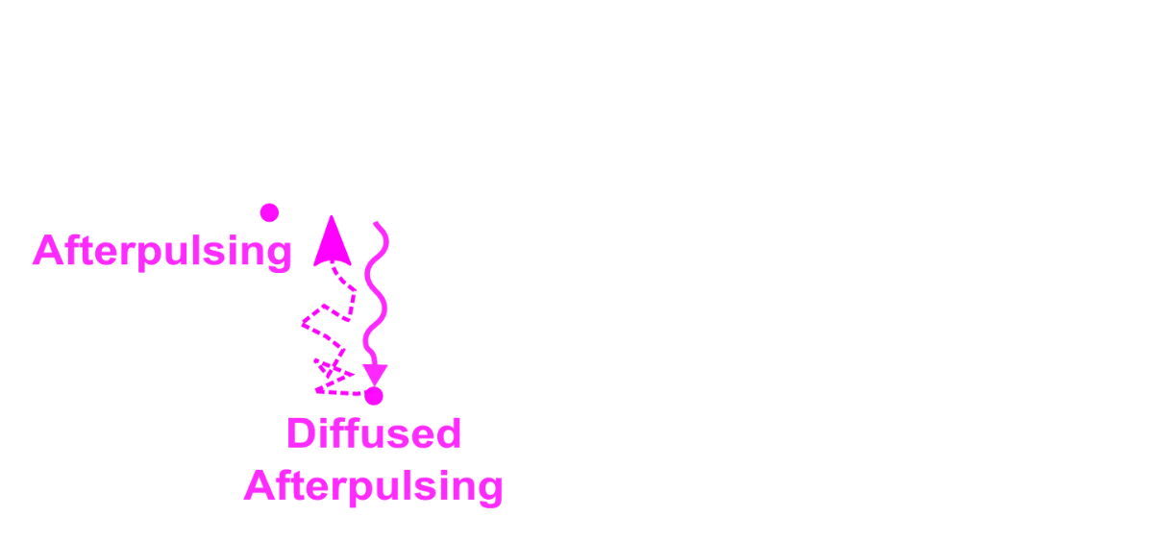
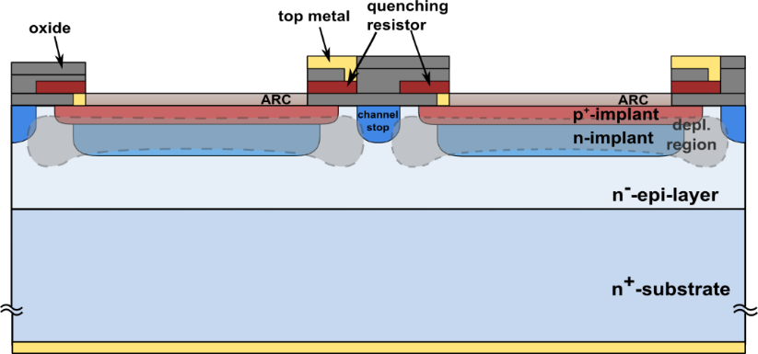
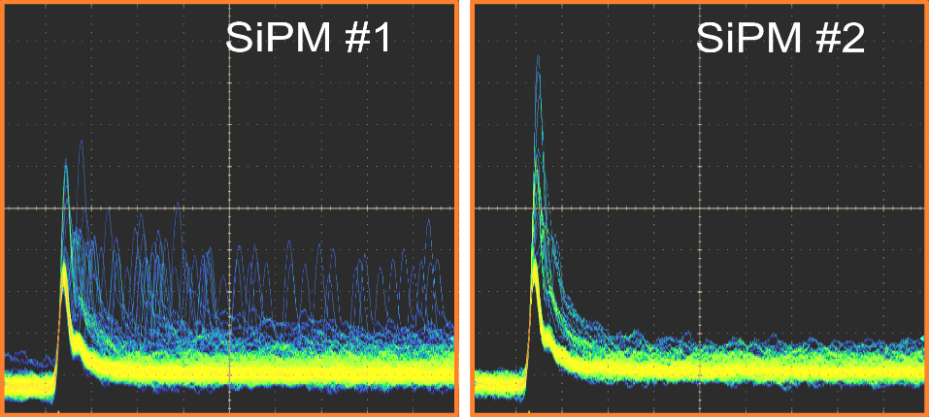


Noise in SiPMs
Different SiPM noise components are related to different physical phenomena.
$$P\left(correlated\right)∝Gain\left(OV\right)$$
DiCT
DeCT
Afterpulsing
Primary
dark counts
Cross-section of the SiPM microcells.
SiPM waveforms acquired with the oscilloscope

Slide 22
Sources of primary DCR
Electric Field
Diffusion
Entrance window
(un-depleted)
Typically dominant at room T
SRH, Poole-Frenkel, Trap assisted tunneling
High-Field region
Direct tunneling (dominant at low-Temp)
Drift Region
SRH generation
Un-depleted epi
Diffusion
Bulk
All these components have different dependence on device parameters and on temperature..

Slide 23
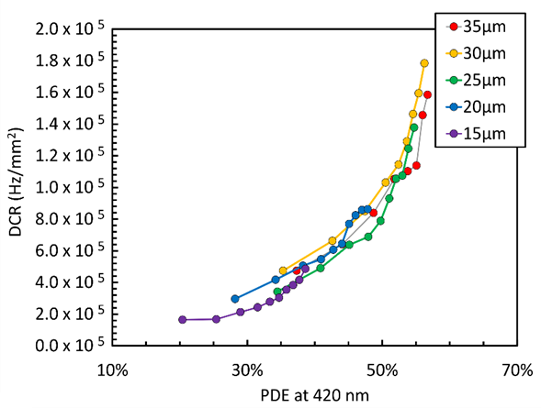
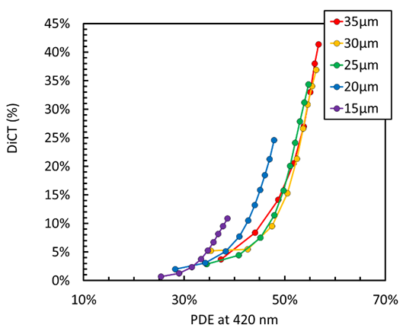
SiPM noise: Dark Count Rate and Optical Crosstalk
T = 20 C
80 kHz
15%
Dark Count Rate
Optical Crosstalk
(Correlated Noise)

Slide 24
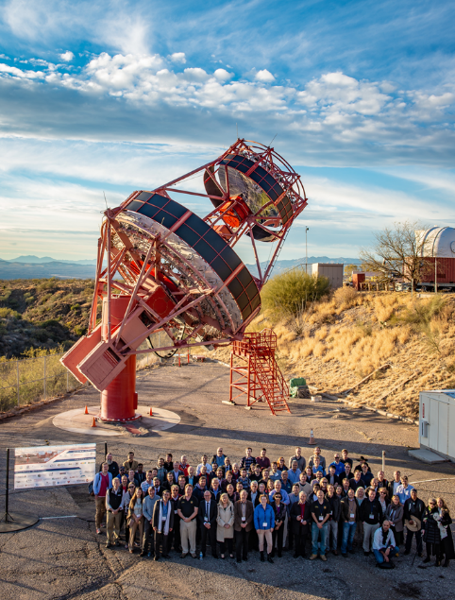
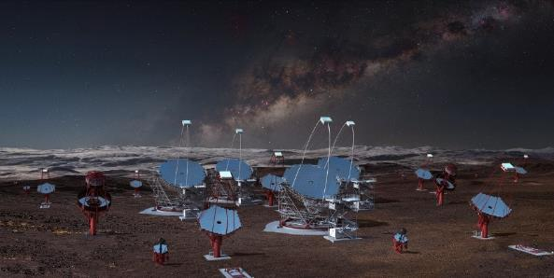
Scientific experiment motivated improvement: NUV-HD-LowCT SiPM technologies
NUV-HD-LowCT technology was initially developed for the focal plane of the Medium Size Telescopes (MST) of the Cherenkov Telescope Array.
Reducing crosstalk probability is important to reduce false triggers, especially in presence of strong Night Sky Background.
FBK SiPMs have been employed for the first time in the focal plane of the prototype Schwarzschild-Couder Telescope (pSCT), installed in the VERITAS (Very Energetic Radiation Imaging Telescope Array System) observatory site, in Arizona, USA.
First gamma-ray signals from the Crab Nebula have been recently detected.
Prototype pSCT installed in the VERITAS, equipped with FBK SiPMs.
Representation of the 99 telescoped planned for the southern hemisphere at ESO's Paranal Observatory.

Slide 25
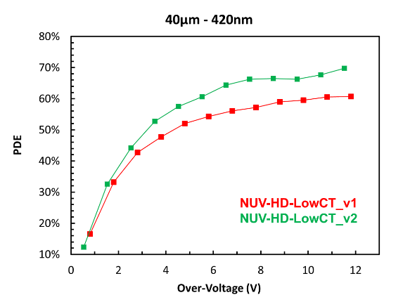
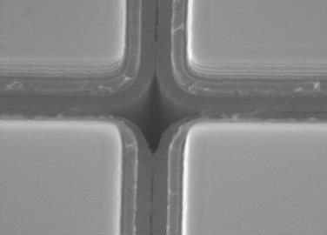
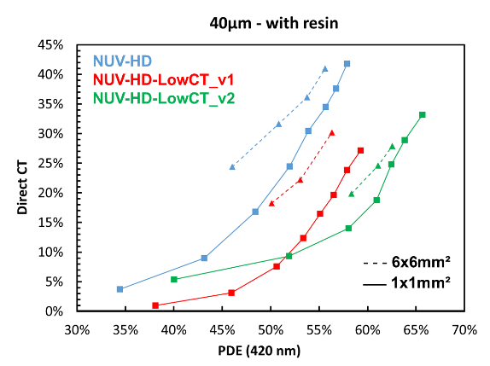
NUV-HD-LowCT SiPM technologies in FBK
Low optical crosstalk technologies can be obtained by inserting material that absorbs or reflects secondary photons, emitted by the avalanches in the microcells.
Electric field engineering increases PDE compared to standard NUV-HD technology.
PDE at 420 nm vs. OV
Up to 70%!
PRELIMINARY
Light absorbing material is placed inside trenches, between adjacent microcells
DiCT vs. PDE
SEM image of trenches, separating adjacent microcells.
>60%
Measurements on 40 µm cell size SiPMs, with silicone resin coating
Metal in trenches is under development..

Slide 26
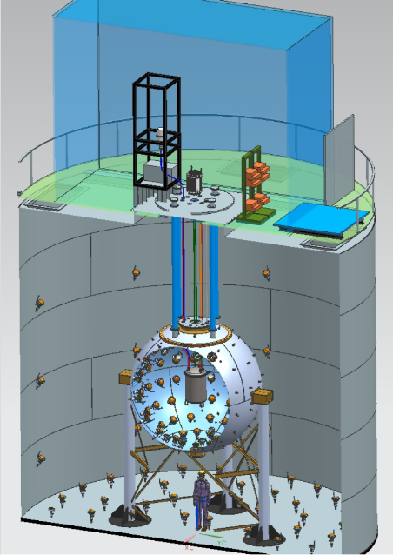
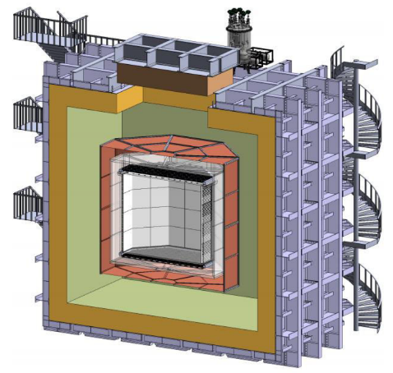

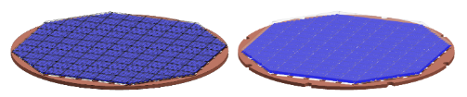

DarksSide-20k Experiment
> 3-year long collaboration between FBK and DarkSide to optimize performance of the NUV-HD technology for the specifications of the project.
~ 23t of UAr
TPB WLS:
emission at 400 – 450 nm
WCD
LAr TPC
LSV
2 light readout planes: 20 m²
(+ veto)
SiPM tiles
DarkSide-50
PMT-based TPC
DarkSide-20k
SiPM-based TPC

Slide 27
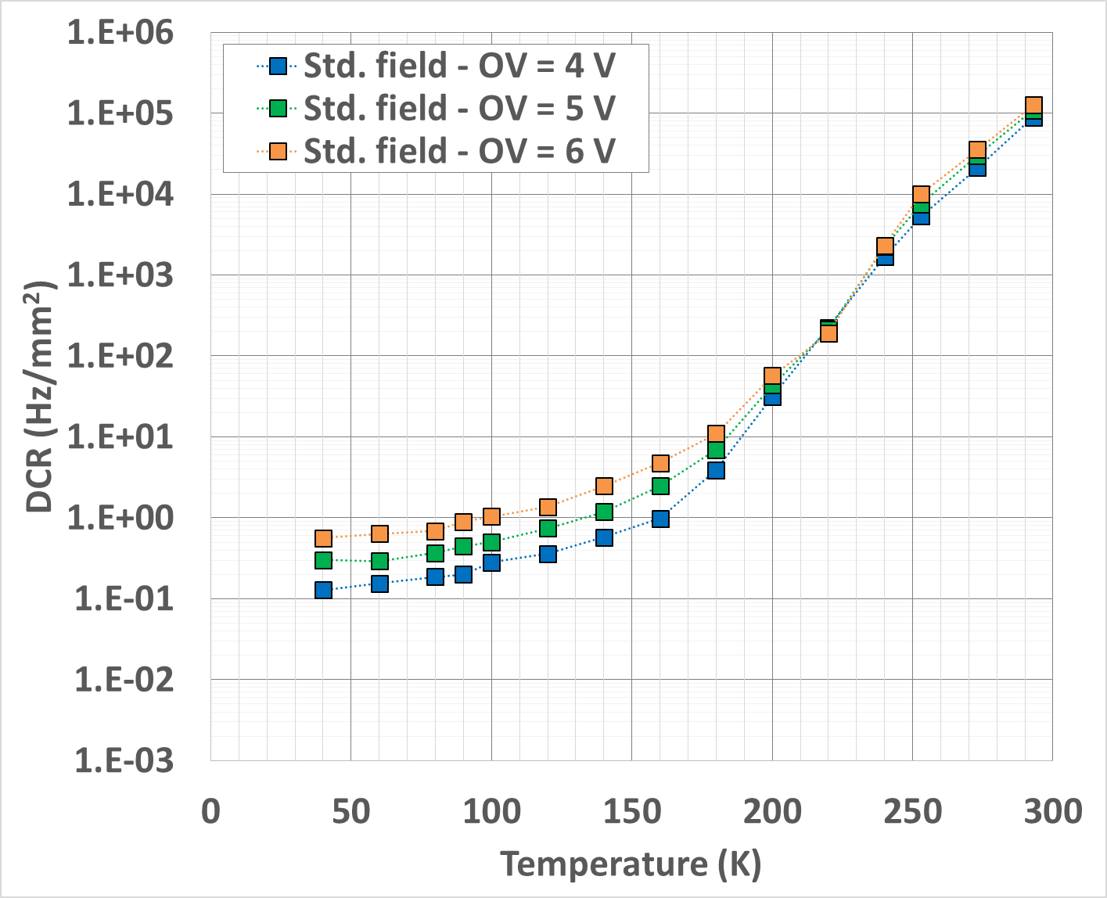
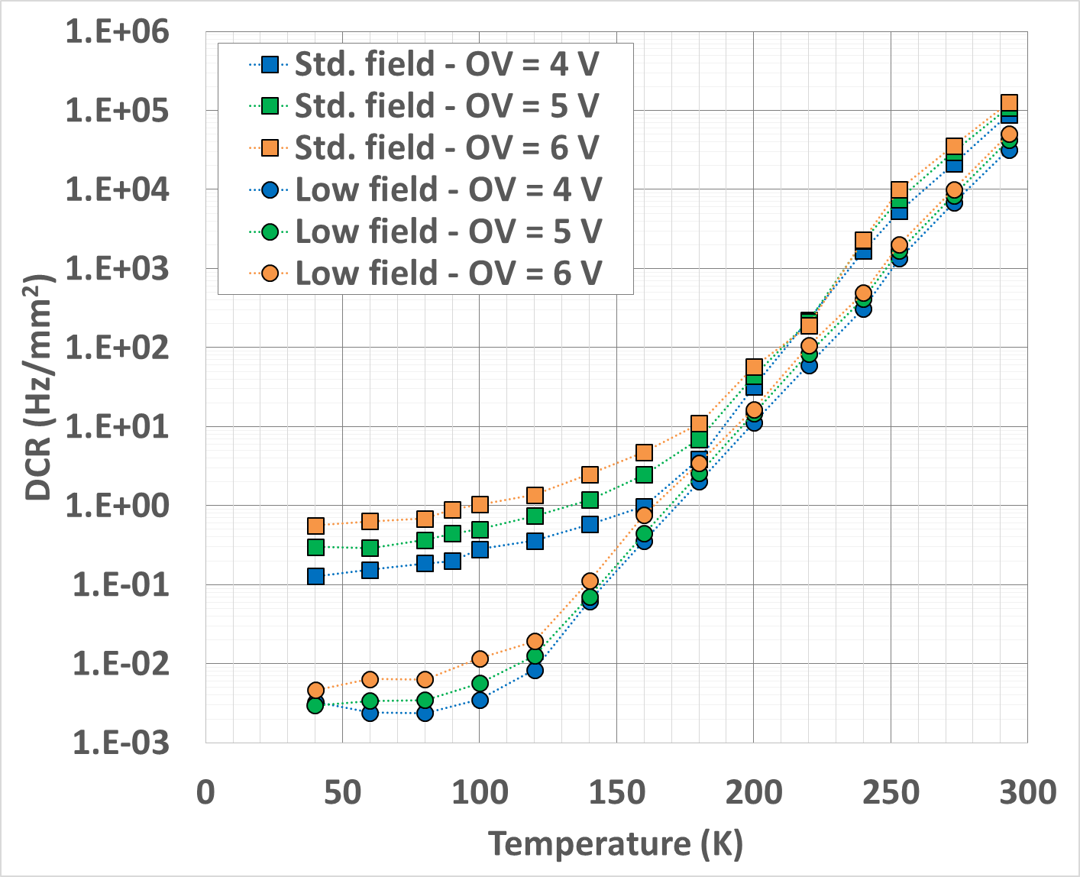
Primary DCR reduction
Thermal generation
25 um cell
> 7 orders of magnitude !
Standard field
Tunneling
> 20x
Low-field
0.3 counts per day per cell at 77 K!
A 10x10 cm² SiPM array would have a total DCR < 100 cps!

Slide 28
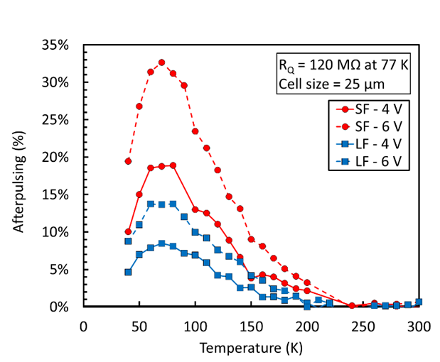
NUV-HD-SF and LF - Afterpulsing
AP is maximum at ~ 77 K!
Cell Size = 25 um
A. Gola et al.,Sensors 19, no. 2, (2019), 308
Increase of release time constant of trapping centers at lower temperatures increases AP probability.
AP increase is partially offset by increase of microcell recharge time constant.

Slide 29

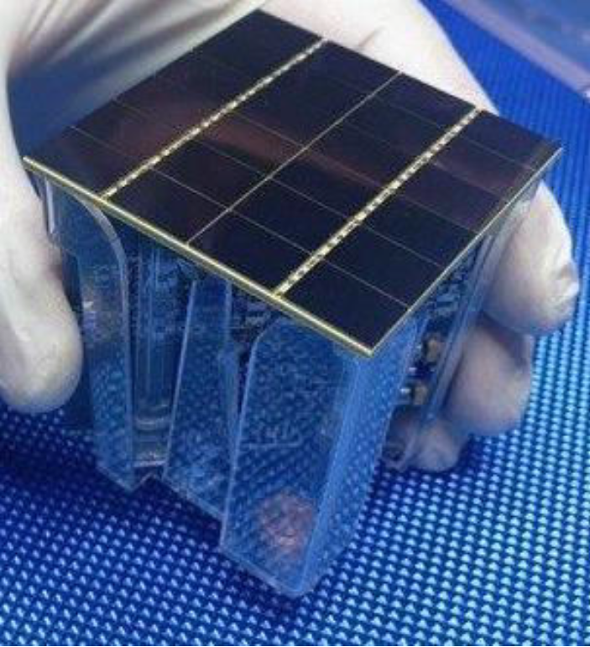
Photo-detector module
24x 12x8 mm² SiPMs (~ 1 cm²)
Front-end cryogenic pre-amplifier with differential output
Sensitivity from single photon to few thousands photons
PDM Specifications:
5x5 cm² active surface
PDE @ 420 nm > 40%
DCR < 0.08 cps/mm2
Baseline hit rate ≤ DCR ↔ SNR > 8
Timing resolution ~ 10 ns
Integration window of 6 μs
20.7 m2 ◦ 6 μs ◦ DCR = 10 pe

Slide 30
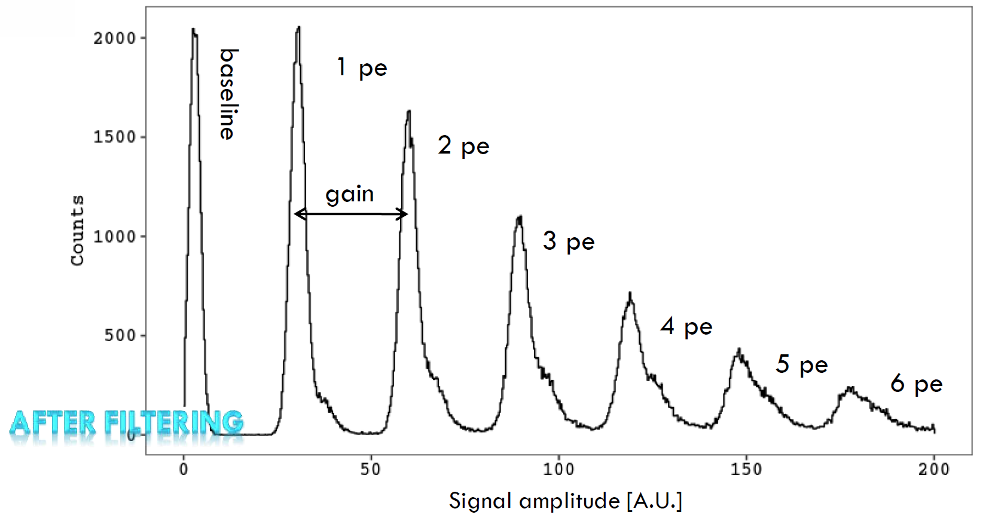
Photon counting with PDM at 77 K
Good gain uniformity of ~ 3M SPADs at 77 K
Total Area = 24 cm²
1 readout channel
30 µm cells, 7 V over-voltage
~500 ns recharge time
Measurements from LNGS

Slide 31
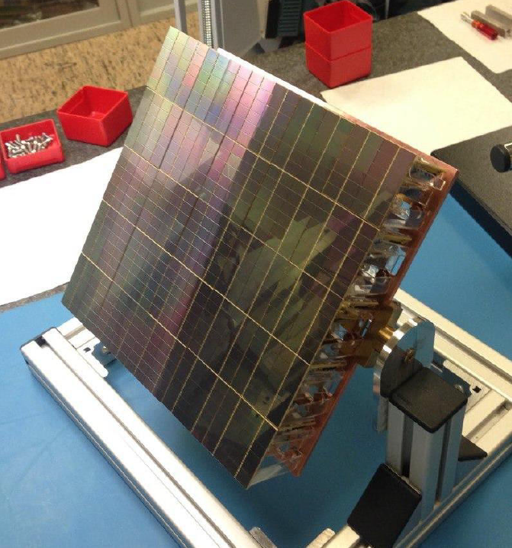
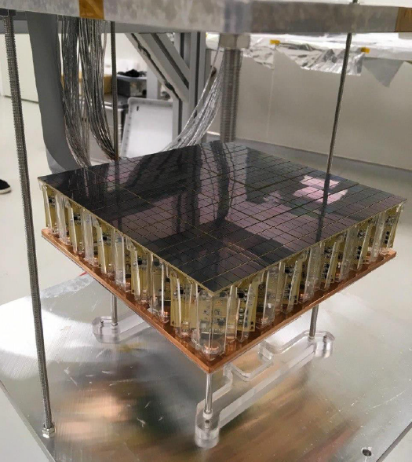
DarkSide Motherborad
Each motherboard contains 25 Photo Detection Modules
+ power distribution and signal transmitter

Slide 32



The nEXO experiment
R&D carried out for nEXO to develop SiPMs capable of direct detection of photons at 178 nm and operation at -100°C
0νββ with LXe
TPC Filled with LXe
4-5 m² SiPM
Single VUV photon sensitive (178 nm)
  > 15% efficiency
  < 20% correlated noise
  < 50 mHz/mm² DCR
Very low radioactivity
  Silicon is generally very radio pure

Slide 33
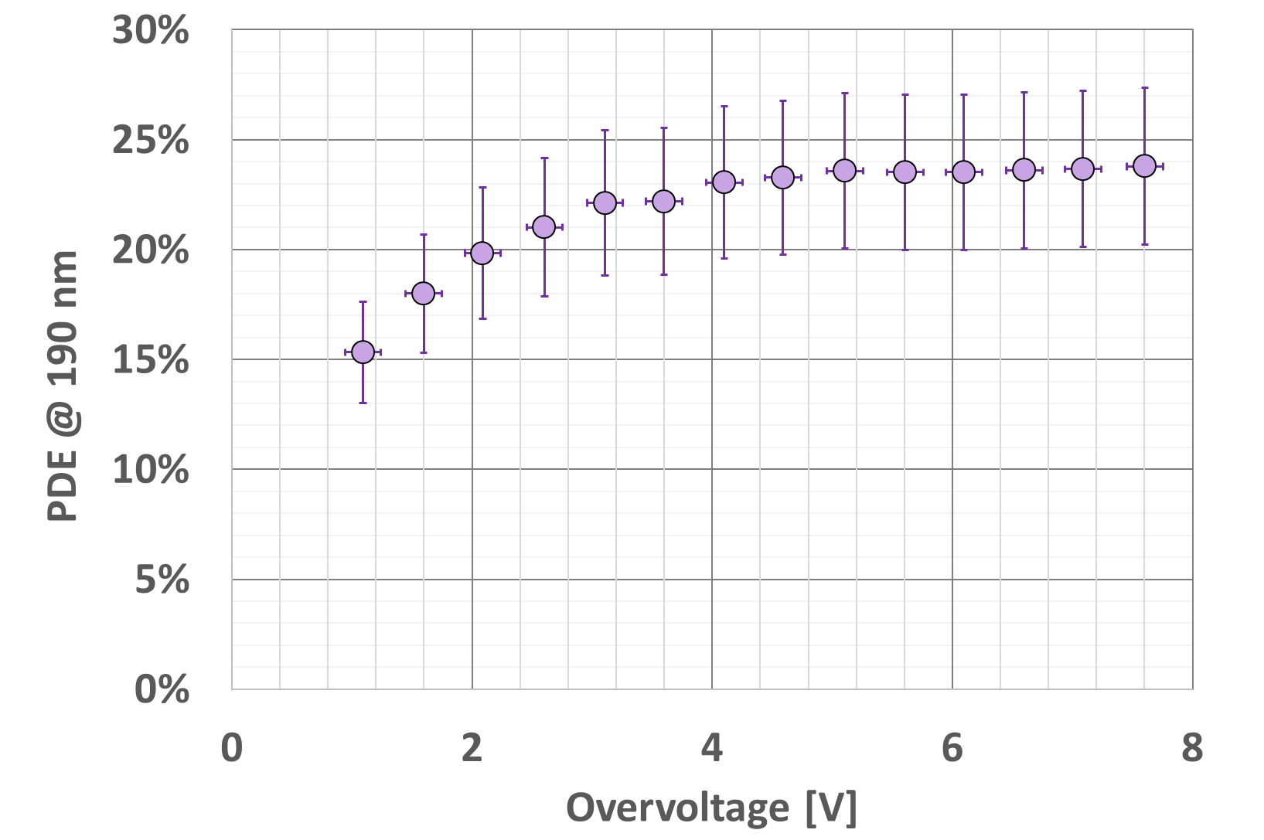

VUV–HD
R&D focused on ARC optimization: Si₃N₄ removal and preservation of surface passivation quality.
PDE vs OV (~190 nm)
nEXO experiment at Stanford
Best result reported in literature
𝜆 = 175 nm
T = -104°C (LXe)
arXiv:1904.05977

Slide 34
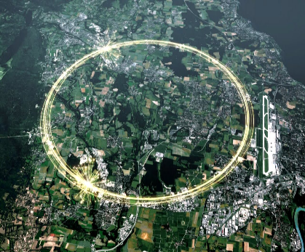


R&D on SiPM Radiation Hardness
Improving radiation hardness of SiPMs is one of the next frontiers of development at FBK for very important applications, both in big science experiments and in space.
Calorimeters for collider experiments: from 10¹⁰ neq/cm² to >10¹⁴ neq/cm²
Geostationary orbit space experiments: ~5∙10¹⁰ neq/cm²
LHC
LIMADOU
Qualification of radiation tolerance of current SiPM technologies.
Study / modeling of the effects of radiation damage on SiPM characteristics, under different sources of radiation.
Development of a highly customized SiPM technology for optimal performanceafter irradiaiton is most likely needed

Slide 35
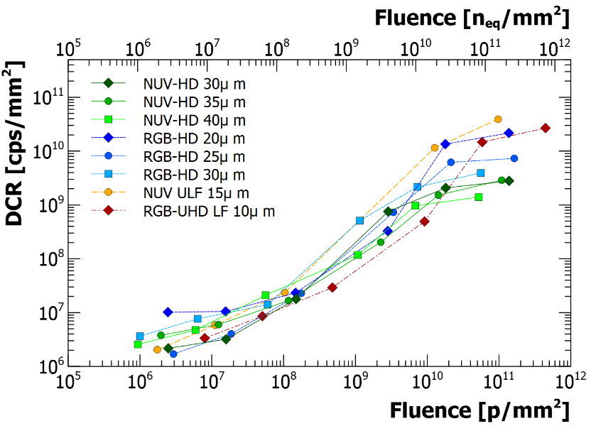
Increase of the primary (Poisson distributed) Dark Count Rate seems the most important effect observed after irradiation.
Faster increase with dose
Saturation effects:
Limited number of cells
Self-heating
..
PRELIMINARY
Slower increase with dose
Example of a broad study of several FBK technologies. 62 MeV proton beam, doses up to 2e13 neq/cm², RT annealing during 1 month. Data from IV analysis. More information at: https://indico.cern.ch/event/983068/

Slide 36
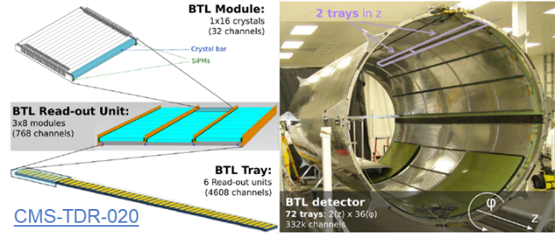
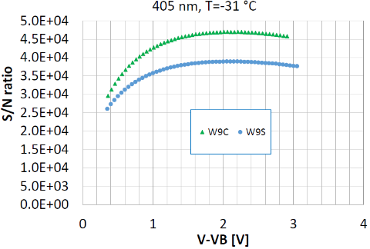
SiPMs with extreme radiation tolerance are required for the Barrel Timing Layer of the CMS experiment, at CERN: 1.9×10¹⁴ 1 MeV n_{eq}/cm².
Custom SiPM technology was developed, combining electric field engineering with small-pitch SiPM technology, for enhanced radiation hardness.
NUV-HD-RH SiPMs
HFF layout
STD layout
The advantage of using small cells for radiation hardness is relevant only if they can still provide very high PDE
FoM measured by from CMS collaboration: A. Heering, Y. Musienko, M. Lucchini et al.)

Slide 37
SUMMARY
Silicon PhotoMultipliers (SiPM) are phasing out the previous technology (the PhotoMultiplier Tubes, PMT) for low light intensity detection.
They exhibit increasingly good performance (in terms of PDE and low dark count rate) in the wavelength range from Near Infrared to Vacuum Ultraviolet.
SiPM are the sensor of choice for high sensitivity, large mass physics experiments where the signal is scintillation light.
Interest by medical, automotive and space industries.

Slide 38
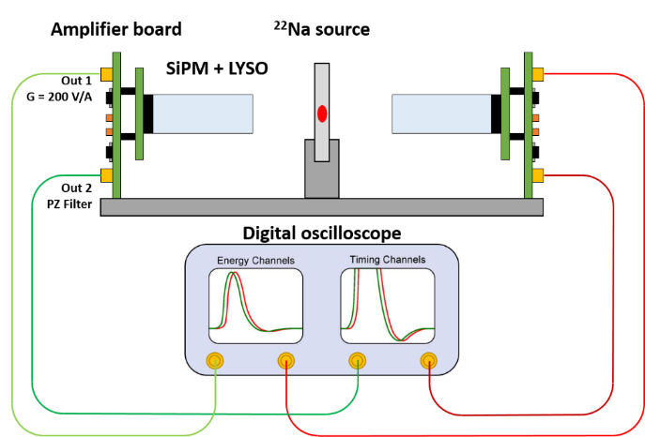

NUV-HD SiPMs for ToF PET
Experimental setup
SiPM
Thermostatic chamber
Scintillator
1 GHz
10 GS/s
Digital data through Ethernet
Scintillator readout with SiPMs for ToF-PET
Leading Edge Discriminator

Slide 39
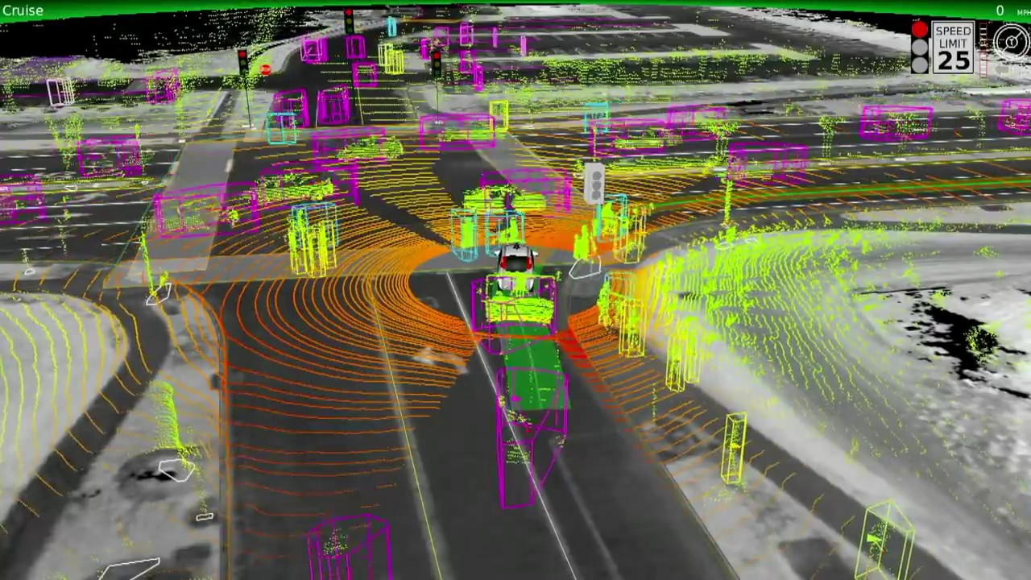
Application of NIR-SiPMs
Ongoing R&D collaborations with 3 companies
LiDAR for Automotive

